Slide 1
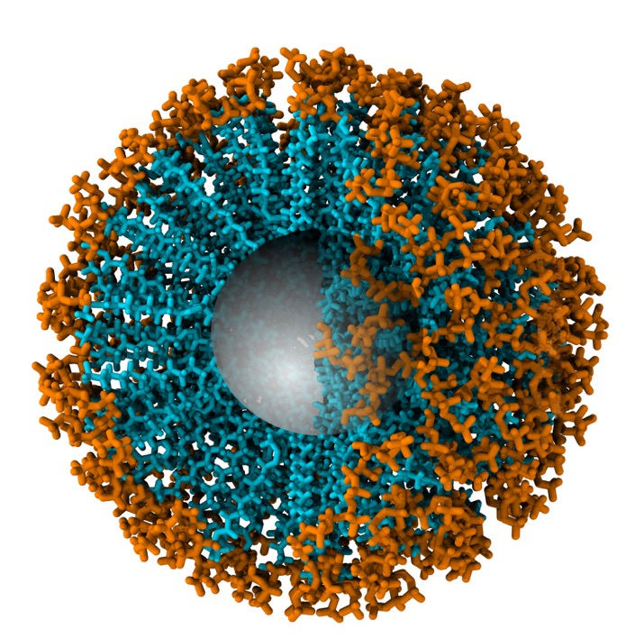
INNOVATE OR EVAPORATE
Why delivery systems are becoming a commercial imperative
George Kokkinis, CEO,
Pharmako Biotechnologies
Naturally Informed | Mastering the Market
Notes:
Innovation is often treated as a product-development function
in reality, it is now a business-survival issue.
In a crowded market, having a recognised ingredient or an attractive label is no longer enough.

Slide 2
THE MARKET HAS CHANGED
More choice. Greater scrutiny. Less room for mediocracy.
The market pressures
Crowded categories
Demand from consumers
Rising expectations of performance
Innovate or Evaporate
Notes:
Consumers have more information and more products to choose from.
Brands are competing not only for attention, but for credibility, repeat purchase and relevance.
Products that do not offer a meaningful reason to choose them become interchangeable.

Slide 3
INGREDIENTS ARE ONLY THE BEGINNING
An ingredient may create the promise.
Delivery determines how that promise is realised.
Ingredient → Formulation → Delivery →
Consumer experience → Commercial outcome
Innovate or Evaporate
Notes:
Two products can feature the same active ingredient yet deliver very different experiences and outcomes.
Solubility, stability, absorption, dose format and ease of use all influence whether the product fulfils its intended purpose.

Slide 4
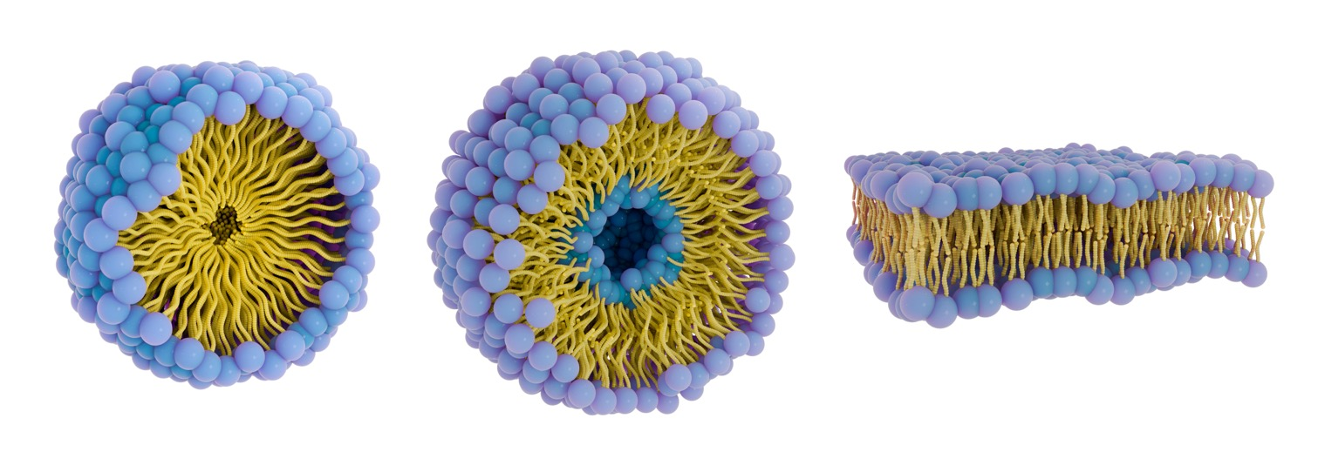
DELIVERY IS A STRATEGIC POSITON
The right delivery system connects science with
commercial performance
Innovate or Evaporate
Notes:
Performance
Differentiation
Consumer experience
Scalability
Delivery technology should not be selected after the commercial concept has already been defined.
It needs to be considered early because it influences product positioning, format, claims strategy, manufacturing and the consumer proposition.

Slide 5
WHERE INNOVATION CREATES VALUE
Better technology creates value across the product lifecycle
PRODUCT
OPERATIONS
MARKET
Improved formulation potential
Distinctive market proposition
Development efficiency
Manufacturing and scale considerations
Clearer differentiation
Greater commercial potential
Innovate or Evaporate
Notes:
Innovation is not valuable simply because it is novel.
It must solve a scientific, consumer or commercial problem.
The best technology decisions create value across more than one part of the business.

Slide 6
THE SYSTEM MUST FIT THE OPPORTUNITY
There is no universally “best” delivery system.
There is a right one for the objective.
What problem are we solving?
Who is the product for?
What must the formulation achieve?
What format supports the proposition?
Can it be manufactured and scaled effectively?
Is the evidence appropriate to the intended claims?
Innovate or Evaporate
Notes:
Companies sometimes begin with a tricky format or technology and then attempt to build a product around it.
The process should start with the intended outcome. Technology is the tool, not the strategy.

Slide 7
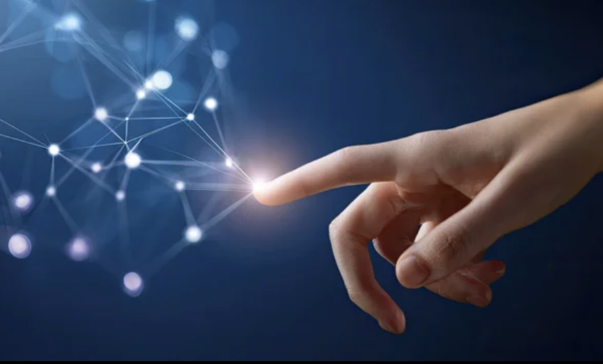
THE PARTNER IS PART OF THE TECHNOLOGY
Technology alone does not deliver a successful product
The right development partner brings:
        Scientific depth
        Delivery system platform expertise
        Formulation capability
        Regulatory awareness
        Manufacturing understanding
        Commercial perspective
Innovate or Evaporate
Notes:
A technology may perform well in principle, but commercialisation requires far more than access to an ingredient or platform.
Brands need partners who understand the interaction between science, formulation, compliance, scale and market positioning.
“The wrong partner can cost more than money. It can cost time, relevance, credibility and market opportunity.”

Slide 8
FROM TECHNOLOGY TO MARKET ADVANTAGE
Competitive advantage comes from alignment, not novelty alone
Consumer need
Relevant science
Right delivery technology
Capable development partner
= A PRODUCT WITH A REASON TO EXIST
Innovate or Evaporate
Notes:
The strongest products are not those using the newest delivery technology for its own sake.
They are products where the consumer need, scientific rationale, delivery system and commercial proposition reinforce one another.

Slide 9

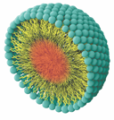

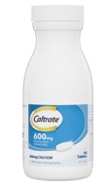

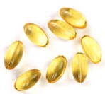

TYPES OF INNOVATION
Architectural
Innovation
Radical
Innovation
Advanced
Delivery
Systems
New
MARKET
Incremental
Innovation
Disruptive
Innovation
Existing
Existing
New
TECHNOLOGY
Innovate or Evaporate
Notes:
Innovation is the practical implementation of ideas that result in the introduction of new goods or services or improvement in offering goods or services.
There are various forms of innovation and all are valid depending on your company’s direction. Some forms are basic while others are more advanced. Today, we are here to discuss delivery systems and advanced delivery systems, in particular.
Delivery systems range from the ordinary capsule to the more sophisticated nanomedicine. It is this radical innovation that we are going to concentrate on today.
Incremental innovation is the most common form. It utilizes existing technology and increases value to the customer within an existing market. Almost everybody does this to a degree. The example here is a calcium tablet that later on has vitamin D3 added to it and a new line extension is created. Very basic, but nonetheless it is still a form of innovation. Important thing is to find which innovation type suits your company and turn it into a success.
Architectural innovation – taking lessons, skills and overall technology and applying them within a different market. In this example, the humble plain gummy bear is now supercharged with vitamins, minerals and other ingredients. Another example is memory foam: this was developed by NASA to improve the safety of aircraft cushions but it had bigger success being applied to bed mattresses.
Disruptive innovation – this is when you’re not the first to do something but you add benefits/functionality and do it very well – the example here is a krill oil capsule that was a second generation source of omega-3 which had the better absorption story due to its phospholipid content. Another example from the phone industry is the Apple iPhone – this was not the first ‘smart’ phone but they did it much better than anyone else.
Radical innovation – creating revolutionary technology. Imagine being able to deliver an active ingredient directly to the cells thereby reducing side effects and dose size. This is where advanced delivery systems come into play.

Slide 10
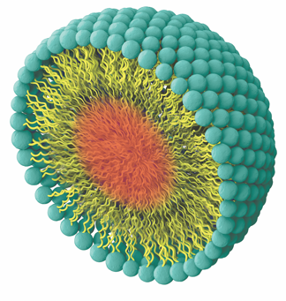
MICELLAR / MICROEMULSION TECHNOLOGY
Pharmacokinetic studies
Omega-3s fish, algal & krill oils
CoQ₁₀
Lutein
Lavender oil
Clinical studies
Change in Omega-3 index
Innovate or Evaporate
Notes:
AquaCelle is our micellar/Nanoemulsion technology or Self Micro Emulsifying Delivery System. This structure forms instantaneously when it comes into contact with water.
It is suitable for liquid lipophilic substances (eg any omega-3 oils, lavender oil, astaxanthin, etc which are housed in the core of the structure.
AquaCelle enhances absorption and/or increases functionality by allowing you to easily mix lipids with water phases.
Another feature of AquaCelle is that the active content is high, for example you can get 85% fish oil mixed in with only 15% AquaCelle and bioavailability is significantly enhanced – our clinical study showed that it was up to 6 times better absorbed.

Slide 11
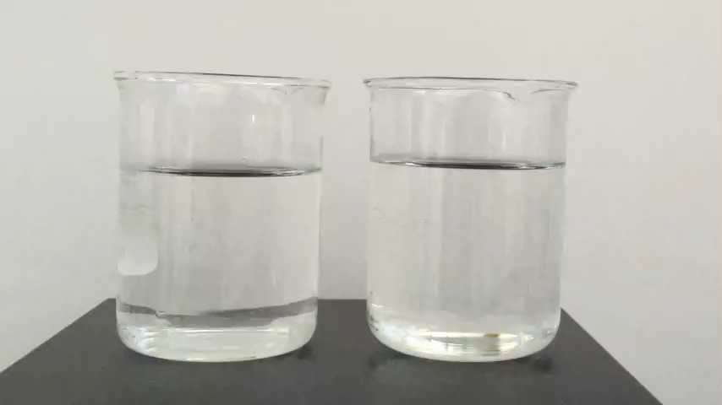
AQUACELLE® FISH OIL INSTANTLY EMULSIFIES IN WATER
Omega 3 Fish Oil
in water
Omega 3 Fish Oil
with AquaCelle®
in water
Innovate or Evaporate
Notes:
You may have already seen this video however I find it a great way to show how AquCelle delivers its benefits.
What you’ll see here is how Fish Oil with AquaCelle performs in water compared to Fish oil without AquaCelle.
PRESS PLAY
You’ll notice the fish oil blobs sit on top of the water and can’t mix or emulsify. Now, imagine the water as being the aqueous environment of our GI Tract. This explains the absorption and fishy reflux challenges of standard fish oil formulations.
Now here Fish Oil with AquaCelle emulsifies immediately on contact with water. This is the mechanism behind its positive impact on absorption and its ability to remove fishy reflux and digestion issues often associated with Fish Oil supplementation. The body does this naturally – but not very well. AquaCelle helps the body do this more efficiently and without the need for food.

Slide 12

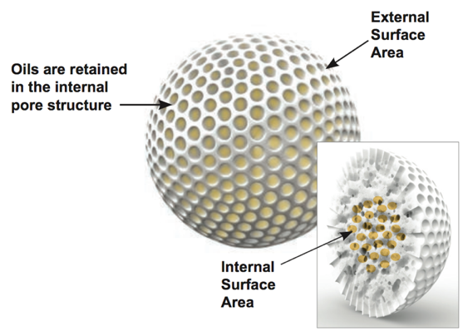
COMPRESSIBLE POWDERED OILS
Pharmacokinetic study
CPO® +AquaCelle® Astaxanthin
Innovate or Evaporate
Notes:
Our next technology is CPO, which converts liquids to free flowing powders. This is very important, as we can now use our liquid technologies and convert them to a powder without altering their bioavailability characteristics.
CPO is not a spray drying technology, which is common across the industry. CPO is based on a specially engineered silica that absorbs liquids at up to two times its weight. One gram of our CPO technology has a surface area of 300 square metres, which gives it this massive capacity to absorb liquids.
It resists pressure, heat and it doesn’t leak, which makes it ideal for tableting and ready to mix powders. The silica beads are approximately 50 microns in diameter, so you don’t get any mouth feel or quick settling in solution.
It is the perfect companion system for AquaCelle and PlexoZome charged liquids, as absorption is significantly enhanced with this combination.

Slide 13
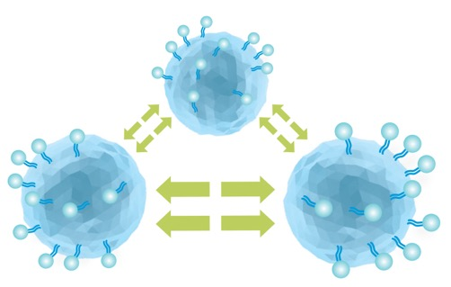
SOLID DISPERSION TECHNOLOGY
Pharmacokinetic studies
Curcuminoids
Palmidrol (PEA)
Resveratrol
Clinical studies
HydroCurc® in joint pain; DOMS; BDNF & iron
Levagen®+ in headache; arthritis; exercise;
Innovate or Evaporate
Notes:
Our next technology is LipiSperse. LipiSperse is suitable for solid lipophilic actives (eg curcumin, resveratrol, PEA, quercetin, etc). Solid lipophilics don’t disperse in water and hence their bioavailability is significantly compromised.
When the lipophilic solid is combined with LipiSperse, the resultant product is still a solid, only now it freely disperses in water and, as a consequence, it now has increased bioavailability
Only 10% of LipiSperse is generally required to convert a hydrophobic powder into a hydrophilic one.
LipiSperse works by coating the surface of the crystals and converting this surface into a hydrophilic one. Lipophilic crystals now disperse when they come in contact with water, increasing the surface area available to the body and allowing the body to process it as it would normally do.

Slide 14
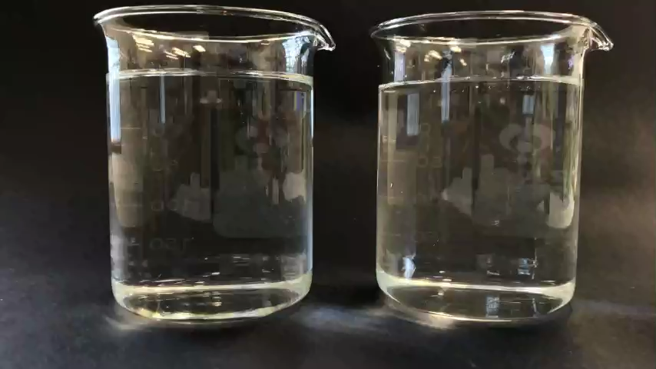
LIPISPERSE® WITH CURCUMIN DISPERSES IN WATER
Curcumin
in water
HydroCurc®
in water
Innovate or Evaporate

Slide 15
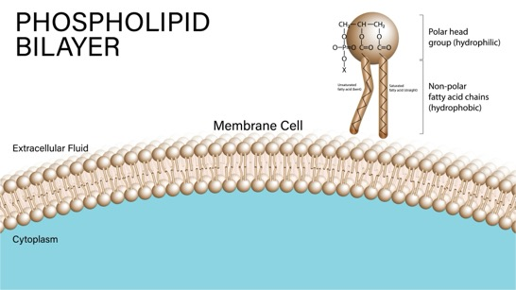
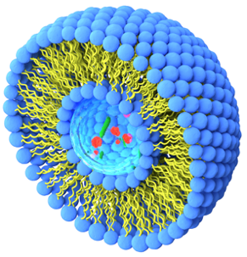
LIPOSOMES
Phospholipids can be used to create a spherical lipid bilayer around a hydrophilic compound to form a liposome.
water
Lipid
bilayer
Innovate or Evaporate
Notes:
Liposomes rely on electrostatic charge between the lipid molecules to keep the membrane in place. They also rely on the subsequent electric potential (referred to as zeta potential) at the interface of the lipid bilayer and the liquid carrier (in our case, water). The higher the zeta potential the more stable the liposome becomes. As a consequence of this, a liposome cannot exist without it being present in water – that is, no water equals no liposome.
When making liposomes, you need to hydrate the phospholipids (usually from lecithin) in order for them to start arranging themselves into a bilayer structure. The hydrophilic head faces the water while the lipophilic tails face each other. This process only creates the flat bilayer membrane which does not have any shape. The spherical shape of the liposome is created by expending a lot of energy. Unlike Self Micro-Emulsifying Delivery Systems, the formation of a liposomal structure is not spontaneous, and it requires a lot of energy to create it.

Slide 16
INNOVATE WITH PURPOSE
Innovation is not an option. It is how brands remain relevant.
The future of the industry will not be defined by ingredients alone,
but by how intelligently and effectively we deliver them.
Choose the right technology. Choose the right partner.
Create a product that matters.
Innovate or Evaporate
Notes:
… back to Innovate or Evaporate.
The message is not that every company needs to chase every emerging technology.
It is that companies must make informed, strategic innovation decisions if they want to create differentiated products and sustainable commercial value.

