Slide 1
Beyond AI Tools: The Rise of AI-Native Intelligence in Natural Products
Dr. Bill Clark, PhD
Founder & CEO
NutriSelect.ai, Inc.
Naturally Informed webinar – ai everywhere: A Selection of AI-based Tools for the Natural/Nutra Industry | September 29, 2026

Slide 2
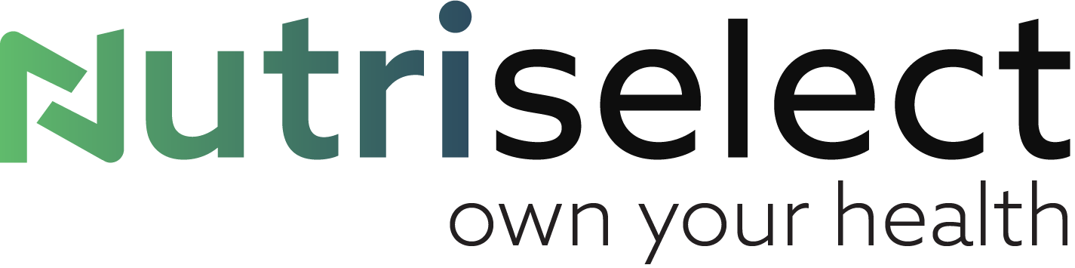
From AI Tools to AI-Native Intelligence
What happens when AI becomes part of the intelligence infrastructure of an industry?
Tools
Systems
Intelligence
The NutriSelect perspective
Precision Supplement IntelligenceTM

Slide 3
The Natural Products Industry Doesn’t Have a Data Problem
It has an intelligence problem.
Scientific Literature
Quality & Regulatory Data
Usable Intelligence
Clinical Trials
Real-World Evidence
Ingredient Data
Individual Health Context
Product Formulations
Lots of information. Very little connected intelligence.
Precision Supplement IntelligenceTM

Slide 4
Precision Supplement IntelligenceTM
Data
Scientific research
Evidence
Evidence evaluation
Intelligence
NScore™
Ingredient data
Product data
Quality & regulatory information
Real-world evidence
Scientific governance
Relevance & applicability
Transparency
Scientific confidence
Contextual interpretation
Continuous learning
Decision
Consumers
Practitioners
Brands
Ingredient suppliers
Researchers & industry partners
AI is not the evidence. AI helps us make sense of the evidence.
Precision Supplement IntelligenceTM

Slide 5
AI Can Do More Than Retrieve Information
LEARNING
What information exists?
What does the information say?
How strong, relevant, and applicable is the evidence?
What changes as new evidence and outcomes emerge?
EVALUATION
SYNTHESIS
SEARCH
The biggest opportunity isn’t making information faster.
It’s making decisions better.
Precision Supplement IntelligenceTM

Slide 6
One Intelligence Layer. Multiple Industry Applications
Precision Supplement Intelligence™
CONSUMERS
What should I take—and why?
Personalized guidance grounded in evidence
BRANDS
Does the product support the promise?
Product science, validation & differentiation
INGREDIENT SUPPLIERS
Does good science receive the visibility it deserves?
Evidence recognition & ingredient differentiation
SCIENCE & INDUSTRY
What can we learn when evidence becomes connected?
Research intelligence, real-world evidence & emerging insights
Ingredient Science Accelerator | Product Science Accelerator | Scientific Consortium
Precision Supplement IntelligenceTM

Slide 7
AI-Native ≠ AI-Autonomous
AI
Human Expertise
Science
The future of the natural products industry is not humans versus AI.
It is what becomes possible when we combine AI with better science, better data, and better human judgment.
Intelligence
Precision Supplement IntelligenceTM

Slide 8
Thank you
Dr. Bill Clark, PhD
Founder & CEO
NutriSelect.ai, Inc.
Email: drbill@nutriselect.ai
www.nutriselect.ai

