Slide 1



Personal Intelligence®
David Bennahum
Co-founder & CEO, Onix
Notes:
David’s feedback:
The deck is something like this in an outline:
Map your current business (show how we look at existing experts and the way they make money before onix). These are essentially our “findings” about how experts earn income.
Choose how Onix can augment what you’re already doing (an extension, not a replacement). This is our recommendation of the way the expert could best monetize their knowledge based on slide 1.
Understanding your potential price based on what you currently charge for what you sell. Our pricing top-line- assume “x”.
Upsells (potential bundling and add-ons that can raise your price or justify the price on slide 3). Now “x” could be “x” plus more if you decide to do this- or not. Maybe KISS is your jam.
GTM together: how we work together to promote your paid onix. We got this with you!
Timeline to launch: the key milestones from planning to revenue.
the. end.

Slide 2



What is Onix?
A Personal Intelligence® platform where health and wellness experts can share their knowledge at scale through their own onix: a digital guide built solely on their expertise, available to provide personalized support at any time.
Expert-led, expert-owned
Built from licensed IP
Private by design
Each onix belongs entirely to the expert who built it.
Grounded in credible expertise, not the open internet.
End-to-end encrypted.
Hippa Compliant. Soc 2 Certified.
Issued March 2026
Issued March 2026
Canada Privacy Jurisdiction
Onix - Personal Intelligence®
2
Notes:
The key idea: trusted, expert-owned Personal Intelligence. Contrast with generic AI, which answers from everywhere and nowhere. Mention privacy early because this audience deals with health data and compliance.

Slide 3
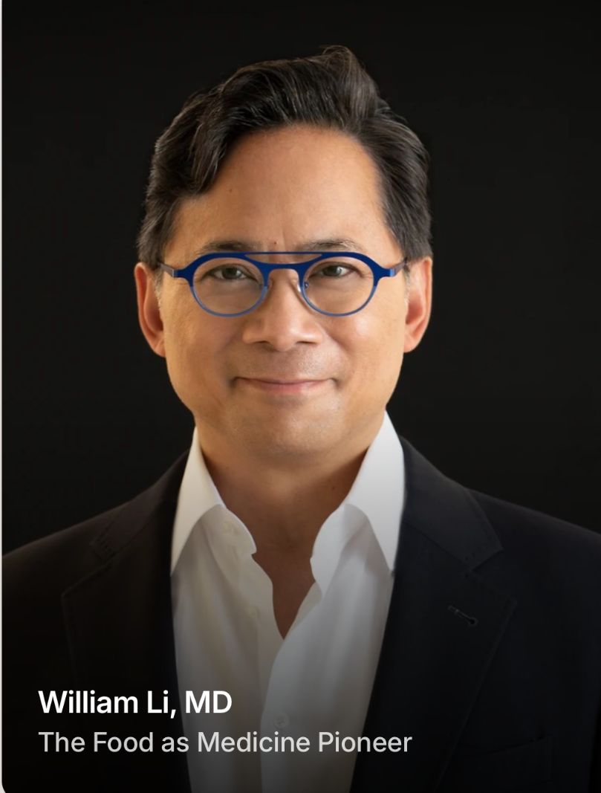
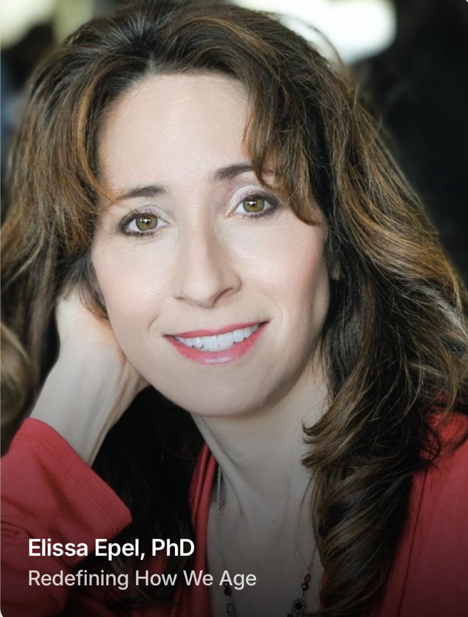
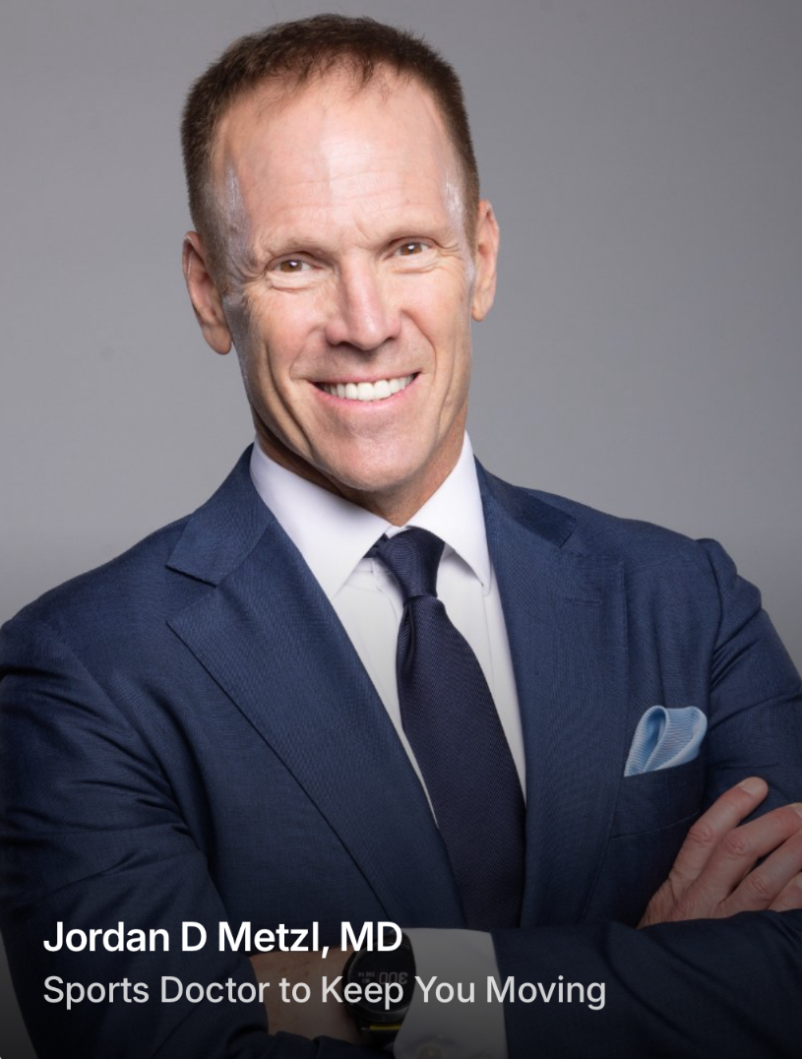
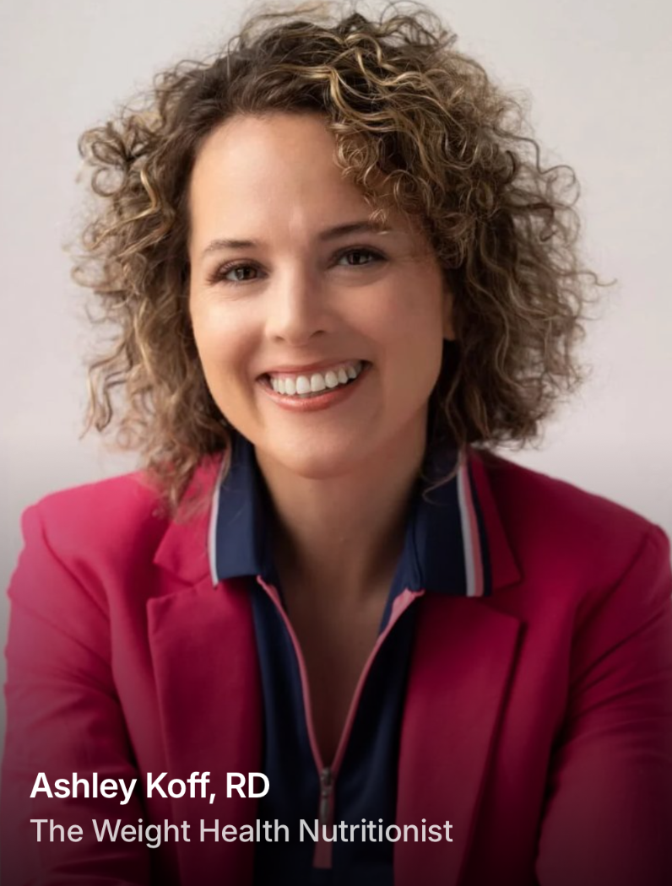
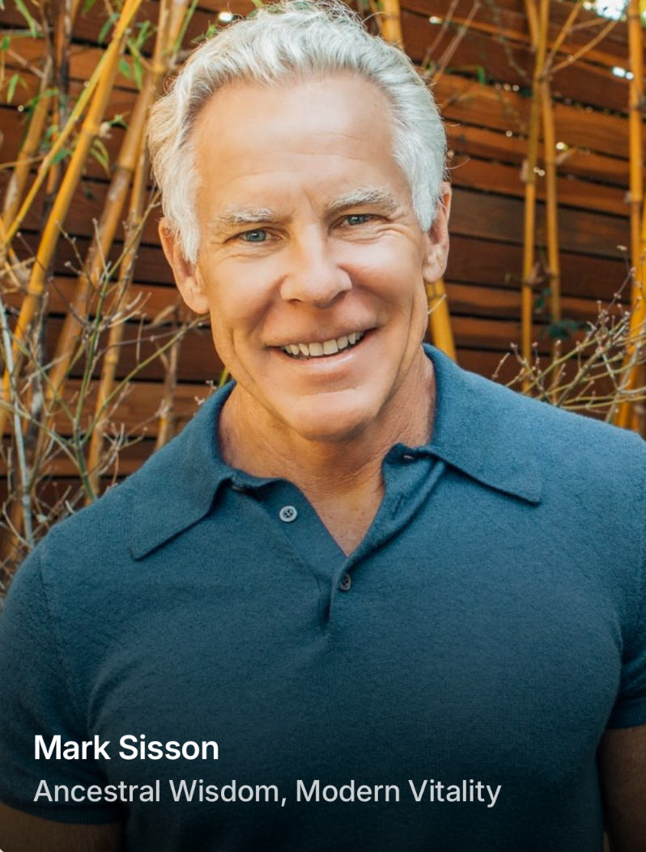
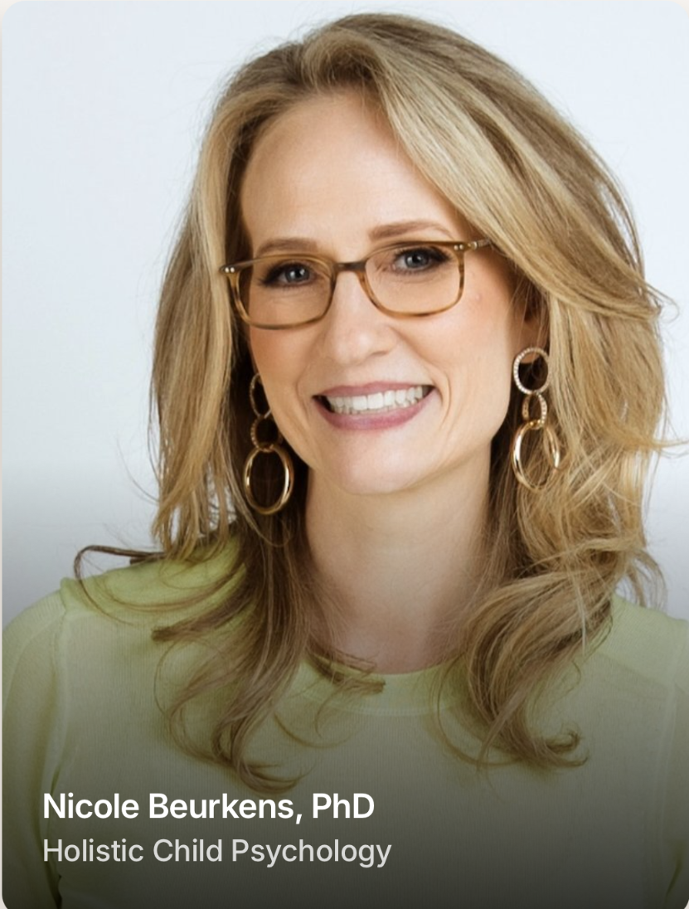
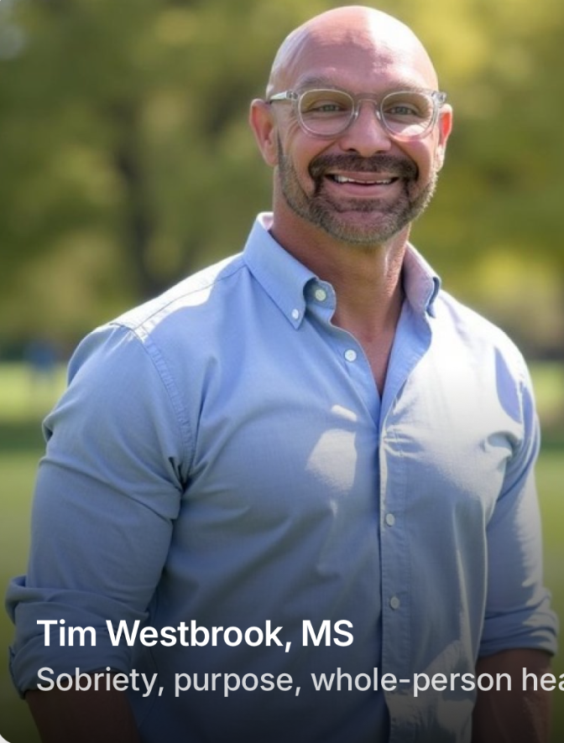
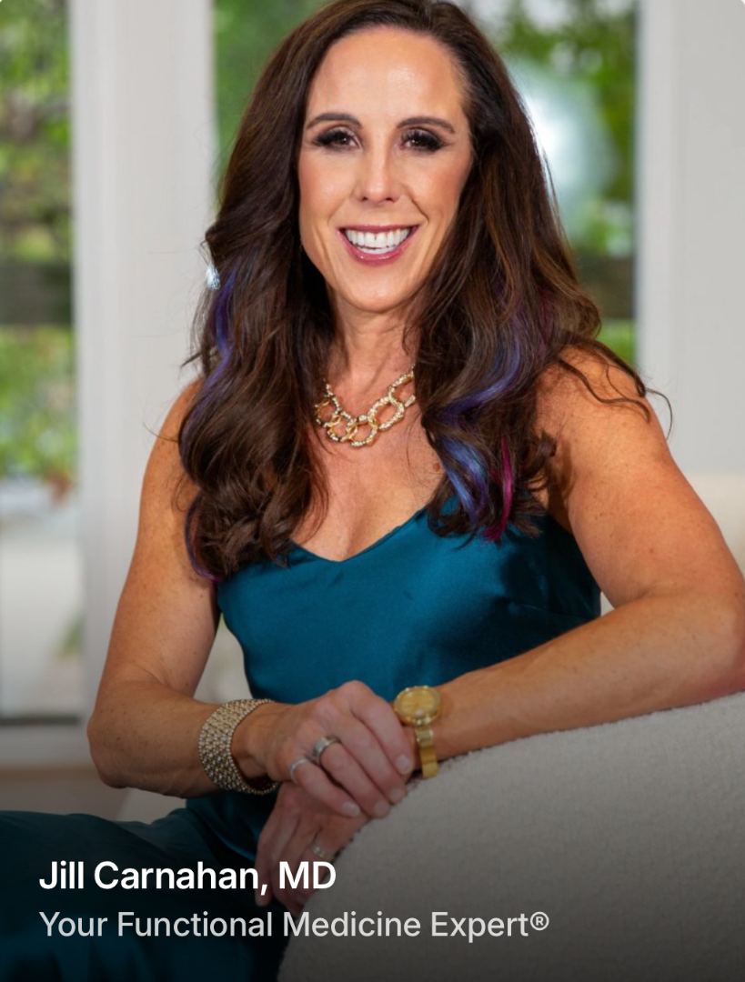
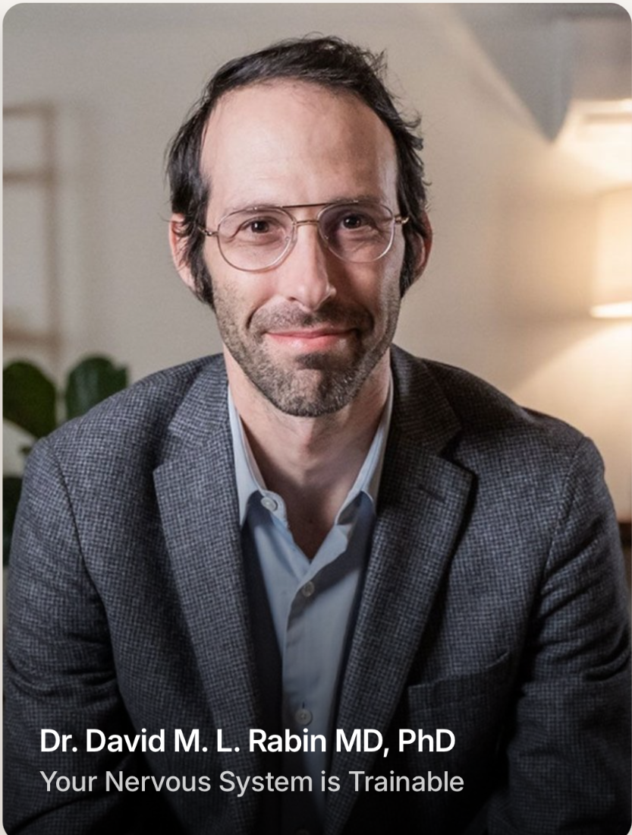
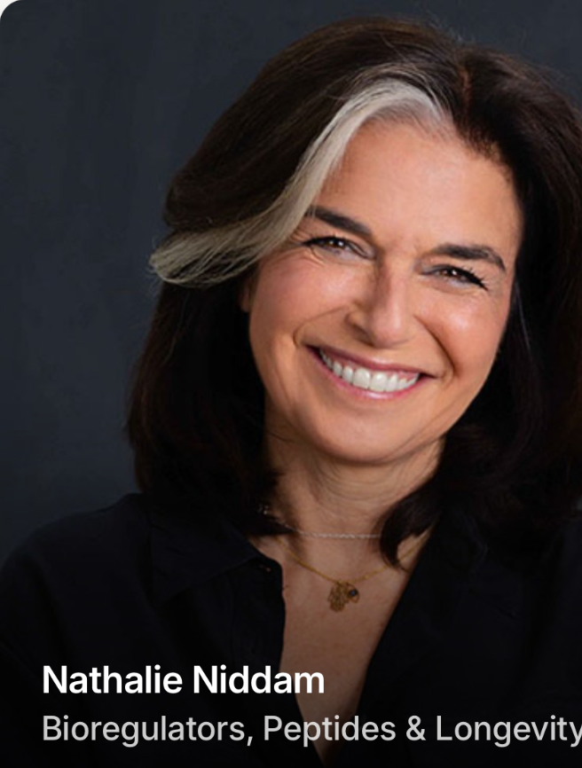
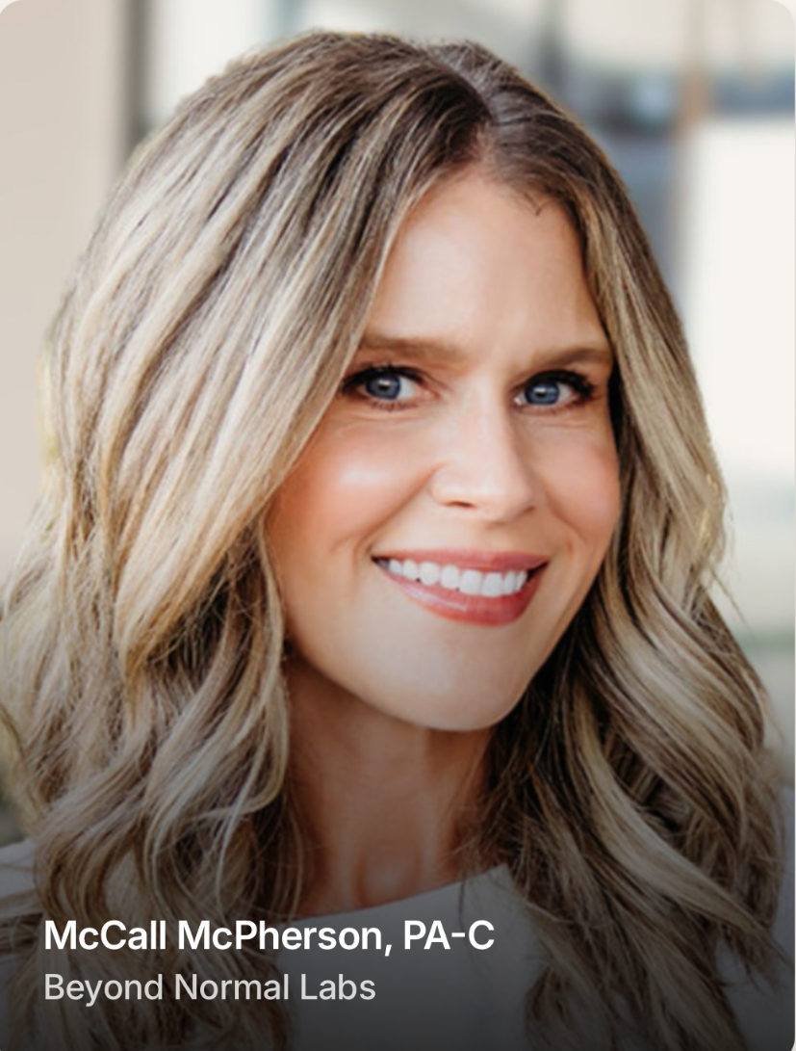
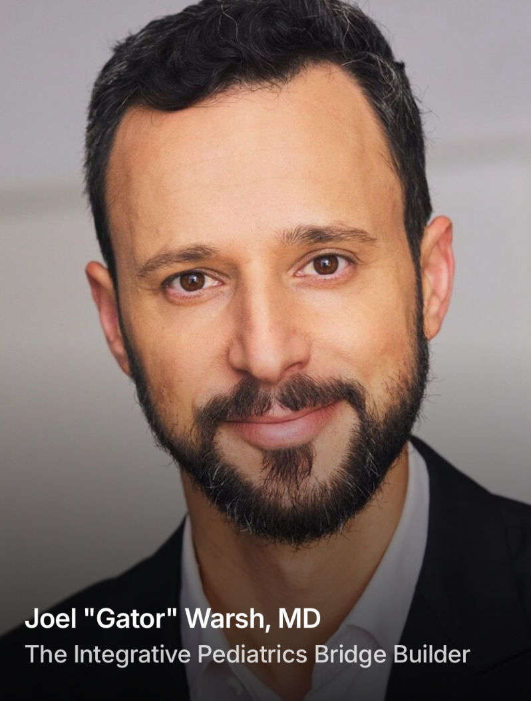
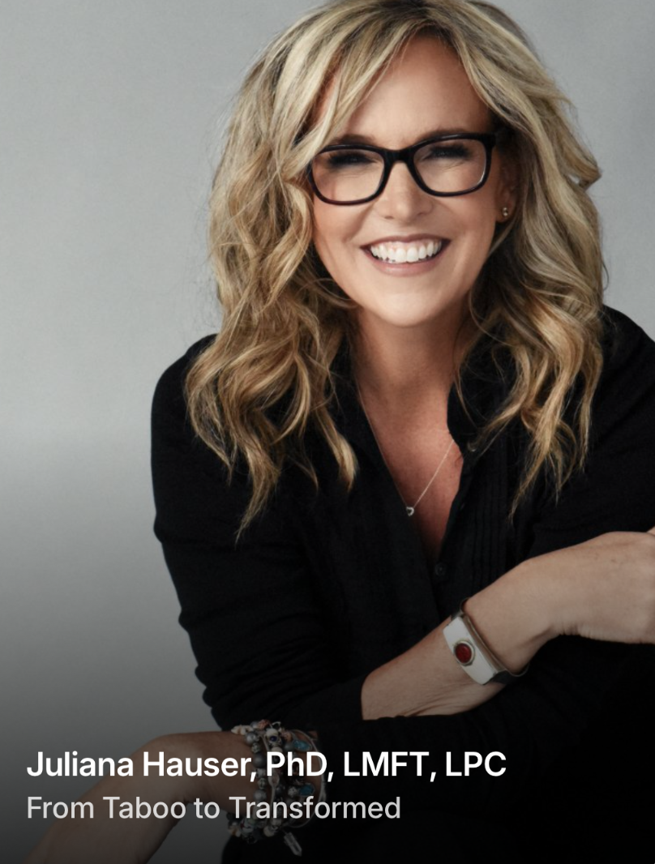
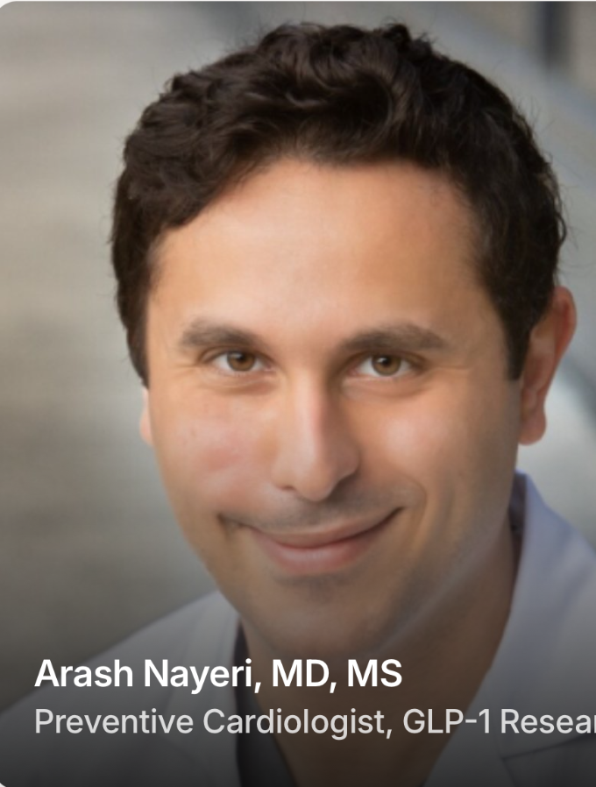
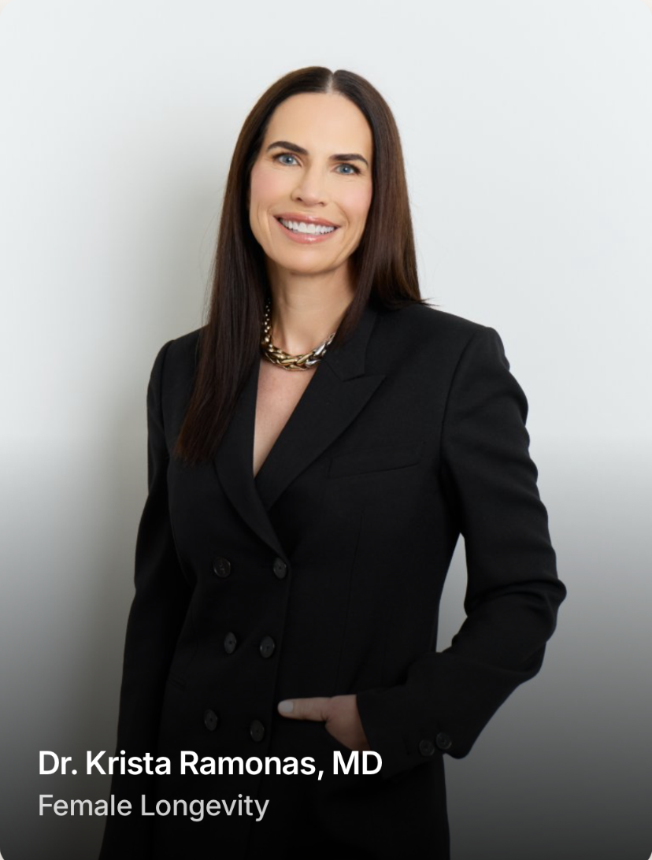
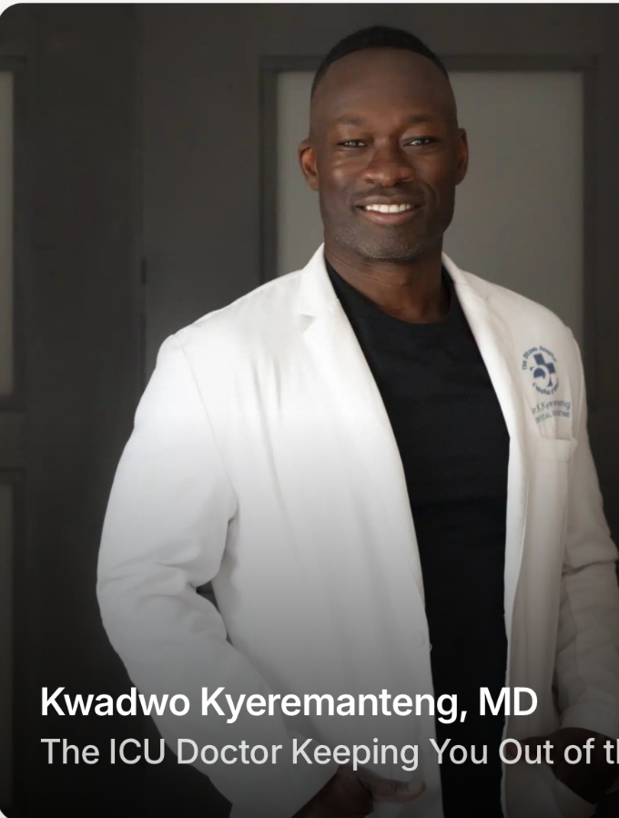
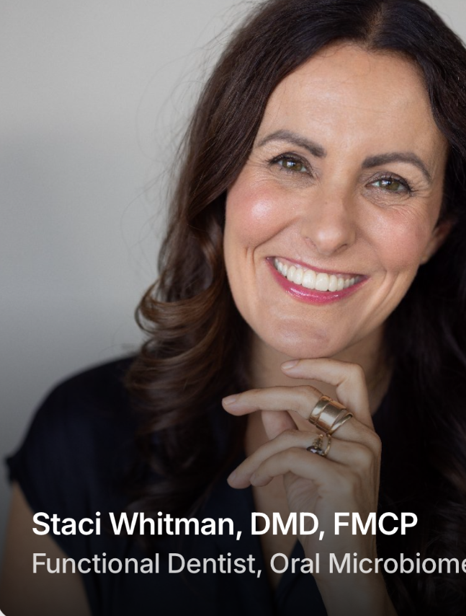
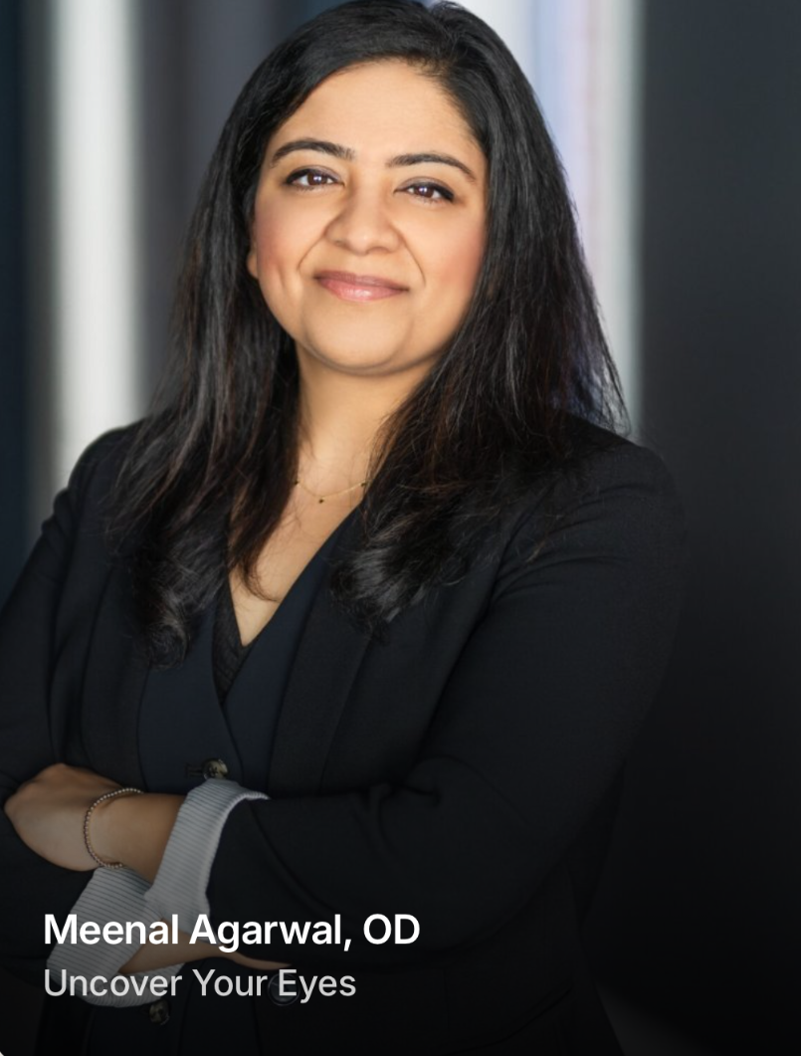
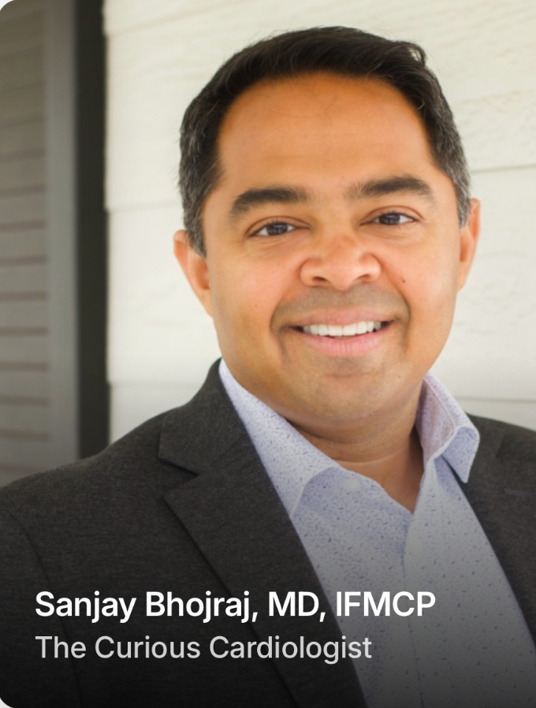
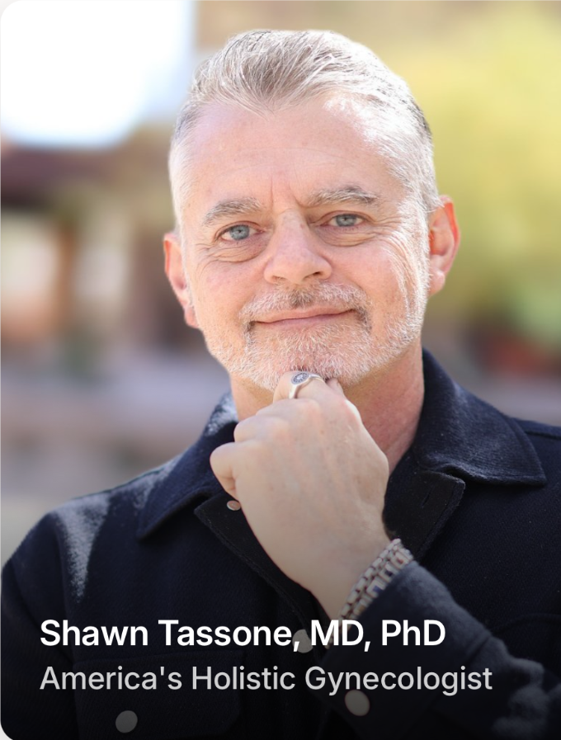
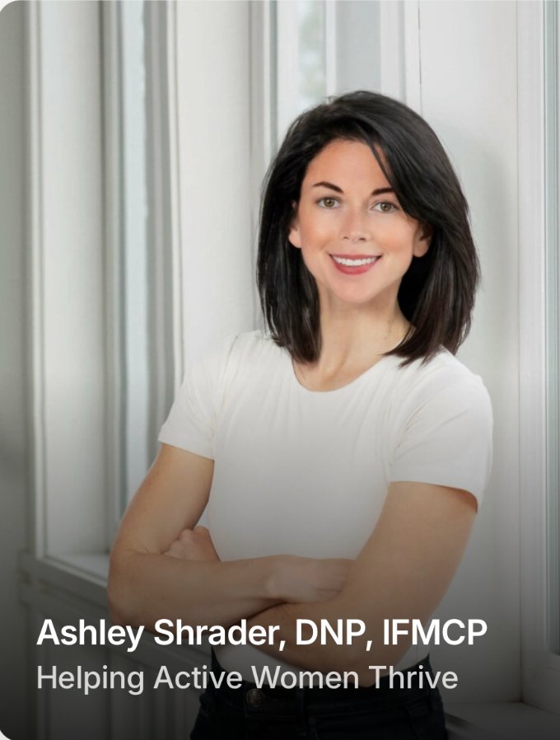
Access to real personalized health and wellness guidance from world-class experts
Onix - Personal Intelligence®
3
Notes:
A sample of the roster, spanning nutrition, functional medicine, sports, mental health and longevity. Point out that many of these names are already familiar to the natural products audience.

Slide 4
What does their business look like on Onix?
Experts lead the way, always.
STEP 1
STEP 2
STEP 3
Their IP
Their onix
Their revenue
→
→
Books, protocols, courses and research they already own.
A guide built on that work, available to their audience 24/7.
Subscriptions they price themselves, with a revenue share of 70/30, in their favour.
Onix - Personal Intelligence®
4
Notes:
The expert's knowledge becomes a recurring product they own. Paid subscriptions launched this September. Fill in the revenue share figure David wants to share publicly, or remove it.

Slide 5
How can this involve third-party providers like you?
For supplement brands and other providers
Onix gives your customers access to trustworthy health and wellness guidance from real, credentialed experts. Bring that expertise directly into your platform, or connect customers to an expert's onix, turning every purchase into personalized support that lasts long after checkout.
Onix - Personal Intelligence®
5
Notes:
Pivot to the audience. Supplement companies, ingredient suppliers and wellness platforms all face the same question from customers: is this right for me? An expert's onix can answer it with credibility.

Slide 6
It works in two directions:
Expert → Your platform
Your platform → Expert onix
The expert's onix, integrated into your site, app or products
Your customers matched with an expert's onix that personalizes their journey
Onix - Personal Intelligence®
6
Notes:
Set up the two models before walking through each. Direction one brings expertise to where your customers already are. Direction two takes your customers to the expert's onix for a personalized path.

Slide 7
Bring the expert right to your customer
Direction 1 · Expert → Your platform
Integrated directly
into your platform
24/7 access to validated, credible expertise
Your customers can ask specific questions and get personalized responses grounded in real expert guidance they can trust.
Guidance comes from the expert's licensed work, with privacy built in, available around the clock.
7
Onix - Personal Intelligence®
Notes:
Example to use live: a supplement brand integrates a registered dietitian's onix so shoppers can ask about fit, timing and pairing before they buy. Keep the framing as guidance, not treatment. Add a real partner example here if one can be named.

Slide 8
Turn a purchase into a personalized journey
Direction 2 · Your platform → Expert onix
1
2
3
4
Customer buys or subscribes on your platform
They get access to an expert's onix
The onix tailors recommendations to their goals
Ongoing guidance keeps them engaged and on track
Your products become part of a guided journey that continues well after checkout.
Onix - Personal Intelligence®
8
Notes:
This is the retention story for brands: guidance drives adherence, and adherence drives results and repeat purchases. Guidance, not treatment. Avoid specific outcome claims unless we have data to cite.

Slide 9
A Win-Win-Win
What each side gets
The brand
The expert
The customer
A credible, named expert voice inside its own platform, without building its own AI.
A new audience and a new revenue stream from work they already own.
Trusted guidance right where they already shop.
Onix - Personal Intelligence®
9
Notes:
This is the retention story for brands: guidance drives adherence, and adherence drives results and repeat purchases. Guidance, not treatment. Avoid specific outcome claims unless we have data to cite.

Slide 10
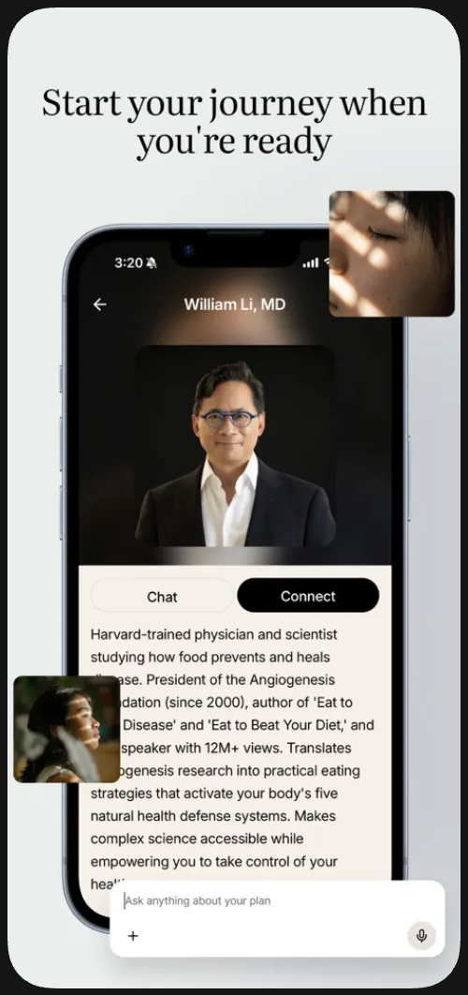
LIVE DEMO
Let's see
how Onix works
→ 1:1 Chat
→ Expert group chats
→ Participant group chats
→ Journeys
& more to come
Onix - Personal Intelligence®
10
Notes:
Switch to screen share. Suggested flow: open an expert's onix, ask a supplement-related question, show how the answer is grounded in the expert's work, then show personalization over a follow-up. Keep it to about 3 minutes and have a backup recording ready.

Slide 11
Thank You
Let's talk
Learn more
david@onix.life
onix.life
Onix - Personal Intelligence®
Notes:
Thank the audience and hand back to Doug for Q&A. Invite brands interested in partnering with an expert to reach out directly.

