Slide 1


Slide 2
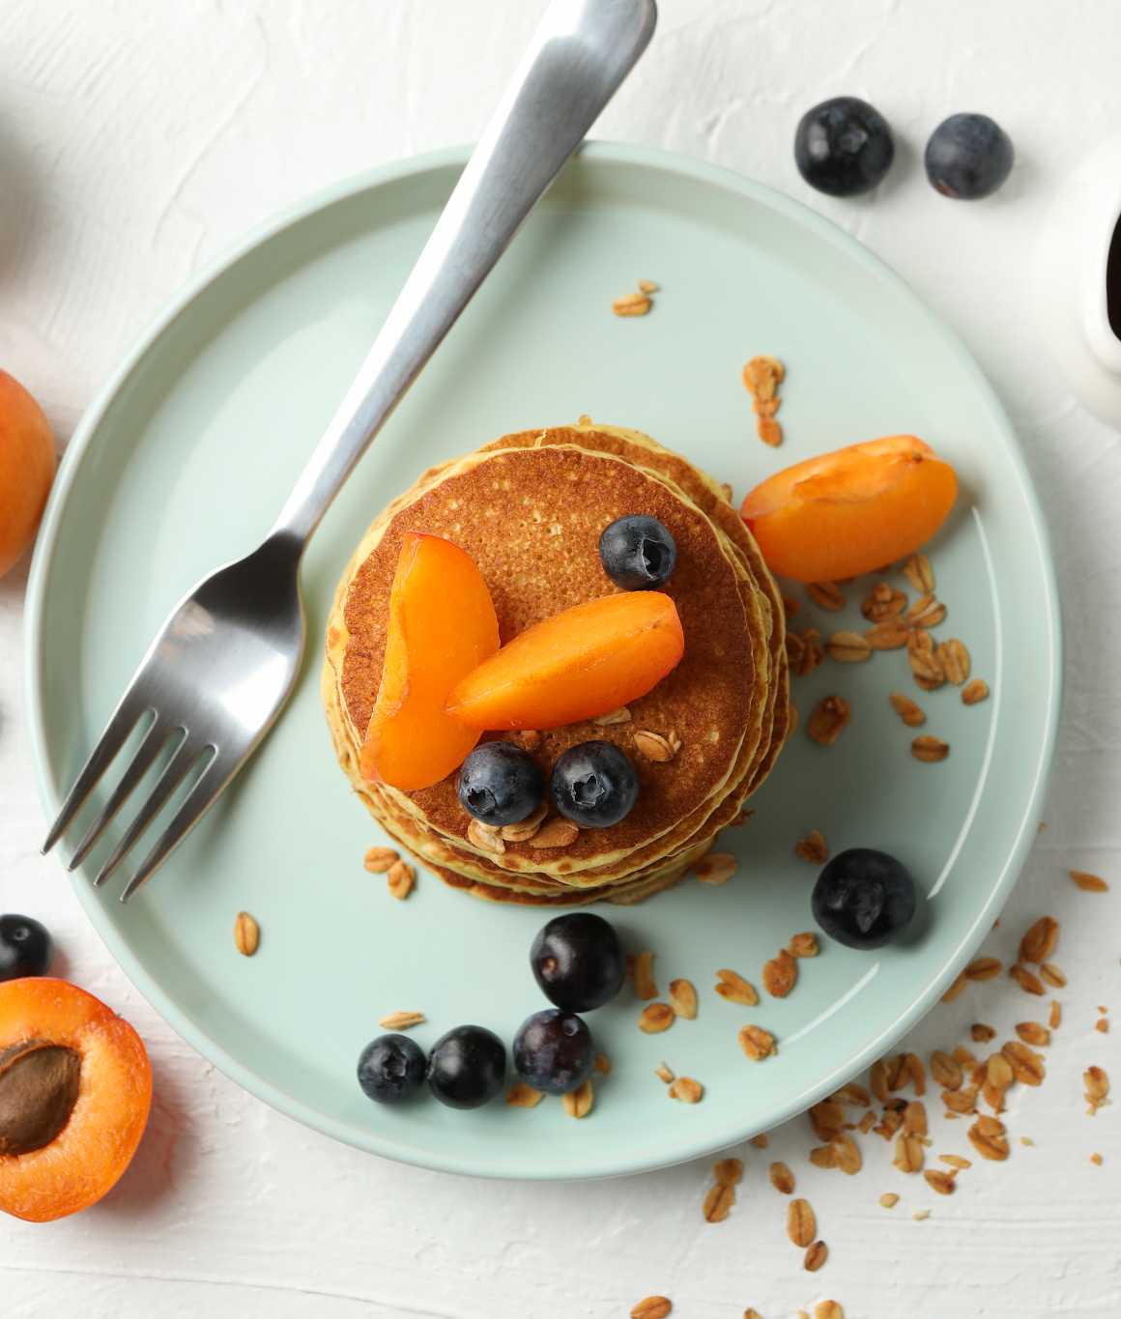

2026 Functional Food and Beverage Survey
GENERAL CONSUMERS

Slide 3

HEALTHIER ALTERNATIVES PREMIUM (TOP 10): US, AGE & GENDER
Key Insight:
We see those willing to pay a premium skew younger, starting with snacks (spike for females 26-34) and baked goods (slight spike for those 18-25). There is a sharp response from males 26-34 for juices and all those under 45 for nutrition bars. Cookies show a spike for males 18-25.
Note: US Female 18-25 n=39, US Male 18-25 n=72, US Female 26-34 n=96, US Male 26-34 n=117, Female 35-44 n=102, US Male 35-44 n=129, US Female 45-54 n=107, US Male 45-54 n=99, US Female 55+ n=159, US Male 55+ n=126. Top 10 Sum of all responses willing to pay a premium (removed responses ‘No Premium” from Question: “How much more would you pay for a healthier alternative of a not healthy product you love?”

Slide 4
IMPORTANT CHARACTERISTICS: US, AGE & GENDER
Key Insights:
The quality of the product stands out, especially among males (notably 45-54) and females 26-34.
'Nutritional profile' clearly skews older.
While lower on the list, a 'health care professional recommendation' shows a spike for females 35-44.
Note: US Female 18-25 n=39, US Male 18-25 n=72, US Female 26-34 n=96, US Male 26-34 n=117, Female 35-44 n=102, US Male 35-44 n=129, US Female 45-54 n=107, US Male 45-54 n=99, US Female 55+ n=159, US Male 55+ n=126. Question: “What characteristics are most important to you when deciding to purchase a functional food or beverage product?”

Slide 5
LABEL AND WEBSITE TRANSPARENCY: COUNTRY
Key Insight:
It is clear that consumers in both the US and UK are influenced by transparency information from a manufacturer. For 35% of consumers (40% in the UK), it greatly increases the chances they would buy.
Note: All Respondents n=2100, US n=1050, UK n=1050. Question: “How likely are you to purchase functional foods and beverages from a manufacturer that provides transparency information on its label or website?”

Slide 6
SIGNALS OF TRANSPARENCY: US, AGE & GENDER
Key Insights:
'A quality seal on the label' was the top response in the US for all groups except females 35-44 and 55+ (grower information). 'Valid contact information' over-indexed for females.
'Country of origin information' stood out for females 55+.
Note: US Female 18-25 n=39, US Male 18-25 n=72, US Female 26-34 n=96, US Male 26-34 n=117, Female 35-44 n=102, US Male 35-44 n=129, US Female 45-54 n=107, US Male 45-54 n=99, US Female 55+ n=159, US Male 55+ n=126. Question: “Which of the following are the strongest signals that a food/beverage brand is operating transparently?”

Slide 7
TRUST: COUNTRY
Key Insights:
We see limited consistency between the two countries, with the 'authentic brand story' clearly ranking highest in the US and close to the top in the UK, with 37% at rank 1 and 38% rank 2.
'Nutritional profile' is a close second in the US, but is clearly outside the top 3 in the UK.
'Consistent product quality' is relatively high in both, while 'a health care professional recommendation' has dropped.
'Social media influencers' has jumped in the UK, but only in rank 1 and rank 2 positions.
US Respondents
UK Respondents
 | Rank 1 | Rank 2 | Rank 3
Authentic brand story | 41% | 36% | 23%
Nutritional profile | 40% | 32% | 28%
Informative website | 36% | 30% | 34%
Consistent product quality | 36% | 30% | 34%
Long-term use of the brand | 35% | 32% | 33%
Values-based certification/seal on label/website | 34% | 35% | 31%
Brand values align with my own | 34% | 36% | 30%
HCP Recommendation | 31% | 30% | 39%
Supports charities/causes | 30% | 38% | 32%
Transparency in supply chain | 30% | 33% | 37%
Quality certification/seal on label/website | 29% | 37% | 34%
Friend/family recommends the brand | 28% | 35% | 37%
Other experts recommend the brand | 24% | 39% | 37%
Social media influencers | 20% | 39% | 41%
Other | 0% | 0% | 0%
 | Rank 1 | Rank 2 | Rank 3
Social media influencers | 38% | 37% | 25%
Consistent product quality | 38% | 36% | 26%
Authentic brand story | 37% | 38% | 26%
Nutritional profile | 36% | 34% | 30%
Long-term use of the brand | 35% | 35% | 30%
HCP Recommendation | 34% | 28% | 37%
Brand values align with my own | 32% | 34% | 34%
Supports charities/causes | 32% | 30% | 38%
Informative website | 32% | 32% | 37%
Transparency in supply chain | 30% | 28% | 42%
Values-based certification/seal on label/website | 30% | 34% | 36%
Other experts recommend the brand | 30% | 39% | 31%
Quality certification/seal on label/website | 29% | 36% | 35%
Friend/family recommends the brand | 29% | 27% | 45%
Other | 0% | 0% | 100%
Note: All Respondents n=2100, US n=1050, UK n=1050.
Question: “What characteristics most encourage you to trust a food/beverage brand?”

Slide 8
IMPACT OF SUSTAINABILITY: US, AGE & GENDER
Key Insights:
In the US, the male skew for sustainability is less evident, though we do see a noticeable younger pattern.
The male skew does hold for those 18-25 and 55+. Otherwise, they are very even.
Note: US Female 18-25 n=39, US Male 18-25 n=72, US Female 26-34 n=96, US Male 26-34 n=117, Female 35-44 n=102, US Male 35-44 n=129, US Female 45-54 n=107, US Male 45-54 n=99, US Female 55+ n=159, US Male 55+ n=126. Question: “Does the sustainability/environmental impact of the nutritional ingredients in your food influence your purchase decisions?”

Slide 9


ITC INSIGHTS 2025 CONSUMER SUPPLEMENT SURVEY
GENERAL REPORT

Slide 10
PREFERRED FORMAT: US, AGE & GENDER
Key Insights:
Pills and tablets are slightly less skewed towards older in the US.
Gummy is heavily driven by females aged 18-25, followed by females aged 26-34, both of whom mark it as their number one format.
Liquid is very popular among males - especially those 26-44.
Softgels, as a format, are skewed towards older and female demographics.
Note: US Female 18-25 n=57, US Male 18-25 n=60, US Female 26-34 n=111, US Male 26-34 n=107, US Female 35-44 n=108, US Male 35-44 n=145, US Female 45-54 n=125, US Male 45-54 n=90, US Female 55+ n=97, US Male 55+ n=101. Question: “In which format do you prefer your supplements?”

Slide 11
TRUST: US, AGE & GENDER
Key Insight:
Age & gender responses are relatively even across the board from US respondents, with noticeable over-indexing from females and males over 55 for a recommendation from a health care professional and long-term usage of a brand.
Males over 55 also had strong responses for clinical research on both brand and ingredient.
Note: US Female 18-25 n=57, US Male 18-25 n=60, US Female 26-34 n=111, US Male 26-34 n=107, US Female 35-44 n=108, US Male 35-44 n=145, US Female 45-54 n=125, US Male 45-54 n=90, US Female 55+ n=97, US Male 55+ n=101. Question: “What characteristics most encourage you to trust a supplement brand?”

Slide 12
TRANSPARENCY PURCHASE INFLUENCE:
US, AGE & GENDER
Key Insights:
Males 35-44 are by far the strongest responders to transparency, sitting at 65%. Males 45-54 are next at over 50%.
Note: US Female 18-25 n=57, US Male 18-25 n=60, US Female 26-34 n=111, US Male 26-34 n=107, US Female 35-44 n=108, US Male 35-44 n=145, US Female 45-54 n=125, US Male 45-54 n=90, US Female 55+ n=97, US Male 55+ n=101. Question: “How likely are you to purchase supplements from a manufacturer that provides transparency information on its label or website?”

Slide 13
TRANSPARENCY PURCHASE INFLUENCE:
US, 2020-2025
Key Insight:
The ‘greatly’ response has shown a steady increase since 2019 while the somewhat response has remained steady.
Note: 2020 US n=1000, 2021 US n=1000, 2022 US n=1000, 2023 US n=1110, 2024 US n=1061, 2025 US n=1003. Question: “How likely are you to purchase supplements from a manufacturer that provides transparency information on its label or website?”

Slide 14
SUSTAINABILITY: US, 2019-2025
Key Insights:
The positive influence categories see significant increases since 2020, peaking in 2024 and 2025, especially the ‘frequently’ response.
Lack of awareness has also seen a precipitous fall, from 27% in 2020 to just 7% in 2025.
Note: 2019 US n=1004, 2020 US n=1000, 2021 US n=1000, 2022 US n=1000, 2023 US n=1110, 2024 US n=1061, US 2025 n=1003. Question: “When deciding which supplements to purchase, to what degree does the sustainability/environmental impact of a supplement ingredient influence your purchasing decision?”

Slide 15
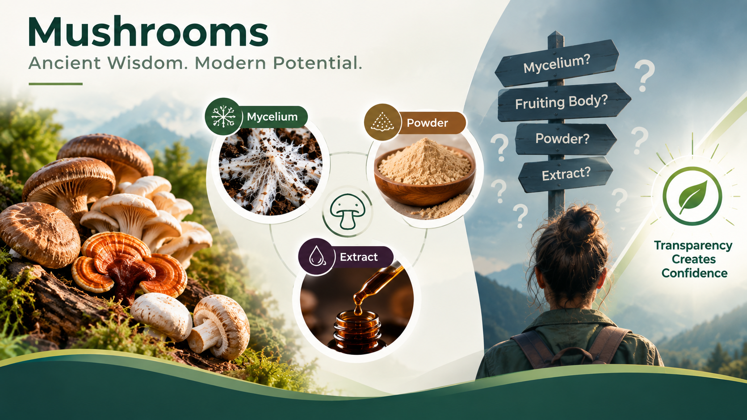

Slide 16
WHY THEY TAKE MUSHROOMS:
US, AGE & GENDER
Key Insights:
US age and gender responses are more varied and diffuse. Stress relief resonates with older males and females 35-44.
Inflammation/autoimmune supersedes immune support, notably for males 26-34, females 26-34, males 18-25 and all those 45-54.
Mood resonates with males 18-25, sleep/relaxation with females 35-44 and 26-34.
Note: US Female 18-25 n=12, US Male 18-25 n=29, US Female 26-34 n=31, US Male 26-34 n=53, US Female 35-44 n=34, US Male 35-44 n=68, US Female 45-54 n=34, US Male 45-54 n=32, US Female 55+ n=14, US Male 55+ n=8. Question: “Why do you take a mushroom supplement?”

Slide 17
IMPORTANT LABEL CHARACTERISTICS:
US, AGE & GENDER
Key Insights:
This chart is indexed on females 18-34.
In the US, the top grouping is more pronounced, with a values-based seal or certification (especially with males 18-25 and 26-34, as well as females 45-54) and ‘a specific type of mushroom’ (especially with females 26-34 and males 45-54) are the strongest responses overall.
Note: US Female 18-25 n=12, US Male 18-25 n=29, US Female 26-34 n=31, US Male 26-34 n=53, US Female 35-44 n=34, US Male 35-44 n=68, US Female 45-54 n=34, US Male 45-54 n=32, US Female 55+ n=14, US Male 55+ n=8. Question: “When you select what mushroom product to purchase, what characteristics do you look for on the label?”

Slide 18


Slide 19
WHY THEY TAKE AN ASHWAGANDHA
SUPPLEMENT: US, AGE & GENDER
Key Insights:
US responses are similar to global age gender splits, with stress relief being the most popular response, especially for those 35-54 and males 26-34.
Mood skews significantly younger and is heavily driven by males 45-54, in fact their top response and then males 18-25 and females 26-34.
There is a spike for females 26-34 for sleep/relaxation.
Note: US Female 18-25 n=20, US Male 18-25 n=25, US Female 26-34 n=39, US Male 26-34 n=58, US Female 35-44 n=50, US Male 35-44 n=65, US Female 45-54 n=32, US Male 45-54 n=32, US Female 55+ n=16, US Male 55+ n=8. Question: “Why do you take a ashwagandha supplement?”

Slide 20
IMPORTANT LABEL CHARACTERISTICS:
US, AGE & GENDER
Key Insight:
Looking for ashwagandha root skews old (over 45), while a values-based certification skews strongly male.
Labelled as ashwagandha resonates as the top response for males 26-34 and females 35-44.
Note: US Female 18-25 n=20, US Male 18-25 n=25, US Female 26-34 n=39, US Male 26-34 n=58, US Female 35-44 n=50, US Male 35-44 n=65, US Female 45-54 n=32, US Male 45-54 n=32, US Female 55+ n=16, US Male 55+ n=8. Question: “When you select what ashwagandha product to purchase, what characteristics do you look for on the label?”

Slide 21





QUESTIONS?
Our team is happy to help!
Len Monheit
CEO, Industry Transparency Center
len@itcstrategy.com
Steve Imgrund
Marketing and Communications Lead Industry Transparency Center
steve@itcstrategy.com
Maggie Feikes
Project Manager
Industry Transparency Center
maggie@itcstrategy.com

