Slide 1
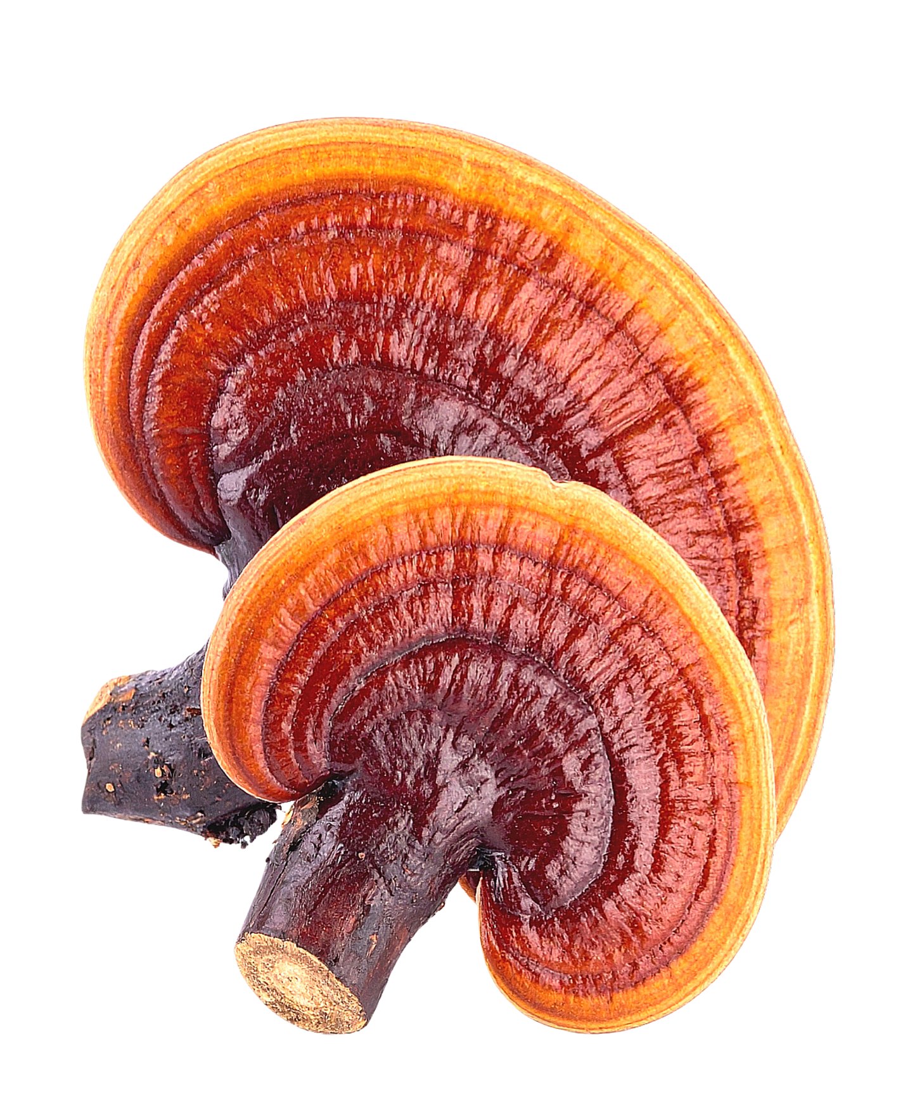
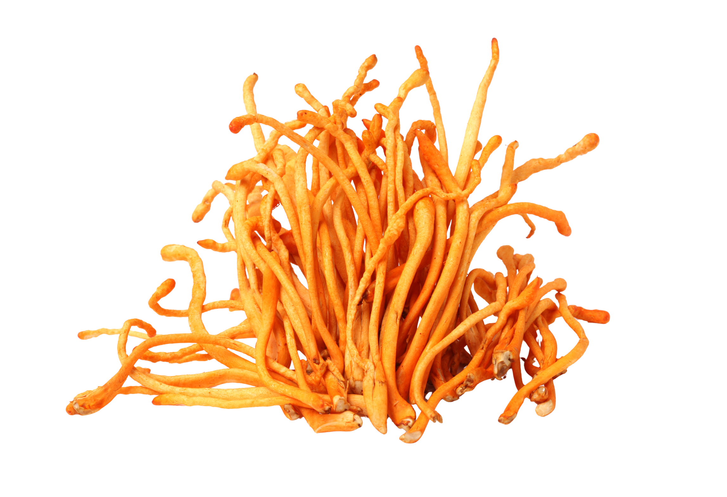
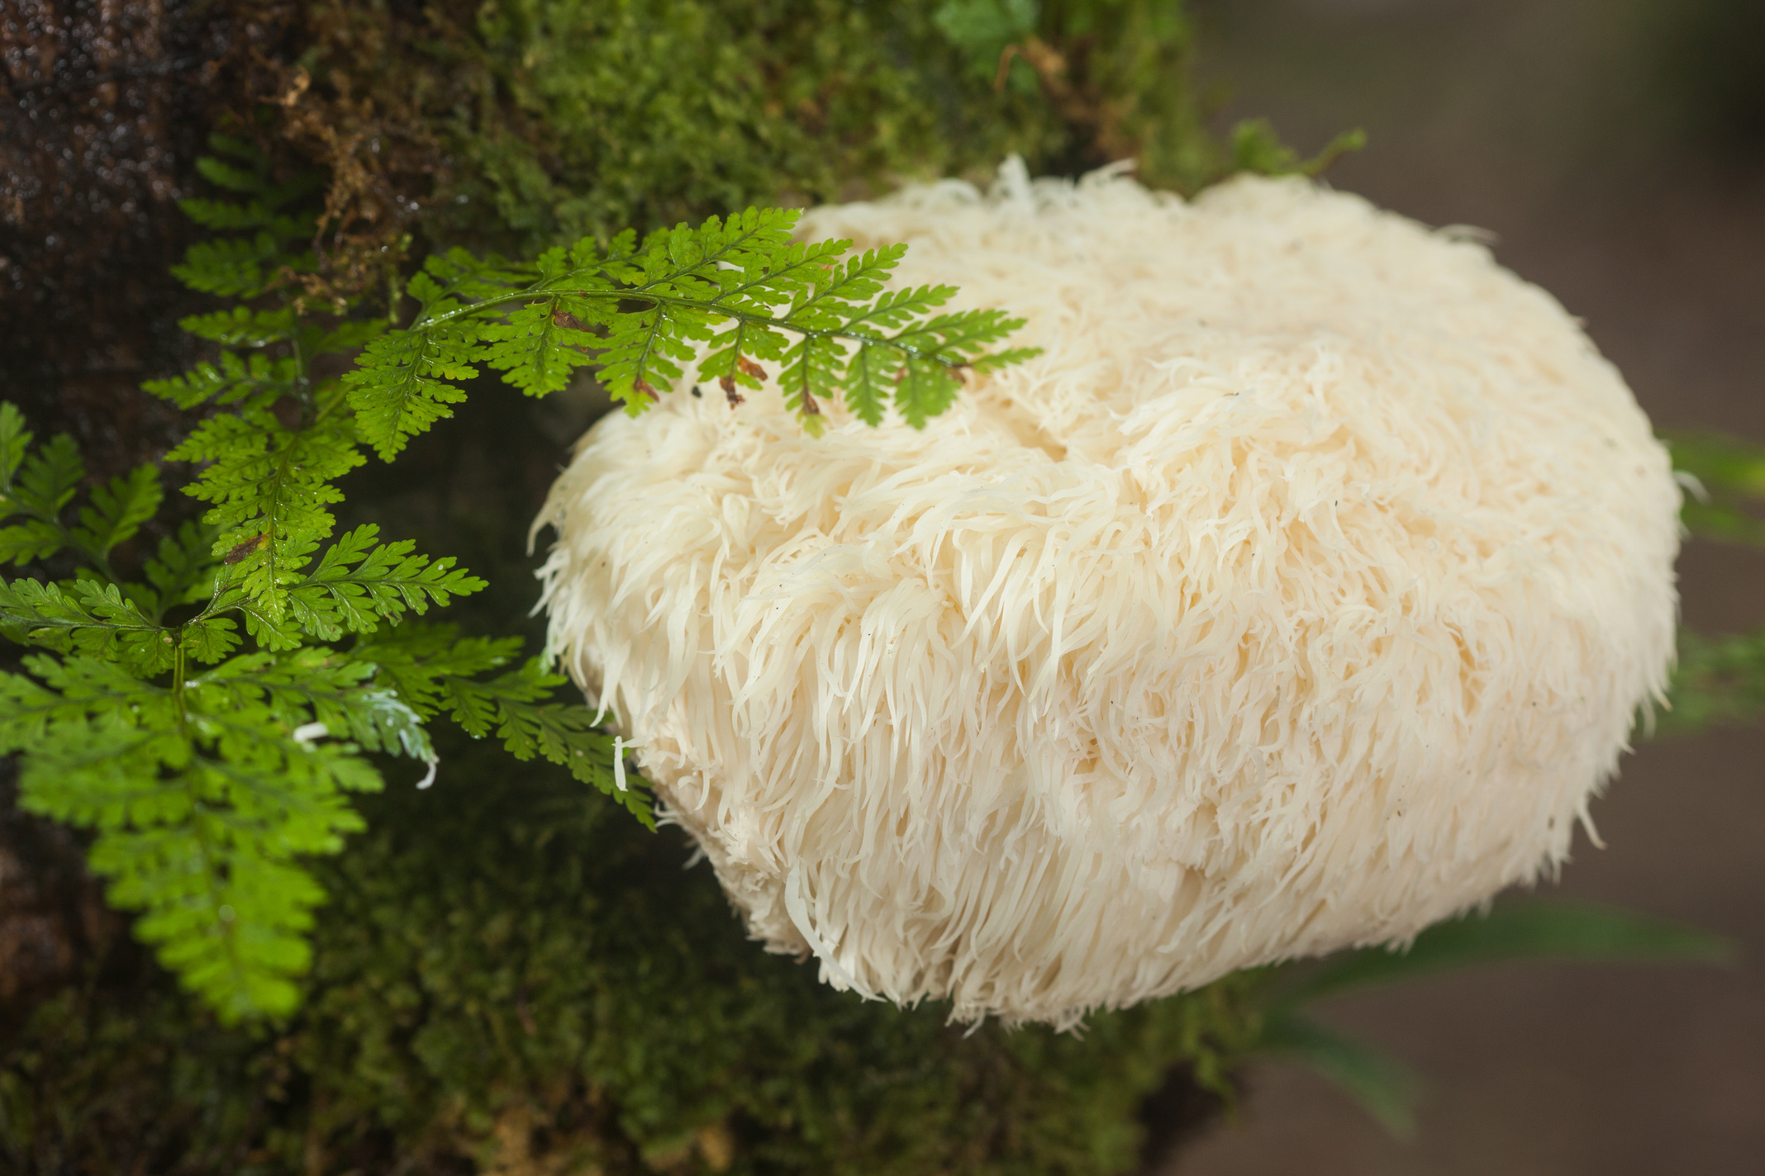
FUNCTIONAL MUSHROOMS 3.0
Grain of Truth
Mushrooms, Labels and the Value of Biodiversity.
Kerry Hughes
Founder & President
Ethnopharm, EBI Network

Slide 2
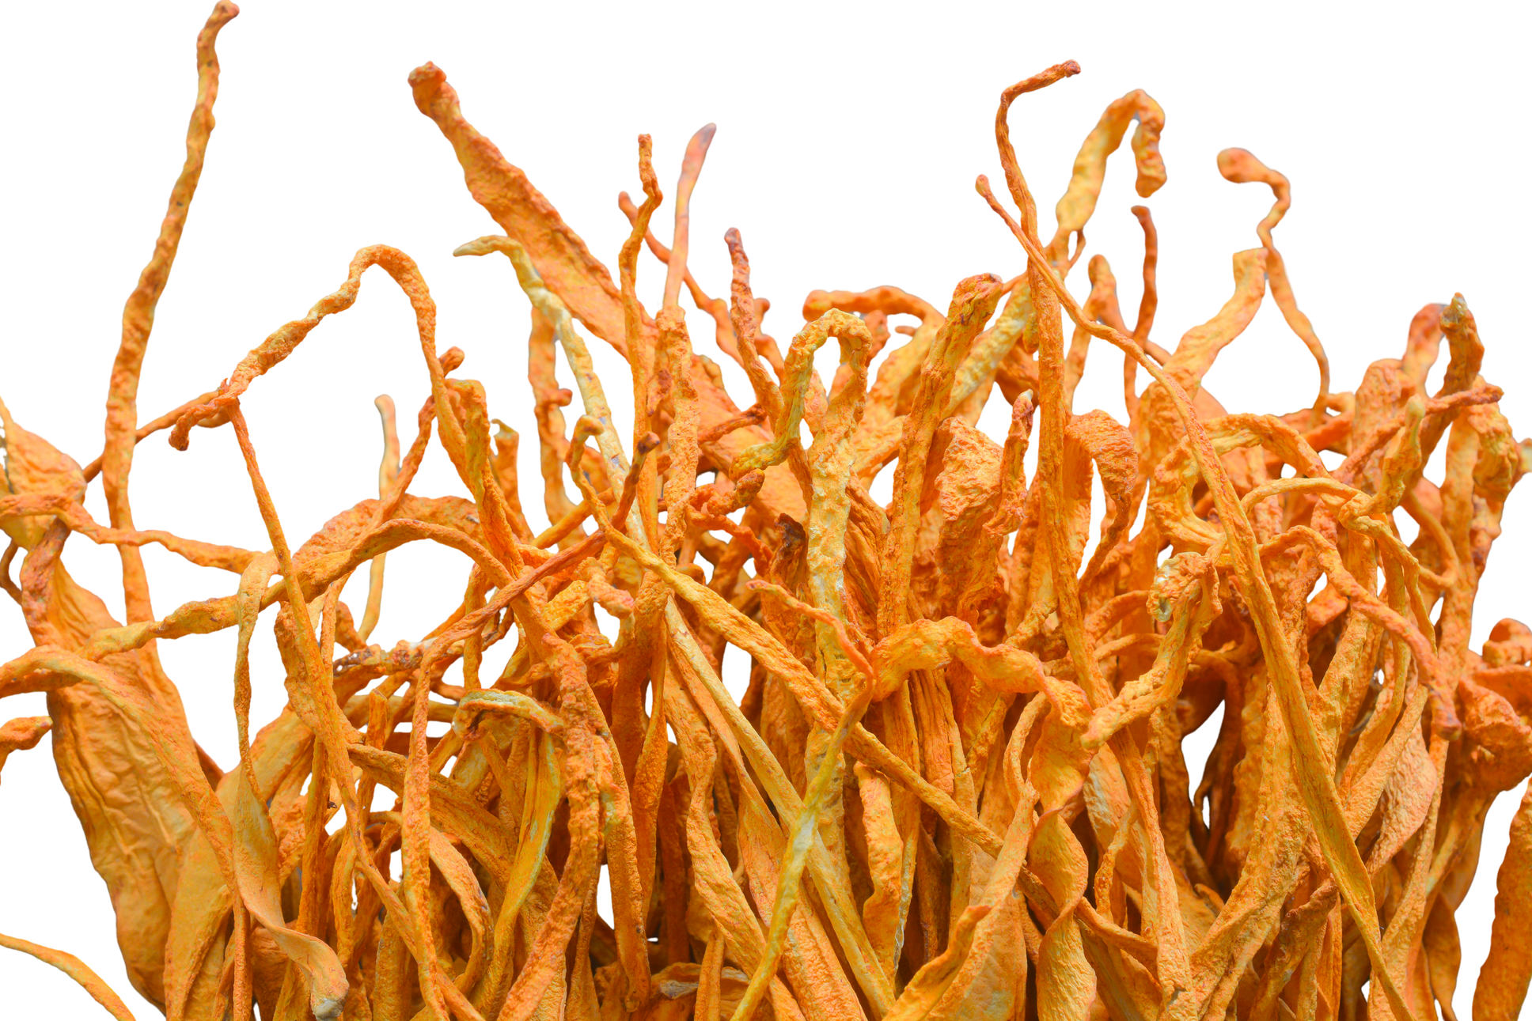
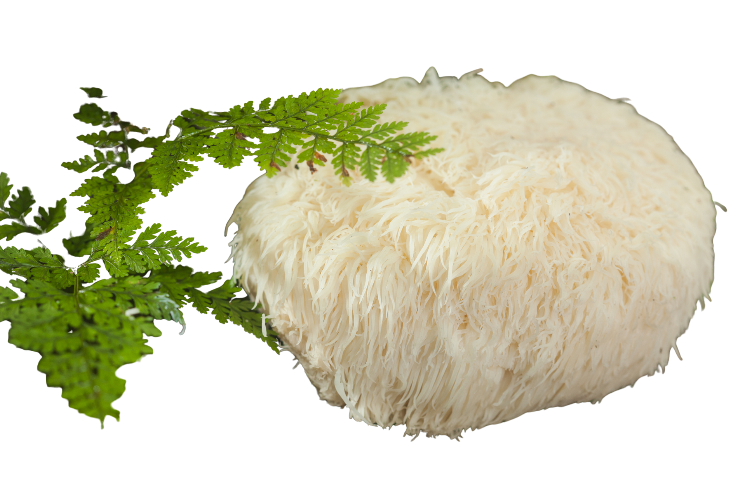
A CROWDED, EXCITING SHELF
Familiar names, new frontiers
Cordyceps militaris
Lion's mane
Reishi
Several studies show positive support of cognition and nerve health. Newer lines of research on bioactives, such as Erinacines and Hericinones.
Prized in TM for use in supporting energy and vitality. Over 1000 studies on cordycepin as bioactive, with effects on energy metabolism and ATP production.
Revered in TCM for thousands of years, esp. for longevity. The ganoderic acids are recognized bioactives with evidence in neuroplasticity, healthy aging and GABAergic modulation.

Slide 3
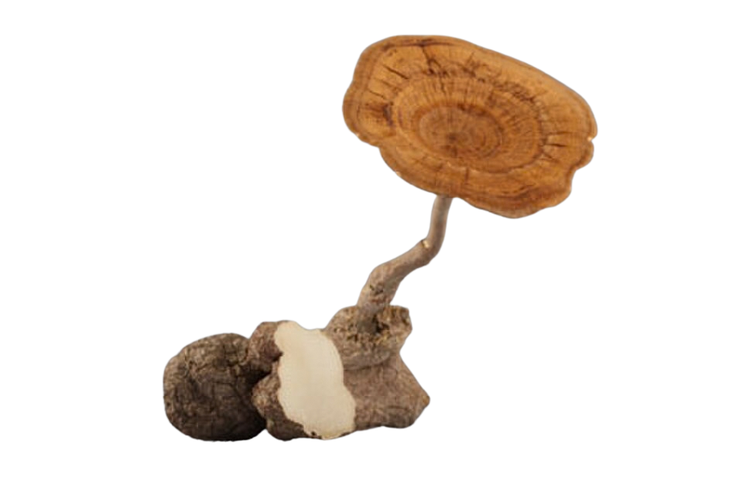
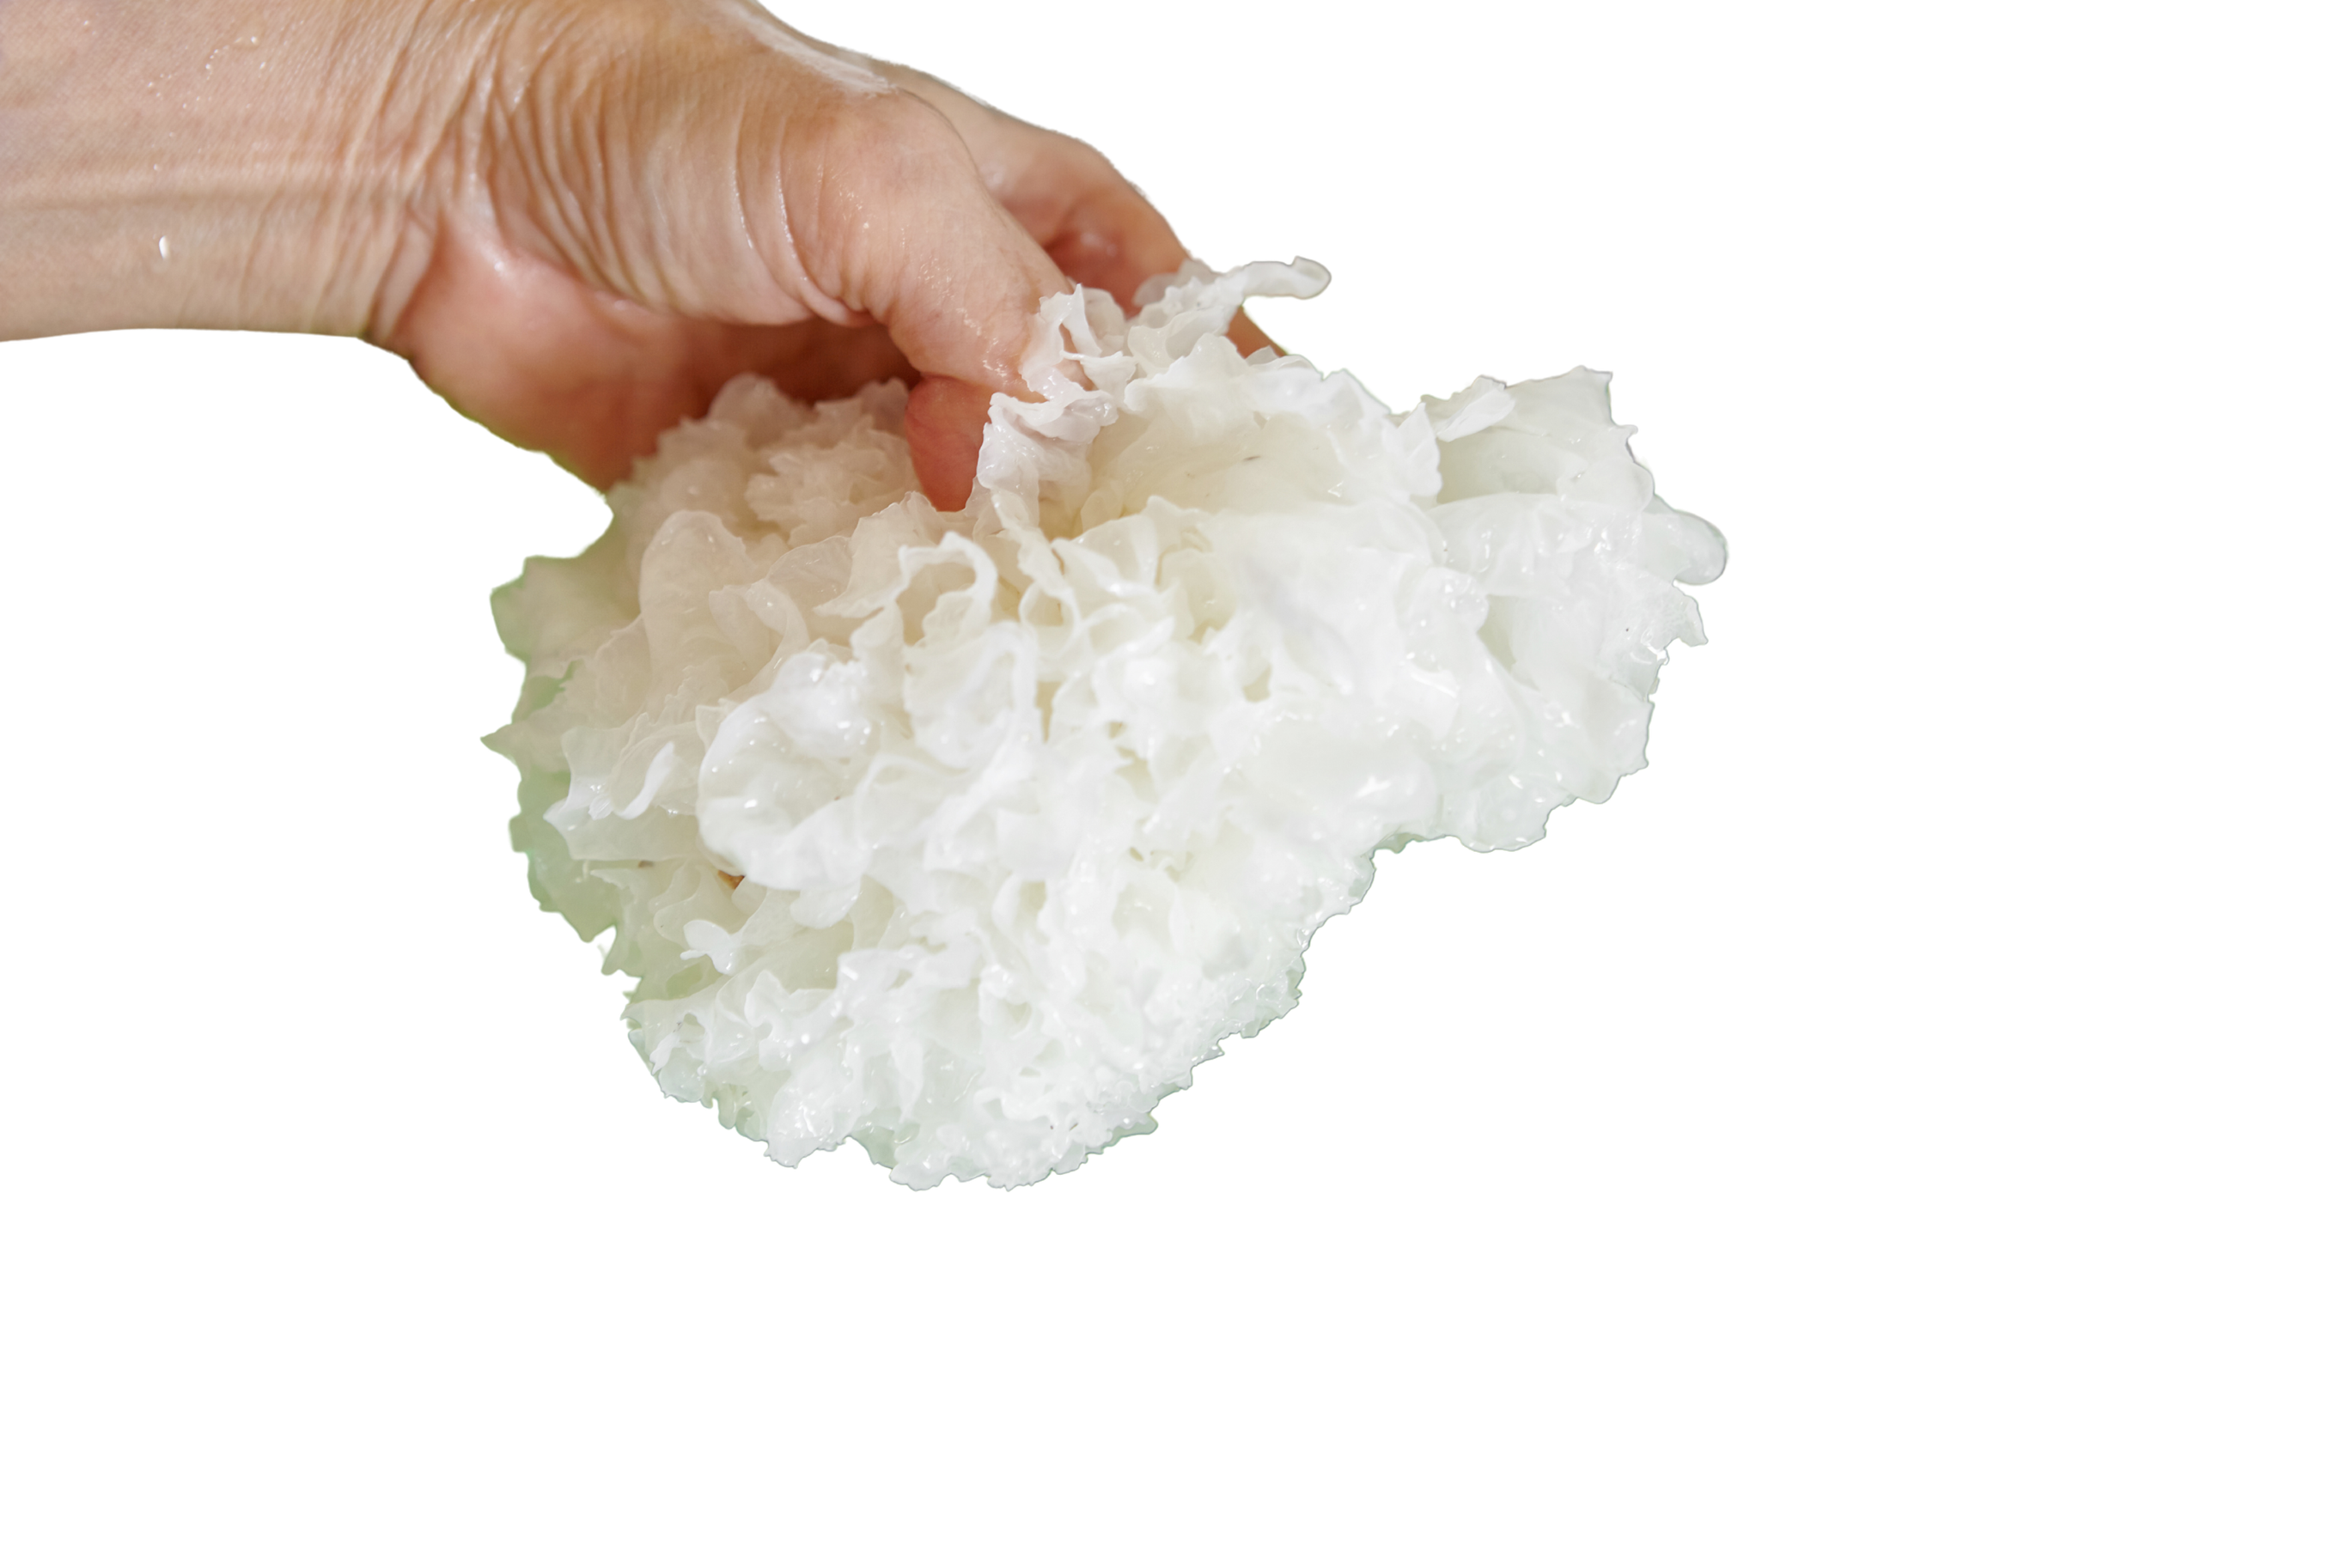
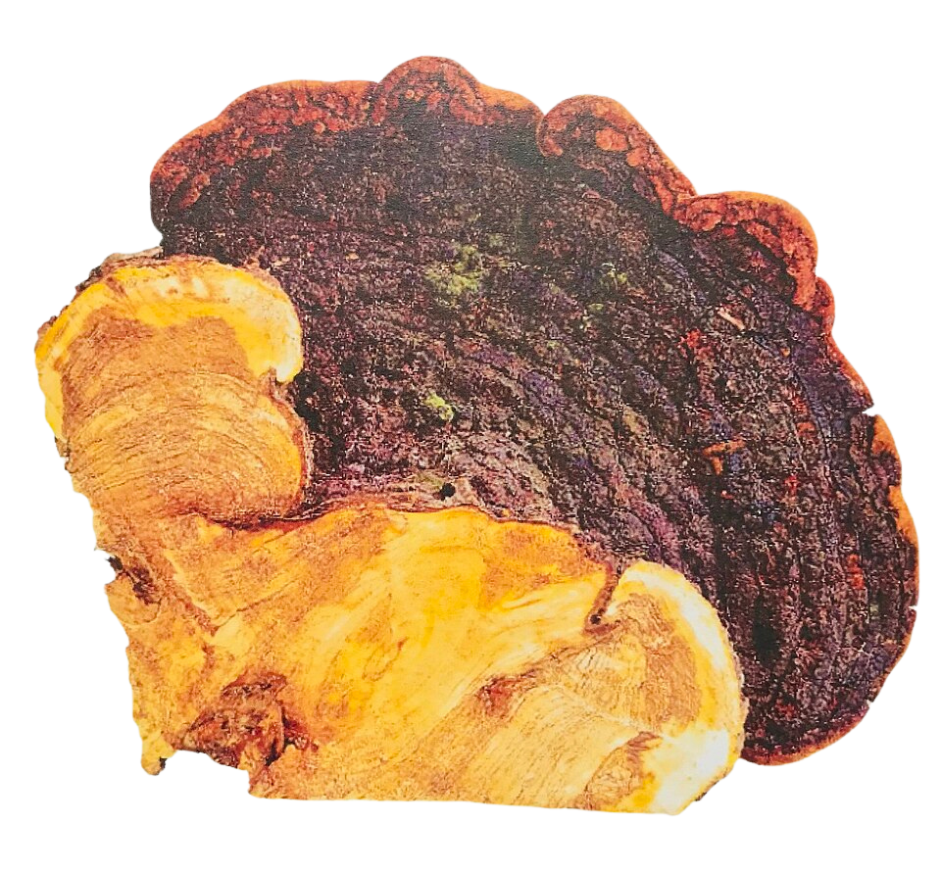
A CROWDED, EXCITING SHELF
Less familiar names, new frontiers
White Jelly Mushroom
Black Hoof Mushroom
Tiger Milk Mushroom
Traditional use in skin, immunity and well being, and used cooked into soups. In vitro and animal evidence building for skin health, but more needed in humans.
This is a woody, hoof-shaped bracket fungus with long TCM history; a unique bioactive hispolon with support of immune system and cellular health.
Wild material is rare, and cultivation is what opened the door to research. Supports nerve growth factor activity; ability to act as an NGF mimetic through the TrkA receptor

Slide 4


THE DISCONNECT
None of it matters if the bioactives don't reach the person
Every study was done on a specific material: a species, a part, a preparation.
If the product doesn't match, the science doesn't transfer.

Slide 5
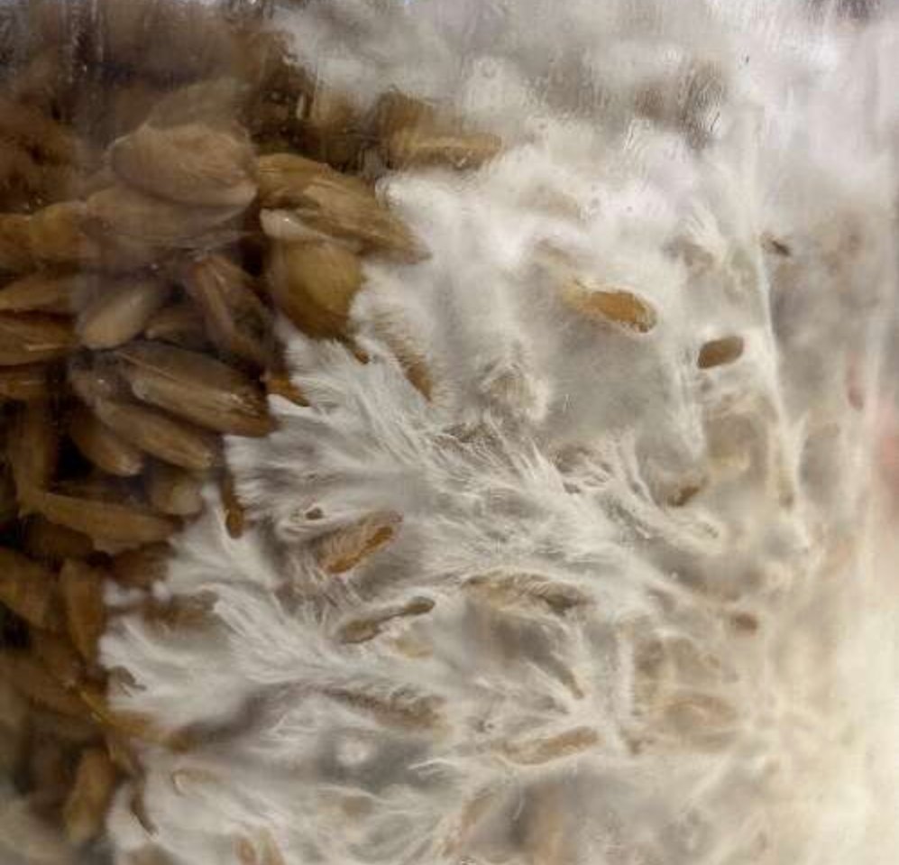
WHAT'S ACTUALLY IN THE CAPSULE
Mush ado about grain
Fruiting body
Mycelium on grain
The label
100% fungal material. No substrate left over. Most history of traditional use.
Often harvested too early, so that the final product that makes it to the market is largely substrate. Modern techniques, not used in traditional medicine.
All products bear responsibility to adequately disclose what they are to the consumer on the label. In addition, they bear the responsibility to use testing methods that are fit-for-purpose to show they contain the real product.

Slide 6


ANALYTICS AS ACCOUNTABILITY
Test for what the science depends on
Identity: species and part (fruiting body vs. mycelium).
Bioactives, if known, help to assess for quality, identity and activity.
Label transparency: substrate, fungal part, and bioactives.
Beta-glucans may not be an appropriate quality marker:
1) They are in some substrate
2) Are easily inflated adulterants
3) They are often not the main functional bioactives for what consumers want.

Slide 7
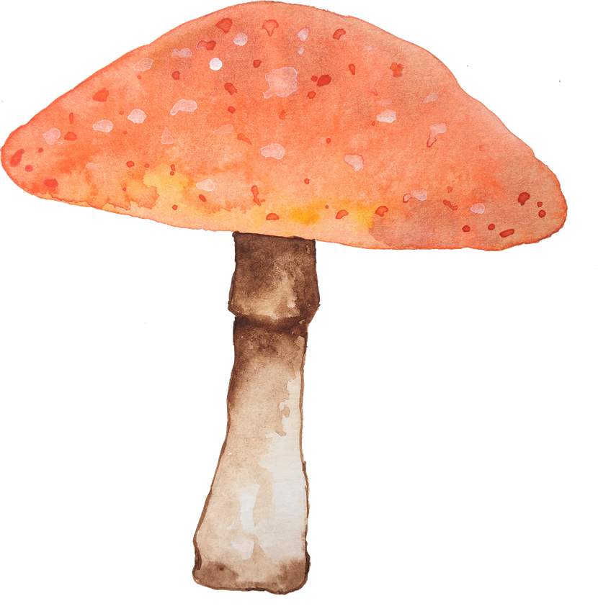
BIODIVERSITY
People don't save what they don't value
Every cultivated mushroom began as wild biodiversity, and fewer than 10% of fungi are described.
Some are still wild and at risk: eg. chaga, Ophiocordyceps sinensis, Agarikon. Over 1,000 on the IUCN Red List.
Dilution & Adulteration takes away benefits from honest growers, stewards, and consumers and from the next discovery. It Devalues the whole chain.

Slide 8


THE ASK
Celebrate the fungi. Prove it's in the bottle.
Brands: disclose part, substrate, and measured bioactives. Claims should match the actual product matrix research. MOG ≠ pure mycelium ≠ fruiting body ≠ standardized extracts.
Buyers & retailers: ask for the data. transparency. Only stock quality products with proper testing to prove it.
Everyone: pay only for real products, so biodiversity has value & Functional Mushrooms Category survives.

Slide 9
SOURCES
Key References
Lion’s Mane —https://pmc.ncbi.nlm.nih.gov/articles/PMC7283924/ ;
Cordycepin- https://www.nature.com/articles/s41598-025-92790-3 ; https://pmc.ncbi.nlm.nih.gov/articles/PMC5236007/
Ganoderic Acids- https://pubs.acs.org/jafcau/article-abstract/74/29/22846/5236594/Ganoderic-Acid-A-Mitigates-Sleep-Deprivation?redirectedFrom=fulltext ; https://pmc.ncbi.nlm.nih.gov/articles/PMC8249598/
White Jelly Mushroom- https://pubmed.ncbi.nlm.nih.gov/36757441/
Black Hoof Mushroom- https://pubmed.ncbi.nlm.nih.gov/38072341/ ; https://pubmed.ncbi.nlm.nih.gov/38991301/
Tiger’s Milk- https://pubmed.ncbi.nlm.nih.gov/26542212/
Nammex FDA petition comment on MOG — downloads.regulations.gov/FDA-2023-P-2340-0009/content.pdf
Beta-glucan in foods- https://pmc.ncbi.nlm.nih.gov/articles/PMC8746796/
Fungal diversity estimates — pmc.ncbi.nlm.nih.gov/articles/PMC11687528; Niskanen et al. 2023

