Slide 1
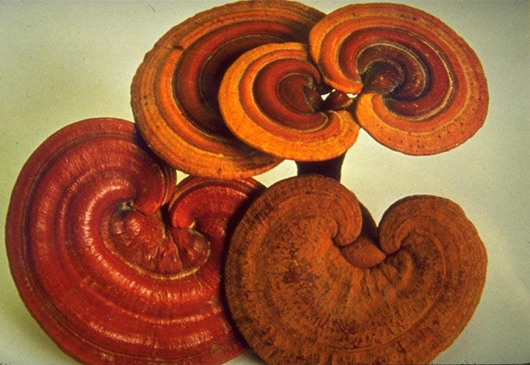
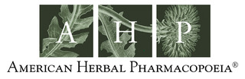

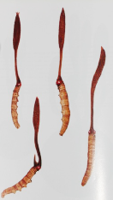
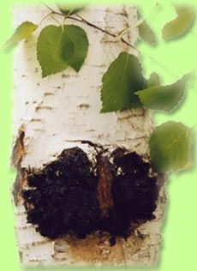
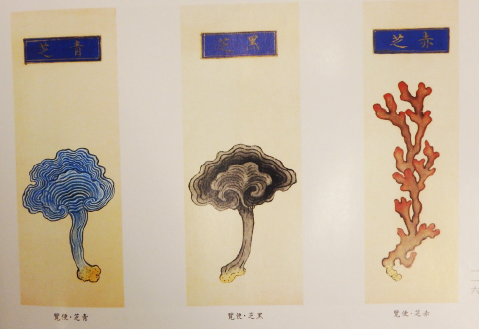
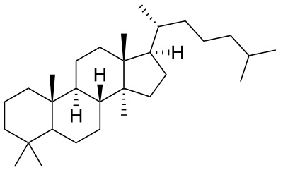
Medicinal Mushrooms
Traditional to Modern and Monographs
Roy Upton, President
American Herbal Pharmacopoeia

Slide 2
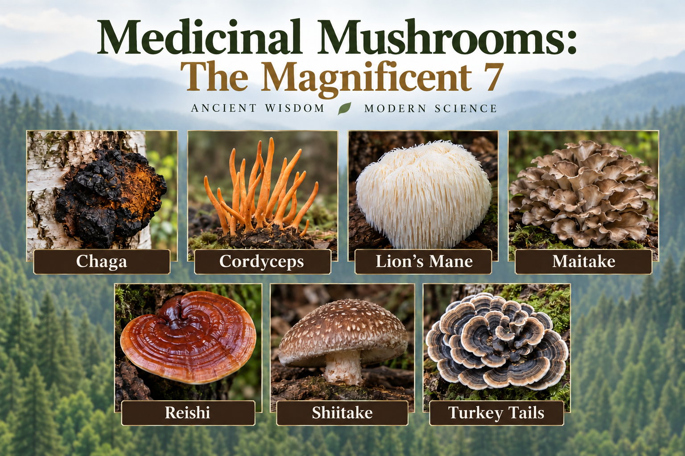

Slide 3
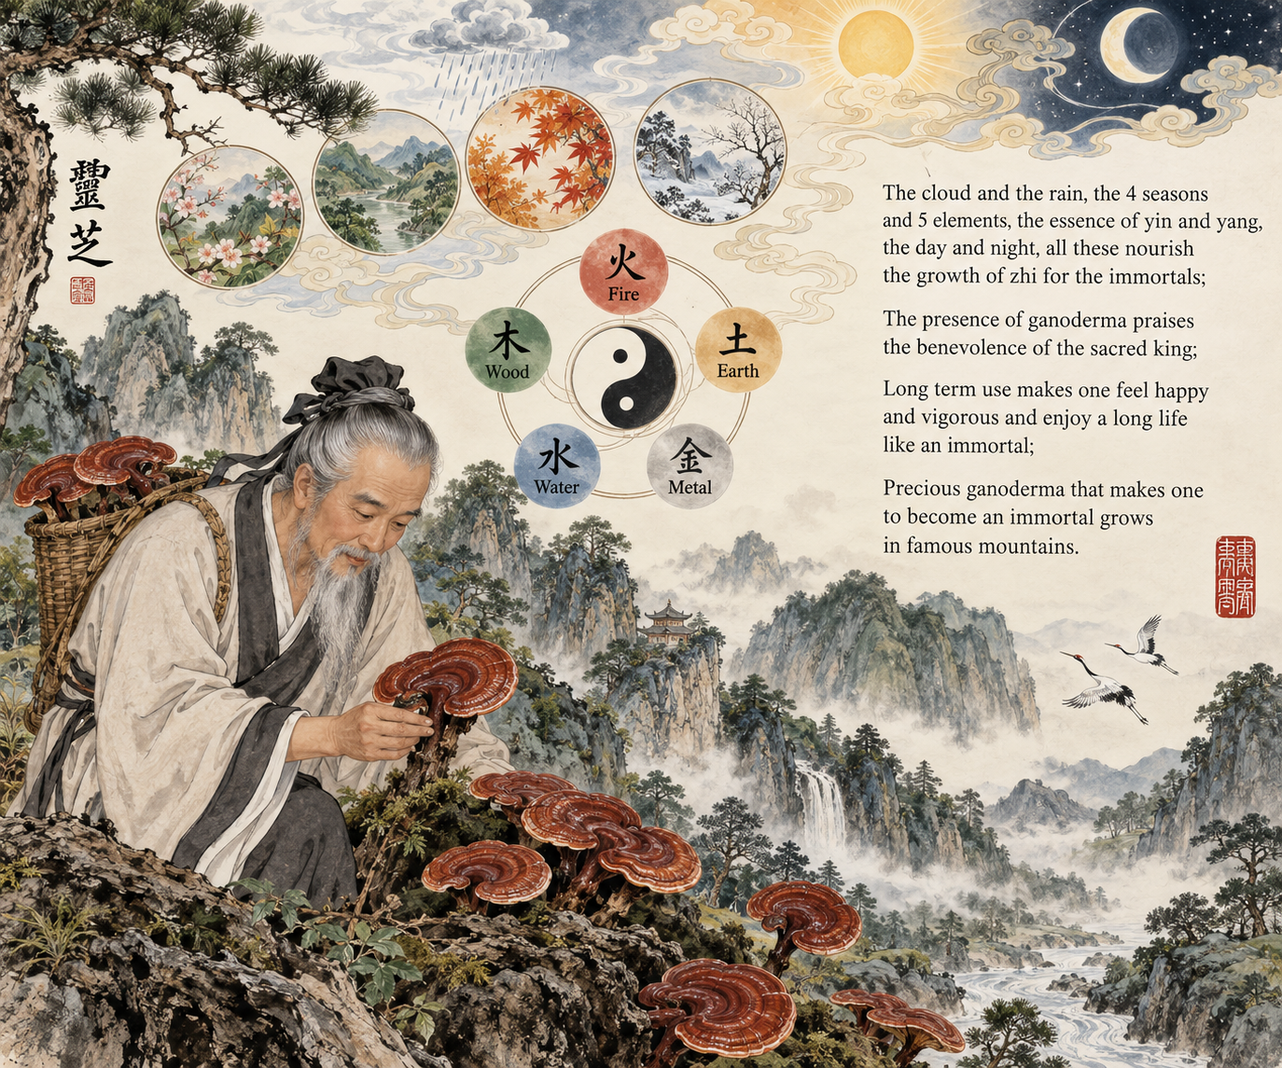
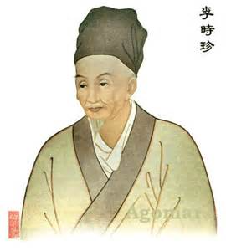
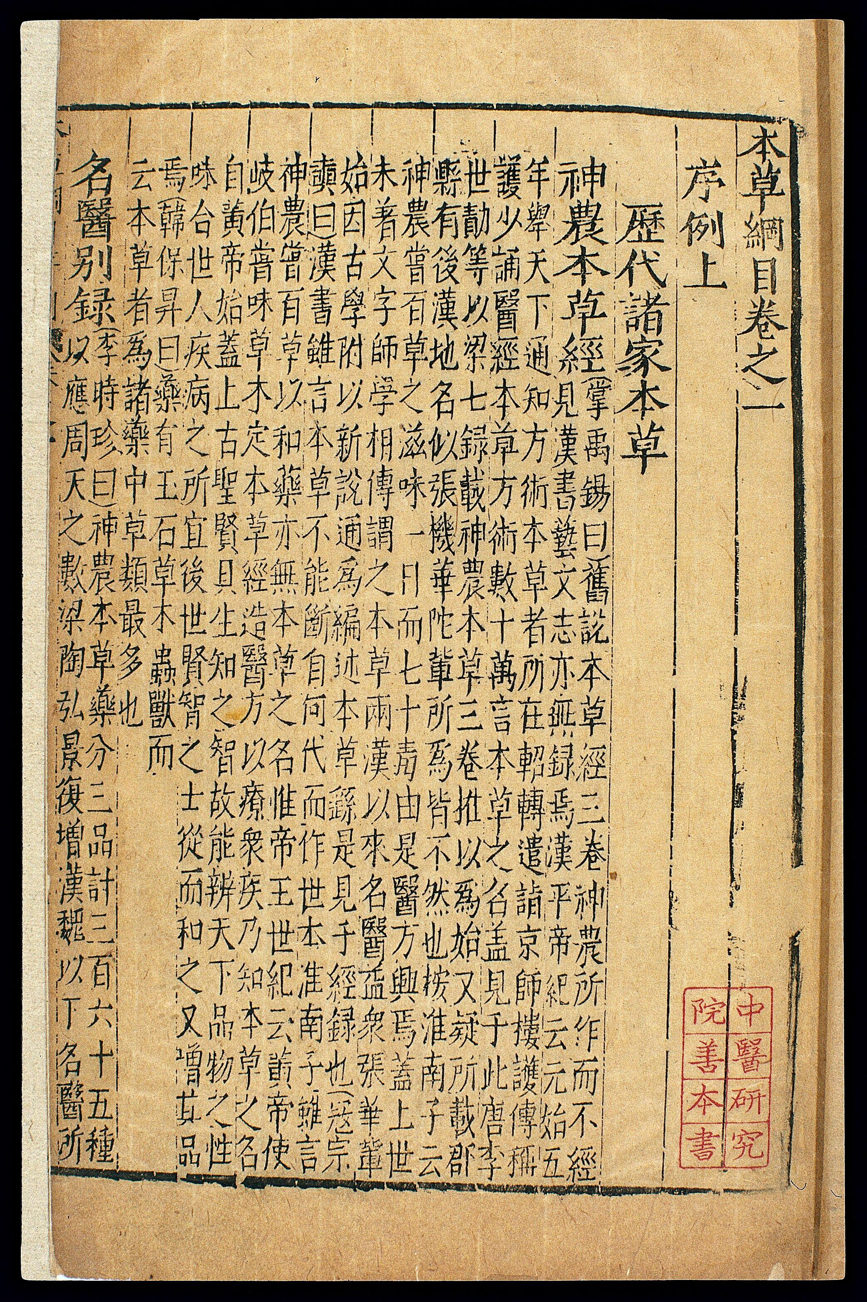
Traditional Use
Bencao Gangmu
The Mushroom of Immortality

Slide 4
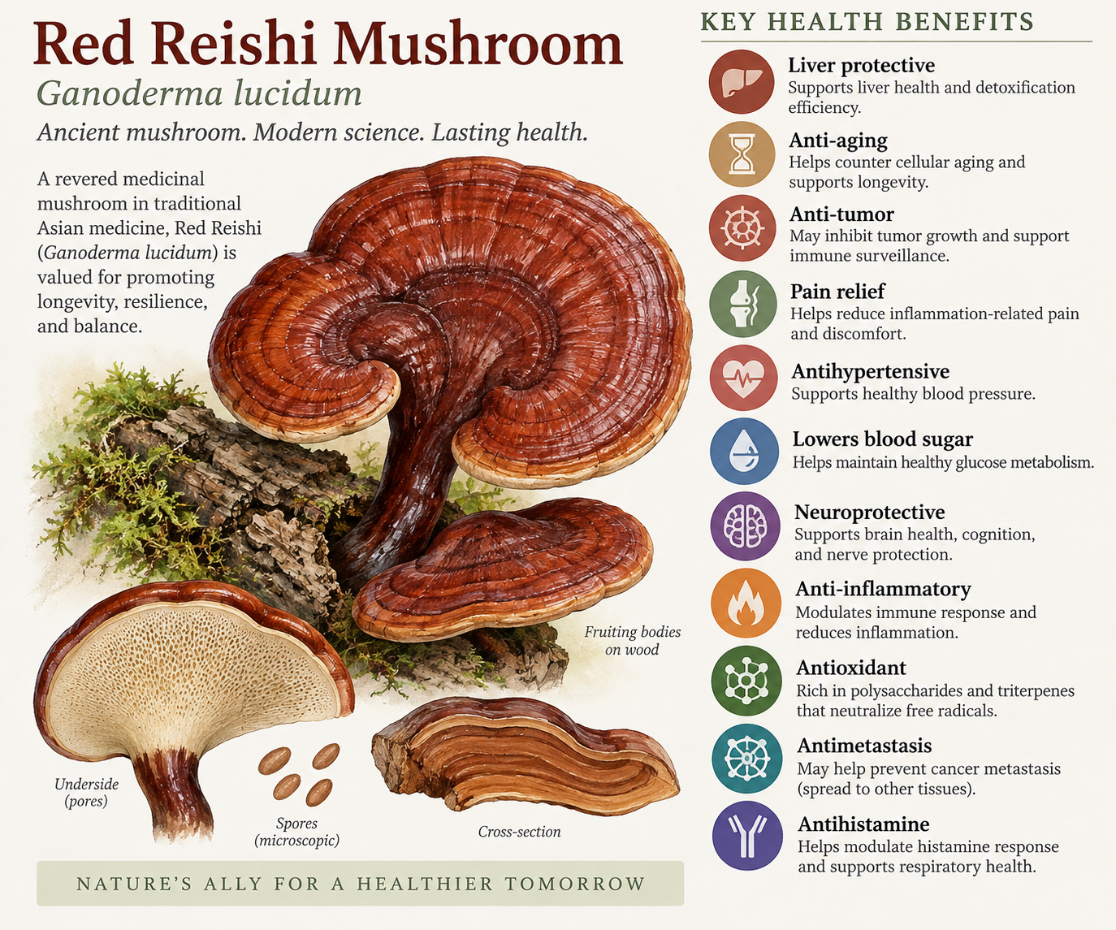
Science
One of the most pharmacologically acting plant-based substances on earth

Slide 5
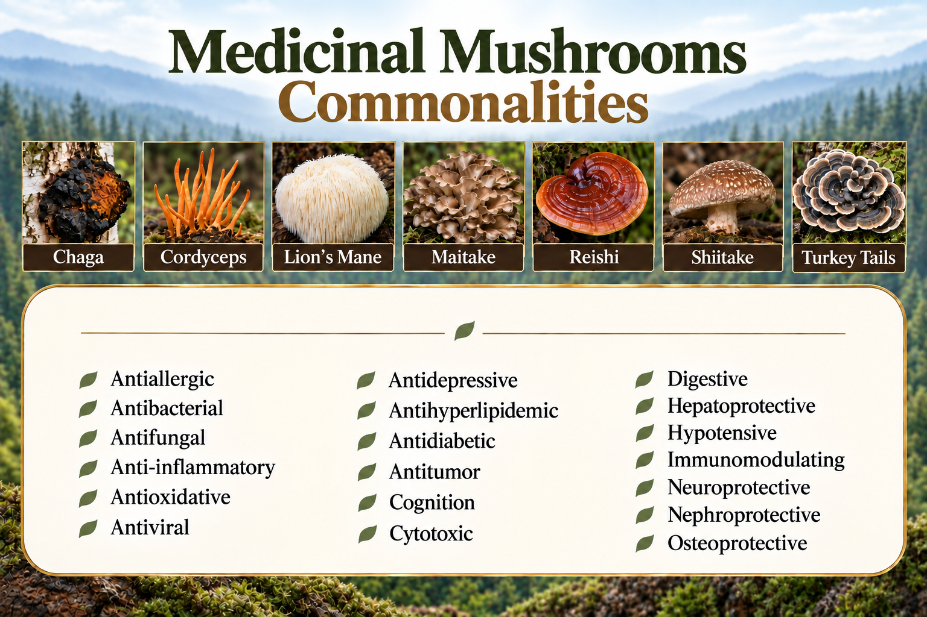

Slide 6
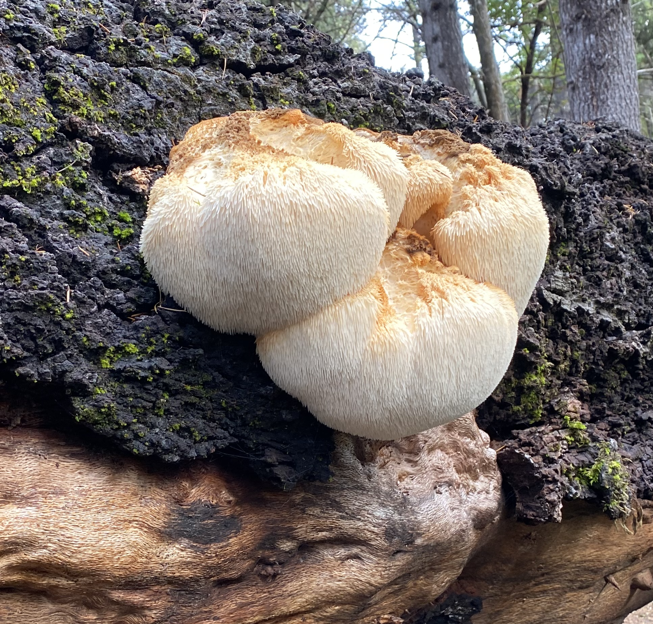
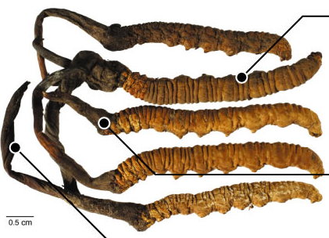
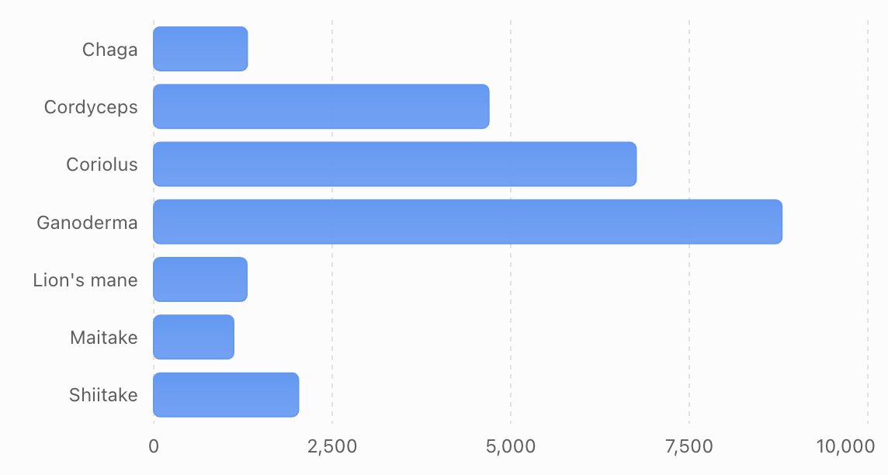
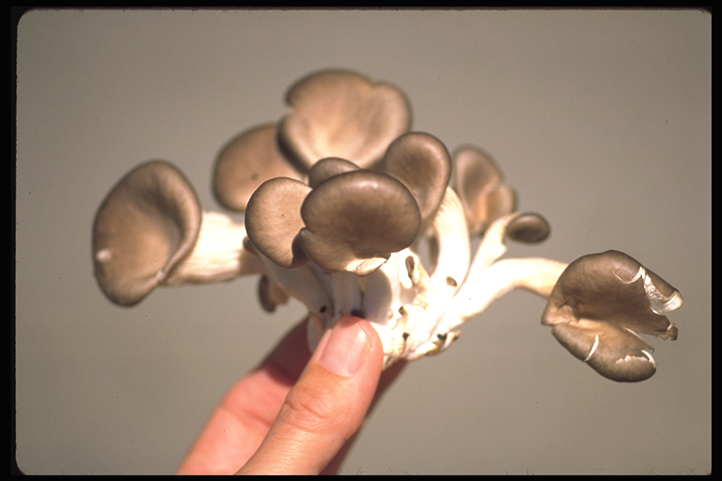
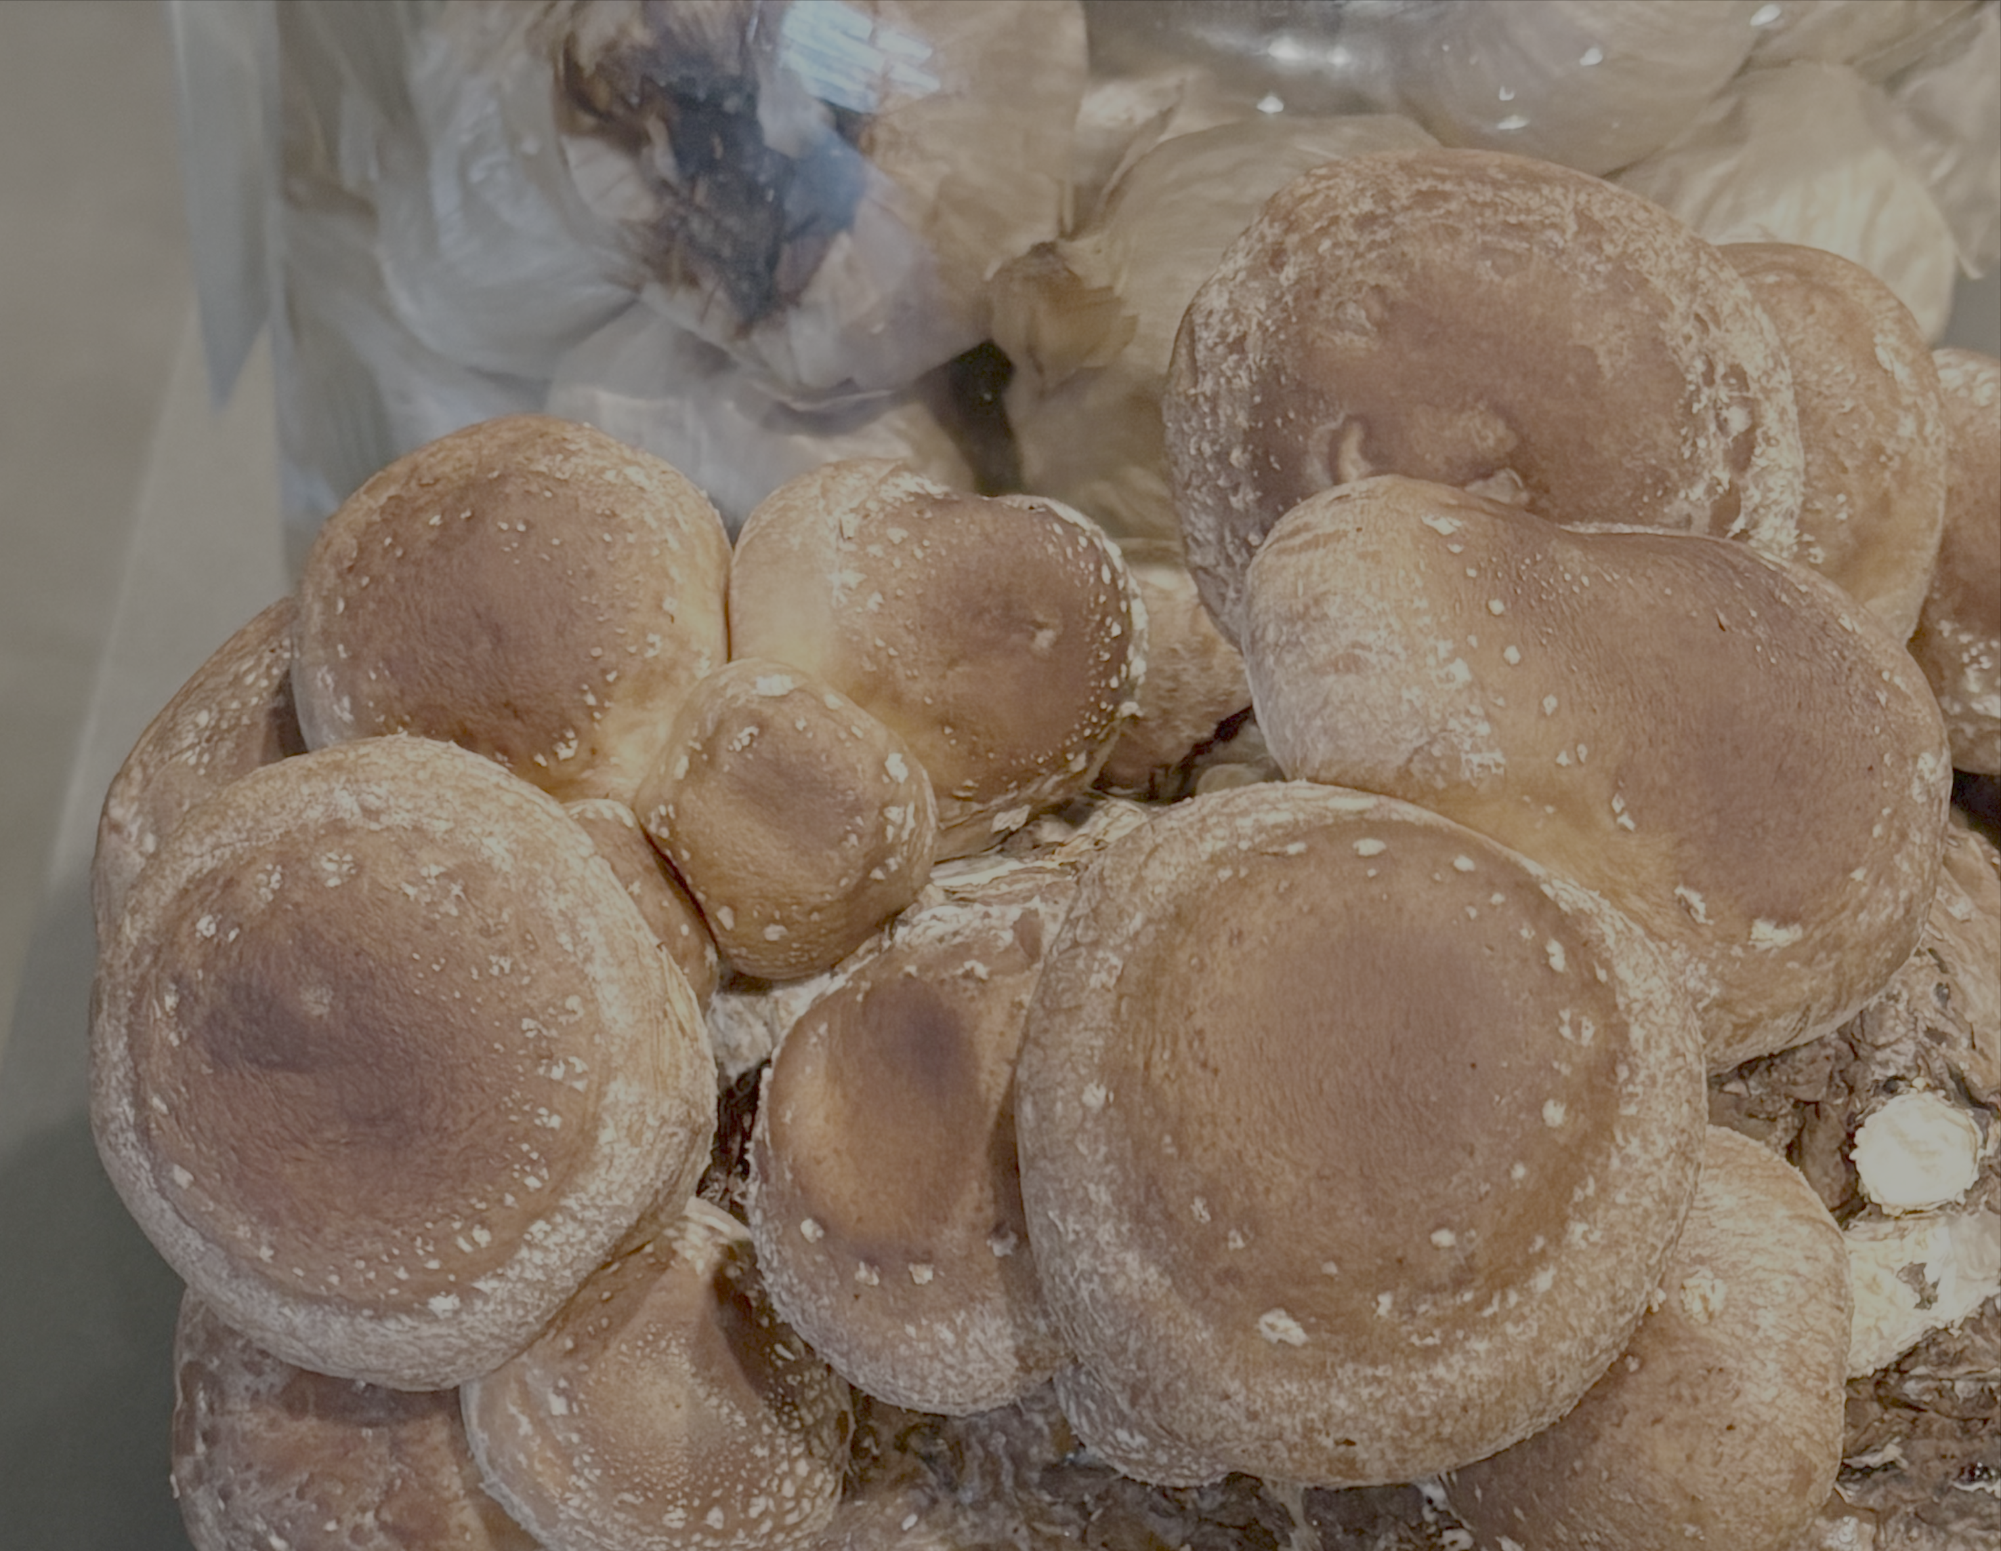
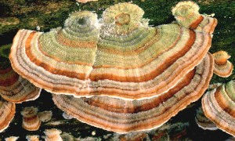
Mushroom Studies: Web of Science 2026
1311
4692
6755
8797
1304
1120
2026

Slide 7
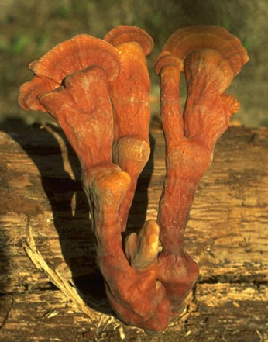
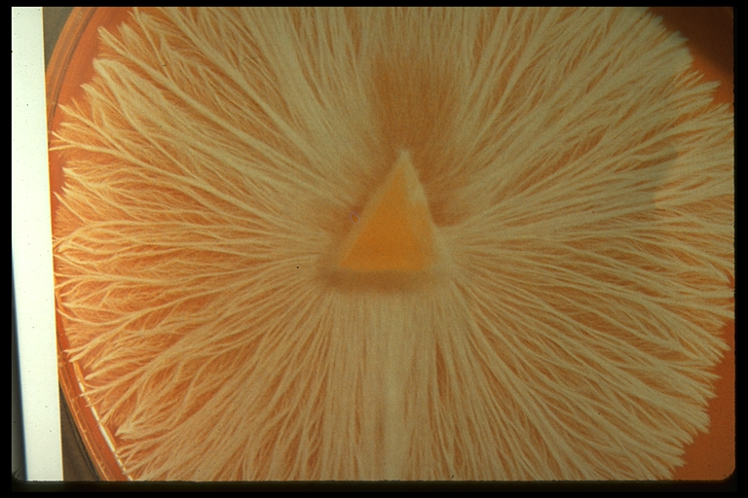
Fruiting Body vs. Mycelium Culture

Slide 8
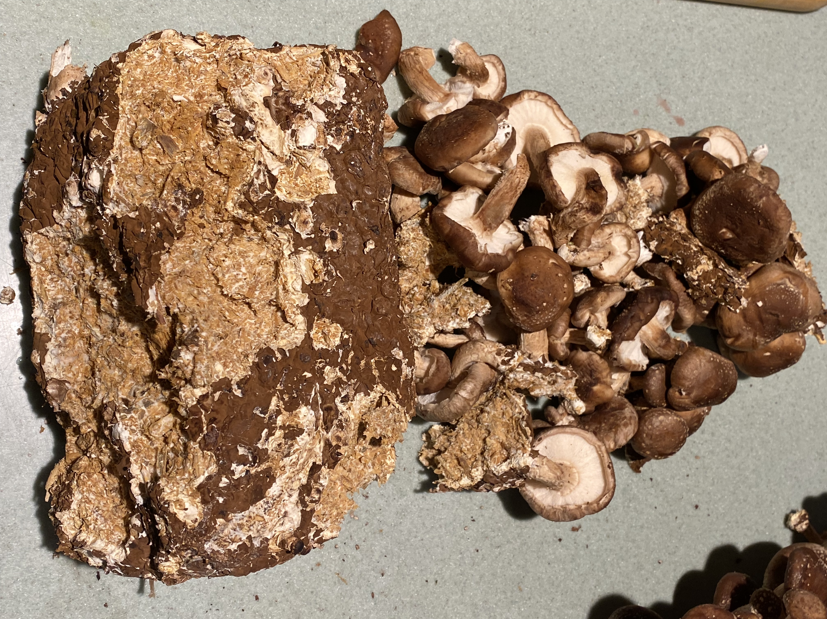
Mycelium Culture vs. Mycelium Biomass

Slide 9
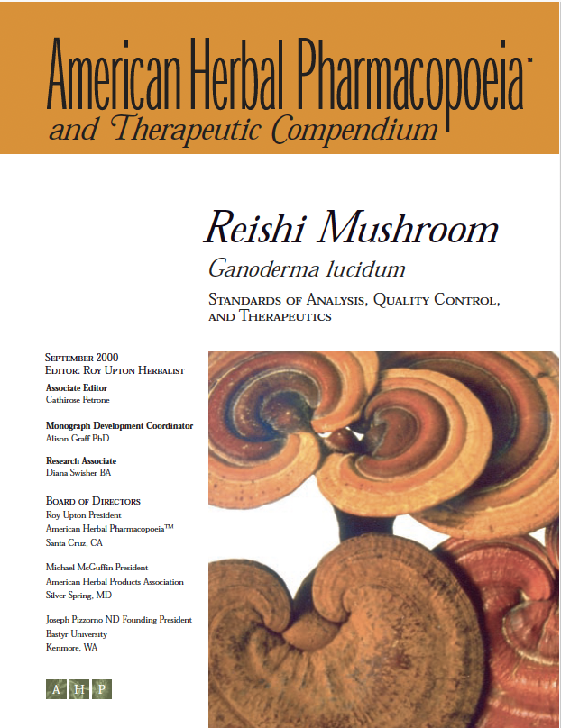
Setting Standards—Moving Target But Possible!
• Reishi: Triterpenoids or polysaccharides?
• Cordyceps: Adenosine?
• Lion’s mane: Polysaccharides, terpenoids (hericenones and erinacines), phenolics?
• Turkey tails: PSP, PSK?
• Fruiting body, fruiting body extracts (water, solvent), mycelium, biomass, spores, spore oil?

Slide 10
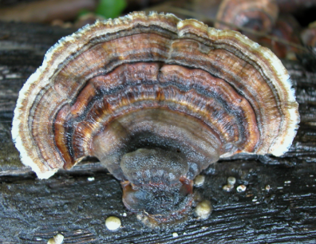
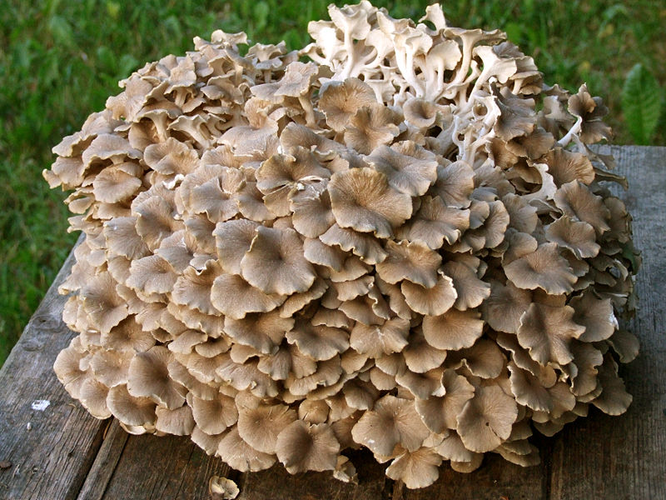
Mushroom Review
“…mushroom polysaccharides are not miracle drugs but can increase the quality of life of cancer patients and may offer increased survival rates for some types of cancer, especially when they are used as adjuncts to conventional forms of treatment. Smith, Rowan, Sullivan University of Strathclyde, UK
“After a quarter century of trials indicating PSK can improve cancer survival, the cumulative human findings amount to a recommendation of its inclusion in standard anticancer protocols. With its risk for adverse events virtually nonexistent, PSK’s contribution to the benefit-risk profiles of these protocols can only be positive.” Paris Kidd, University of California, Berkley

Slide 11
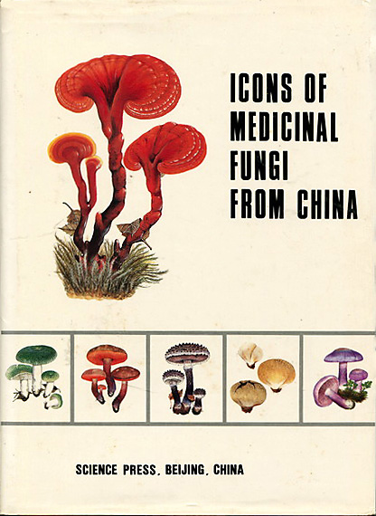
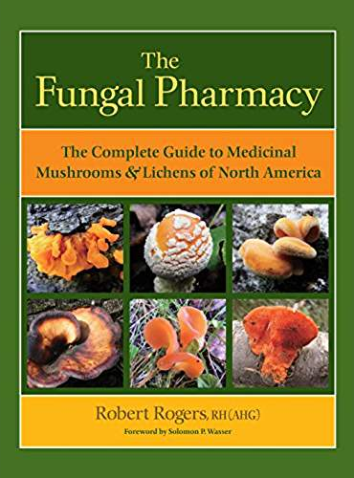
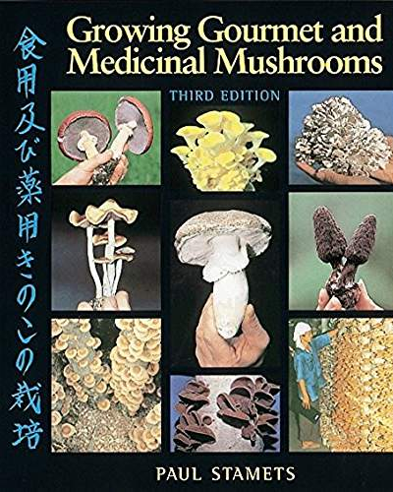
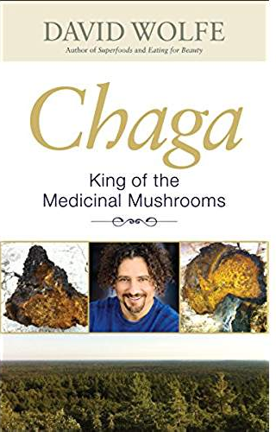
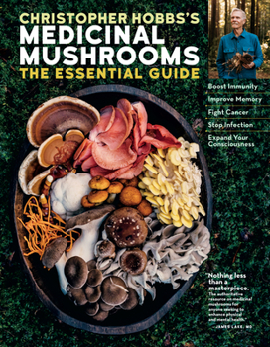
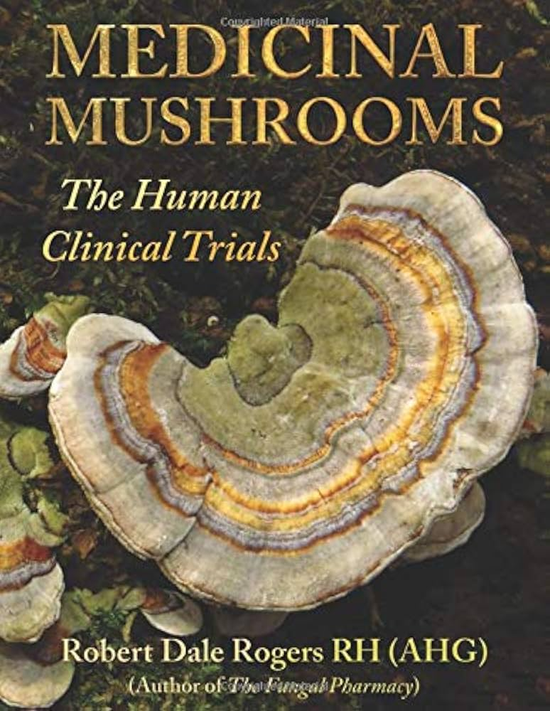
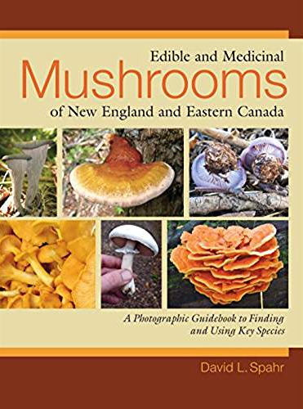
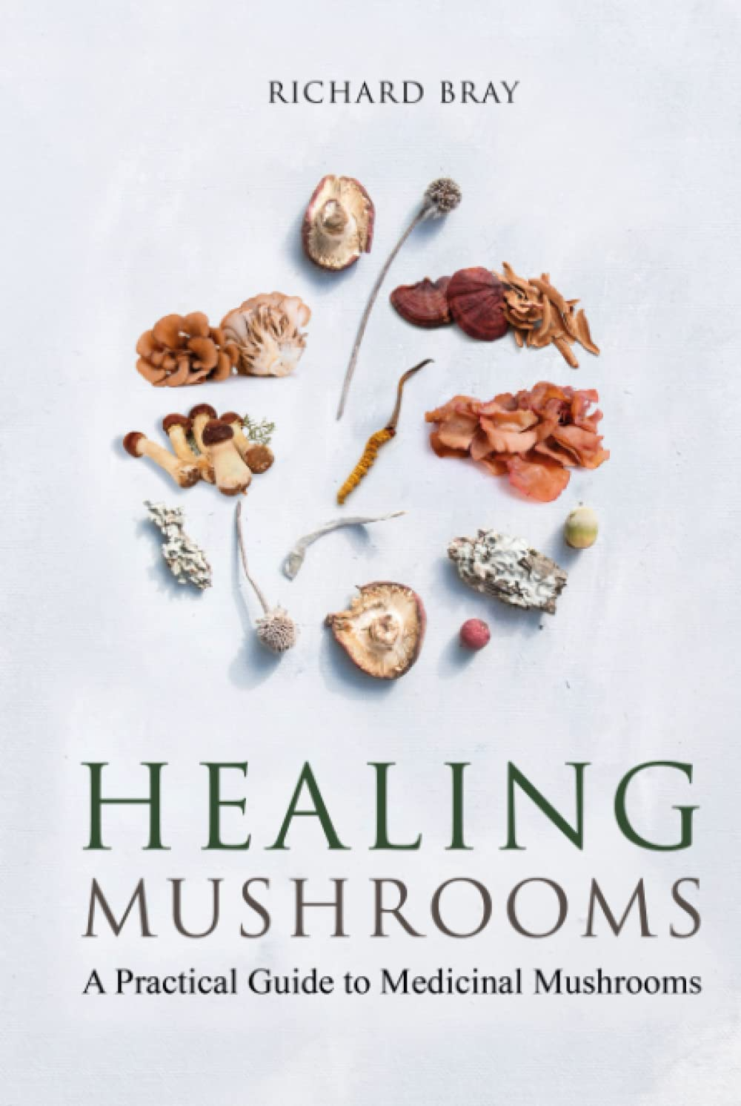
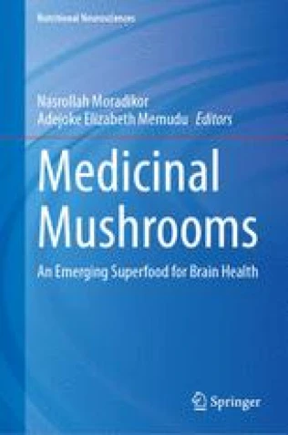
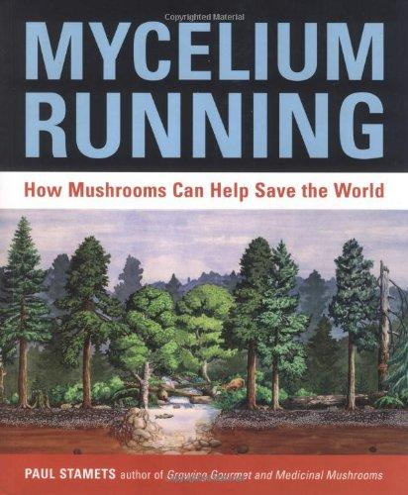
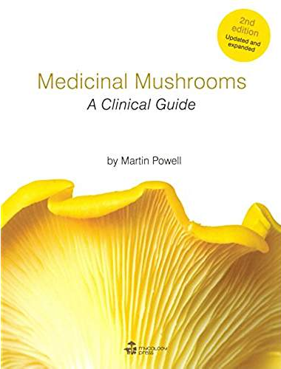
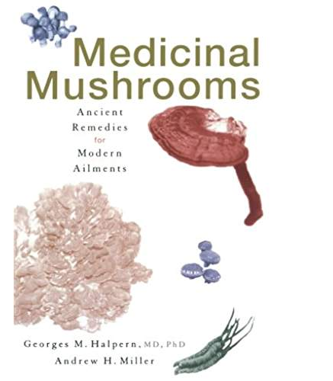
Mushroom Resources: Popular References

Slide 12
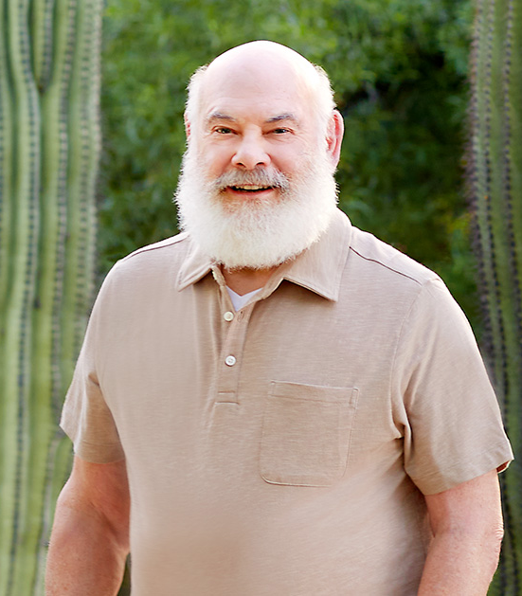
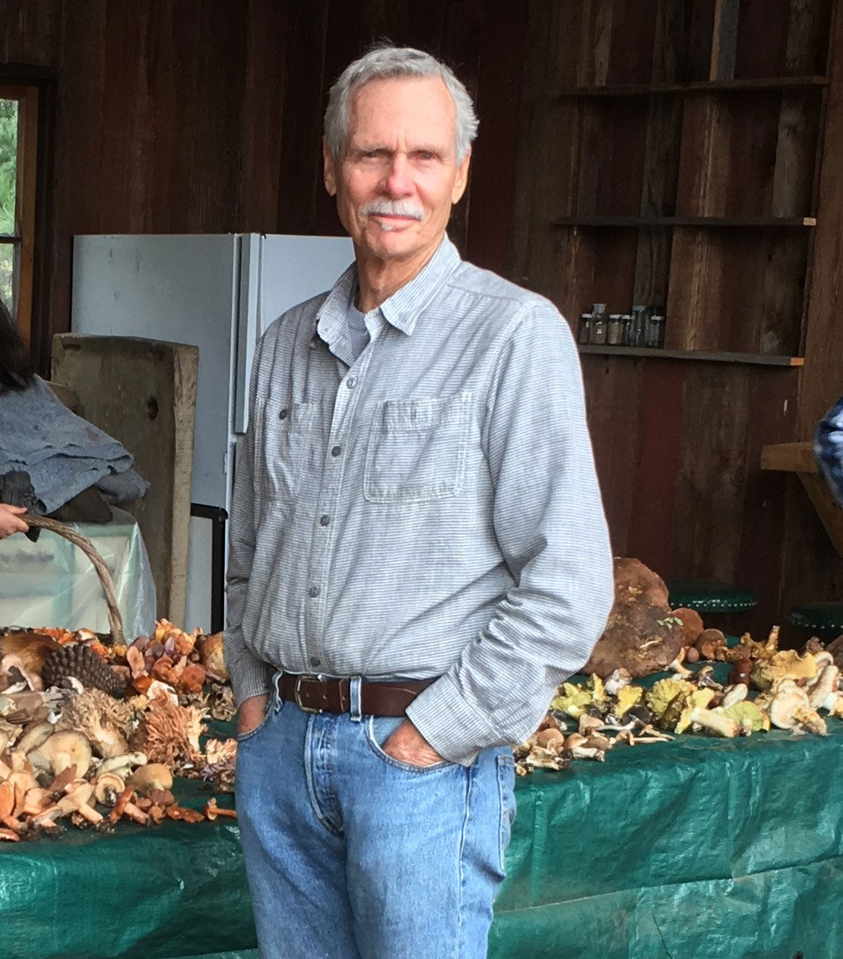
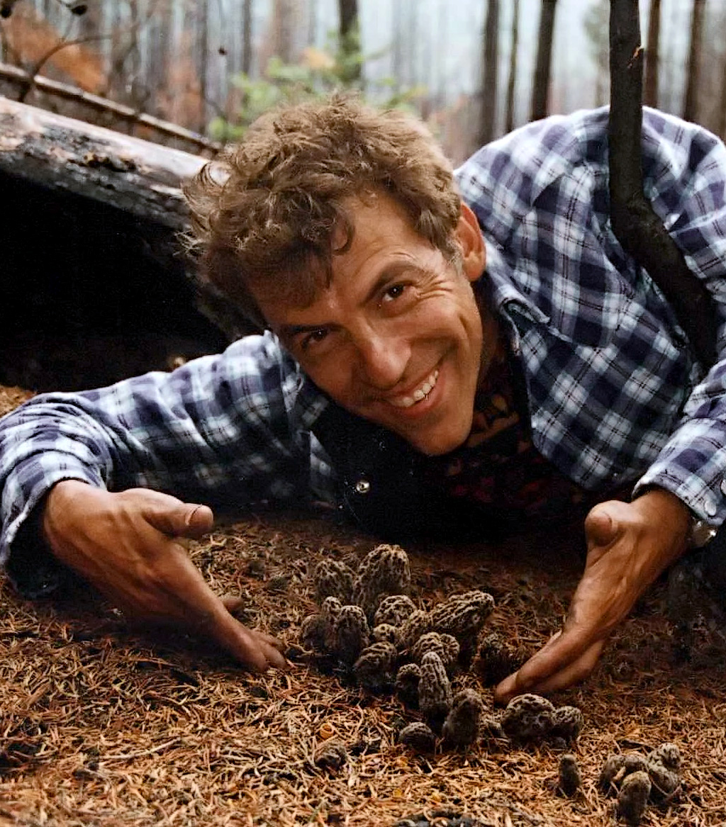
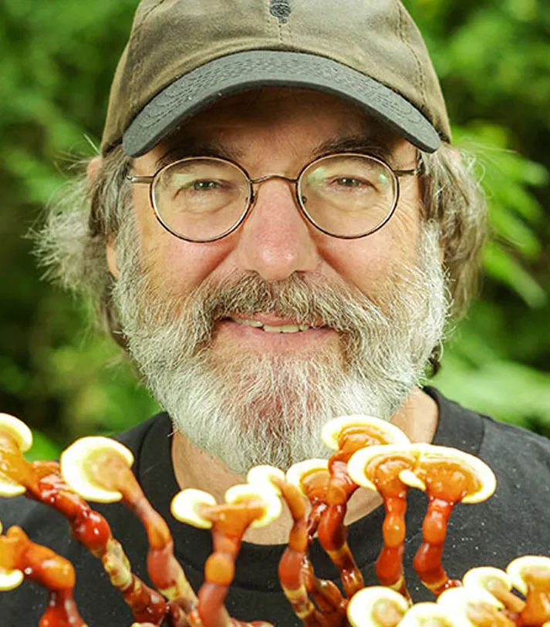
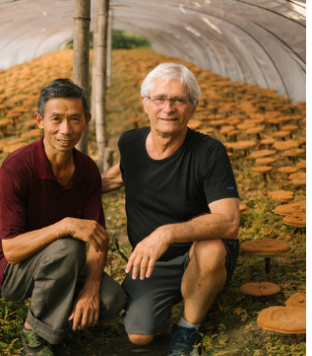
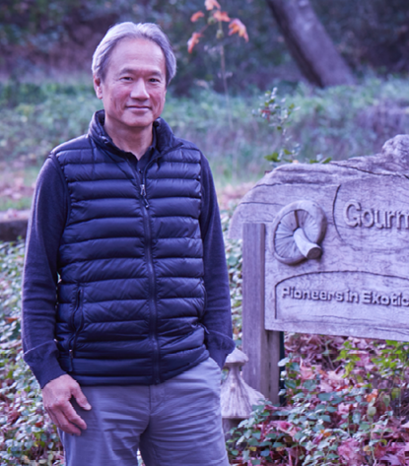
Medicinal Mushroom Pioneers (US)
Andrew Weil
David Aurora
Christopher Hobbs
Paul Stamets
Jeff Chilton
David Law

