Slide 1

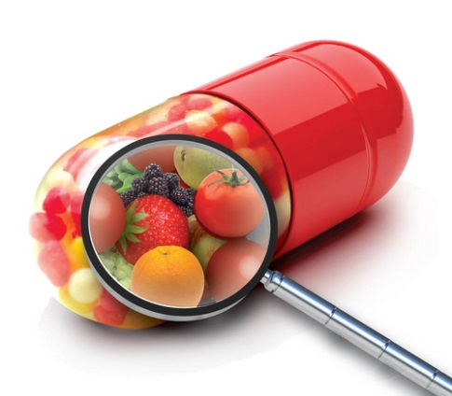

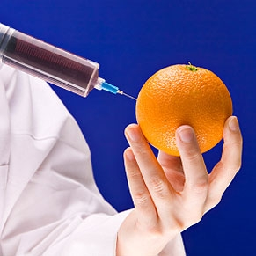
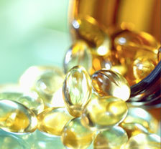


ALT
APPLIED LABORATORY TECHNOLOGIES
AI to Advance Ingredients
Artificial Intelligence to Rapidly Develop, Improve, and Expand Use of Natural Ingredients
Rigorous Analysis.
Reliable Results.
appliedlabtech.com
Dr. Paul A. Spagnuolo, Ph.D. | Sept 2026

Slide 2
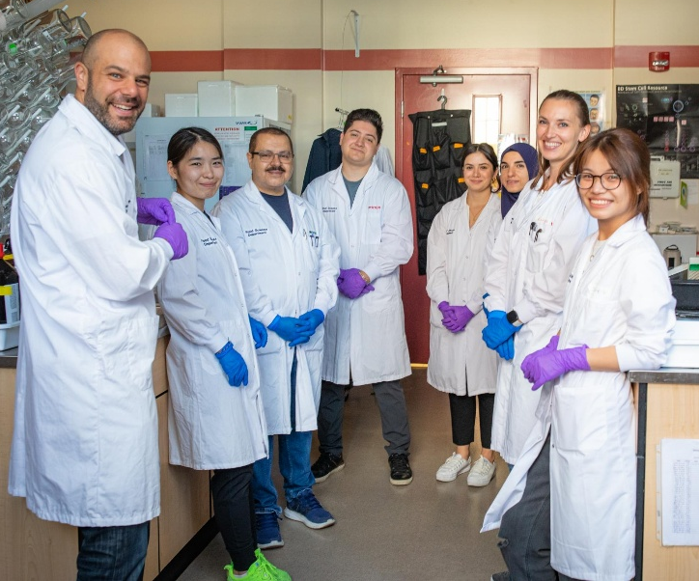

01: Spagnuolo Lab Research
Discovered / Validated > 10 Molecules
Anit-Cancer
Anit-Diabetic
Four Patents
> 70 Publications
Two Approved Products
Multiple National / International Awards
3

Slide 3
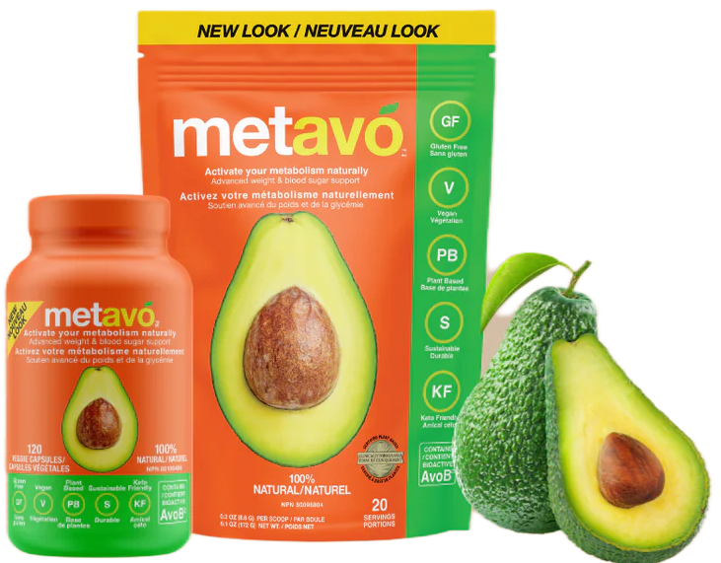
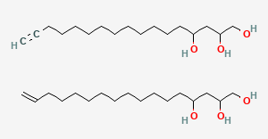
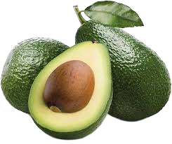
01: Ingredient Development Platform
How we traditionally developed our ingredients in the lab.
Discovery
Validation
Commercialization
Discovery
Historical
Use
In
Vitro
Science
(Target)
Pre-Clinical
Formulation
Clinical
Regulatory
Approval
LAB EXAMPLE
COMMERCIAL PRODUCT
Avo B
www.metavo.com
www.metavo.ca
6

Slide 4
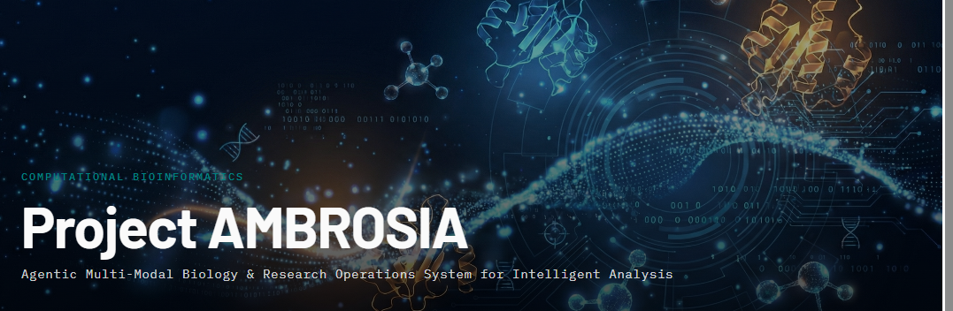
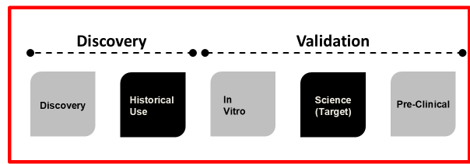


02: Game changing technology
How do we increase efficiency & decrease costs in this ingredient development process?
Use Agentic AI workflows to accelerate and augment human-centric workflows in the discovery and initial validation stages of discovery.
12

Slide 5
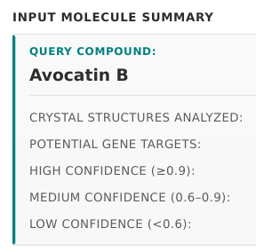

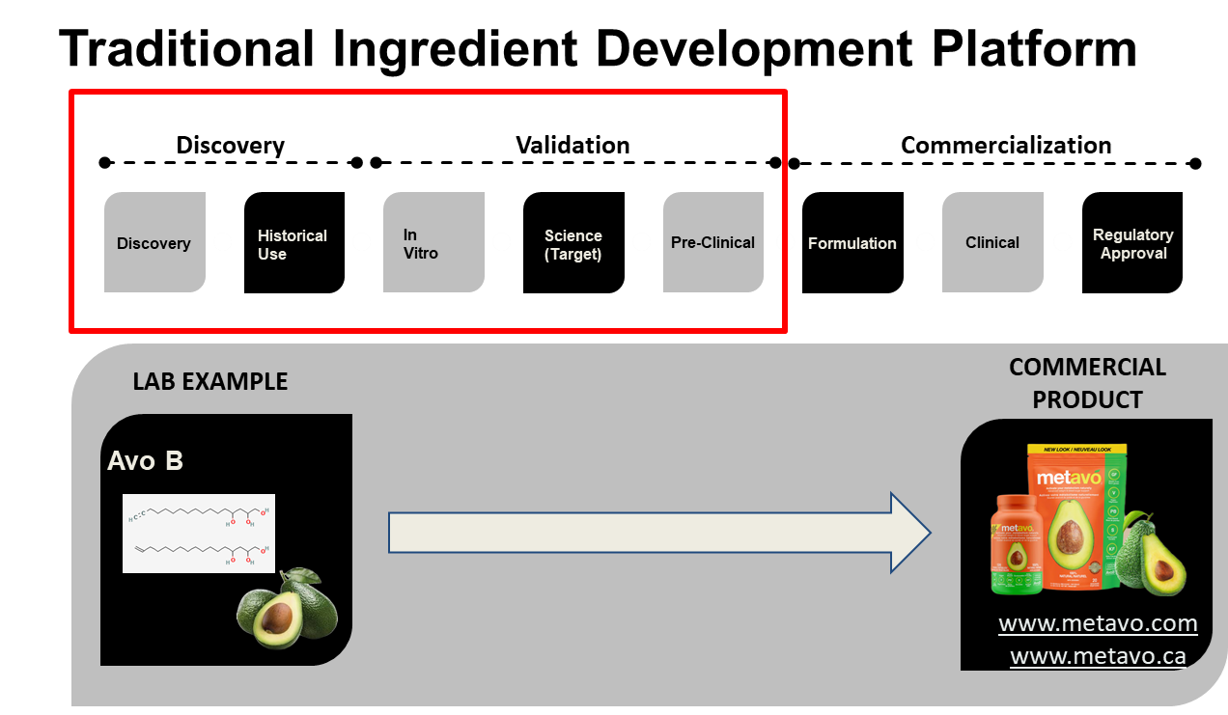
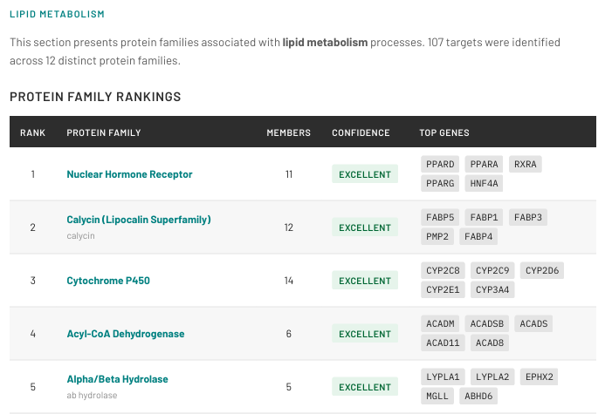
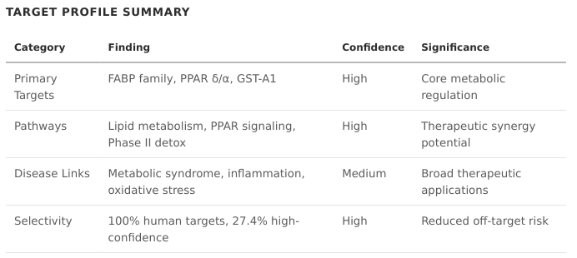
02: Retroactive Confirmation Of Effectiveness
CUT valuable TIME from the DEVELOPMENT PIPELINE
15

Slide 6
02: Reducing Costs In The Development Pipeline
CUT valuable TIME from the DEVELOPMENT PIPELINE
5-10 years
$$$$ Millions $$$$
5-10 days
$ Thousands $
14

Slide 7
02: Benefits of Utilizing AMBROSIA
CUT valuable TIME from the DEVELOPMENT PIPELINE using AI to ACCELERATE food-ingredient DISCOVERY & DEVELOPMENT
  Decreases time from discovery to market
  Increases success rate of ingredient validation research
  Less expensive than conventional platform
  Identify new markets for existing ingredients
  Define bioactivity within an extract
16

Slide 8
SECTION
03
Commercial Success & What’s Next...
ALT moved directly into a COMMERCIAL engagement with a SUCCESSFUL run of the AMBROSIA platform
20

Slide 9

03: Finzelberg
AMBROSIA uncovers how plant compounds interact with key biological pathways for Finzelberg
Recently, Finzelberg has had excellent experiences with AMBROSIA, the computational AI-based analysis offered by Applied Laboratory Technologies. Through this advanced approach, Finzelberg uncovers how plant compounds interact with key biological pathways—such as hormone signaling, inflammation, and detoxification. This innovative method accelerates the development of effective botanical solutions, ensuring that Finzelberg’s products set new standards for natural health and scientific credibility.
Recent analyses of Menofelis®—Finzelberg’s extract from Siberian rhubarb, which supports women during menopause—demonstrate AMBROSIA’s ability to identify multi-target profiles spanning hormone signaling, inflammation, and detoxification. This enables faster, smarter development of plant-based solutions.
21

Slide 10
04: In Summary ...
AMBROISA is positioned as a critical COMPONENT of the discovery pipeline.
DEVELOPED on 10 years of laboratory technology and process.
Its aim is to INCREASE EFFICIENCY, and the PROBABILITY of SUCCESS.
Finding NEW uses for EXISTING ingredients AND identifying biological targets.
Unlocking RAPID development!
HELPING complete LAB VALIDATION of results through MULTIPLE VISUALIZATIONS of data.
23

Slide 11
Rigorous Analysis. Reliable Results.
Thank You
Questions or inquiries
paul.spagnuolo@appliedlabtech.com
paul.spagnuolo@uoguelph.ca

