Slide 1
NATURALLY INFORMED · SUPPLY CHAIN, DELIVERY SYSTEMS AND EMERGING TECHNOLOGY
Ashwagandha
A Candid, Transparent Discussion of Science, Quality —
And the Need for Industry to Get This Right
Thomas Brendler, Ph.D.
University of Johannesburg, South Africa · University of Illinois Chicago, USA · Southern Cross University, Australia · Plantaphile, USA
Blake Ebersole
NaturPro Scientific LLC & Fearless Naturals USA, Ashwagandha Standards Alliance
Holly E. Johnson, Ph.D.
American Herbal Products Association (AHPA)
September 30th, 2026, 12:55pm – 1:25pm EST

Slide 2
REGULATORY CHRONOLOGY & THE CASE
What happened — and what exactly are the concerns?
REGULATORY CHRONOLOGY
REGULATORY CONCERNS PRIOR TO COMPREHENSIVE REVIEW
2013
Level A risk assessment — not enacted
German Federal Institute for Risk Assessment (BfR)
A
Endocrinological effects
B
Abortifacient effect
Thyroid, adrenal & gonadal axes
Attributed to traditional use
2020–23
15 global reports of liver injury associated with ashwagandha root
Danish FDA / DTU Food Institute and others, with market of billions of doses per year
C
Immunological effects
D
Hepatotoxicity
2023
Half-measures imposed
Immunomodulation
Based on spontaneous case reports
Netherlands considers ban; India AYUSH restricts use in AYUSH medicines without enforcement
2024-2025
Request to Member States for further data
Action pending, likely scenario: EC mandates EFSA to conduct safety assessment similar to other botanicals
These issues have been resolved.
At this point, the concerns are not safety.
The issue is quality.
2026
Potential bans pending review; India AYUSH/ FSSAI ban on paper, halted by judicial action in Karnataka and lack of enforcement.
Brendler et al. 2025, Phytotherapy Research 70151 (Part 1: Regulatory Review).
3

Slide 3
CLINICAL SAFETY
Adverse events across the trial corpus
~150
clinical + safety trials on root, root+ leaf preparations
WHAT WAS ACTUALLY REPORTED
Digestive discomfort, headache and drowsiness predominate
All non-serious and transient, mostly at the start of treatment
Hormone, glucose, lipid, immune and blood-pressure endpoints remained within normal clinical ranges
>6,000 participants in the verum groups
(across randomised, double-blind trials of >20 preparations. The most extensively studied extracts are KSM-66 (root) Sensoril (root+ leaf) and Shoden (root+leaf)
For products of known composition made to GMP, this is a remarkable safety profile.
Brendler & Williamson. Ashwagandha: is it safe? Part 3: A review of clinical safety. Phytotherapy Research 2026, under review.
7

Slide 4
WILLIAMSON & BRENDLER
Preclinical toxicology & exposure margins
2,000+
Negative
Negative
≈20 g
mg/kg bw
genotoxicity
reproductive toxicity
1-7 g/d
Oral NOAEL in rodents (OECD 407·408·423·425)
Ames, in vivo micronucleus and chromosomal aberration assays all negative
No maternal or fetal toxicity in Wistar rats to 2,000 mg/kg bw, GD 5–19
Human-equivalent daily dose implied by the rodent NOAEL; raw-material equivalent in trials up to 52 weeks (almost API compliant)
Extract | DER | NOAEL (mg/kg bw) | Human dose (mg/kg → total) | Raw material equiv. (mg) | With ×100 safety factor (mg)
Shoden | 40:1 | 2,000 | 325 → 19,500 | 780,000 | 7,800
KSM-66 | 12:1 | 2,000 | 325 → 19,500 | 234,000 | 2,340
Witholytin | 8:1 | 2,000 | 325 → 19,500 | 156,000 | 1,560
Shagandha | 15–20:1 | 2,000 | 325 → 19,500 | 341,250 | 3,412
Sensoril | 5:1 | 4,000 | 650 → 39,000 | 195,000 | 1,950
Even after a ×100 safety factor, permitted intake exceeds typical label doses by a wide margin.
Williamson & Brendler 2025, Part 2 (Phytother Res 70090); Brendler & Williamson 2026, under review.
8

Slide 5
UMBRELLA REVIEW OF THE EFFICACY EVIDENCE
And does it work?
~150 trial reports over 45 years, clustered by endpoint. Randomised, double-blind, placebo-controlled designs account for 92 of them.
Endpoint domain | Trials | Participants | Evidence | Outcomes
Stress, anxiety & mood | 31 | 1,299 | Moderate | Positive
Energy, endurance & musculoskeletal | 24 | 309 | Moderate | Mixed
Reproductive & sexual health | 19 | 884 | Moderate | Mixed
Sleep | 11 | 420 | Moderate | Positive
Cognitive function | 13 | 448 | Emerging | Mixed
Metabolic & cardiovascular health | 9 | 216 | Emerging | Positive
Endocrine & hormonal health | 8 | 309 | Emerging | Mixed
Five further domains (including cancer research) | 21 | 2,343 | Preliminary | Mixed
Total | 152 | 6,228
Moderate, largely positive
evidence for stress and mood, sleep, energy and endurance, and reproductive and sexual health.
Everything else is emerging or preliminary.
Brendler & Rattray. Ashwagandha: An umbrella review of the clinical evidence. Phytotherapy Research 2026 (under review). Pharmacokinetic and safety studies excluded.
12

Slide 6
ADVERSE EVENT REPORTS
77 cases under the microscope
THE REPORTING IS THE PROBLEM
615
records identified across four databases
Only 10 case reports name the commercial product; 26 identify it merely as “ashwagandha”
Almost no implicated product was analytically characterised — adulteration cannot be excluded
Polypharmacy and co-ingestion of other botanicals are common; several doses exceeded label directions
RUCAM was in places applied incorrectly, and had to be re-scored
57
adverse event reports included
Nearly all cases scored “unlikely” or “unrelated.” Six remain where the clinical observations warrant further attention; at least one is more consistent with an idiosyncratic reaction than with intrinsic, dose-related toxicity.
77
individual cases, across five organ systems
Several authors cite prior published cases as grounds for attribution — a textbook confirmation-bias loop, in which the apparent signal is partly self-reinforcing.
VerMeer A, Brown A, Kingston R, Schmidt M, Vollmer G, Brendler T. Ashwagandha: is it safe? Part 4: A review of adverse event reports. Phytotherapy Research, under review.
11

Slide 7
WHAT WE SHOULD BE WORRYING ABOUT
The real problem is quality control, both ID and potency
high degree of deviation
WHY THIS UNDERMINES EVERYTHING UPSTREAM
1
Clinical findings may not transfer
Trial results are obtained with characterised, GMP-manufactured extracts. They cannot be extrapolated to every preparation.
of quality, especially, the measured withanolide content from label statement in commercial products
2
Case reports become uninterpretable
Without lot-specific analysis of the implicated product, an adverse event cannot be attributed to ashwagandha rather than to another ingredient, an adulterant or an off-label dose.
Why? - Pharmacopoeial divergence.
A direct comparison of British and US Pharmacopoeia standards for ashwagandha supplements in commerce found the two methods are not interchangeable — the standard chosen changes the verdict on the same product. Also, neither method is fit-for-purpose for leaf-containing preparations.
3
Regulators are forced to make uniformed decisions
The variability is a manufacturing and enforcement (labeling) problem. Banning the ingredient does not address the problem.
Avula et al. A Comparison of British and US Pharmacopoeia Standards for Quality of Ashwagandha Dietary Supplements in Commerce. Phytotherapy Research 2025, 70148.
13

Slide 8
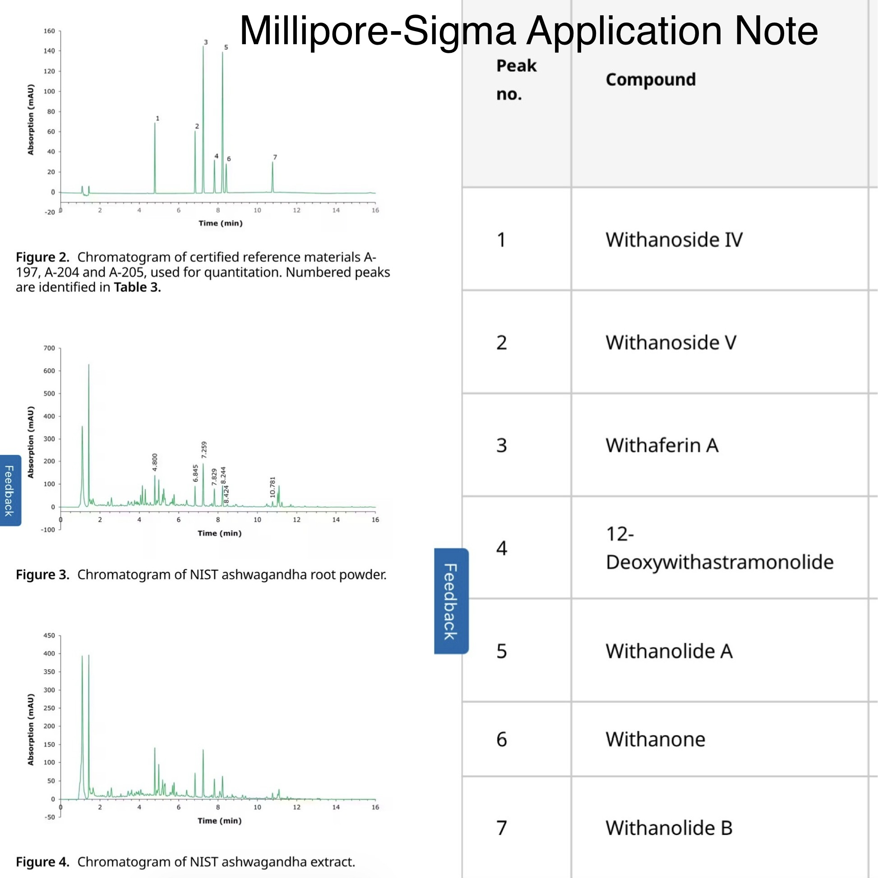
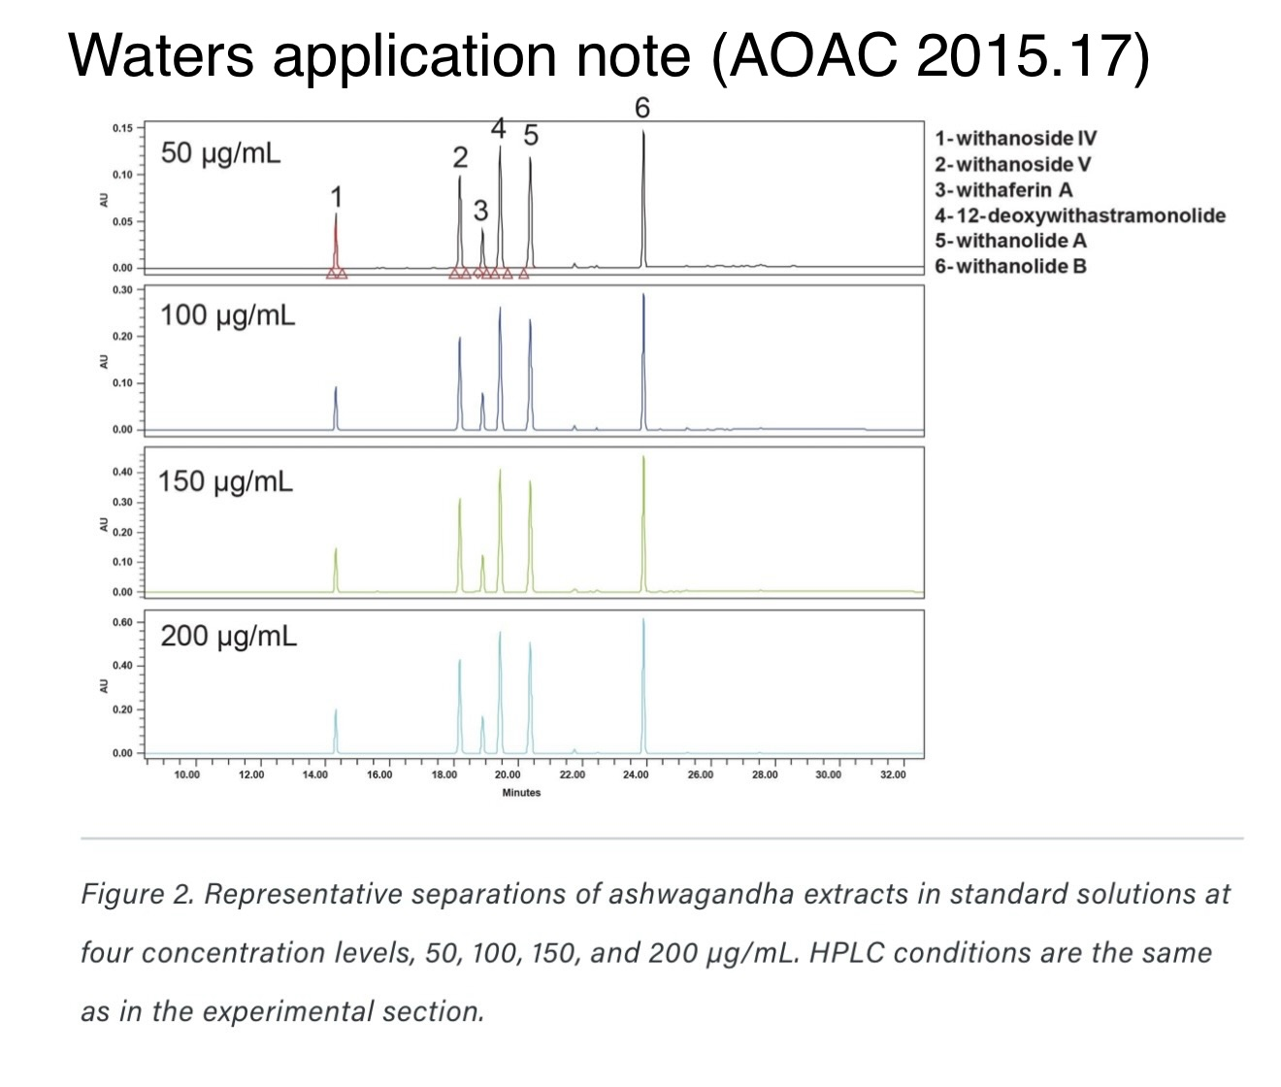
WHAT WE SHOULD BE WORRYING ABOUT
We know how to test ashwagandha
But…
13

Slide 9
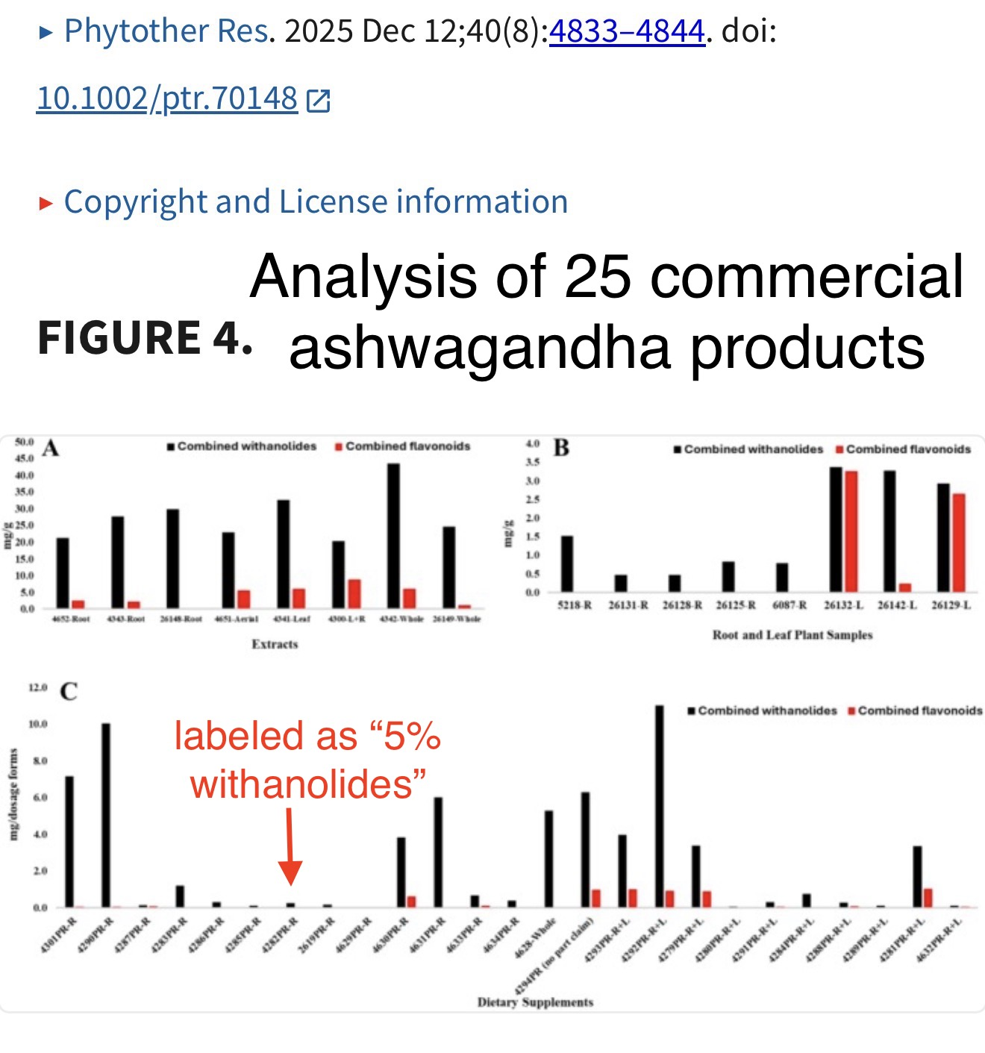
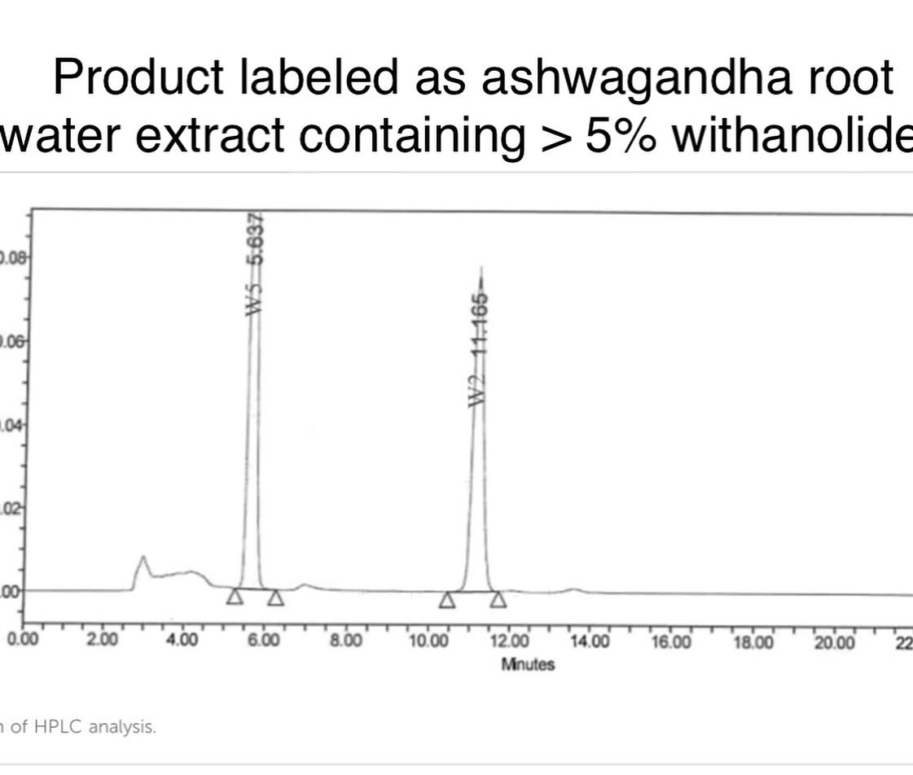
WHAT WE SHOULD BE WORRYING ABOUT
But quality issues for commercial products remain…
13

