Slide 1


Next-Generation Women’s Wellness
Science-Backed Ingredients & Enabling Technologies for Healthspan Support
Notes:
The market for women’s health is changing. Women are no longer looking to treat individual symptoms; they are for more holistic approaches to their challenges. They are moving from single ingredient, single issue products to products that are working on whole systems.

Slide 2
Agenda
Healthspan
Stress & Sleep
Midlife Vitality
Delivery Technologies
Notes:
Today we are going to take a deep dive into the science behind some ingredients that could help formulators meet women where they are going.
We are going to look at healthspan rather than just where a woman is

Slide 3

Female Longevity and Aging
Notes:
L: One of the most important growth areas in healthy aging is female health — particularly peri-menopause and post-menopause.
Historically, the category focused heavily on hot flashes and hormonal symptoms.
But when women are asked what they actually want help with, the answers are often very different.
They talk about mental fog, disrupted sleep, increased stress, low motivation, declining libido, changes in body composition, and feeling like they are no longer functioning at their best.
This creates a major opportunity for more modern, multidimensional formulations that support both physiological and lifestyle-related outcomes

Slide 4
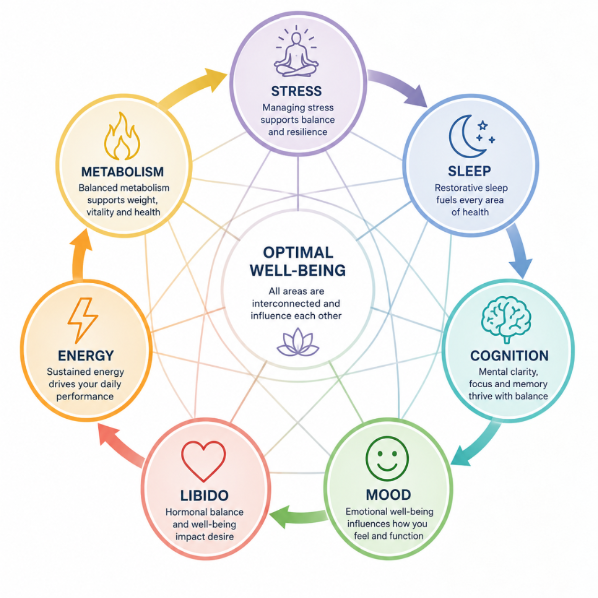
Notes:
Goal of this slide is to connect feminine issues to ingredients that can provide proven benefits. If we could add Saanroo ingredients to the slide around the areas of concern it would tie in well
L: The biggest opportunity may actually be the symptoms that are less openly discussed but have enormous quality-of-life impact.
Mental fog, poor sleep, stress overload, lack of motivation, and reduced vitality directly affect productivity, relationships, and emotional wellbeing.
This is where multifunctional ingredient systems can create very meaningful differentiation.
Especially when formulations combine cognitive support, stress modulation, sleep optimization, metabolic health, and inflammation management into a cohesive platform
Ingredients like Affron, saffron extract are increasingly beneficial in this category because it has over 14 clinical studies showing benefits around stress, sleep, mood, cognition, nearly all of the areas of need for many women.
One area that has been woefully underserved is female libido. If you speak to peri and post menopausal women, many of them will not even have realized how much their reduced libido has impacted their lives. Providing an opportunity for women to go back to a time where sex didn’t just feel like an obligation, but was something that they looked forward to, initiated and truly enjoyed with ingredients like Libifem, a proprietary fenugreek extract proven to increase libido in women, doesn’t just improve their lives, it improves soiety as a whole…can you imagine if peri and post menopausal women were actually happy??!!

Slide 5
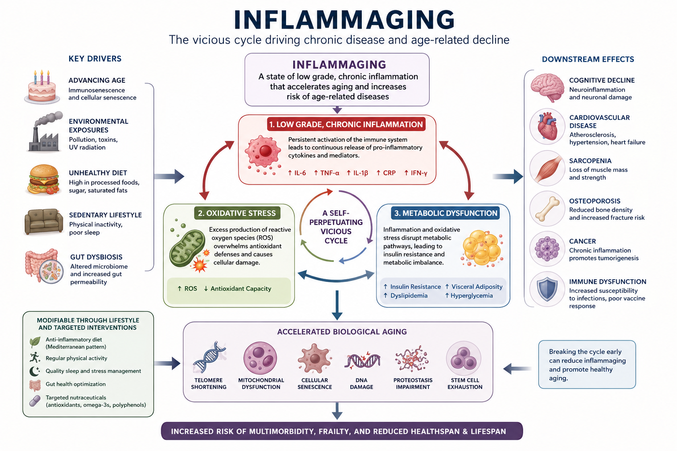

Slide 6
Understanding Inflammaging
Immune activation
Cellular stress
Mitochondrial dysfunction
Biological aging

Slide 7
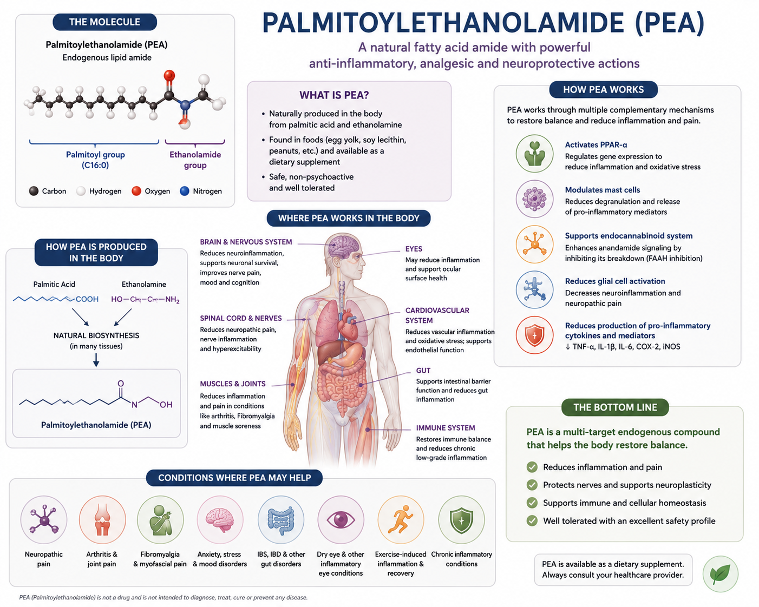

Slide 8
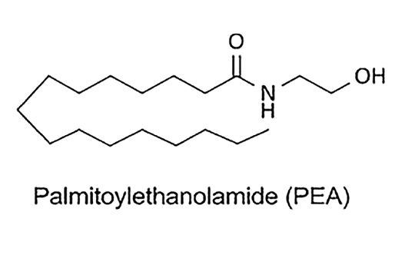


Host Defense Cell
How Does It Work?
Reduced inflammation
Reduced pain

Slide 9
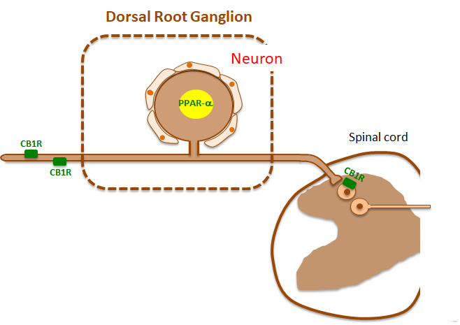

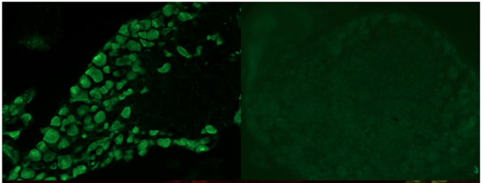
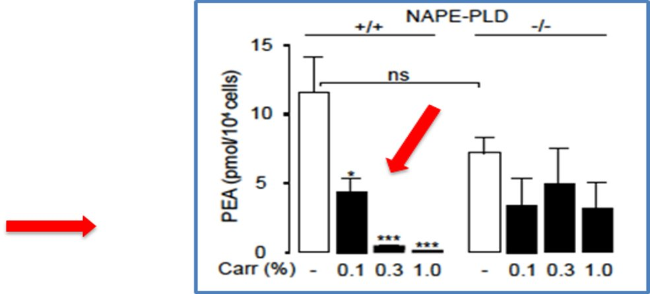

How Does It Work
Anandamide
*Also inhibits Mast Cell Degranulation
Macrophage
PEA
Dorsal Root Ganglion
WT
PPAR-α KO
Painful, inflammatory stimuli lower PEA production

Slide 10
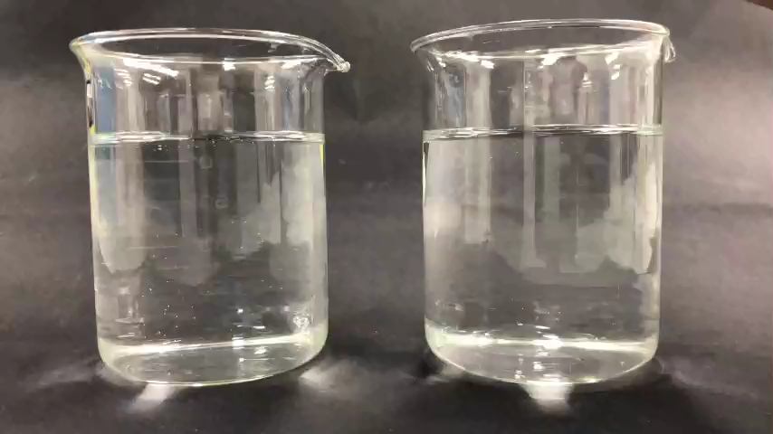


Levagen®+ | The Industry’s Most Bioavailable PEA
Endogenous fatty acid amide used in the body in response to pain, inflammation, & stress
Natural analgesic, anti-inflammatory & immuno-modulator
No risk of toxicity or adverse effects
Powered by LipiSperse® technology
14 published studies
  175% ABSORPTION
CHALLENGES OF PEA:
  Poor bioavailability
  Levels decrease with age and stress
  Limited format options

Slide 11
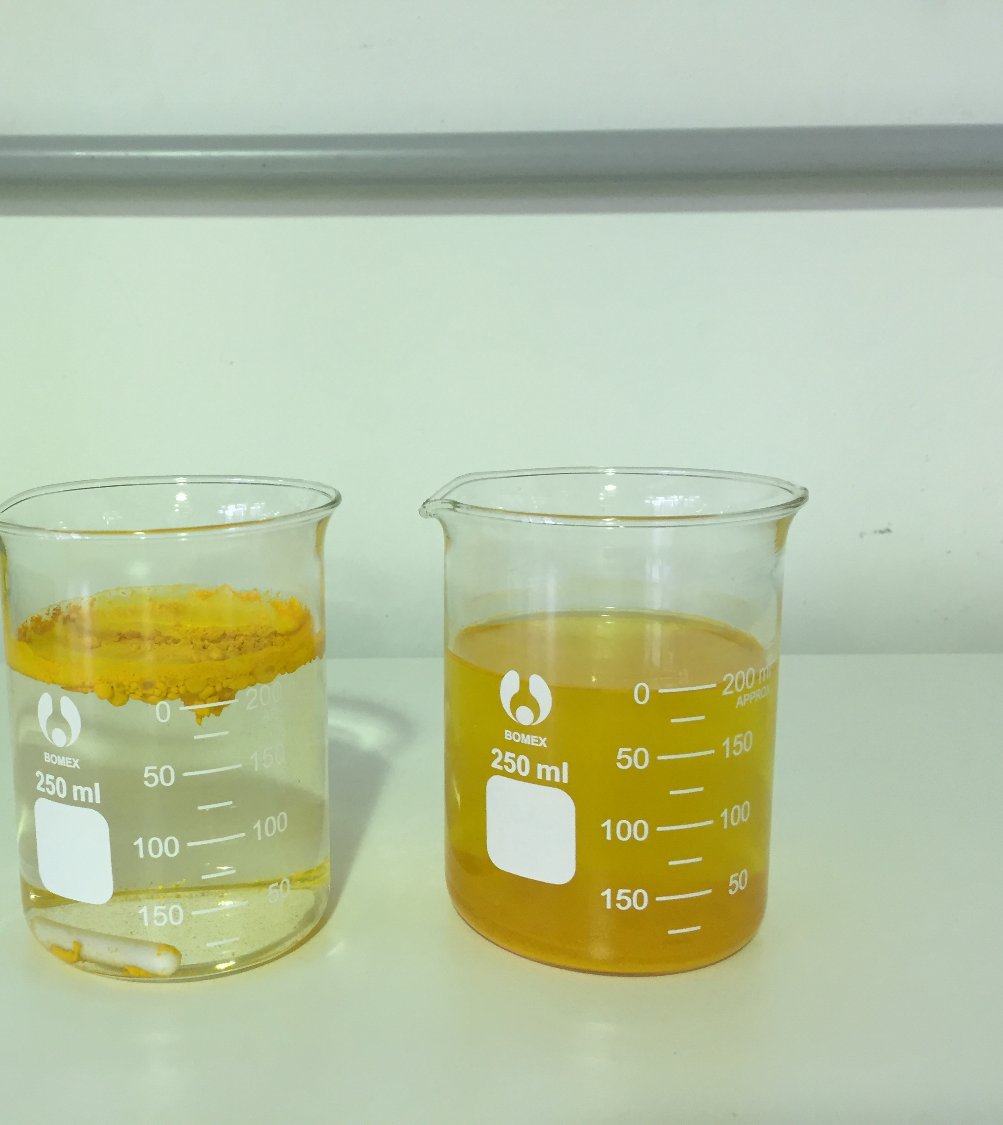
The Bioavailability Challenge
Poor solubility
Poor absorption
First-pass metabolism
Variable performance
Notes:
Many ingredients fail to reach their full potential without delivery innovation.
Expand with published clinical studies, proprietary data, and references where appropriate.

Slide 12

The BioBerb® Solution
The industry problem: Standard berberine suffers from poor dispersion and low absorption, resulting in high dosing, GI upset, and poor compliance.
BioBerb uses LipiSperse, the same lipid-dispersion technology that produces ~7× improved dissolution and dramatically better dispersion for fat-soluble actives like curcumin and quercetin.
High active load (90% Berberis aristata)
Higher bioavailability (supported by PK study)
Lower 300 mg dose gives over 2x absorption vs top branded competitor
Better dispersion → more predictable efficacy
Better tolerability, minimizes side effects
Source: https://www.futuremarketinsights.com/reports/berberine-market
Notes:
The accurate way to measure absorption of bioavailable berberine is to look at pg/mL or ng/mL of total berberine in blood plasma.
How much is being absorbed in the blood?
BioBerb® 802 pg/mL
** The next best only achieved 410 pg/mL in 2 tablets

Slide 13
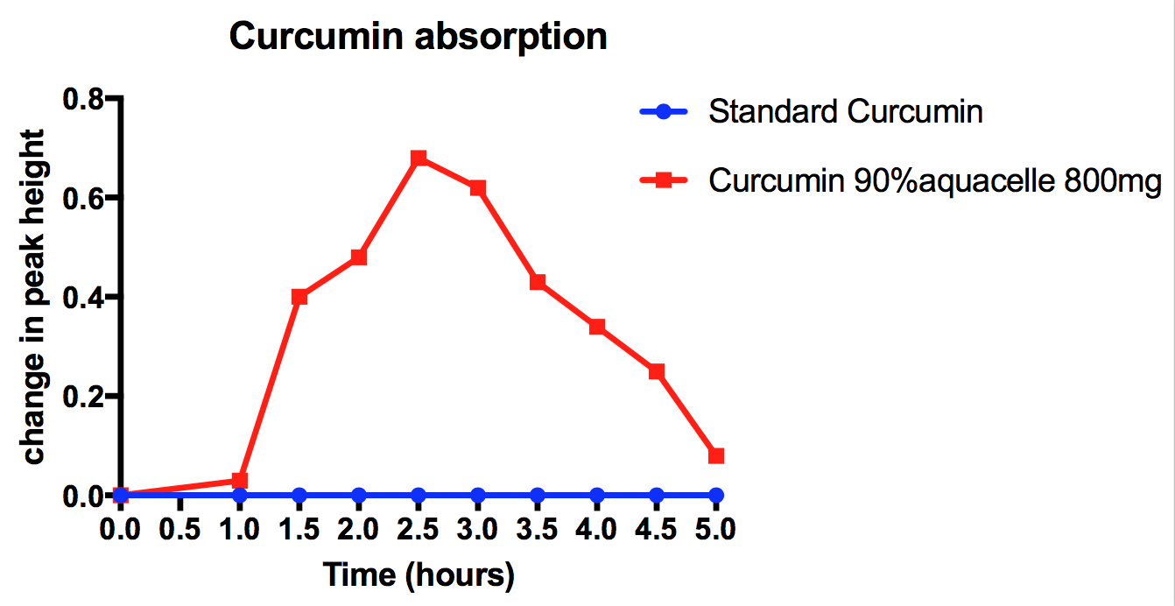

Slide 14
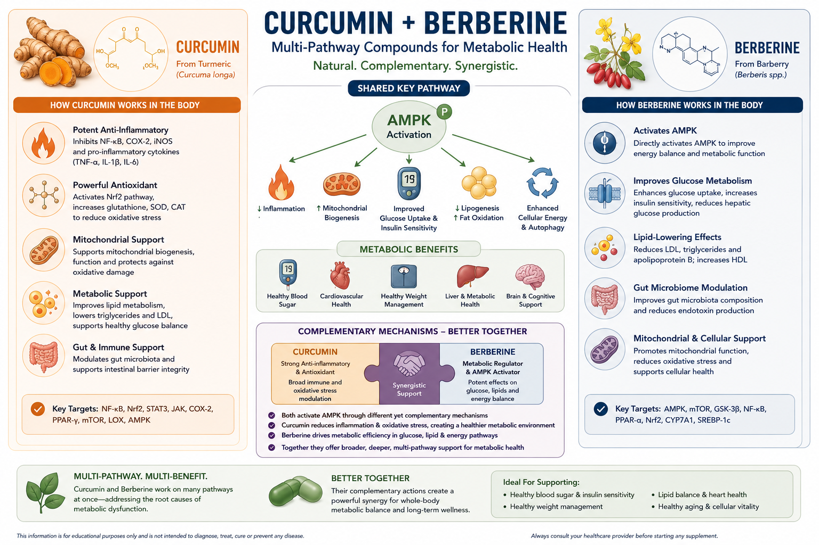

Slide 15


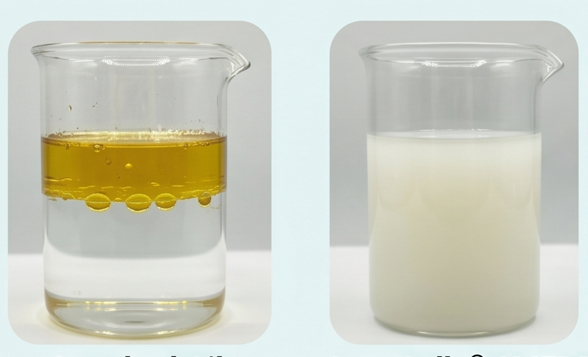

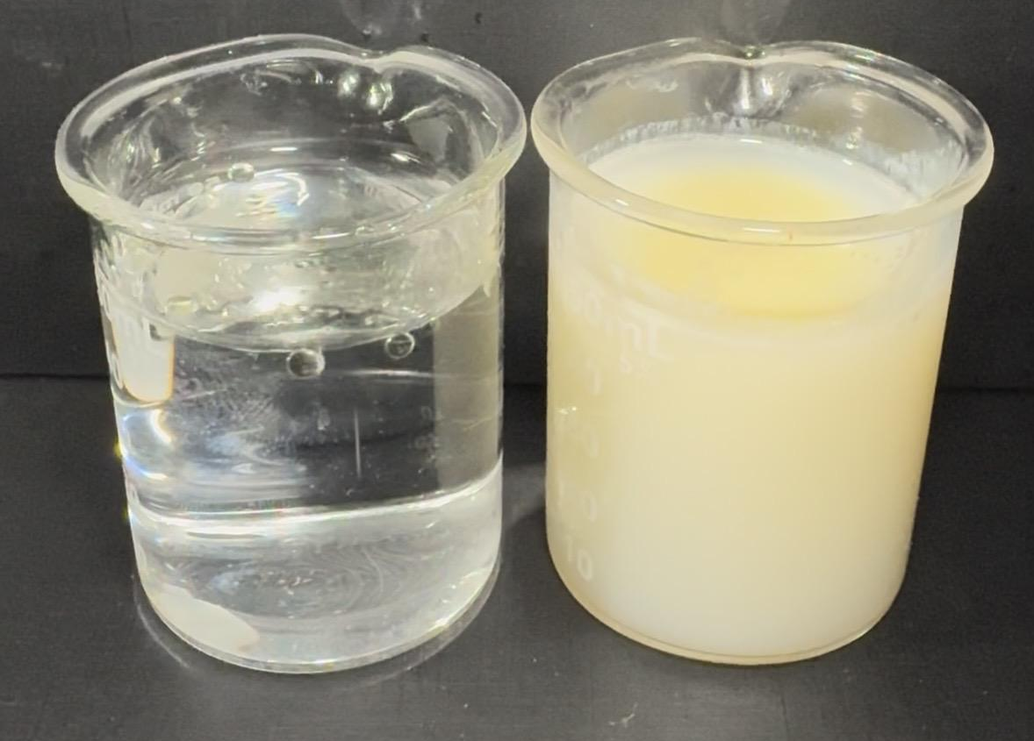
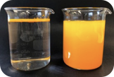

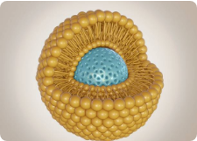
Technology Matters: Bioavailability and Format Solutions
AquaCelle®
LipiSperse®
CPO®
PlexoZome®
SMEDDS: Advanced micellar system that enhances oil absorption (Omega-3/CoQ10) up to 6x while eliminating fishy reflux.
CWD: Patented dispersion technology for fat-soluble powders. Ensures 90% active load and instant cold-water dispersibility.
Powdered Oils: Compressible Powdered Oils utilizing AquaCelle® to convert liquids into free-flowing powders for solid dosages.
Liposomes: Genuine lipid bilayers that mimic cell membranes. Available in both Liquid & Powder options.

Slide 16
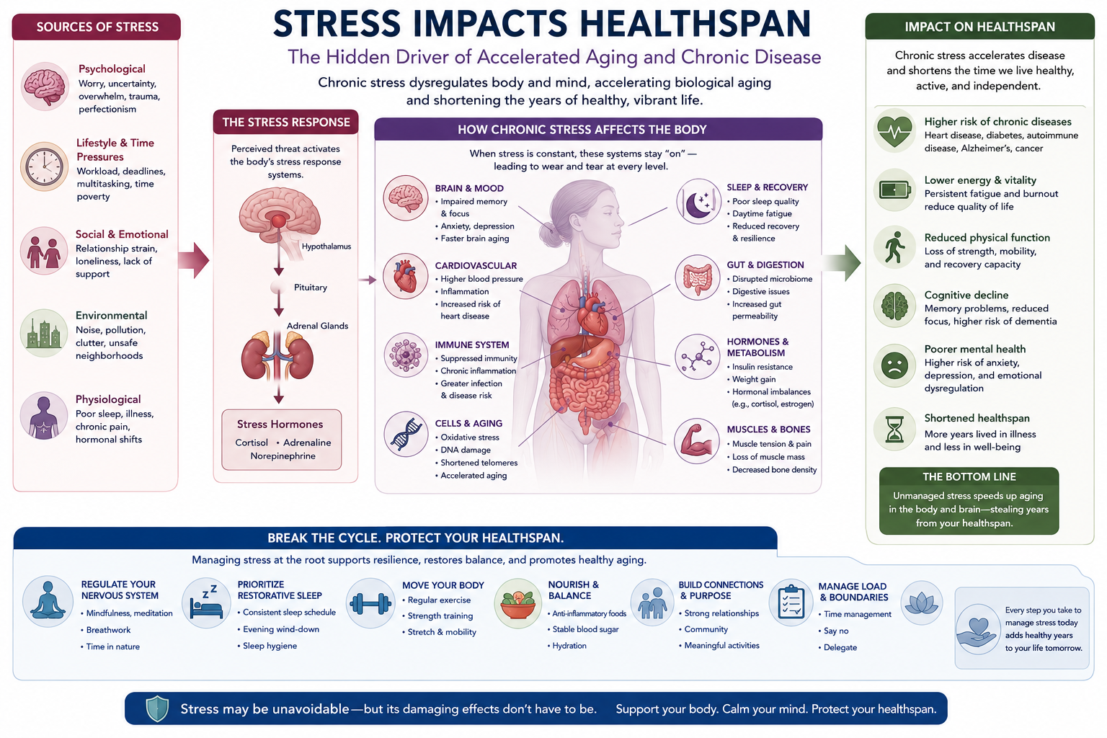
Notes:
Transition into emotional wellbeing and recovery.
Expand with published clinical studies, proprietary data, and references where appropriate.

Slide 17


Slide 18
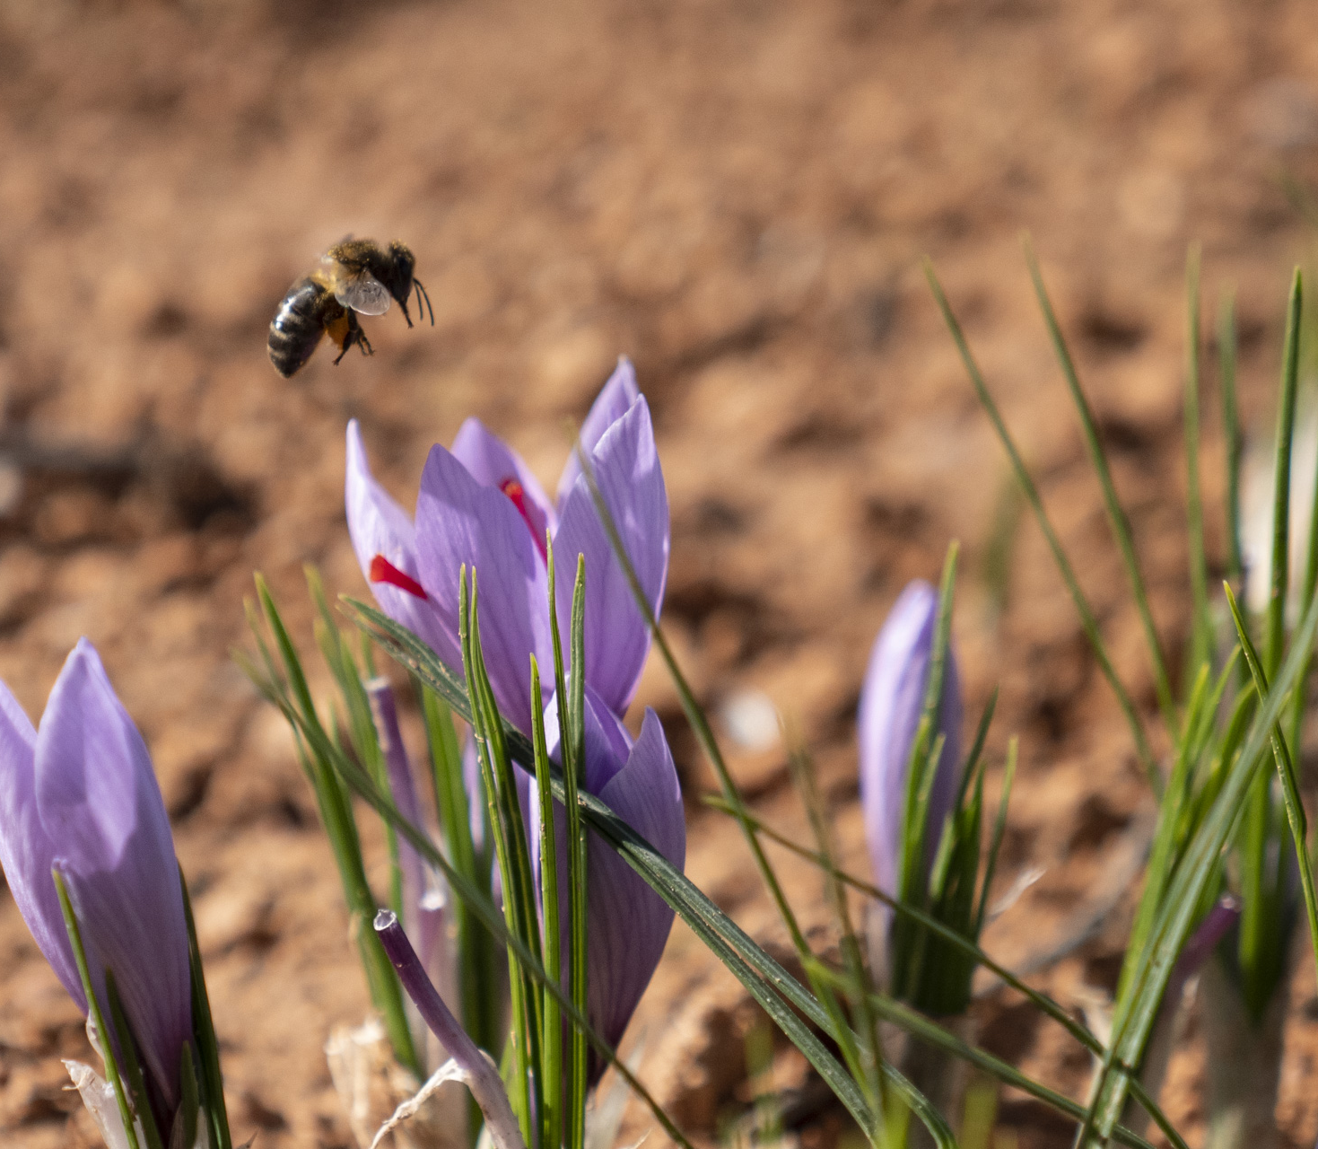
Affron Saffron Extract
Mood support
Stress resilience
Sleep quality
Notes:
Review key clinical findings and positioning opportunities.
Expand with published clinical studies, proprietary data, and references where appropriate.

Slide 19
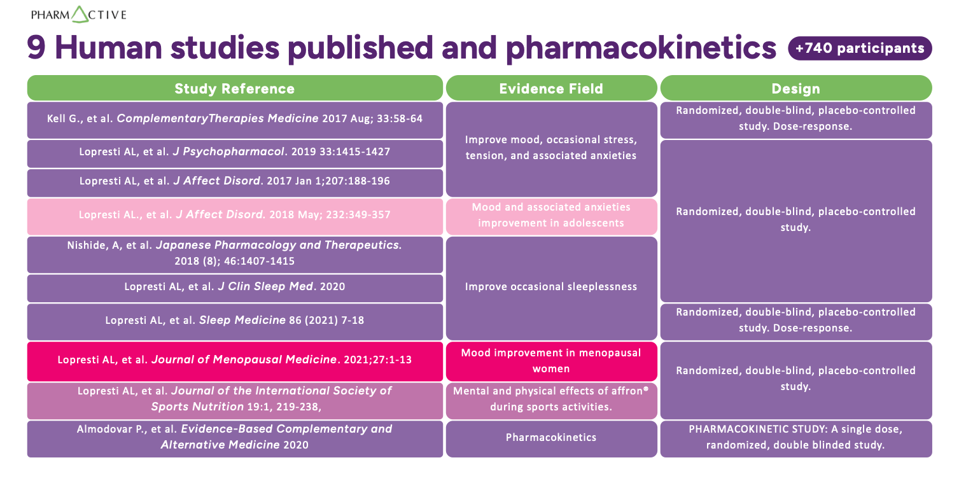

Slide 20
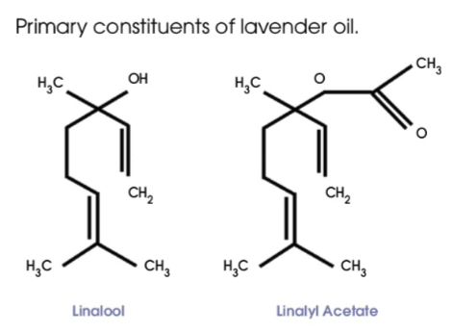
Lavender Oil Science
Notes:
Discuss evidence supporting mood and relaxation benefits.
Expand with published clinical studies, proprietary data, and references where appropriate.

Slide 21

Innovative Lavender Supplement Opportunity
Science
Calm
Anxiety
Despression
Notes:
Global Gener

Slide 22
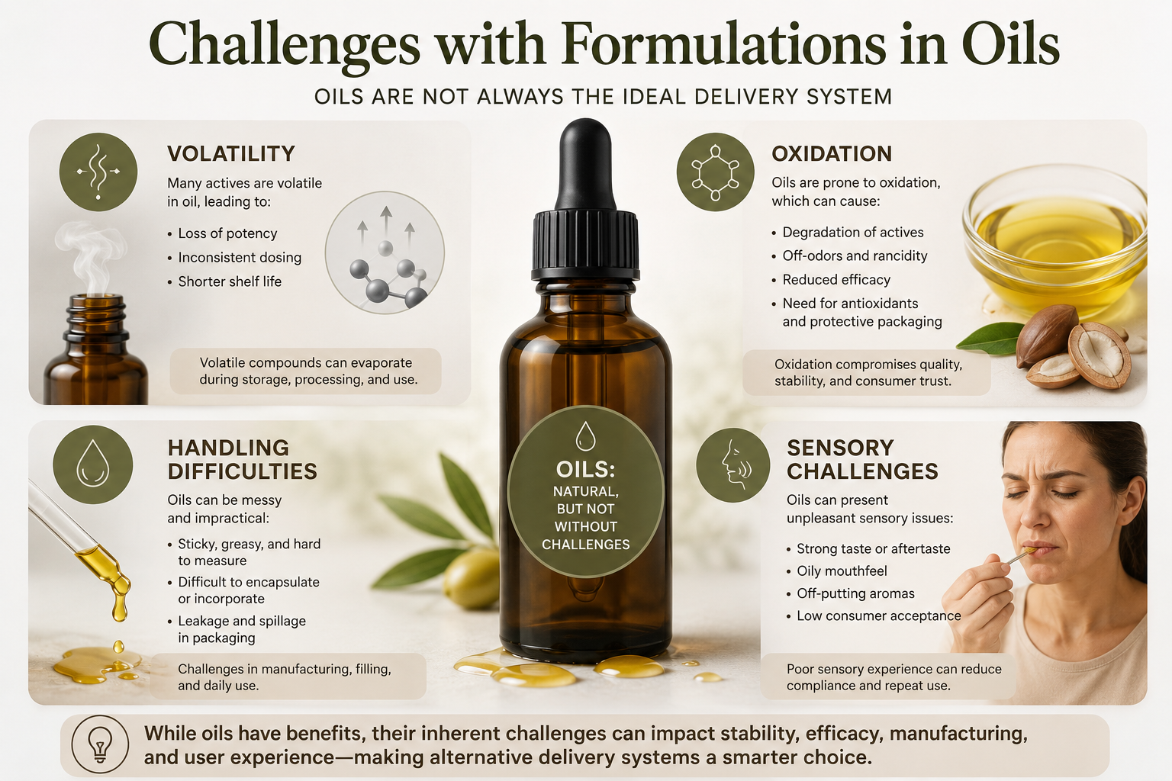
Formulation Challenges with Oils
Volatility
Oxidation
Handling difficulties
Sensory considerations
Notes:
Introduce the need for advanced processing approaches.
Expand with published clinical studies, proprietary data, and references where appropriate.

Slide 23
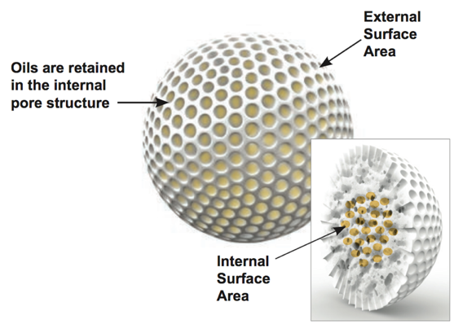
What is CPO®
Compressible Powder Oils
  Specially designed silica bead.
  Oil is adsorbed into the bead
  Internal structure is hydrophobic (hates water). External surface is hydrophilic (loves water).
  Oil is trapped inside, only releasing when the bead comes into contact with gastric juices and breaks down.
Notes:
CPOs are made up of a specially designed silica bead that is a solid honeycomb structure.
The oil is adsorbed into the silica
Once in the silica, the oil stays there until the bead comes into contact with water / or gastric juices. At that time, the oil is released / digested.
The bead has a surface area of over 350 sq metres.

Slide 24

CPO®
Compressed Powdered Oil (CPO) technology that readily allows for conversion of oils into powder
50% active load
Flexible applications including:
  Tables
  Capsules
  Water dispersible for ready-to-mix (RTM) powders
Alternative to microencapsulation to avoid issues such as leaching, sticking, and stability/spoilage issues
Can be combined with AquaCelle® technology for enhanced bioavailability
Ingredients that have already been successfully piloted with CPO® include
  Betacarotene – (3 mg)
  Lavender oil – (40 mg)
  Astaxanthin – (3 mg)
  Vitamin D3 – Lichen Source in combination w/ Aquacelle (400 IU)
    Also possible as Plexozome Pro
  Lutein – In Combination w/ Aquacelle (15 mg)
PK study CPO ® + AquaCelle ® Astaxanthin

Slide 25

Pillar 3: Thriving Through Midlife
Beyond hot flashes
Body composition
Metabolic health
Libido
Notes:
Frame menopause innovation beyond traditional symptom management.
Expand with published clinical studies, proprietary data, and references where appropriate.

Slide 26
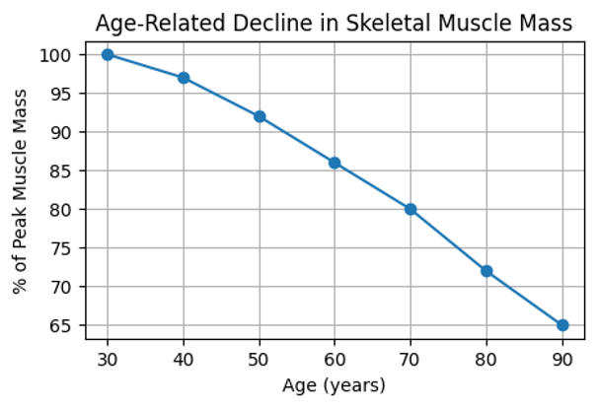
Muscle Loss & Midlife Health
Notes:
Explain why muscle preservation is becoming a priority.
Expand with published clinical studies, proprietary data, and references where appropriate.

Slide 27
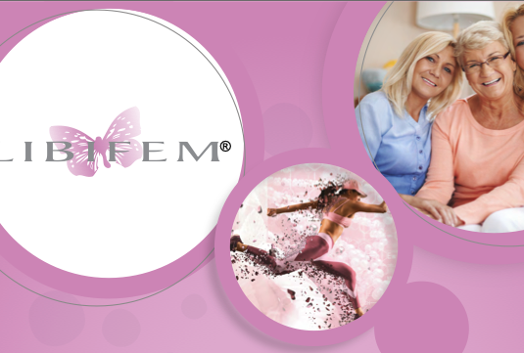
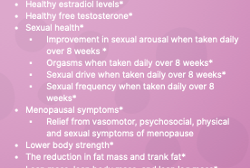
Libifem® Fenugreek Extract
Notes:
Position fenugreek as a multifunctional ingredient for midlife women.
Expand with published clinical studies, proprietary data, and references where appropriate.

Slide 28
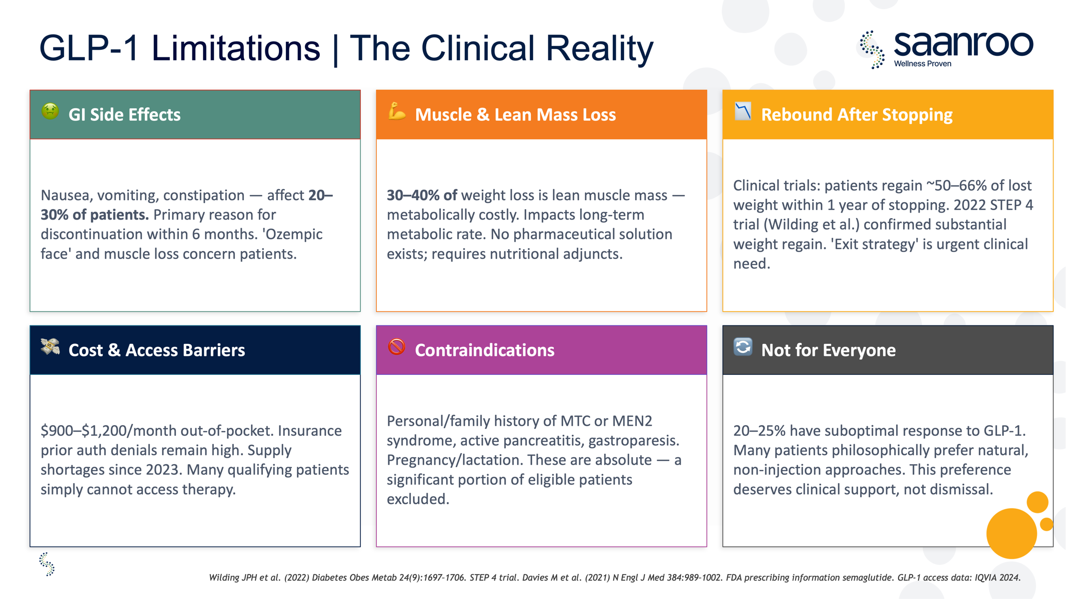
The GLP-1 Continuum
Lifestyle support
Prescription-adjacent support
Weight maintenance
Notes:
I cant find the slides from Pavitra and Virals presentation but there are some that should be added here if possible

Slide 29
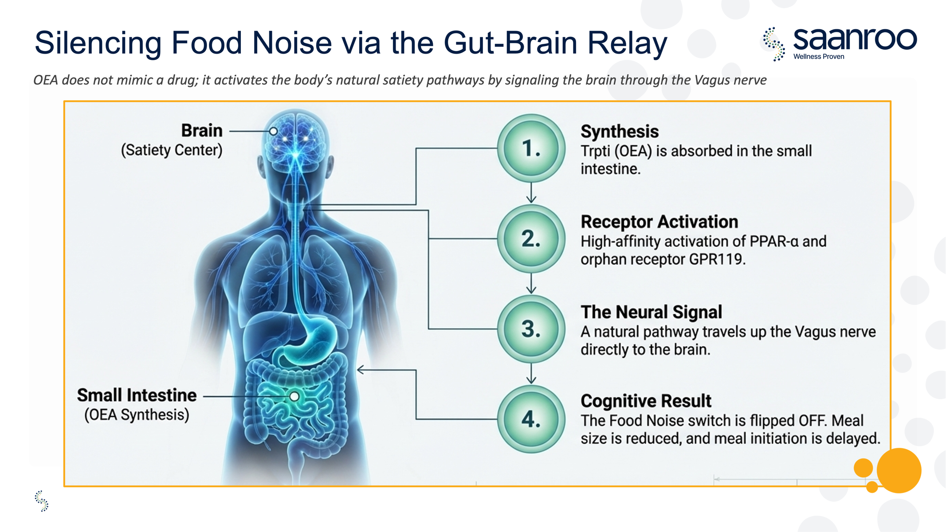
OEA and Metabolic Wellness
Satiety signaling
PPAR-α activity
GLP-1 pathways
DPP-4 interactions
Notes:
Need Pavitra/Viral slides inserted here

Slide 30
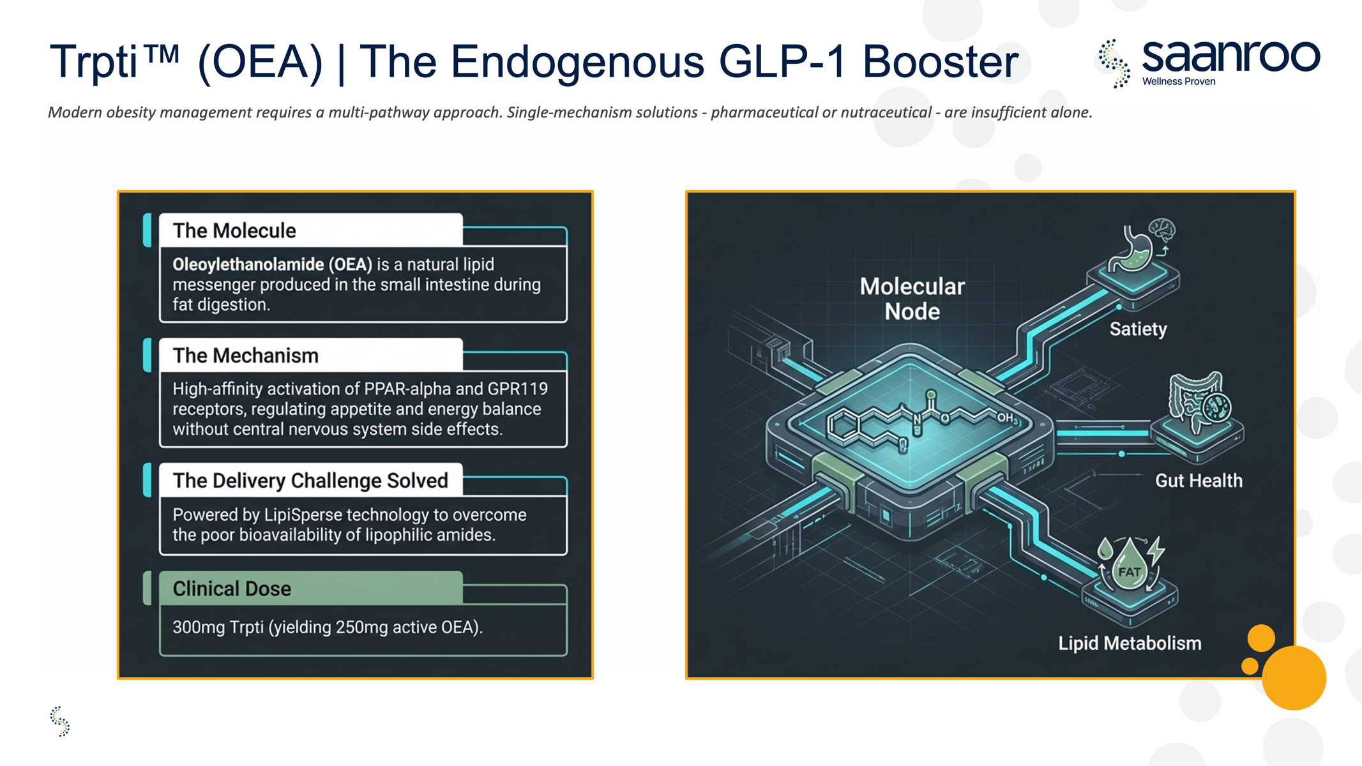
Future Innovation Opportunities
Multi-benefit formulas
Ingredient systems
Delivery technologies
Clinical validation

Slide 31
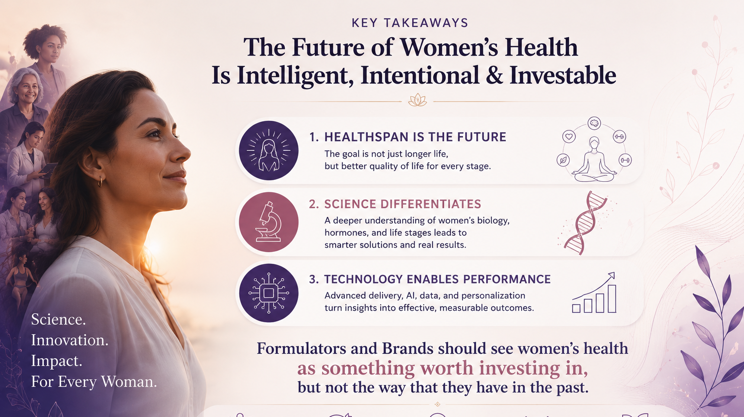

Slide 32
For More Information on Clinical Science
https://www.levagenplus.com/science-research
https://www.hydrocurc.com/science
https://www.pharmako.com.au/bioberb
https://www.affronsaffron.com/science-research
https://www.pharmako.com.au/cpo
https://libifem.net/science-and-research/
https://trpti.net/science/

