Slide 1
Designing Low-Dose Prebiotic Strategies for Digestive Health & Beyond
Aicacia Young, RDN
Microbiome Formulation Strategist

Slide 2

Traditional Prebiotic Strategy
Higher dose = greater benefit
Broad spectrum > precision
Trickle-down fermentation
Limitations:
Capsule space
RTD solubility
GI tolerance
Cost per serving

Slide 3
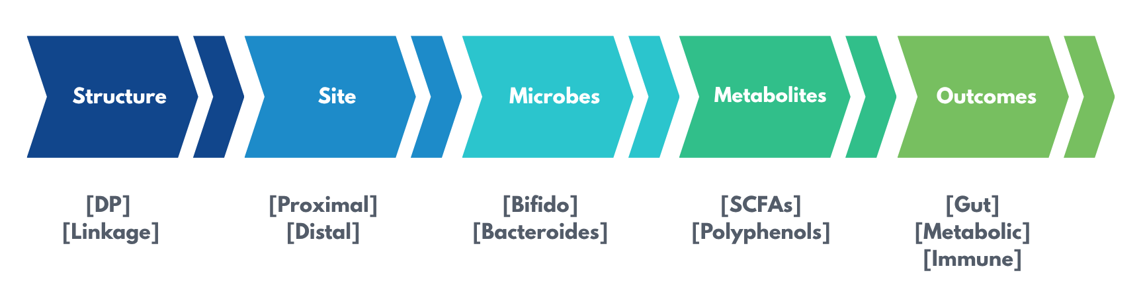
Low-Dose Prebiotic Design Strategy

Slide 4
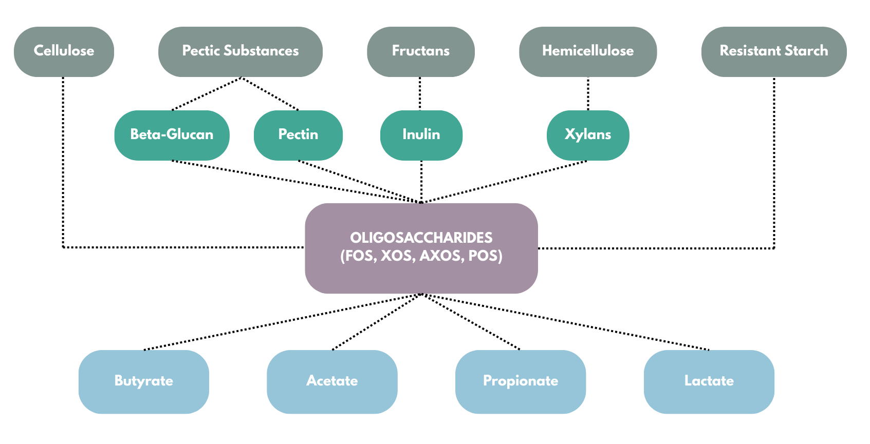
Saccharolytic Fermentation
Precision Prebiotics

Slide 5
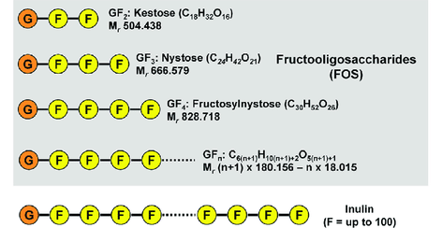
Not All Fiber Is The Same
Structure/Degree of polymerization determines:
Which microbes ferment it
Rate of fermentation
Location of fermentation in the intestine
Oligosaccharide degree of polymerization (DP): 3-10

Slide 6
Fermentability Determines Function
Fiber | Gut Health Dose (g/d) | Metabolic Health Dose (g/d) | Fermentation Location | Format Compatibility
Psyllium husk | 5-10 | 20-25 | Mostly unfermented | Powder
Pectin | 6-24 | 6-40 | Distal | Powder
Inulin | 5-15 | 15-20 | Distal | Powder/RTD
Resistant Starch | 10-30 | 30-40 | Proximal | Powder
FOS | 5-15 | 10-20 | Proximal | Powder/RTD
Oat β-Glucan | 3-6 | 2-6 | Proximal | Powder
XOS | 1-3 | 4-8 | Proximal | Capsule/RTD/Powder
Yeast β-Glucan | 0.12-0.20 | 0.25-2.5 | Proximal | Capsule/RTD/Powder
Notes:
Instead of comparing fibers by dose, it’s more useful to think of them along a spectrum of fermentability—from largely unfermented bulking agents to highly efficient, low-dose prebiotics
RS: https://pmc.ncbi.nlm.nih.gov/articles/PMC9559413/
Pectin: https://www.cambridge.org/core/journals/nutrition-research-reviews/article/nutrition-and-health-effects-of-pectin-a-systematic-scoping-review-of-human-intervention-studies/01BF0759F09A2BBC419F333B8B1D4FF9

Slide 7
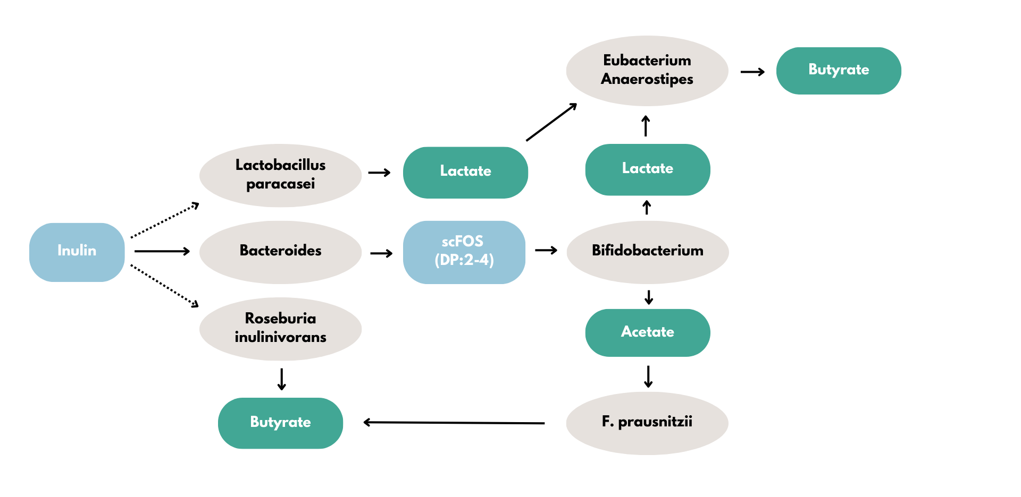
Fermentation Pathway
Notes:
Inulin yields less butyrate than FOS
https://www.nature.com/articles/s41522-024-00524-6
https://pubmed.ncbi.nlm.nih.gov/26420851/
https://pmc.ncbi.nlm.nih.gov/articles/PMC222221/

Slide 8
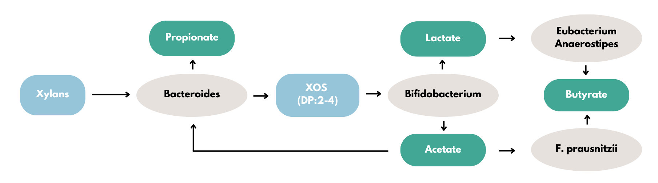
Why Oligosaccharides Are Key
Key Advantages:
Low dose
Anti-inflammatory properties
Selective growth of beneficial bacteria
Minimal side effects (bloating, discomfort)
Notes:
Bamboo shoots, corn cobs, sugarcane
Cross feeding
https://pmc.ncbi.nlm.nih.gov/articles/PMC222221/
https://www.nature.com/articles/s41522-024-00524-6

Slide 9
Why Butyrate Matters
Primary fuel for colonocytes → central output of microbial cross-feeding
Strengthens gut barrier → supports tight junctions, reduces permeability
Modulates immune response → downregulates pro-inflammatory cytokines (e.g., IL-6, IL-12)
Regulates motility → supports balanced transit (IBS-C ↔ IBS-D)

Slide 10
Oligosaccharide Overview
Prebiotic | Origin | Dose Range | Selective Targets | Fermentation Location
scFOS | Sucrose (Chicory, beet) | 2.5-10g | Broad (Bifido + others) | Proximal
GlcOS | Glucose (Enzymatic) | 2g | Mixed (Bifido + Bacteroides) | Proximal
AXOS | Cereal arabinoxylan | 2g | Mixed (Bifido + butyrate producers) | Proximal/ Transverse*
GOS | Lactose | 1.3-3g | Bifidobacterium (strong) | Proximal
XOS | Xylan (Corn cob, sugar cane) | 1-3g | Bifidobacterium (highly selective) | Proximal
broad
selective
*Depending on DP
Notes:
Origin isn’t just a sourcing detail—it influences enzyme accessibility, microbial recognition, and ultimately fermentation behavior.
GOS: 380 mg (ex vivo)

Slide 11
Functional Spectrum of Prebiotics
Prebiotic | Selectivity | Speed | Functional Outcome
scFOS | Broad | Fast | General fermentation
GlcOS | Mixed | Moderate | Acetate + propionate
AXOS | Mixed | Slower | Butyrate support
GOS | Targeted | Moderate | Clinical bifidogenic effect
XOS | Highly selective | Controlled | Precision microbial feeding
Notes:
Instead of thinking about prebiotics as interchangeable fibers, it’s more useful to think of them along a spectrum—from broad fermentation to precision microbial targeting.
https://www.mdpi.com/2304-8158/7/9/140

Slide 12
Low-Dose Prebiotic Blend Strategy
🧩 Complementary Fast + slow fermentation → SCFA diversity
📡 Fermentation Kinetics Proximal → distal delivery → Reduced competition
🎯 Dose Efficiency Lower individual doses → Better formulation fit
🌬️ Tolerability Avoid rapid overload → Less gas, better compliance
Notes:
Blend for function—not redundancy

Slide 13
Low-Dose Synbiotic Strategy
XOS
GOS
FOS
Bifidobacterium
Lactobacillus
Bacteroides
Faecalibacterium
SCFAs
Gut barrier support
Metabolic signaling
Immune signaling
Prebiotic
Target Microbes
Functional Output
Strain–substrate alignment: Feed the strains you include
Cross-feeding cascade: Primary → secondary fermenters

Slide 14
Prebiotics Beyond the Gut
Prebiotic | Metabolic Evidence | Immune Evidence | Best Supported Application | Dose
XOS | ★★★★☆ | ★★★☆☆ | Glycemic control | 4-8 grams
GOS | ★★★☆☆ | ★★★★☆ | Immune modulation (microbiome-mediated) | 3-4 grams
AXOS | ★★☆☆☆ | ★★☆☆☆ | Butyrate production + Gut barrier support | 10-15 grams
FOS | ★★☆☆☆ | ★★☆☆☆ | Laxation + Mineral absorption | 10-20 grams
GlcOS | ★☆☆☆☆ | ★★☆☆☆ | Microbiome modulation + Digestive comfort | 2 grams
Yeast β-Glucan | ★★☆☆☆ | ★★★★★ | Innate immune defense | 250-500mg
★ = relative strength of human evidence within domain
Notes:
Not all prebiotics influence immunity the same way—some act indirectly through the microbiome, while others like beta-glucans directly engage immune receptors and train innate immunity.
B-GOS in overweight adults found significant reductions in plasma C-reactive protein, insulin, total cholesterol, triglycerides, and TC:HDL ratio, alongside increases in fecal bifidobacteria and fecal secretory IgA and decreases in fecal calprotectin.
GOS has been shown to reduce atopic dermatitis risk in infants, modulate allergic responses by reducing IgE, inhibit pro-inflammatory IL-17 production, and induce IL-10, with several randomized controlled trials supporting immune modulation across age groups.
https://pubmed.ncbi.nlm.nih.gov/23303873/
https://pubmed.ncbi.nlm.nih.gov/28396144/

Slide 15
Polyphenols as Microbiome Modulators
🌿 Polyphenols
Poorly absorbed → reach colon
Selectively metabolized by microbes
Generate bioactive metabolites
Microbiome-dependent
🧩 Why Combine with Prebiotics?
Enhance microbial capacity
Increase metabolite production
Improve consistency of response
Amplify downstream effects
Polyphenols don’t just rely on the microbiome, they help shape it
Notes:
Polyphenols behave a lot like prebiotics—they’re selectively metabolized by the microbiome. The difference is, their effects depend heavily on whether the right microbes are present. Prebiotics help ensure that those microbes are there and active.

Slide 16
Where Prebiotic Formulations Go Wrong
⚠️ Dose mismatch Too much → intolerance Too little → no effect
⚠️ Poor substrate–microbe fit Non-selective fermentation → Inefficient outcomes
⚠️ Overlapping fermentation Too many fast fibers → Gas + bloating
⚠️ Format mismatch High-dose fibers in capsules/RTDs → Not viable
Notes:
Effective formulations are designed—not stacked

Slide 17
Regulatory Considerations (FDA)
Approved as Dietary Fiber:
scFOS
GOS
Pectin
Inulin
Arabinoxylan
Resistant Starch
Oat/Barley β-Glucan
NOT Approved as Dietary Fiber:
IMO
XOS
AXOS
GlcOS
Yeast β-Glucan

Slide 18

What Makes an Ideal Modern Prebiotic?
Low effective dose
Selective fermentation
Controlled fermentation kinetics
High GI tolerance
Formulation compatibility

Slide 19

PreticX® (XOS): A Precision Prebiotic
Designed for low-dose, targeted microbiome modulation
🧪 Selective fermentation
Targets Bifidobacterium spp. → Precision over broad fermentation
🌬️ High GI tolerance
Controlled fermentation → Less gas, better compliance
🎯 Dose efficiency
Effective at ~1 g/day → Enables capsule & RTD formats
📊 Position in Prebiotic Spectrum
High selectivity + low dose = modern prebiotic design
Notes:
PreticX is a low dose XOS prebiotic - Because of it’s unique structure it is undigestible and able to get to lower gut for use by gut microbiome

Slide 20
Key Takeaways
Precision > volume → Dose is about selectivity, not grams
Structure determines function → Fermentation, selectivity, and outcomes all follow
Cross-feeding drives impact → Local fermentation → system-wide effects
Outcomes are interconnected → Gut, immune, metabolic, mood share common pathway
Formulation is strategic → Match ingredient to need and format

Slide 21

THANK YOU!
Aicacia Young, RDN
Microbiome Formulation Strategist

