Slide 1
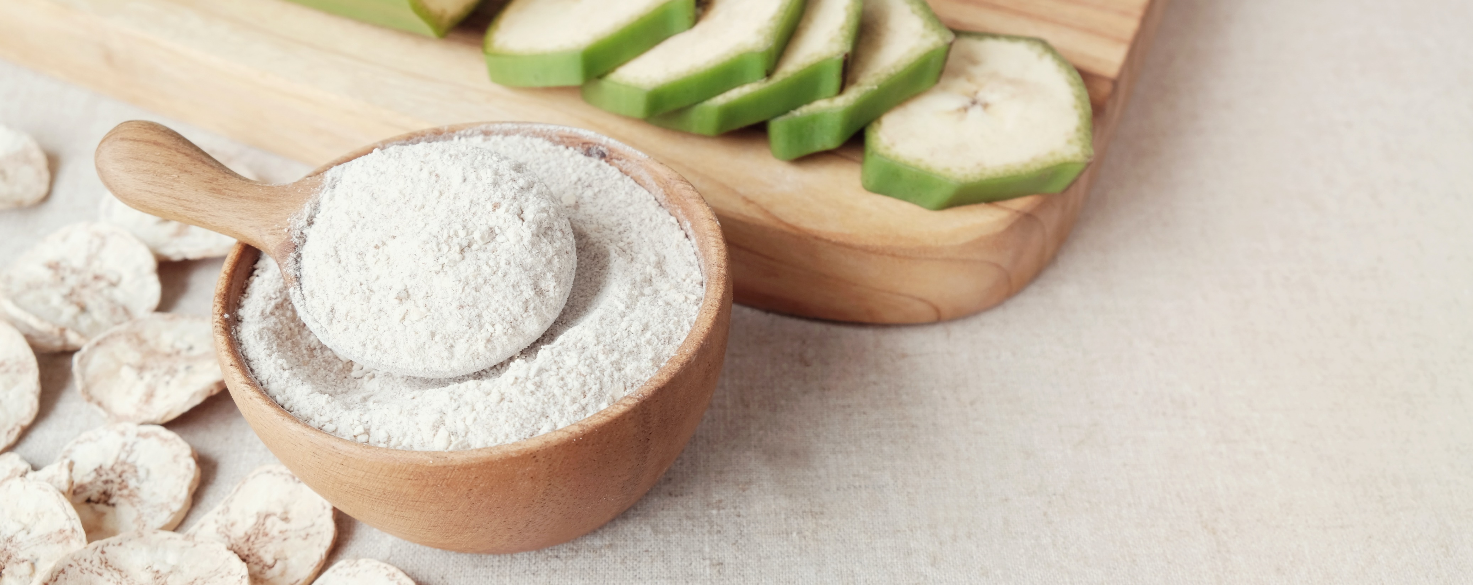

State of the Prebiotic Market in 2026
March 24, 2026

Slide 2




Mission
Champion the prebiotics category by increasing public awareness and understanding of the science supporting both
well-known and newfound benefits and create needed transparency about prebiotics and their interaction with the microbiome.

Slide 3











































Our Members:

Slide 5
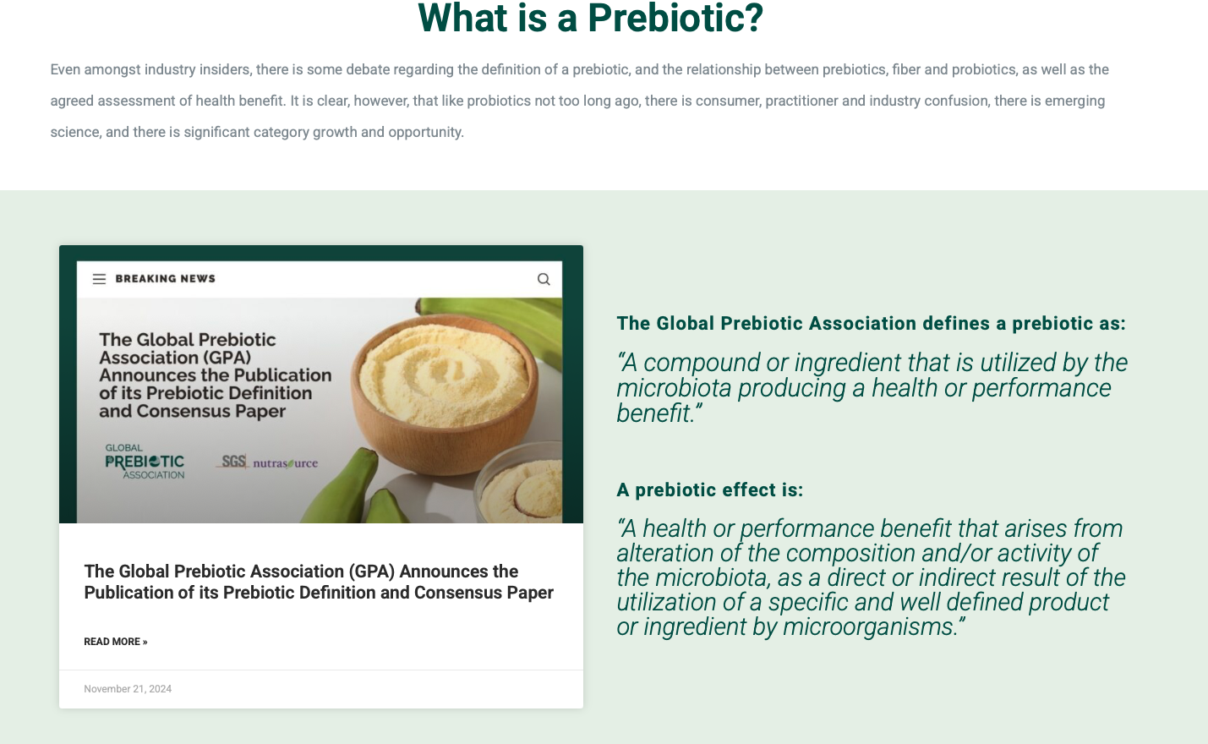

Slide 6
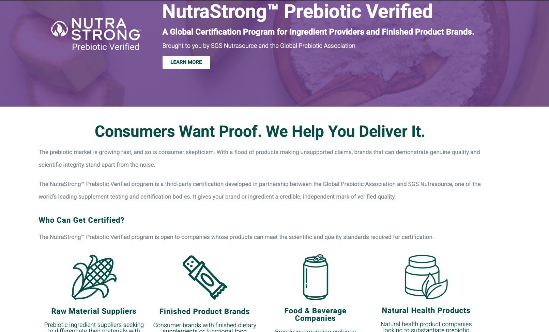
A Certification to Elevate Efficacious Prebiotics

Slide 7










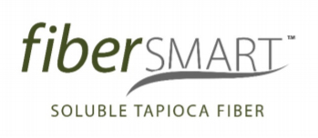
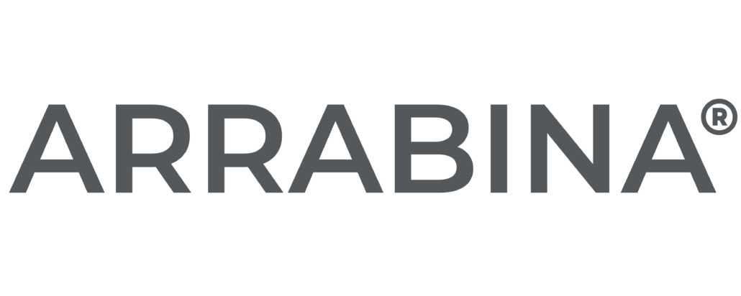


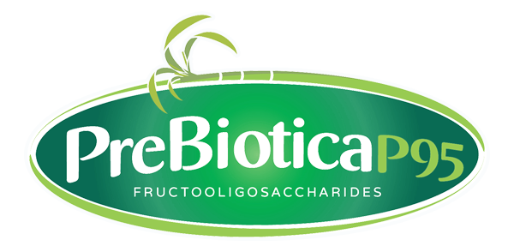

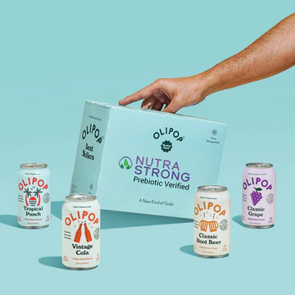
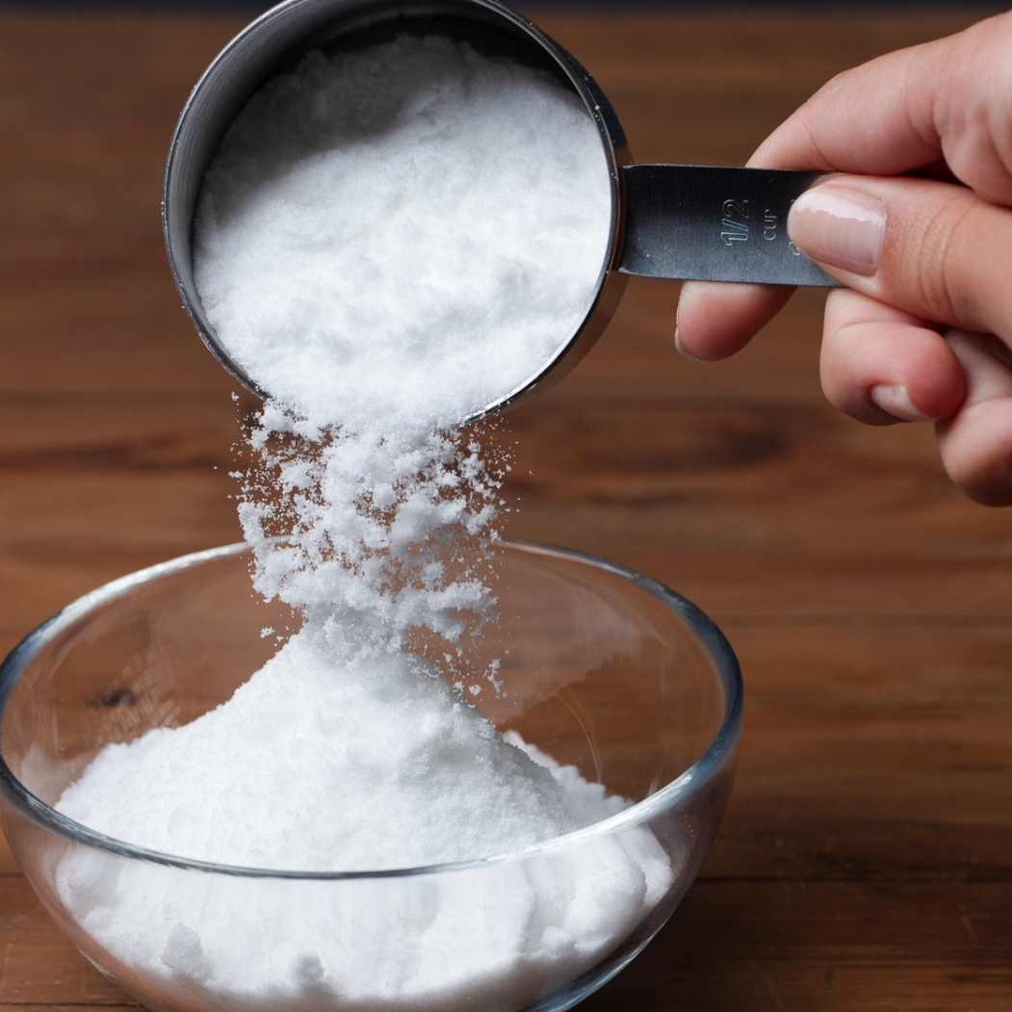
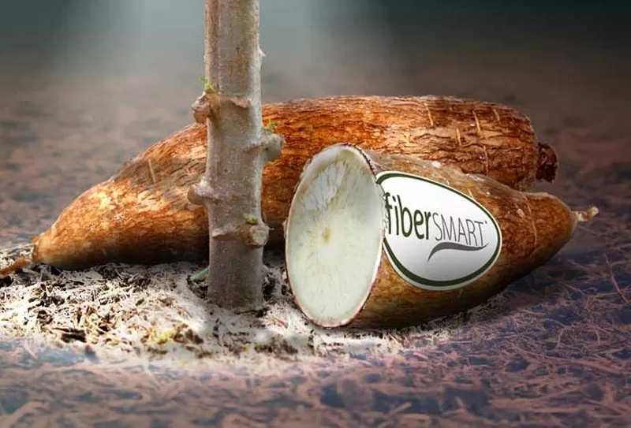
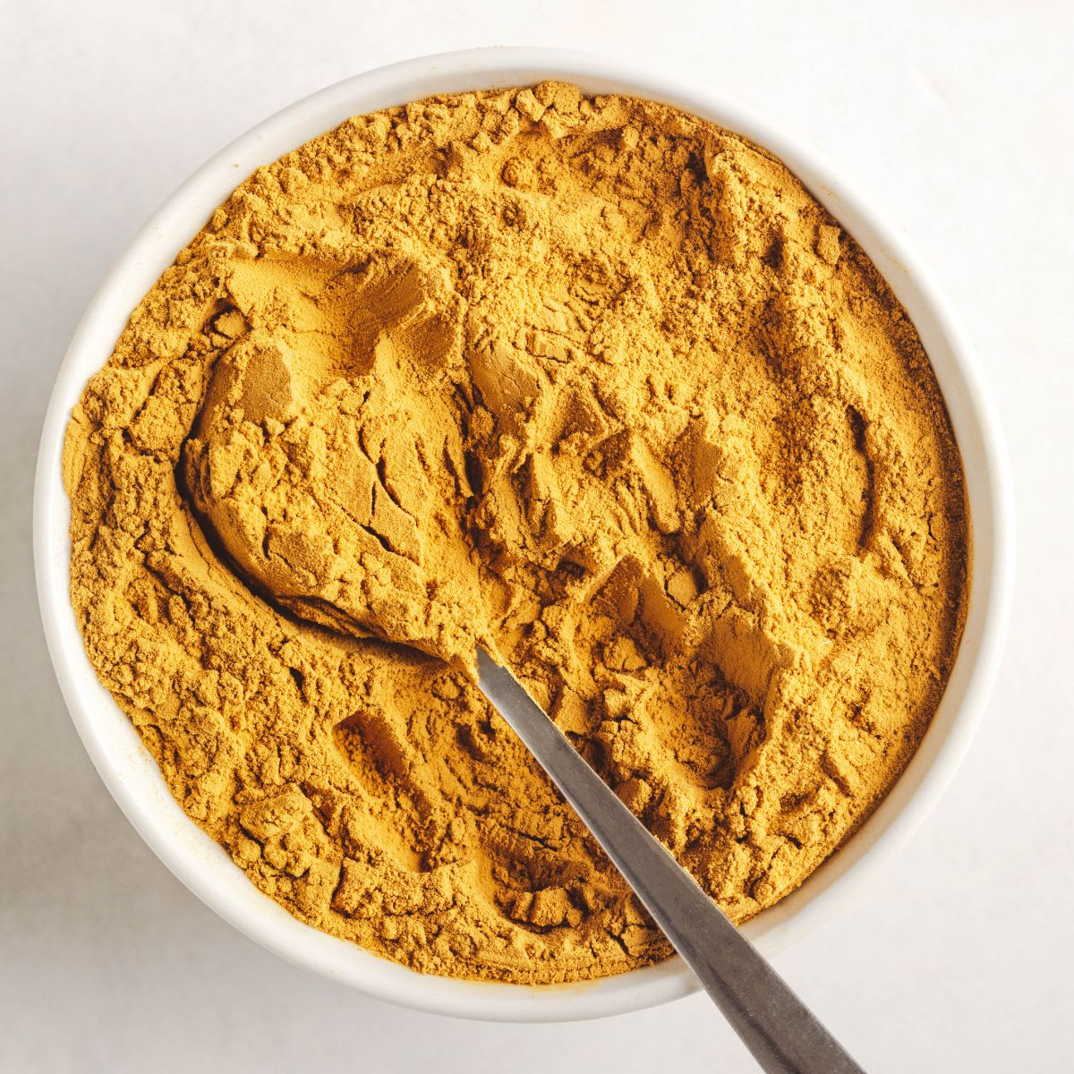
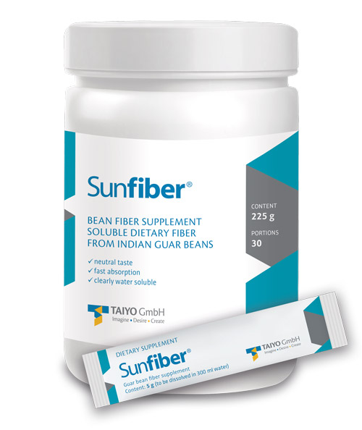
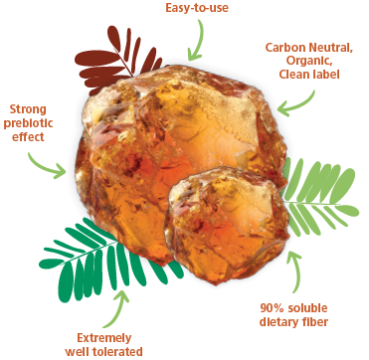
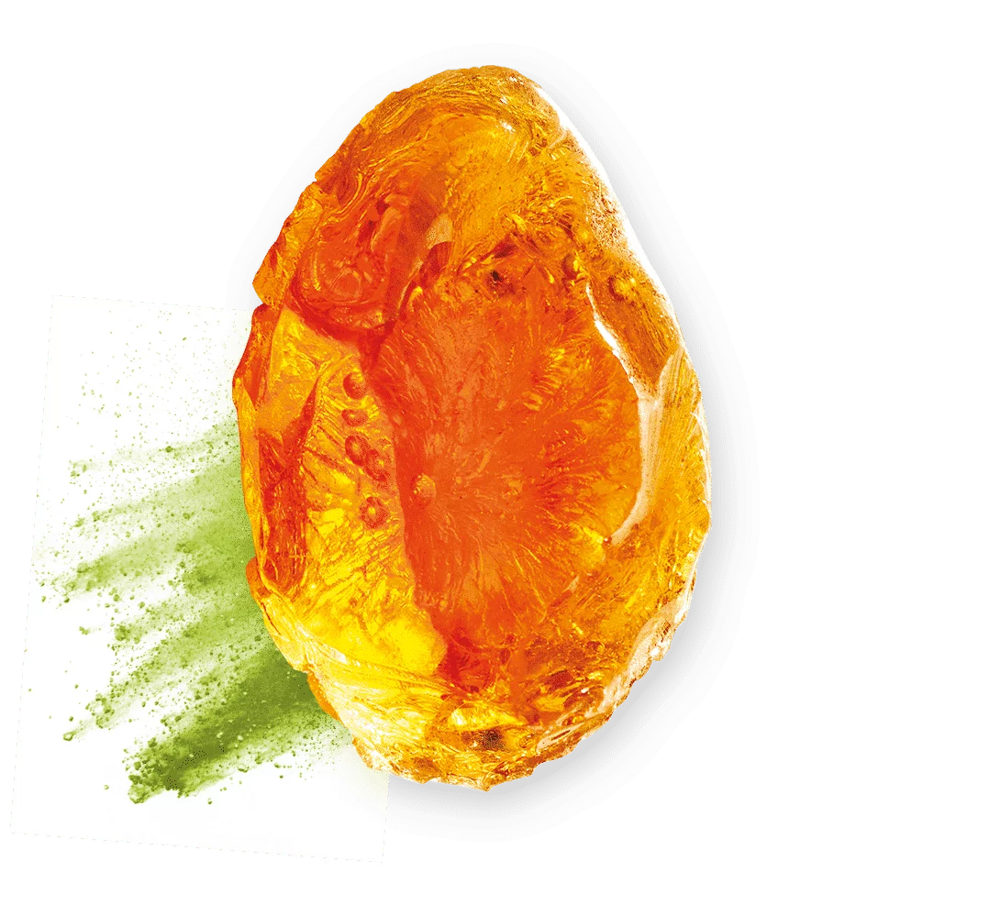

Prebiotic Verified Brands / Ingredients

Slide 8
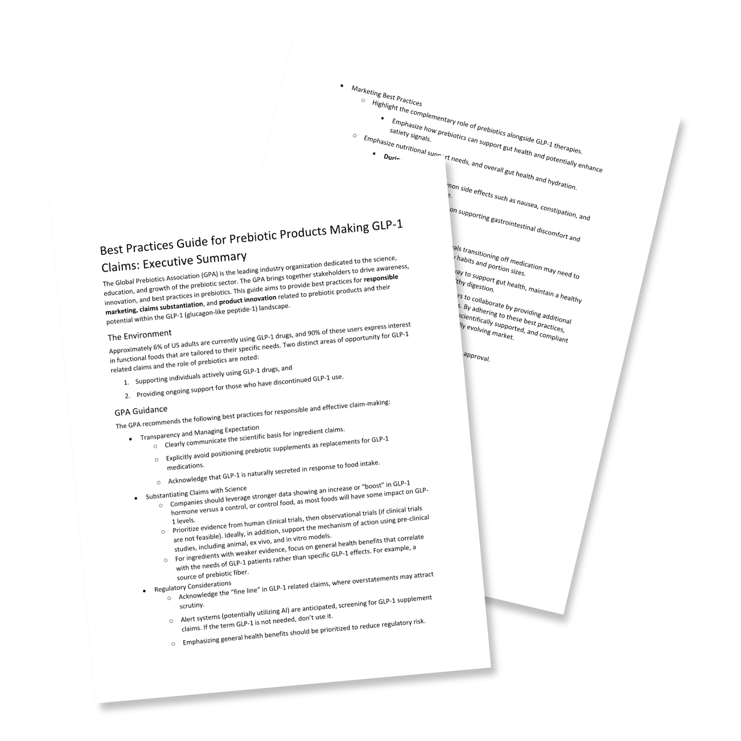
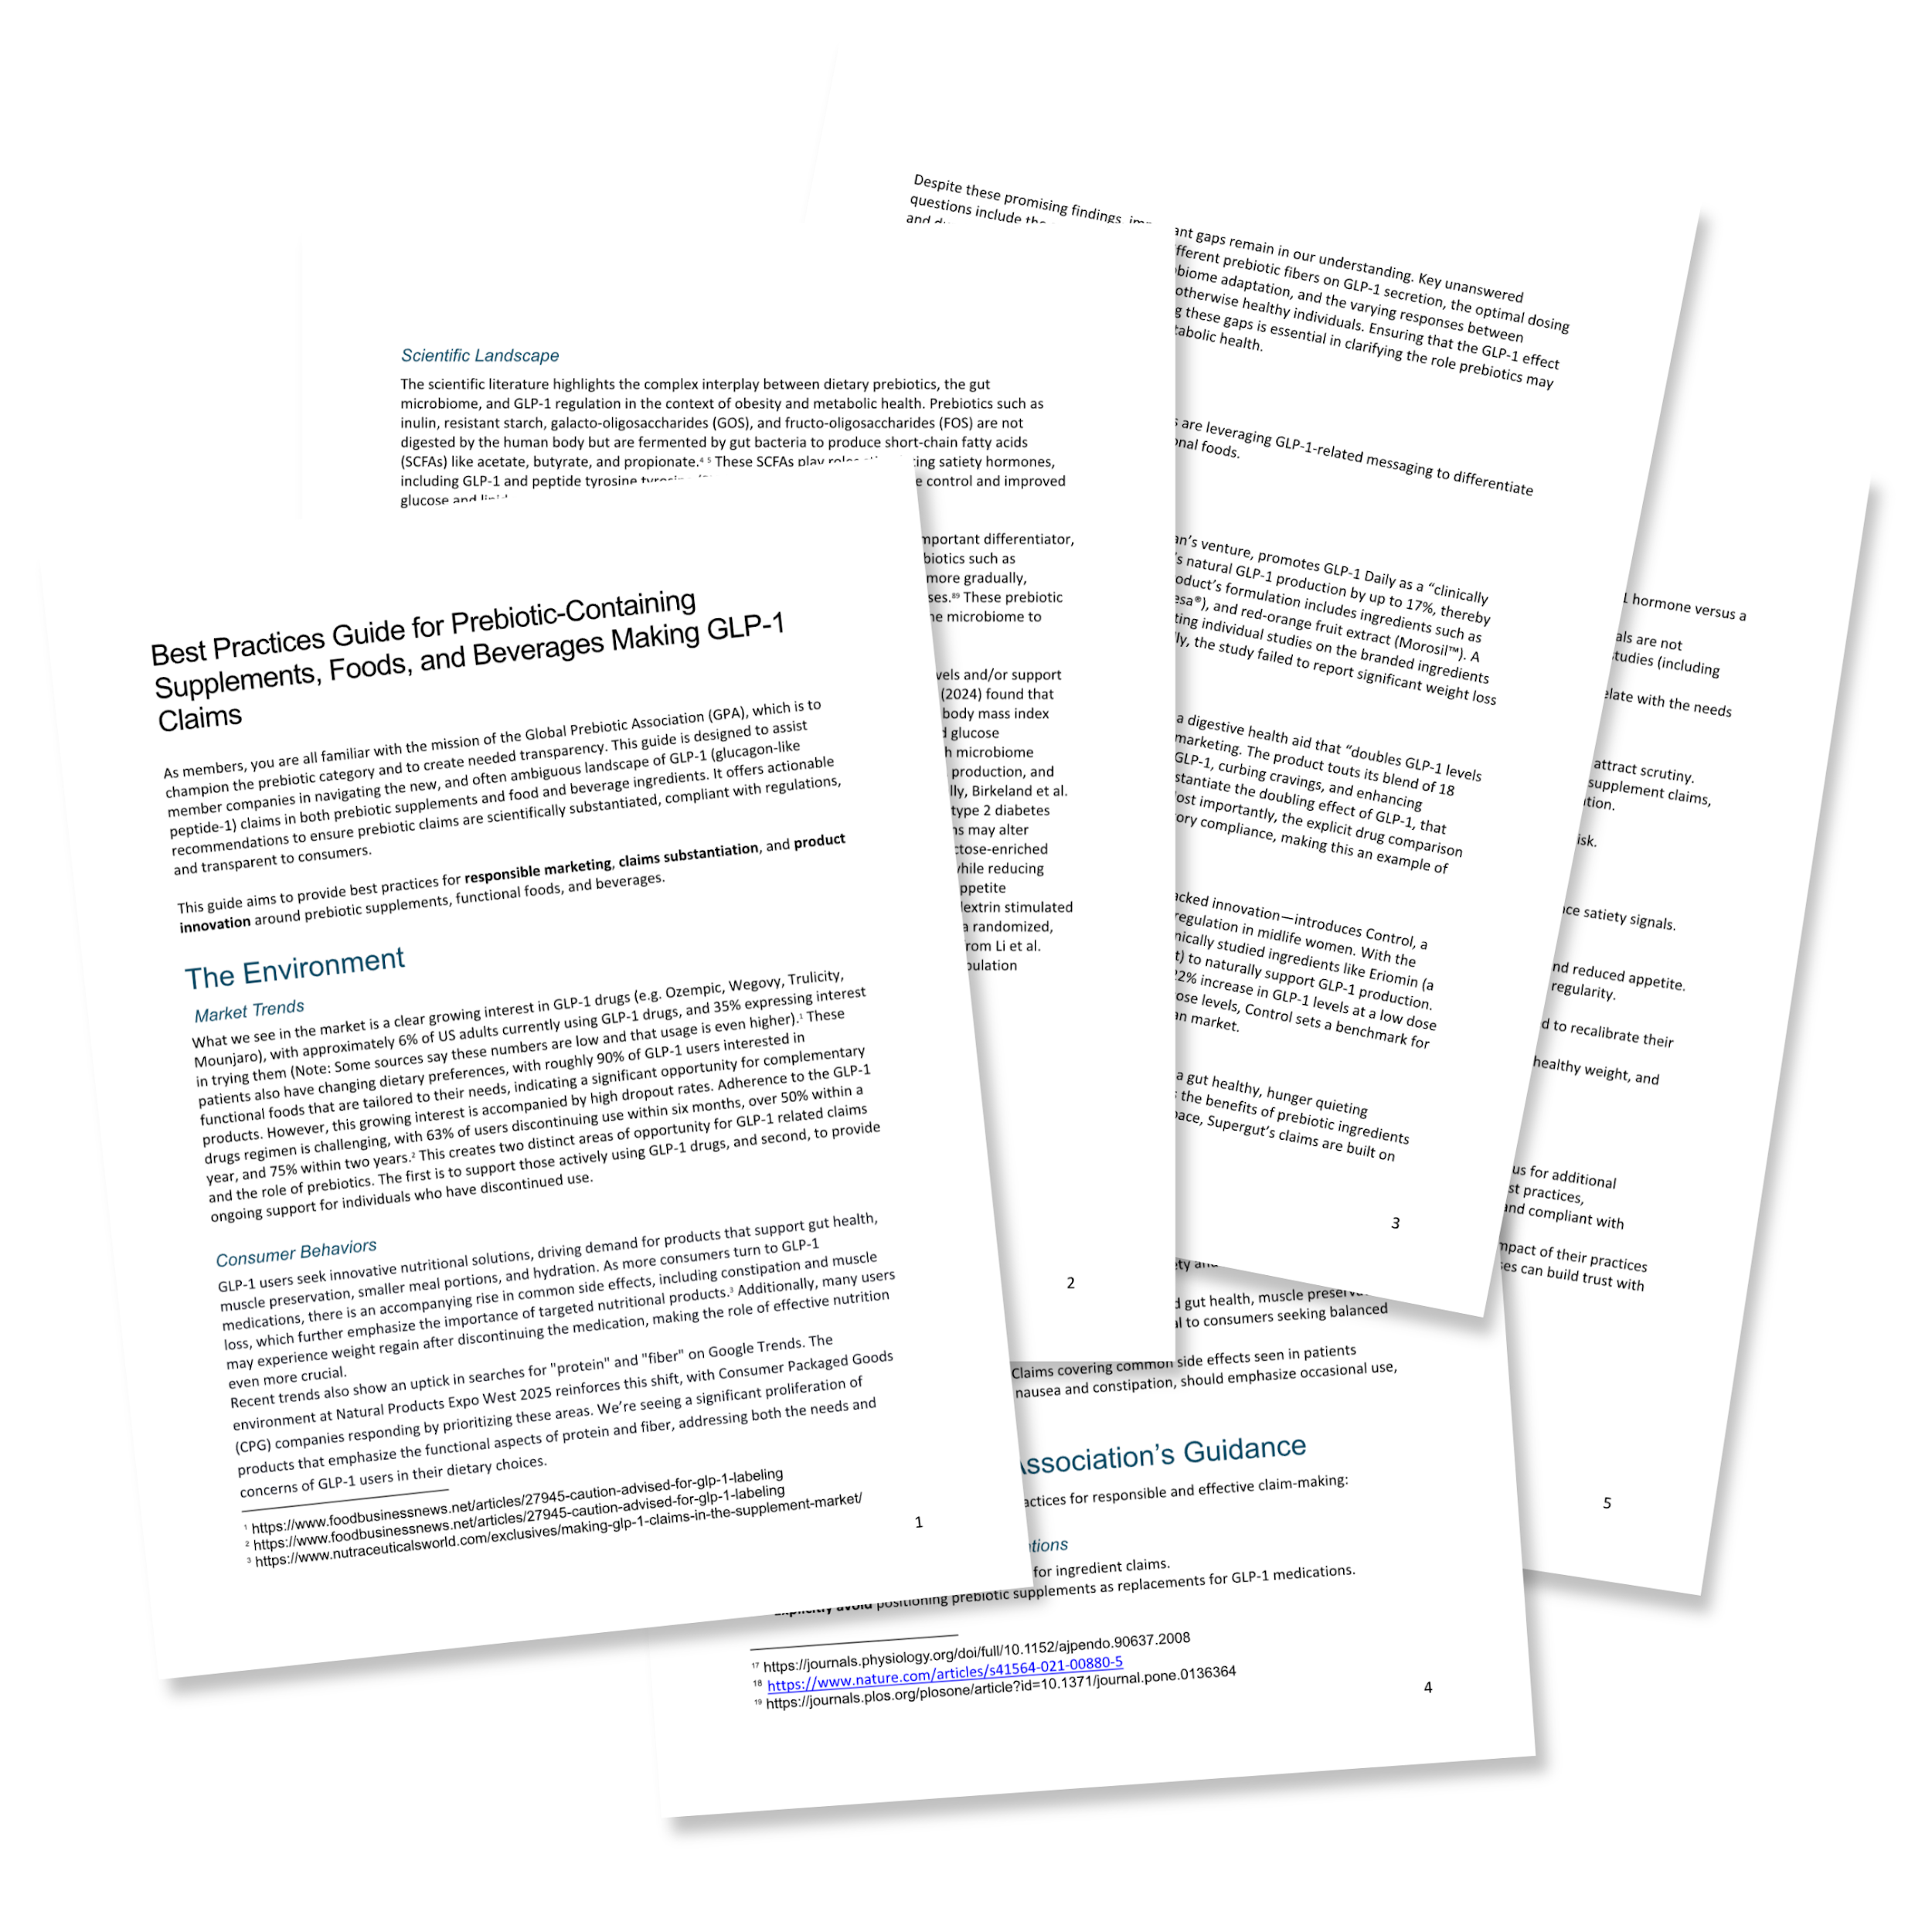
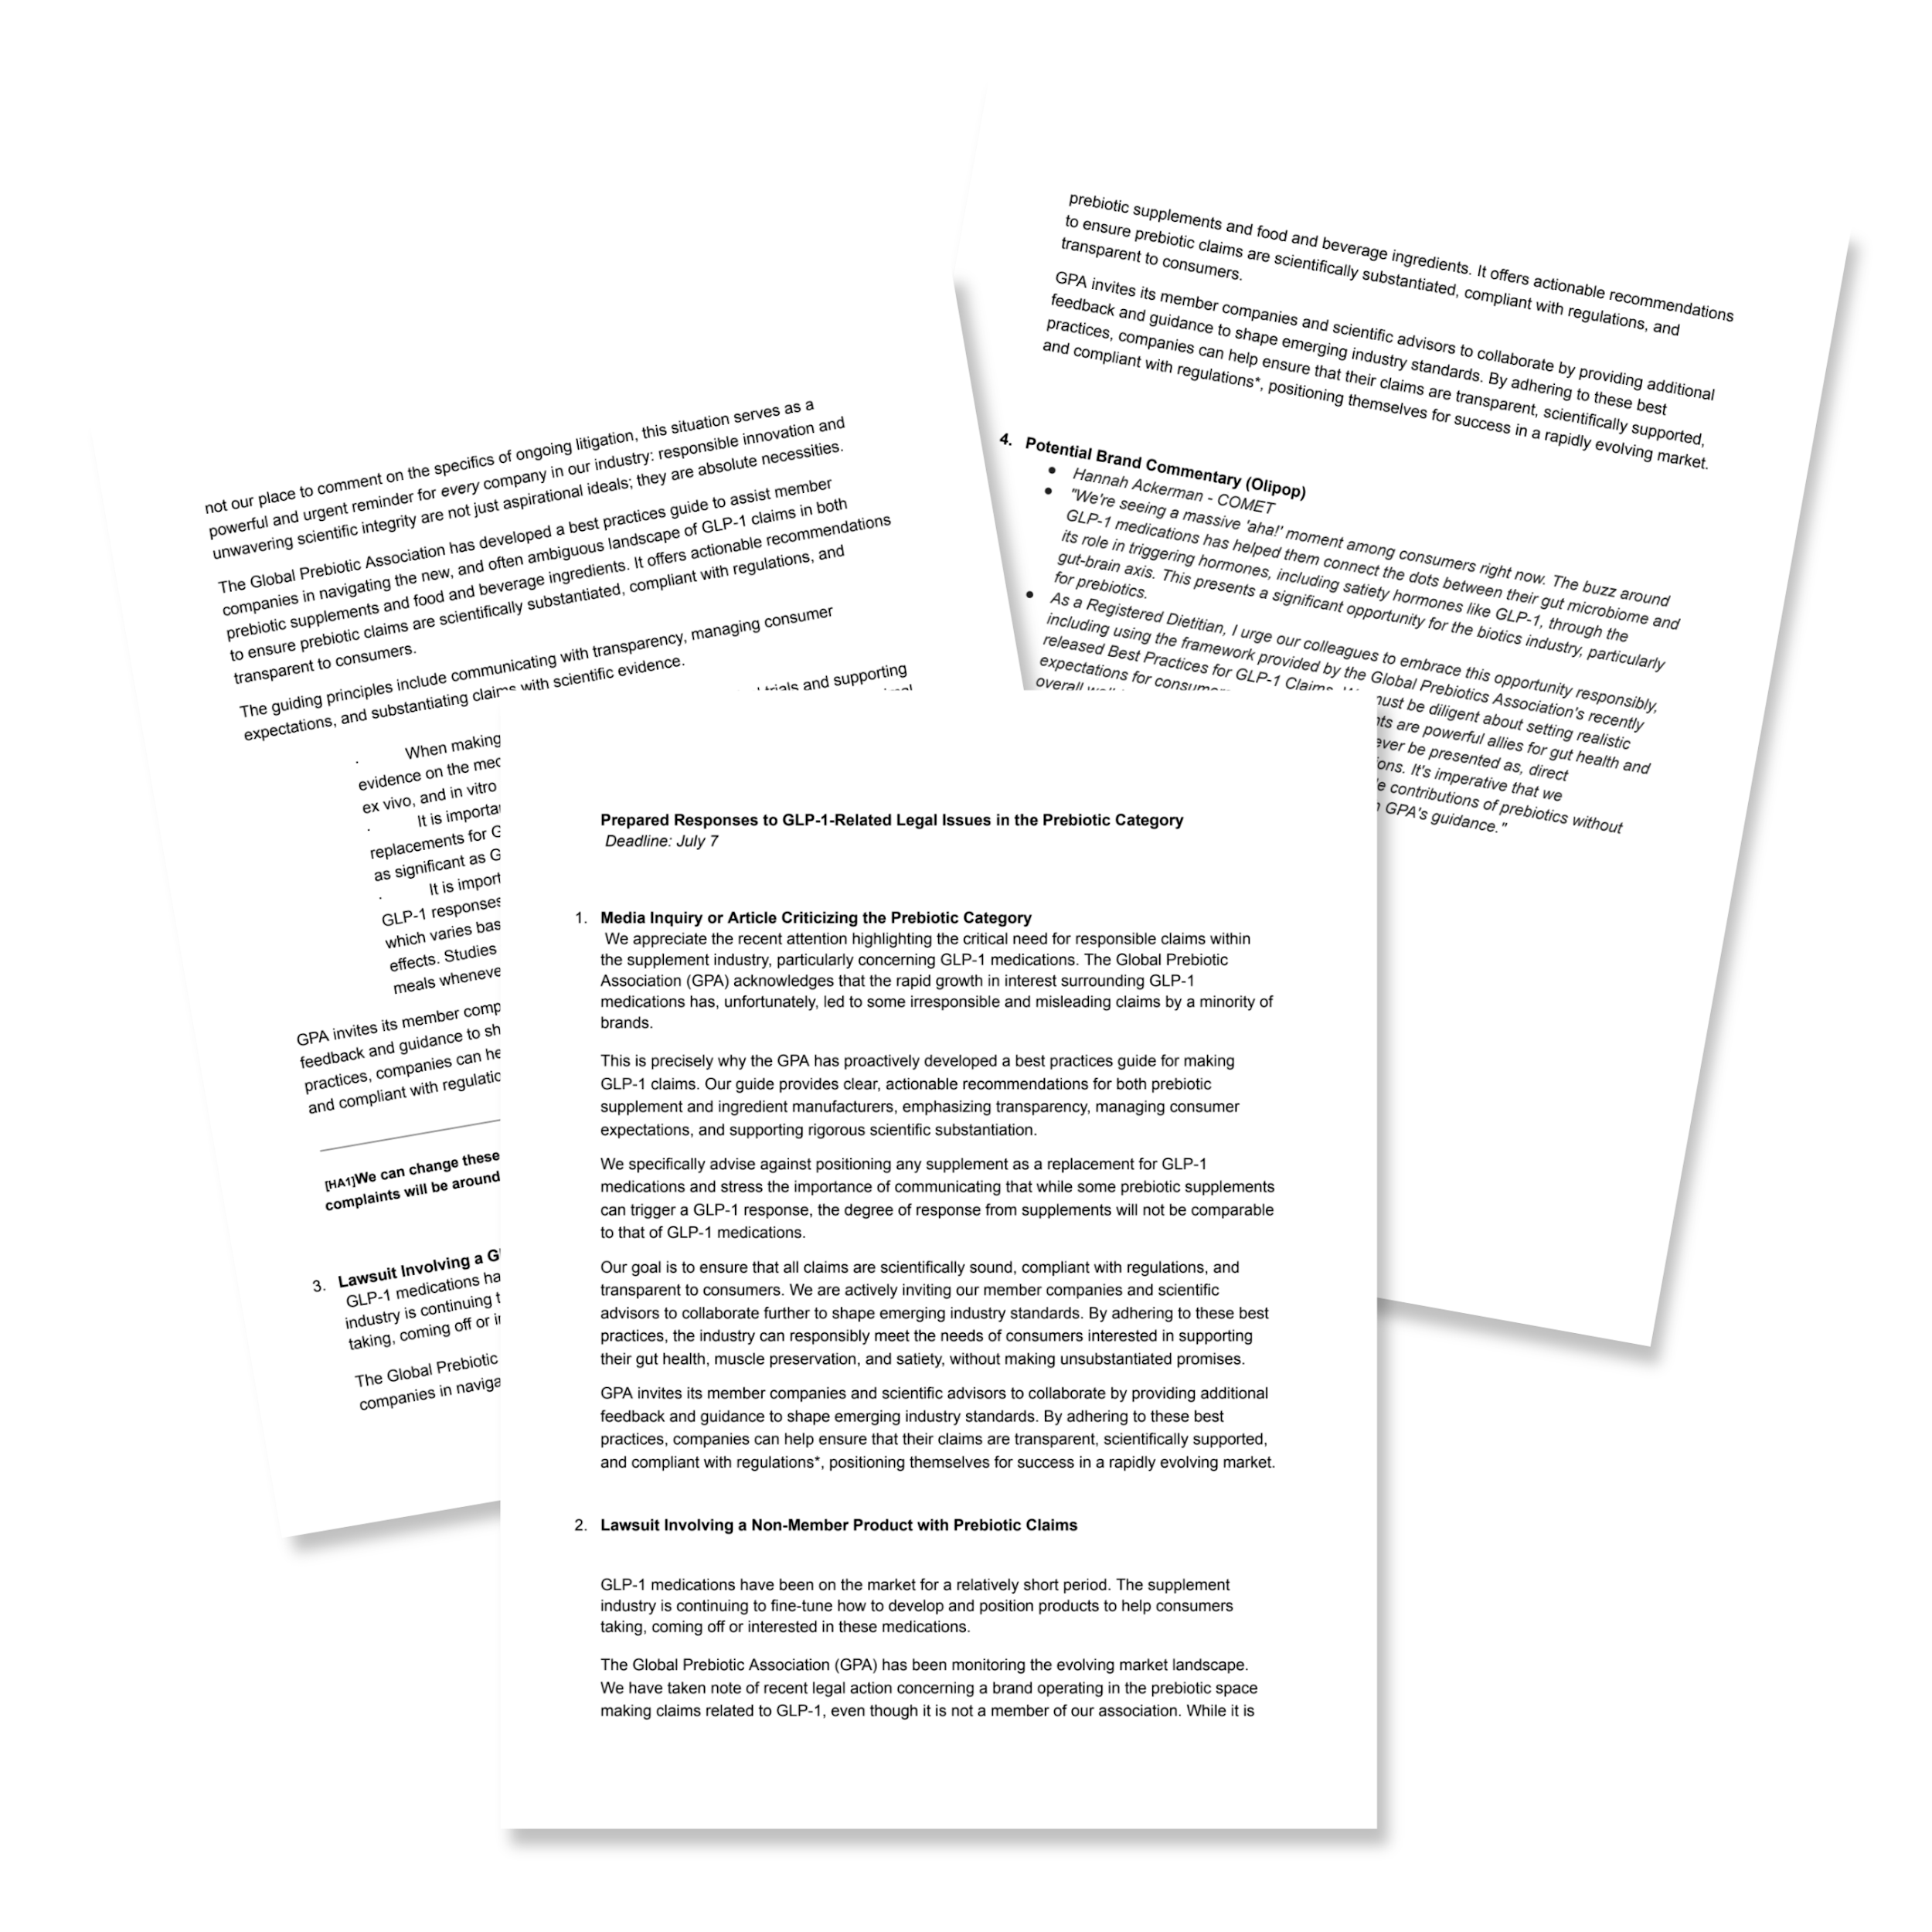
GLP-1 Efforts from our GLP-1 Task Force:
Best Practices Guide, White Paper, & Prepared Responses
With more work to be published in 2026.

Slide 9
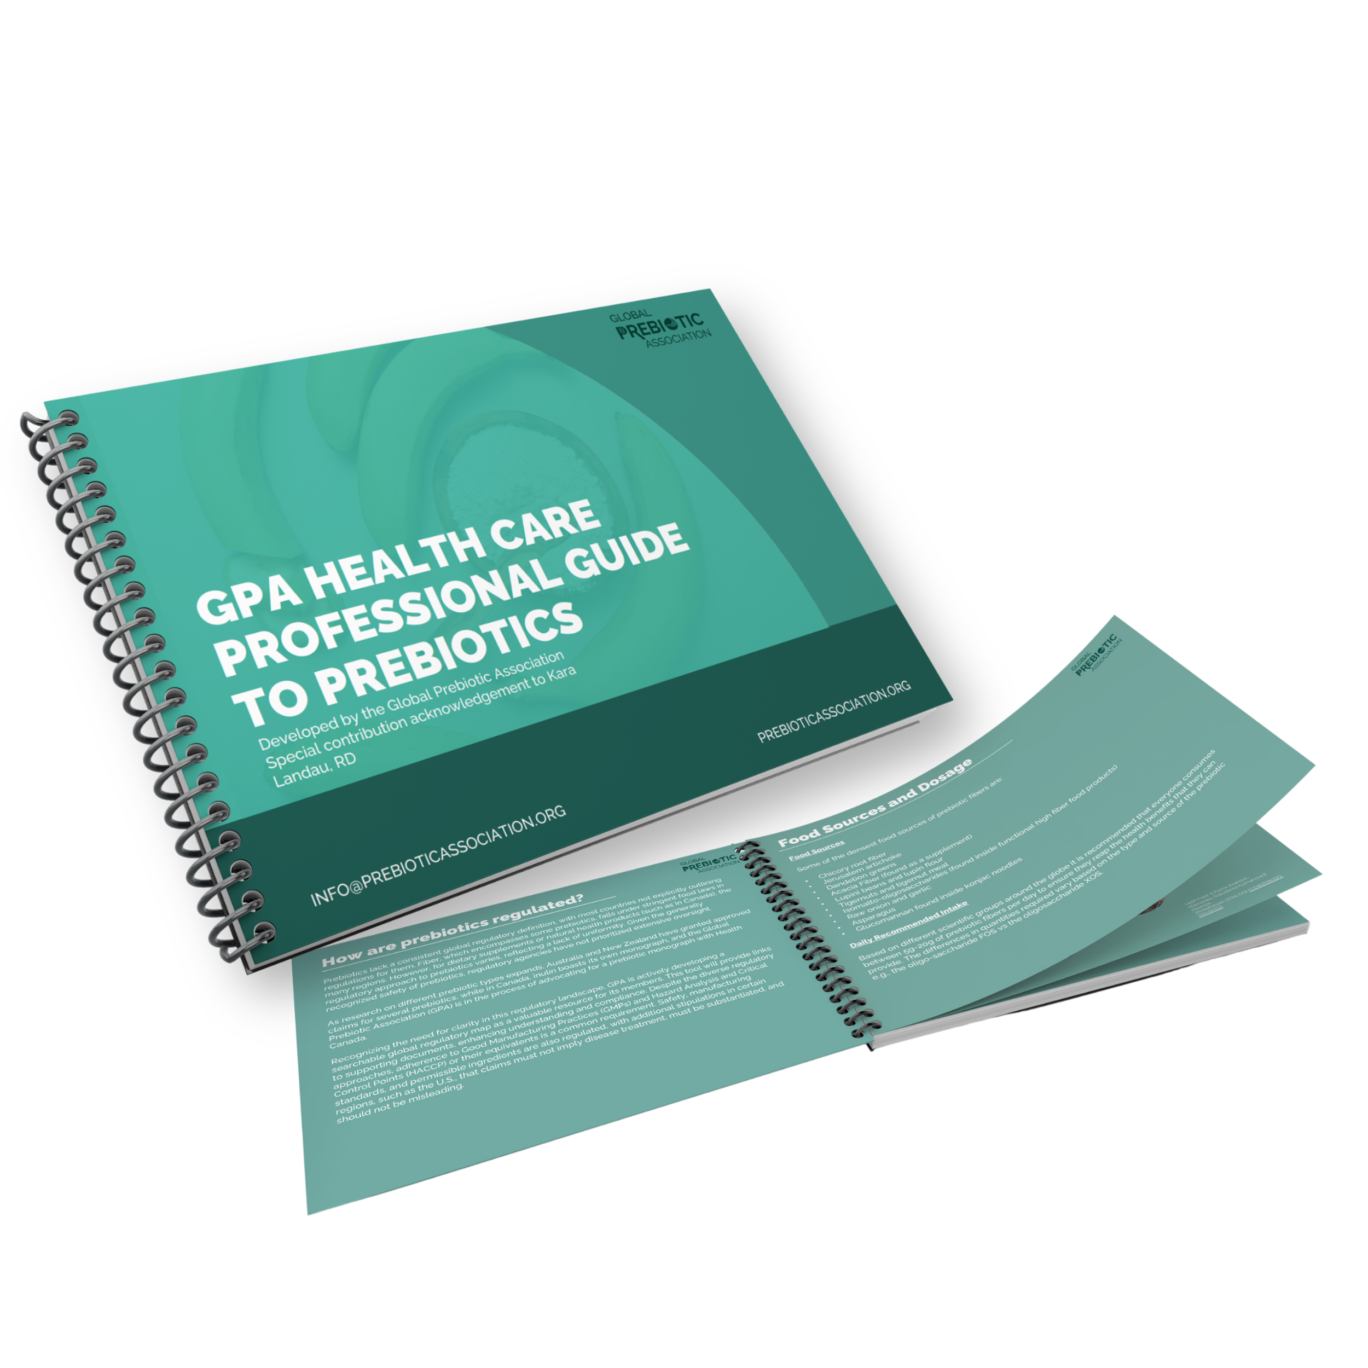
Health Care Practitioners Guide

Slide 10
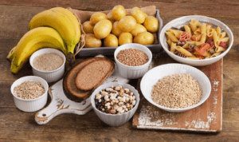
Prebiotics in the News

Slide 11
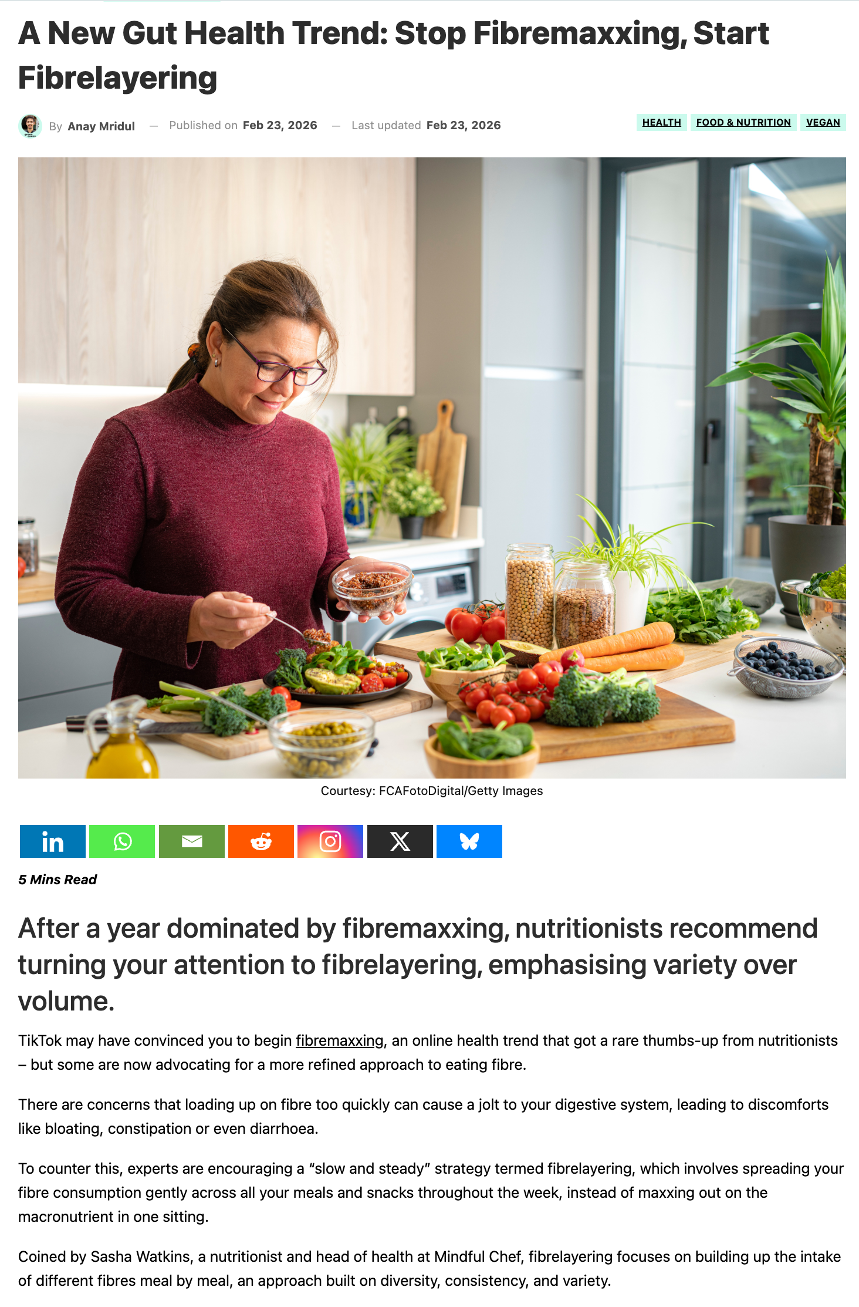
A New Gut Health Trend:
Fibermaxxing and Fiber layering
With all the hype, buoyed by the new US dietary guidelines, the focus on fiber in the wake of widespread GLP-1 drug adoption and nutritional fallout, fiber is having a rebirth.
Like any rebirth, this one is tricky as on the one hand, who wouldn’t want to try to make fiber sexy and address nutritional gaps. On the other hand, be careful what you wish for…

Slide 12
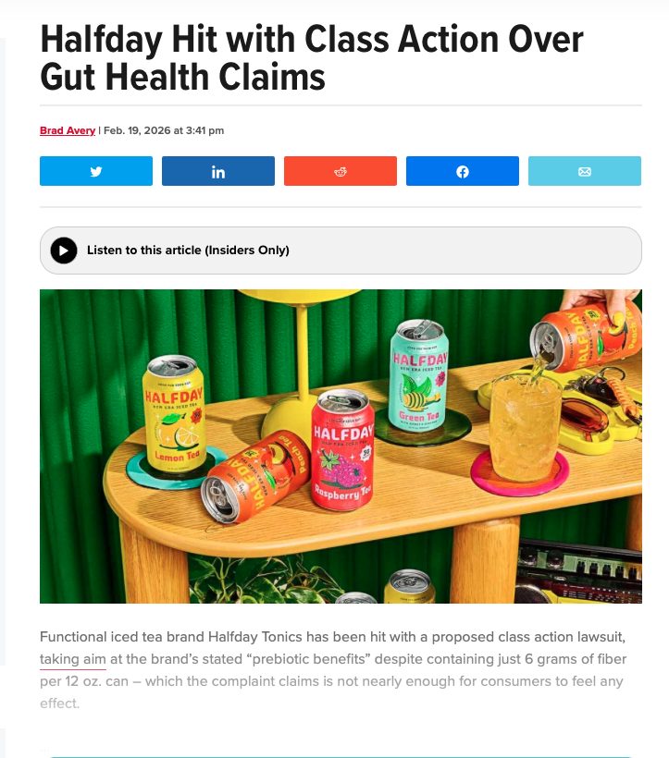
Prebiotic Beverages on Center Stage
As the popularity of prebiotic products increases, especially in the functional beverage category, expect to see more call for transparency, calling out of inconsistency and general overall scrutiny.

Slide 13
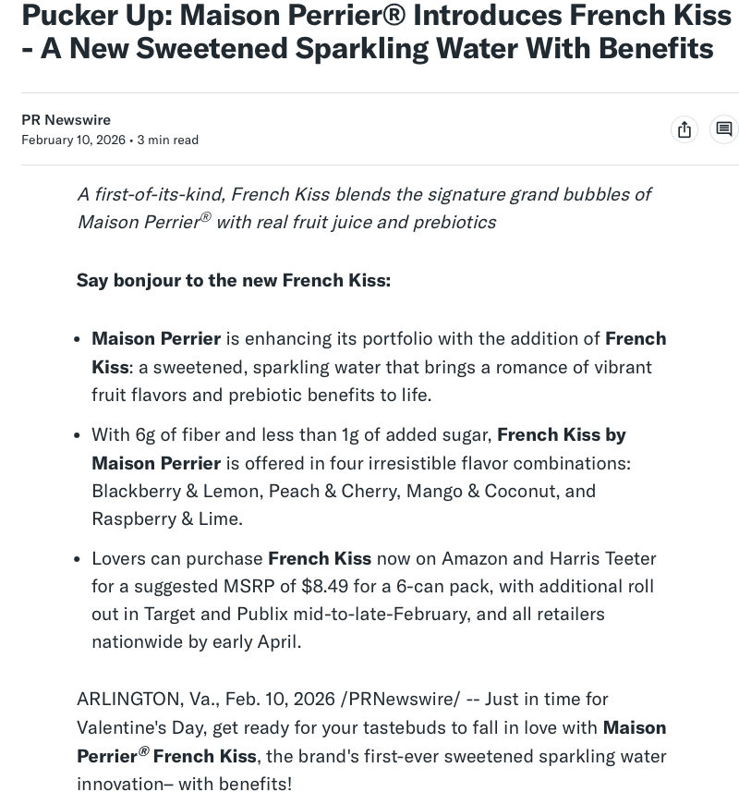

Prebiotic Beverages on Center Stage
It’s a global trend. Watch this space!

Slide 14

Recent Prebiotic Science

Slide 15
Recent Prebiotic Science:
The effects of inulin supplementation on eating behaviors in children and adolescents with obesity: a randomized double-blinded placebo-controlled study
A randomised controlled trial of the effects of galacto-oligosaccharides on the gut brain-axis of young females
Intervention: supplementation with 13 g/day inulin (from Thai Jerusalem artichoke)
Intervention: GOS (7.5 g/day containing 5.5g/day active Biotis® GOS)
Key takeaways:
Overweight or obese children and adolescents often exhibit eating behaviours, such as eating speed and emotional or stress-related eating linked to imbalanced energy intake.
Supplementation with 13 g/day inulin may improve eating behaviours, gut hormones, and anthropometric outcomes in overweight or obese children and adolescents.
Access the study: https://pubmed.ncbi.nlm.nih.gov/40796902/
Key takeaways:
The gut-brain axis represents a promising and novel avenue to target youth mental health for its ability to regulate and produce neurochemicals.
Supplementation with GOS did not lead to improvements in anxiety among young females, but increased Bifidobacterium abundance, suggesting microbiota modulation.
Further research is warranted in male participants, older populations, and using other prebiotic ingredients.
Access the study: https://www.sciencedirect.com/science/article/pii/S0889159125002375?via%3Dihub

Slide 16
Recent Prebiotic Science:
Impact of prebiotics and postbiotics in their management of constipation: analysis of their differentiated modulation of intestinal microbiota
Multi-omics analysis of a prebiotic intervention with pectin in lipid transfer proteins (LTPs) allergic patients
Intervention: prebiotic and postbiotic combination (ABB C24; 5g NextDext™ and 200 mg ABB C22®) 3 times daily, for 14 days.
Intervention: high methoxyl apple-derived pectin (HMP; AP-DWhigh), or 3) placebo, twice daily for 2 months, for a total quantity of 20g/day pectin
Key takeaways:
Dysbiosis of the gut microbiota contributes to inflammatory diseases and immune diseases, such as food allergies.
Treatment with both pectins led to significant improvements in allergen tolerance, as indicated by decreased cytokines associated with an allergic inflammatory response, such as IL-13.
Further research is warranted to investigate and identify additional treatment options for patients with LTP allergy.
Key takeaways:
Chronic constipation is associated with changes in the gut microbiota, such as increased presence of methanogenic organisms.
Supplementation with a prebiotic alone, or in combination with postbiotics improves stool consistency and gut microbiota in constipated patients, with greatest stool improvement observed among the prebiotic-only group.
Participants who observed greater stool improvement also showed microbiota modulation (i.e. increased Bifidobacterium longum and decreased constipation-related bacteria), compared to those without stool improvement.
Access the study: https://www.clinicalnutritionespen.com/article/S2405-4577(25)02889-X/fulltext

Slide 17
Recent Prebiotic Science:
Polyphenols non-covalently bound to artificial plant cell walls are readily accessible to fecal microbiota and transiently alter fermentation activity
A human milk oligosaccharide alters the microbiome, circulating hormones, and metabolites in a randomized controlled trial of older adults
Intervention: a three-component bacterial cellulose analogue of the apple cell wall (aACW) soaked in a PP extract from apples (aACW + PP) on gut microbiota responses at 0, 5, 24, and 48 h.
Intervention: 5 g/day 2′-FL
Key takeaways:
The study investigated the interactions between DFs and PPs at concentrations reflecting actual dietary habits and their synergistic effects on gut microorganisms using an apple pomace (aACW) as model system in an in vitro analysis.
Using two treatments, aACW alone or aACW combined with PP at 0.8 g/L, a physiologically relevant concentration, revealed a donor-dependent response in microbiota shifts rather than a not treatment-dependent effect.
The aACW with PP showed a transient but significant rise in acetic acid levels at the 5-hour point compared to the control (only aACW), but no sustained overall short-chain fatty acid increase at later timepoints.
Access the study: https://pubmed.ncbi.nlm.nih.gov/40795553/
Key takeaways:
HMOs, especially 2′-FL, are well known for their role in shaping the infant gut microbiome and immune system, but their effects in older adults remain largely unexplored.
This randomized, placebo-controlled trial assessed the safety, tolerability, and impact of 2′-FL supplementation on the gut microbiome, immune markers, and metabolic outcomes in healthy adults aged 60 years and older.
2′-FL induced a transient but significant increase in Bifidobacterium abundance at week 3, with increases in fasting insulin, HDL cholesterol, and FGF21, though no significant group-level changes were seen in the primary outcome of cytokine response score.
Future research should explore the mechanisms of action and evaluate personalized responses to 2′-FL supplementation.
Access the study: https://pubmed.ncbi.nlm.nih.gov/40738103/

Slide 18
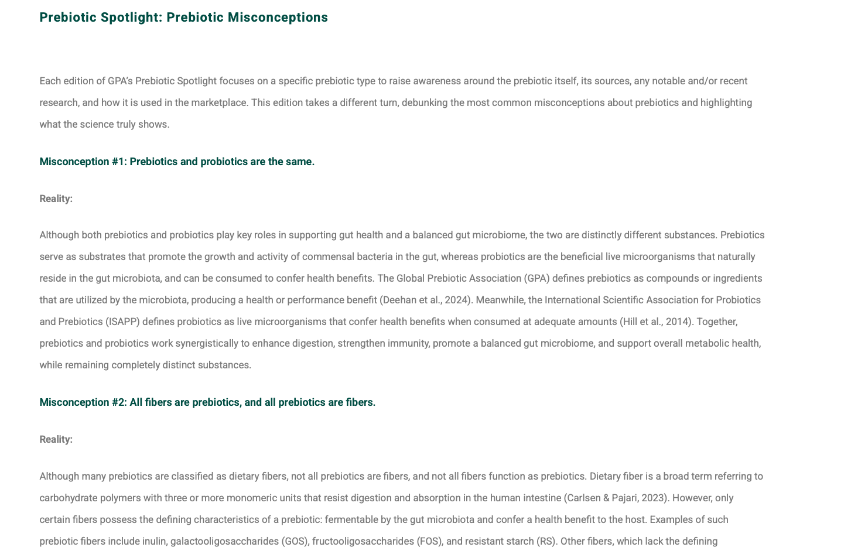
Recent Prebiotic Science:

Slide 19

FAMILIARITY: ALL USERS
Key Insight:
For all supplement users, familiarity with prebiotics continues to rise, now at 20% for top familiarity and 47% for top-two familiarity, up from 20% and 35%, respectively.
Note: All Respondents=4029. Question: “How familiar would you consider yourself regarding the use of these supplements?”

Slide 20
What we’re watching…..
Smaller doses, precision interactions
Playing in plant-based, leveraging the ‘right’ fiber story
Capitalizing on whole food/ circular, up-cycling
More than the gut
Multi-microbiomes
Smart synbiotics
Integration with diagnostic tools
Pet markets
Reduction/elimination of non-responders
Beverages and more
Watch this space!

Slide 21
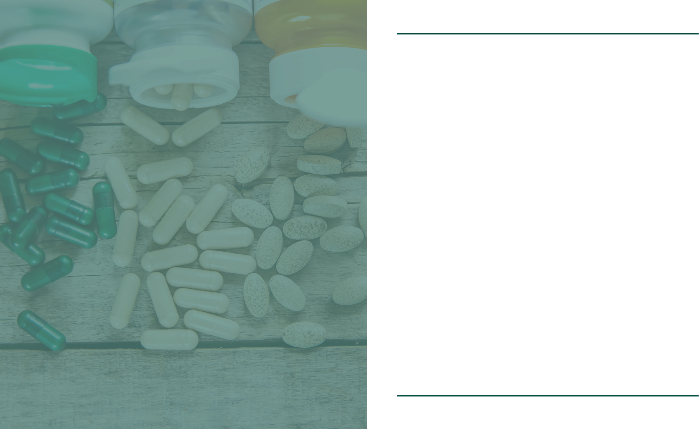


Thank you!
Len Monheit
Executive Director
len@itcstrategy.com
Paula Guerra
Science & Technical Lead
pguerra@nutrasource.ca
Steve Imgrund
Communications Director
steve@itcstrategy.com
Maggie Feikes
Project Specialist
maggie@itcstrategy.com

