Slide 1
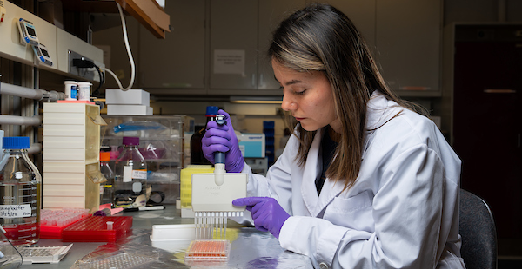
The potential of precision prebiotics
Bruce Hamaker and Thaisa Cantu-Jungles
Disclosure: RiteCarbs LLC

Slide 2
Precision prebiotics – what are they?
Our proposed definition:
“prebiotics that preferentially and predictably promote a specific bacterial taxon or groups of bacterial taxa, or a defined microbial metabolic function, doing so effectively and consistently across individuals”
Cantu-Jungles and Hamaker, in preparation

Slide 3
Alignment and targeting of fibers to gut bacteria
Matching fibers to preferentially support beneficial bacteria or bacterial groups holds the promise of:
Predictable and precise response for prebiotics
Consistent response for population benefit
Notes:
CODEX describes DF as CHO polymers with a DP not lower than 3 (to exclude mono- & disaccharides) and includes 1) naturally occurring edible CHO polymers 2) CHO polymers obtained from food raw material by physical, enzymatic or chemical means and 3) synthetic CHO polymers.
However, WHO/FAO specified that ‘the term DF should be reserved for cell wall polysaccharides of vegetables, fruits and whole grains, the health benefits of which have been clearly established, rather than synthetic, isolated or purified oligasaccharides with diverse or unique physiological effects.’

Slide 4

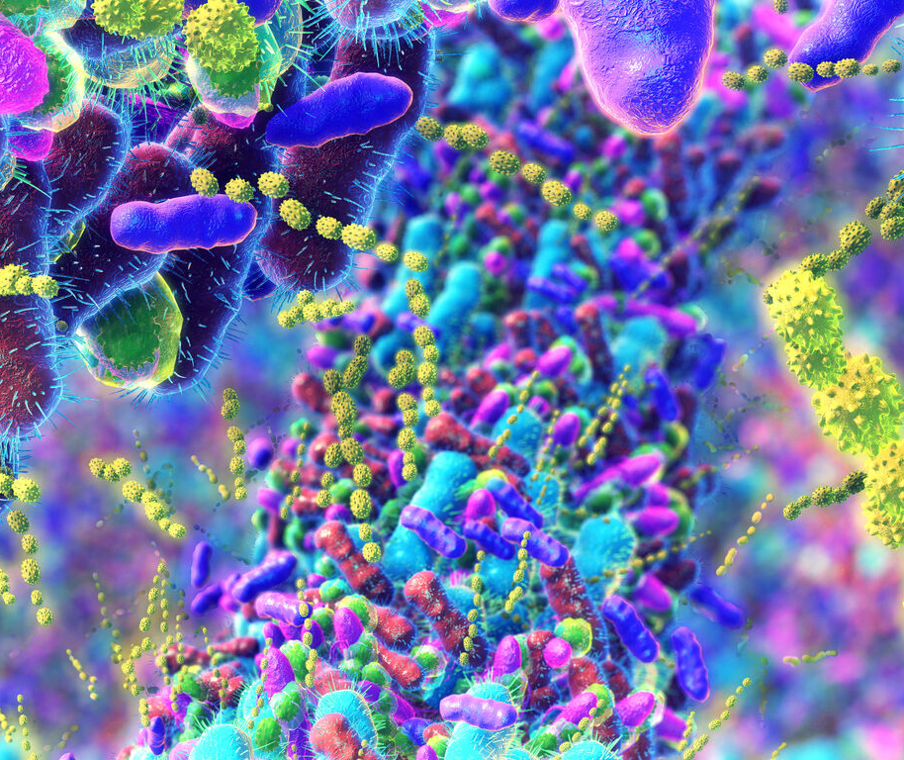
Concept: Fermentable fiber structures match with specific gut bacteria and can be used to preferentially support them
Not about making a new fiber and testing for prebiotic potential
Think from the gut bacteria perspective to identify matched fibers
https://biologicalsciences.uchicago.edu/news/gut-microbiome-data-underscores-gaps-global-representation

Slide 5
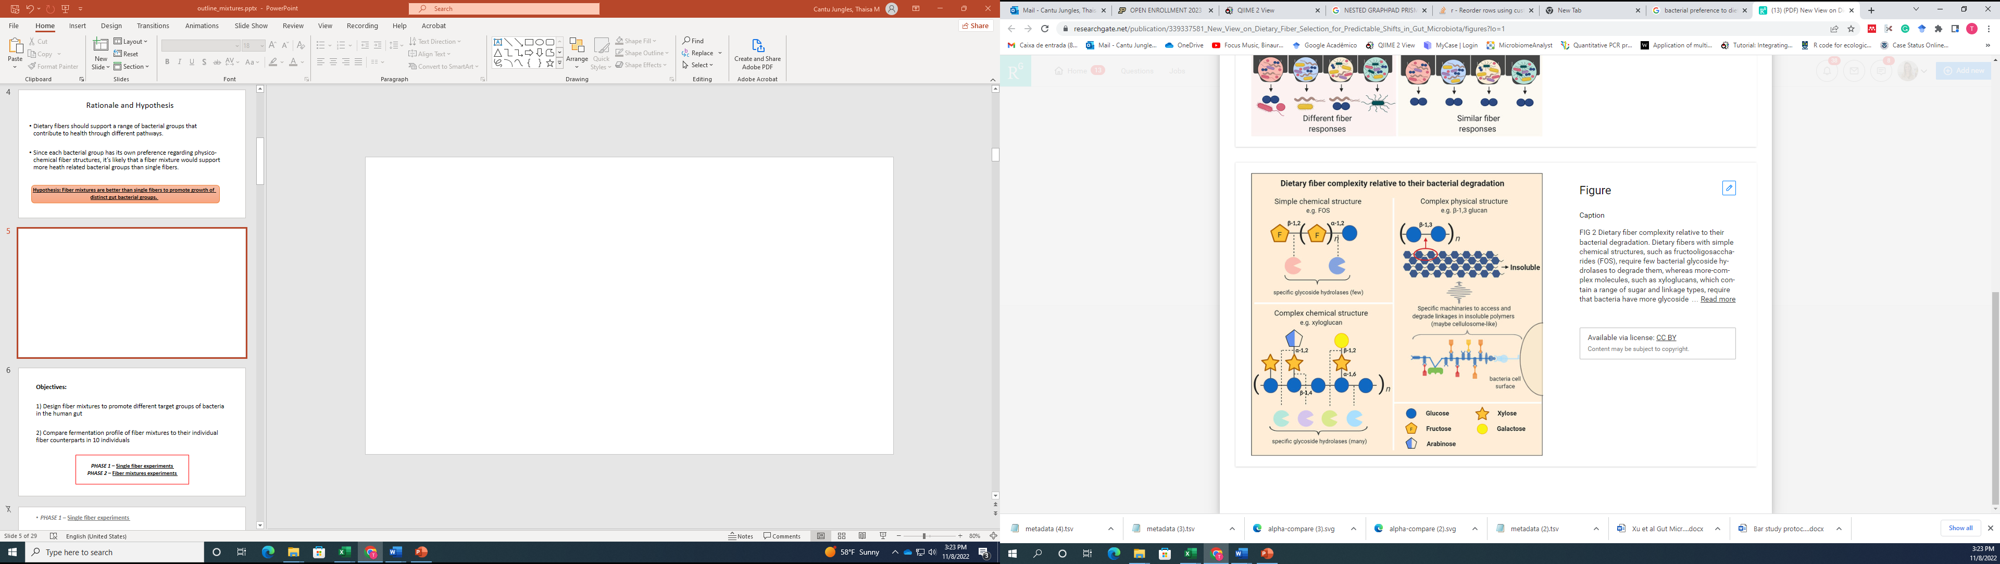

Fibers can be selected to promote specific gut bacteria
Dietary fibers are the main energy source to beneficial gut bacteria
Bacterial have specific machineries for fiber degradation
Dietary fibers can stimulate the growth of specific bacteria from the large intestine
Cantu-Jungles and Hamaker, 2019

Slide 6
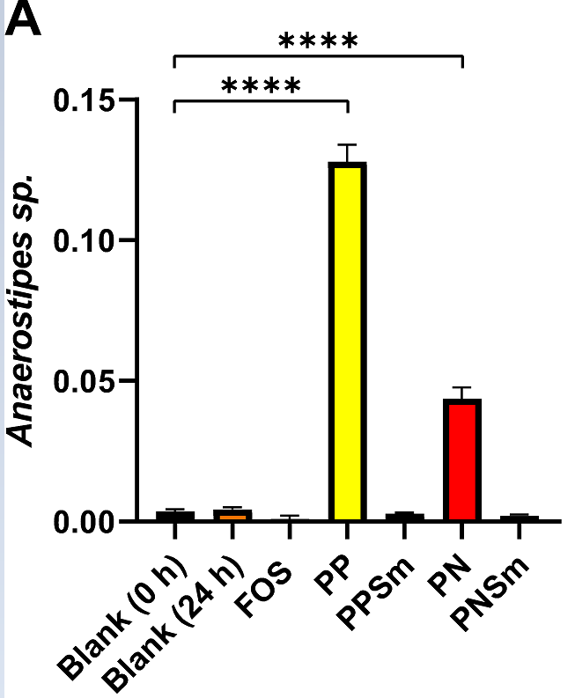
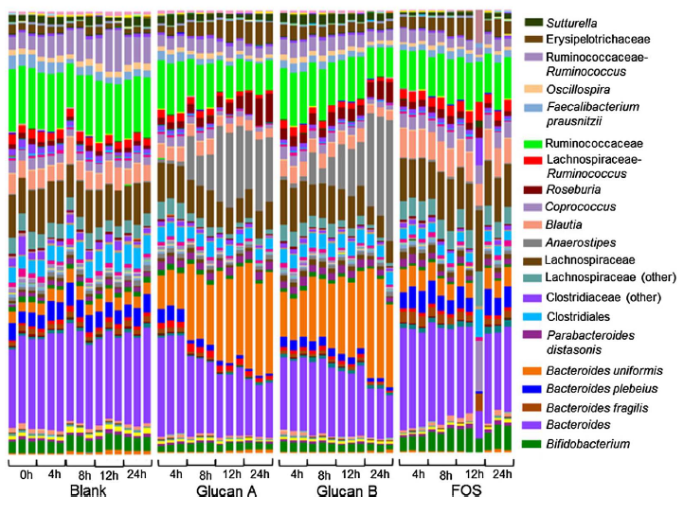
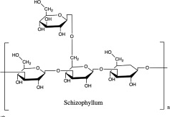
Matching Fibers to Specific Gut Bacteria
Mushroom glucan to promote Anaerostipes (butyrate producer)
Removal of β-D-glucan branches prevents promotion of Anaerostipes sp.
X
β-1,3/1,6-glucan
Branched, soluble
Branched, Insoluble
Debranched, insoluble
Debranched, (in)soluble
Cantu-Jungles at al, Carbohydr Polym. 2018
Zavadinack et al, Carbohydr Polym 2024
6

Slide 7
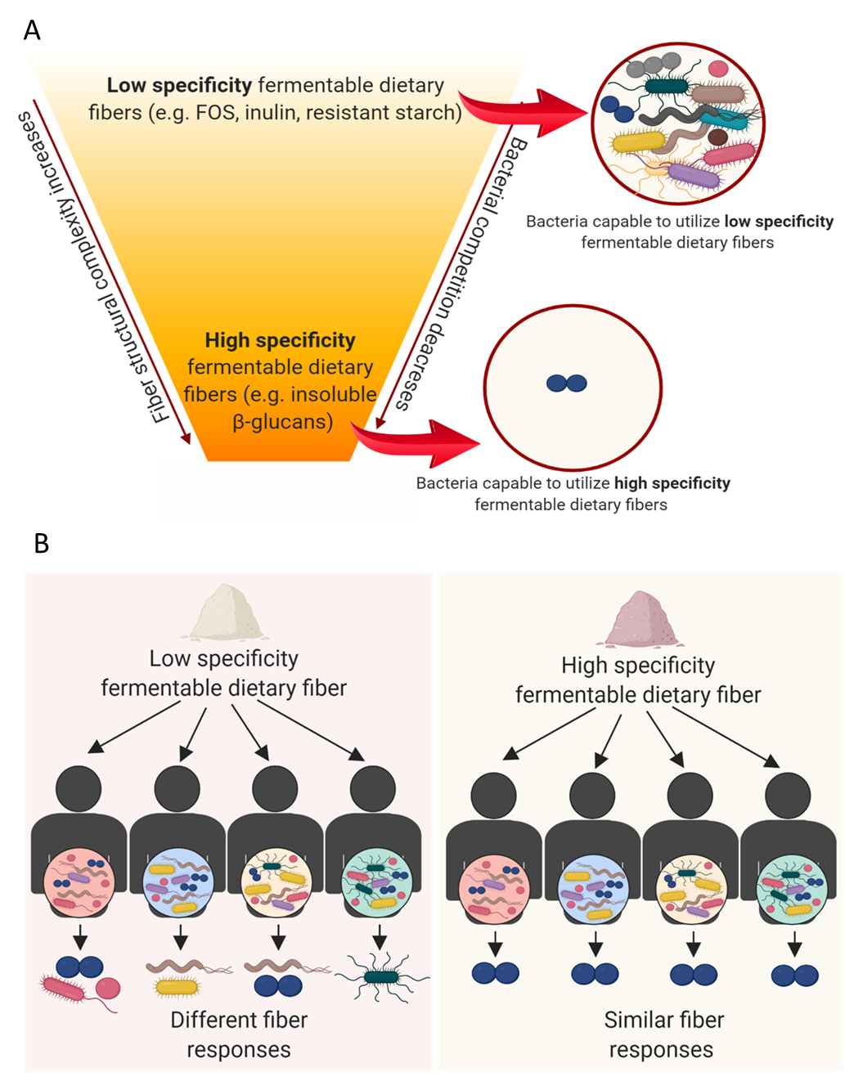
Differences in Responses Across People
Fiber Specificity Model
(Cantu-Jungles & Hamaker, 2020)

Slide 8
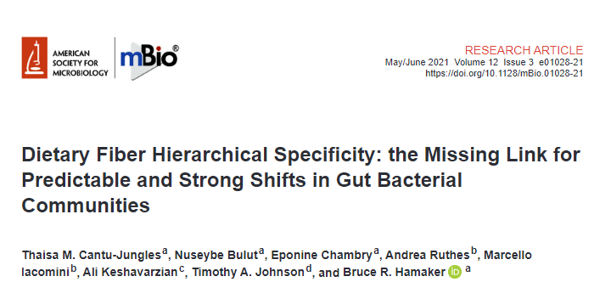
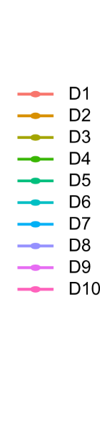
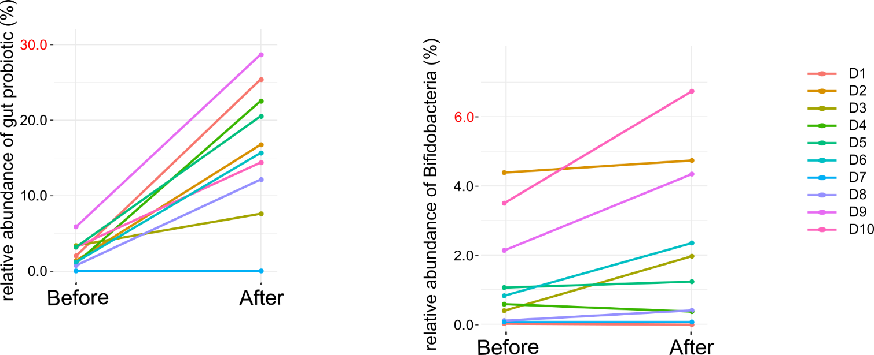
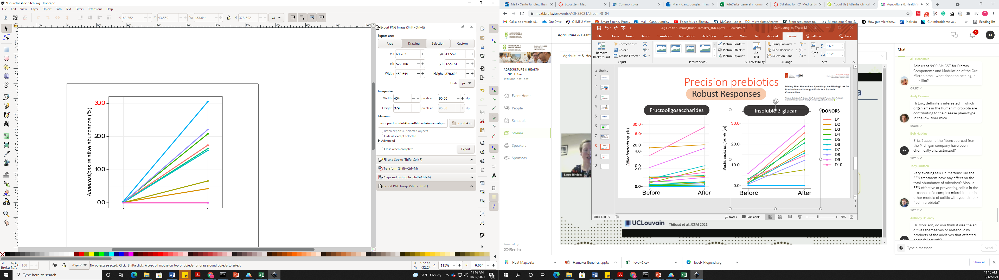
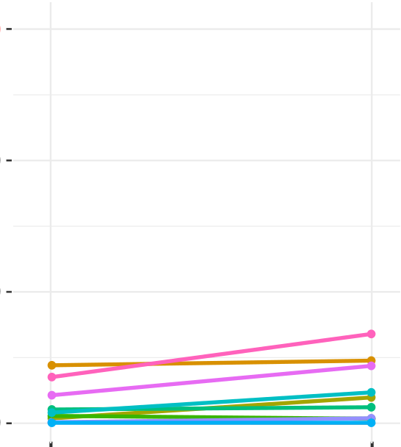
Fiber Specificity Model
Everyone benefits
Robust Responses
Low-specifcity (FOS)
High-specificity (β-glucan)
DONORS
30.0
30.0
6.0
20.0
20.0
Bifidobacteria sp. (%)
Anaerostipes sp. (%)
4.0
10.0
10.0
2.0
0.0
0.0
0.0

Slide 9
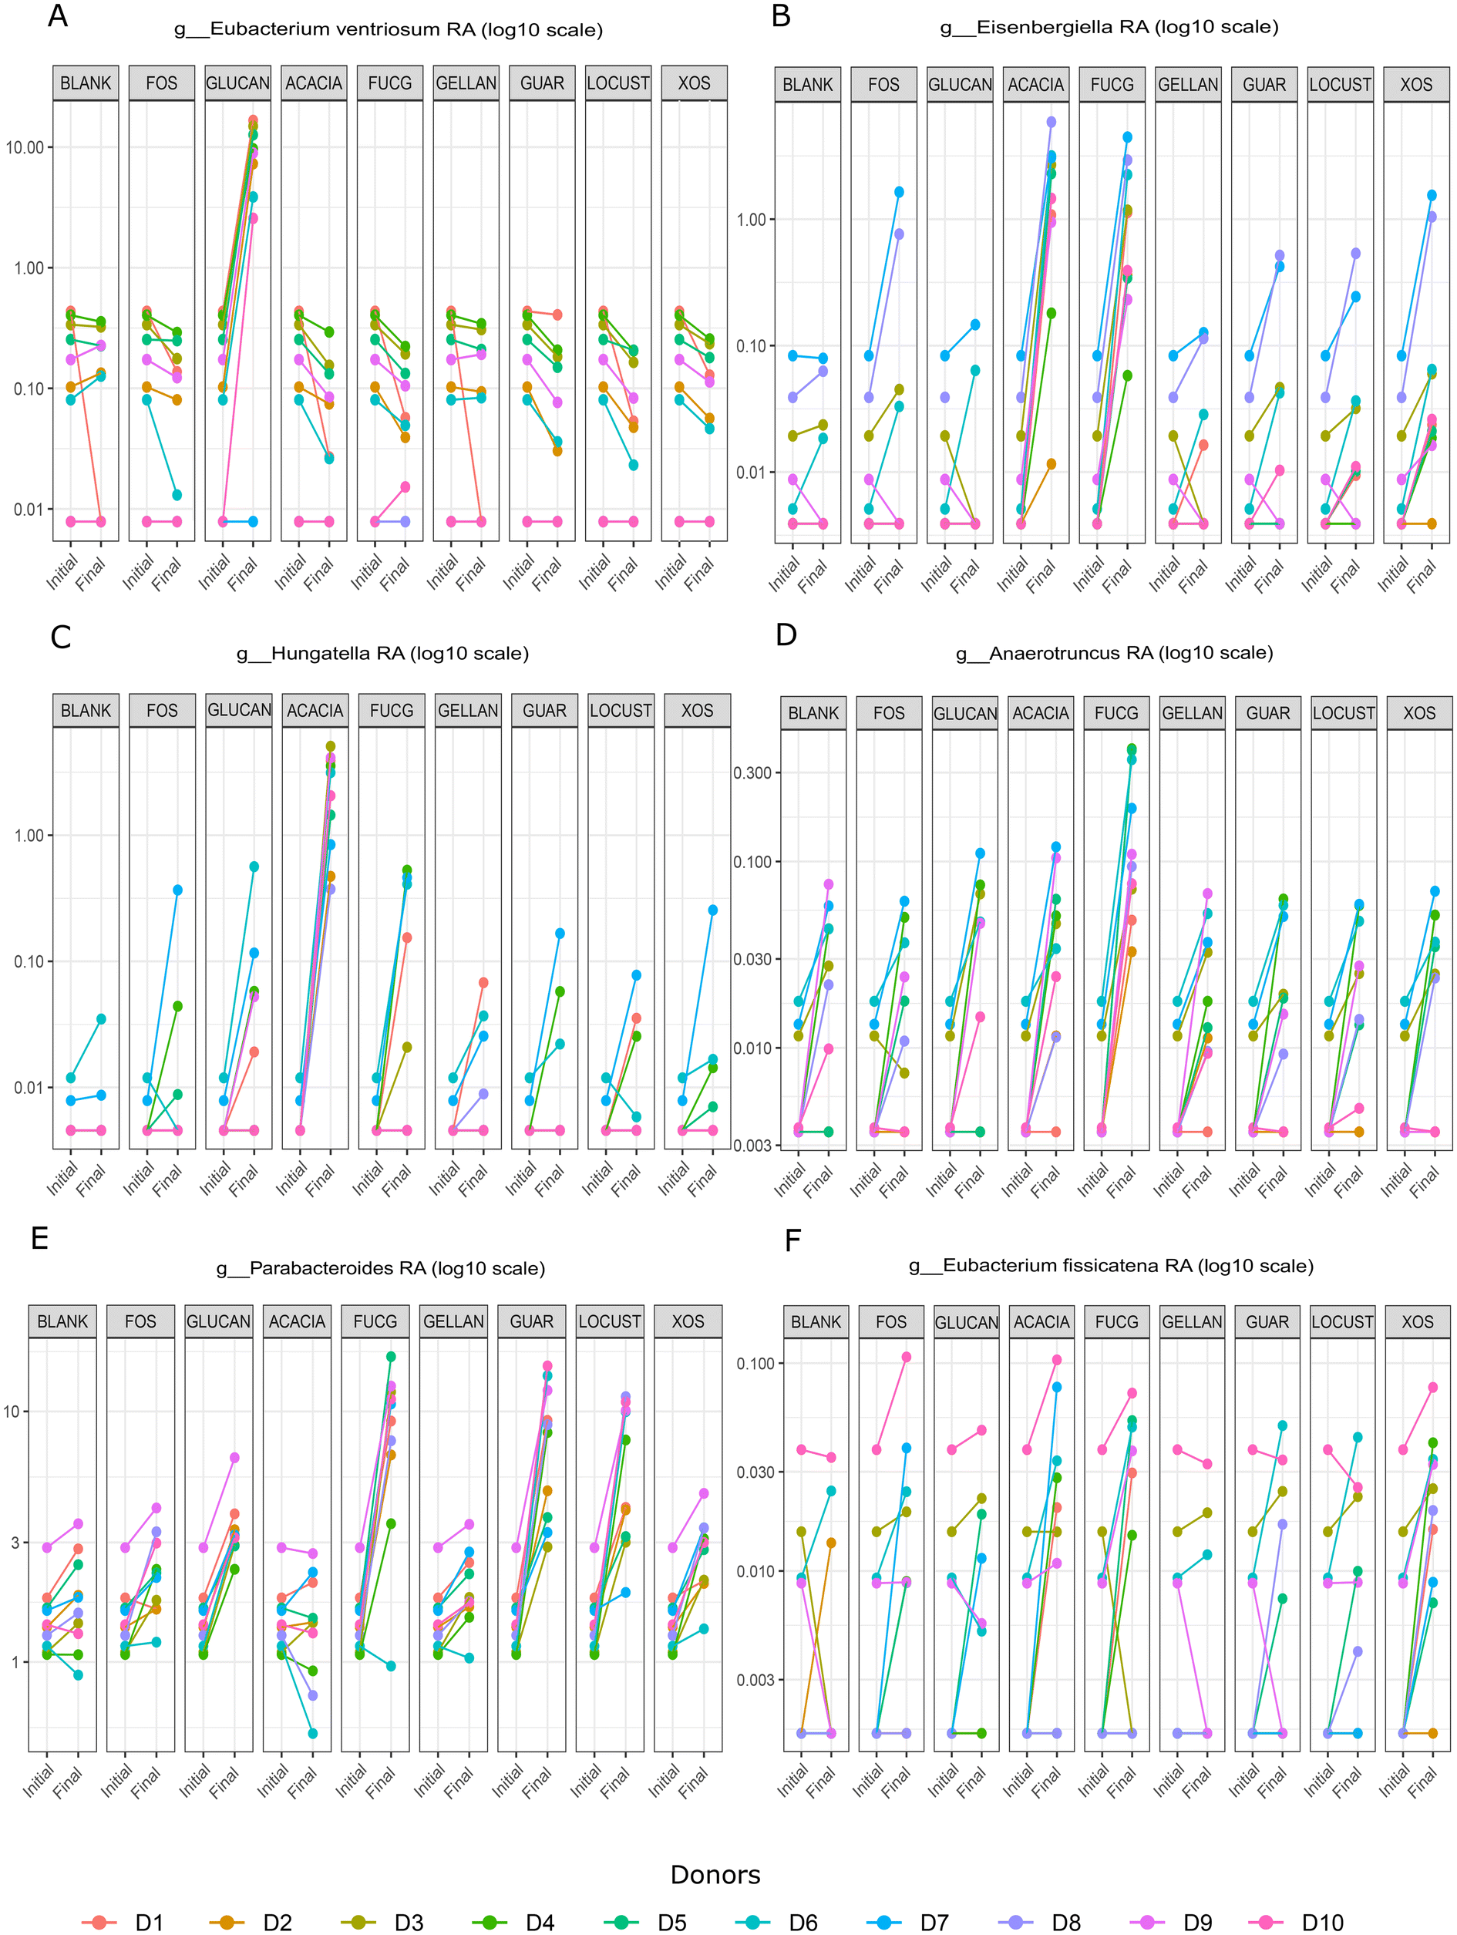

Other high-specificity fibers
In recent paper, identified other high-specificity fibers with predictable, high response in promoting one or more known beneficial bacteria

Slide 10
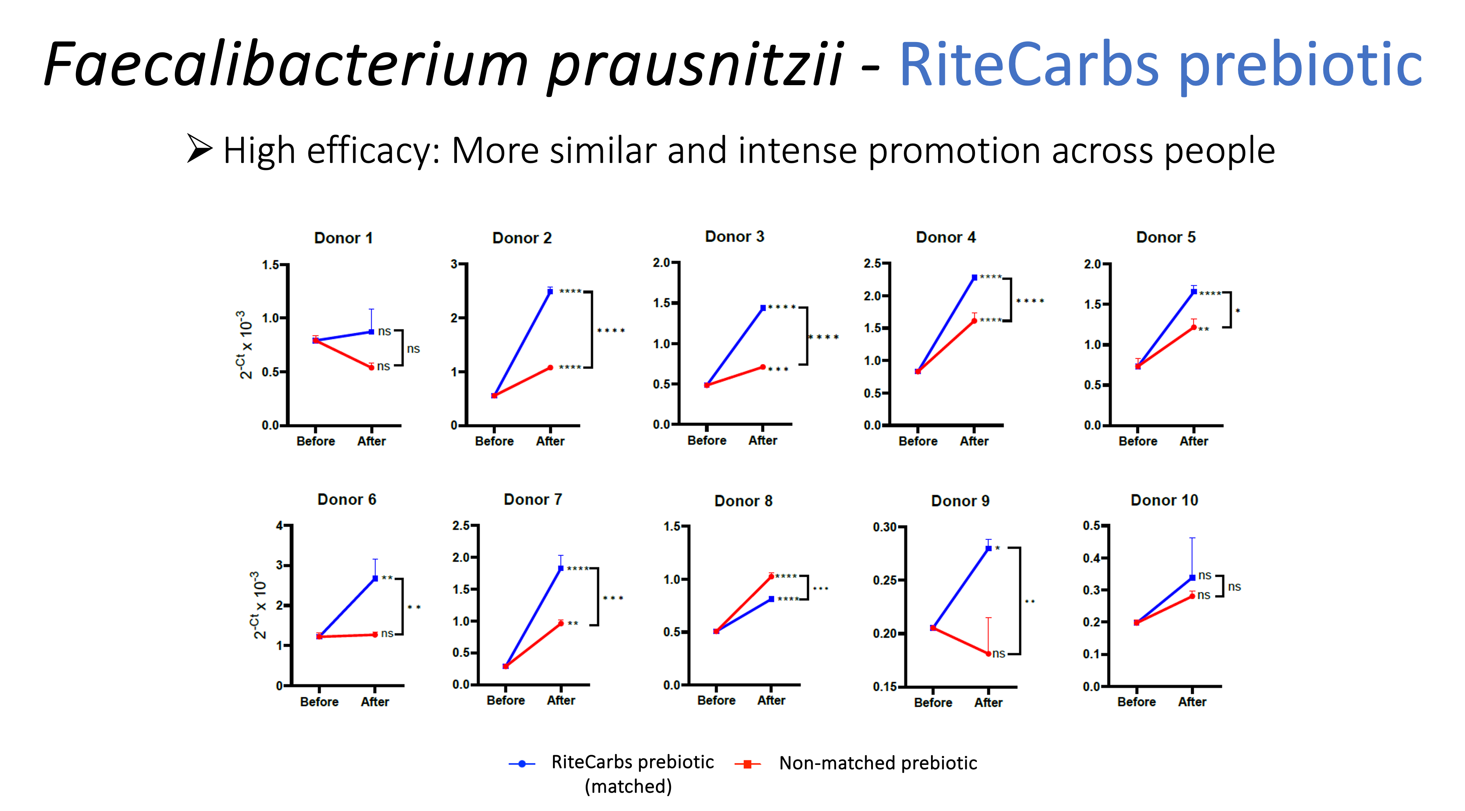
Prebiotics that
act like probiotics
Protocol for identifying bacteria-promoting prebiotics

Slide 11
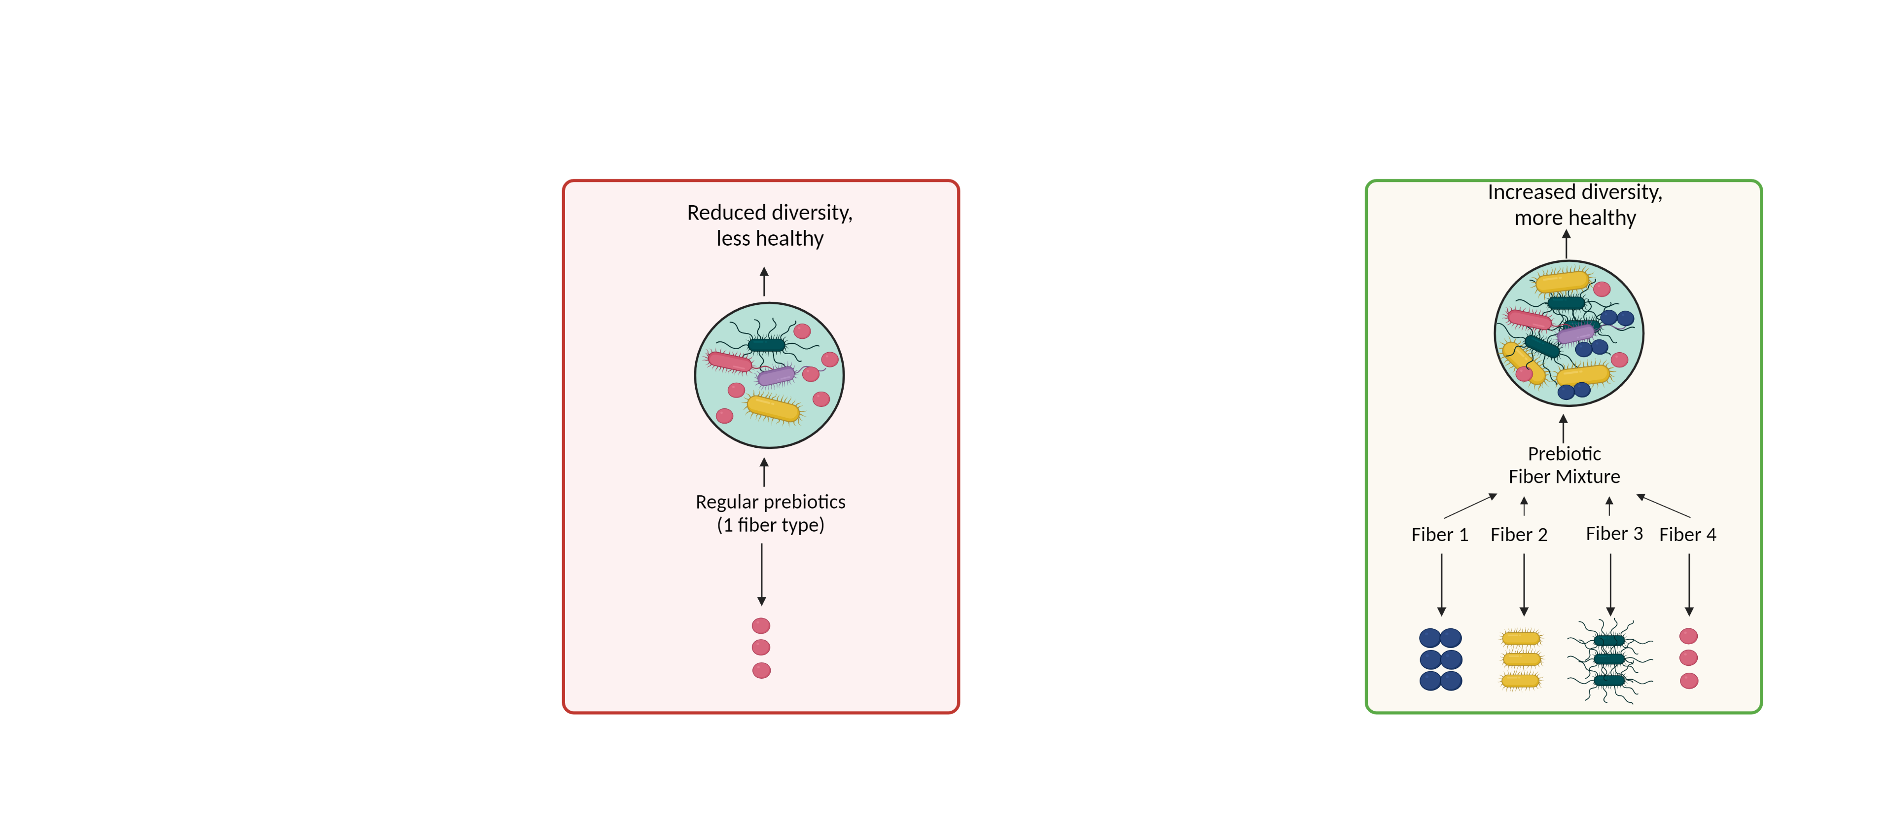
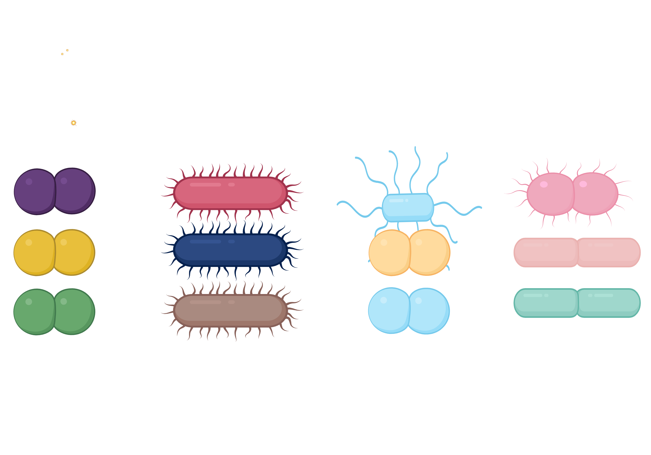
Science-based prebiotic mixtures
Group-matched prebiotics : Fibers that precisely align to groups of taxa
Blends of group-matched prebiotics : Support of core groups of beneficial bacteria in the gut

Slide 12
Science-based prebiotic mixtures
Most regular prebiotics are single fibers and do not well support gut health
A designed fiber mixture is able to support different health-related bacteria and promote gut health

Slide 13
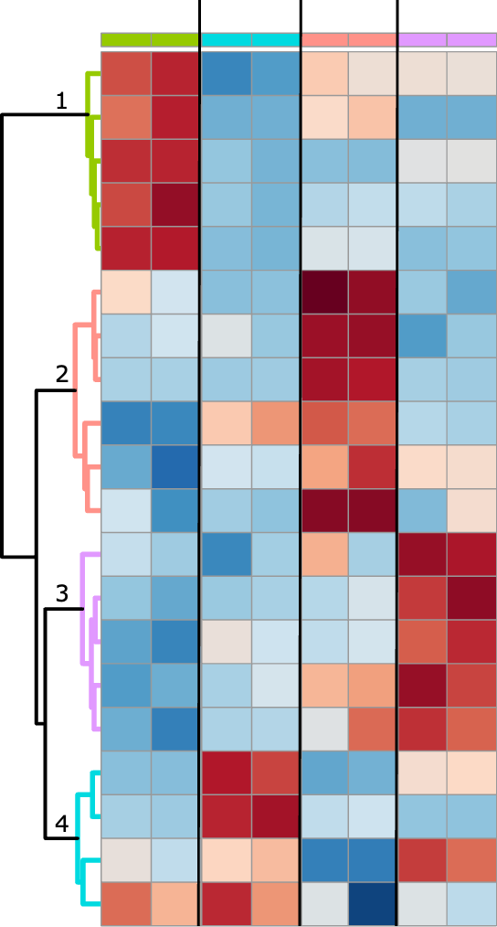
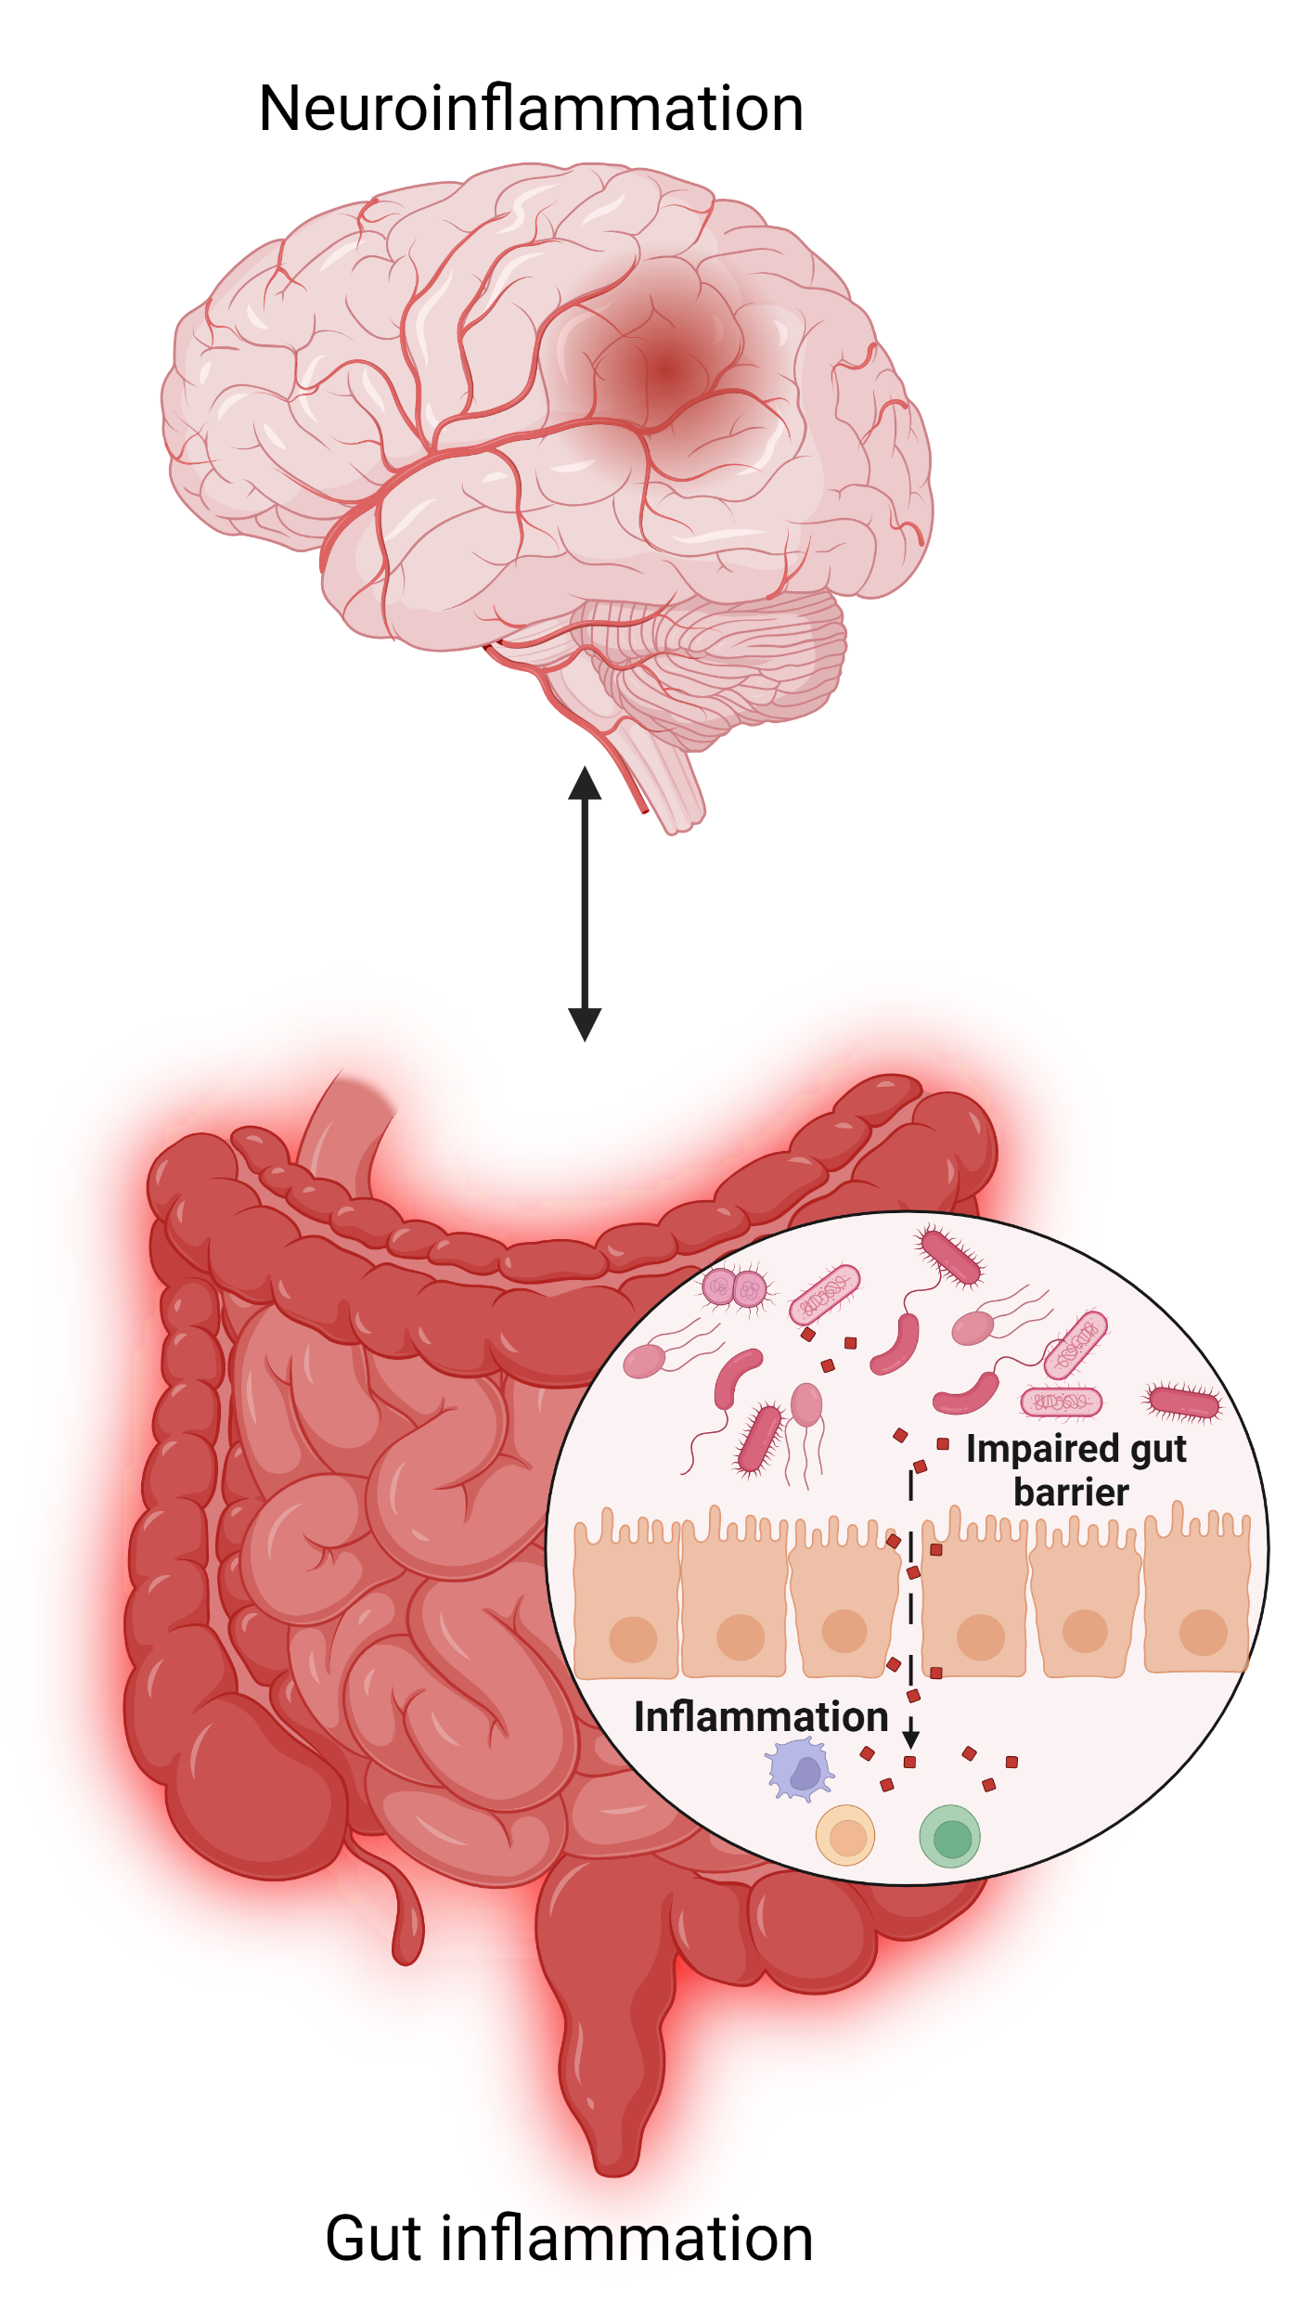
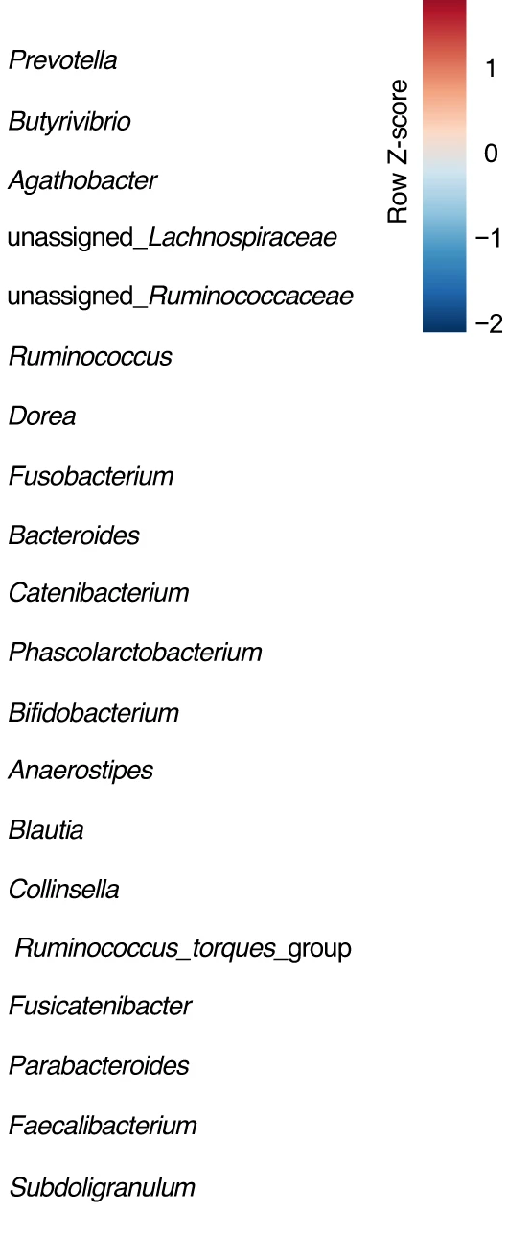

Parkinson’s Disease: Designed Mixture
Parkinson’s disease
Fiber B
Fiber C
Fiber D
Fiber A
Complementary groups of bacteria and metabolites are promoted with the designed prebiotic mixture

Slide 14
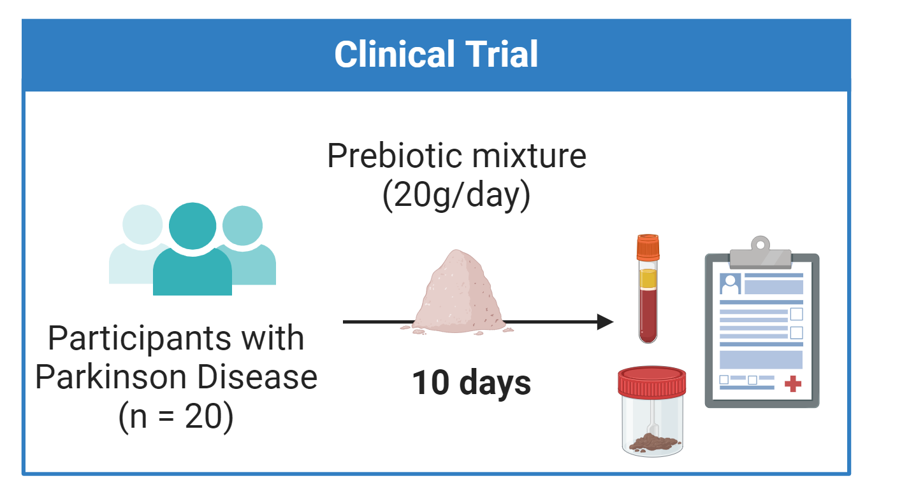
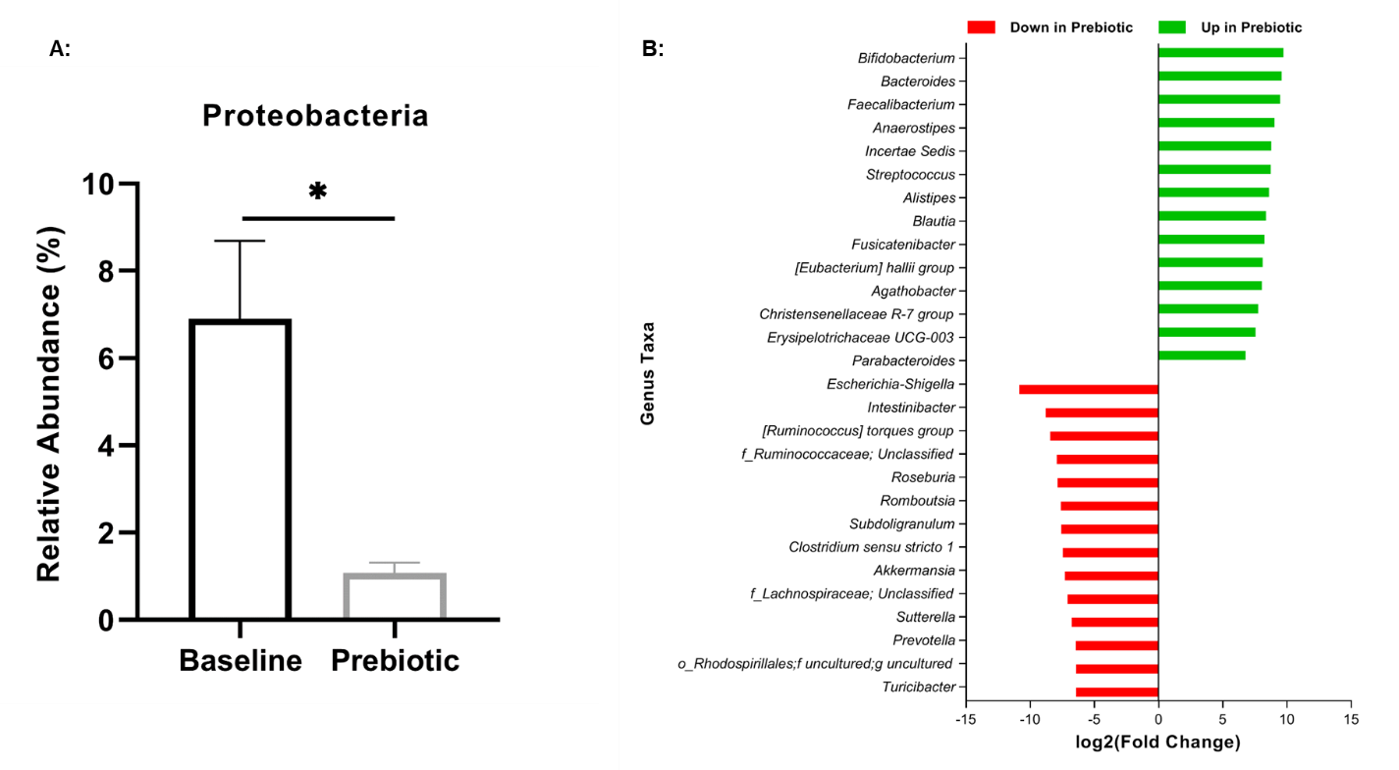
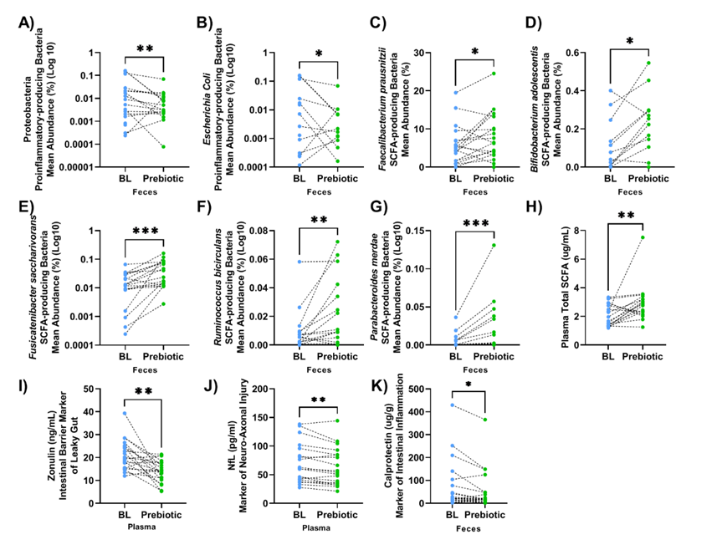
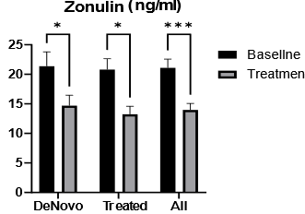
Parkinson’s Disease: Designed Mixture
1.
2.
*
Highly tolerable¹
Effective¹ in only 10 days to:
Promote a healthier balance of bacteria in the gut
Reduce intestinal inflammation
Improve gut barrier function
Reduce brain injury
3.
4.
*RiteCarbs (patent pending)
(Hall et al, Nat. Commun. 2023)

Slide 15
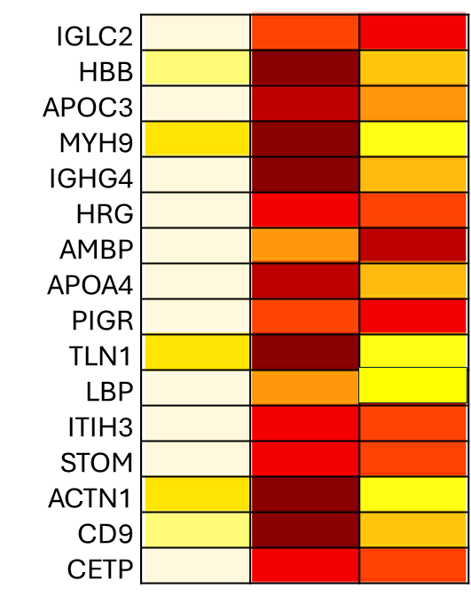
Designed prebiotic mixtures for core gut microbiota support – Parkinson Disease
Parkinson’s + Prebiotic
Parkinson’s
Healthy controls
Prebiotic treatment improved
Inflammation
Immune response
Neural development and repair
Dopaminergic neuron functions
Blood-brain barrier
Neurotransmission
Lipid metabolism
Food as medicine
s-medicine
Activation of pharma-targeted biochemical pathways
Serum proteins

Slide 16


Hypothesis
Designed mixture for Irritable Bowel Syndrome (IBS)
The previously designed prebiotic mixture is well tolerated and as effective (or more effective) than a wildly used probiotic in improving IBS-C symptoms.
Leading Commercial Probiotic
(Lactobacillus rhamnosus GG)
vs

Slide 17
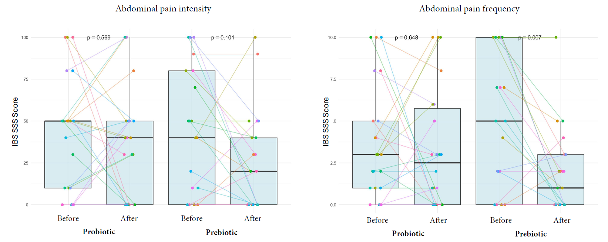
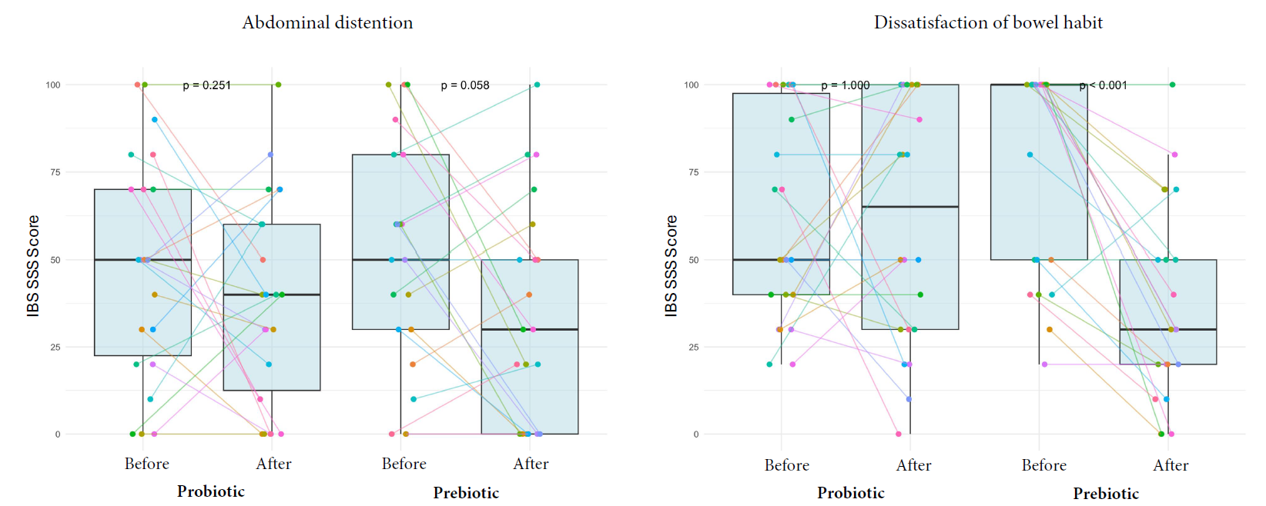
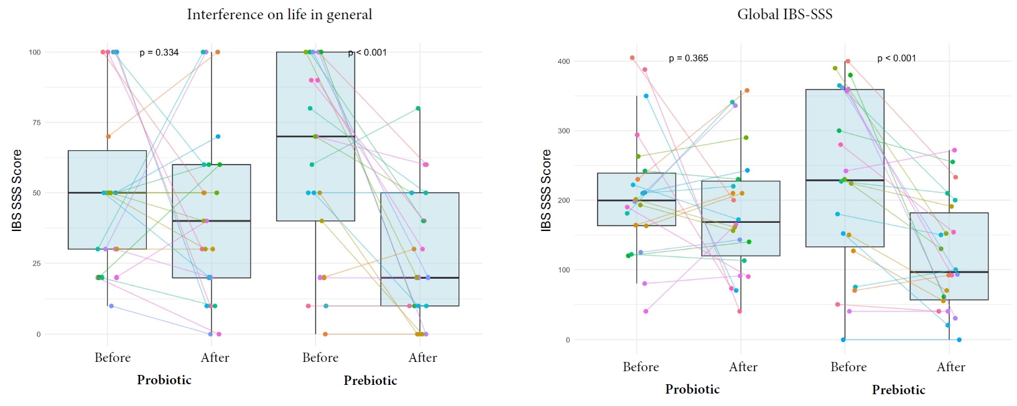
Designed mixture for Irritable Bowel Syndrome (IBS)
unpublished data

Slide 18
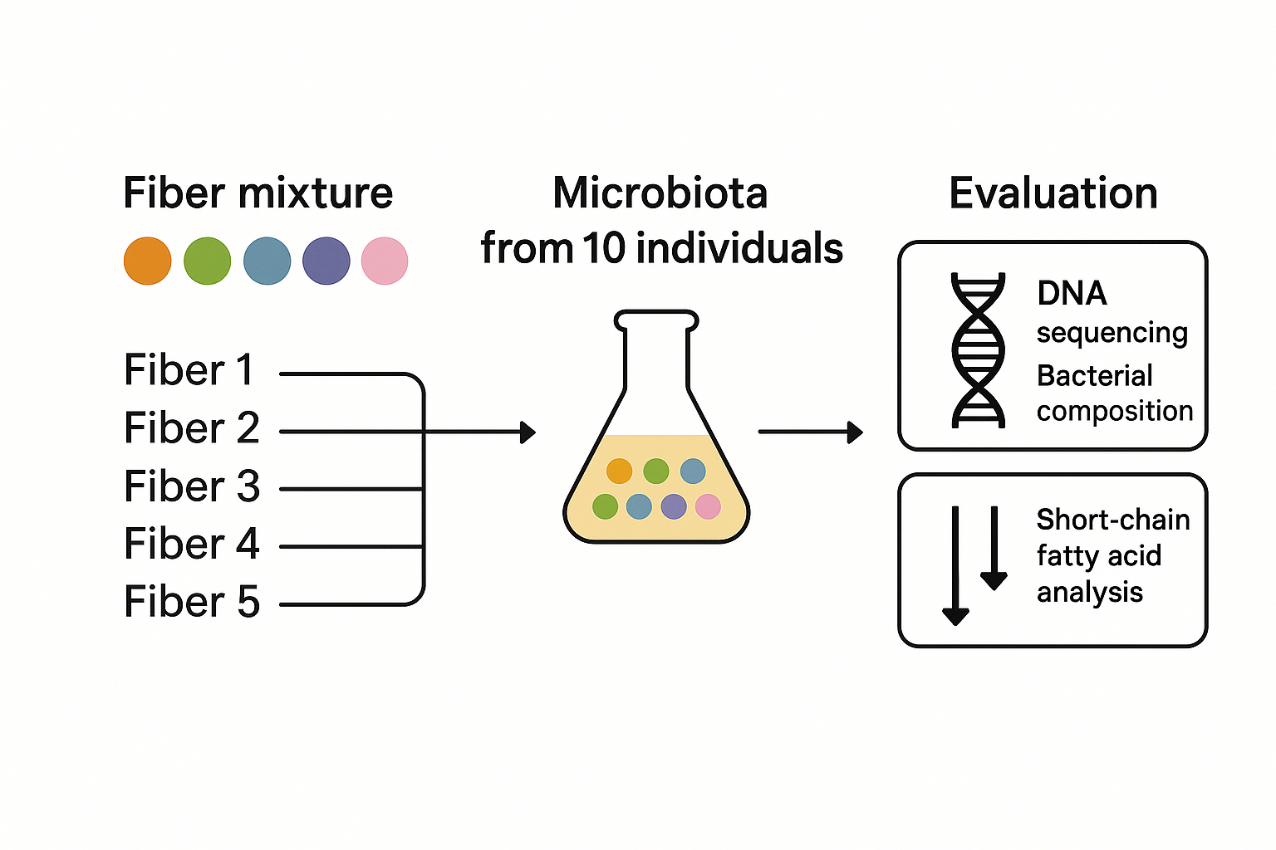
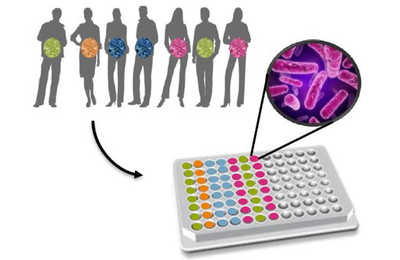
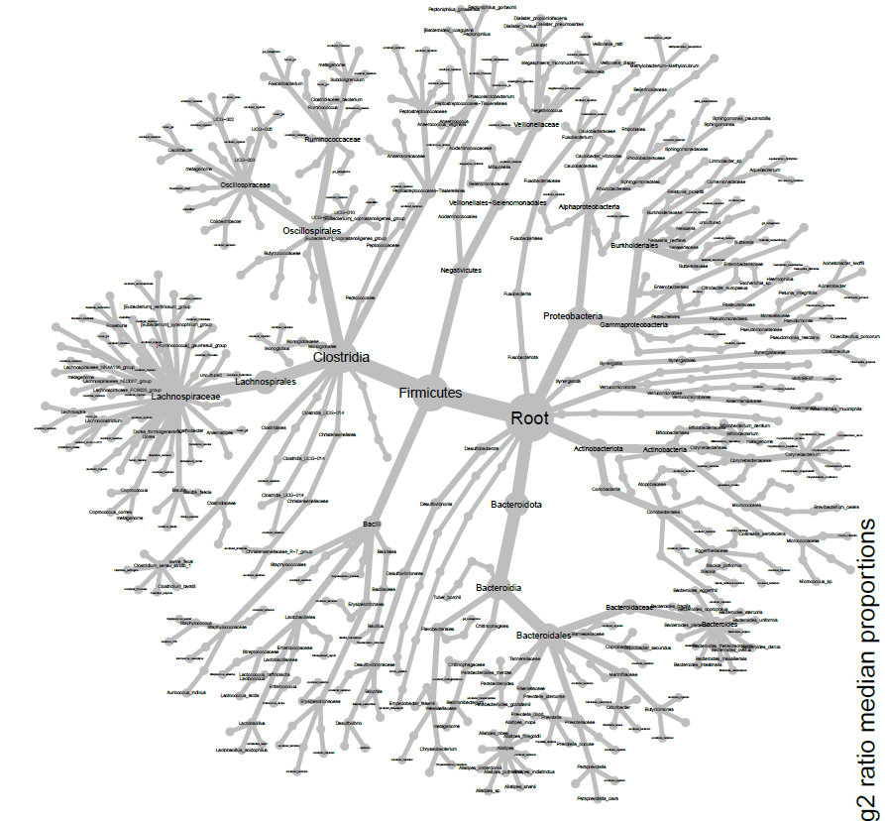
How it works
Collaboration: Frank Schuren (TNO)
Hypothesis:
Mixtures increase the number of beneficial bacterial taxa promoted
Mixtures increase consistency in response
18

Slide 19
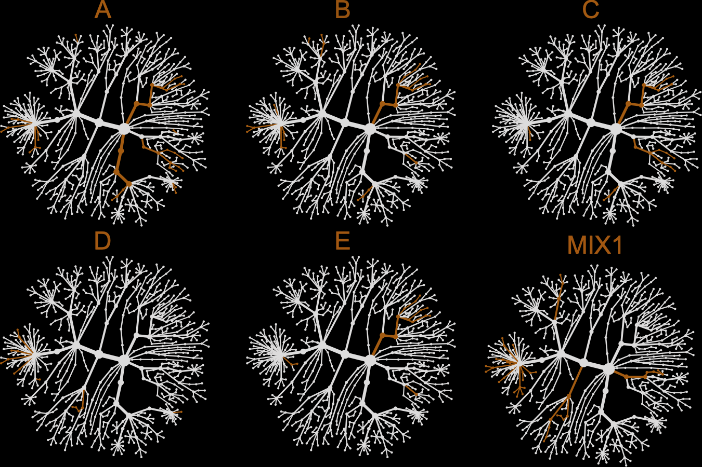
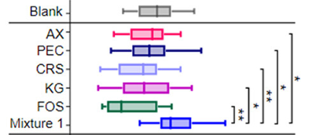
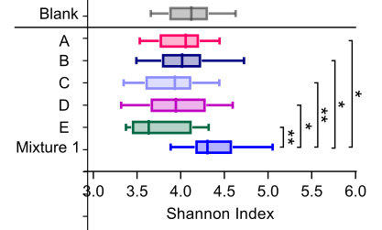
Fiber Mixtures – comparison to individual fibers
AX
PEC
CRS
KG
FOS
Mixture 1
Bacteria higher in fiber treatment
(Cantu-Jungles, T. M., et al. Gut Microbes 2025)

Slide 20

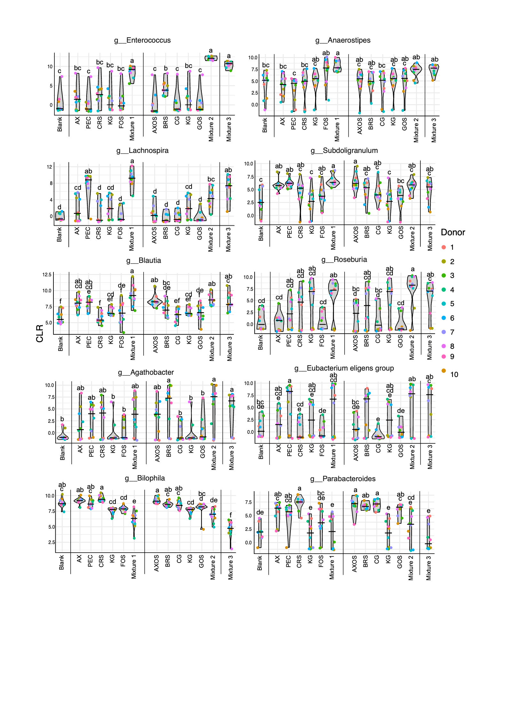
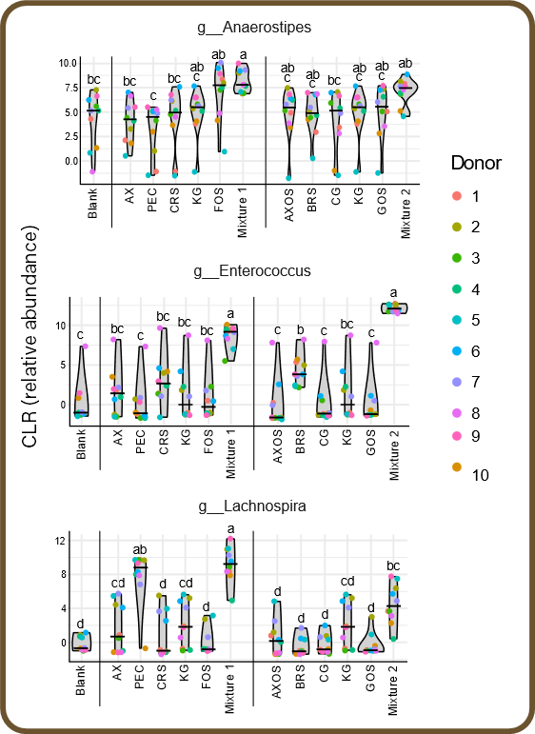
Fiber Mixtures – comparison to individual fibers
Provide support to a larger number of beneficial bacteria
Have more consistent responses in different individuals
Unexpected finding - synergistic interactions that:
Taxa that are not supported by any of the mixture components are supported by the mixture
(Cantu-Jungles, T. M., et al. Gut Microbes 2025)

Slide 21
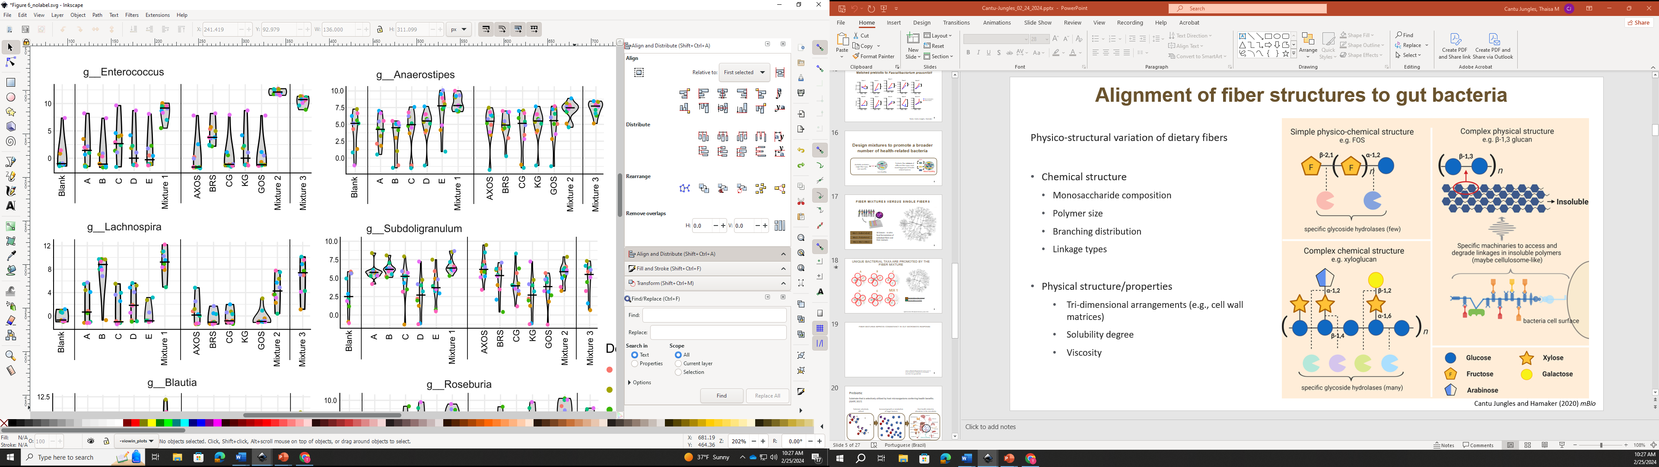
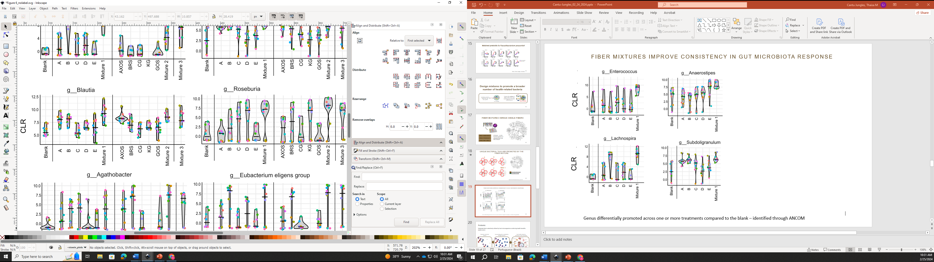
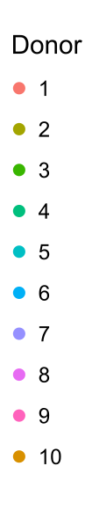
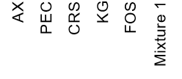
Fiber Mixtures – comparison to individual fibers
Average promotion by individual fibers
Genus differentially promoted across one or more treatments compared to the blank – identified through ANCOM
(Cantu-Jungles, T. M., et al. Gut Microbes 2025)

Slide 22
Fiber Mixtures – comparison to individual fibers
Provide support to a larger number of beneficial bacteria
Have more consistent responses in different individuals
Unexpected finding - synergistic interactions that:
Taxa that are not supported by any of the mixture components are supported by the mixture
Promote taxa at higher levels than expected
Cantu-Jungles, T. M., et al. Gut Microbes 2025

Slide 23
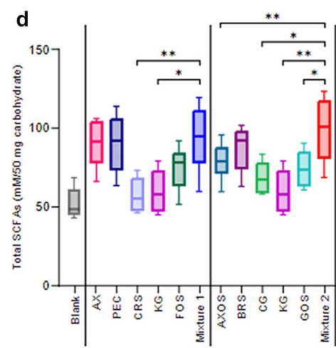
Fiber Mixtures – comparison to individual fibers
Provide support to a larger number of beneficial bacteria
Have more consistent responses in different individuals
Unexpected finding - synergistic interactions that:
Taxa that are not supported by any of the mixture components are supported by the mixture
Promote taxa at higher levels than expected
Boost short chain fatty acid production above expected
Cantu-Jungles, T. M., et al. Gut Microbes 2025

Slide 24
Further optimization by modeling

Slide 25
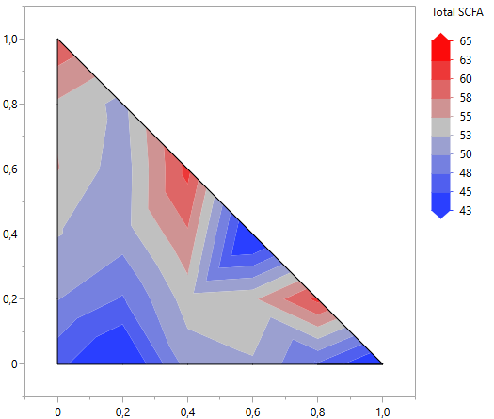
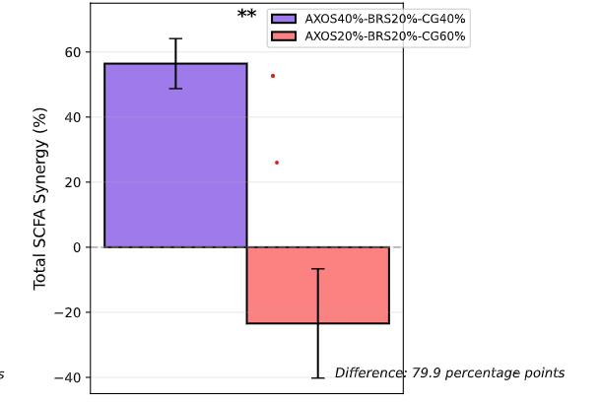
Complementarity of fibers leads to higher SCFA output
Fiber A
Fiber B
Random fiber mixtures can lead to reduction in SCFAs

Slide 26
Opportunities for predictable gut microbiome modulation with precision prebiotics
Individual fibers matched to specific gut bacteria for targeted, predicted, and common bacterial responses across individuals
Mixtures of fiber aligned to different health-related microbial groups to shape the core community and synergistically promote health
Tolerable
Optimized for
Health-related endpoints
Food product functionality

Slide 27

Purdue University
Whistler Center for Carbohydrate Research
745 Agriculture Mall Drive
West Lafayette, IN 47907-2009
whistlercenter@purdue.edu
www.whistlercenter.purdue.edu
QUESTIONS?
An Equal Access/Equal Opportunity University

