Slide 1

Impact of different protein sources on the gut microbiome: investigation of microbiome-mediated effects on gut health in an ex vivo study
Ingmar van Hengel, PhD
Director of Business Development
Cryptobiotix

Slide 2
Cryptobiotix and the SIFR® technology

Slide 3






The company
Cryptobiotix: preclinical CRO / research services
Founded in 2021; Belgium
Today: 15⁺ FTE’s + 3 part-time
SIFR® technology pipeline
(Systemic Intestinal Fermentation Research)
Gastrointestinal simulation
Digestion
Gut microbiome
Interaction with host
Human & animal GI simulation
Testing actives (pharma) & ingredients (food/feed)
CEO & co-founder
CSO & co-founder
Director of BD
BD Manager
Project Manager

Slide 4



Gut health product development requires predictive data
Screening
In-depth mechanistic characterisation
Clinical
predictive for
Clinical data
Preclinical SIFR® data
Market
Health claim
SIFR® in prism mode
Anticipate clinical variation
De-risk product development
SIFR® in screening mode
Discovery
Notes:
USA - FDA Modernisation Act 2.0: remove the requirement for animal trial
European Parliament - Directive 2010/63/EU, works on the development and promotion of non-animal approaches to testing and research

Slide 5
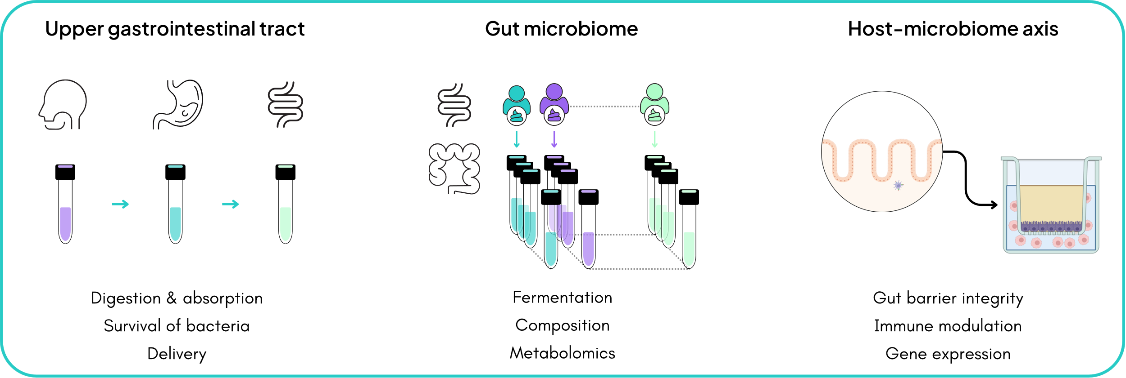
SIFR®: modular simulation technology

Slide 6
Preclinical study

Slide 7
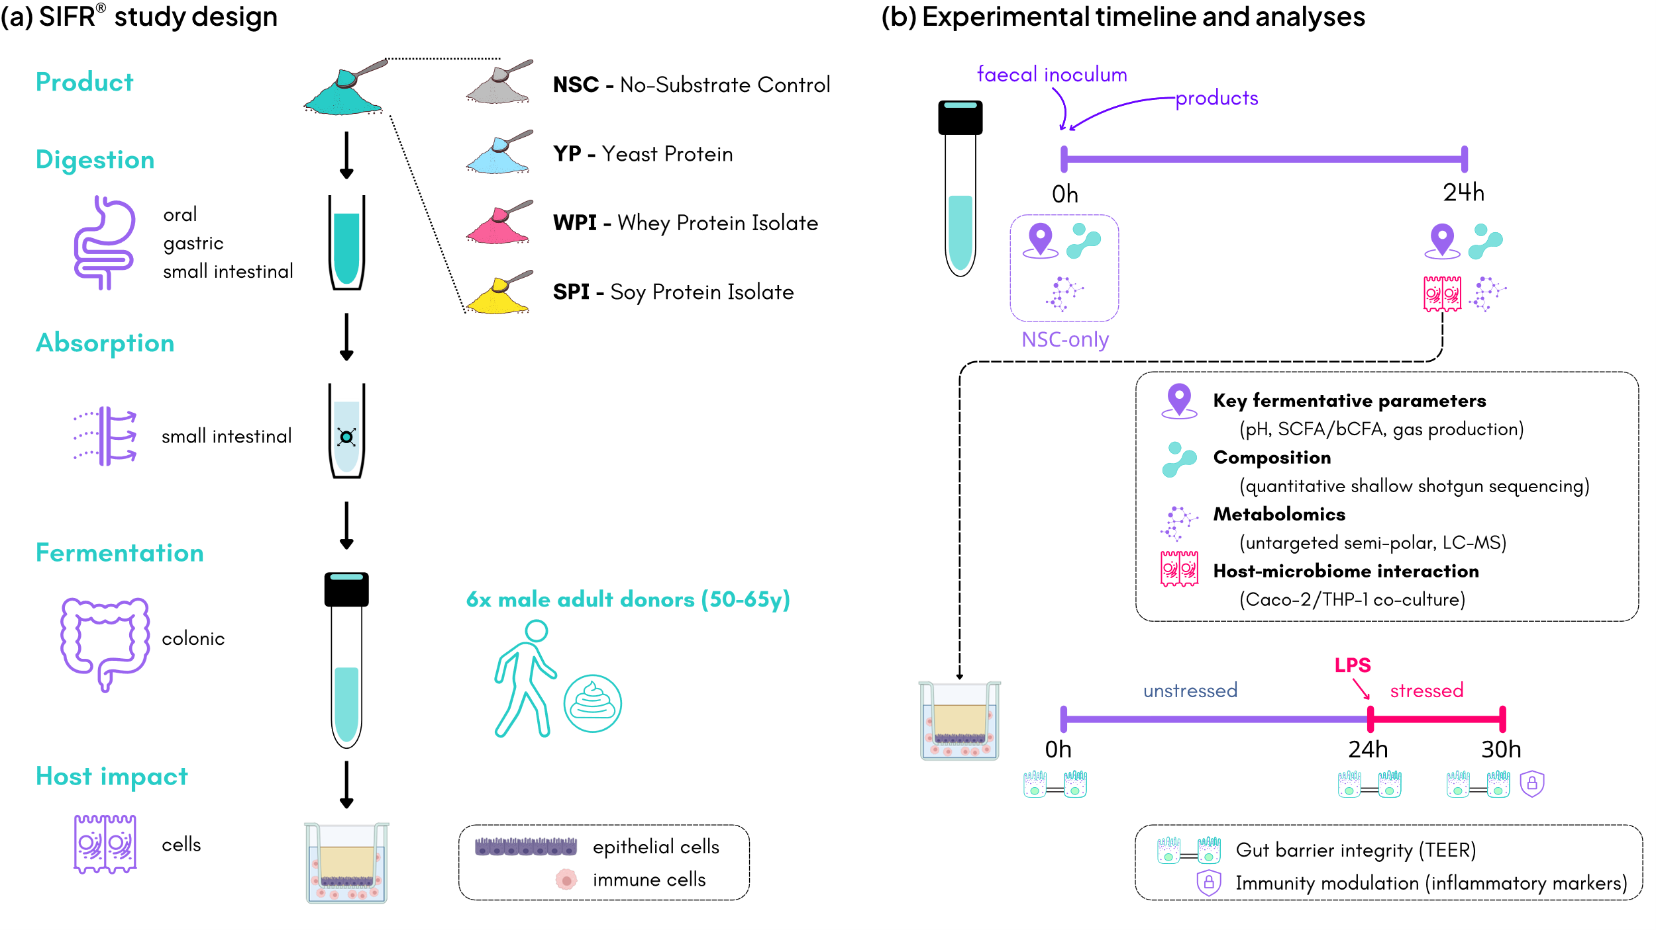
Study aim & experimental setup
Compare impact of different protein sources on gut health
Yeast protein (YP), whey protein isolate (WPI) and soy protein isolate (SPI), tested at 40g/day
Focus on healthy aging: donors 50-65 y.o.
Manuscript submitted

Slide 8
SIFR®: modular simulation technology

Slide 9
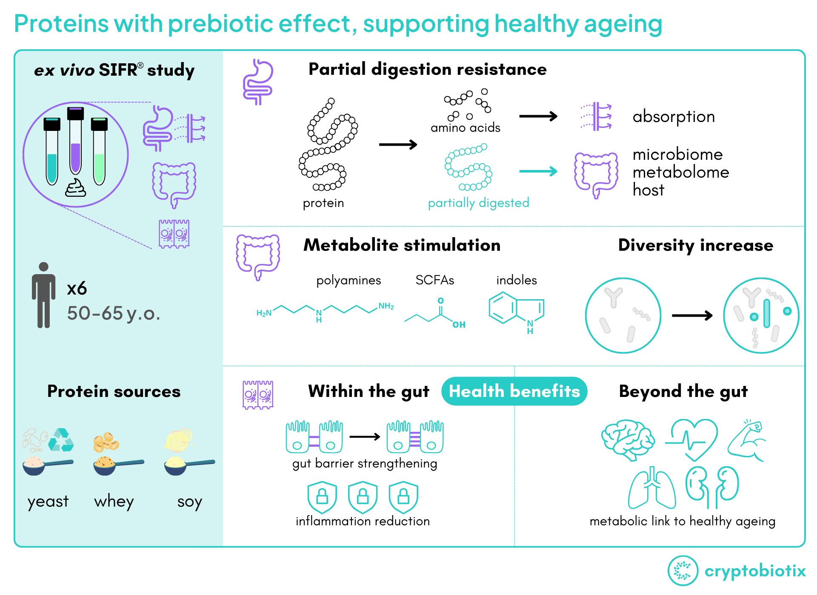
Outcomes

Slide 10
Key fermentative parameters
Product-specific effects

Slide 11
SCFA & gas production
Enhanced SCFA and gas production
Gas production
SCFA/bCFA

Slide 12
Microbiota composition

Slide 13
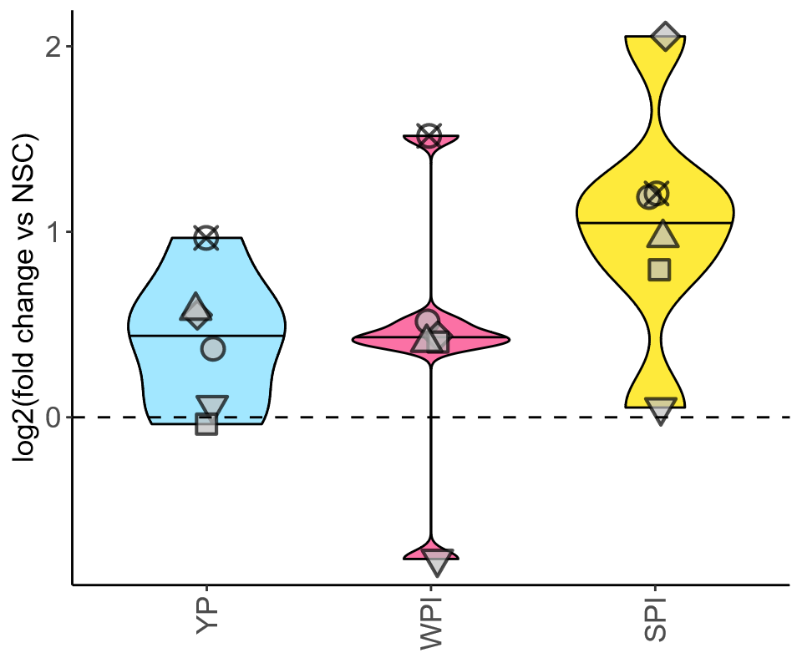
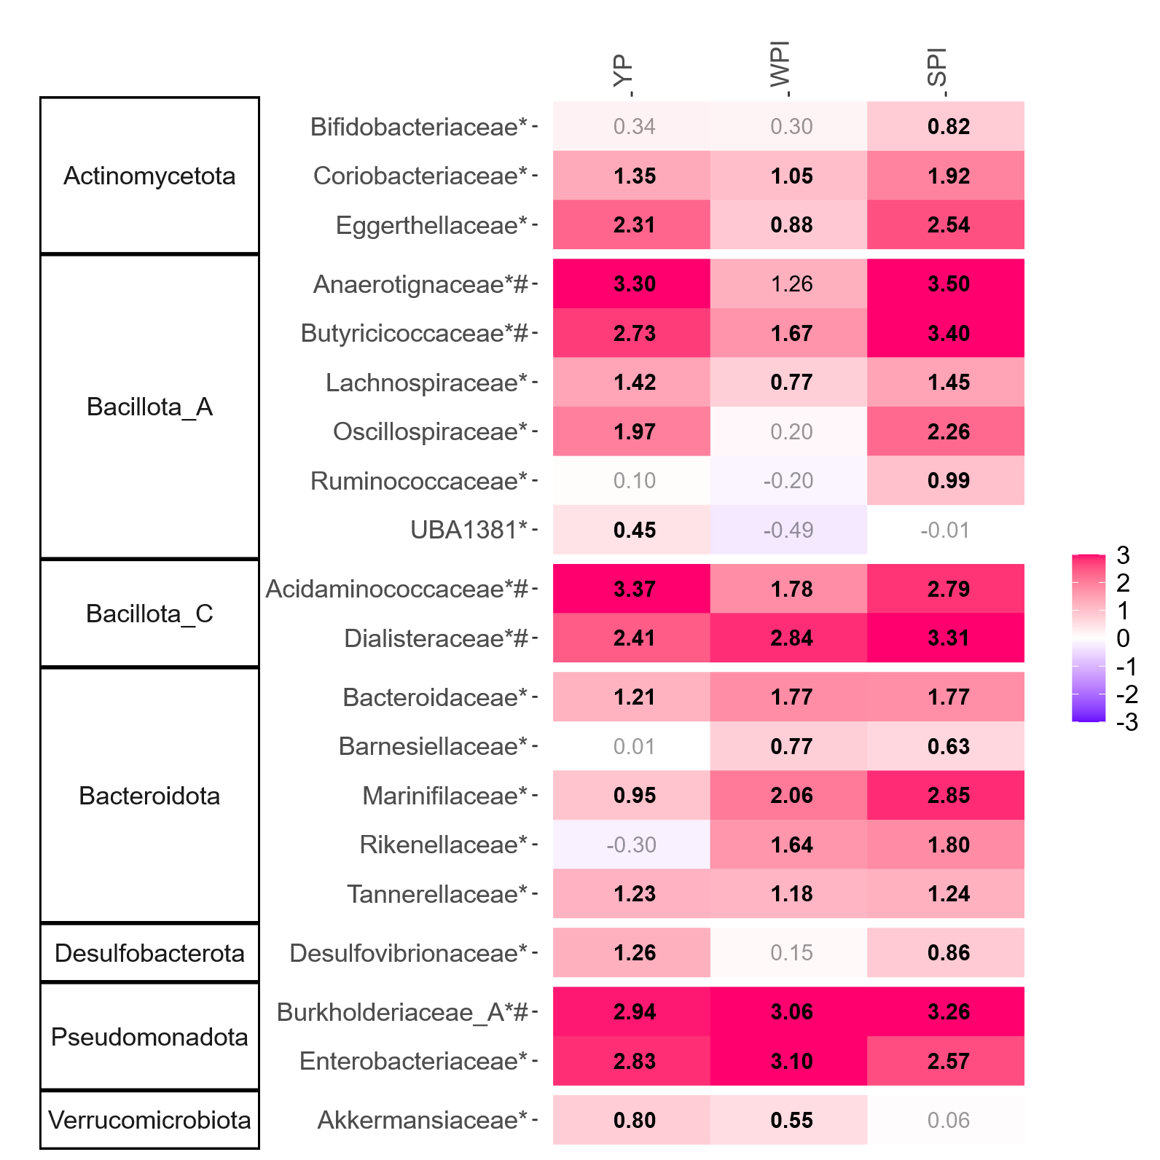
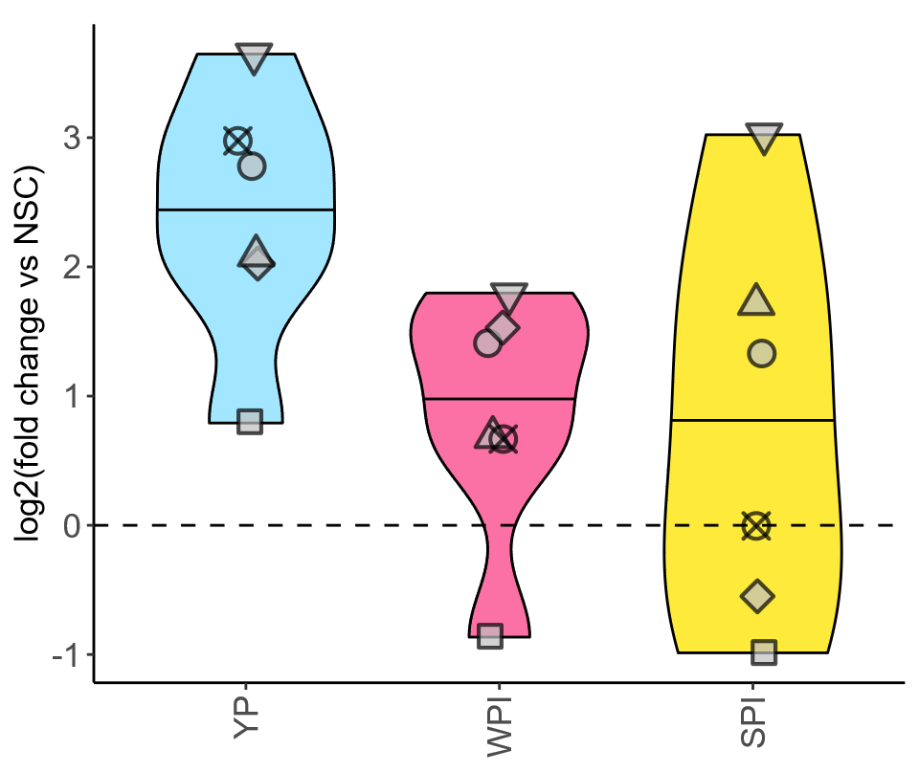
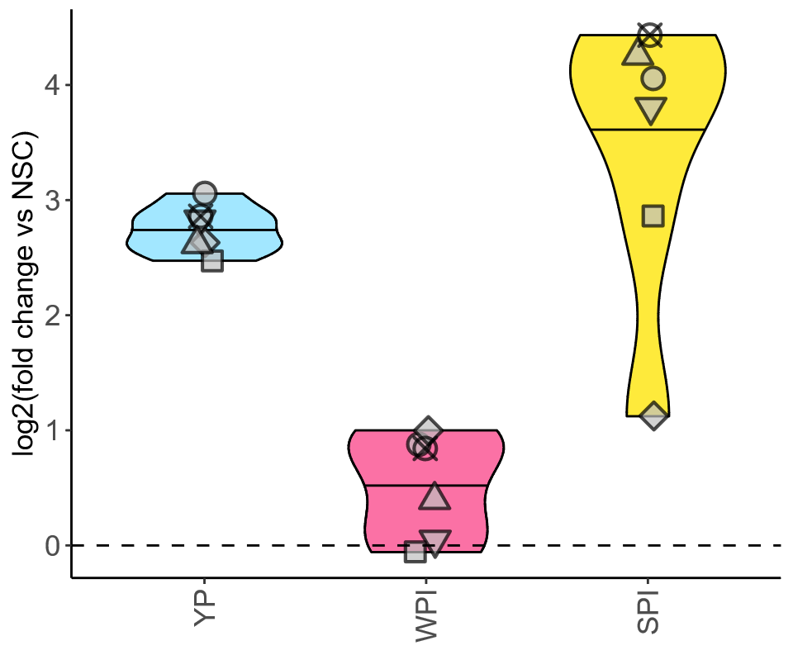
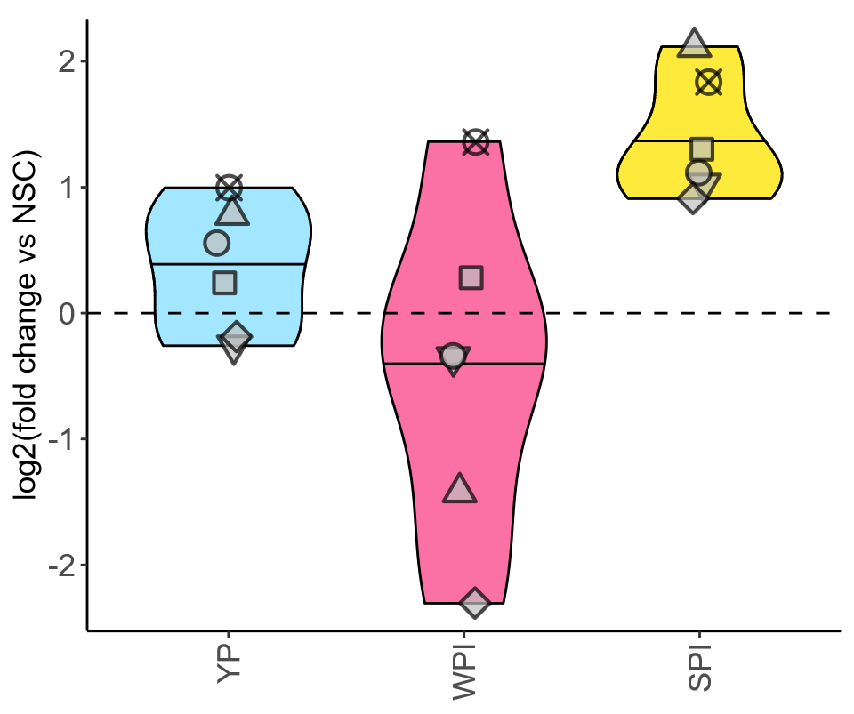
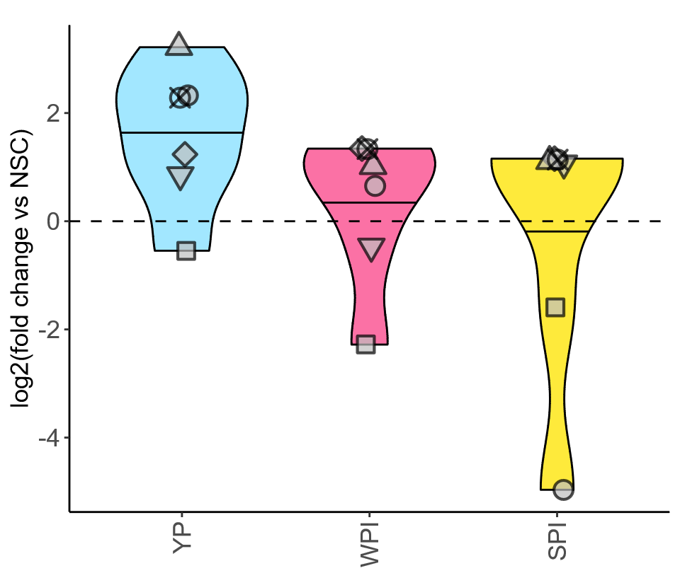
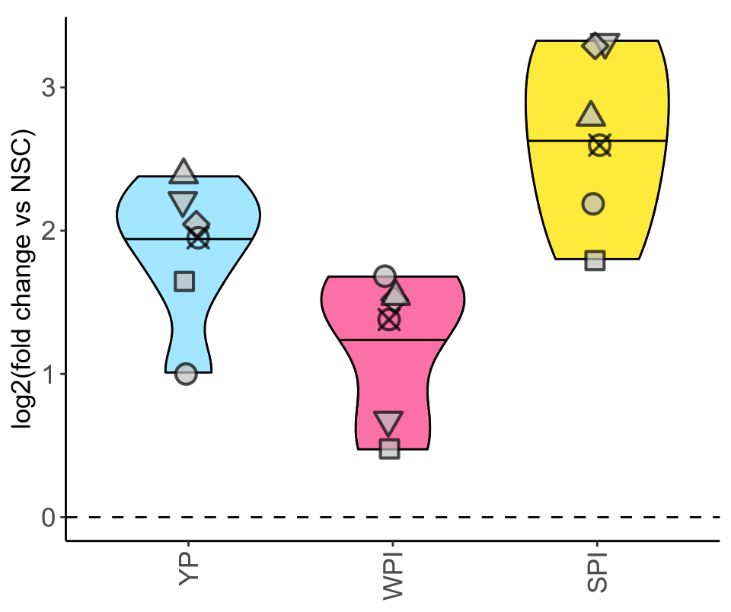
Microbial shifts
Bifidobacterium adolescentis
Large number of phyla impacted
Anaerostipes hadrus
Roseburia hominis
F. prausnitzii
Butyrate
producers
Bacteroides thetaiotaomicron
Bacteroides uniformis
Acetate/propionate
producers

Slide 14
Microbiota diversity and composition
Diversity strongly enhanced by all proteins
Microbiota diversity
Microbiota composition (phylum)

Slide 15
Microbiota diversity

Slide 16
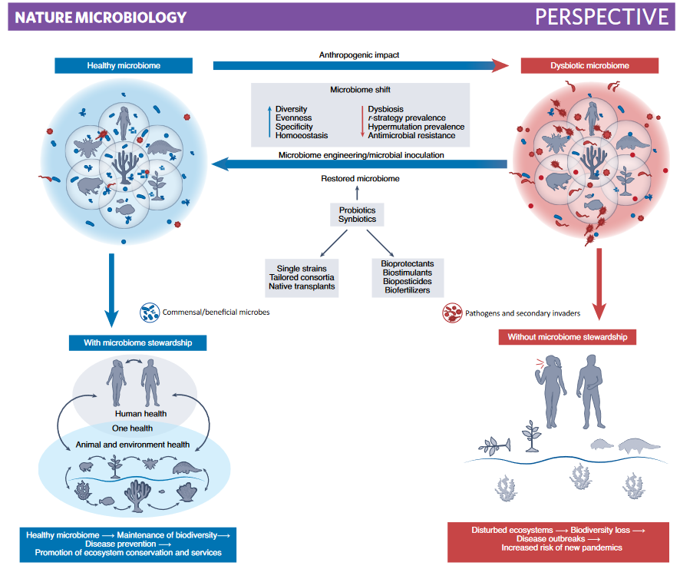
α-diversity
Important for planetary health
Diversity loss in human gut microbiome ~ “The Invisible Extinction”
Industrialization: antibiotics, C-section, processed foods, …
Diseases: diabetes, cancer, asthma, autism, …
Develop strategies to protect/promote diversity
→ Need for tools to quantify diversity
Peixoto et al., 2022, Nature Microbiology
Notes:
The Invisible Extinction

Slide 17
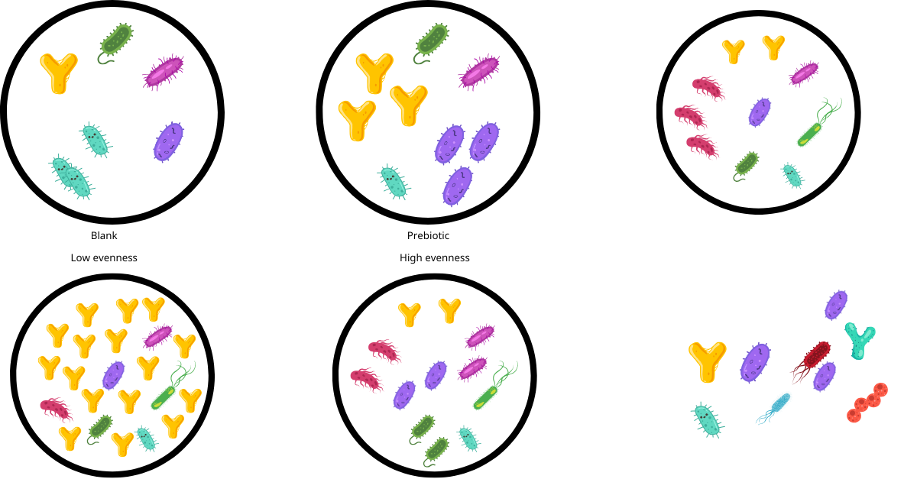
Current indices to assess microbiome α-diversity
Species richness = higher as more taxa are present
Observed number of species → 7
Chao1 index → 10
Species evenness = higher as taxa are more evenly distributed
Reciprocal Simpson index
Shannon index
Low evenness
High evenness

Slide 18
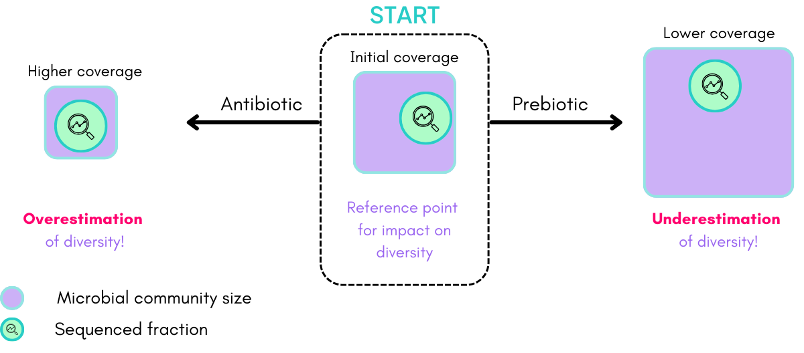
Bias in diversity indices
Current indices = biased by unequal sampling depth
Cell density is not accounted for

Slide 19
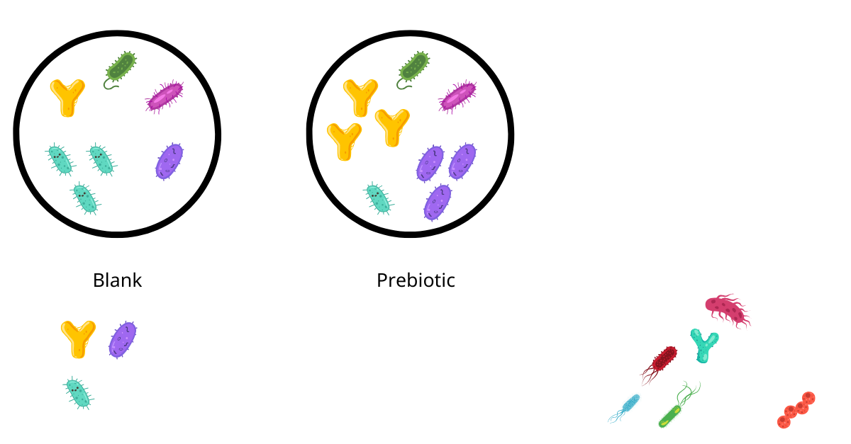
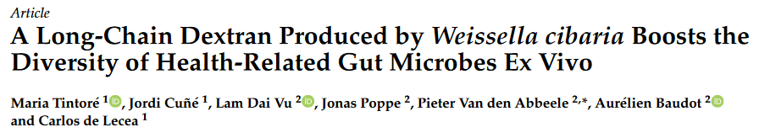
Community modulation score (CMS): new diversity index
Blank
Prebiotic
Take home message:
CMS > 0 → product increases diversity
CMS < 0 → product reduces diversity
Positive CMS (CMS⁺): # species stimulated
Negative CMS (CMS⁻): # species inhibited
Combined CMS (CMS⁺ − CMS⁻): nett # species stimulated
Overall: beneficial effect on diversity!
= 2
= 1
cryptobiotix.com/scientific-evidence/long-chain-dextran-diversity/

Slide 20
Carob & acacia fibres: boost microbiota diversity
Carob+Acacia: positive impact on microbiota diversity
Combined CMS: +29 species
+38
Positive CMS
Negative CMS
-9

Slide 21
Metabolites & gut health

Slide 22
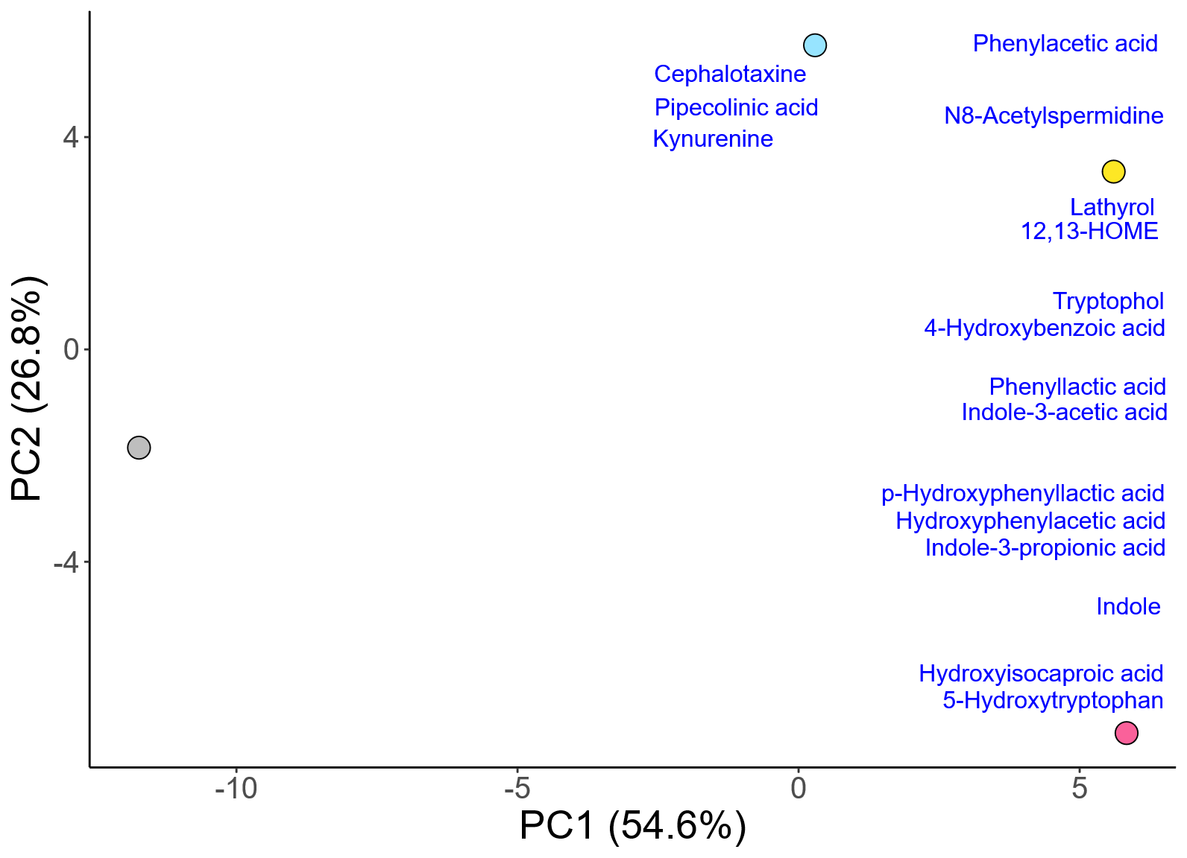
Metabolite profile
Wide spectrum of metabolites impacted
(78 significantly impacted metabolites)
YP
SPI
Proteins impact gut metabolome
Protein-specific effects
NSC
WPI

Slide 23
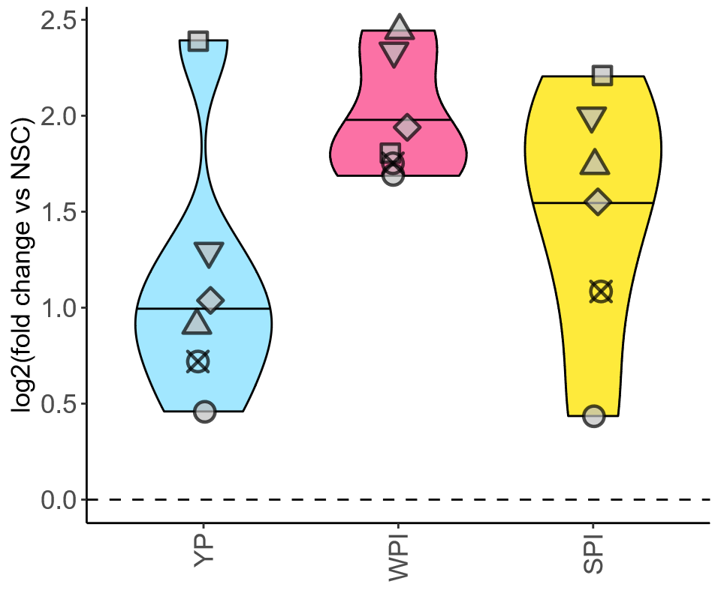
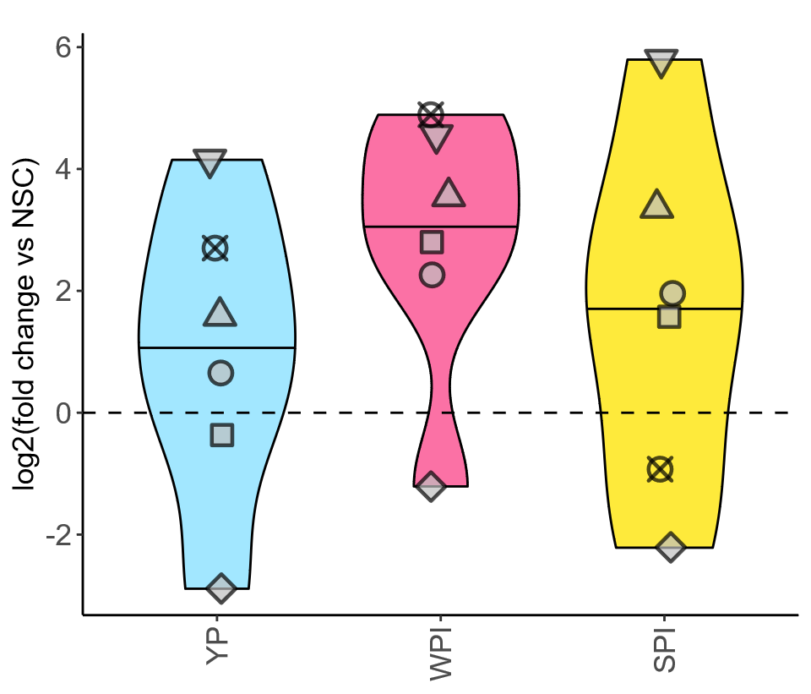
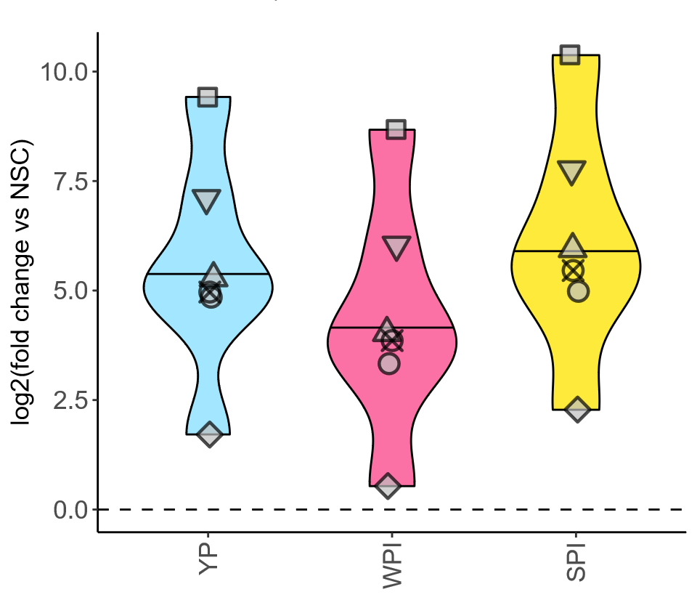
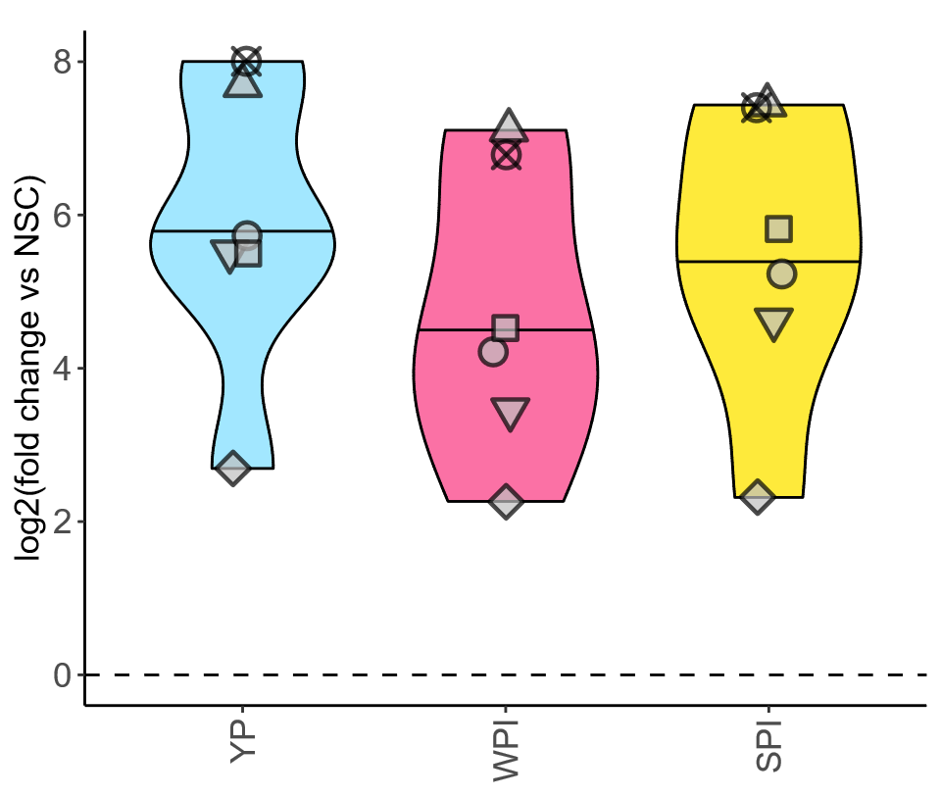
Metabolite profile
IPA
immunity
Agmatine
neuroprotective
Putrescine and spermidine
longevity
Indole-3-propionic acid (IPA)
N-Acetylagmatine
N-Acetylputrescine
N8-Acetylspermidine

Slide 24
Impact on gut health
All proteins: supported gut barrier integrity & immune function
Yeast protein → strongest impact on gut barrier integrity
Soy protein isolate → strongest reduction of pro-inflammatory cytokines
Gut barrier integrity
Immune function
Anti-inflammatory
Pro-inflammatory
Unstressed (24h)
Stressed (30h)

Slide 25
Conclusion

Slide 26
Conclusion
All proteins supported gut health
Promotion of gut barrier integrity
Reduced inflammation
Protein specific results:
Metabolic profiles
Yeast protein → barrier integrity
Soy protein isolate → less pro-inflammatory cytokines

Slide 27
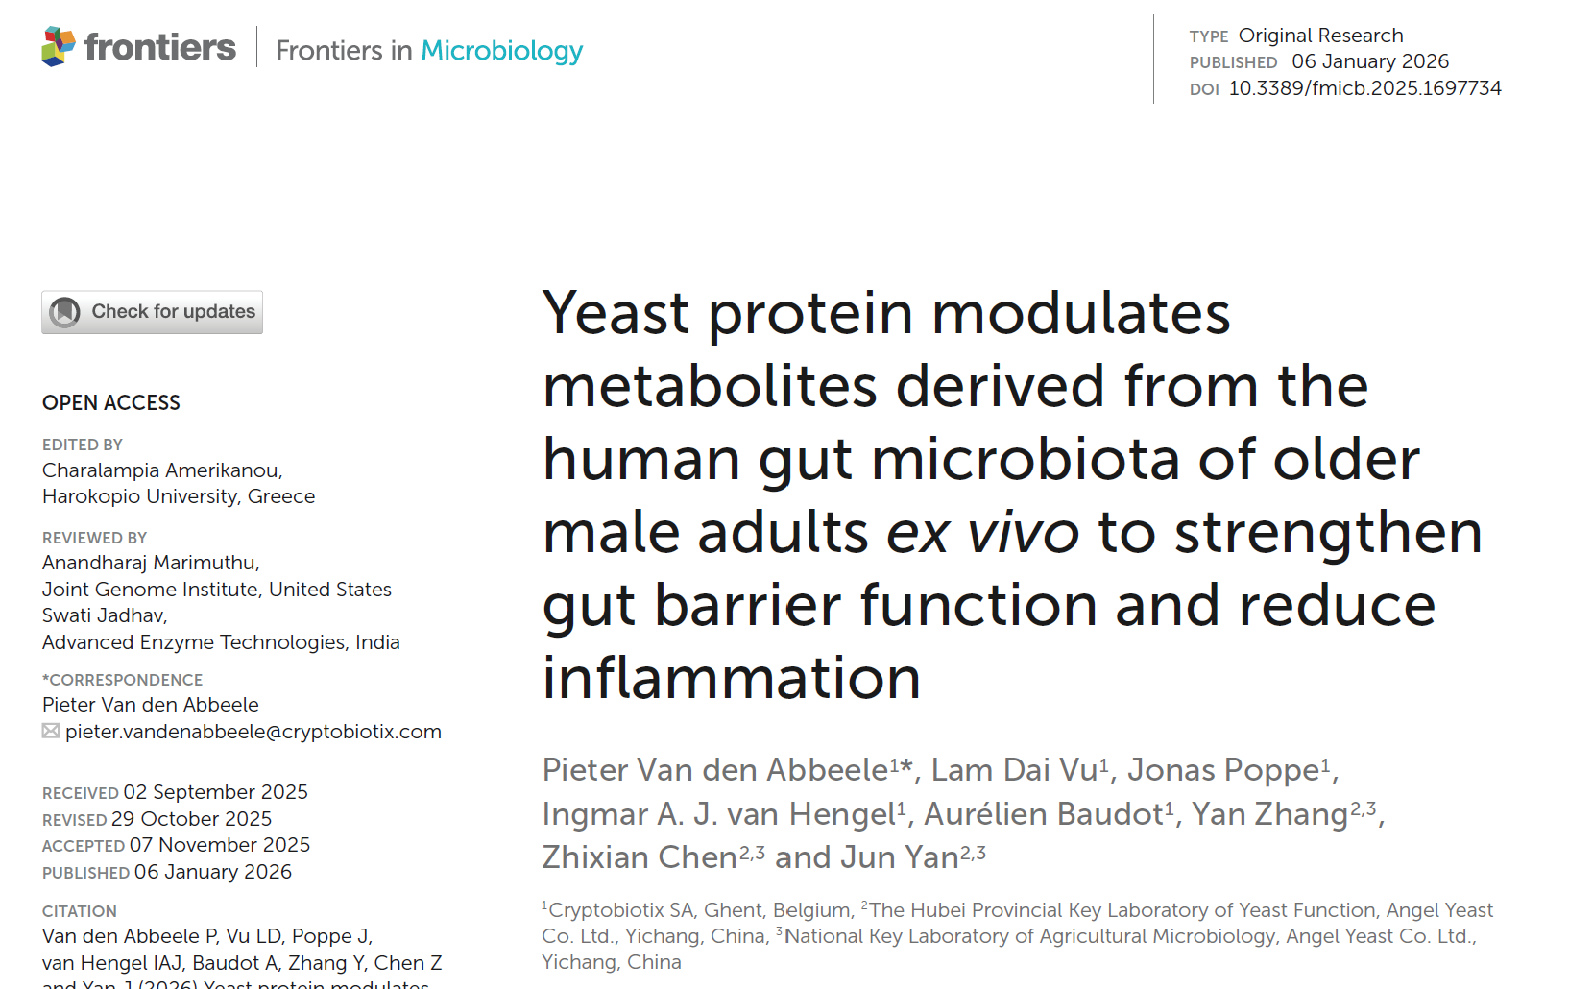
Publication
Proteins with prebiotic effect supporting healthy ageing

Slide 28
Thank you!
Cryptobiotix
research@cryptobiotix.com

