Slide 1



Building Resilience Through the Gut:
From Microbiome Discovery to Precision Interventions
The presented content is intended for educational or informational purposes only is not intended as medical advice, treatment or instructions.

Slide 2

Colleen Cutcliffe, PhD
Colleen Cutcliffe, PhD, is a scientist and gut microbiome expert with more than 25 years of experience advancing biology and human health across academia, biotechnology, and pharmaceuticals.
She earned her PhD in Biochemistry and Molecular Biology from Johns Hopkins University, completed her postdoctoral training at Northwestern University, and serves on the Health Advisory Board at Johns Hopkins. She is the Co-Founder and Chief Executive Officer of Pendulum, a company backed by Mayo Clinic.
Colleen is widely recognized as a trusted voice in gut microbiome science and is known for translating emerging microbiome research into clear, credible insights for both scientific and public audiences.
Learn more at PendulumLife.com
Learn more at PendulumLife.com
Notes:
Taylor

Slide 3



Slide 4
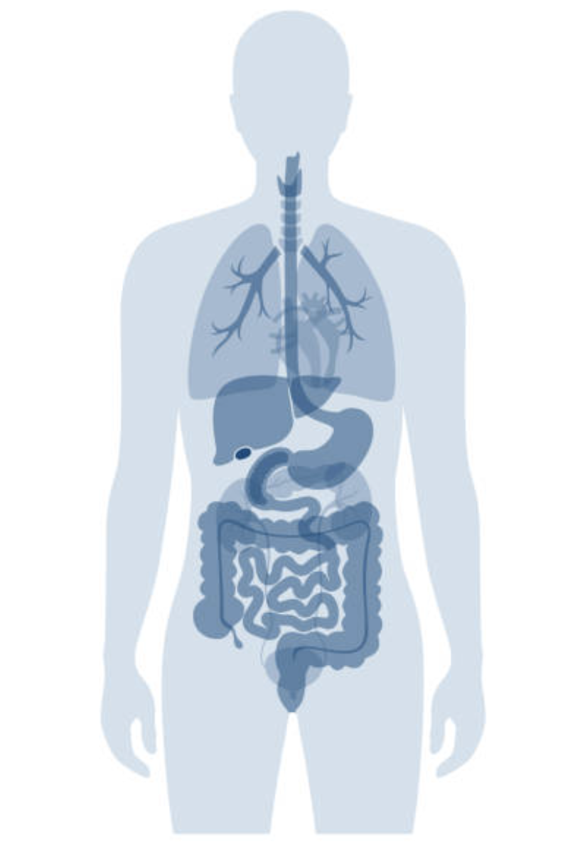

The Microbiome Underpins All Eleven Human Systems
Circulatory System
Respiratory
System
Digestive
System
Nervous
System
Endocrine
System
Urinary
System
Reproductive
System
Musculoskeletal
System
Integumentary
System
Immune
System
Lymphatic
System

Slide 5






Throughout Life, Our Microbiome is Under Constant Attack
© 2026 Pendulum

Slide 6
This Can Lead to a Wide Breadth of Issues
Esophagitis, Barrett’s esophagus and esophageal adenocarcinoma
Autism
Parkinson’s
Hypertension and cardiovascular disease
Asthma, Allergies
Kidney stone formation
Atopic dermatitis
Inflammatory bowel disease
Metabolic syndrome and obesity
Colorectal cancer
Rheumatoid arthritis
© 2026 Pendulum

Slide 7
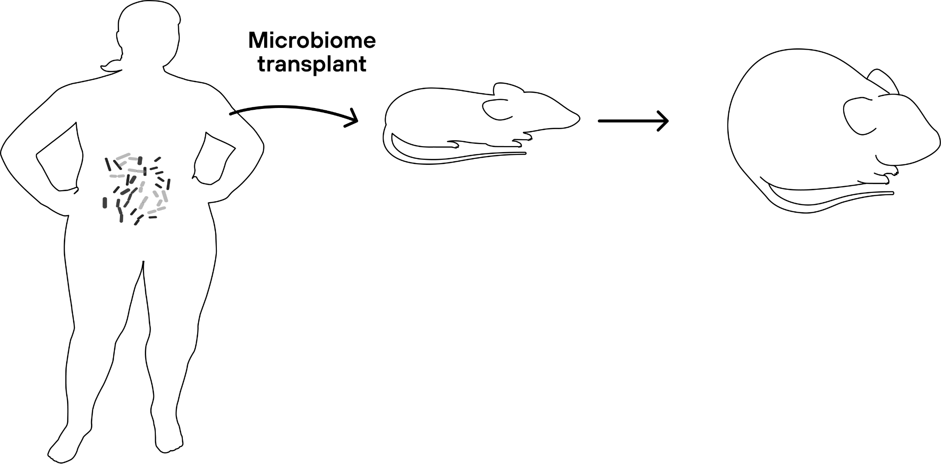
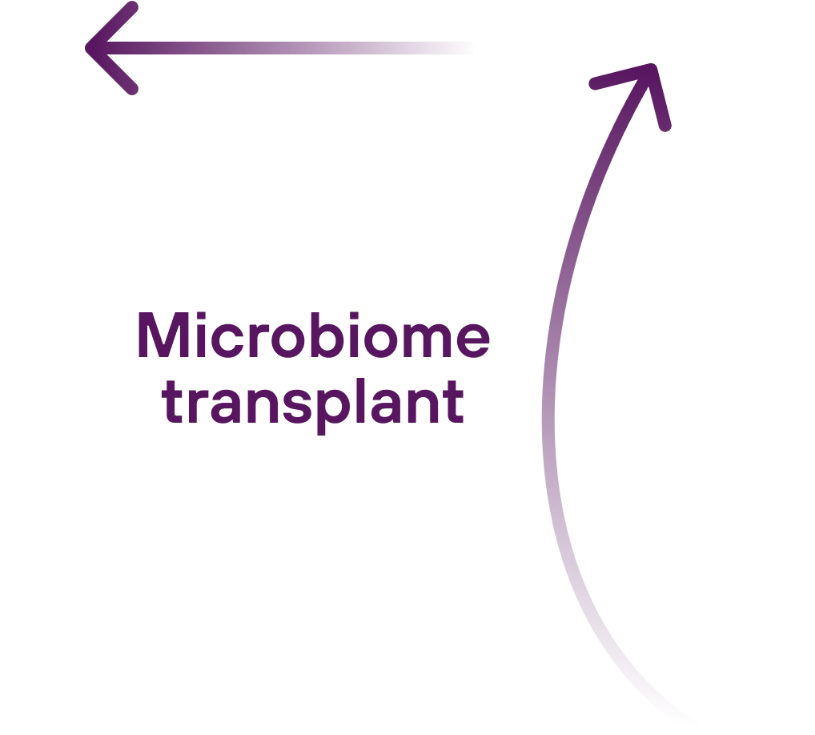
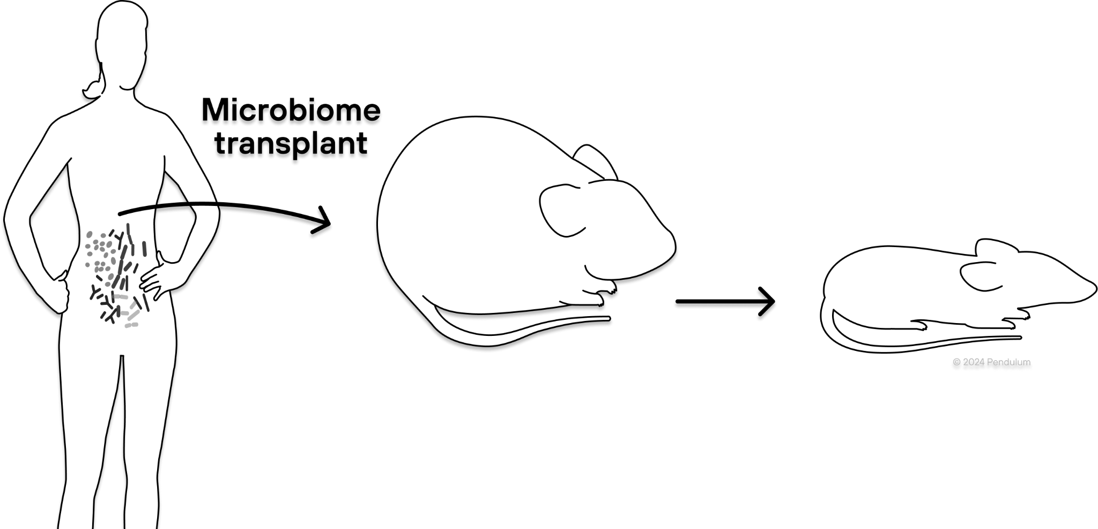
Ridaura VK, et al., 2013

Slide 8

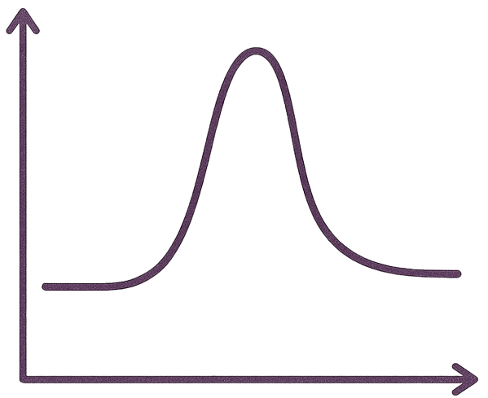



The Microbiome Influences Many Areas of Health
Metabolism through the production of butyrate and GLP1
Wijdeveld M, et al 2023
Mood, behavior and stress through the production of neurotransmitters
Miri S, et al 2023
Gut barrier through stimulating healthy mucus & regulating tight junctions
Paone P and Cani PD, 2020
© 2025 Pendulum
Skin hydration + elasticity through short chain fatty acids and sphyngomyelinase
Munteanu C, et al 2025

Slide 9
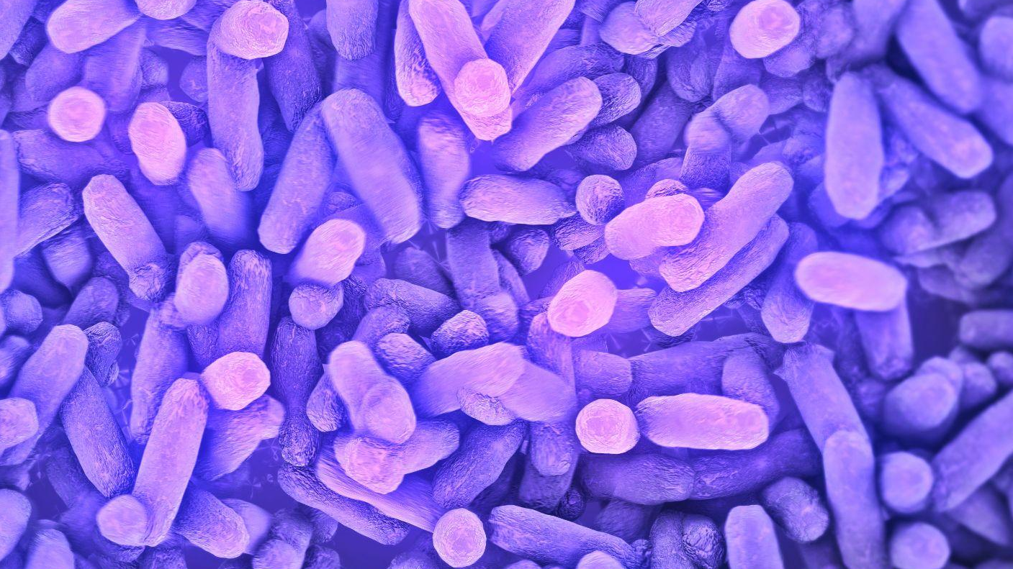
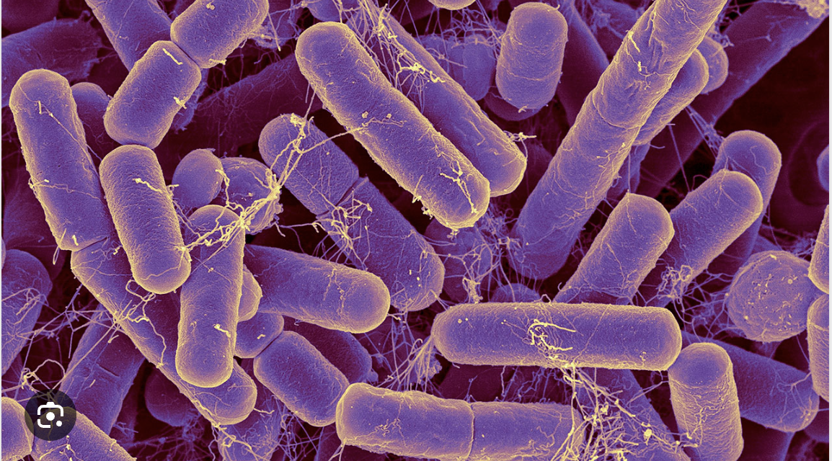
Pendulum microbiome science is revolutionizing
human health

Slide 10
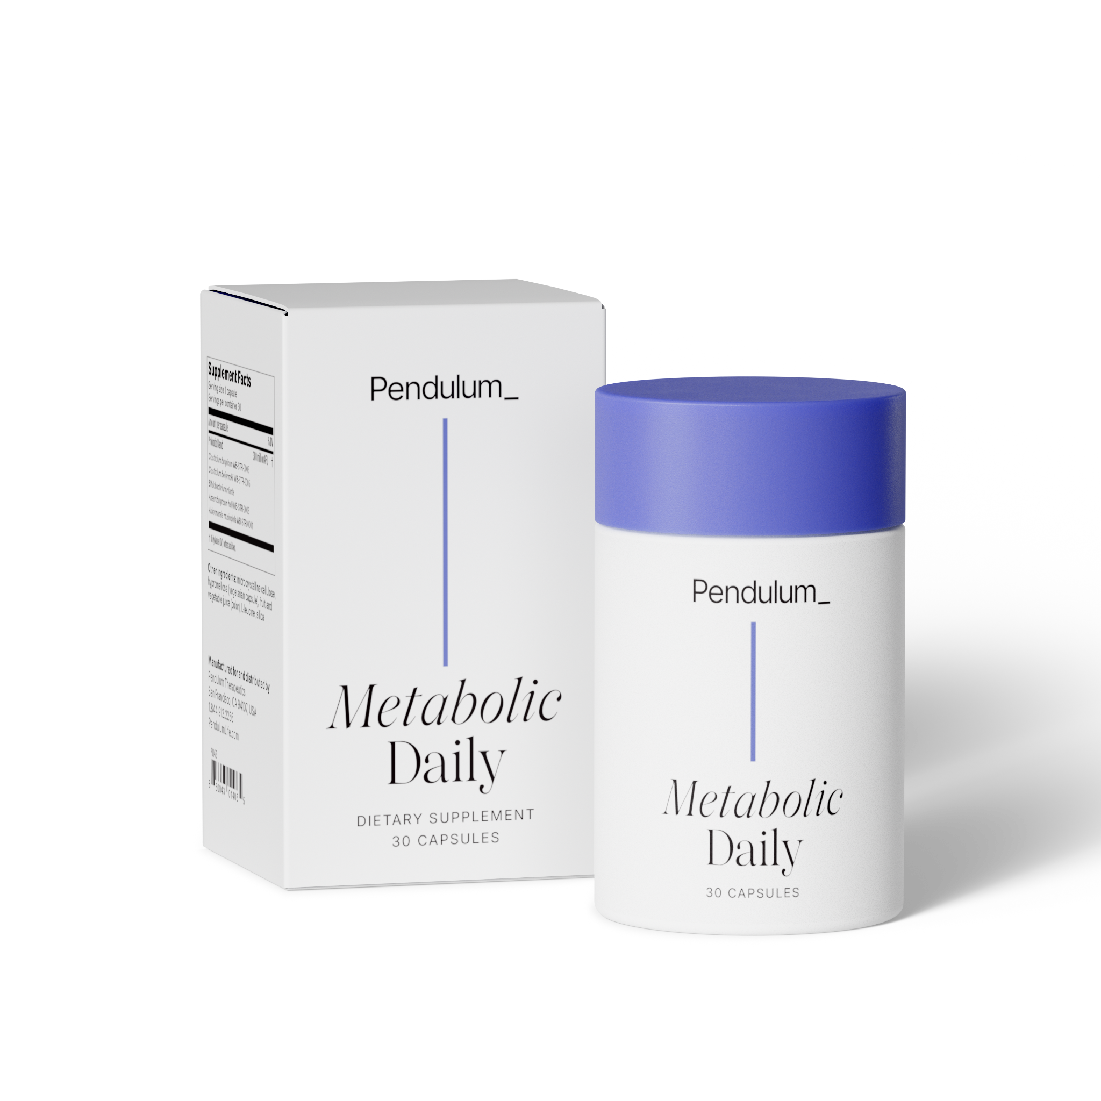
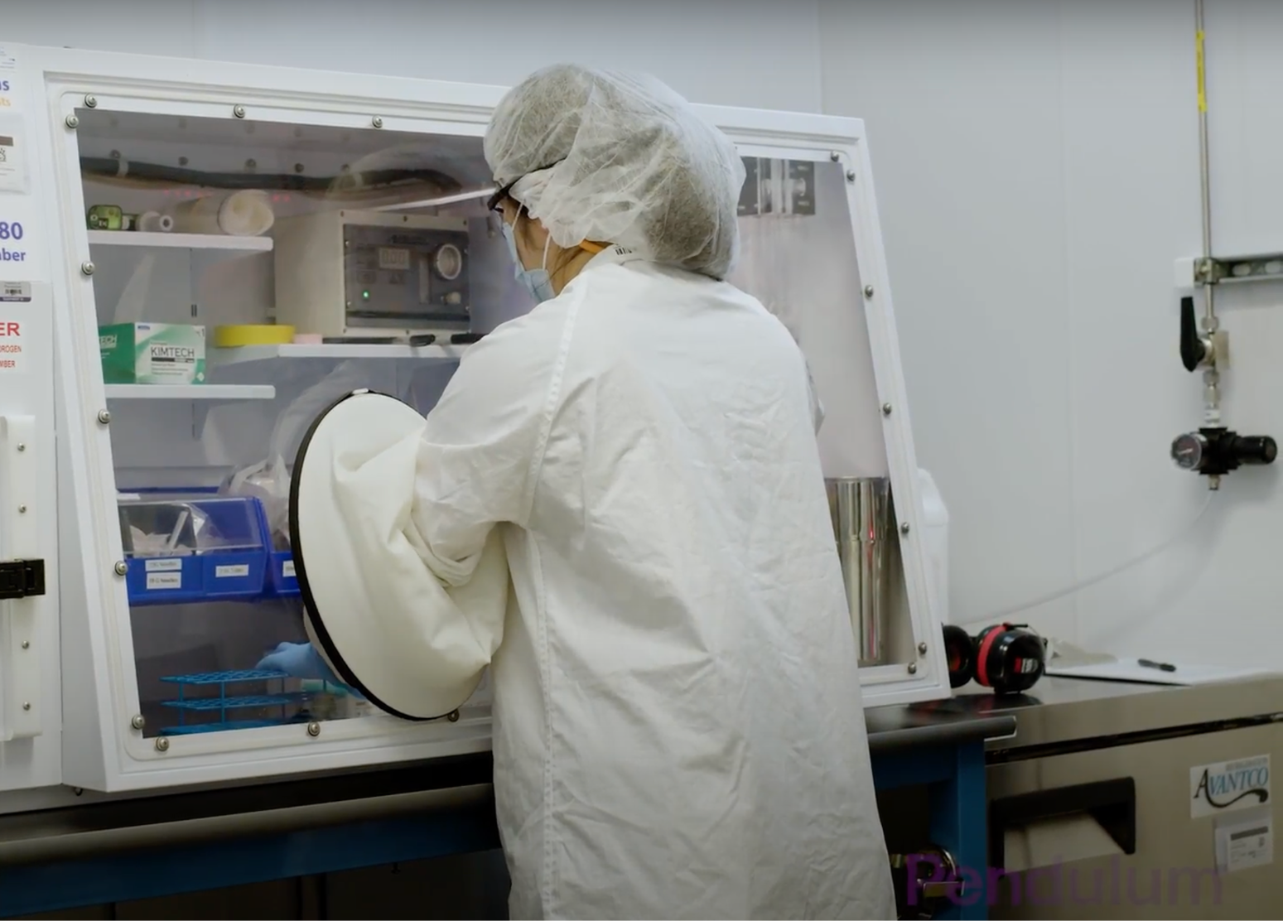
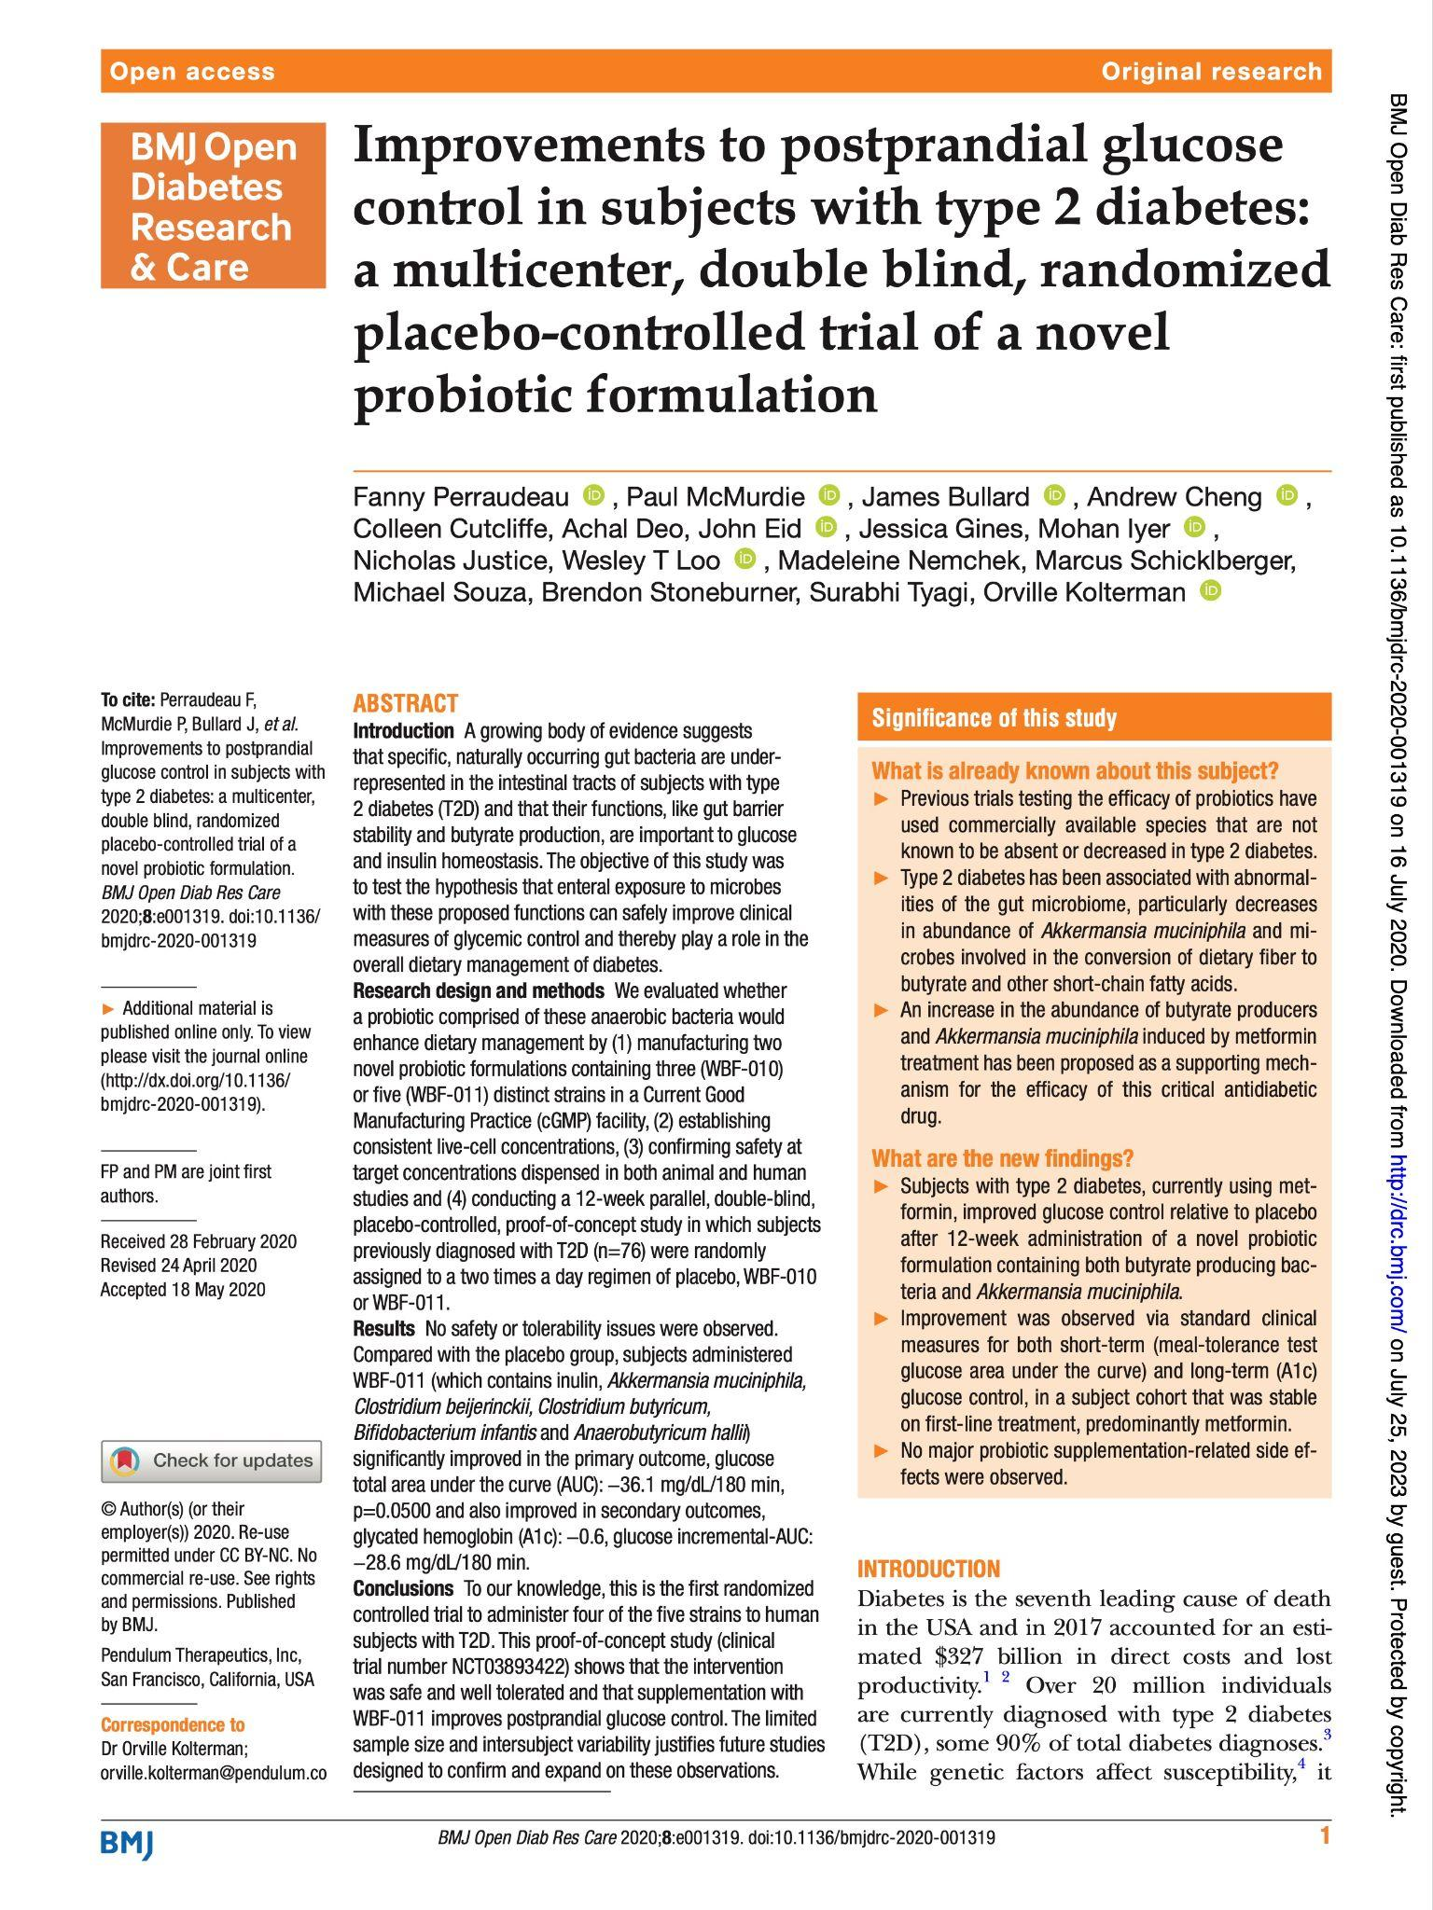
Pendulum: a Microbiome Pioneer for Metabolic Health
Cutting-edge manufacturing
Research-backed formulations
Keystone strains
We developed next-generation technology needed to mass produce live anaerobic strains
>15 clinical trials underway

Slide 11
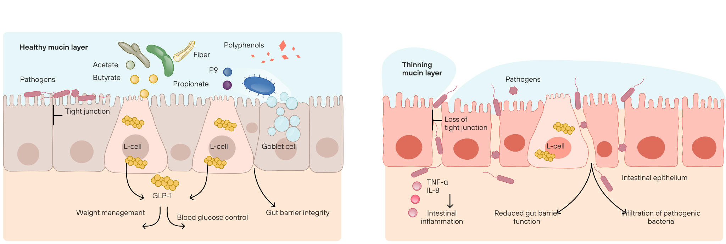
A Strong Gut Lining is the Foundation of Better Health
Unhealthy Microbiome
Healthy Microbiome
Pendulum Therapeutics
Pendulum Therapeutics

Slide 12

Live Akkermansia nurtures your gut garden

Slide 13

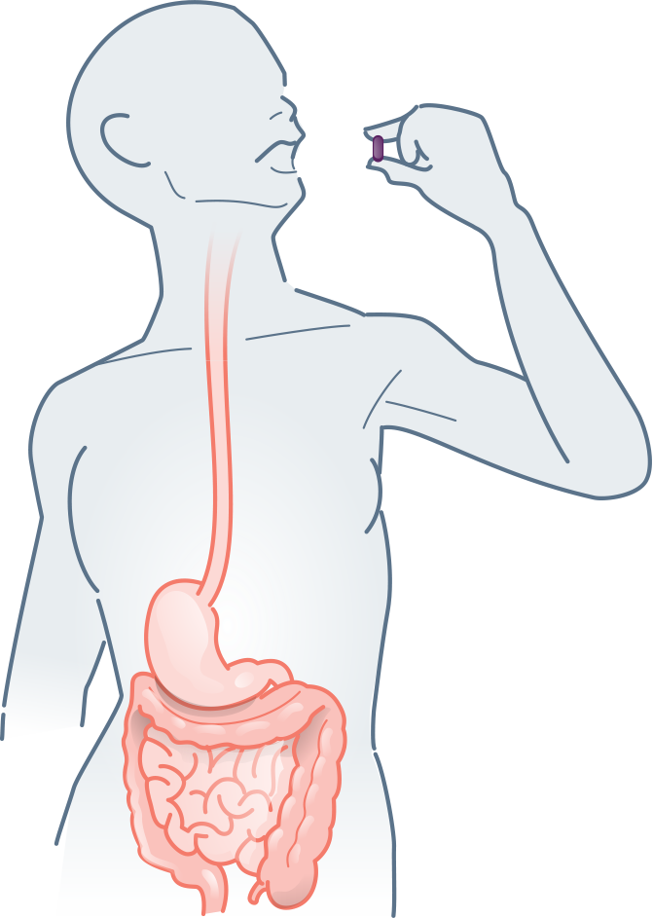
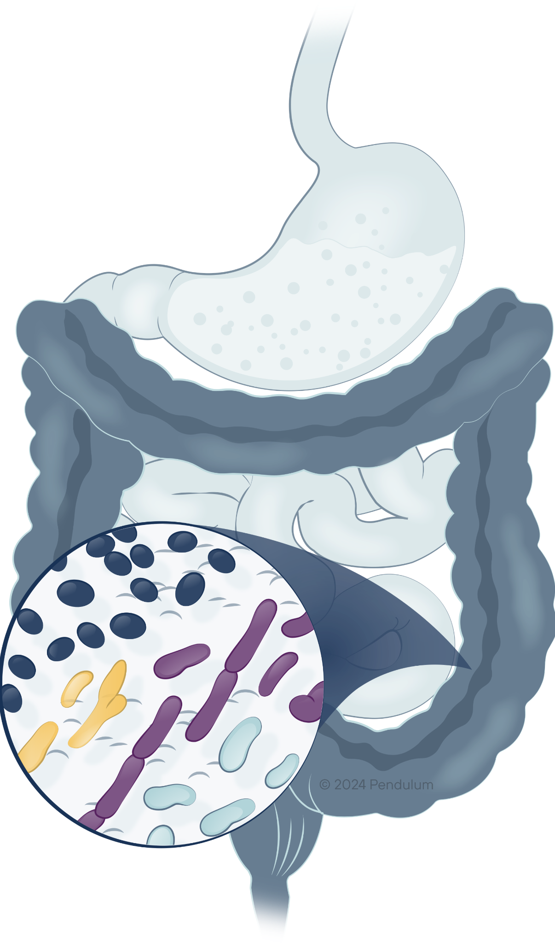
Delivering efficacy from the bottle to your microbiome
The acid-resistant capsule protects the live probiotics from being killed by the stomach acid
The delayed-release capsule opens in the intestines
© 2025 Pendulum
The live probiotic strains travel to the active site of the colon to get to work

Slide 14
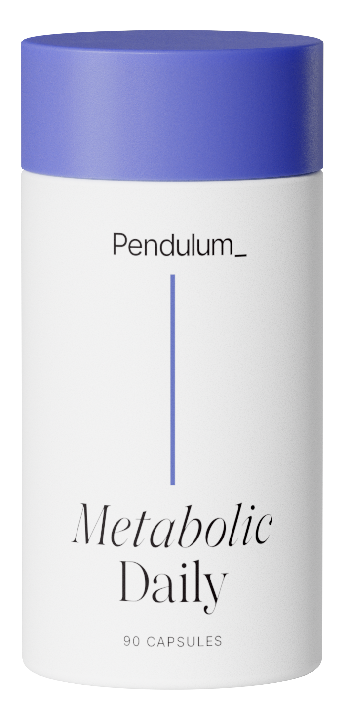

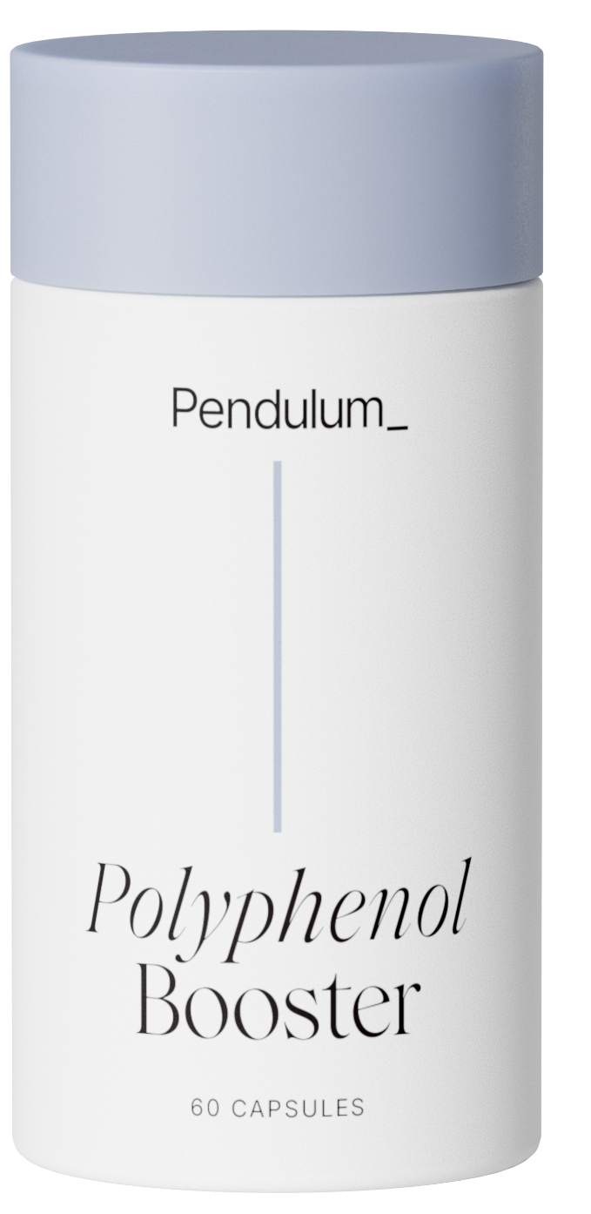
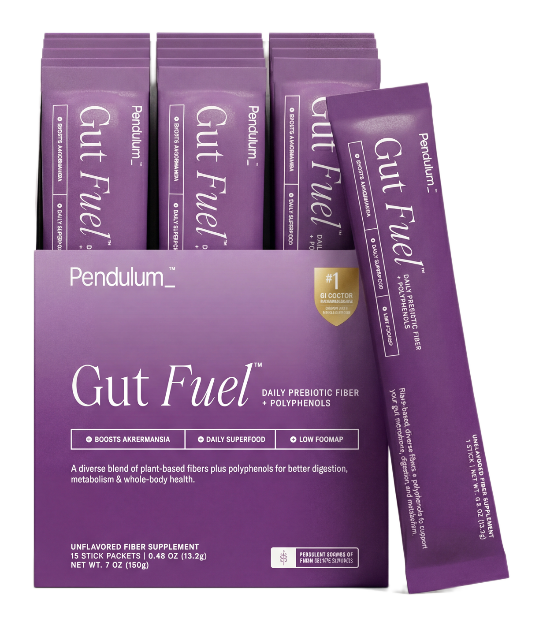

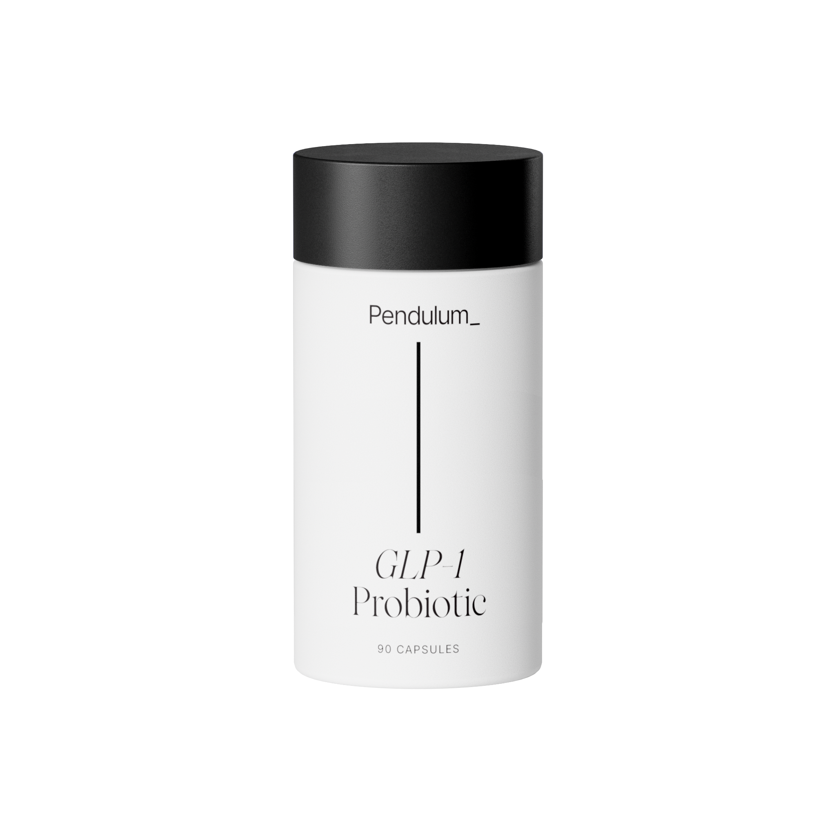
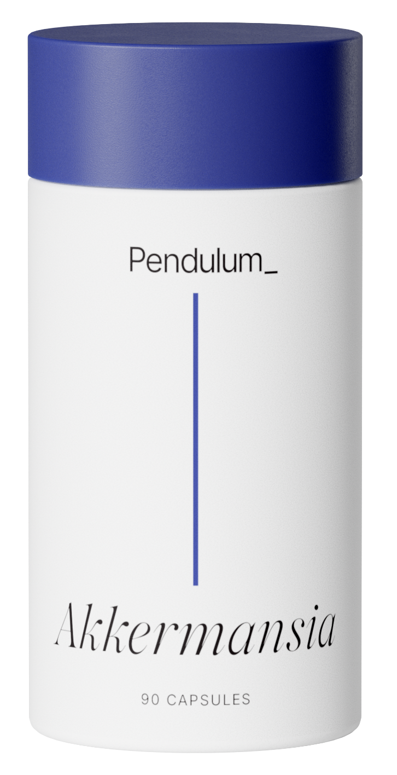
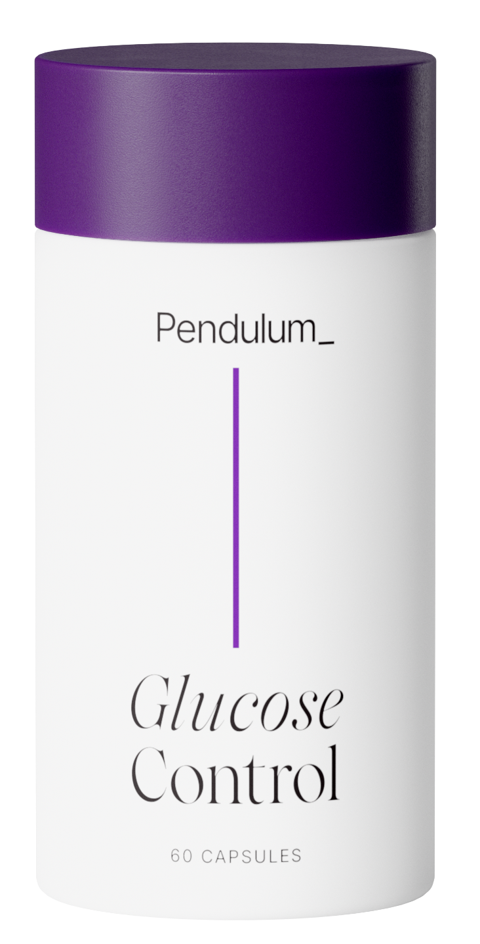
Next-Generation Science. Results You Can Feel.
FLAGSHIP
COMPANION
Polyphenol Booster
Gut Fuel
Turbo boost your probiotics
Feed what fuels you
SPECIALTY PROBIOTICS
Metabolic Daily
Akkermansia
Glucose Control
GLP-1 Probiotic
Replenish Akkermansia & Strengthen Your Gut
Lower Sugar Spikes & Reduce A1C for Type 2 Diabetes*
Supports GLP-1 Signaling Pathways
NOT SOLD DTC
5-Strains | 4-in-1 Metabolism, Energy, Mood, & Digestion
*For the nutritional management of Type 2 diabetes

Slide 15

Pendulum Metabolic Daily
Formulated to improve your metabolism with 4-in-1 benefits
Pair with Pendulum Polyphenol Booster
Recommend to someone looking to naturally support their metabolism, energy, sleep & mood

Slide 16
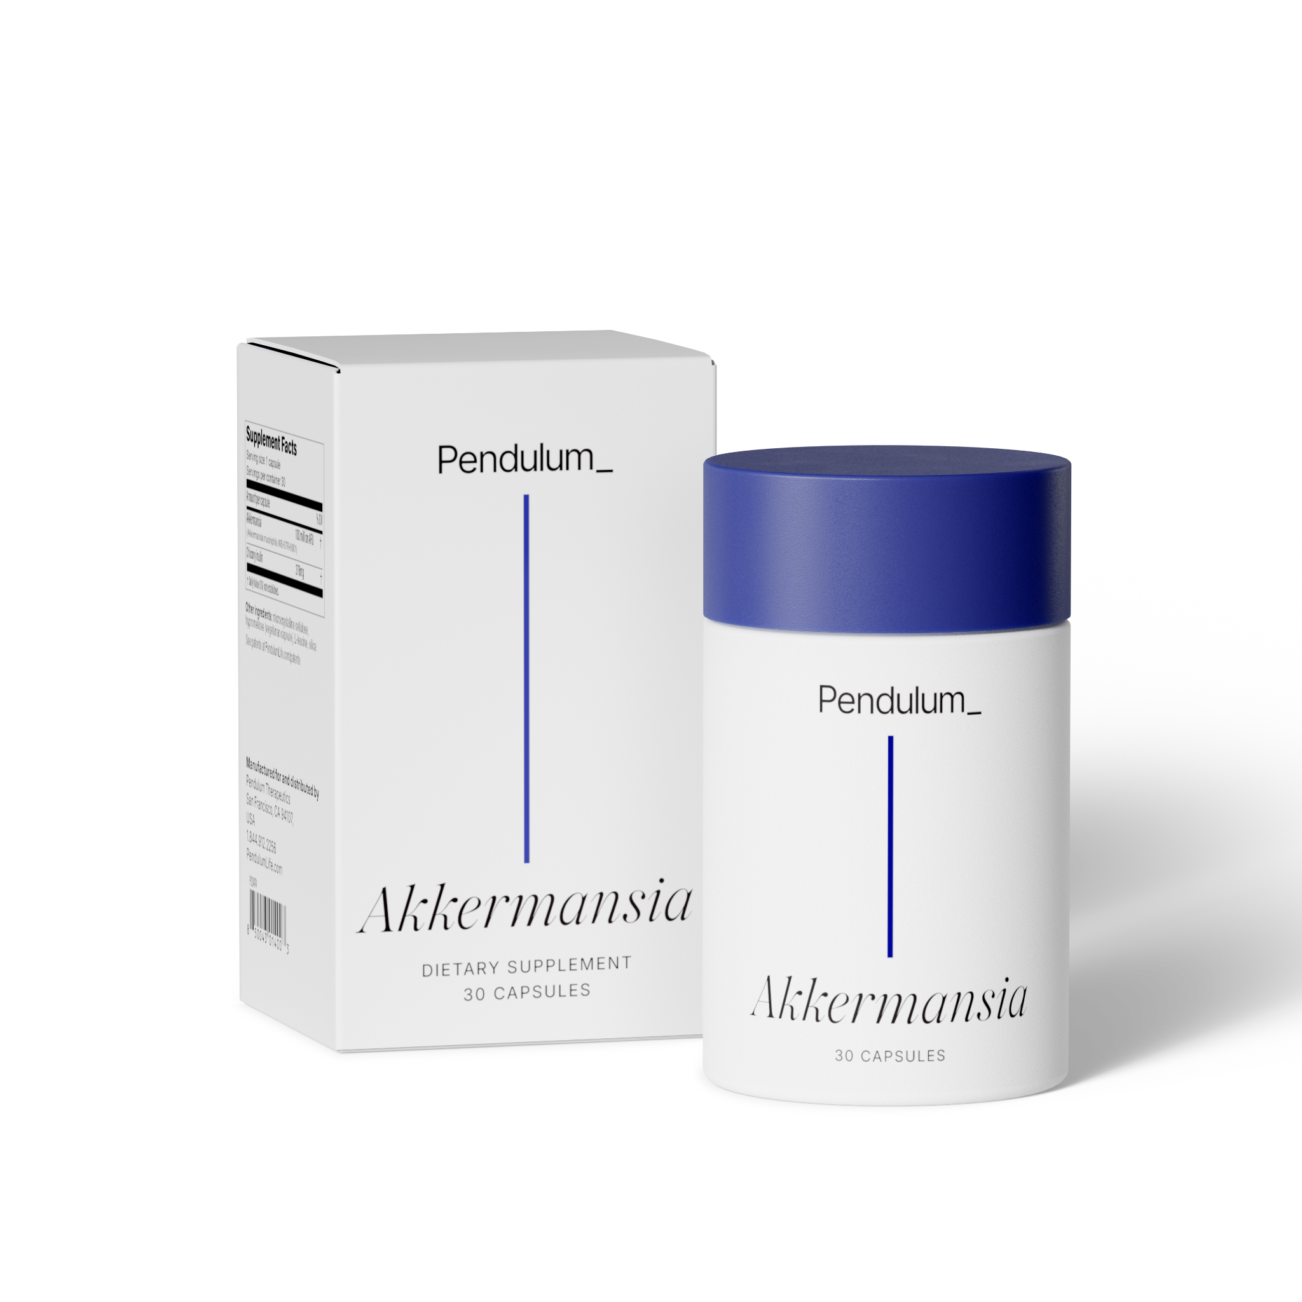
Pendulum Akkermansia
Formulated to strengthen your gut
Pair with Pendulum Polyphenol Booster
Recommend to someone looking to replenish their gut lining & address gut permeability (aka “leaky gut”)

Slide 17
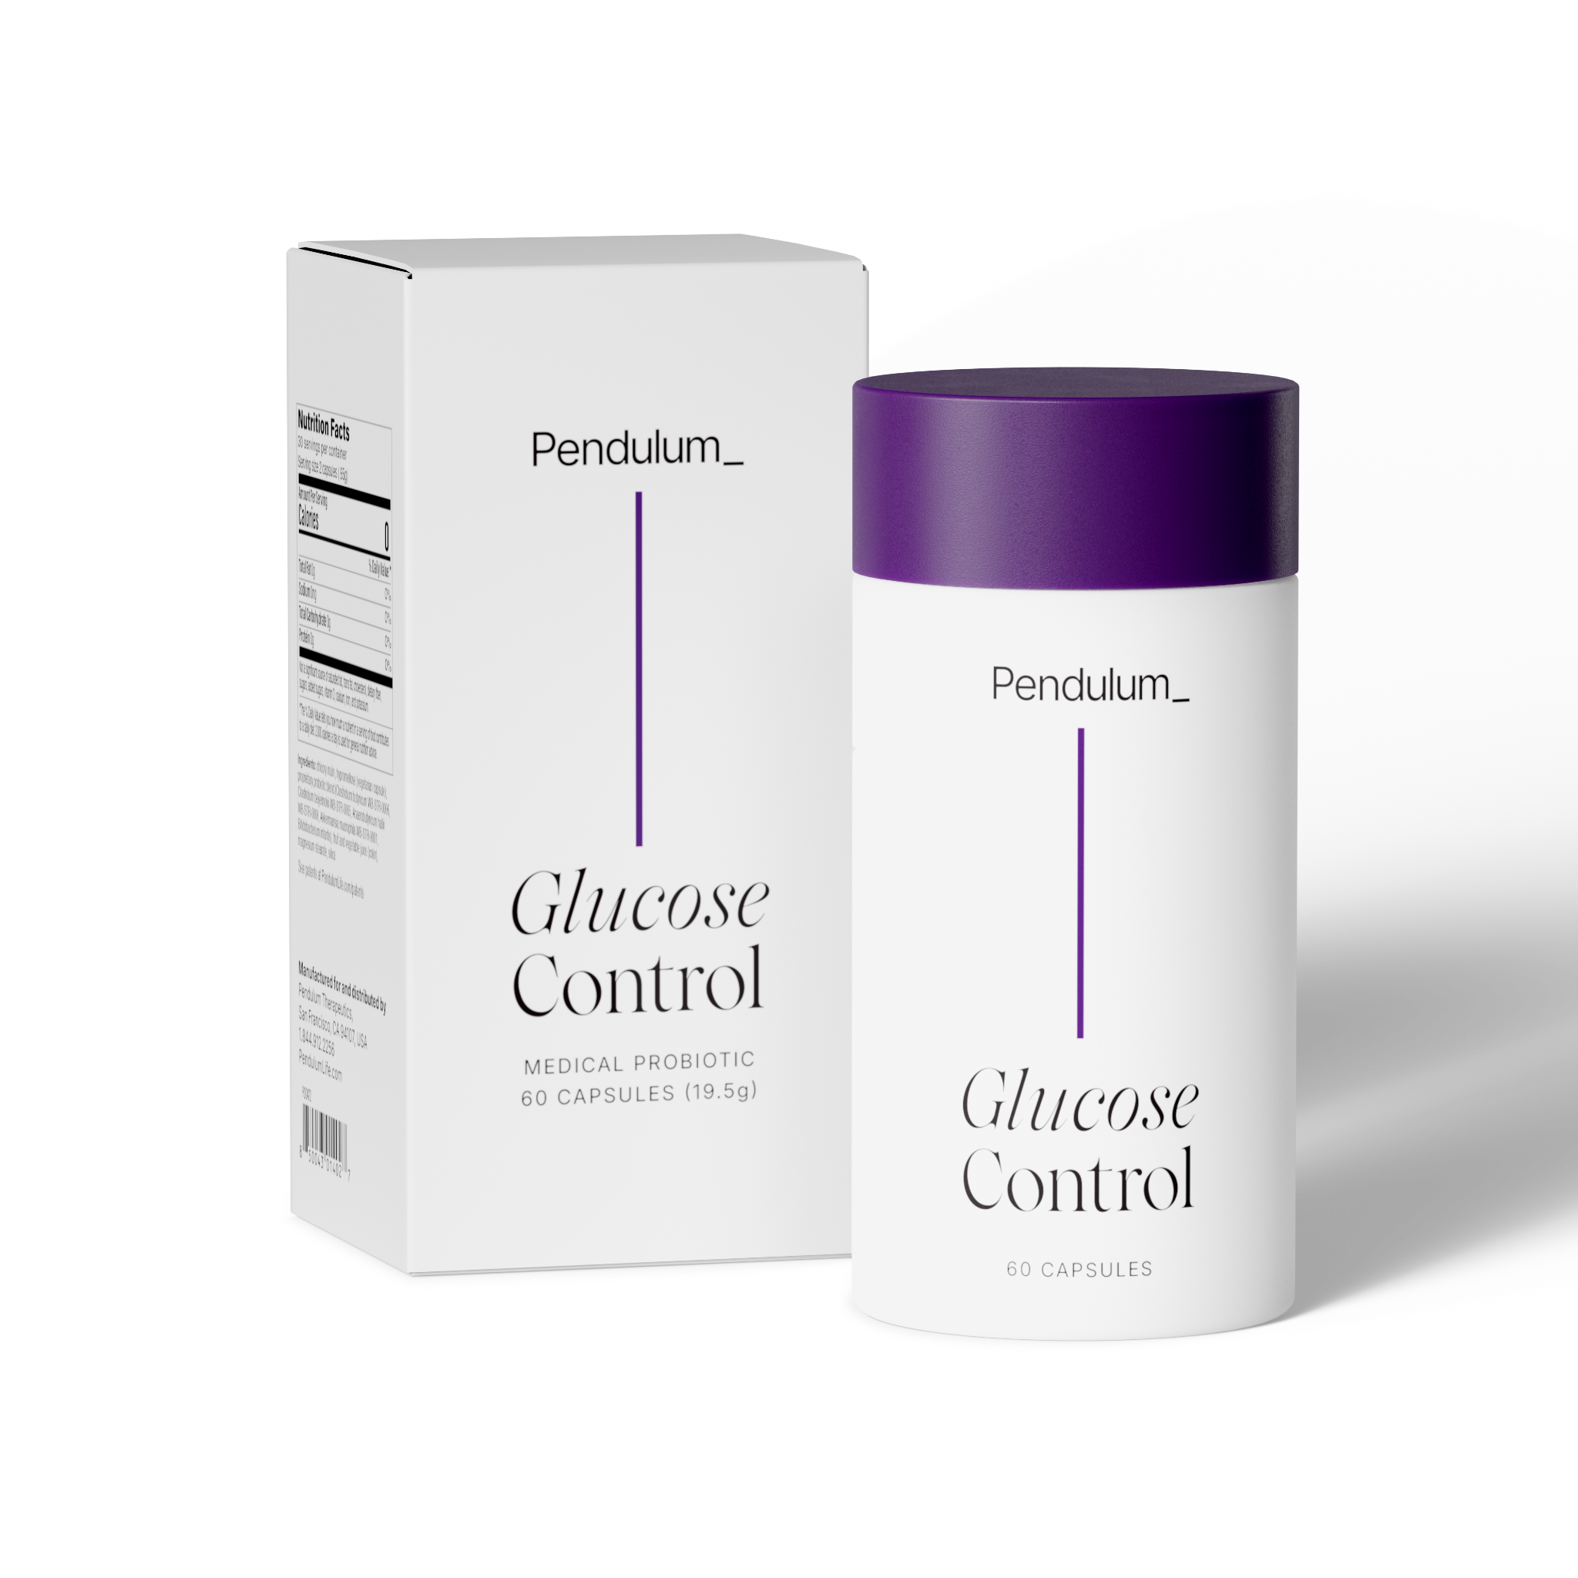
Pendulum Glucose Control
Formulated to lower your A1C, naturally
Pair with Pendulum Polyphenol Booster
Recommend to someone focused on naturally lowering their blood sugar spikes* or struggling to manage their A1C levels naturally*
*For the nutritional management of Type 2 diabetes

Slide 18
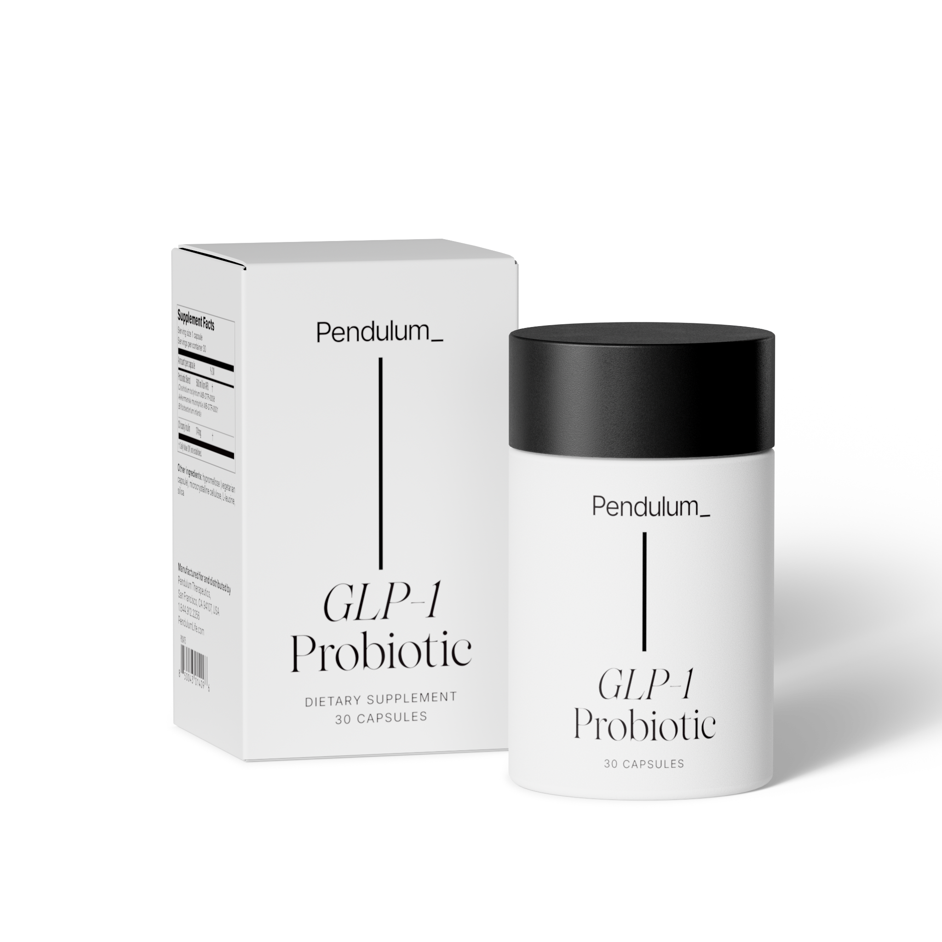
Pendulum GLP-1 Probiotic
Formulated to curb your cravings, naturally
Pair with Pendulum Polyphenol Booster
Recommend to someone who needs a solution for their food cravings and those looking to support their GLP-1 signaling pathways*
*Based on preclinical studies. Product not intended for weight loss

Slide 19
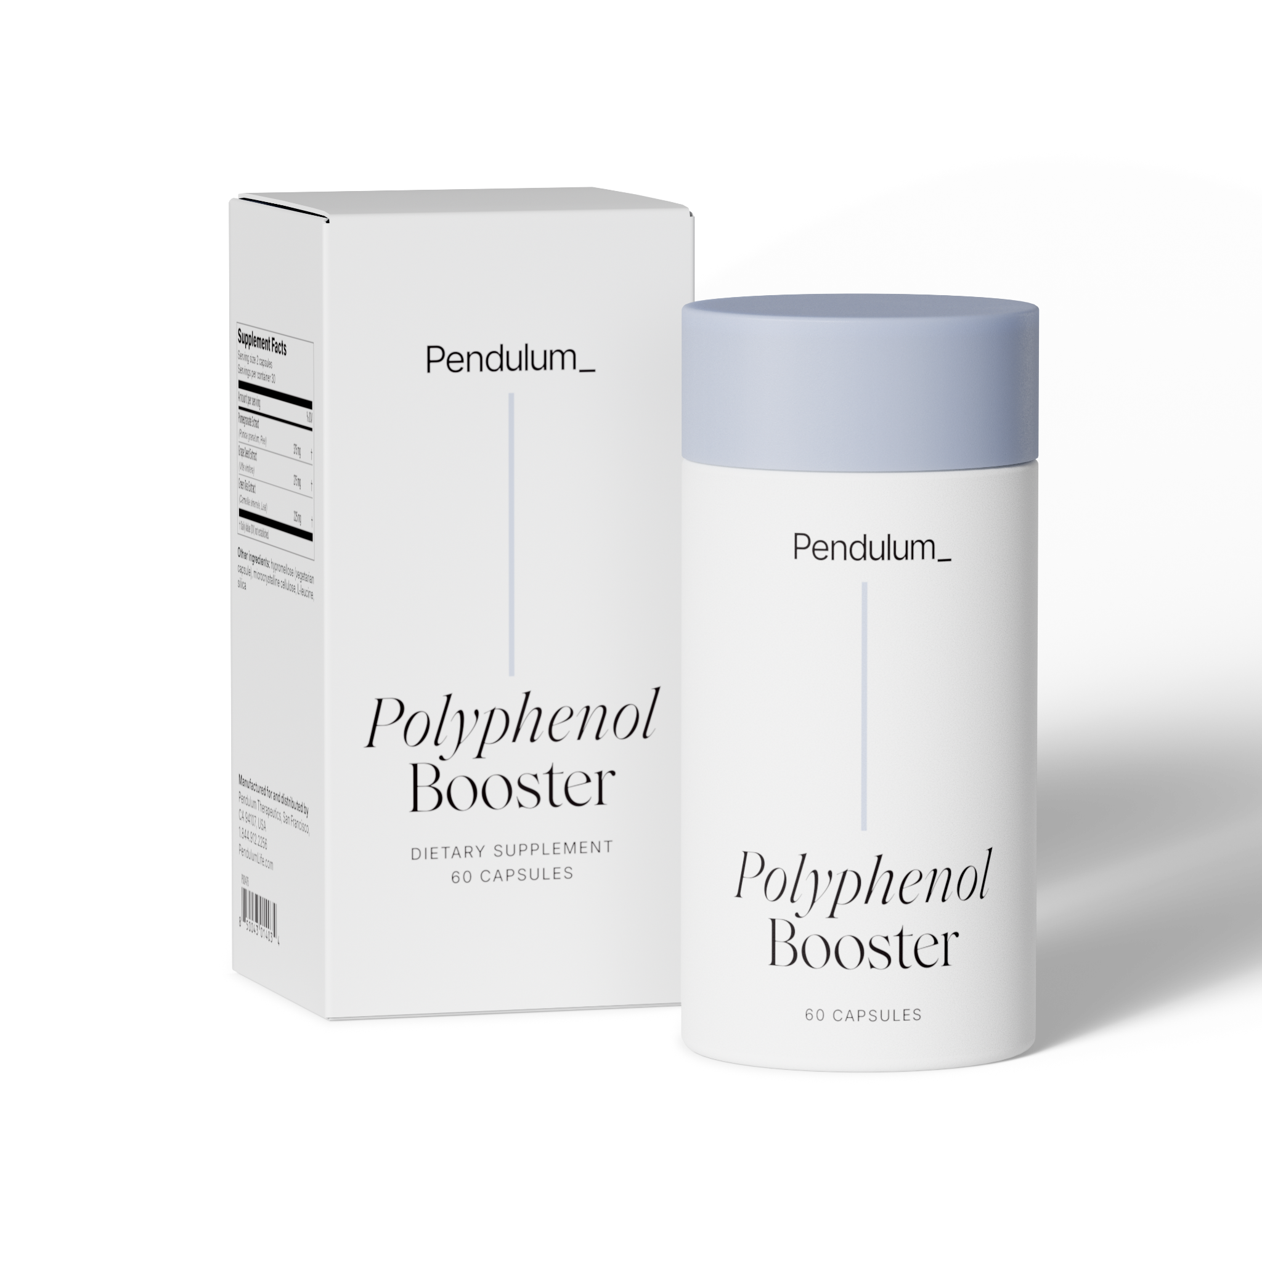
Pendulum Polyphenol Booster
Formulated to feed your probiotic
Pair with all Pendulum probiotics
Recommend to those looking to increase their Akkermansia levels* or lacking polyphenols in their diet
*Based on preclinical studies

Slide 20

Pendulum Gut Fuel
A doctor-formulated blend of diverse fibers + polyphenols designed to turn everyday foods into superfoods and to support gut and metabolic health
Pair with all Pendulum probiotics
Best for those looking to boost Akkermansia levels, close the fiber gap for themselves and kids, with a low FODMAP formulation
*Based on preclinical studies

Slide 21




The #1 GI Doctor recommended Akkermansia-based Probiotic
4,000+ peer-reviewed papers have studied Akkermansia
#1 GI Doctor Recommended Akkermansia- based probiotics
Recommended by 30,000+ medical professionals
Driving powerful results beyond gut health for
1M+ orders
Dr. Kara Fitzgerald
Dr. Darshan Shah
Dr. Amy Shah
Dr. William W. Li

Slide 22

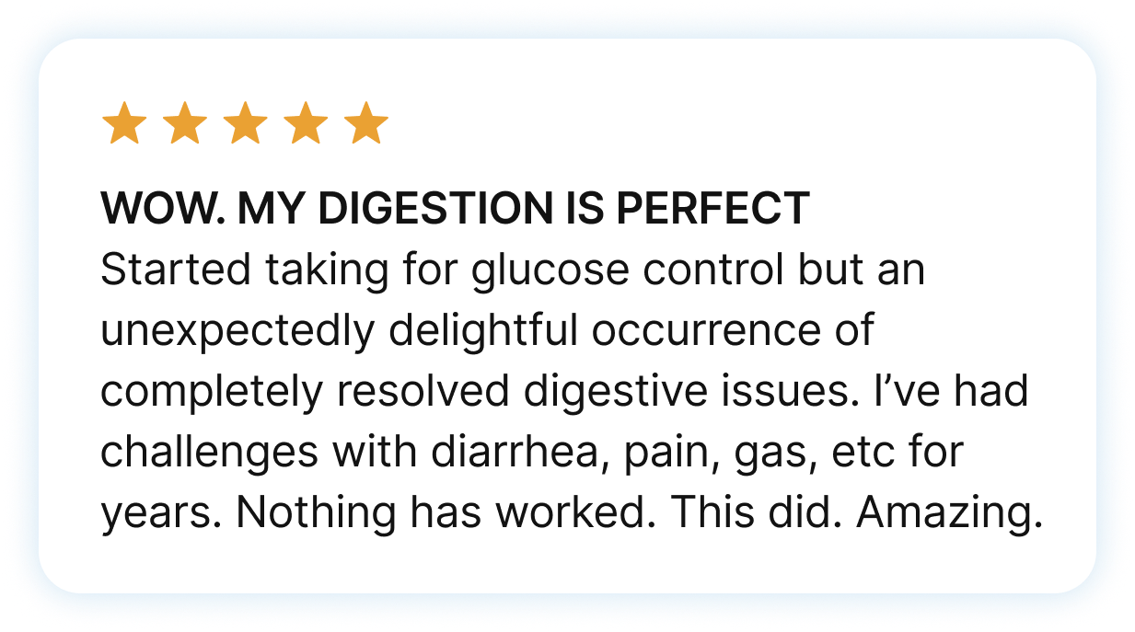
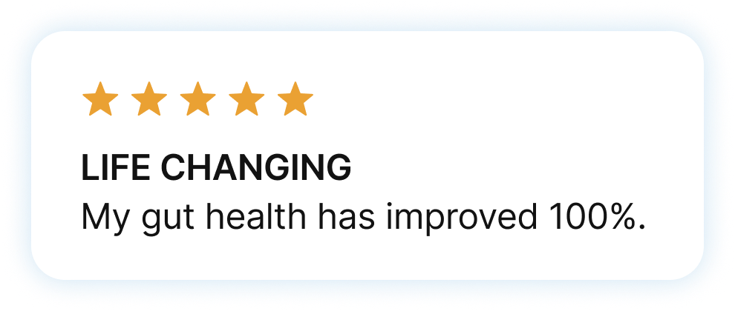
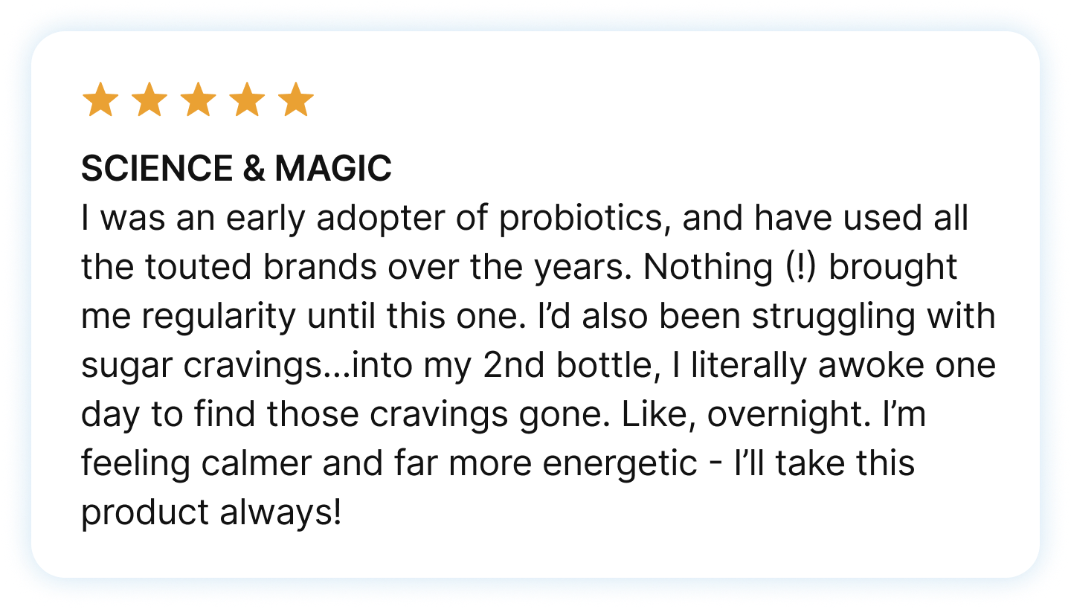

Real science leads to results you can feel
ENERGY
I had no expectations with product. I was looking to improve my gut health after stomach bug. Within a couple of days, I noticed my mood and energy improve. I’m feeling more clearheaded and energetic throughout the day. I use to always feel sluggish in the morning, even after walking my dog. I’m loving this product.

Slide 23


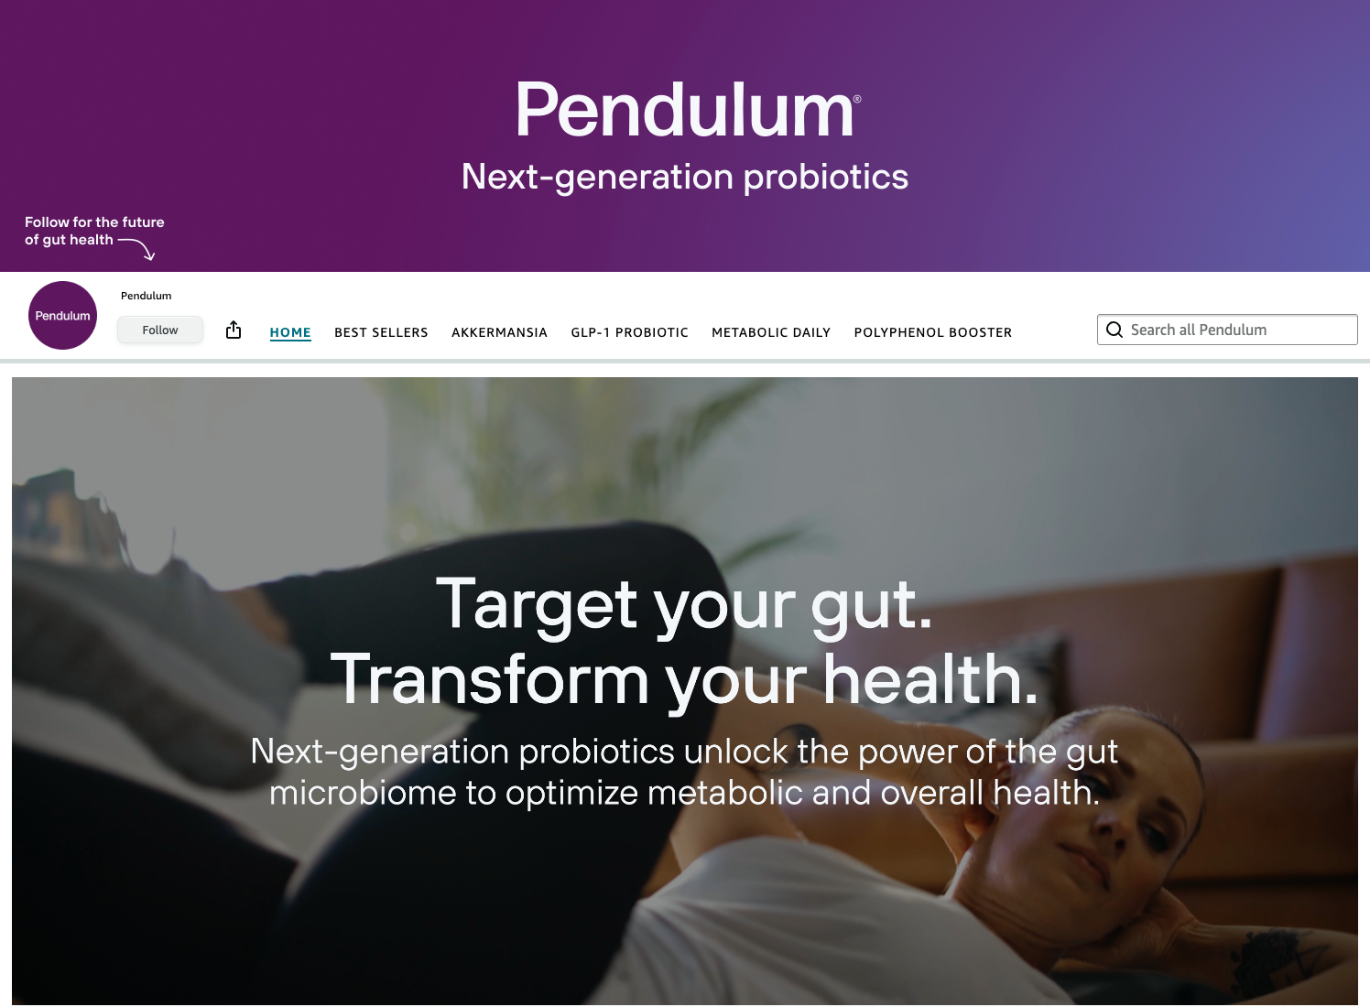
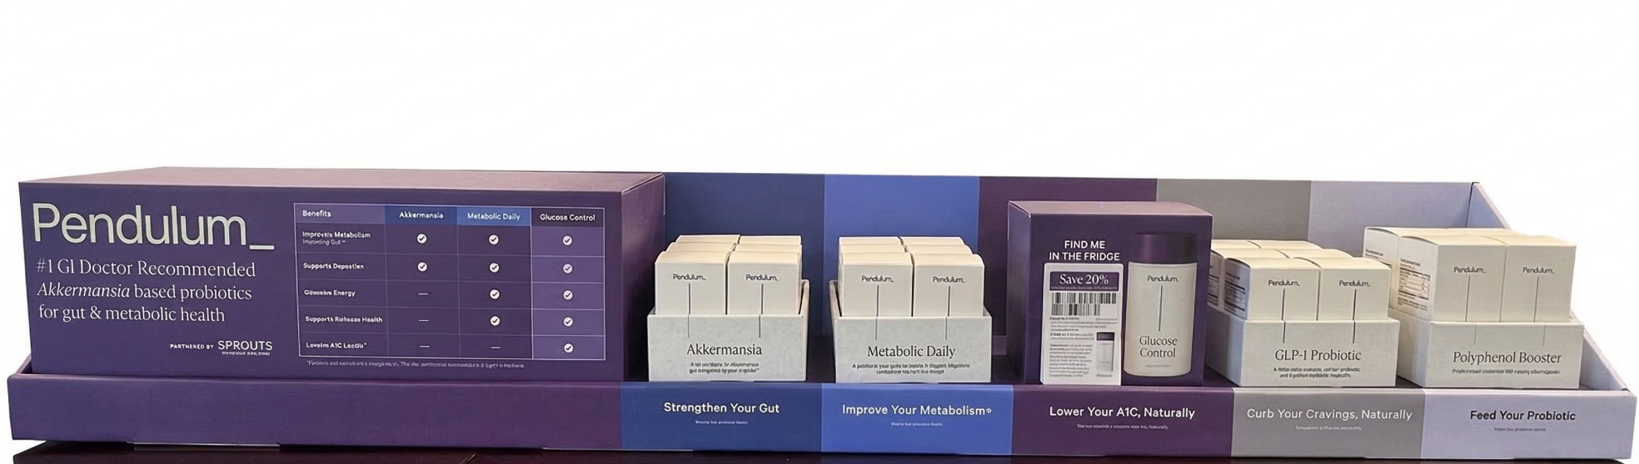

Available: Pendulum.co, Amazon, Fullscript, and building in Sprouts

Slide 24
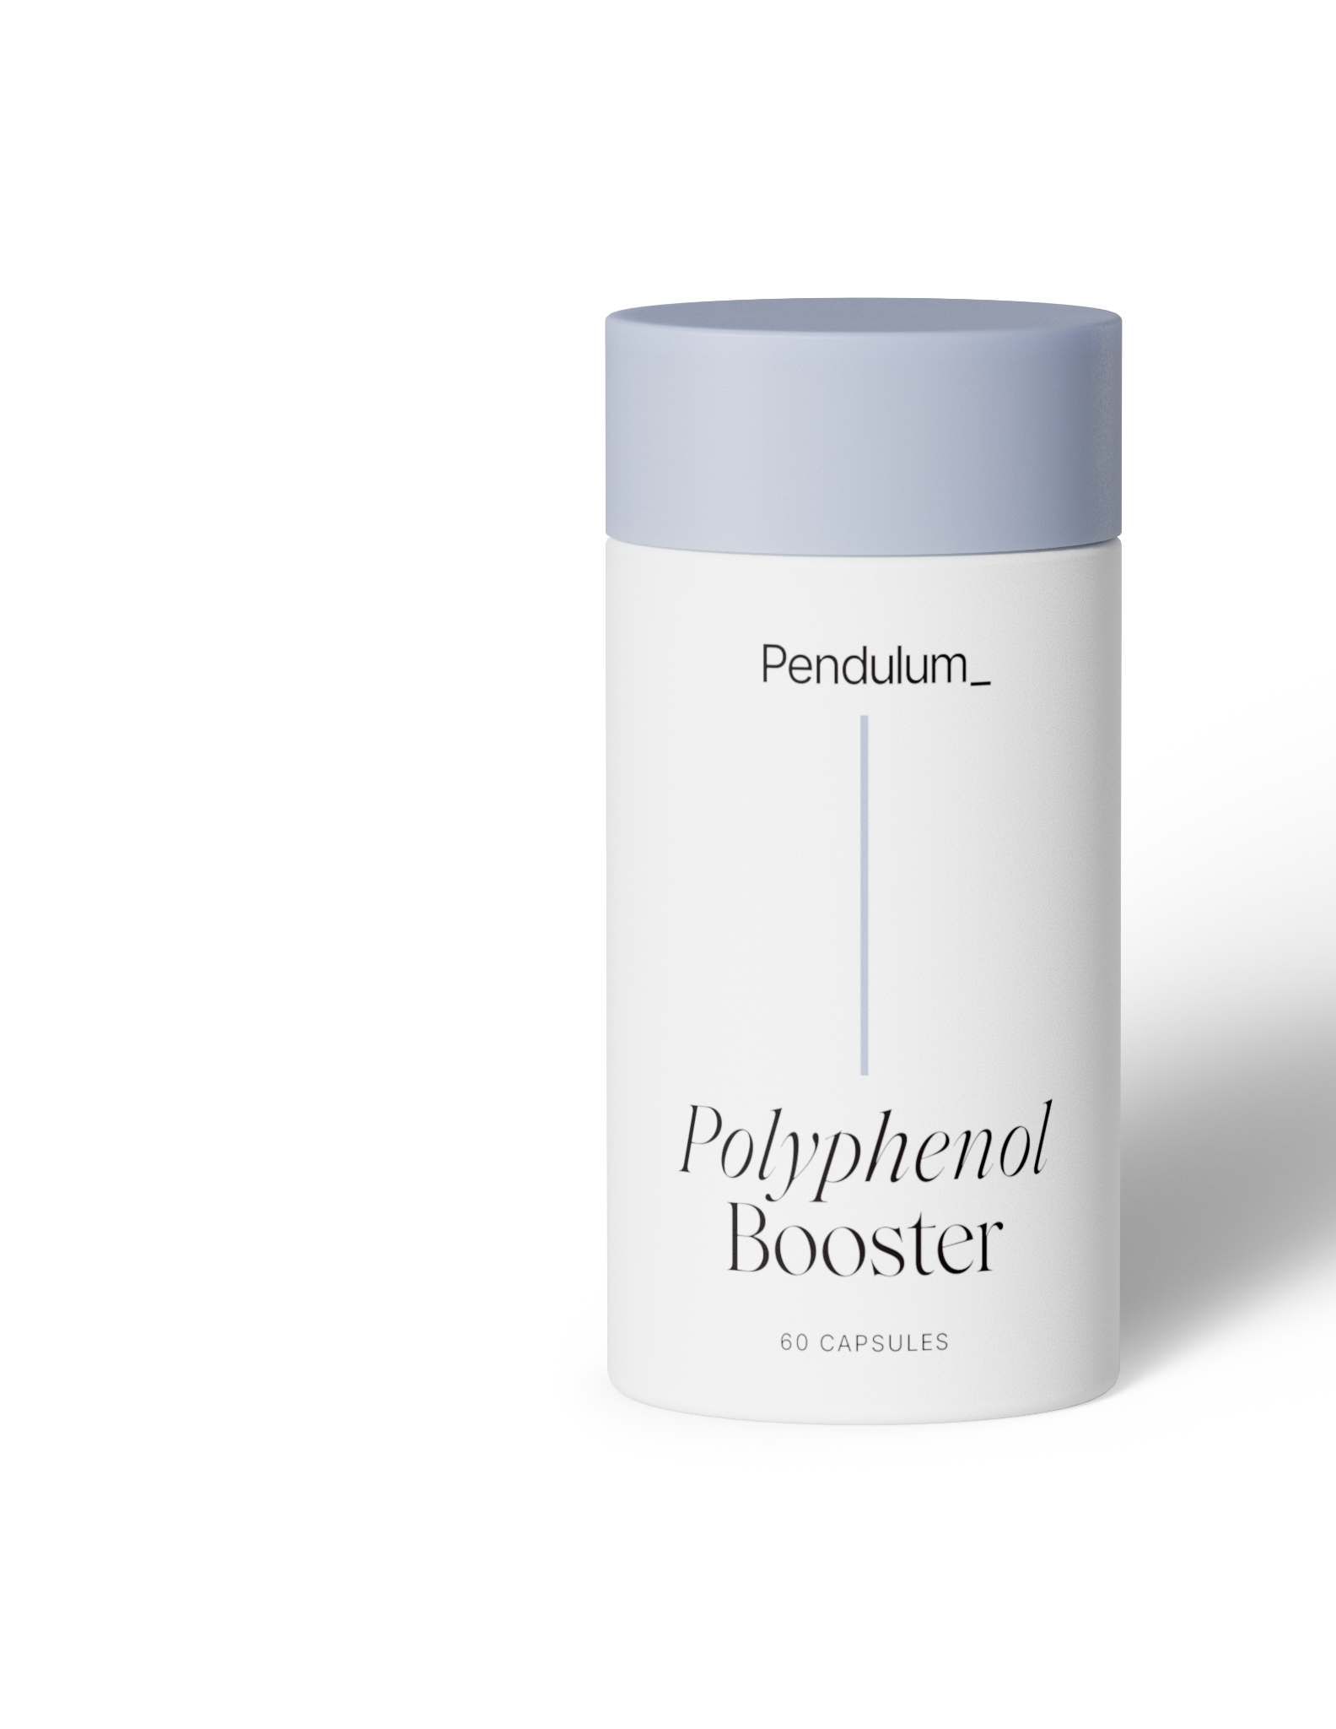
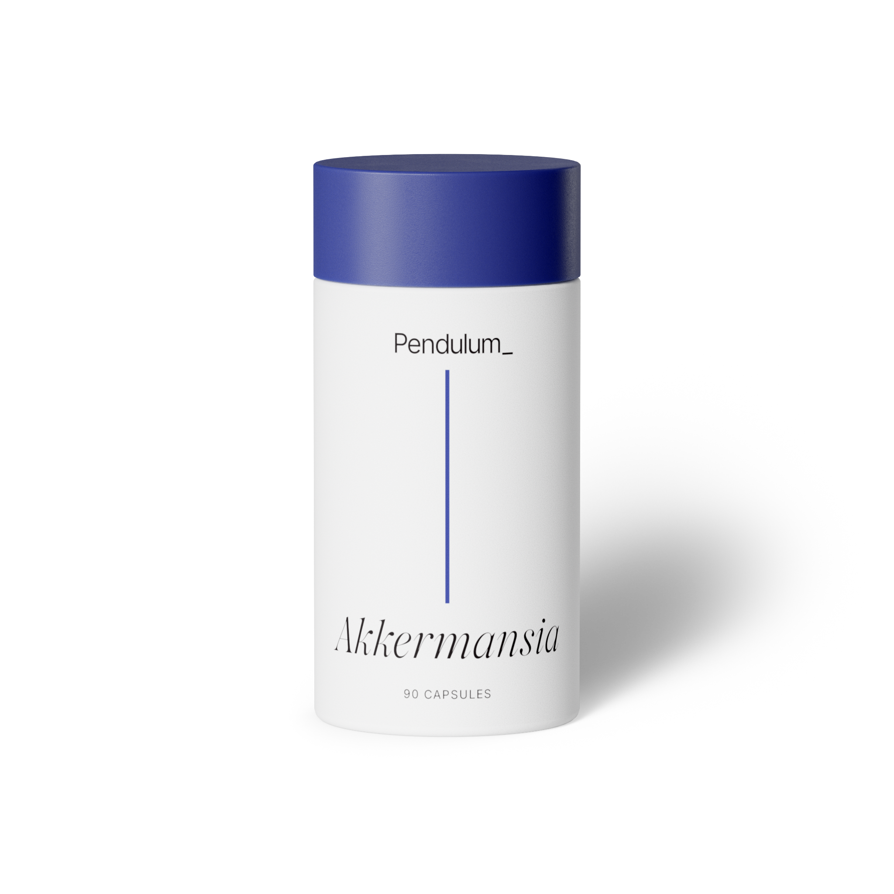
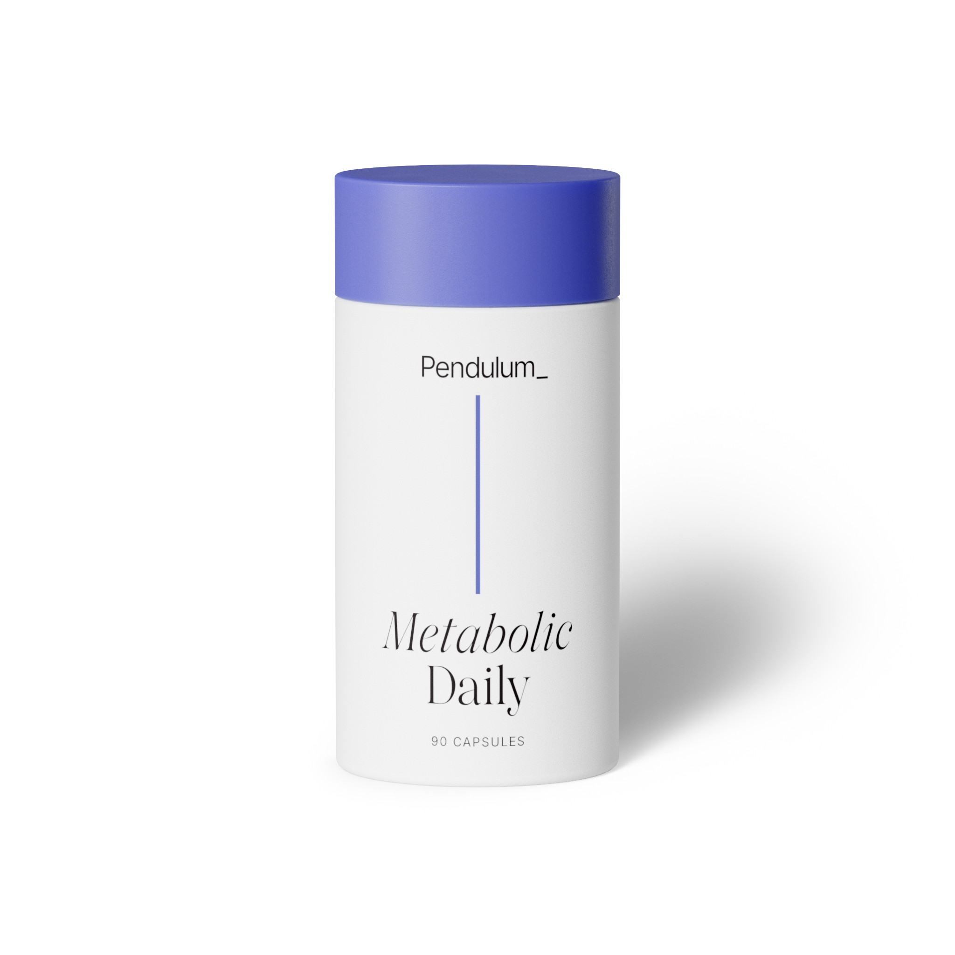
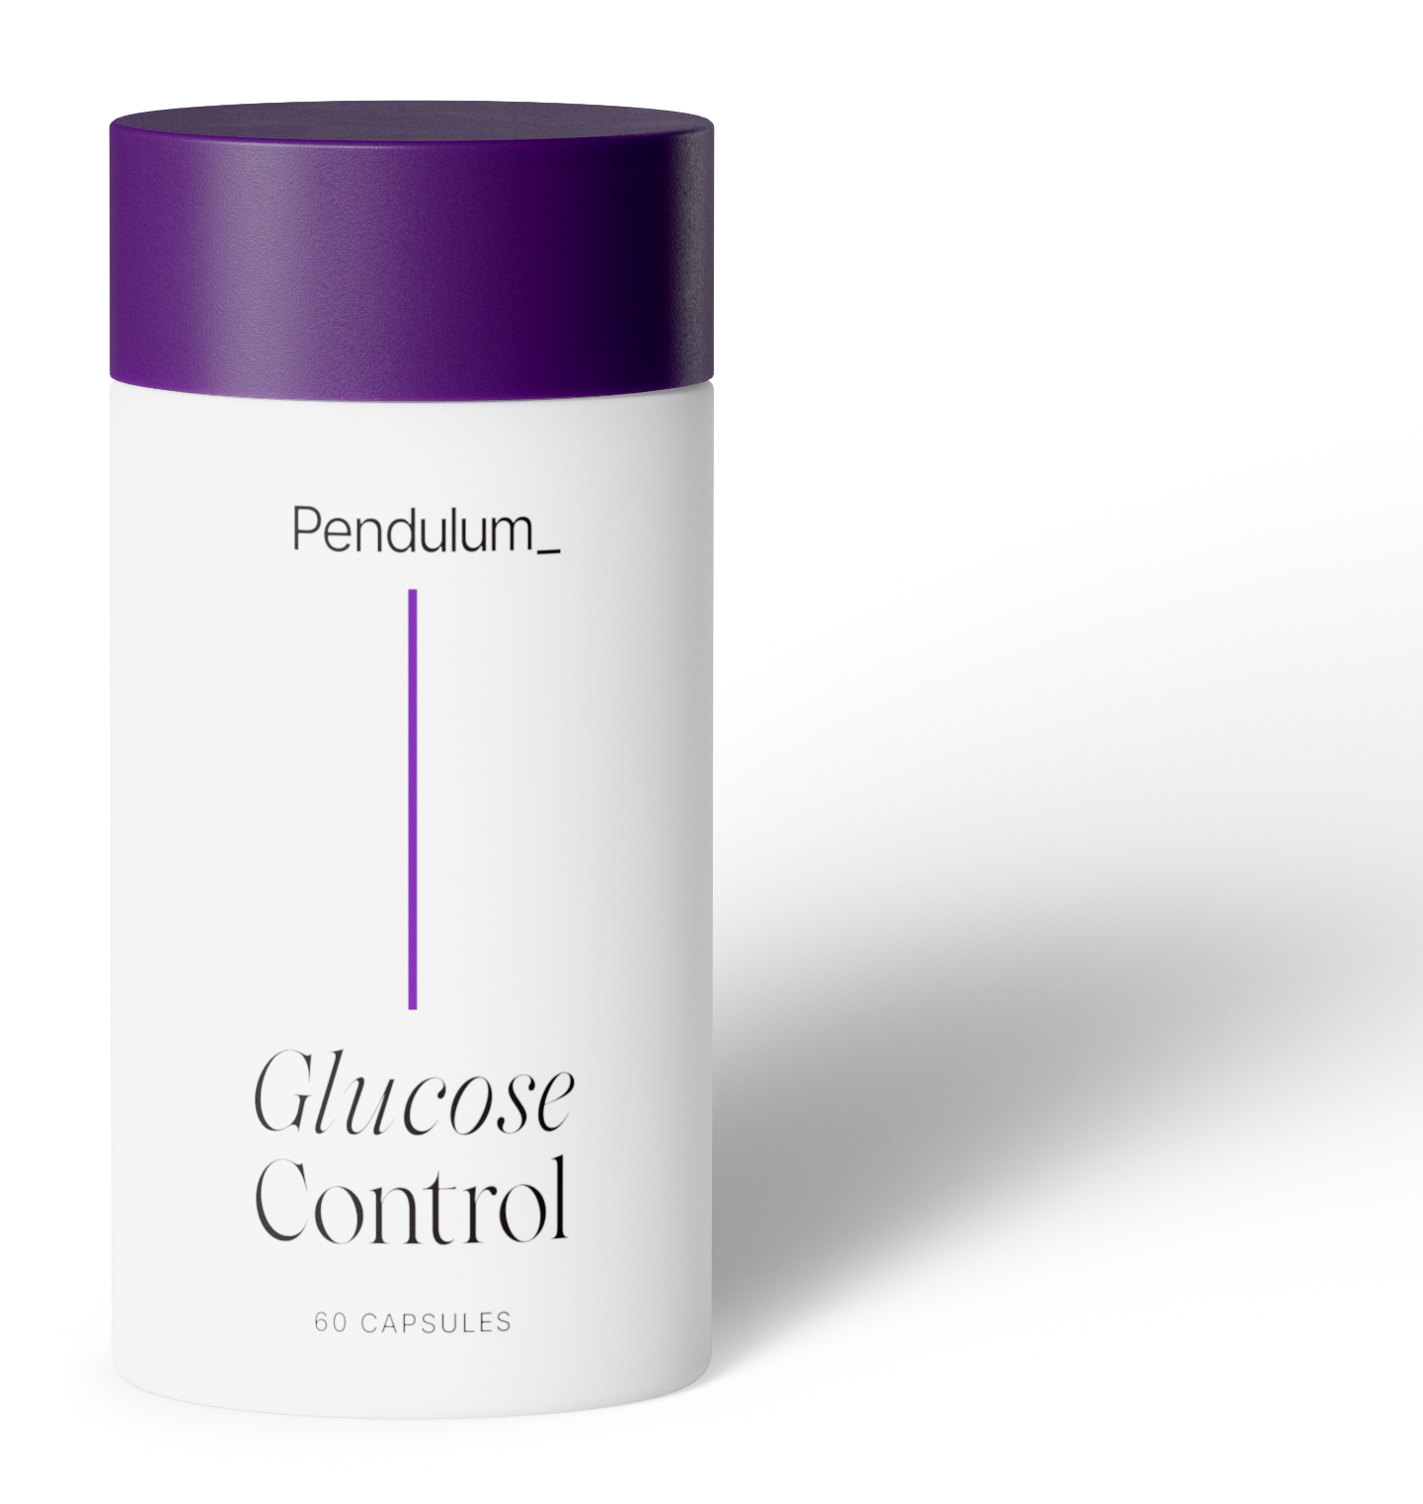

Thank you

