Slide 1

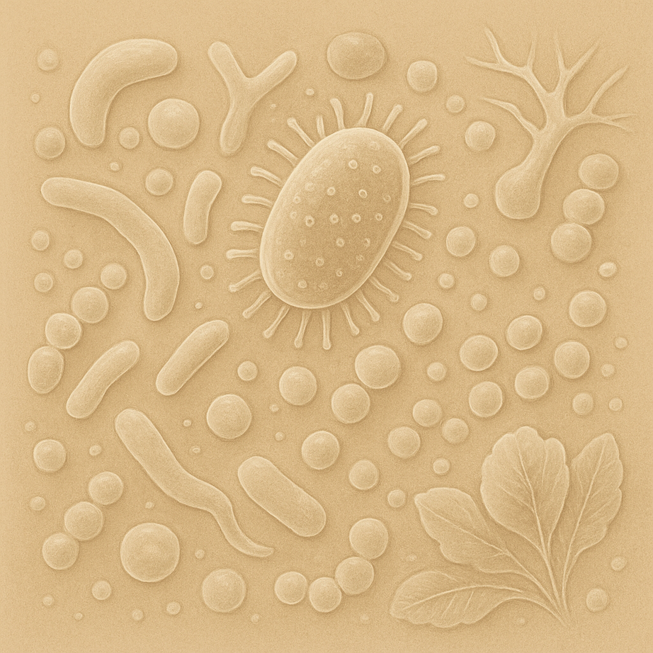


FROM EVIDENCE TO ACTION:
A PRACTICAL FRAMEWORK FOR BUILDING A RESILIENT MICROBIOME
KAYTEE HADLEY, MS, RDN, IFMCP, CPT
FOUNDER OF THE INTEGRATIVE CENTER FOR IBS AND SIBO

Slide 2
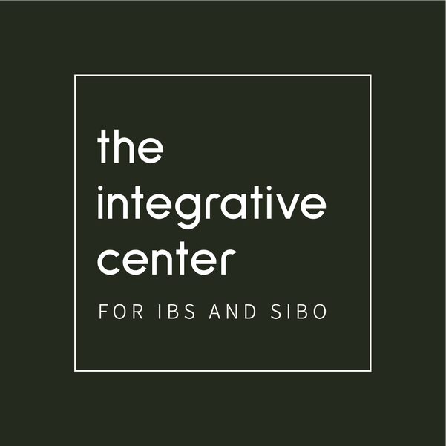


KAYTEE HADLEY
MS, RDN, LD, IFMCP, CPT
“The Anti-IBS Dietitian”
  Functional Medicine Dietitian
  Founder of The Integrative Center for IBS & SIBO
  Brand consultant and spokesperson
Notes:
work with patients experiencing:
Chronic digestive symptoms
Food sensitivities
IBS & SIBO
Fatigue and inflammation

Slide 3


Who we see:
  Chronic and complex
  IBS, SIBO, IBD
  “Everything looks fine”
  Fatigue, immune, skin, and metabolic concerns

Slide 4
Who we see:
  Chronic and complex
  IBS, SIBO, IBD
  “Everything looks fine”
  Fatigue, immune, skin, and metabolic concerns
How we help:
  Root cause, holistic approach
  Toolkit for symptoms
  Lifestyle sustainability
  Non-diet approach

Slide 5
THE MICROBIOME BOOM
How do we help patients build a resilient gut microbiome?
Research
  Microbes, strains, & metabolites
  Isolated interventions
  Biochem and pathways
Clinicians
  Diet patterns, lifestyle, & habits
  Integrated approach
  Practicality and sustainability

Slide 6
FRAMEWORK FOR MICROBIOME RESILIENCE
Lifestyle
What to eat
How to eat
When to eat
Targeted Supplementation

Slide 7

2 TIERS
Tier 1: Foundations
  Lifestyle (nutrition, stress, movement, sleep, nature)
  Targeted supplementation
  Eating patterns & behaviors

Slide 8
2 TIERS
Tier 1: Foundations
  Lifestyle (nutrition, stress, movement, sleep, nature)
  Targeted supplementation
  Eating patterns & behaviors
Tier 2: When foundations are not enough
  Functional testing (SIBO, dysbiosis, stool test)
  Therapeutic supplements
  Personalized interventions

Slide 9

LIFESTYLE
Stress & Nervous System
Movement
Sleep
Community
Time in nature

Slide 10

STRESS & NERVOUS SYSTEM
  Directly impacts digestion & motility
  Chronic stress → shifts microbiome composition
  Reduced vagal tone → impaired gut signaling
Rest & digest state is required for optimal function

Slide 11
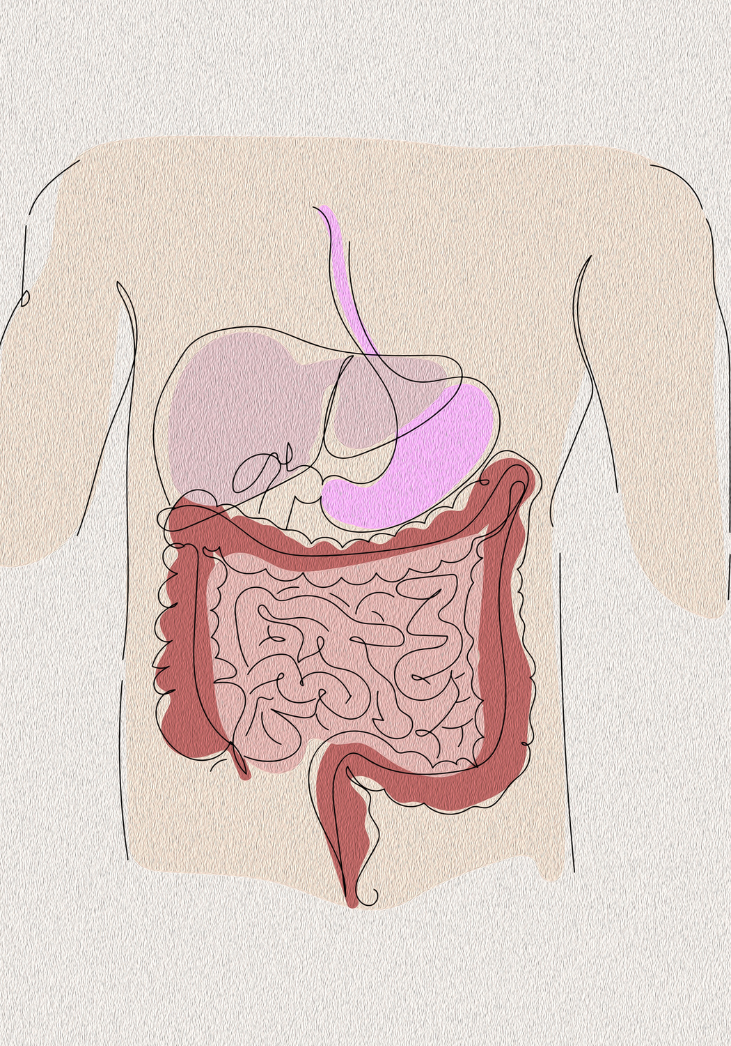
SUPPORTING THE VAGUS NERVE
  Breathwork
    Diaphragmatic breathing
  Humming, loud singing
  Gargling
    2x a day, 60 seconds
  Meditation
  Yoga
  Cold exposure
  Social connection
→

Slide 12

MOVEMENT
  Supports gut motility
  Increases microbial diversity
  Reduces inflammation
  Improves insulin sensitivity
  HIIT vs light movement

Slide 13

SLEEP
  Regulates circadian rhythm of the microbiome
  Poor sleep → increased inflammation
  Impacts gut permeability
  Linked to metabolic and GI dysfunction
Sleep is a primary regulator of microbiome function

Slide 14

COMMUNITY, CULTURE & CONNECTION
  Shared meals support nervous system regulation
  Cultural diversity → microbial diversity
  Enjoyment improves digestion and tolerance
Connection is a key driver of microbiome resilience

Slide 15

TIME IN NATURE
Nature supports microbial diversity & nervous system regulation

Slide 16

What
NUTRITION
When
How

Slide 17
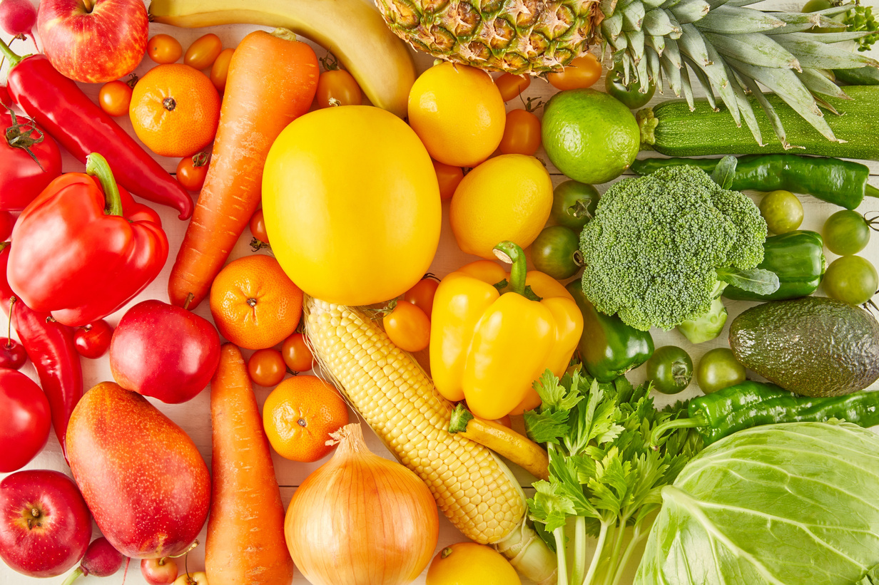
WHAT TO EAT
  Diversity
  Whole foods
  Fiber & prebiotics
  Fermented foods & probiotics

Slide 18
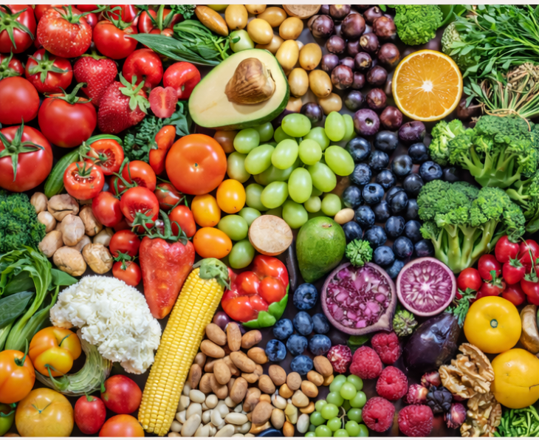
DIVERSITY
Microbiome resilience
Focus on:
  30 + unique plants/week
  Variety of plant foods
  Color diversity

Slide 19
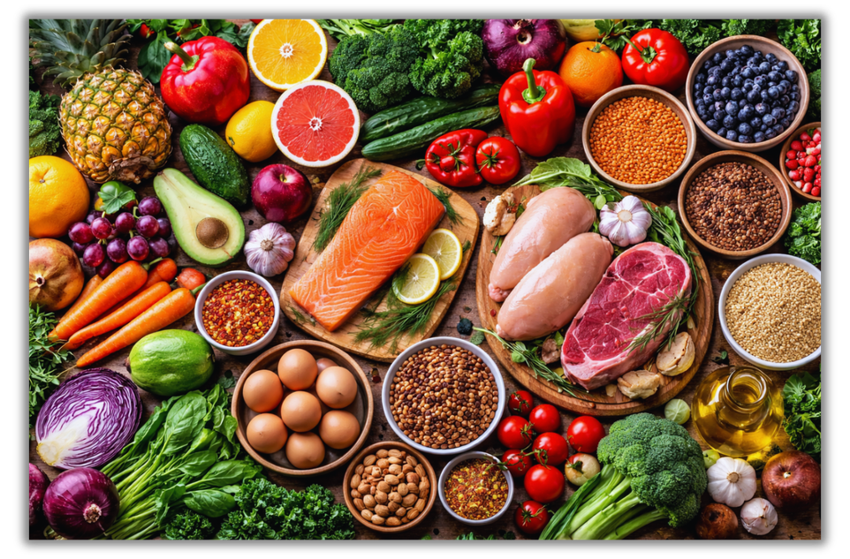
WHOLE FOODS
  Polyphenols & antioxidants → support microbial diversity
  Omega-3 fatty acids → reduce inflammation & support gut barrier function
Whole foods provide the foundation for microbiome resilience
Notes:
- Whole foods should be prioritized

Slide 20
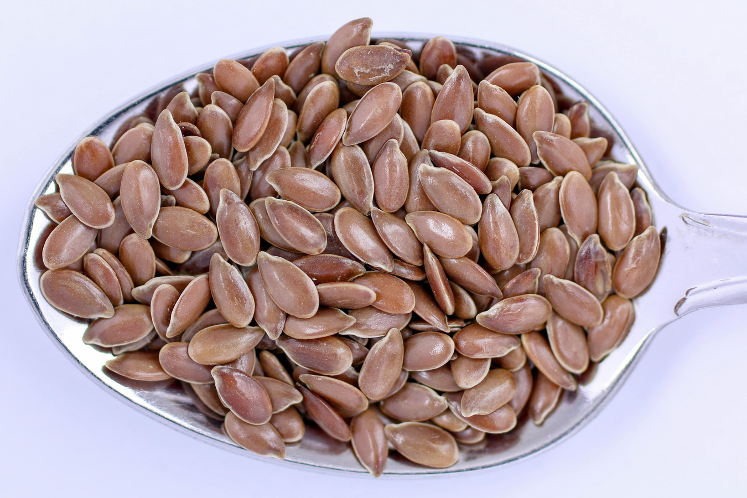
FIBER
  Supports SCFA production & microbiome function
  Intake is 10-20g/day vs RDA of ~25-38g/day
  Tolerance varies → increase gradually
  Common sources: plants, legumes, seeds, whole grains
  Supplement options: psyllium, PHGG

Slide 21
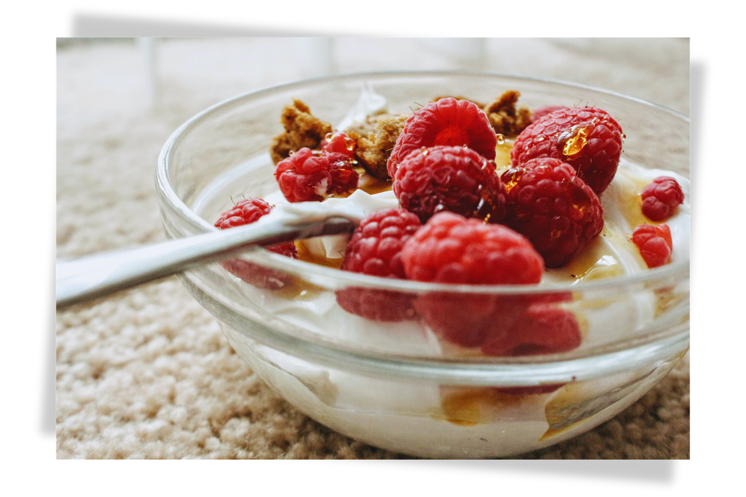
PREBIOTICS
  Selectively fermented by beneficial microbes
  Support microbial balance & function
  Tolerance varies between individuals
  Common sources: garlic, onion, asparagus, legumes
  Supplement options: targeted prebiotic fibers

Slide 22
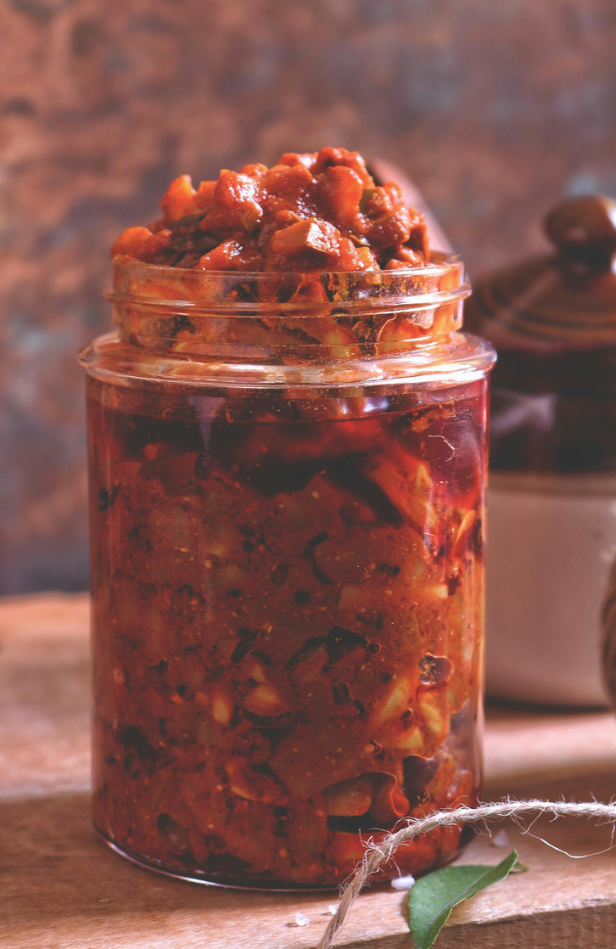
FERMENTED FOODS
  Increase alpha diversity
  Introduce beneficial microbes to the gut
  Decrease inflammatory markers
  Common sources: yogurt, kimchi, kombucha, tempeh, raw pickles, miso
  Supplement options: probiotics

Slide 23
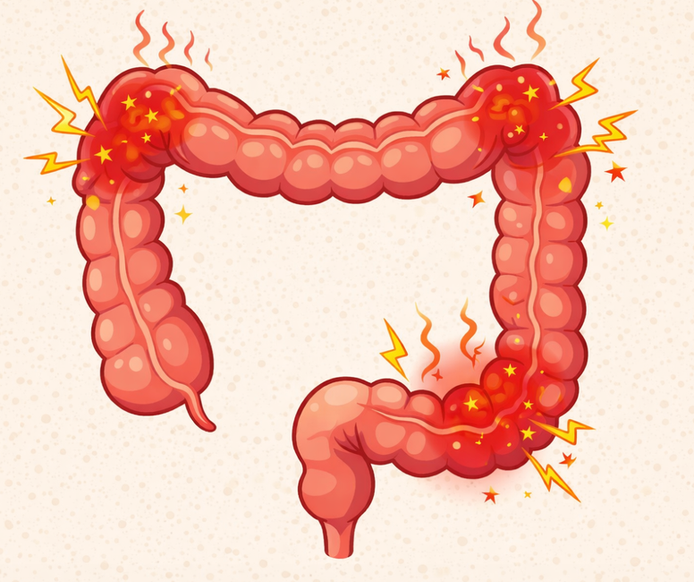
WHEN TOLERANCE IS LIMITED
  Not all patients tolerate foundational strategies
  Consider SIBO, dysbiosis, IBS, histamine intolerance
  Start low, go slow, personalize

Slide 24
FOUNDATIONAL VS THERAPEUTIC
Omega 3 fatty acids
Vitamin D
Vitamin B12
Digestive enzymes
Bitters
Magnesium

Slide 25

SUPPLEMENTS
  Clinically effective dosing & formulations
  Third-party testing & certifications
  Avoid unnecessary additives & fillers
Quality and dosing determine efficacy
Notes:
- make sure to add more is not always better
- can say D+K, EPA+DHA etc

Slide 26
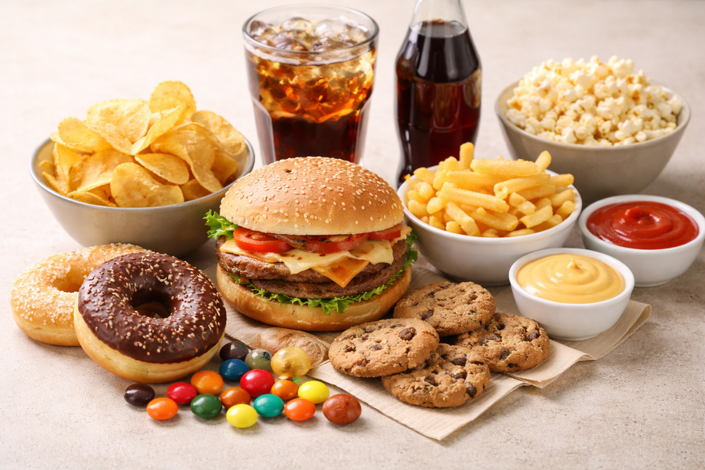
FOODS TO MINIMIZE
  Highly processed foods
  Low-fiber diets (carnivore)
  Added sugars
  Saturated fat
    Beef tallow vs seed oils
  Alcohol
  Excess caffeine

Slide 27
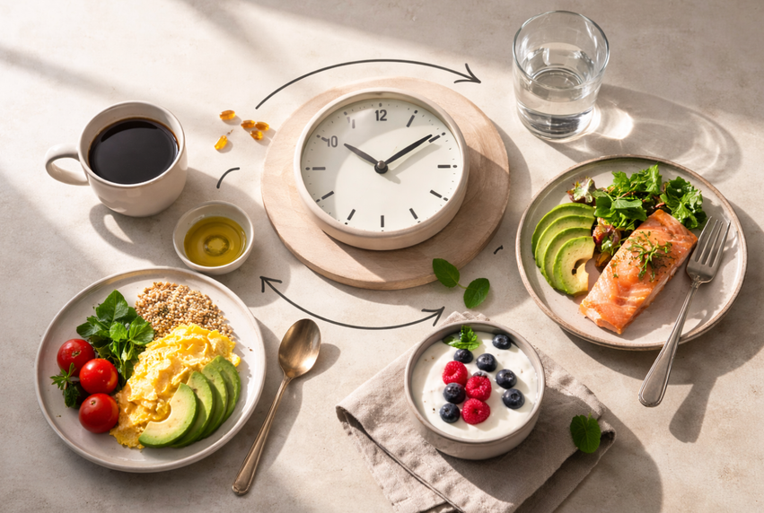
WHEN TO EAT
  Consistent meal timing
  Reducing constant grazing
  Spacing meals
    Snack 2-3 hours apart
    Meals 4-5 hours apart
  Overnight fasting (~10-12 hours)
  Stop eating 2-3 hours before bed

Slide 28
HOW TO EAT
Minimize distractions
Engage sensory input
Maintain posture (during + after meals)
Incorporate bitter stimulation (bitters, greens)
Intentional eating pace
Supports parasympathetic activation
Initiates cephalic phase digestion
Supports gastric emptying + reduces reflux risk
Promotes digestive secretions
Enhances satiety signaling + food tolerance

Slide 29

CASE STUDY
  24 yo F
  Chronic GI symptoms
  Bloating, gas, alternating D/C
  Fatigue, brain fog, skin rashes
  PMH: H. pylori, anxiety
  Diet: low fiber & highly processed foods
Notes:
- This pt presents with classic microbiome dysfunction symptoms. High MSQ score
- history of stomach problems & low energy
- Stool testing + history:
Dysbiosis, possible SIBO, leaky gut
- Diet is a major contributor: Eats low fiber. low microbial diversity
Higher processed foods → inflammation

Slide 30
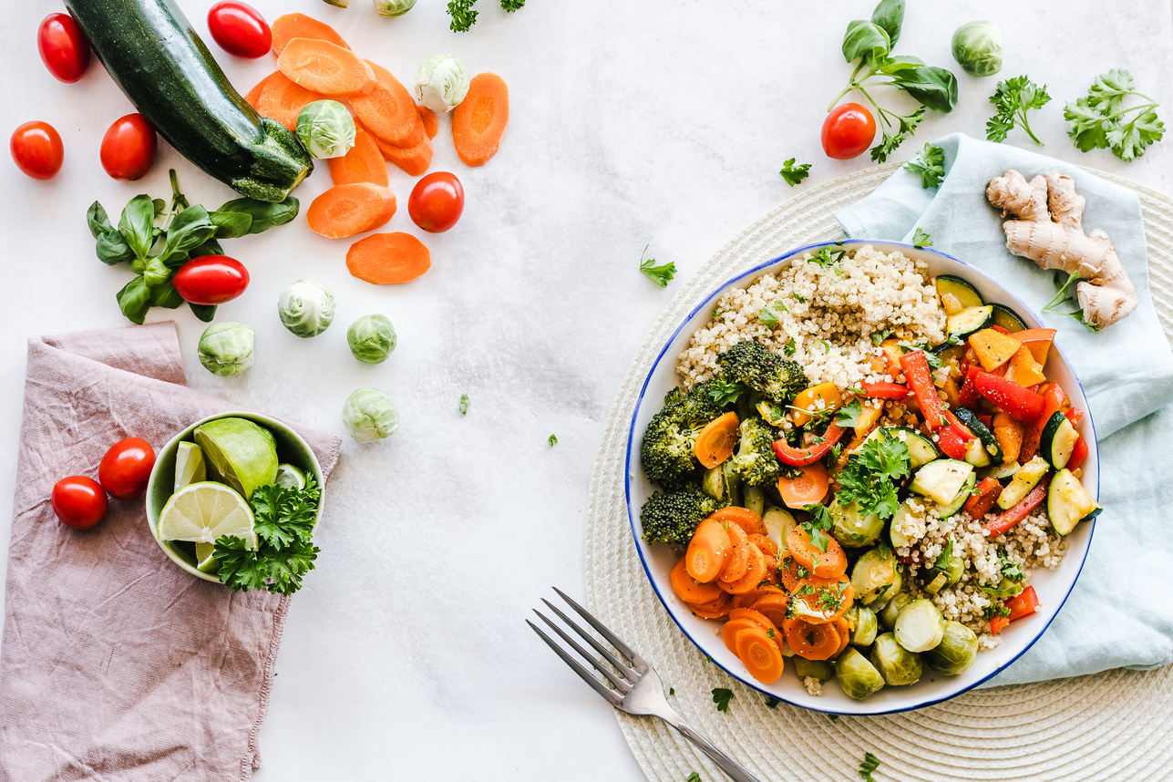
NUTRITION APPROACH
  Increase plant diversity
  Prioritize fiber & prebiotic-rich foods
  Include fermented foods
    (2–4 servings/day)
  Balance macronutrients
  Establish a consistent eating schedule
  Increase omega-3-rich foods
  Minimize ultra-processed foods
  Limit red meat & alcohol

Slide 31

LIFESTYLE APPROACH
  Prioritize a consistent sleep schedule
  Engage in regular physical activity
  Incorporate daily stress management (mindfulness)
  Foster social connection + community

Slide 32
OUTCOME
After 4-8 weeks:
  Reduced bloating & GI discomfort
  Improved energy + mental clarity
  Better tolerance to previously triggering foods
  More regular bowel movements
  Reduced overall symptom burden

Slide 33
CONCLUSION
  A resilient microbiome is built through consistent daily habits
  Clinicians guide patients by addressing what, when, and how they eat and live
  These foundations create the conditions where targeted therapeutic interventions can be effective

Slide 34
Q&A
Don't hesitate to ask questions!

Slide 35


THANK YOU!
KayteeHadley.com
Kaytee@KayteeHadley.com

