Slide 1




Fermented Foods and the Microbiome: Building the Science and Market Through the Canadian Fermented Food Initiative
Jeremy Burton
Departments of Surgery, Microbiology & Immunology

Slide 2

A holobiont is an assemblage of a host and the many other species living in or around it, which together form a discrete ecological unit through symbiosis
https://www.quantamagazine.org/how-microbiomes-affect-fear-20191204/
Notes:
We see pictures like this but still most don’t believe this, that we are one.

Slide 3
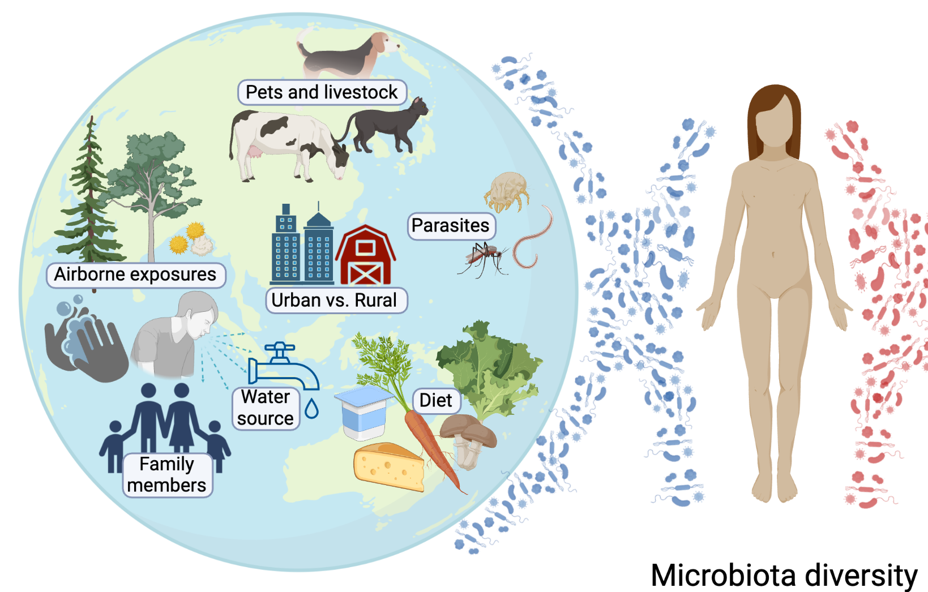
If you are a germaphobe then this planet is not good for you

Slide 4
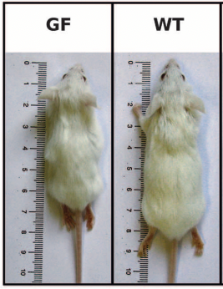
Science 19th February 2016

Slide 6














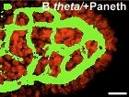









An organ?
Angiogenesis
Vitamins, cofactors, bioenergetics
Signaling molecules
Epithelium and Immune development and modulation

Slide 7
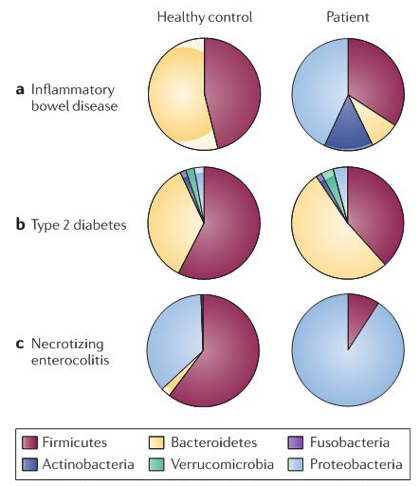
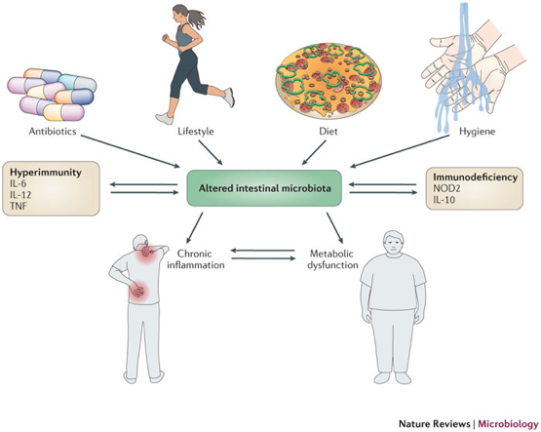
“Dysbiosis”-We noticed that things changed
Sommer et al. Nat Rev Microbiol 2013
Spor et al. Nat Rev Microbiol 2011

Slide 8

Food pasteurisation and hygiene have reduced foodborne illness, but have we inadvertently lost something else?
AMERICAN meal plan 1.4 × 10⁶ CFU/day (limited live microbes, dead and microbial products?)
Consumption of fermented food in North America is thought to be moderate
Limited bacterial ”food” substrates in diets (prebiotics) are found in fruit and vegetables

Slide 9
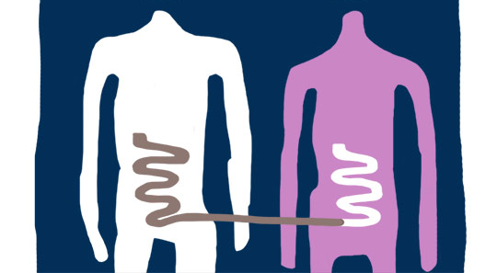


Through faecal microbiota transplant (taking healthy stool and putting it into a diseased person), we have realised that microbes are powerful potentiators of health (e.g. immuno oncology, neurodegenerative potentials)
Not very practical

Slide 10

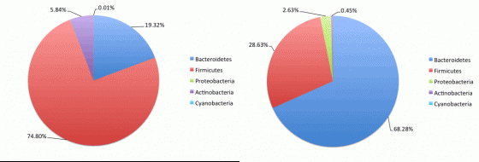
Diet is most practical
What we eat our microbes also “eat”
Diet determines products that are microbially produced and those that impact our health
We have dietary guidelines for various conditions relating to nutritional and other inputs but not for microbiota
Is it enough? Do we need to add microbes and their products?

Slide 12
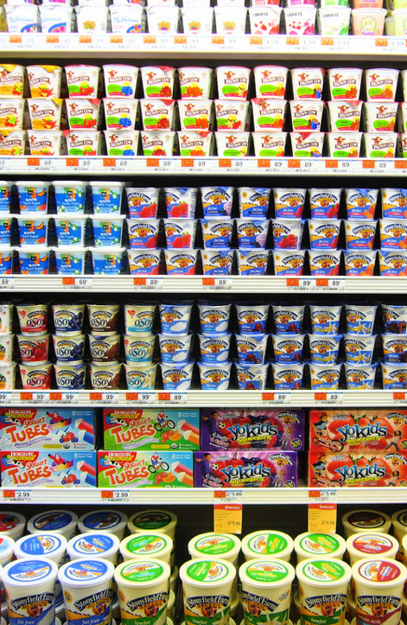


Probiotics
‘Live microorganisms that, when administered in adequate amounts, confer a health benefit on the host’
Adding microbes directly
They are not yogurt, fermented foods or good bacteria in your intestinal tract
Typically, products contain 1 to 10 types of microbes as pure strains
Typically purchased, not homemade

Slide 13

Fermented food
Microbes and their molecules that can potentially influence our health

Slide 14
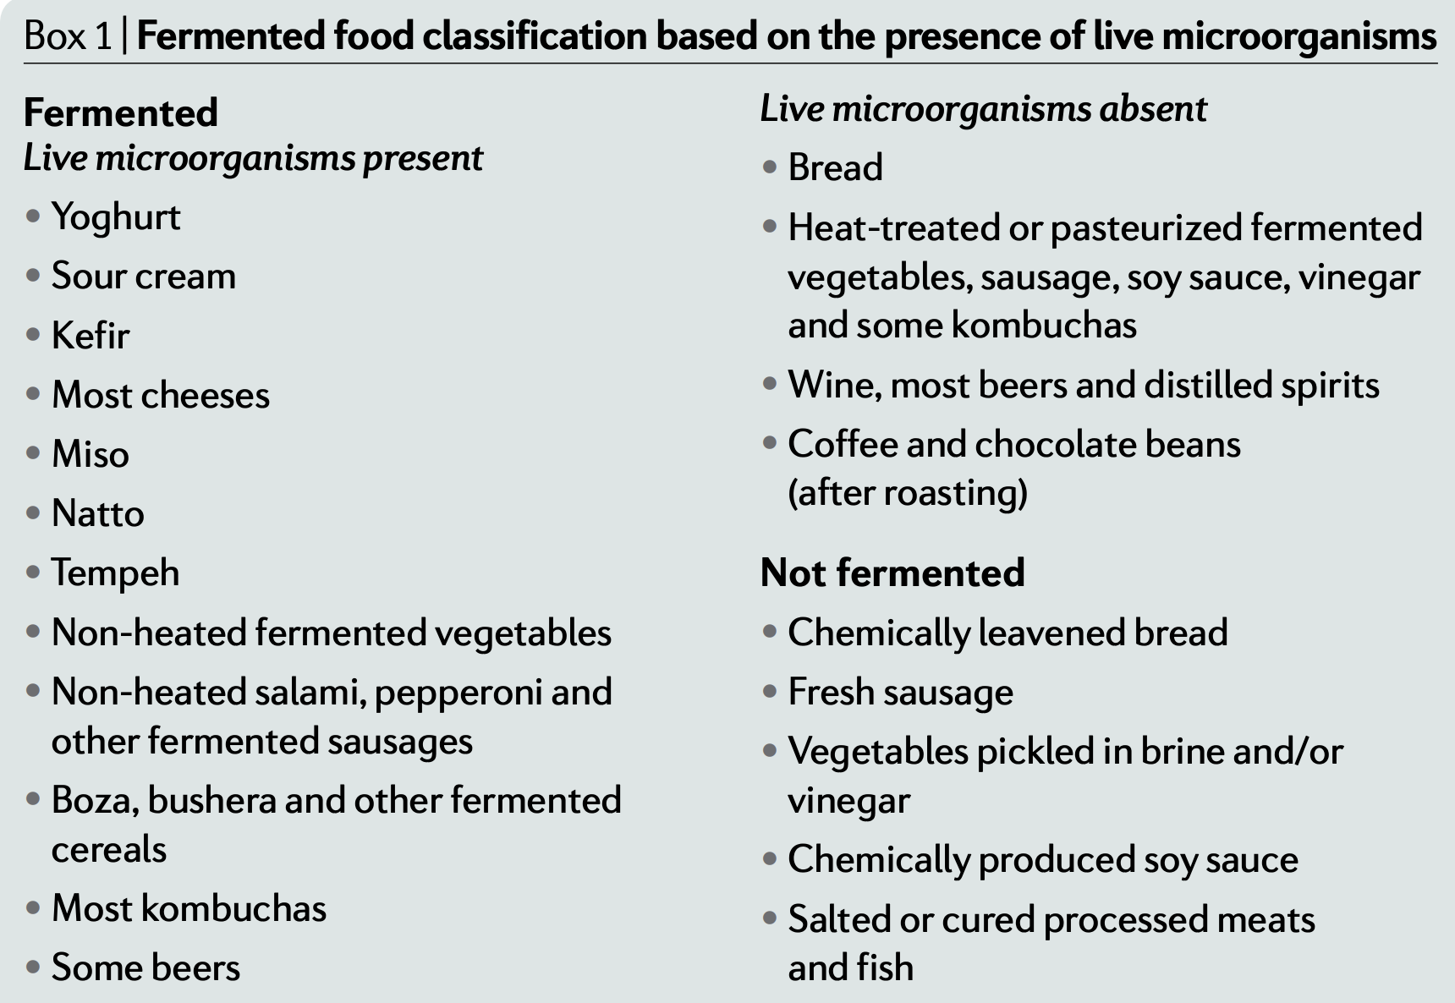
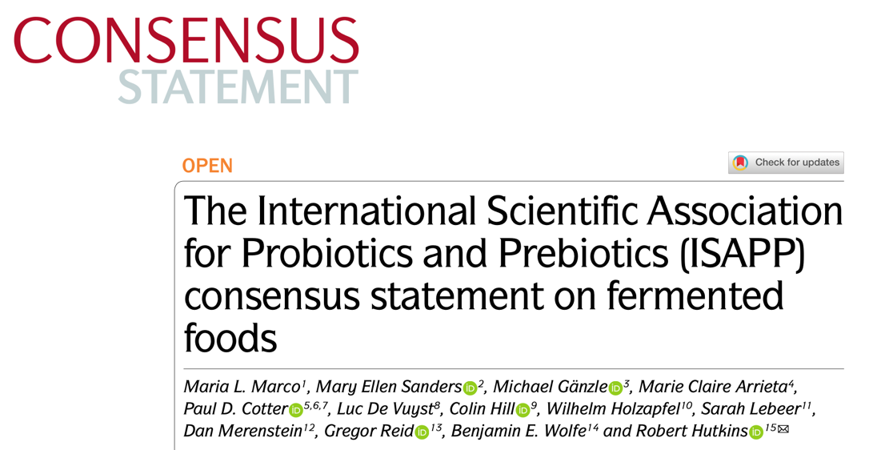
What is fermented food?

Slide 16
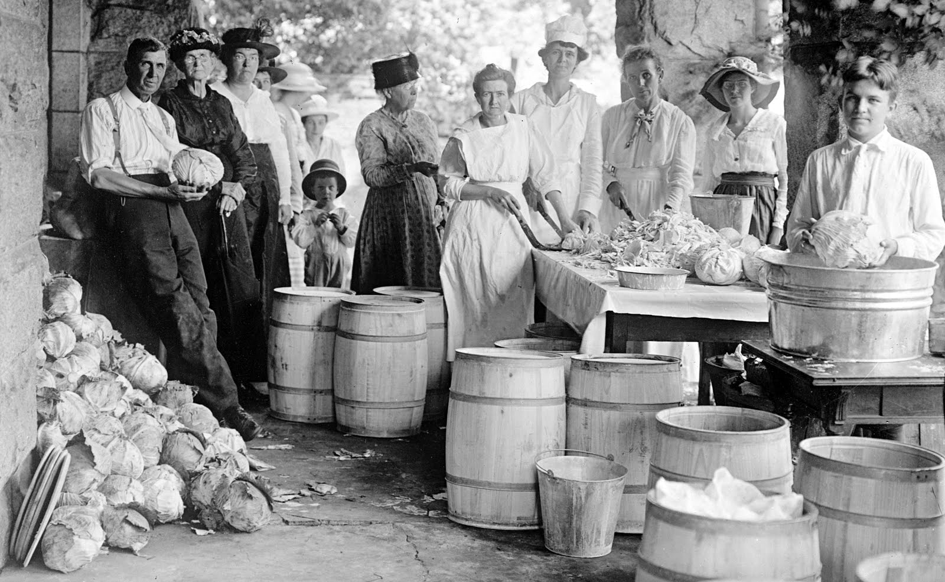
https://guideofgreece.com/

Slide 17
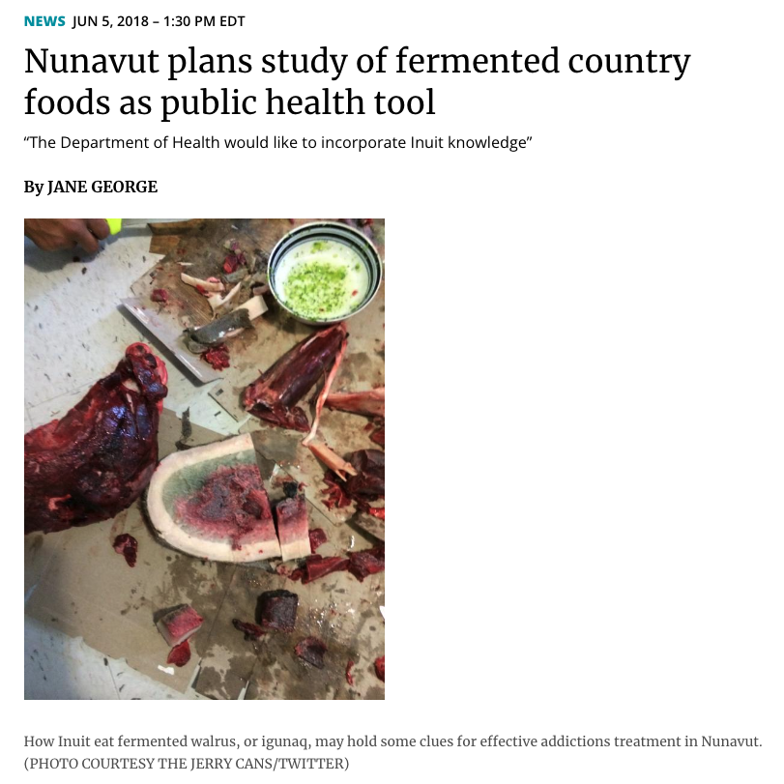

Slide 18
Raw ingredients
Microbes
Transformation
Milk
Vegetables
Sugar
Nuts
Grains
Soy
Fish
Meat
Added or present
Why ferment food?
Preservation, taste, health, sustainability?
Biochemical
pathways

Slide 19
Vastly different in their composition
SCFA’s (acetate, lactate) or alkaline products
Microbes
Texture/ structure
Other metabolites (vitamins, organoleptic molecules)
Which components are important for human health?
Prebiotic, microbes, postbiotic, metabolites, structure?

Slide 20

From known benefits to new frontiers in fermented foods

Slide 21

Not new
Anson’s voyage (1740-42) brought scurvy and lack of fresh food to the public’s attention. Jame Lind showed citrus prevented
The Cook voyages (exploration of Australia and New Zealand 1768-1719) introduced “Sour Kroutt”, but Asian cultures had been eating it for thousands of years.

Slide 22


Alcohol, undesirable metabolites, microbes and toxins are potentially present

Slide 23

Health benefits?
Even fermented foods of the same type can be quite heterogeneous in their content
Product-specific benefits?
No guidance yet on RDI etc.
Fermented foods with microbes are not necessarily probiotic
Unless specifically added or proven
That does not mean they aren’t beneficial, as shown by large population studies.
Mechanisms? Likely many

Slide 24
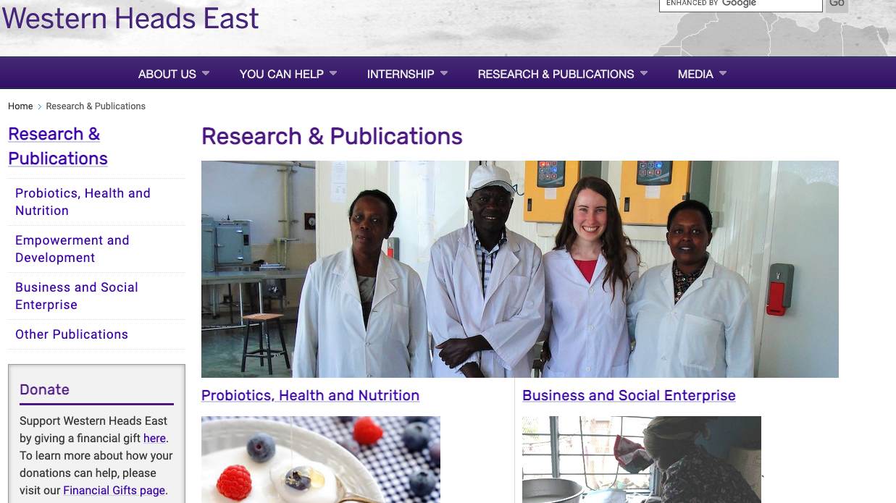

Gregor Reid
Twenty years has led to 250 social enterprises producing yogurt for more than 260,000 consumers a week in Tanzania

Slide 25

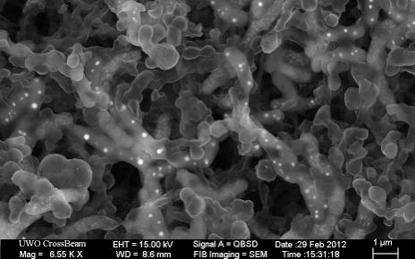
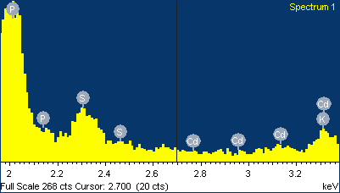

Dr. Jordan Bisanz
Heavy metals added to Lactobacillus
250 g of yogurt (probiotic & fermented food) per day reduced arsenic uptake by 75% and mercury by 36% within three months.

Slide 26
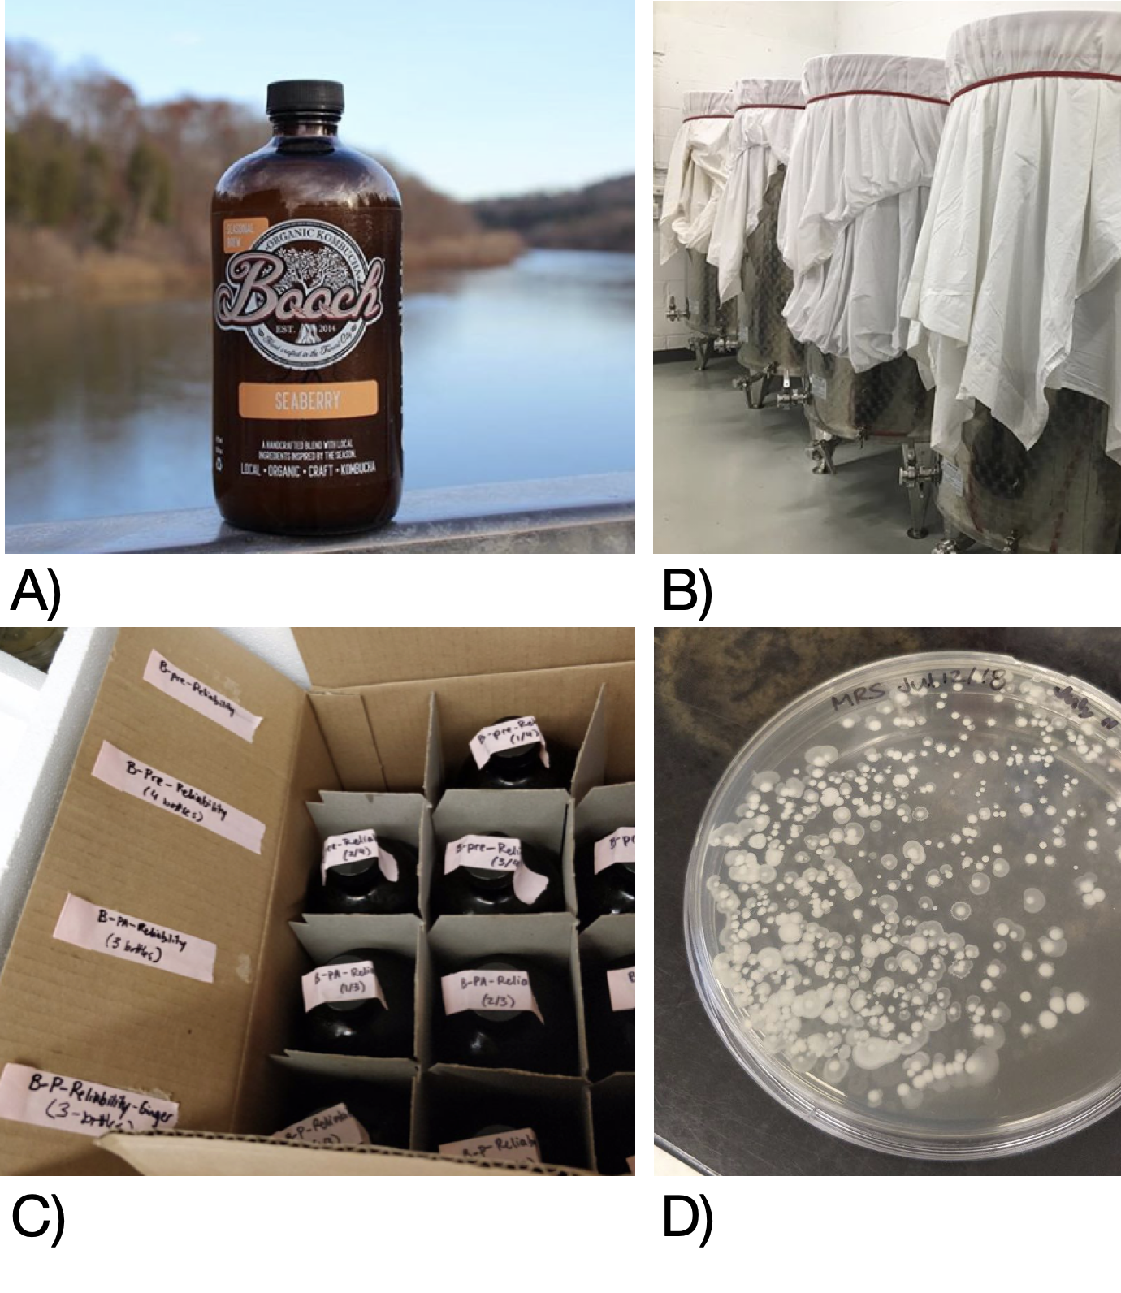


Exciting local fermented foods are emerging!

Slide 27
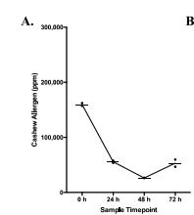
Fermentation can reduce allergen content

Slide 28
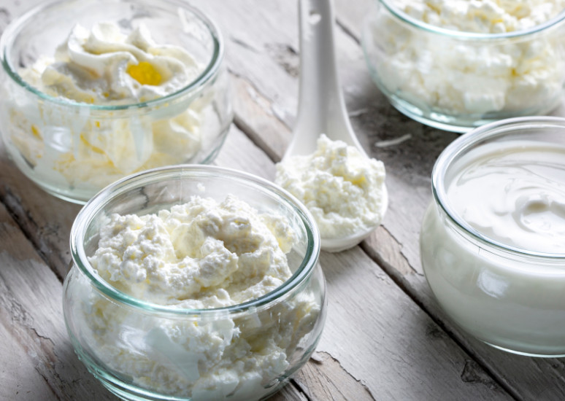

Fermented foods are shown to decrease chronic disease in population studies
In 1,962,774 participants, yogurt and fermented dairy consumption decreased cancer risk (~13-19% less likely)
But there are many other fermented foods. Not all consume dairy traditionally
Large population-based studies have shown the general benefits of consuming fermented foods, but the reasons for their benefits have been elusive.
https://www.dairyfoods.com/articles/96408-the-benefits-of-using-cultured-dairy-products-as-ingredients

Slide 29



Slide 30
A practical way of showing the benefits of fermented food, not focused on single products

Slide 31

In reverse. Medicine to fermented food

Slide 32

Patients diagnosed with prostate cancer
No treatment
Androgen deprivation therapy
ADT + Abiraterone acetate (AA)
AA
250
mg
30
Oral
Systemic
Systemic
n=33
n=21
n=14
Notes:
To test this, we performed a clinical study on 68 prostate cancer patients in which we sampled the rectal microbiota of those receiving either no active treatment, traditional androgen deprivation therapy, or androgen deprivation therapy combined with oral abiraterone acetate

Slide 33
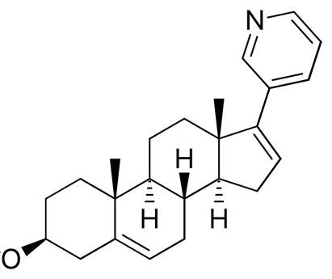
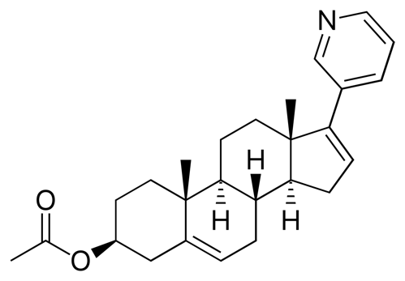
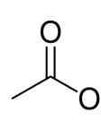
Abiraterone acetate– a poorly absorbed prostate cancer drug
N
Abiraterone
N
Decreases androgen production via CYP17A inhibition
Prodrug
Many bacterial types can utilise in colon, partially responsible for efficacy
H
>55% of parent compound eliminated in feces
Acetate
Inactive “fermentation” end product
Notes:
-Known as abiraterone acetate, which is used to treat prostate cancer, but has very poor absorption with up to 55% of the parent compound being excreted in the feces
-Notably, abiraterone acetate is a prodrug
*click*
meaning it requires hydrolyric cleavage of its inactive conjugate acetate,
*click*
in order to release the active ingredient of the drug, abiraterone, which then acts to decrease androgen biosynthesisin the body via cyp17A inhibition
-however abiraterone exhibits higher than expected efficacy in comparison to many other androgen inhibiting drugs

Slide 34
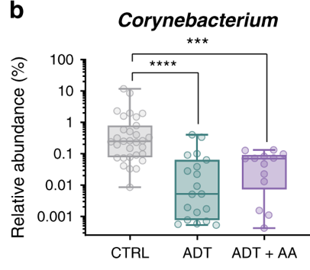
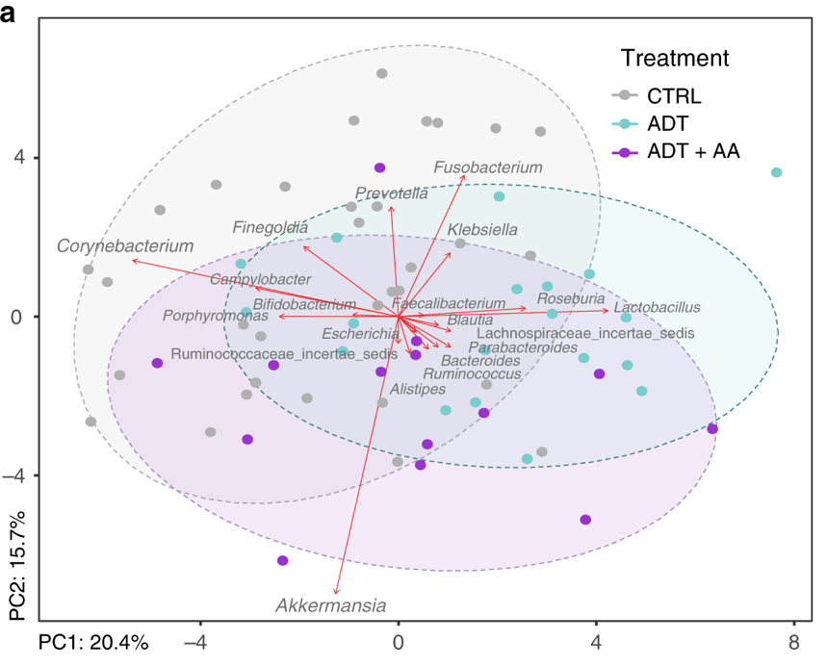
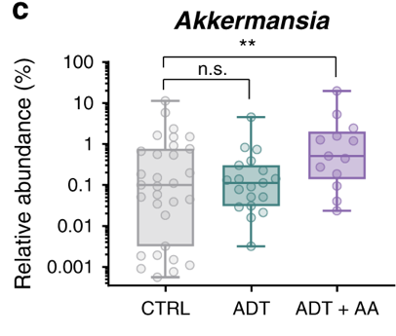
Abiraterone acetate enriches for an important commensal bacterium
~5X higher Akkermansia loads in patients receiving AA on average compared to the control group and ADT only group
Daisley et al. 2020, Nature Communications
Notes:
Following DNA extraction and microbiota sequencing, principal component analysis of the dataset revealed only 1 bacterial genus, Akkermansia, to be significantly higher in patients receiving AA
-On average, Akkermansia was approximately 5 times higher compared to patients either receiving no treatment or adt alone
-So why this was particularly interesting to us was because Akkermansia has recently been shown to be inversely correlated with a wide range of metabolic disorders including certain cancers
-Based on recent findings showing akermansia to improve response to anti-PD-1 based immunotherapy drugs as well, many research groups are actively searching for ways to improve this species through microbiota management strategies
significantly increased in relative abundance
The findings from the study demonstrate that

Slide 35



Slide 36
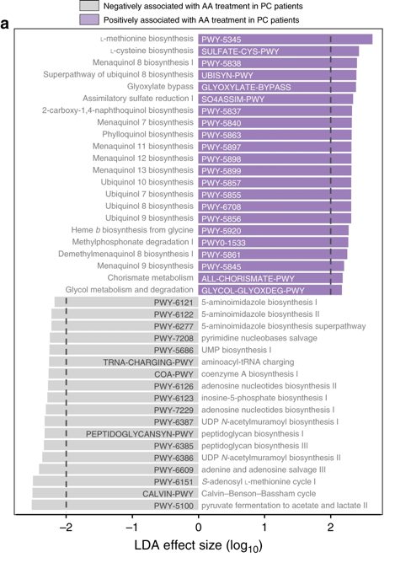
Increased vitamin K2 production
Menaquinone = Vitamin K2
Past studies show vitamin K2 to be a prospective anticancer agent
Stimulation of microbes such as Akkermansia associated with anti-cancer and anti-obesity responses
Daisley et al. 2020, Nature Communications
Notes:
Demostrating the major impact that Akkermansia can have on the functional, or rather metabolic capacity, of the gut microbiome, we identified several bacterial biosynthesis pathways predicted to be significantly altered during exposure to AA as well
*click*
-Mostly notably, nearly all bacterial vitamin K2 biosynthesis pathways were significantly elevated in patients receiving AA
*click*
-relevant to this study, past work has shown vitamin k2 is a prospective anti cancer agent with activity against both androgen dependent, and independent cancer cells in vitro
*click*
-moreover, a large European prospective study showed dietary vitamin k2 to inversely associated with development of prostate cancer
Going one step further, metabolic inferencing identified that

Slide 37
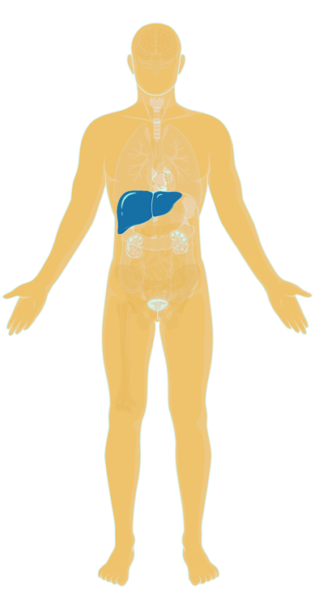
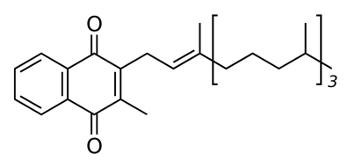

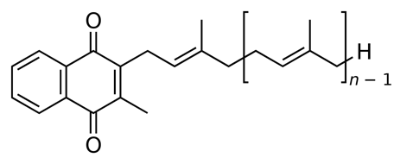

Vitamin K1 (Phylloquinone)
Vitamin K2 (Menaquinone) MK-n

Slide 38


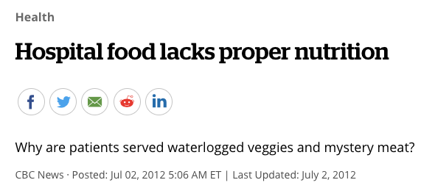
Is this how we look after our microbiota?

Slide 39

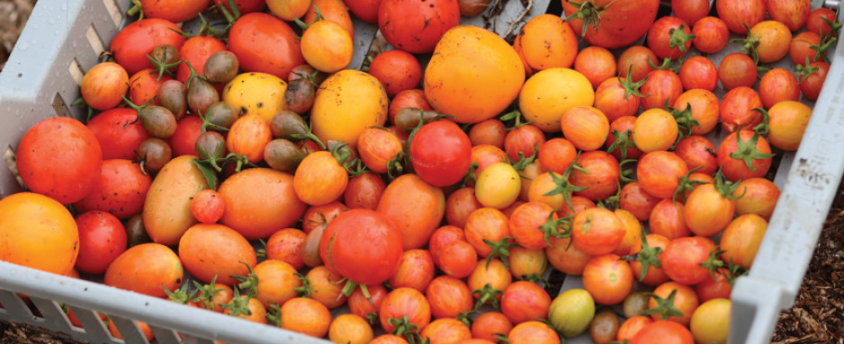

No Canadian FF intake guidelines
St. Joseph’s has aged care, veteran and mental health facilities
Planning with dieticians to study if adding a variety of fermented foods to patient’s diets broadly improves their QOL (eg. bowel and cognitive functions)
Started growing our own produce. Next step: fermentation!

Slide 40
Not everyone likes fermented food
Those who consume more fermented foods tend to be younger, have a partner, higher education, greater wealth, and children. The elderly eat less, especially women.
Deliver fermented food in pill form?

Slide 41

In our research, we found that a prostate cancer drug was partly effective because it contained an acetate group, which promoted beneficial bacteria.
Acetate is common in fermented foods, including ACV made from fermented apple juice. It is ubiquitous in the ‘health food’ market in liquid and powder forms.
Usually, acetate is absorbed quickly, but when bound within food matrices or a drug (Abi), like in some fermented foods, it reaches lower in the digestive tract and becomes more available to bacteria.

Slide 42
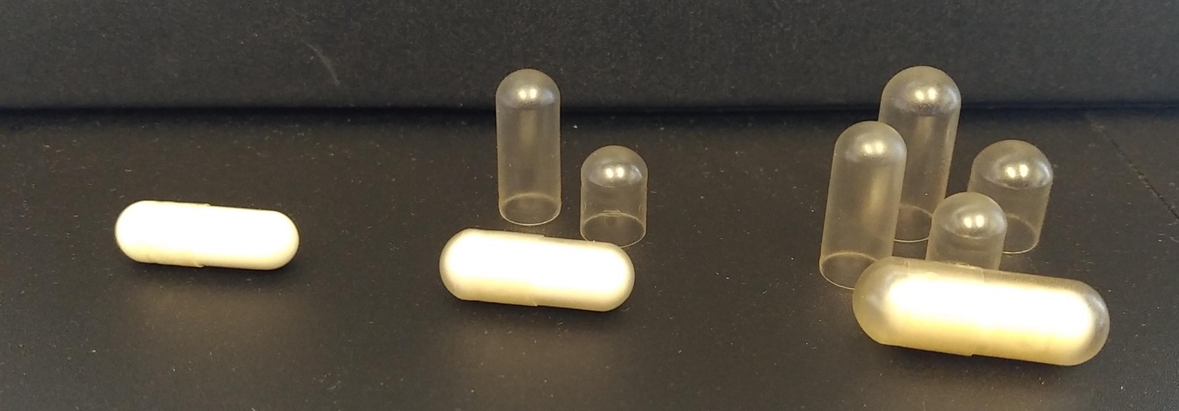
Delayed-release ACV capsules
Capsules are not typically enteric-coated to help with delivery to the colon
Delayed-release (DR) capsules to encase the commercial ACV capsules
6X ACV capsules daily

Slide 43

A pilot study involving 16- to 35-year-olds using antidepressants and mood stabilisers examined whether modulating the microbiota can prevent weight gain, a common barrier to treatment compliance.
These individuals typically have a poor diet and do not consume fermented food products, so the study tests substituting delayed-release ACV for 3 months.

Slide 44
Preliminary results only- see full results Translational Psychiatry (accepted)

Slide 45
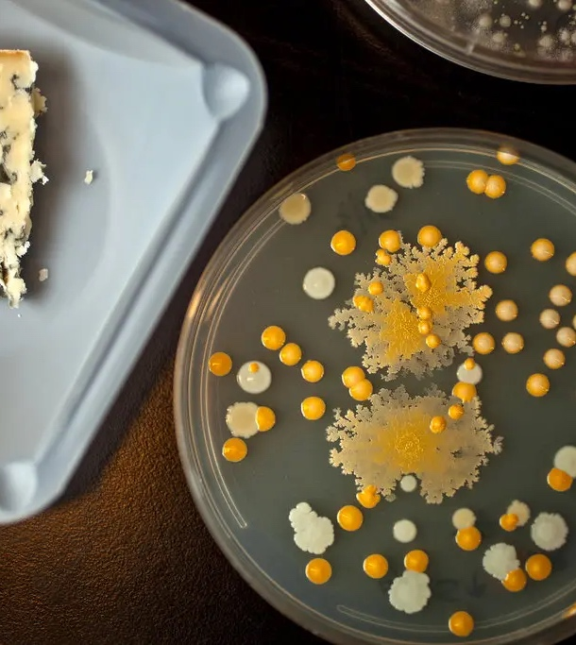
Microbes are incredibly powerful potentiators of health, but we need more accessible treatments to radically modulate the microbiota in a sustainable way
Not all fermented foods are equal in their health benefits but are patient populations could really benefit from their consumption

Slide 46

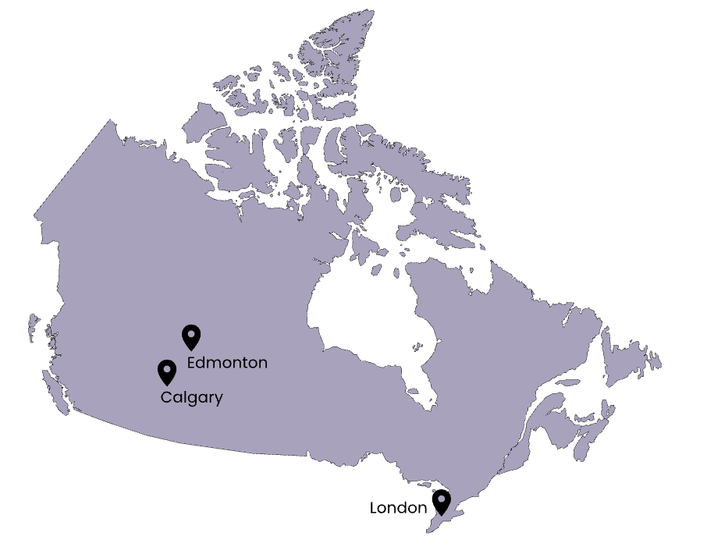




The Initiative
The Canadian Fermented Foods Initiative (CFFI)

Slide 47

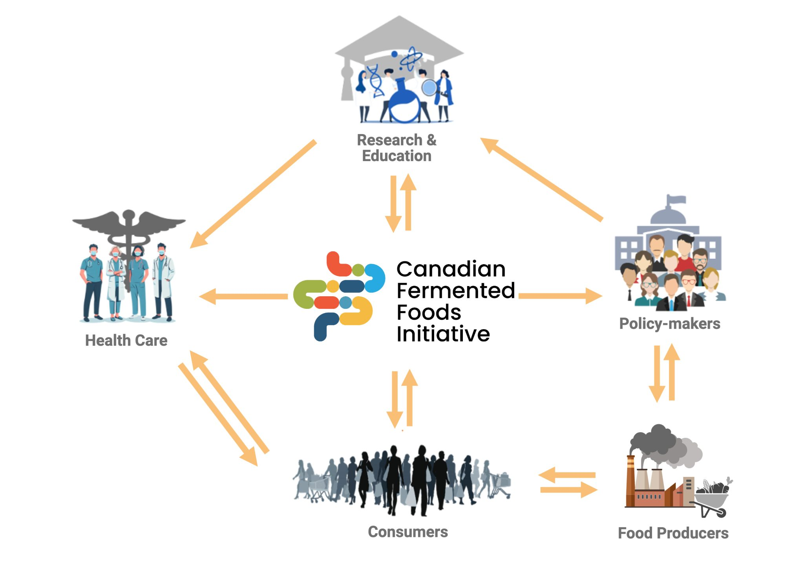
Supported by:
The Initiative
A nationwide effort to unlock the potential of fermented foods for public health, scientific innovation, and sustainable food systems.
Vision: To establish Canada as a global leader in fermented food research, education and innovation.
Notes:
By Jeremy, Raylene, Ben

Slide 48






Mission
To advance the role of fermented foods in health and food systems across Canada
Chef, master fermenter and teacher, Connor Flynn

Slide 49
Steps
Step 1
Step 2
Step 3
Review the evidence
Population survey
Kombucha study
Canadian landscape (regulatory, education, industry…)
Website
Workshop
Collaboration
Education & Outreach
Advance Research
Support Industry
Change Policy
Notes:
By Jeremy, Raylene, Ben

Slide 50
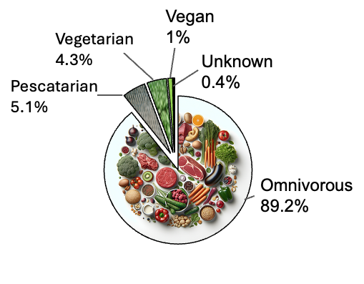

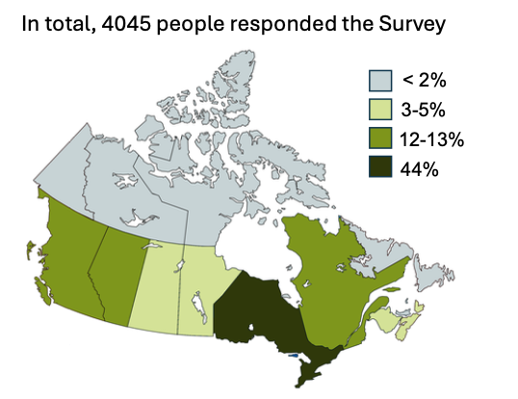
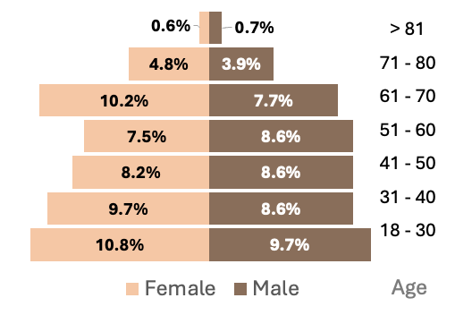
Fermented Food Consumption Patterns
What do Canadians Say?
4,045 Surveyed Canadians
Notes:
Overall, 25.7% of respondents reported consuming all 18 listed fermented foods at least once. Cheese (95.7%) and yogurt (93.2%) were the most consumed, while fermented fish (38.9%) and fermented cereals/grains (40.2%) were least consumed. Consumption patterns varied by age, sex, income, and education. Lower intake was seen in older adults, those with lower income or education, and those for whom health was not a primary consideration in food choice. Taste was the main motivator for consumption, with health second. Home fermentation was uncommon (10%) but more frequent among younger, more educated individuals. While there was a willingness to try new products (29.1%) and adopt home fermentation (30%), participants expressed uncertainty about their safety (18.4%) and potential health benefits (52.7%). Nonetheless, two-thirds wanted to learn more about fermented foods, and nearly half supported their inclusion in Canada’s Food Guide.

Slide 51
Fermented Food Consumption Patterns
What do Canadians Say?
% Respondents
4,045 Surveyed Canadians
Notes:
Overall, 25.7% of respondents reported consuming all 18 listed fermented foods at least once. Cheese (95.7%) and yogurt (93.2%) were the most consumed, while fermented fish (38.9%) and fermented cereals/grains (40.2%) were least consumed. Consumption patterns varied by age, sex, income, and education. Lower intake was seen in older adults, those with lower income or education, and those for whom health was not a primary consideration in food choice. Taste was the main motivator for consumption, with health second. Home fermentation was uncommon (10%) but more frequent among younger, more educated individuals. While there was a willingness to try new products (29.1%) and adopt home fermentation (30%), participants expressed uncertainty about their safety (18.4%) and potential health benefits (52.7%). Nonetheless, two-thirds wanted to learn more about fermented foods, and nearly half supported their inclusion in Canada’s Food Guide.

Slide 52
What do Canadians Say?
Sociodemographic characteristics, prior exposure to fermented foods, openness to trying new foods, and health-related behaviors are positively associated with higher fermented food consumption.
Higher education, higher income, and younger age are associated with higher fermented food consumption.

Slide 53
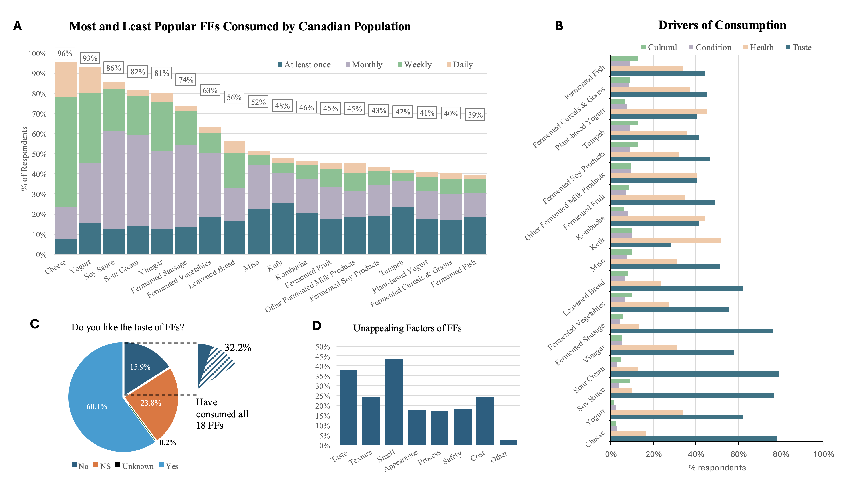




What do Canadians Say?
Drivers of consumption
#1 Taste
#2 Health
4,045 Surveyed Canadians
Notes:
Overall, 25.7% of respondents reported consuming all 18 listed fermented foods at least once. Cheese (95.7%) and yogurt (93.2%) were the most consumed, while fermented fish (38.9%) and fermented cereals/grains (40.2%) were least consumed. Consumption patterns varied by age, sex, income, and education. Lower intake was seen in older adults, those with lower income or education, and those for whom health was not a primary consideration in food choice. Taste was the main motivator for consumption, with health second. Home fermentation was uncommon (10%) but more frequent among younger, more educated individuals. While there was a willingness to try new products (29.1%) and adopt home fermentation (30%), participants expressed uncertainty about their safety (18.4%) and potential health benefits (52.7%). Nonetheless, two-thirds wanted to learn more about fermented foods, and nearly half supported their inclusion in Canada’s Food Guide.

Slide 54
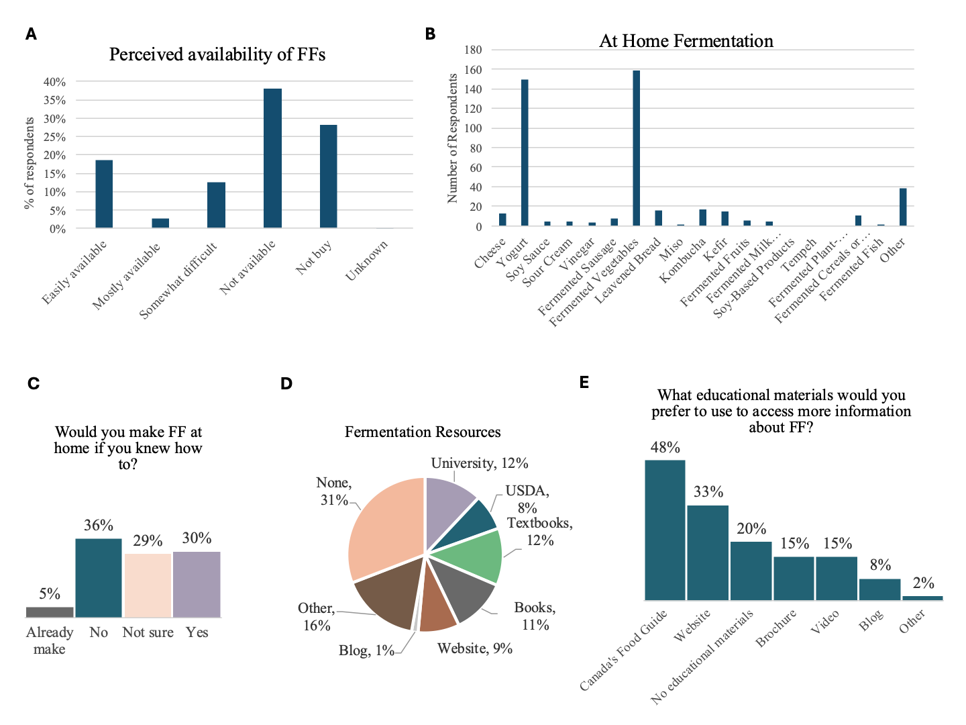
Most perceive fermented foods as not readily available, while at-home fermentation is low (10%) and primarily focused on yogurt and fermented vegetables.
What do Canadians Say?

Slide 55
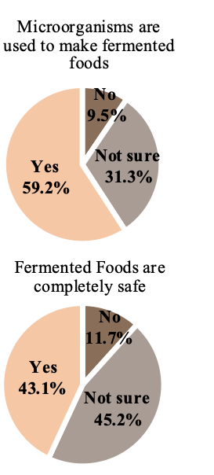
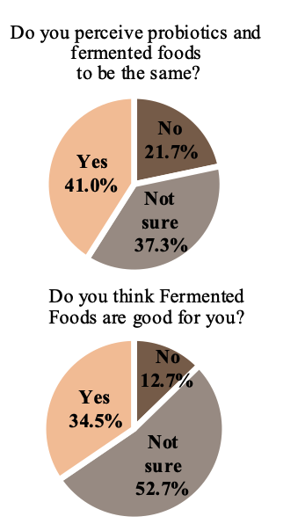

Fermented Food Consumption Patterns
What do Canadians Say?
While many Canadians recognise that microorganisms are used to make fermented foods, there remains substantial uncertainty about their safety, health benefits, and how they differ from probiotics.
Notes:
Overall, 25.7% of respondents reported consuming all 18 listed fermented foods at least once. Cheese (95.7%) and yogurt (93.2%) were the most consumed, while fermented fish (38.9%) and fermented cereals/grains (40.2%) were least consumed. Consumption patterns varied by age, sex, income, and education. Lower intake was seen in older adults, those with lower income or education, and those for whom health was not a primary consideration in food choice. Taste was the main motivator for consumption, with health second. Home fermentation was uncommon (10%) but more frequent among younger, more educated individuals. While there was a willingness to try new products (29.1%) and adopt home fermentation (30%), participants expressed uncertainty about their safety (18.4%) and potential health benefits (52.7%). Nonetheless, two-thirds wanted to learn more about fermented foods, and nearly half supported their inclusion in Canada’s Food Guide.

Slide 56
What do Canadians Say?
Many Canadians report they would make fermented foods at home if they knew how and would like to see more educational resources on fermented foods, including in Canada’s Food Guide.

Slide 57
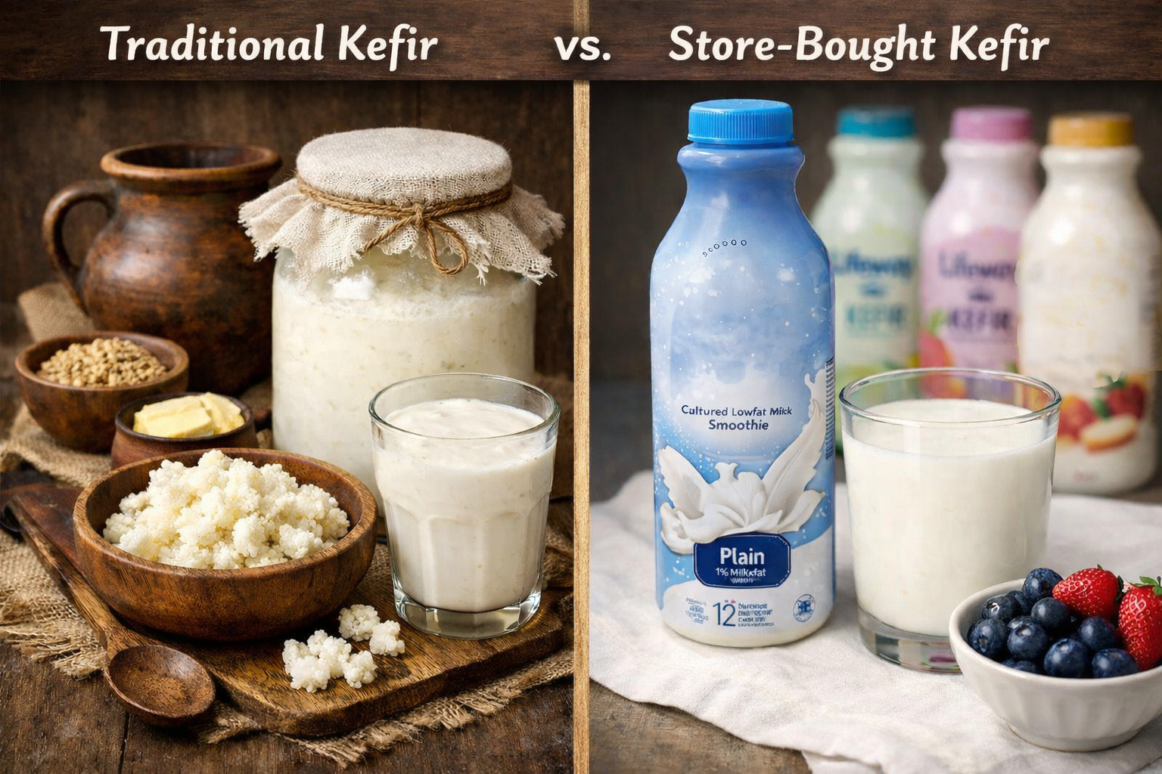

Considerations
The same fermented food types can vary widely, so we cannot assume they all confer the same health benefits. Kombucha study coming. Do we need a quality standard? At present we will support the way directionally with science and information.
Notes:
Talk here about Ben’s Kefir study as well as kombucha study

Slide 58
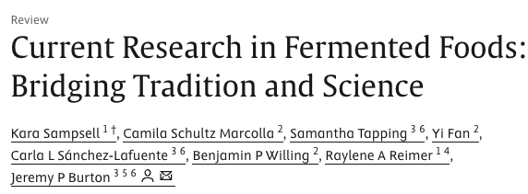
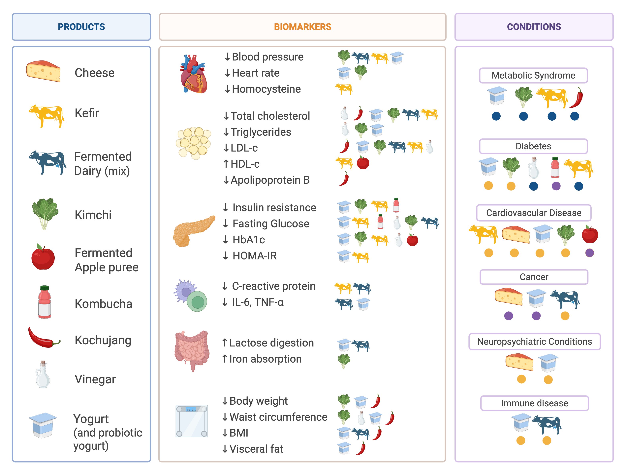

Benefits of Fermented Foods
Multiple Potential Health Benefits
Stronger evidence for dairy fermented foods and metabolic conditions
Fermented Foods might prevent or help manage chronic diseases, but more research is needed
Scan for Manuscript
Notes:
What Does Science Say About Health Benefits?
Research has linked fermented food consumption with:
Metabolic health
Cardiovascular health
Gut health
Immune function
Mental health
However, the strength of evidence varies by food type.
The strongest evidence so far is for fermented dairy products and metabolic conditions such as type 2 diabetes.

Slide 59


CFFI’s White Paper
Mapping the current landscape of fermented foods in Canada from consumer, research, education, policy and regulatory and industry perspective
Request a copy

Slide 60

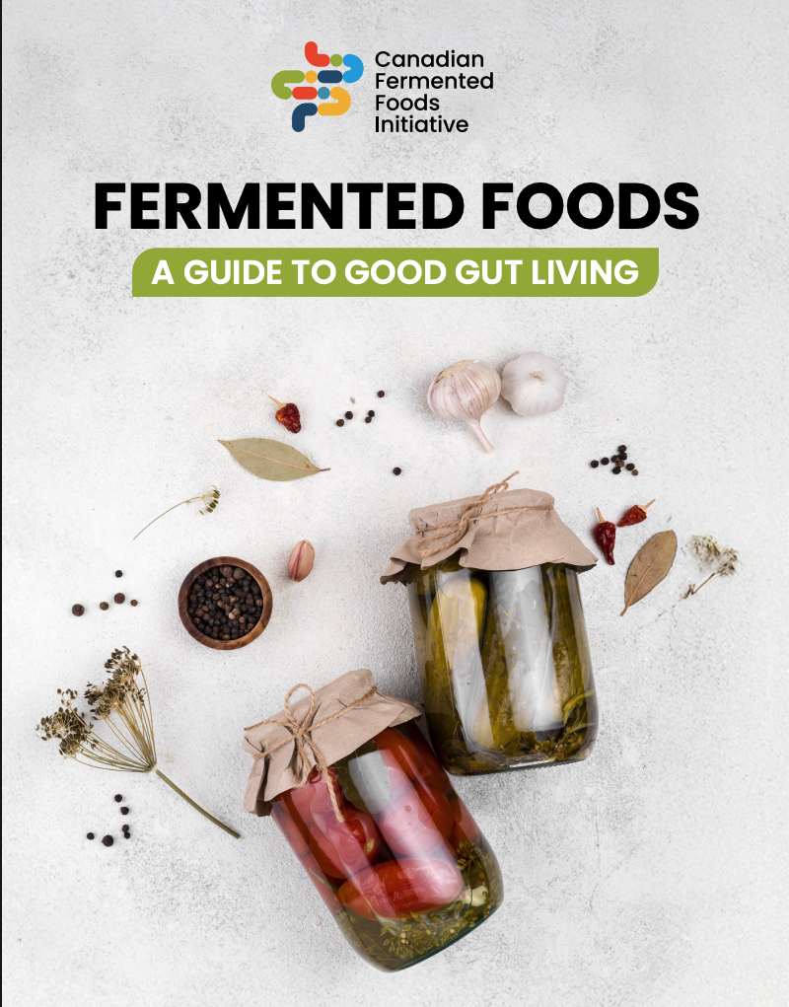

Digital Resources
Scan for pdf

Slide 61








Website
Instagram
Facebook
LinkedIn
www.fermentedfoods.ca
@CanadianFermentedFoods
@Canadian-Fermented-Foods-Initiative
Researchers
Consumers
Industry
HCPs
Consumers
Industry
HCPs
Researchers
Industry
HCPs

