Slide 1
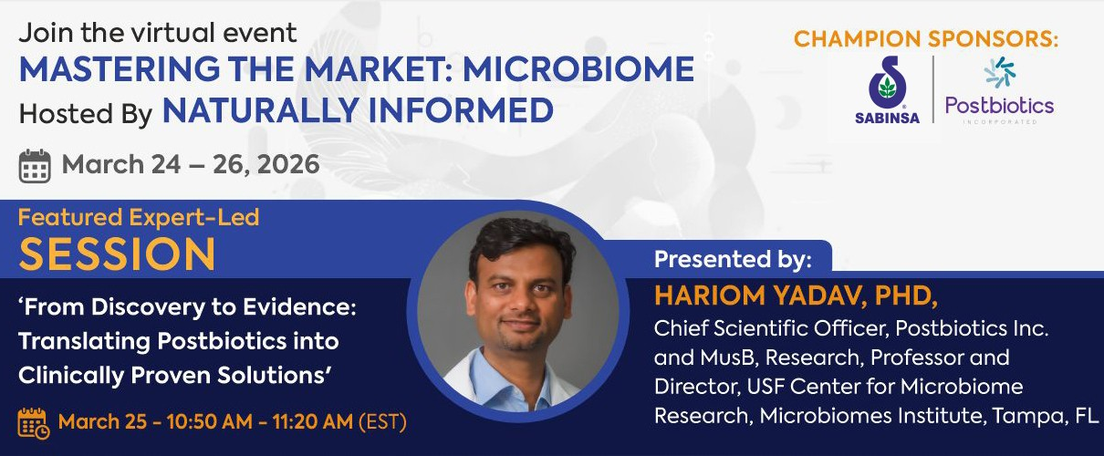


From Discovery To Evidence: Translating Postbiotics Into Clinically Proven Solutions
Hariom Yadav, PhD
Director, USF Center for Microbiome Research, Microbiomes Institute
Professor, Department of Neurosurgery, Brain and Spine
Vice-President, MusB Research

Slide 2

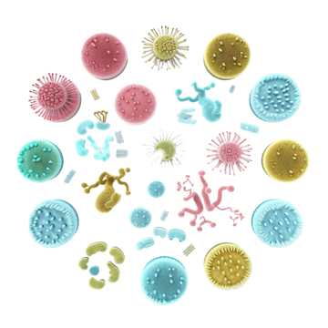
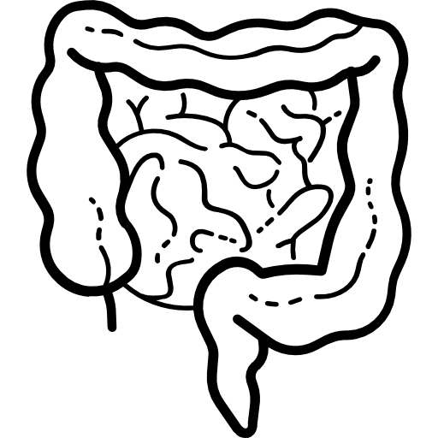

Today’s talking points
Whether and how microbiome contributes in longevity?
Can manipulation of microbiome enhance longevity?
Classical example: How we can improve brain and muscles through gut.
Discovery of Postbiotics
Moving from lab to market with clinical substantiation
A path forward: a platform for faster, inexpensive and robust clinical trials for addressing global markets

Slide 3
Today’s talking points
Whether and how microbiome contributes in longevity?
Can manipulation of microbiome enhance longevity?
Classical example: How we can improve brain and muscles through gut.
Discovery of Postbiotics
Moving from lab to market with clinical substantiation
A path forward: a platform for faster, inexpensive and global markets

Slide 4
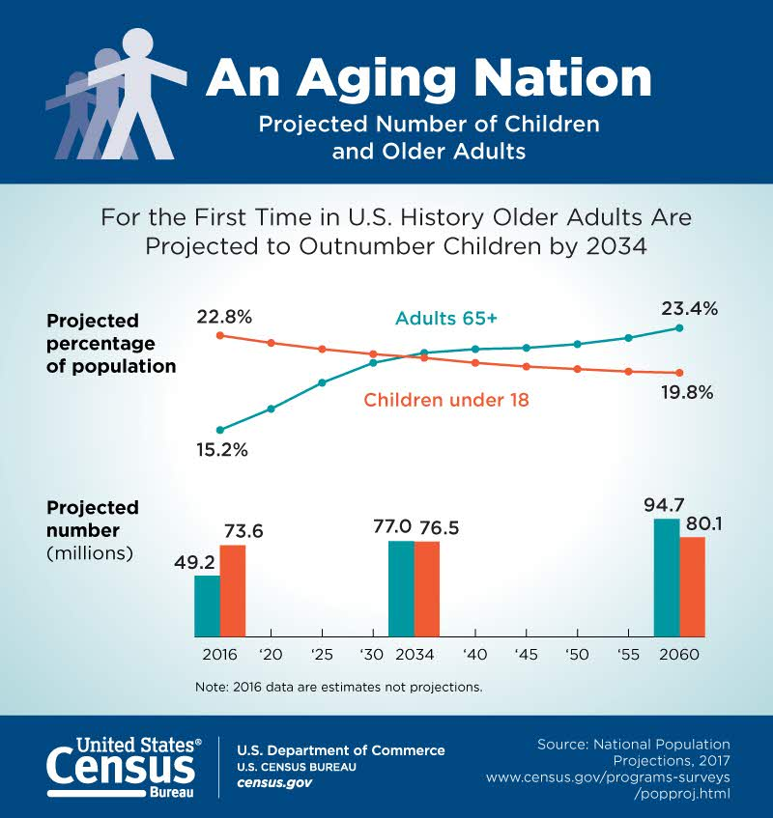
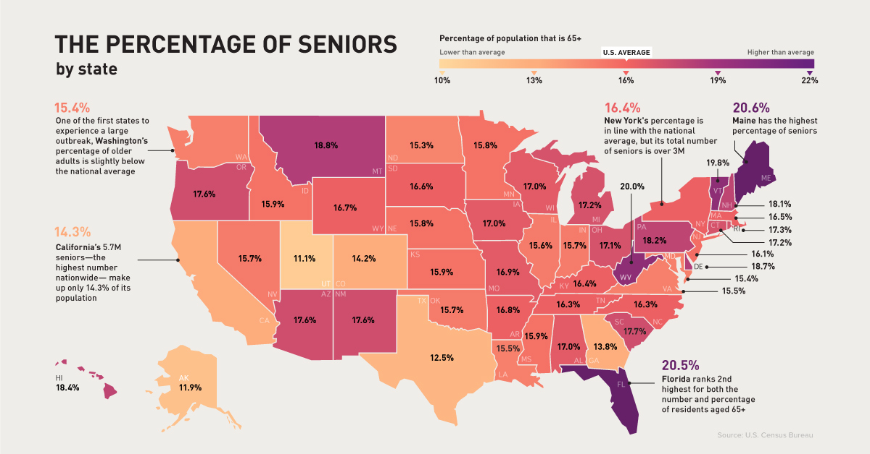
Aging: a Tsunami knocking our doors
Aging is not a disease, therefore no FDA approved anti-aging drugs are available
However, aging is a key risk factor for several chronic diseases
But how remains largely unknown
Also, how we can prevent or treat aging-related conditions

Slide 5
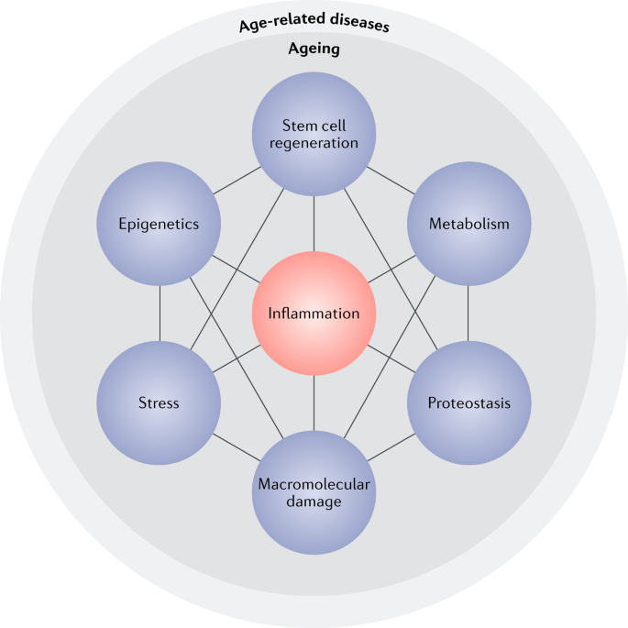
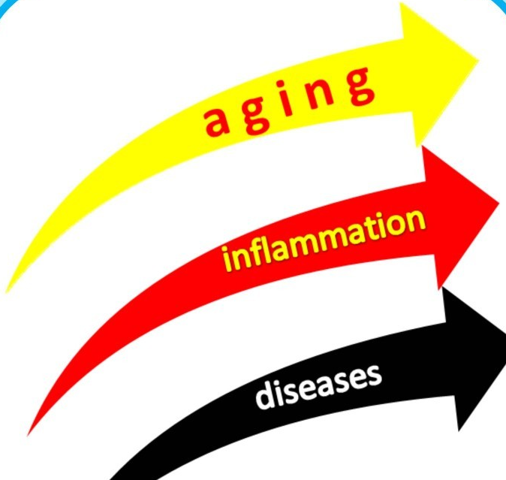
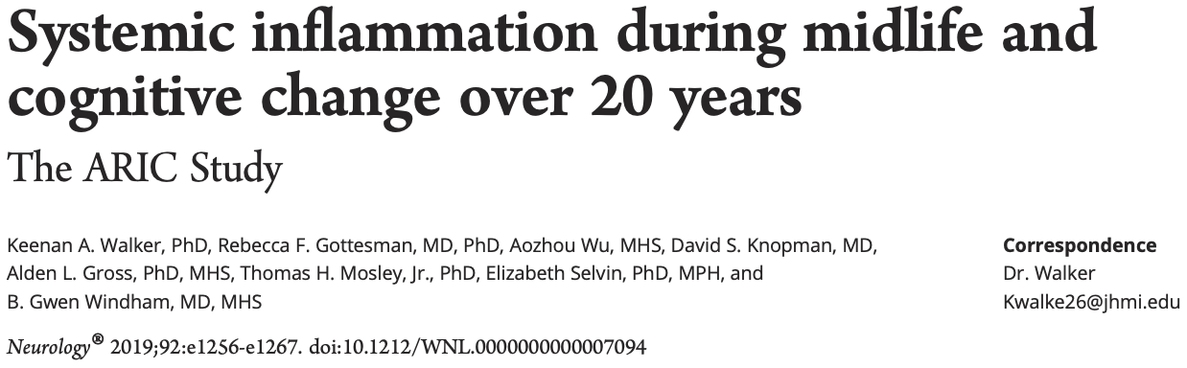
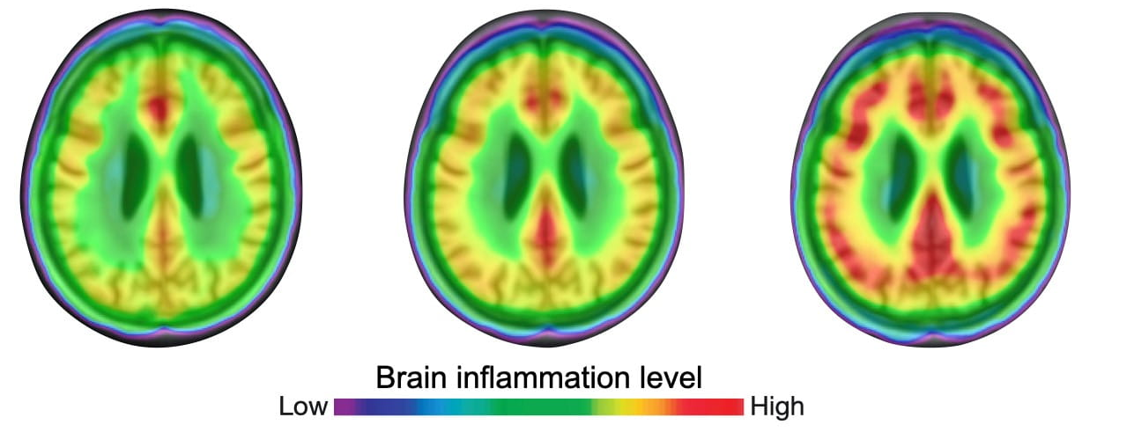
Inflammation is a key risk factor for increasing risk of aging related conditions
Hallmarks of aging biology
Where this inflammation comes from in aging?
Source: Franceschi, et al (2018).
Nature Reviews Endocrinology; 14: 576–590.
A phenomenon called “Inflammaging”: Inflammation is a key pillar of aging biology to impact healthspan

Slide 6
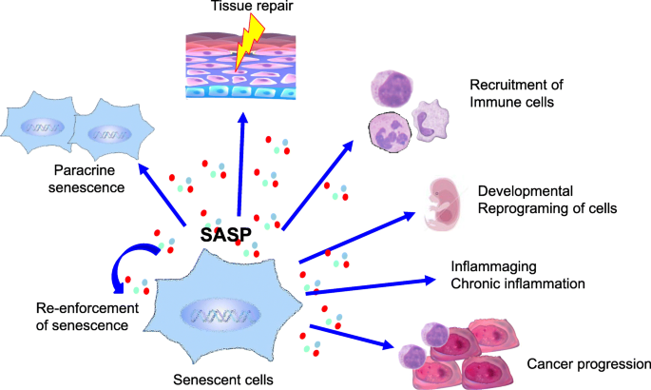
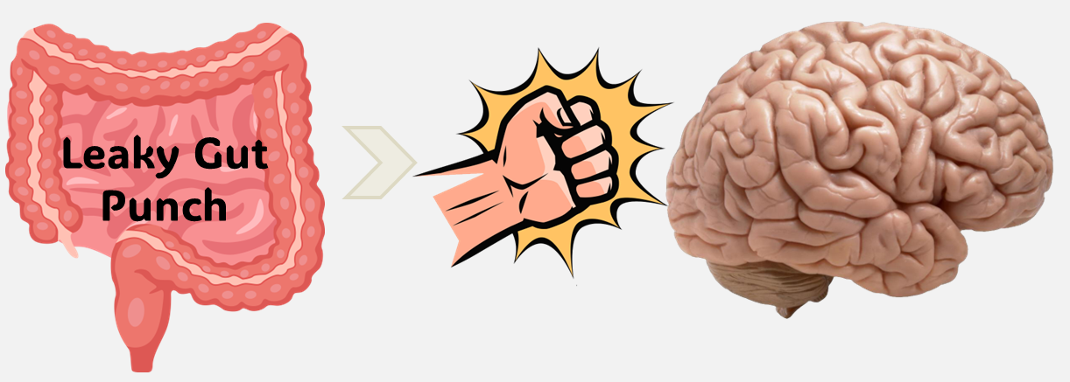

Two major sources of inflammation in aging
Senescence
Leaky gut
We will focus on this today
p16 --| CDK4 →E2F3 → PGC-1a → Mitochondria
Published in “Journal of Clinical Investigation, 2023”
DOI: 10.1172/JCI162479

Slide 7
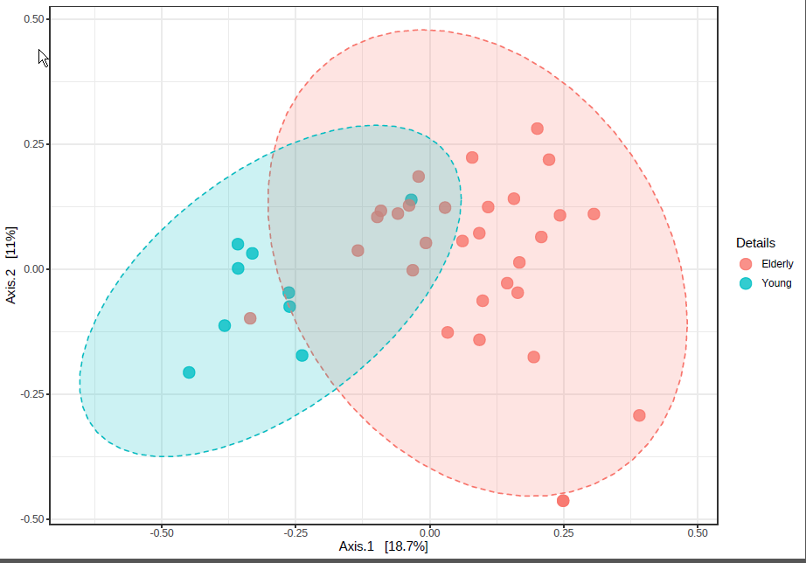
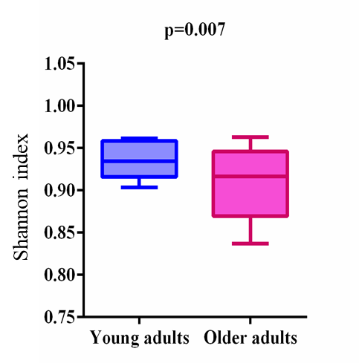
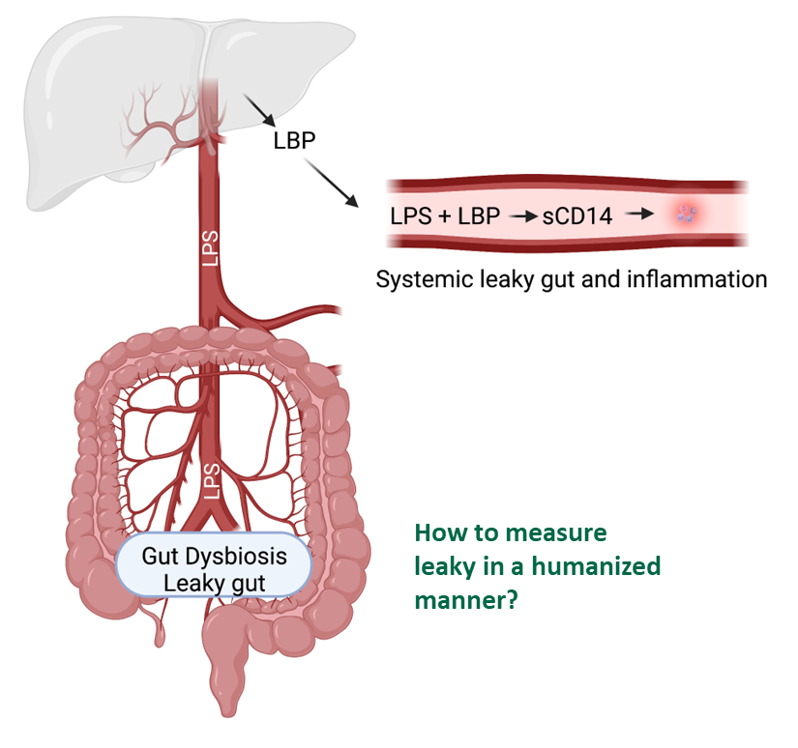
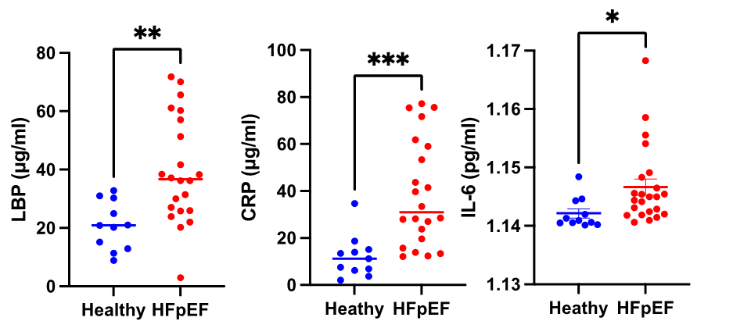

Old gut harbors a dysbiotic microbiome, linked with increased systemic inflammation and leaky gut
Whether aged microbiota causal for leaky gut?
Chaudhari et al, Yadav lab (Geroscience, 2023: PMID: 37213047 )
Young Old
Young Old
Young Old
Similar observations in rodents-
Yadav lab, JCI-Insight; 2024 (PMID: 38329121)

Slide 8
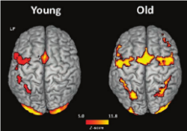
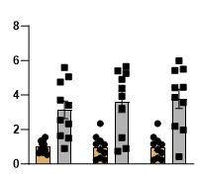
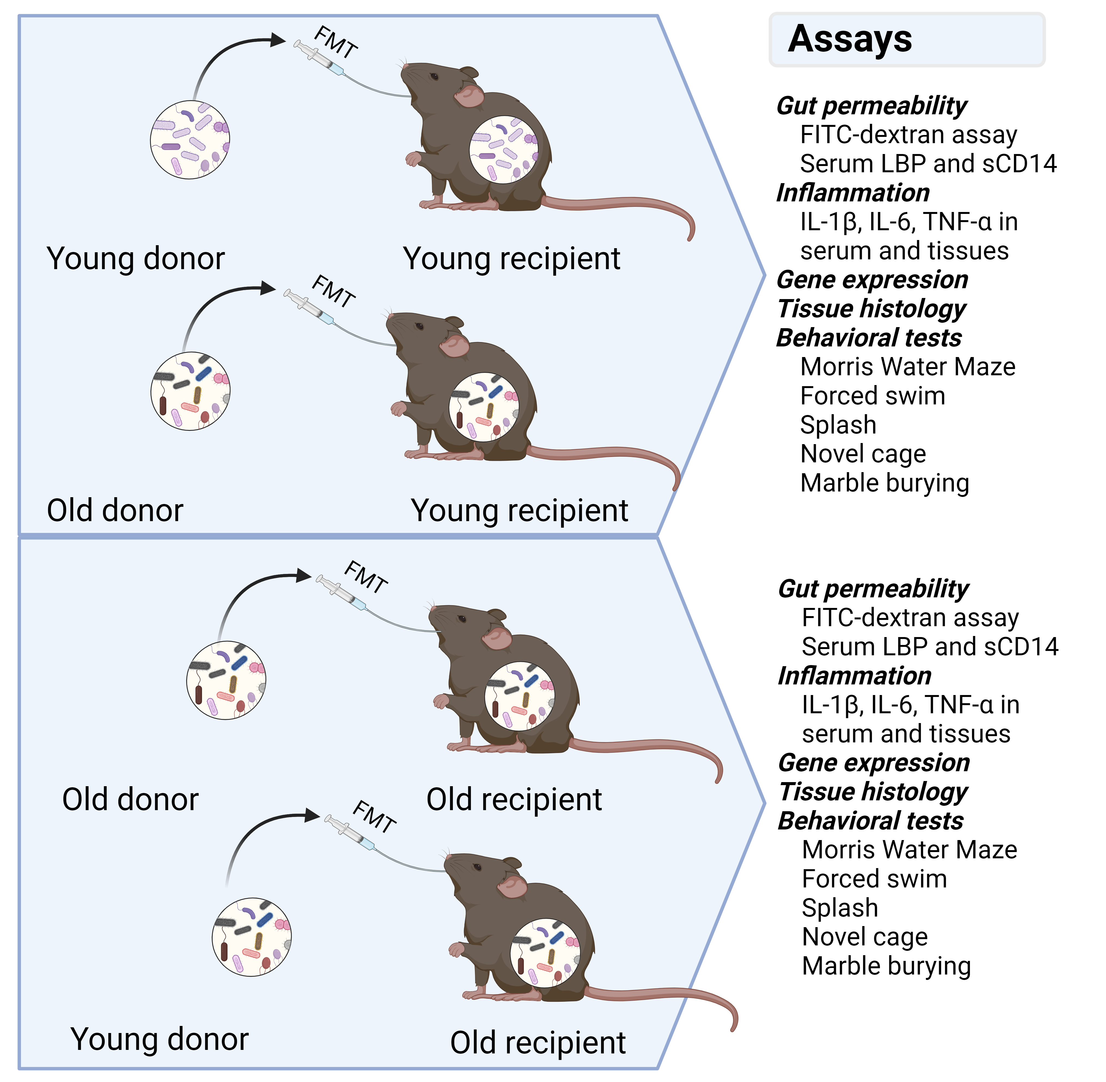

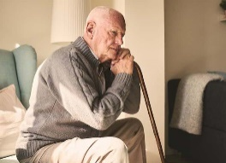

Aged FMT promotes leaky gut, neuroinflammation and brain aging
Neuroinflammation
Leaky gut Inflammation in gut Inflammation in brain
***
***
***
***
**
*
Anxiety
Old
Old
***
Old
Old
Gut permeability FITC (µg/ml)
Gene expression (Fold change/18S)
Gene expression
(Fold change /18S)
Depression
Y→Y FMT
Y→Y FMT
Y→Y FMT
Y→Y FMT
Y→Y FMT
O →Y FMT
O →Y FMT
O →Y FMT
O→Y FMT
Y→Y FMT
O →Y FMT
Y→Y FMT
O →Y FMT
O →Y FMT
Il1b
Il6
Tnfa
Il1b
Il6
Tnfa
Dementia
Mishra et al by Yadav lab, JCI-Insight; 2024 (PMID: 38329121)

Slide 9
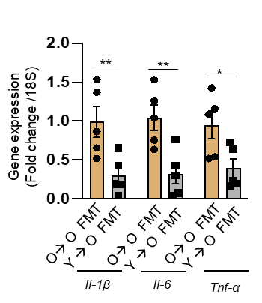
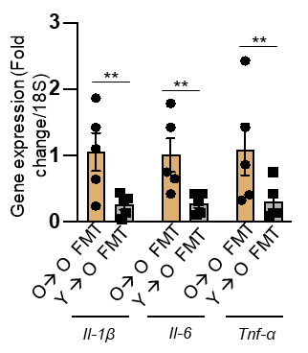

Young FMT reverses leaky gut, neuroinflammation and brain aging
Neuroinflammation
Leaky gut Inflammation in gut Inflammation in brain
***
***
***
***
**
*
Anxiety
Old
Old
***
Old
Old
Gut permeability FITC (µg/ml)
Gene expression (Fold change/18S)
Gene expression
(Fold change /18S)
Depression
Y→Y FMT
Y→Y FMT
Y→Y FMT
Y→Y FMT
Y→Y FMT
O →Y FMT
O →Y FMT
O →Y FMT
O→Y FMT
Y→Y FMT
O →Y FMT
Y→Y FMT
O →Y FMT
O →Y FMT
Il1b
Il6
Tnfa
Il1b
Il6
Tnfa
Dementia
*
Gut permeability FITC (µg/ml)
O→ O FMT
Y → O FMT
Il1b
Il6
Tnfa
Il1b
Il6
Tnfa
Mishra et al by Yadav lab, JCI-Insight; 2024 (PMID: 38329121)

Slide 10
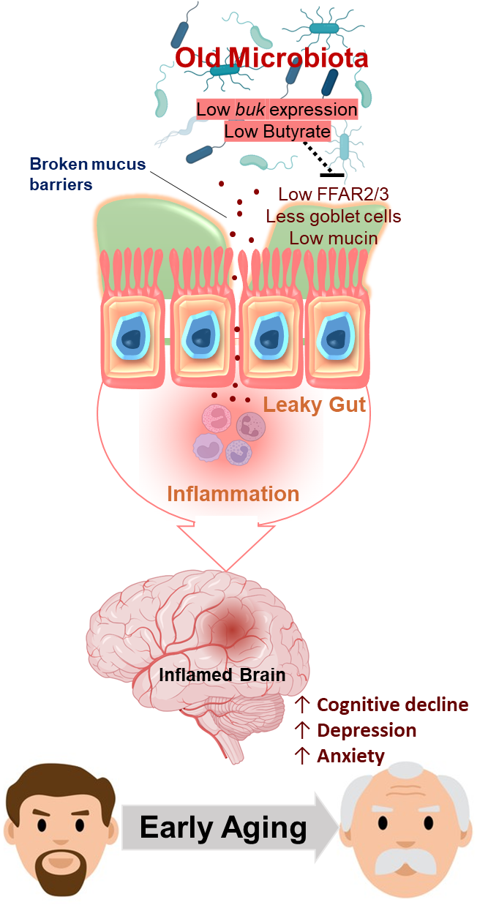
Summary #1
Young FMT
Butyrate
Mishra et al by Yadav lab, JCI-Insight; 2024 (PMID: 38329121)

Slide 11
Today’s talking points
Whether and how microbiome contributes in longevity?
Can manipulation of microbiome enhance longevity?
Classical example: How we can improve brain and muscles through gut.
Discovery of Postbiotics
Moving from lab to market with clinical substantiation
A path forward: a platform for faster, inexpensive and global markets

Slide 12
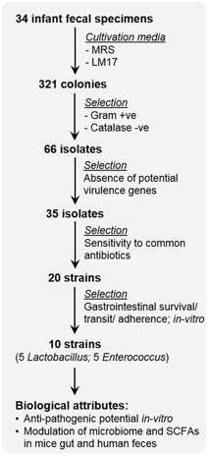
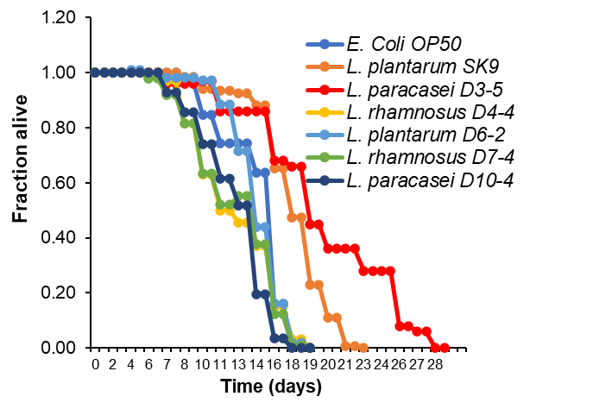
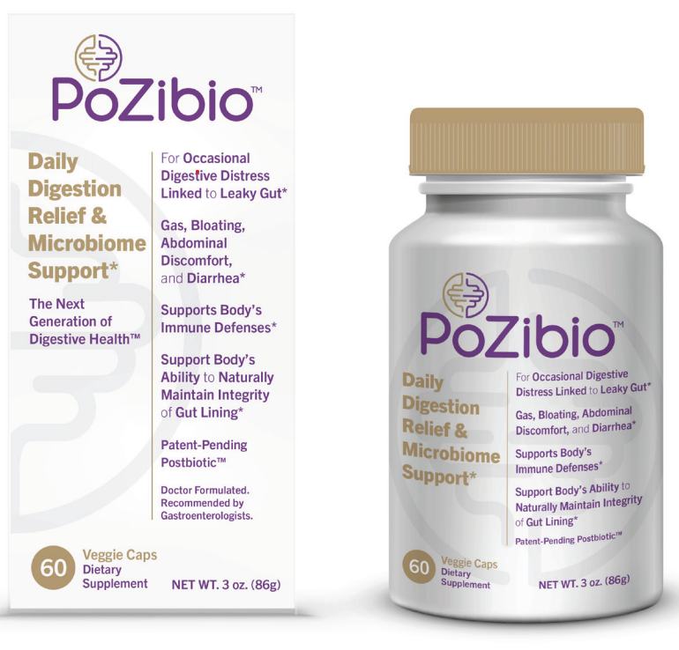
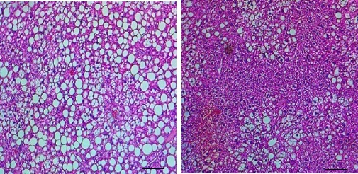


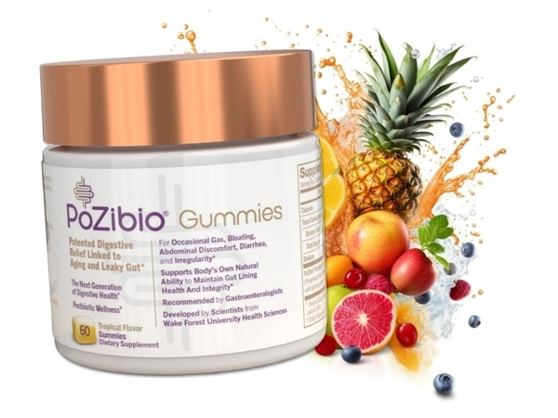

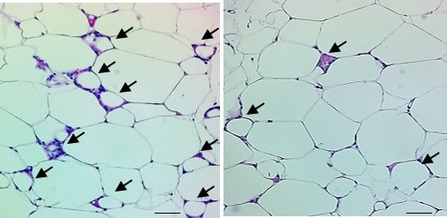
Heat inactivated LpD3.5 protects metabolic dysfunction in older mice
GTT
Gut permeability (µg of FITC per ml serum)
*
IL-1β mRNA (fold change)
*
IL-6 mRNA (fold change)
Change in blood glucose (%)
**
Control
**
*
D3-5
Control
**
Control
AUC
D3-5
D3-5
Control
D3-5
Control
D3-5
ITT
*
*
10 µm
10 µm
White adipose tissue Liver
AUC
Control
Three Clinical Trials
Four more are coming
D3-5
50 µm
50 µm
Wang et al, 2019. Geroscience, doi:10.1007/s11357-019-00137-4

Slide 13
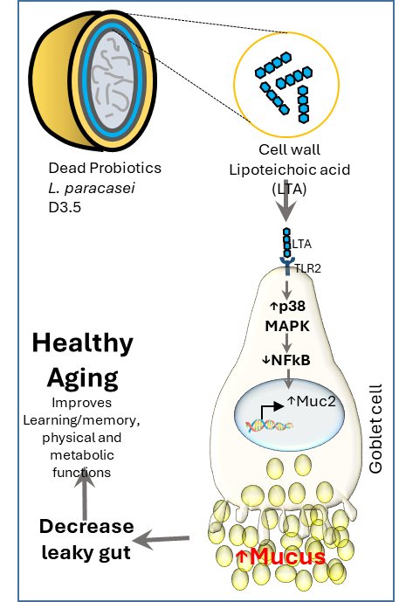
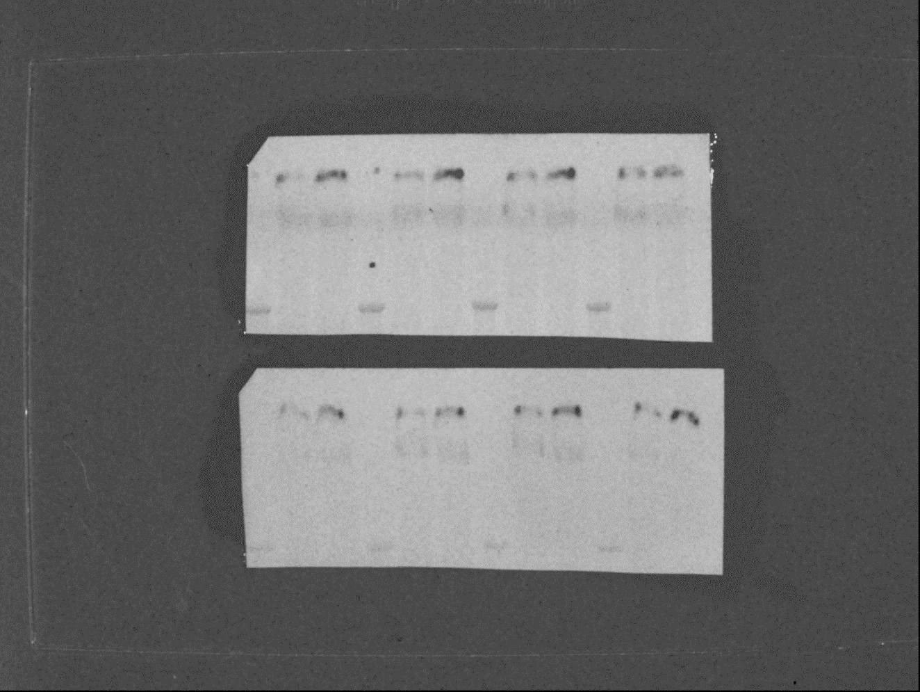
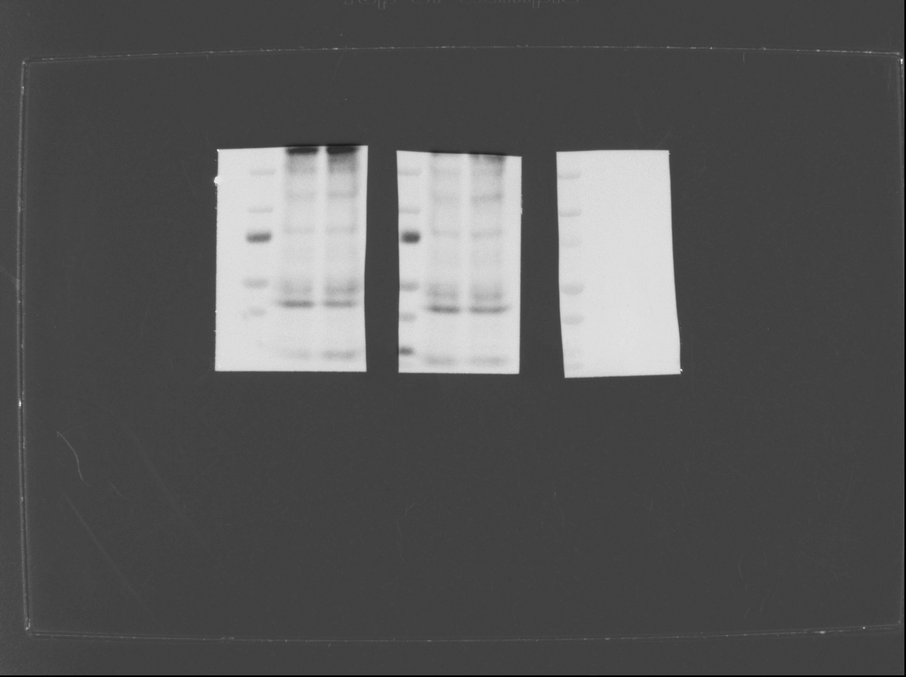
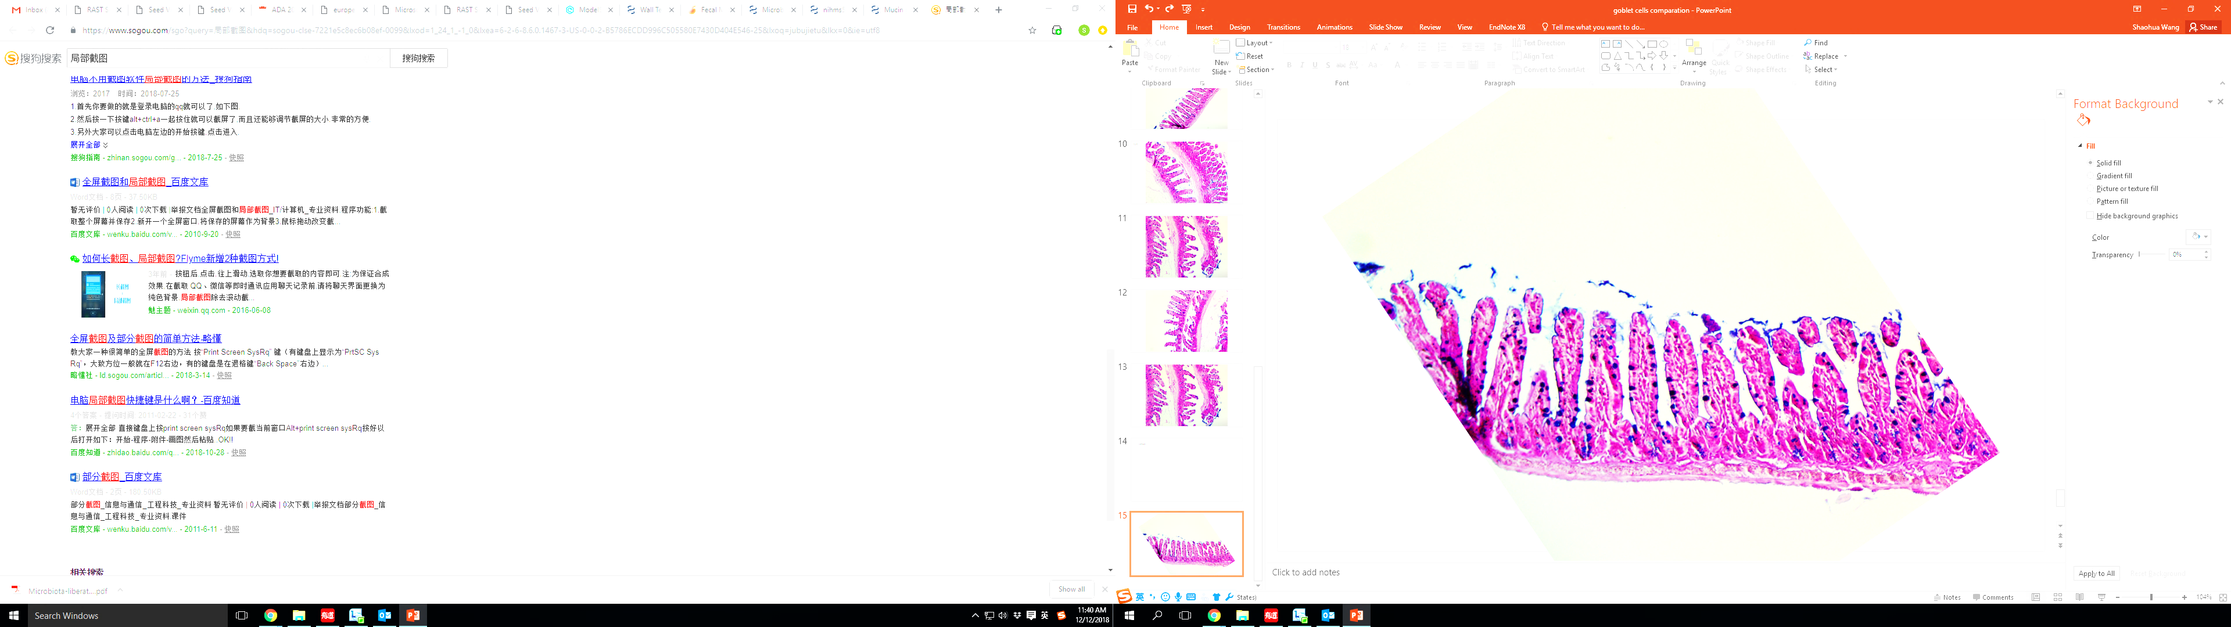
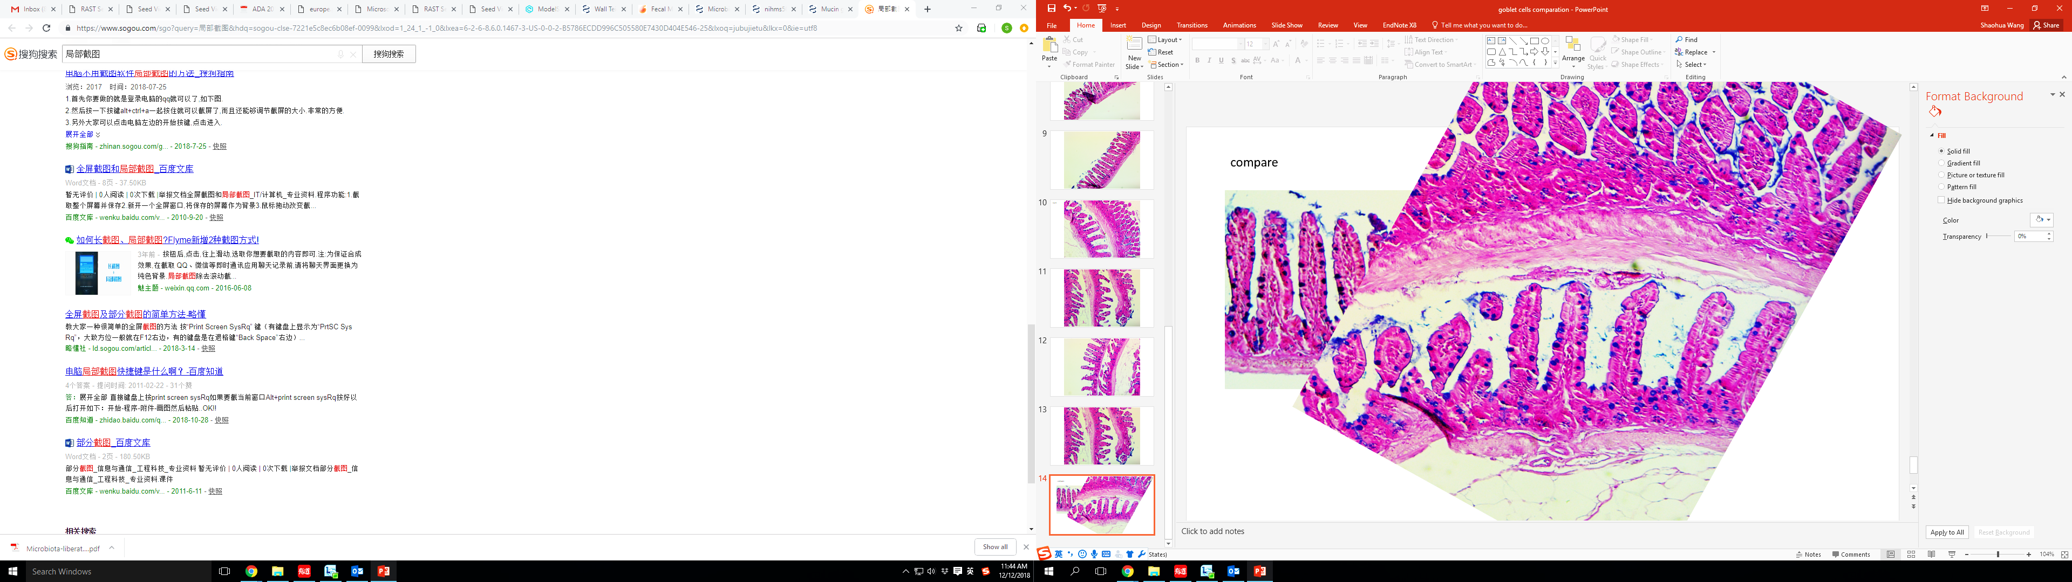

Dead LpD3.5/PoZibio® strengthen mucus barriers to reduce leaky gut and protects from metabolic disorders
**
*
*
Muc2 mRNA (fold change)
Control
D3-5
*
Fecal mucin (mg/g feces)
Mucin-2
250 kDa
55 kDa
Tubulin
D3-5
D3-5
D-5
D3-5
45 kDa
Control
Control
Control
Control
Control
D3-5
Duodenum Jejunum Ileum Colon
**
Number of goblet cells per villus
Control
D3-5
Control
D3-5
Wang et al, 2019. Geroscience, doi:10.1007/s11357-019-00137-4

Slide 14
Today’s talking points
Whether and how microbiome contributes in longevity?
Can manipulation of microbiome enhance longevity?
Classical example: How we can improve brain and muscles through gut.
Discovery of Postbiotics
Moving from lab to market with clinical substantiation
A path forward: a platform for faster, inexpensive and global markets

Slide 15

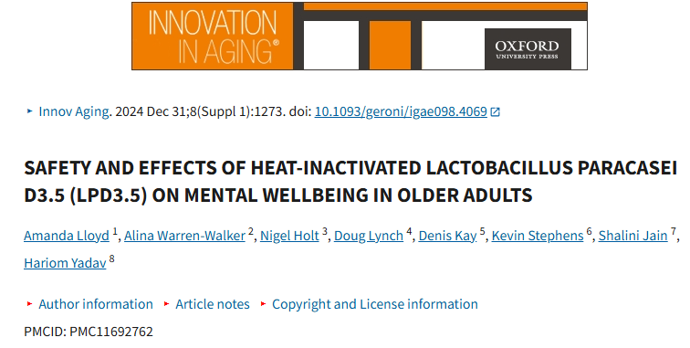
Trial #1
Safety clinical trial- improves quality of life in elderly
4 x PoZibio® capsules daily (167 mg per capsule) for 30 days, two to be consumed in the morning
and two at night
Pre-Post- Open Label trial
Done in UK
PoZibio® is safe, tolerant with no adverse effects, and improves Quality of Life in Older Adults

Slide 16
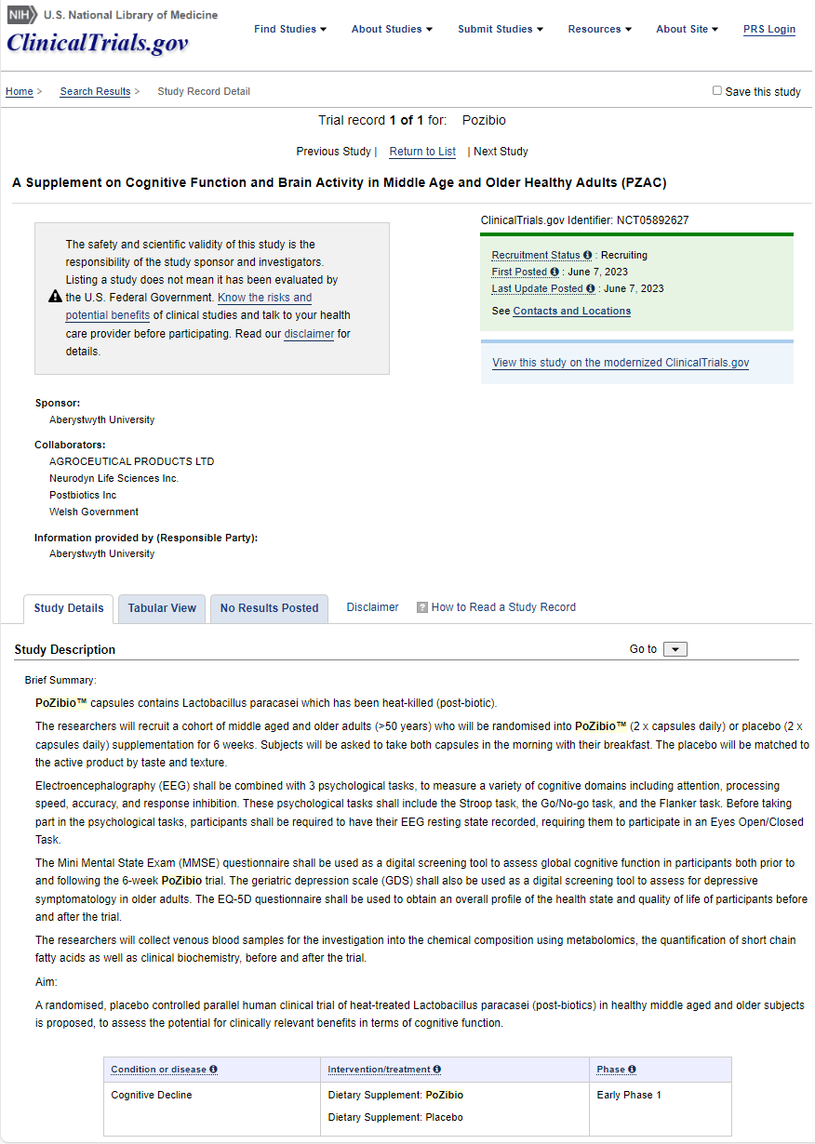
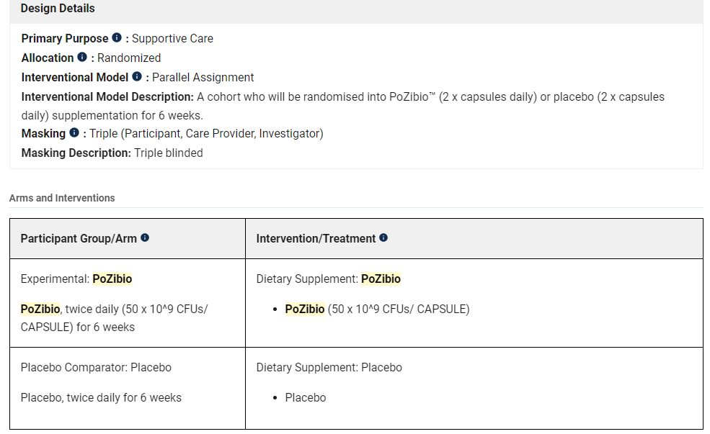
Trial #2
UK Govt Funded Clinical Trial is ongoing
Part of Better Brain Study in UK
Funded by Innovate UK
PZAC Trial
Primary Outcome Measures
Cognitive Control (Selective attention, processing speed, mental flexibility)
Response inhibition (core construct in cognitive control and self-regulation)
Selective attention and response inhibition (core constructs in cognitive control and self-regulation)
Electroencephalogram (EEG)
EuroQol 5 Dimension 5L (combined score)
Secondary Outcome Measures
Short chain fatty acids
Microbiome
Leaky gut
Inflammation
Outcomes: PoZibio® ‘s impact on gut-brain axis

Slide 17
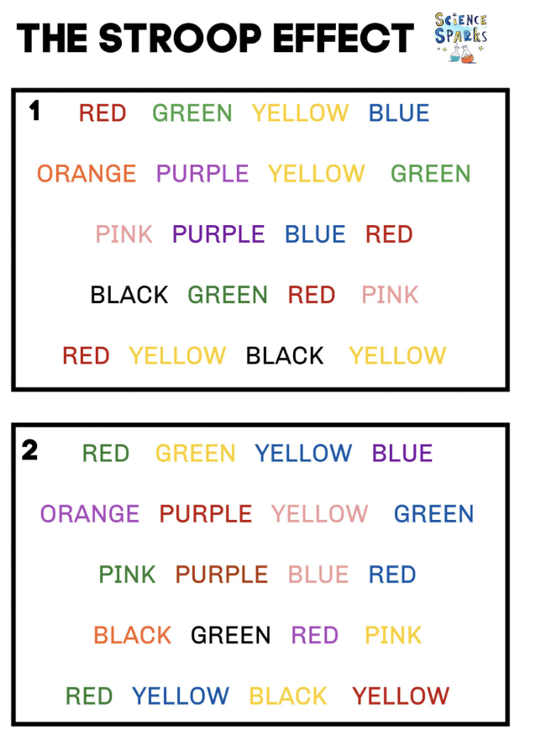
Clinical Trial #2
UK Govt Funded Clinical Trial
PZAC Trial
PoZibio versus Placebo
Research conducted at Abersystwyth University, Wales
Dose at 170mg, once per day
PoZibio® stand-alone formula
Stoop Test for Cognitive Function
Y (Placebo) | Z (Active)
Females | Males 24 | 5 | Females | Males 22 | 6
Age Range: 58-81 Average Age: 68 | Age Range: 56-85 Average Age: 66
Outcomes: PoZibio® ‘s impact on gut-brain axis

Slide 18
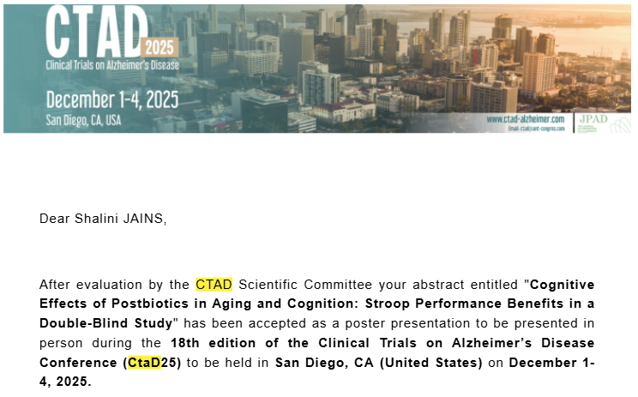
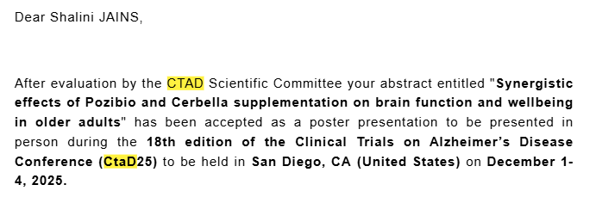
Stroop Test Results
Clinical Trial #2
Under-investigation (upcoming)
Mucin barrier markers
Leaky gut markers
Inflammation markers
Microbiome analyses
Metabolites
Samples are already collected and need to be analyzed!
UK Govt Funded Clinical Trial
PZAC Trial
TWO ABSTRACTS ACCEPTED IN NATIONAL CONFERENCE AND WILL BE PUBLISHED IN INTERNATIONAL JOURNAL
The Stroop task revealed significant improvements in inhibitory control in the intervention group after 60 days, suggesting cognitive benefits of the intervention not observed in controls
Outcomes: PoZibio® ‘s impact on gut-brain axis

Slide 19
Clinical Trial #3
Gut Wellness Study: Evaluating the Impact of PoZibio® Supplementation on Digestive Health
Aim: To evaluate the effectiveness of a novel nutritional supplement, PoZibio® in improving digestive wellness in adults with mild to moderate gastrointestinal discomfort.
Study Type: Randomized, single-blind, placebo-controlled trial (App-based)
Duration: 8 weeks
Number of Participants: 82 adults aged 18-65
Study Arms: Three-arm
Placebo (0 mg PoZibio® ; 750 mg Sunfiber)
Lifestyle Nutrition (100 mg PoZibio®+750mg Sunfiber)
Medical Nutrition (340 mg PoZibio® + 750 mg Sunfiber )
Supplementation: Participants take two capsules daily (before lunch and dinner)
Data collection: Via Ingredients for Life™ (IFL) mobile app
Outcomes: Impact on Gut Health Wellness

Slide 20
Clinical Trial #3
Gut Wellness Study: Evaluating the Impact of PoZibio® Supplementation on Digestive Health
% Reduction in symptom severity from baseline to weeks 4 & 8 across study arms
Fig 1. Bar chart showing the % reduction in average symptom scores among study arms at week 4
Fig 2. Bar chart showing the % reduction in average symptom scores among study arms at week 8
Outcomes: Impact on Gut Health Wellness

Slide 21
Ongoing/Upcoming Clinical Trial
Clinical Trials/ Studies
Completed
Ongoing Trials

Slide 22
Trail # 4 & 5
Two Pilot Clinical Trials are Funded by USF
LIBD (LpD3.5 in IBD) Trial
LISA (LpD3.5 Intervention Study in Older Adults) Trial
Randomized Cross-over trial in 10 patients
60 days
Randomized Cross-over trial in 10 patients
60 days
Primary outcome:
Fecal mucin
The secondary outcomes:
Markers of leaky gut
Exploratory outcomes:
Frequency and dose of medications
Markers of inflammation
Quality of life
IBD clinical scores
Primary outcome:
Leaky gut markers
The secondary outcomes:
Mucin levels in stools,
Markers of inflammation in the gut (calprotectin in stools) and circulation (CRP, IL-6, TNF-α, and IL-1β in plasma),
Cognitive function assessed using Clinical Dementia Rating- Sum of Boxes (CDR-SB), AD Assessment Scale, Cognitive Subscale 14 (ADAS-Cog14), and AD Cooperative Study- Instrumental Activities of Daily Living (ADCS-iADL) scores.
Exploratory outcomes:
Blood levels of pTau217.
IRB Approved- Recruiting
IRB Approved- Recruiting
Outcomes: Impact on IBD and Cognition

Slide 23
Trail # 6
Clinical Trial: Colon Cancer Patients
Study Title | Postbiotics for mitigation of postoperative dysbiosis in colon cancer resections
Study Design | Pilot randomized control trial
Primary Objective/Purpose | To measure efficacy of postbiotic supplements in mitigating the gut dysbiosis induced in the perioperative period of colorectal cancer resections
Secondary Objective(s)/Purpose | To use collected data as pilot to design a microbiome-targeted intervention in future trials
Research Intervention(s)/ Investigational Agent(s) | Administration of a nutraceutical supplement (PoZibio® from Postbiotics Inc, Wiston-Salem, NC)
IND/IDE # | Not applicable
ClinicalTrials.gov NCT# | Pending
Study Population | Patients 18 years and older undergoing colon cancer surgery
Sample Size | 30
Study Duration for individual subjects | Multiple visits to coincide with standard of care clinical visits over a 1-year period
Study Specific Abbreviations/ Definitions | Colorectal Cancer - CRC
 | Day 0 (Baseline +2 days) | Day 10 (± 2 days) | Day of Surgery | Day 42 (± 14 days) | Day 120 (± 30) | Day 390 (±30 days)
Informed consent | X
Inclusion/Exclusion criteria | X
Physical exam | X
Vital signs | X
Randomization | X
Provision of intervention supplement vs placebo | X |  |  | X | X
Treatment start | X
Treatment end |  |  |  |  | X
Review AEs |  | X |  | X | X | X
Review adherence | X | X |  | X | X | X
Stool sample | X | X |  | X | X | X
Normal colon and tumor collection |  |  | X
Follow-up visit |  |  |  | X | X | X
Follow-up call |  | X
Final data collection on disease status and course of care |  |  |  |  |  | X
Outcomes: Microbiome, Side Effects, Recovery, Resilience

Slide 24
Today’s talking points
Whether and how microbiome contributes in longevity?
Can manipulation of microbiome enhance longevity?
Classical example: How we can improve brain and muscles through gut.
Discovery of Postbiotics
Moving from lab to market with clinical substantiation
A path forward: a platform for faster, inexpensive and global markets

Slide 25
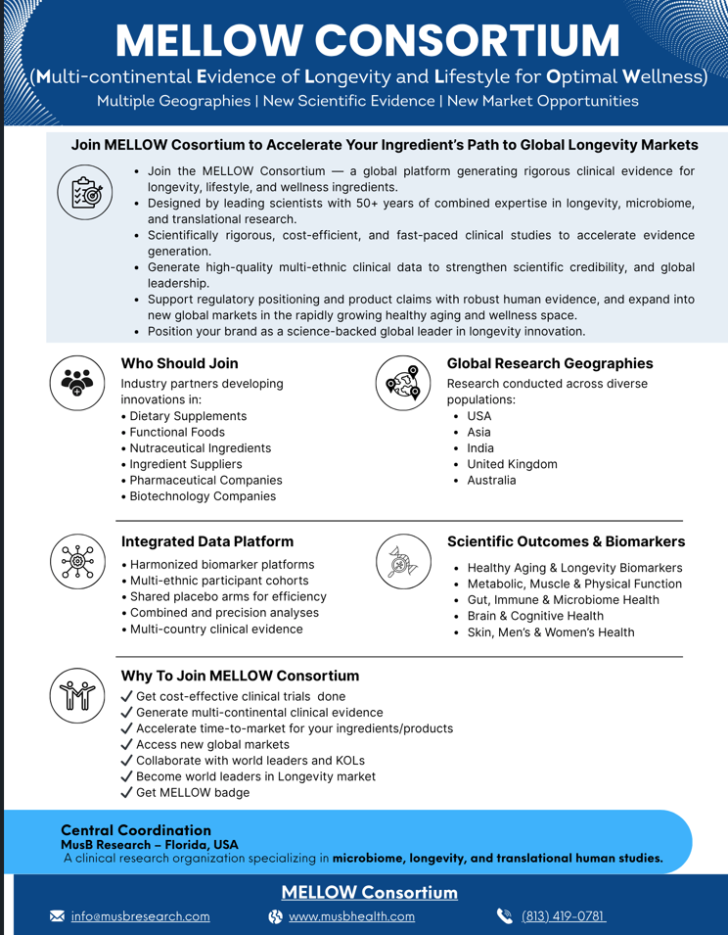
MELLOW Consortium
Multi-continental Evidence of Longevity & Lifestyle for Optimal Wellness
Multiple Geographies | New Scientific Evidence | New Market Opportunities
A platform for conducting clinical trials with most validated, and comprehensive biomarkers for longevity, microbiome and wellness.
Most inexpensive and comprehensive trial models
Multi-geographies populations for global markets coverage
Access to KOLs
Please CONTACT US for more details and how to join!

Slide 26













Discovery
Clinical Substantiation
Market
Global CTs
Overall Summary
It truly takes a whole village to move these technologies forward.

Slide 27




Acknowledgements, and Looking for Your Collaboration
Our Team
Rohit Shukla, Postdoc Fellow
Vivek Kumar, Postdoc Fellow
Santosh Prajapati, Postdoc fellow
Sidharth Mishra, Postdoc fellow
Brandi Miller, PhD student
Adewale James, PhD Students
Sherri Huang, MD, PhD, Physician Resident
Dayna Goltz, MD student
Divyani Tangudu, Undergraduate student
Julia Hoover, Undergraduate student
Lauren Buddendorff, MD student
Manan Mahani, BS/MD student
Mihir Kulkarni, BS/MD student
Sima Malek, International fellow
Surabhi Gangani, MS Student
Big thanks for our participants and their family members!!
Funding Support
Contact us anytime:
hyadav@usf.edu
yadavh@musbresearch.com
813-974-8222

