Slide 1







From Measurement to Meaning:
Practical Approaches to Healthy Aging Outcomes in Clinical Trials
Stephanie-Anne Girard, PhD
Director, Scientific Affairs
SGS Nutrasource
PROUD MEMBER

Slide 2

Speaker
15+ years of natural health product/dietary supplement and pharmaceutical clinical research experience
Education
  PhD in Nutritional Sciences from the University of Florida
  Post–Doctoral degree through an Industrial R&D Fellowship Program from the Natural Sciences and Engineering Research Council of Canada (NSERC) in collaboration with Lallemand Health Solutions.
Director, Scientific Affairs at SGS Nutrasource
  Lead the development of high-quality scientific documents, data interpretation, and clinical trial design, working closely with teams across biostatistics, medical writing, and regulatory affairs.
15+ published scientific articles in peer-reviewed journals
WIN
  Scientific Committee Member
  Webinar Committee Co-Chair
Stephanie-Anne Girard, PhD
Director, Scientific Affairs
SGS Nutrasource

Slide 3
Agenda
What is Healthy Aging - Definition and Trends & Opportunities
Hallmarks of Aging
Biomarkers of Aging
Surrogates of Biological Aging - Frailty & Intrinsic Capacity
Gut Microbiome and Aging
Aging Animal Models
Interpreting Outcomes
Clinical Design Considerations
Ongoing Clinical Trials

Slide 4
Healthy Aging
Definition
Aging = universal biological process; speed and quality varies between individuals
Biological aging involves accumulation of molecular & cellular damage over time
Healthy aging = maintaining functional ability across domains:
  Physical function & mobility
  Cognitive health & mental function
  Endocrine, metabolic & immune resilience
  Overall well-being and quality of life
World Health Organization (WHO) definition: “the process of developing and maintaining the functional abilities that enable well-being in older age”
Aging is heterogeneous & modifiable; lifestyle, environment, nutrition, and interventions can influence trajectory
Notes:
https://doi.org/10.1016/j.arr.2023.101934
Emphasize that aging is inevitable, but the speed and quality of aging vary widely across individuals.
Damage accumulation occurs across multiple biological processes — not just “getting old.”
Healthy aging focuses not on extending life span at any cost, but on maximizing health span — the years lived with preserved functionality and independence.
This definition underpins why interventions (nutrition, lifestyle, supplements, clinical trials) aimed at healthy aging are relevant and scientifically justified.
Importantly, show that “aging” is not a monolith — there is inter-individual variability and room for intervention, which opens opportunity for clinical research and supplement development.

Slide 5
Healthy Aging
Why It Matters: Trends & Opportunities
Global Demographic Shift: increasing proportion of older adults
  By 2030, 1 in 6 people ≥ 60 years old (1⁺B)
  Those ≥ 80 years old expected to triple between 2020-2050 (426 million)
Economic impact: cost to healthcare and long-term care if healthy aging not maintained
Opportunity window: aging is modifiable. Evidence supports influence via nutrition, lifestyle, supplementation, microbiome.
Research & market growth: growing interest in clinical trials targeting healthy aging, functional outcomes, and validated biomarkers
Competitive advantage: clinical evidence supporting healthy aging claims (S/F or Health Claims) differentiates products and supports regulatory/commercial acceptance
Notes:
https://doi.org/10.1016/j.arr.2023.101934

Slide 6
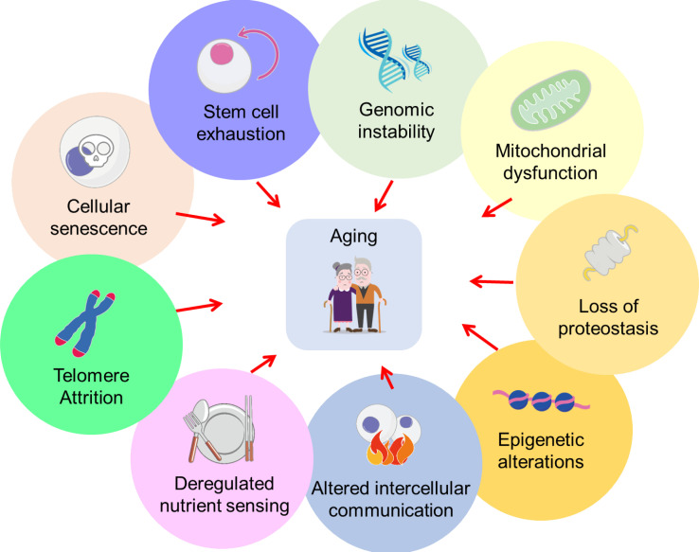
Hallmarks of Aging
Fundamental Cellular & Molecular Processes
Interconnected mechanisms
  Genomic instability, telomere attrition and mitochondrial dysfunction interact and amplify each other over time.
Targets for intervention
  Each hallmark is a potential leverage point for nutrition, lifestyle, and therapeutic strategies aimed at maintaining/improving intrinsic capacity.
Early changes precede symptoms
  Alterations often begin decades before clinical deficits appear, prevention and mid-life interventions important.
These hallmarks influence mobility, cognition, vitality, metabolic health, and resilience—key determinants of healthy aging trajectories.
Tsai et al 2020 Biosci Microbiota Food Health
doi:10.12938/bmfh.2020-026
Notes:
doi: 10.12938/bmfh.2020-026
https://pmc.ncbi.nlm.nih.gov/articles/PMC7576259/
https://www.sciencedirect.com/science/article/pii/S2161831325001590?via%3Dihub
https://www.nature.com/articles/s43856-025-01073-5

Slide 7
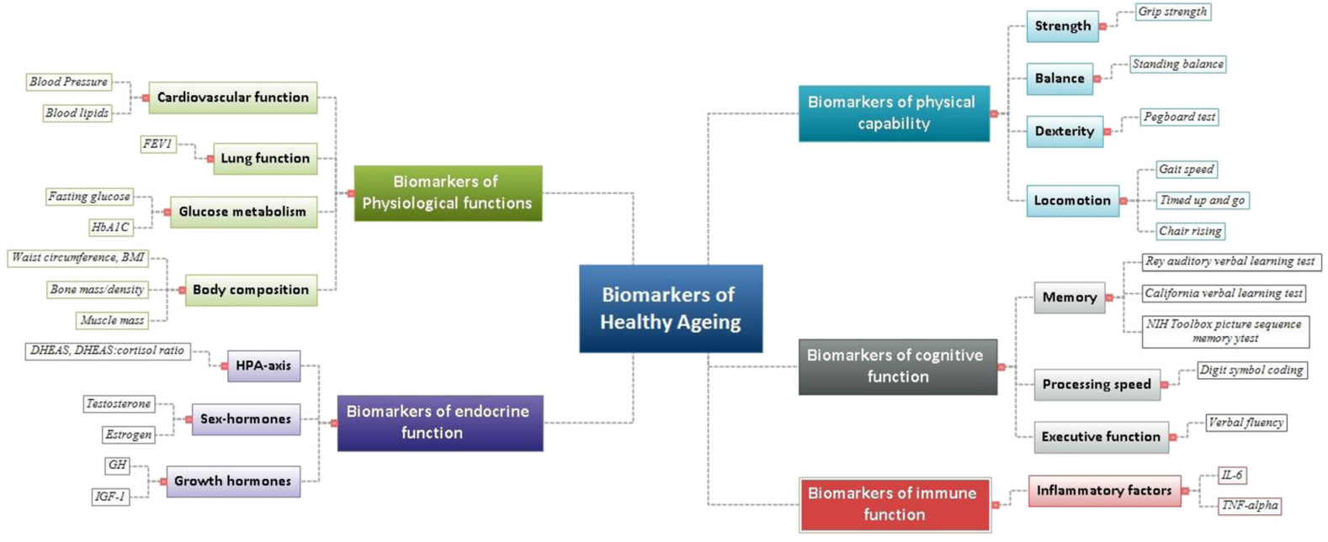
Biomarkers of Aging
Tsai et al 2020 Biosci Microbiota Food Health
doi:10.12938/bmfh.2020-026
Notes:
https://pmc.ncbi.nlm.nih.gov/articles/PMC4572626/

Slide 8
Physical Function Biomarkers
Performance/Mobility: Measure gait, balance, and transfer (30+ assessments available)
  Timed Up and Go (TUG) – assesses balance and walking ability, including the everyday tasks of standing, walking, and turning
  Short Physical Performance Battery (SPPB) – examines gait, balance, strength, and endurance
  Six-minute walk test – evaluate physical performance, endurance, and mobility
Grip strength: an indicator of overall strength and medical status
  Measured with a dynamometer
  Link between strength and upper limb function, BMD, fractures, heart health, cognition
Notes:
https://doi.org/10.1155/2019/1354362
https://doi.org/10.1136/bmjopen-2024-088950
10.2147/CIA.S194543

Slide 9
Surrogates of Biological Aging
Frailty
State of increased vulnerability
Decline in function across multiple domains
Associated with predicting mortality and adverse health outcomes.
Focuses on capturing the individual's health deficits using diverse operational instruments.
Frailty index:
  Symptoms (e.g., fatigue, poor sleep)
  Signs (e.g., grip strength)
  Chronic disease
  Functional impairment (e.g., difficulty walking, ADL limitations)
  Laboratory abnormalities (e.g., inflammation)
  Cognitive issues
Notes:
https://link.springer.com/article/10.1186/s12877-024-05377-4
https://link.springer.com/article/10.1186/1471-2318-8-24

Slide 10
Surrogates of Biological Aging
Intrinsic Capacity
Derived from a public health framework
Prioritizes the person's capacities and reserves
Promotes a positive vision of aging
5 domains (Physical and Mental Capacities)
  Locomotion
  Cognition
  Vitality
  Sensory
  Psychological
Notes:
https://link.springer.com/article/10.1186/s12877-024-05377-4
https://link.springer.com/article/10.1186/1471-2318-8-24

Slide 11
Surrogate of Biological Aging
Strengths and Weaknesses
 | Strengths | Weaknesses
Frailty | Well-validated, with decades of evidence Predicts mortality, hospitalization, disability Strongly associated with biological aging pathways (inflammation, sarcopenia, mitochondrial dysfunction) Highly responsive to stressors → useful in intervention trials | Often reflects late-stage decline → may miss early aging changes Many frailty tools exist → heterogeneity across studies Some components are subjective (e.g., exhaustion) Less sensitive in younger or healthier populations (e.g., healthy adult trials)
Intrinsic Capacity | Holistic and domain-based → captures early aging before clinical deficits Can be used in younger old or healthy populations Integrates physical, cognitive, and psychological functions WHO-endorsed → harmonization across studies Suitable for multidimensional interventions (nutrition, exercise, cognition) | Newer → fewer validated cut-offs and normative values Domain scoring and weighting still evolving Requires more extensive assessments (cognitive tests, sensory tests, etc.) Responsiveness to change is still being characterized
Notes:
https://link.springer.com/article/10.1186/s12877-024-05377-4
https://link.springer.com/article/10.1186/1471-2318-8-24

Slide 12
Surrogate of Biological Aging
When to use?
 | Ideal for | Considerations
Frailty | Older adults (≥65) Interventions targeting resilience, sarcopenia, inflammation, mitochondrial support Trials with expected clinically meaningful changes within short timeframes Pharmacological or high-impact nutritional interventions | Need standardized definition and protocol Baseline frailty status influences event rates → stratification may be needed Ceiling effects in healthy participants
Intrinsic Capacity | Healthy mid-life or healthy older adult population Trials focusing on healthy aging, prevention, lifestyle and nutrition Multidomain intervention (cognition + mobility + vitality) Early detection of aging trajectory shifts | Complex assessment burden Need clear scoring and domain weights Possibly longer timelines to detect change More sensitive to small improvements (e.g., gait variability, dexterity, psychological resilience)
Notes:
https://link.springer.com/article/10.1186/s12877-024-05377-4
https://link.springer.com/article/10.1186/1471-2318-8-24

Slide 13
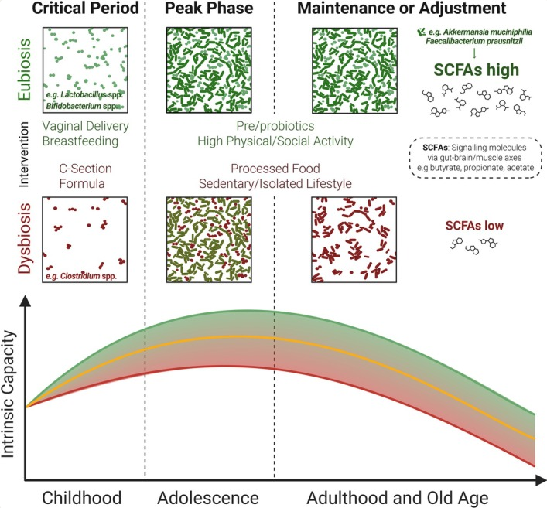
Gut Microbiome & Intrinsic Capacity
Healthy Gut (Eubiosis)
  Supported by vaginal delivery, breastfeeding, immune stimulation, high physical activity
  Promotes higher, healthier intrinsic capacity (trajectory) across life
Unhealthy Gut (Dysbiosis)
  Linked to C-section, formula feeding, poor lifestyle
  Lowers SCFA production
  Associated with poorer intrinsic capacity over time
Benner et al 2025 Aging Cell
doi: 10.1111/acel.70146
Notes:
https://pmc.ncbi.nlm.nih.gov/articles/PMC12341812/
https://pmc.ncbi.nlm.nih.gov/articles/PMC12116569/ - looks like a review for background if you’re interested in scanning something for info

Slide 14
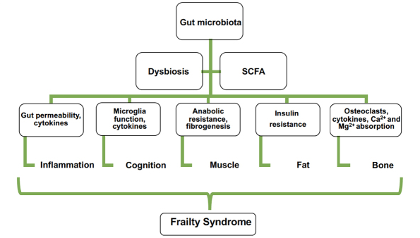
Gut Microbiome & Frailty
Frailty Domains linked to Dysbiosis
Inflammation
  Dysbiosis ↑ gut permeability and ↓ SCFAs, driving chronic systemic inflammation that accelerates frailty
Cognition
  Dysbiosis disrupts Gut–brain axis, contributing to cognitive decline, mood changes, and ↓ neurological resilience
Muscle
  Dysbiosis ↓ nutrient absorption and SCFA availability, worsening muscle strength, mass, and function
Fat (Metabolic Health)
  Dysbiosis promotes visceral fat accumulation, insulin resistance, and metabolic inflammation that feed into frailty
Bone
  Dysbiosis affects calcium absorption, immune signaling, and bone turnover, ↑ bone loss and fracture risk
Sánchez y Sánchez de la Barquera et al 2022 J Nutr Health Aging doi: 10.1007/s12603-022-1842-4
Notes:
https://pmc.ncbi.nlm.nih.gov/articles/PMC9483424/#cesec10

Slide 15
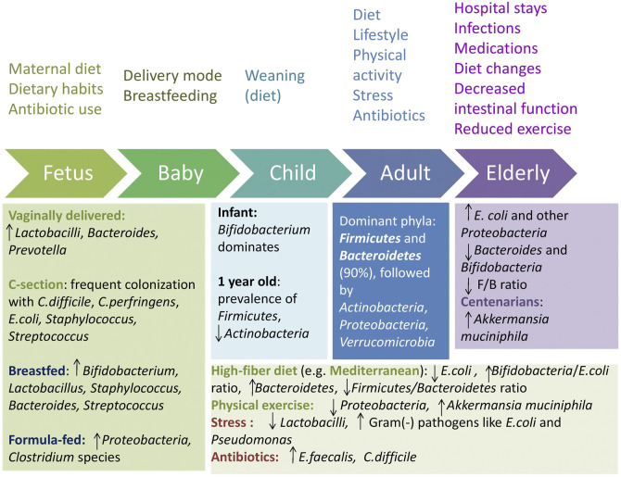
Gut Microbiome & Aging
Gyriki et al 2025 Front Aging
doi: 10.3389/fragi.2025.1452917
Notes:
https://pmc.ncbi.nlm.nih.gov/articles/PMC12116569/
https://pmc.ncbi.nlm.nih.gov/articles/PMC9483424/#cesec90

Slide 16
Gut Microbiome & Aging
Study population | Study design | Results | Ref.
17 young subjects (21-33 y.o.), 23 elderly (68-88 y.o.) 19 centenarians (99-107 y.o.), Italy | Cross-sectional study | Centenarians more diverse core microbiota than the young and elderly: Reduced levels of F.prausnitzii and E.rectale and increased levels of Methanobrevibacter smithii and Bifidobacterium adolescentis. | Wu et al 2019
21 centenarians (99-104 y.o.) 43 elderly (63-78 y.o.) 20 young adults (25-40 y.o.), Italy | Cross-sectional study | Similar microbiota between young adults and 70 y.o. Differences in centenarians: rearranged Firmicutes increased facultative anaerobes like Proteobacteria and Bacilli, increased E.limosum and A.muciniphila. | Biagi et al 2010
Notes:
https://pmc.ncbi.nlm.nih.gov/articles/PMC12341812/
Examples of healthy aged adults and the microbiota

Slide 17
Gut Microbiome & Aging
Study population | Study design | Results | Ref.
Adults (> 40 y.o.) N=650, U.S.A. | Randomized, double-blind, placebo-controlled study with postbiotic | Measuring cognitive function, fatigue, sleep score at 8 weeks | NCT07060898 Active, not recruiting
Adults (50-75 y.o.) N=236, Germany | Randomized, double-blind, placebo-controlled study of postbiotic for 12 weeks | Measuring stress, anxiety, cognition/memory, grip strength, chronic inflammation at 12 weeks | NCT07110896 Not yet recruiting
Notes:
https://pmc.ncbi.nlm.nih.gov/articles/PMC12341812/
Examples of healthy aged adults and the microbiota

Slide 18
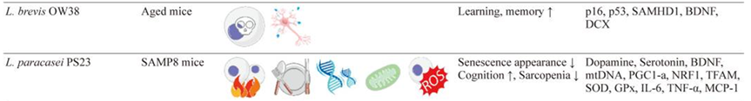
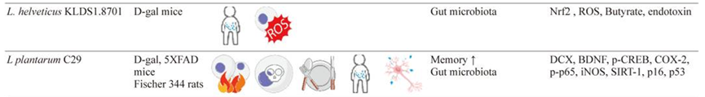
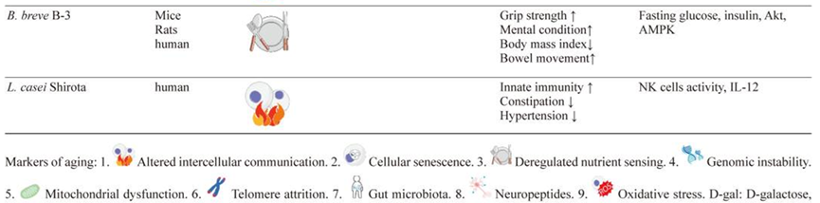
Aging Animal Models
Tsai et al 2020 Biosci Microbiota Food Health
doi: 10.12938/bmfh.2020-026
Notes:
https://pmc.ncbi.nlm.nih.gov/articles/PMC7817508/#s5
The chart above is snippets from a larger figure summing probiotic strains reported to have beneficial health effects in preclinical studies using aging animal models and in clinical studies for seniors

Slide 19
Interpreting Outcomes
What is the nature of the outcome?
  Biological vs functional aging
Assessing clinical meaningfulness
  Are there gains in health or quality of life?
  Small gains may not translate to substantial functional improvement in older adults
Lack of standardized definition and validated endpoints complicates cross-trial comparison
  Causes vs Associations - Biological nature of aging still being elucidated
  Cell-specific aging – biomarkers in blood may not reflect aging in organ systems
Are outcomes validated and appropriate for older populations?
Notes:
Unlike trials targeting a single disease endpoint, aging-related studies often assess physical, cognitive, metabolic and psychosocial domains, so interpretation requires a multidimensional and cautious approach that must go beyond statistical significance to include clinical, functional and contextual relevance.
https://www.sciencedirect.com/science/article/pii/S0092867423008577
https://pmc.ncbi.nlm.nih.gov/articles/PMC6736231/
https://www.sciencedirect.com/science/article/pii/S0092867423008577#sec5

Slide 20
Interpreting Outcomes
Validated Questionnaires for older adults (≥60-65 y.o.)
Category | Frailty and Physical Function | Cognition | Mental Health | Nutrition | Quality of Life | Sleep
Questionnaires validated in older adults | FRAIL Scale, Tilburg Frailty Indicator (TFI) Clinical Frailty Scale SARC-F | MoCA (Montreal Cognitive Assessment) MMSE (Mini Mental State Examination) ADAS-Cog | Geriatric Depression Scale (GDS-15/GDS-30) Geriatric Anxiety Inventory (GAI) | Mini Nutritional Assessment (MNA) Simplified Nutrition Appetite Questionnaire (SNAQ) | WHOQOL-OLD OPQOL-35 / OPQOL-13 | Pittsburgh Sleep Quality Index (PSQI)
Notes:
Unlike trials targeting a single disease endpoint, aging-related studies often assess physical, cognitive, metabolic and psychosocial domains, so interpretation requires a multidimensional and cautious approach that must go beyond statistical significance to include clinical, functional and contextual relevance.
https://www.sciencedirect.com/science/article/pii/S0092867423008577
https://pmc.ncbi.nlm.nih.gov/articles/PMC6736231/
https://www.sciencedirect.com/science/article/pii/S0092867423008577#sec5

Slide 21
Interpreting Outcomes
Limited Validity for Aging Population
Category | Physical Activity | Cognition | Mental Health | Nutrition & Appetite | Quality of Life | Sleep
High Cognitive Load or Poor Fit for Aging | IPAQ GPAQ | STROOP Task Digit Symbol Substitution | Beck Depression Inventory (BDI) STAI | General Appetite VAS | Adult QoL tools without elderly validation (e.g. Nottingham Health Profile) | Smartphone/app-based sleep diaries
Main issue | Recall bias Inaccurate intensity Estimation | Education and age bias | Somatic symptom overlap Low specificity | Issues with vision, motor control and cognition | Misses aging-specific domains | Digital literacy barriers
Notes:
Unlike trials targeting a single disease endpoint, aging-related studies often assess physical, cognitive, metabolic and psychosocial domains, so interpretation requires a multidimensional and cautious approach that must go beyond statistical significance to include clinical, functional and contextual relevance.
https://www.sciencedirect.com/science/article/pii/S0092867423008577
https://pmc.ncbi.nlm.nih.gov/articles/PMC6736231/
https://www.sciencedirect.com/science/article/pii/S0092867423008577#sec5

Slide 22
Clinical Design Considerations
Population considerations – Defining “Healthy”
  More nuanced than defining health in young adults
  “Healthy” may include managed chronic conditions (hypertension, mild dyslipidemia)
  Consideration of polypharmacy and drug–nutrient/supplement interactions
  Implications eligibility criteria and achievable recruitment pools
Context: Consider the whole person
  Sex, ethnicity, SES, environment, lifestyle
  Exposure to lifelong factors (diet, physical activity, stress) creates variable baselines
  High risk of underrepresenting subpopulations (e.g., oldest-old, rural, low SES)
Notes:
Diagram: https://pmc.ncbi.nlm.nih.gov/articles/PMC8559396/
https://pure-oai.bham.ac.uk/ws/files/180568943/SyedM2022Optimising.pdf

Slide 23
Clinical Design Considerations
Safety & Tolerability
  Safety thresholds must be age-adjusted
  Events tolerable for 40–60 y.o. may be unacceptable for 65+
  Increased sensitivity to GI effects, hemodynamic changes, sleep disruption
  Monitor for interactions with existing medications and comorbidities
  Design for early detection of minor safety signals
Outcome Selection & Measurement
  Choose outcomes that are meaningful to aging (mobility, cognition, vitality, fatigue, GI comfort)
  Consider slower physiological changes (need for sensitive or composite endpoints)
  Use validated tools for older adults (e.g., SPPB, gait speed, GSRS, PROMs for aging)
  Risk of floor/ceiling effects if tools not validated in aging populations
Notes:
Diagram: https://pmc.ncbi.nlm.nih.gov/articles/PMC8559396/
https://pure-oai.bham.ac.uk/ws/files/180568943/SyedM2022Optimising.pdf

Slide 24
Clinical Design Considerations
Study Logistics & Feasibility
  Visit burden: reduce travel, include home-based or hybrid assessments
  Ensure accessibility: transportation, mobility accommodations, larger font, hearing-friendly environment
  Retention strategies must be adapted to older participants
Intervention Practicality
  Ease of use: dosage form, swallowability, taste, packaging
  Timing with meals and medications
  Realistic adherence expectations in daily life
  Consider cognitive load for instructions or complex regimens
Ethical and Equity Considerations
  Avoid excluding older adults without strong justification
  Ensure informed consent procedures consider sensory or cognitive limitations
  Include diverse aging populations to enhance real-world relevance
Notes:
Diagram: https://pmc.ncbi.nlm.nih.gov/articles/PMC8559396/
https://pure-oai.bham.ac.uk/ws/files/180568943/SyedM2022Optimising.pdf

Slide 25
Ongoing Clinical Trials
Active, not recruiting OR Recruiting OR Not yet recruiting
clinicaltrials.gov
Search conducted on 03DEC2025
Condition/disease: aging OR aging well OR aging and geriatric health OR aging signs OR aging process
Eligibility: Older adult (65+), Accepts healthy volunteers
Results: 539 Clinical Studies
393 interventional
146 observational

Slide 26
Ongoing Clinical Trials
Types of Interventions
Cognitive & Neurological Health
Alzheimer’s
Musculoskeletal & Physical Function
Falls
Metabolic & Cardiovascular Health
Obesity
Skin & Healthy Aging
Wrinkles
Osteoporosis
Physical activity
Cardiovascular Health
Frailty
Women’s Health
Appetite loss
Dementia
Sarcopenia
Hydration
Firmness
Cognitive decline
Memory impairment
Anxiety
Depression
Sleep
Menopause
Osteoporosis

Slide 27
Takeaways
Aging is universal but the rate and quality of aging differ dramatically between individuals.
This variability creates a powerful opportunity for targeted interventions, including nutrition and dietary supplements.
Emerging biomarkers and functional constructs are advancing how we measure and understand healthy aging.
Because aging affects physical, cognitive, metabolic, and psychosocial domains, results must be interpreted through a multidimensional lens, prioritizing clinical and functional relevance and not just statistical significance.

Slide 28

For more information, please contact:
Stephanie-Anne Girard, PhD
Director, Scientific Affairs
sgirard@nutrasource.ca

