Slide 1


The Effects of Free Radicals &
Oxidative Stress on Healthy Aging & Immunity

Slide 2



Introduction
Dr. Danielle Citrolo, PharmD
Vice President, Scientific & Regulatory Affairs
Kyowa Hakko, USA

Slide 3

Healthy Aging
What is “Healthy Aging”?
Aging has become more about living better, not just living longer.
People want to stay active, independent, and confident as they grow older.
“Aging well” has become a health goal across generations.

Slide 4
Healthy Aging
Consumer Insights
In 2024, 770 U.S. supplement consumers were surveyed on their interest and habits around supplements.
Interest in immunity and aging supplements spans across Millennials, Gen X, and Boomers.
31%
72%
“Healthy aging is important to me”
Concerned about how their skin looks and feels
78 %
19 %
Concerned about immune health
Tried anti-aging supplements in the past 12 months
Source: Nextin Research. 2024 Supplement Trends.

Slide 5
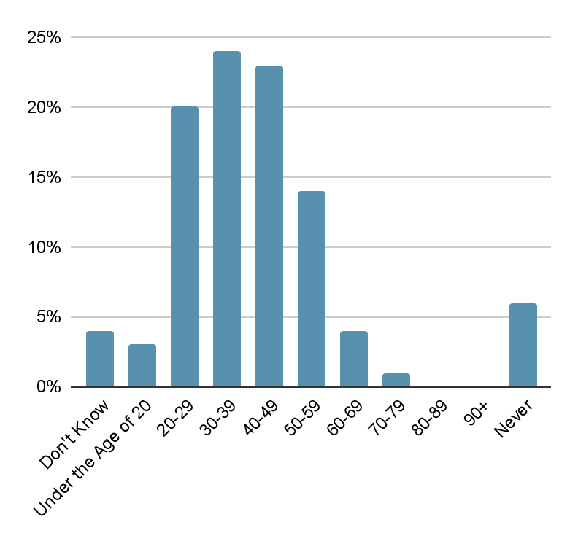
Healthy Aging
When Do People Start?
Anti-aging habits begin surprisingly early — 20s & 30s.
Younger consumers are motivated by prevention, not repair.
Social media and wellness culture amplify awareness of aging and ways to prevent it.
Source: Nextin Research. 2024 Supplement Trends.

Slide 6
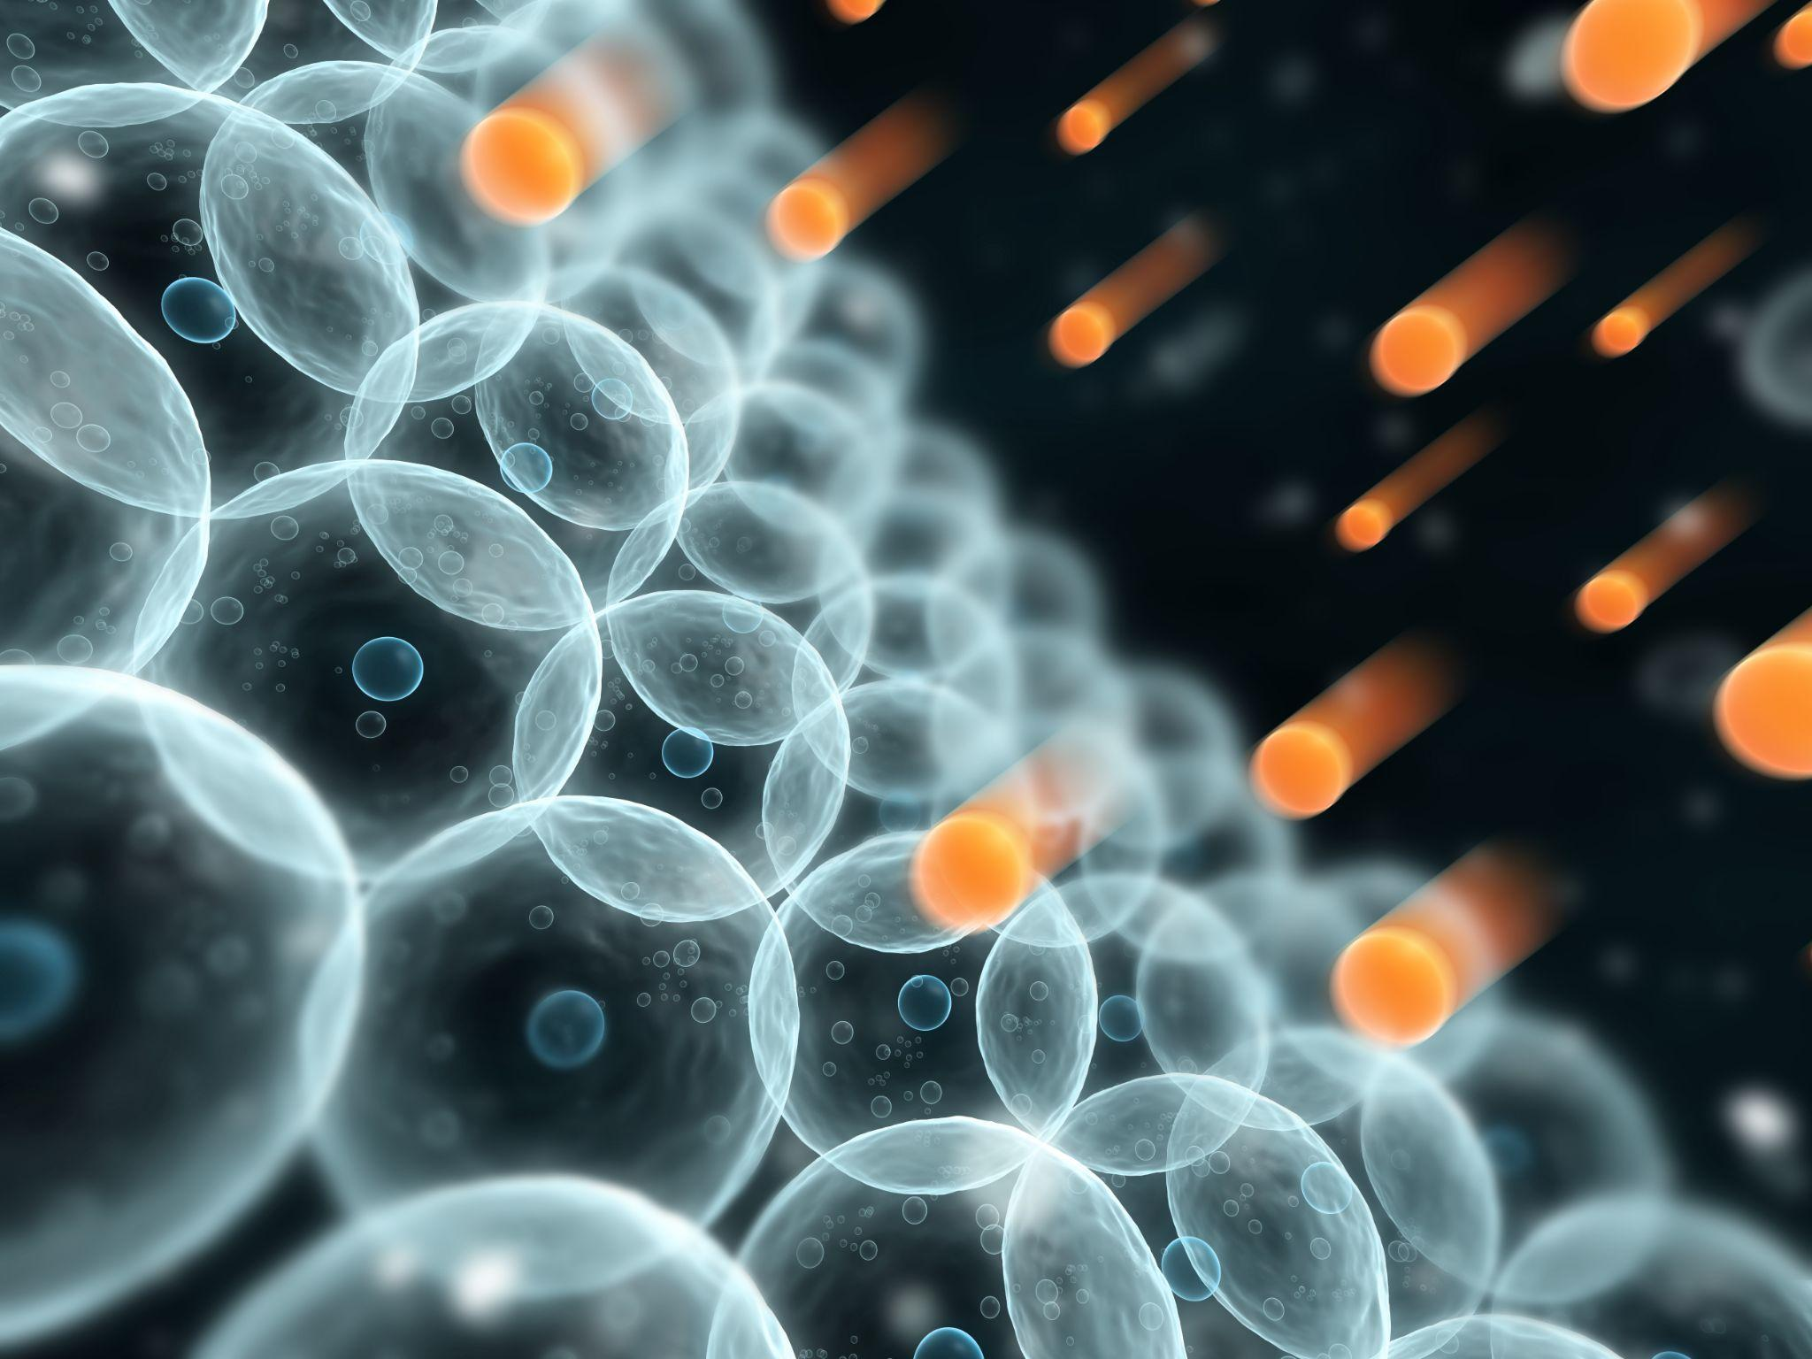
Causes of Aging
What Causes Aging?
Free radicals — unstable molecules that result from lifestyle stressors and have been linked to suboptimal health and aging.
Oxidative stress — cumulative cell damage caused by free radicals that can harm DNA, proteins, and other vital molecules.

Slide 7
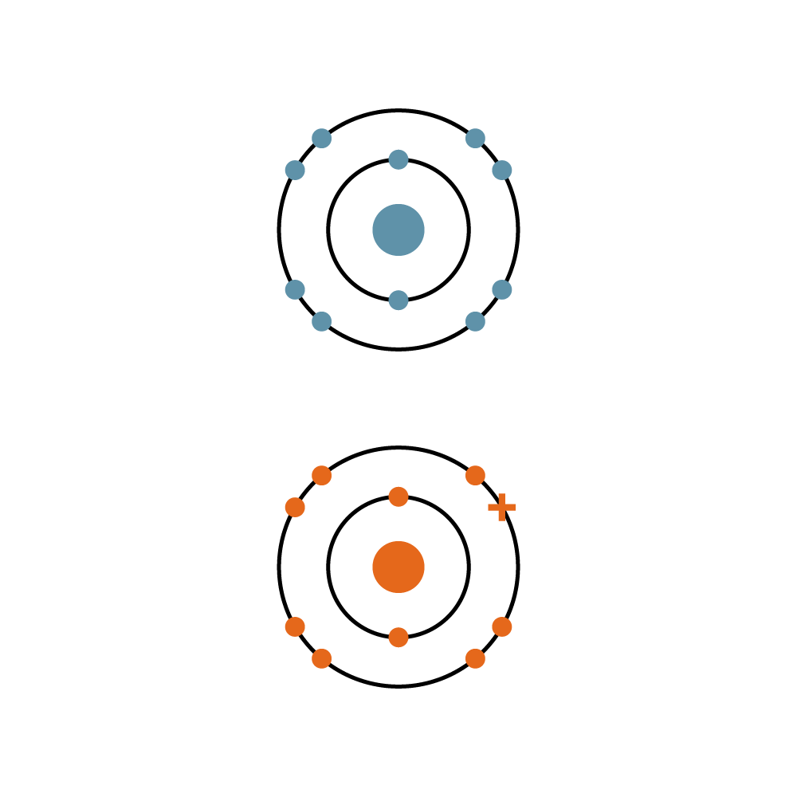
Causes of Aging
What Are Free Radicals?
Free radicals are highly reactive and unstable atoms, ions, or molecules.
They form when a molecule loses or gains electrons. This lack of balance makes them unstable.
We all have free radicals roaming our bodies all the time, but if not controlled, they can disrupt normal cell function.
Healthy Stable Atom
Unpaired Electron
Free Radical

Slide 8
Causes of Aging
What Is Oxidative Stress?
If free radicals are left unchecked, they can cause cells to enter a state of oxidative stress.
Oxidative stress is the state of imbalance between the production of free radicals and antioxidants.
In this state, free radicals can be allowed to damage critical cellular components like DNA, proteins, and lipids. This can lead to a variety of dysfunctions, mutations, and even cell death.

Slide 9
Causes of Aging
Glutathione/Antioxidants
Chronic Disease
Oxidants
Aging & Obesity

Slide 10




Causes of Aging
Environmental Factors That Can Decrease Glutathione
Tobacco Use
Obesity
Alcohol Consumption
Air Pollution
49.2M Americans currently use some form of tobacco
100M American adults over the age of 20 have obesity
27.1M chronically consume excessive amounts of alcohol
156.1Mare living in places that get failing grades for unhealthy levels of ozone or particle pollution
Source: Centers for Disease Control and Prevention. http://www.cdc.gov/nhcs/data/hus/hus07.pdf

Slide 11

Glutathione Overview
The Body’s Natural Defense
The body fights free radicals and oxidative stress at the cellular level using an antioxidant called glutathione.
Glutathione is a vital, naturally occurring tripeptide that the body uses for:
Maintaining structural integrity of cell walls
Detoxification
Liver health
Overall immune health
Antioxidant
Free Radical (Unstable Molecule)
Unpaired Electron
Stable Molecule

Slide 12
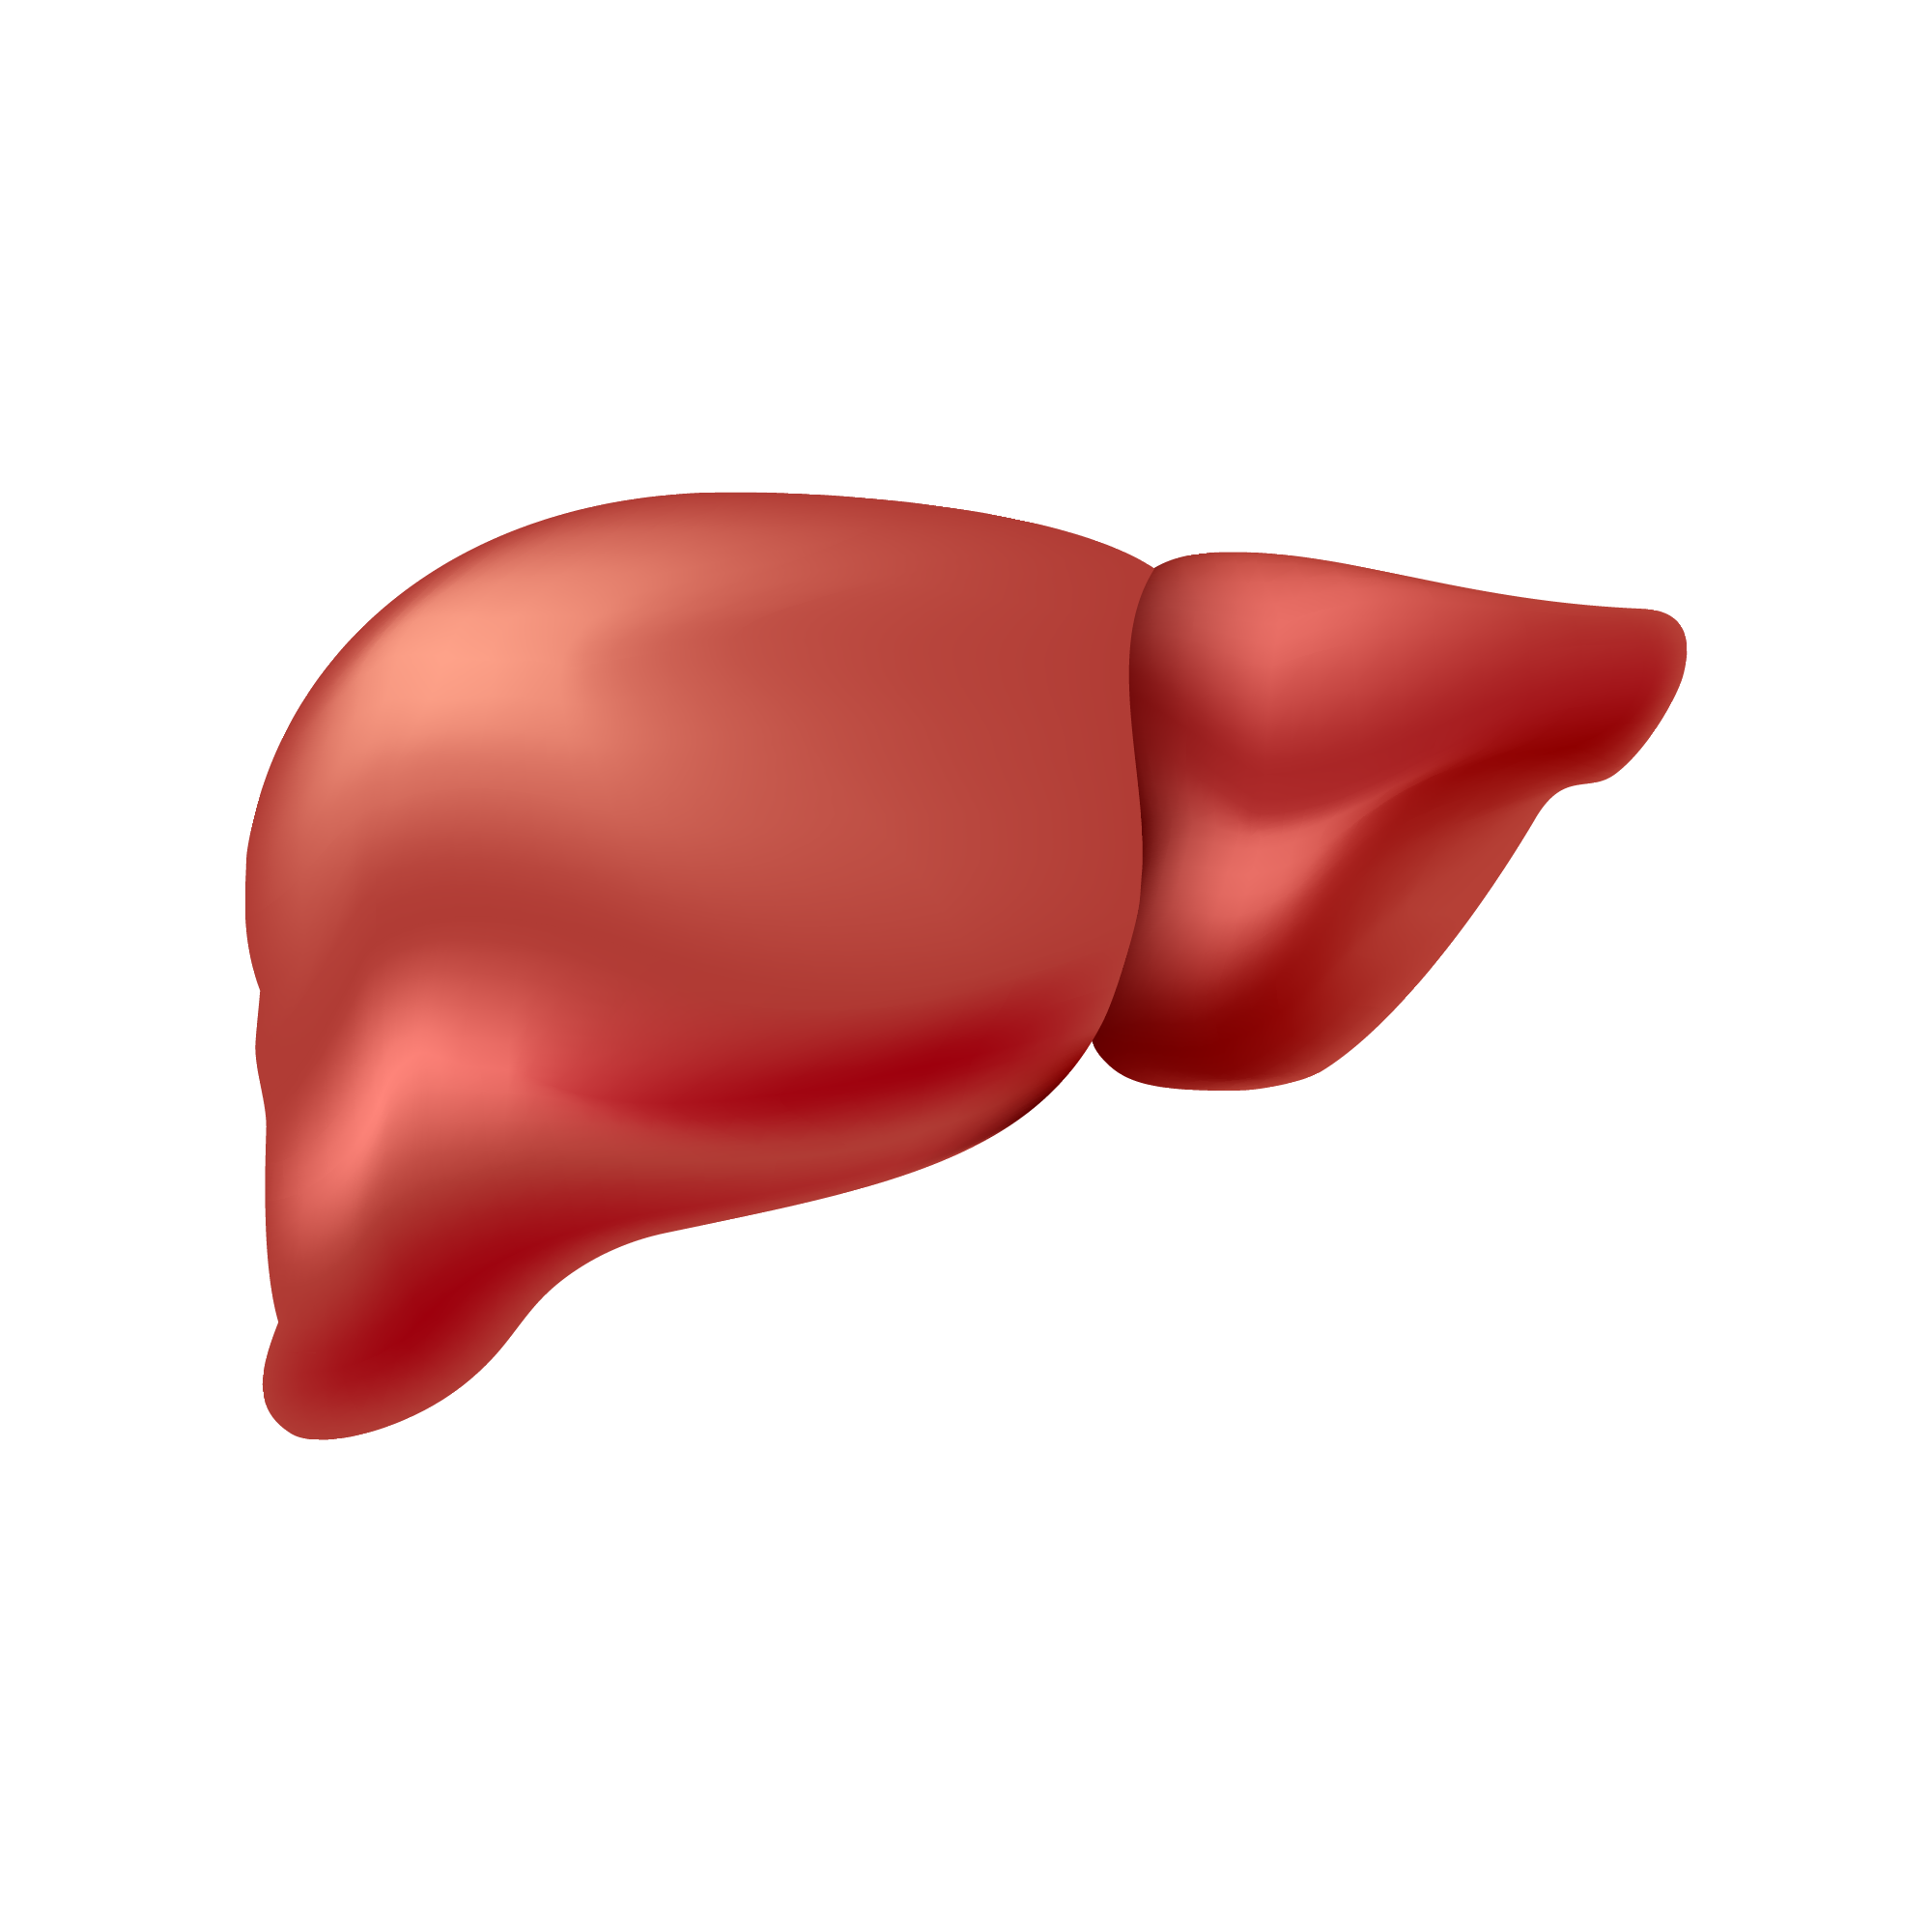
Glutathione Overview
How Glutathione Works
Binds to heavy metals and fat-soluble toxins
Carries harmful compounds to the kidneys for safe excretion
Boosts the effectiveness of other antioxidants, including vitamins C and E
Helps protect cells and ensure they are functioning optimally
Toxic substance enters body
Glutathione bonds to toxins and escorts them out of the body

Slide 13
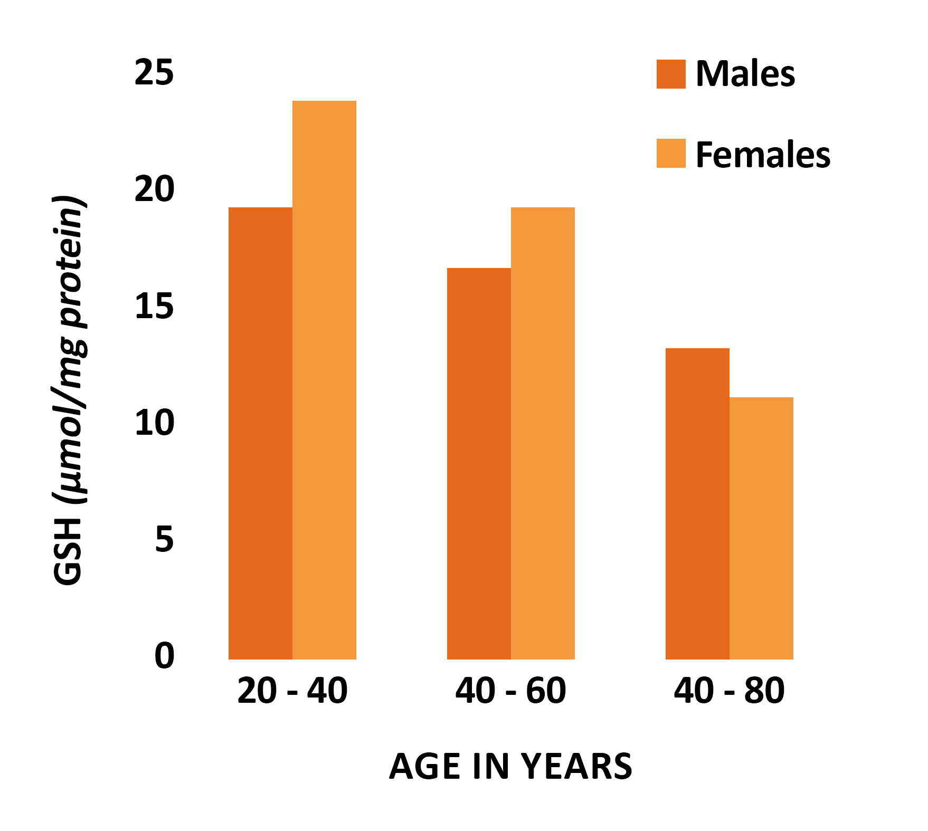
Glutathione Overview
Aging & Glutathione
Glutathione levels decline naturally with age.
Lower glutathione levels are associated with:
Increased oxidative stress
Reduced detoxification capacity
Impairment of critical cellular functions
Enhanced susceptibility to oxidative- stress related disease and disorders

Slide 14
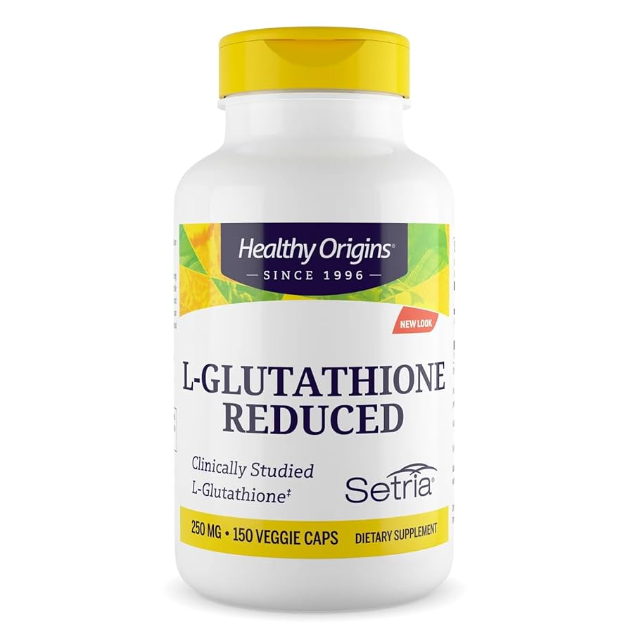
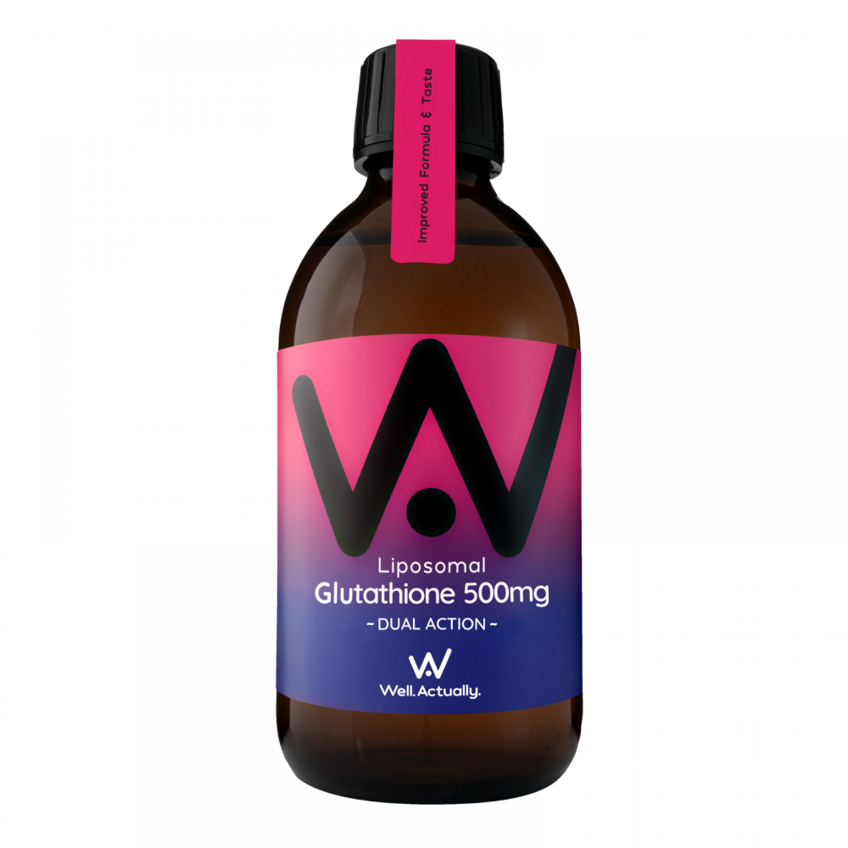
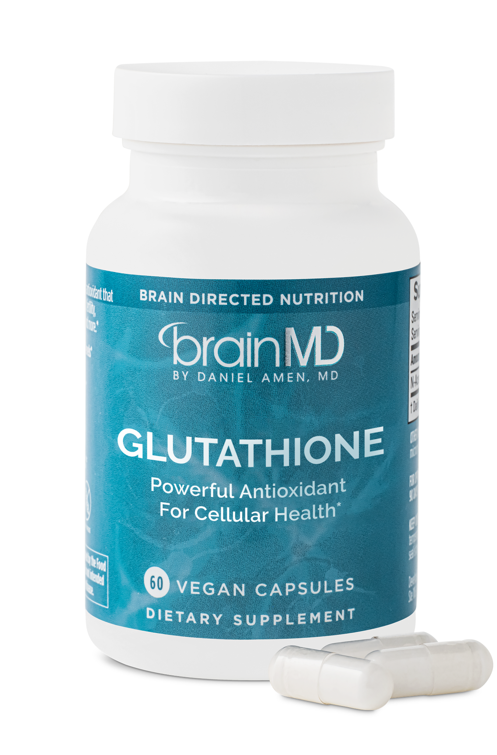
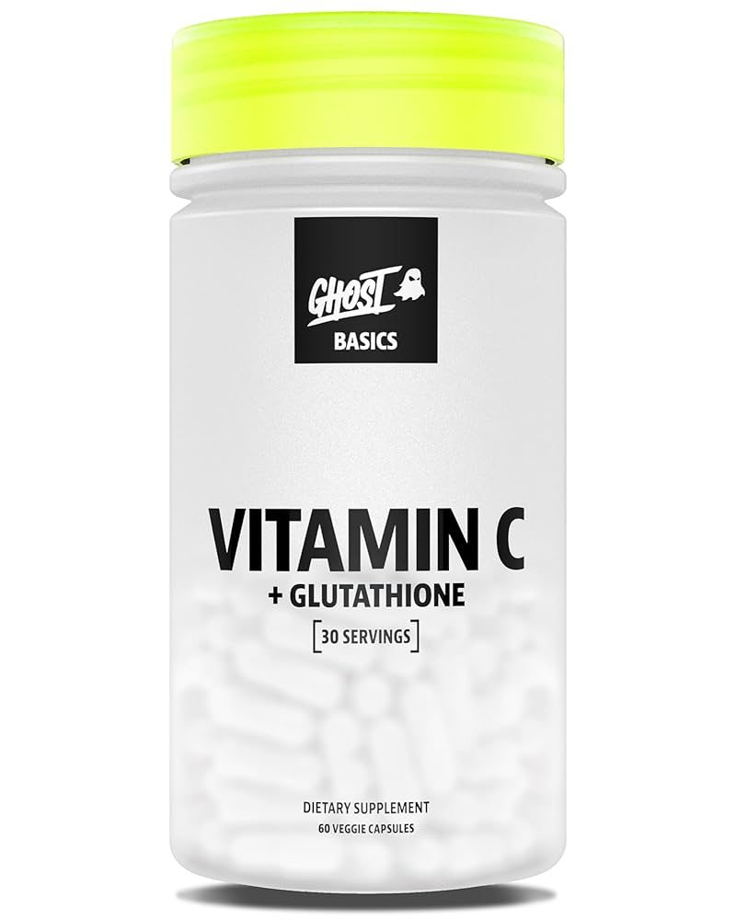
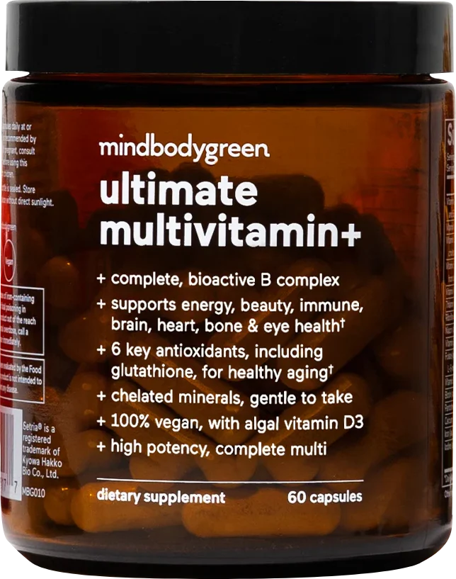
Glutathione Overview
Glutathione Supplementation
Many adults are turning to glutathione supplements to:
Restore and maintain healthy levels
Help the body keep pace with modern stressors
Support cellular resilience and overall healthy aging

Slide 15
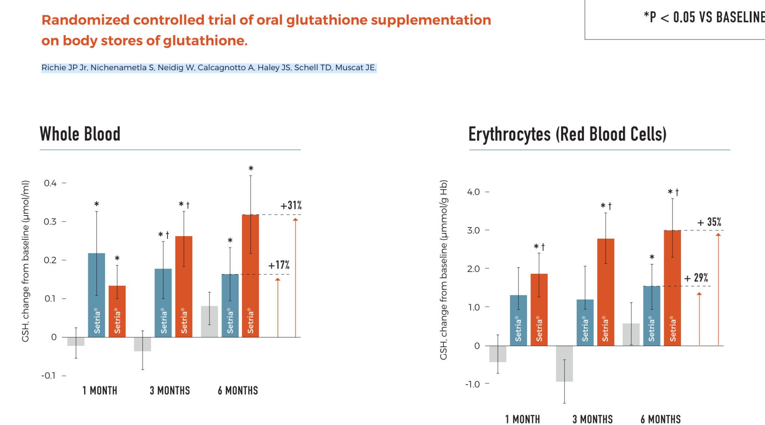
Glutathione Benefits
Glutathione supplementation has been shown to raise glutathione levels in the body.
Healthy adults taking daily oral doses of 250mg-1,000mg saw significant increase of glutathione in whole blood, erythrocytes, and plasma after six months.
Whole Blood
Erythrocytes
(Red Blood Cells)
Source: Richie JP Jr. Nichenametla S. Neidig W. Calcagnotto A. Haley JS. Schell TD. Muscat JE.

Slide 16

Glutathione Benefits
Glutathione Supports Healthy Immunity
Healthy levels of glutathione are also needed for the production and function of lymphocytes (white blood cells) and natural killer (NK) cells.
These cells are the first line of defense and are critical for the immune response:
Identify stressed or abnormal cells
Produce antibodies (B-cells)
Eliminate cells infected with viruses
Eliminate tumorigenic cells

Slide 17
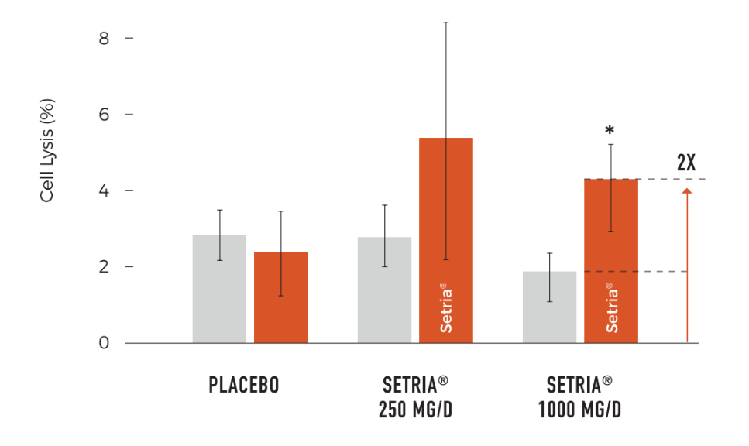
Glutathione Benefits
Daily supplementation with Setria® Glutathione has been shown to increase the cytotoxicity of NK Cells
Healthy adults taking oral doses of 1000mg saw 100% increase of NK cell cytotoxicity from baseline at 3 months, improving ability to eliminate abnormal or infected cells.
Natural Killer (NK) Cell Cytotoxicity Increased 2-fold from Baseline at 3 Months
Source: Richie JP Jr. Nichenametla S. Neidig W. Calcagnotto A. Haley JS. Schell TD. Muscat JE.

Slide 18

Setria® Overview
The world’s most trusted form of glutathione.
Supported by 65 years of clinical research and development.
Tested in 28 clinical trials since 1991.
1956 — World’s first invention of the process of amino acid (L-Glutamic acid) production by fermentation.
1969 — Release of “KYOWA L-Glutathione” for medical use.
2006 — Launch brand marketing of Setria® in USA.
Today — Supplying L-Glutathione reduced globally.
Setria® is the LARGEST branded glutathione.
1960s — Establishment of technology for manufacturing glutathione.
2000s — Establishment of groundbreaking fermentation method for both reduced and oxidized glutathione production.
2023 — Setria® is approved in Brazil.
Future — Continue studying the science of glutathione with various academic organization.

Slide 19

Setria® Overview
How Setria® Works
State-of-the-art precision fermentation gives Setria® exceptional purity and efficacy and allows it to be delivered in a stable, high quality form.
Bind to free radicals and stabilize them on the cellular level*
Help eliminate toxins and ingested chemicals the body has already absorbed*
Intercept and neutralize toxins in the GI tract before they can be absorbed*
*These statements have not been evaluated by the Food and Drug Administration. This product is not intended to diagnose, treat, cure, or prevent any disease.

Slide 20
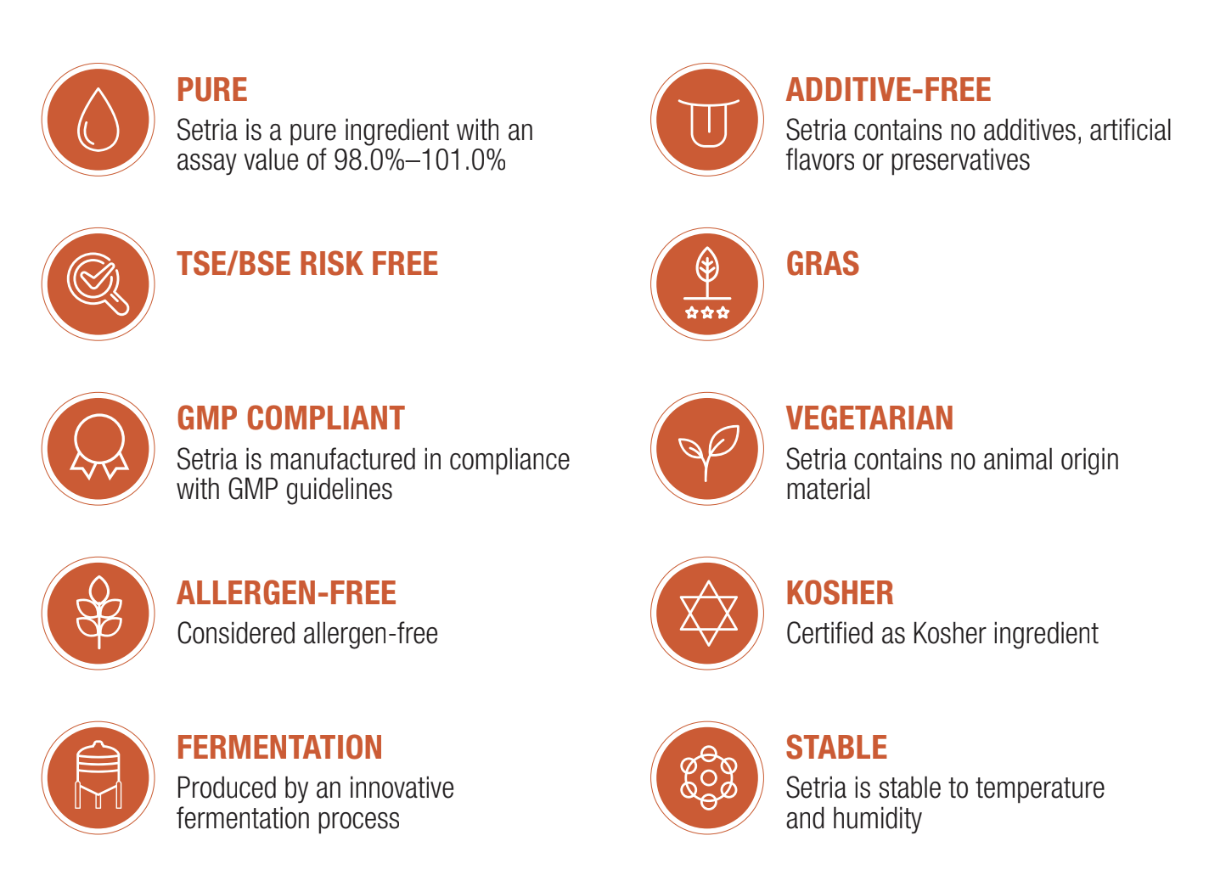
Setria® Features & Benefits

Slide 21
Setria® Structure-Function Claims for Active Aging
Helps to reduce everyday toxins in the body*
Helps support respiratory health*
Daily consumption increases the body’s glutathione levels*
Helps your body fight oxidative stress*
Supports immune health*
Supports your body’s natural defense system*
Supports healthy skin*
May help with skin brightening*
Supports healthy aging and overall health*
*These statements have not been evaluated by the Food and Drug Administration. This product is not intended to diagnose, treat, cure, or prevent any disease.

Slide 22

Q&A
What questions do you have about healthy aging, glutathione, or Setria®?

Slide 23
THANK YOU
Questions?
For more information please contact us at: info@kyowa-usa.com or info@setriaglutathione.com

