Slide 1


Live Longer, Live Better
The Longevity Blueprint

Slide 2

Why Focus on Longevity?
Longevity is not just about living longer, but about living better.
We're moving from a disease-centric healthcare model to a health-centric one. A sick care system to a true healthcare system.
The goal: to not just add years to your life, but to add life to your years.

Slide 3
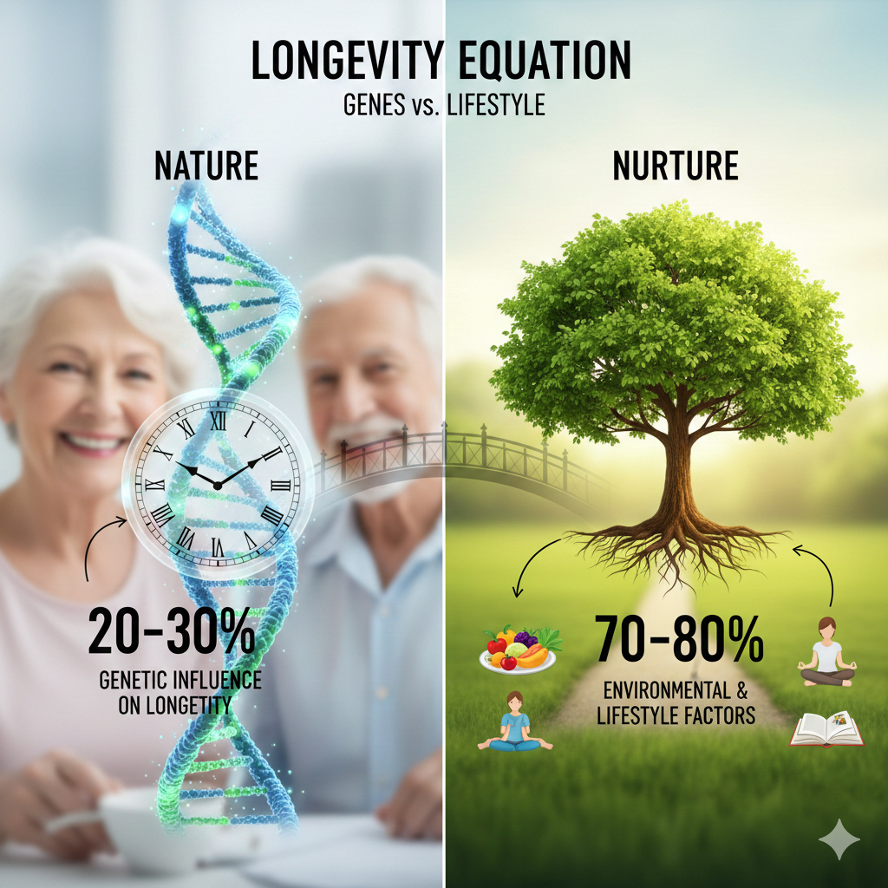
ESTIMATES OF GENETIC INFLUENCE ON LONGEVITY
RANGE FROM 20-30%.

Slide 4
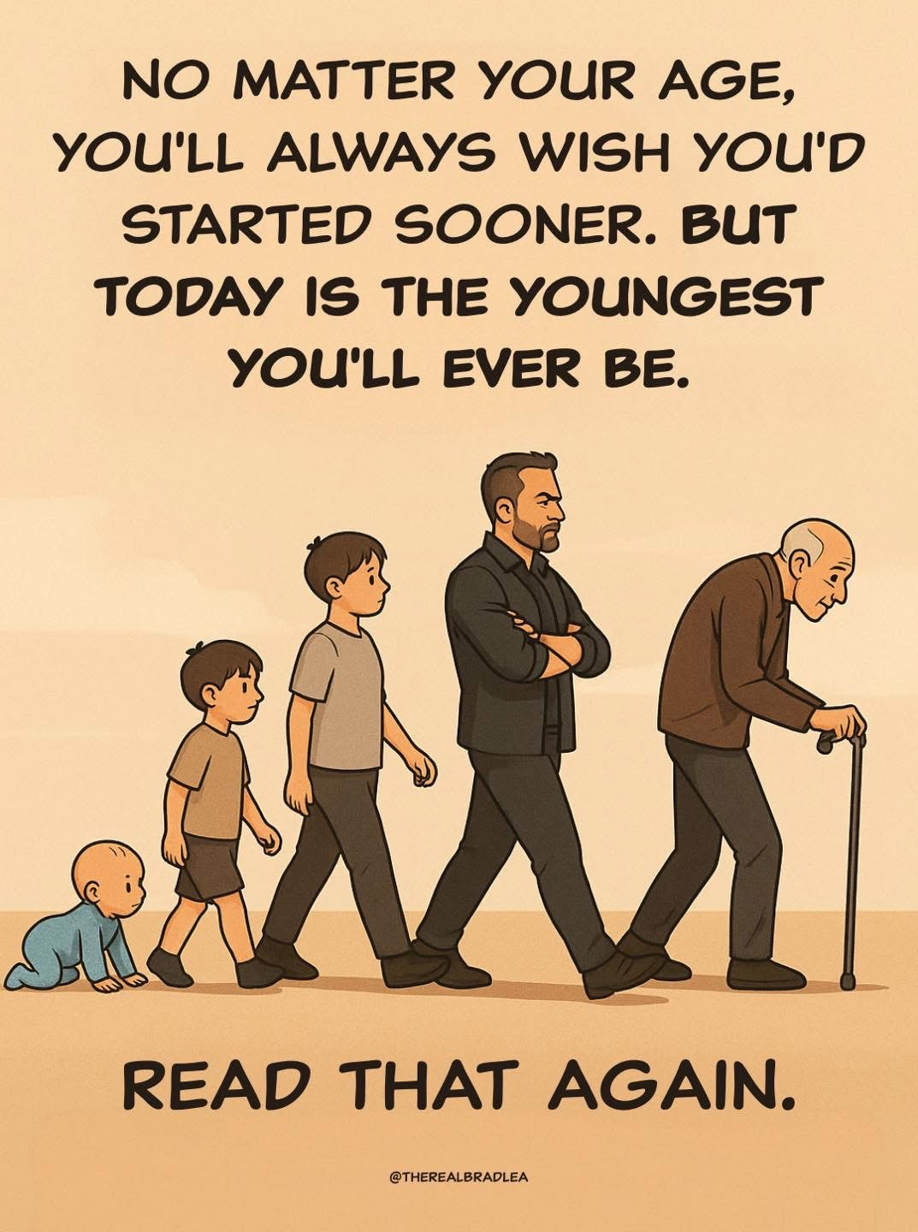

Slide 5

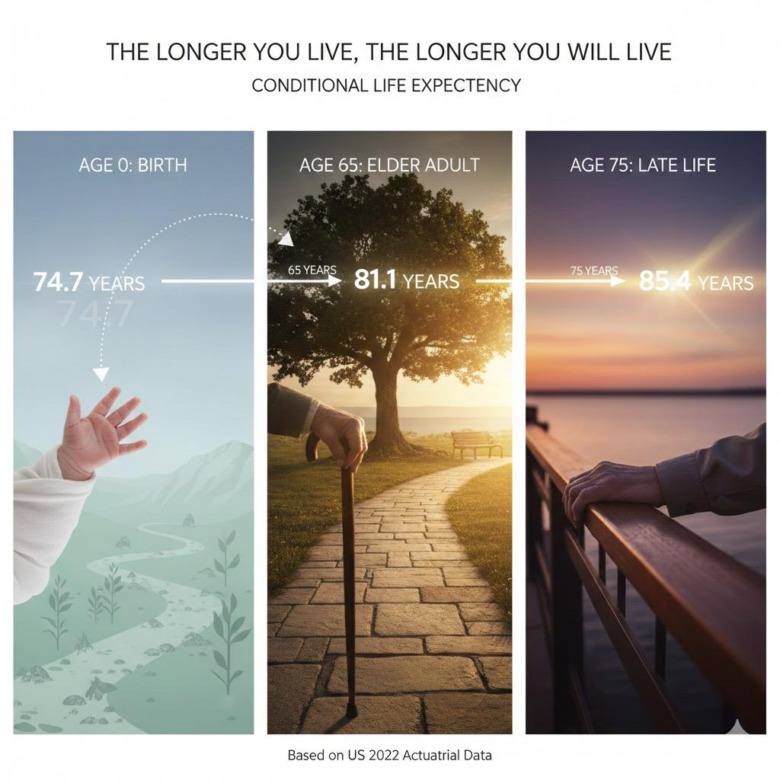

Slide 6


Slide 7
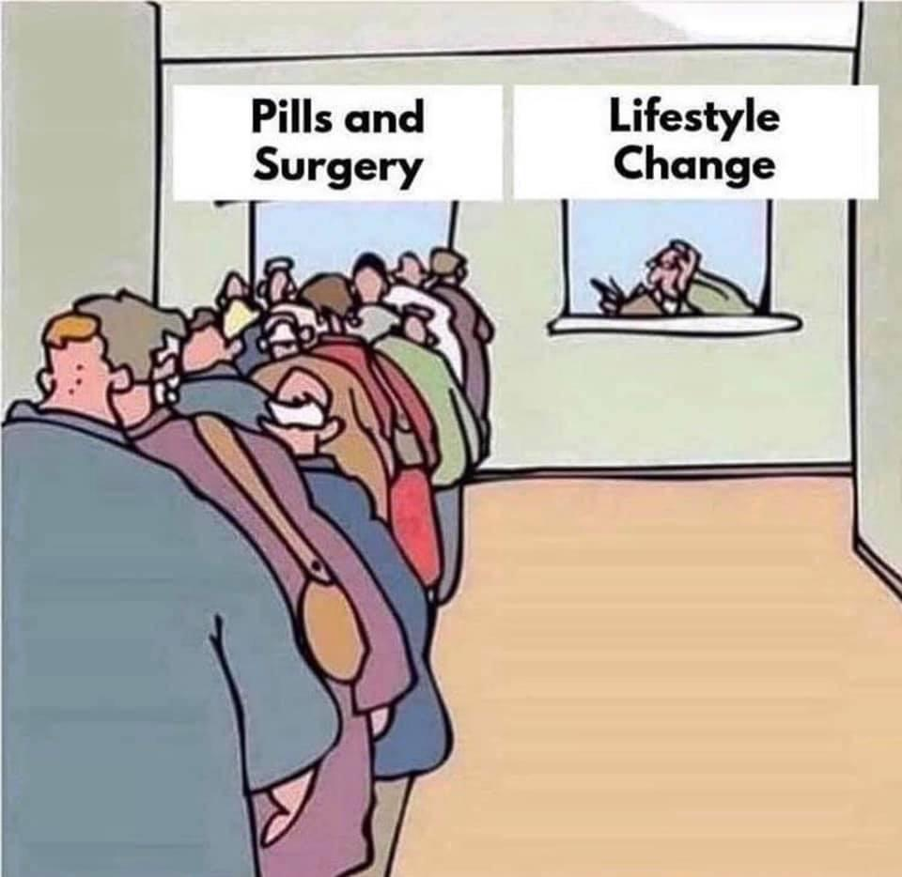

Slide 8
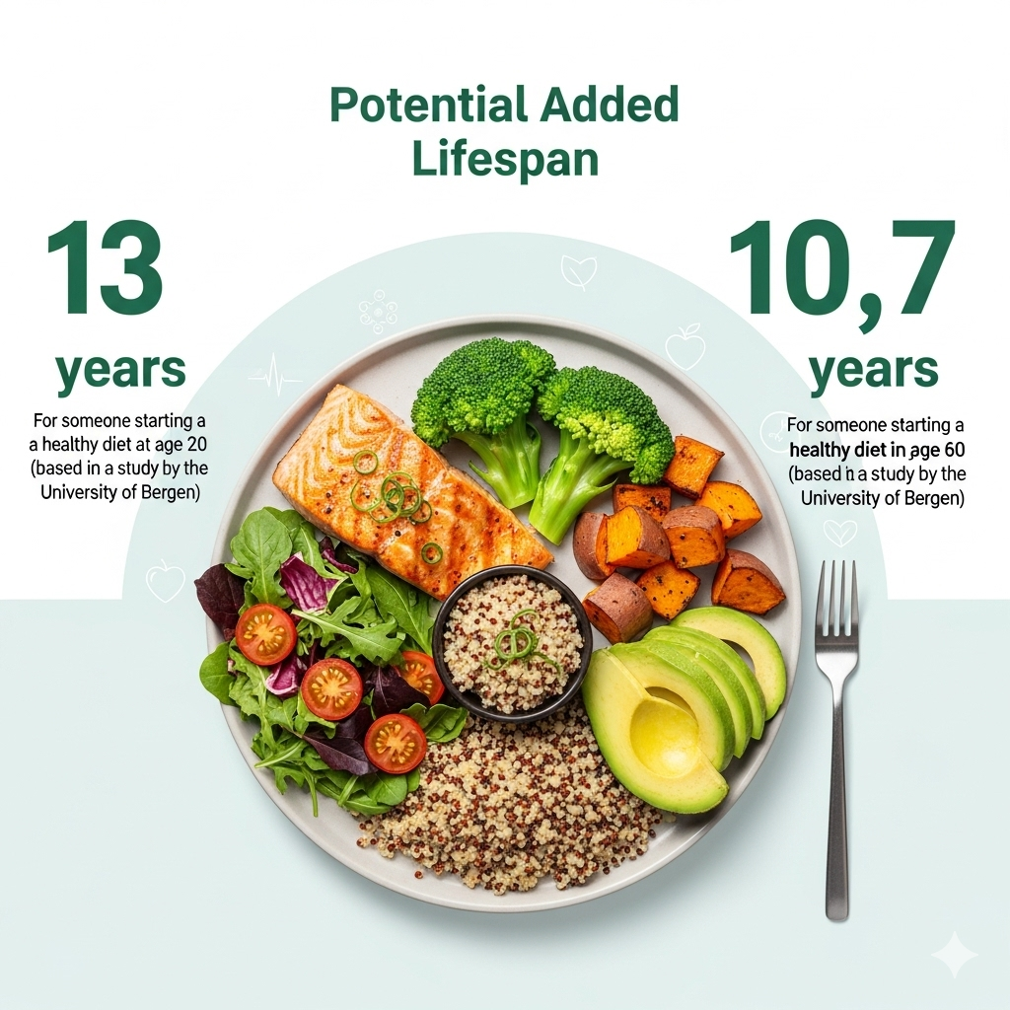
Pillar 1: Nutrition
Fueling Your Future: The Power of Nutrition
The Stats: Unhealthy diets contribute to an estimated 678,000 deaths annually in the U.S. from diseases like heart disease, cancer, and type 2 diabetes.
A diet high in processed foods and low in nutrients is a leading cause of disability.
How it adds years: A study found that adopting an optimal diet (rich in whole grains, legumes, and nuts) could add an estimated 13 years to a man's life and 10.7 years to a woman's. Even starting at age 60 could add 8 years.
Key takeaway: Small, consistent dietary changes have a massive cumulative effect on health and longevity.

Slide 9
Here are the main dangers of added sugar:
Weight Gain and Obesity: Added sugar, especially in sugary drinks, contributes to increased calorie intake without providing satiety, leading to weight gain and significantly raising the risk of obesity. Obesity, in turn, is a major risk factor for many other chronic diseases.
Increased Risk of Type 2 Diabetes: High intake of added sugar can lead to insulin resistance, where the body's cells become less responsive to insulin. This forces the pancreas to produce more insulin, eventually leading to pancreatic fatigue and increasing the risk of developing type 2 diabetes.

Slide 10
Heart Disease Risk:
  High Triglycerides: Excess sugar is converted into fat in the liver, leading to elevated triglyceride levels, a known risk factor for heart disease.
  High Blood Pressure: Sugary diets can increase blood pressure, further straining the cardiovascular system.
  Inflammation: Added sugars promote chronic inflammation throughout the body, which is a key driver of atherosclerosis (hardening of the arteries) and other cardiovascular problems.

Slide 11
Cognitive impairment and Alzheimer's disease:
High sugar consumption can lead to insulin resistance in the brain, impairing its ability to use glucose for energy, a connection sometimes dubbed "Type 3 Diabetes."
Additionally, excess sugar promotes chronic inflammation and oxidative stress in the brain, both of which contribute to neurodegenerative pathology.

Slide 12
Non-Alcoholic Fatty Liver Disease (NAFLD): Fructose, a component of added sugar, is metabolized by the liver. Excessive fructose intake can overwhelm the liver, leading to the accumulation of fat in liver cells, even in people who don't consume alcohol. This can progress to more severe liver damage.
Dental Problems: Added sugars provide an easy food source for bacteria in the mouth, which then produce acids that erode tooth enamel, leading to cavities and tooth decay.
Increased Risk of Certain Cancers: While research is ongoing, high sugar intake is indirectly linked to an increased risk of some cancers. This is often through mechanisms like promoting obesity, insulin resistance, and chronic inflammation, all of which are cancer risk factors.

Slide 13
Poor Mental Health:
  Mood Swings and Energy Crashes: Rapid spikes and drops in blood sugar can lead to irritability, mood swings, and feelings of fatigue.
  Increased Risk of Depression and Anxiety: Some studies suggest a link between high sugar consumption and an increased risk of depression and anxiety, though the exact mechanisms are still being researched.
  Accelerated Skin Aging: Advanced glycation end products (AGEs), formed when sugar reacts with proteins in the body, can damage collagen and elastin, leading to premature wrinkles and accelerated skin aging.

Slide 14
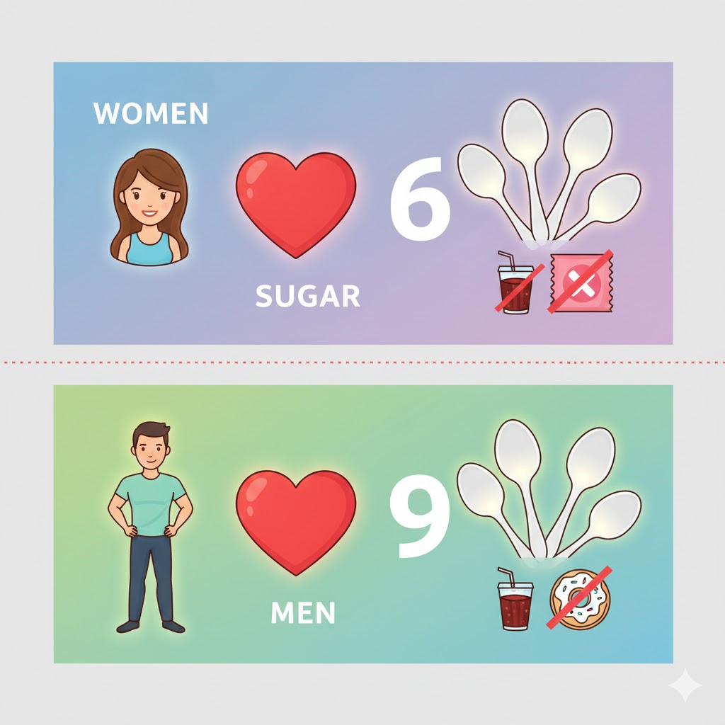
The American Heart Association recommends limiting added sugar intake to no more than 6 teaspoons (25 grams) per day for women
and 9 teaspoons (36 grams) per day for men, to avoid these significant health risks.

Slide 15


Slide 16

Pillar 2: Exercise
The Movement Prescription: Exercise and Lifespan
The Stats: Physical inactivity is a leading risk factor for noncommunicable diseases. The World Health Organization estimates that 4-5 million deaths per year could be averted if the global population was more active.
Regular physical activity can reduce the risk of many types of cancer by 8–28%, heart disease and stroke by 19%, and diabetes by 17%.
How it adds years: Regular physical activity has been shown to increase life expectancy by 0.4 to 6.9 years, with many studies pointing to an average of about 4 years.
Key takeaway: Consistency is more important than intensity. Even a little movement each day makes a big difference.

Slide 17
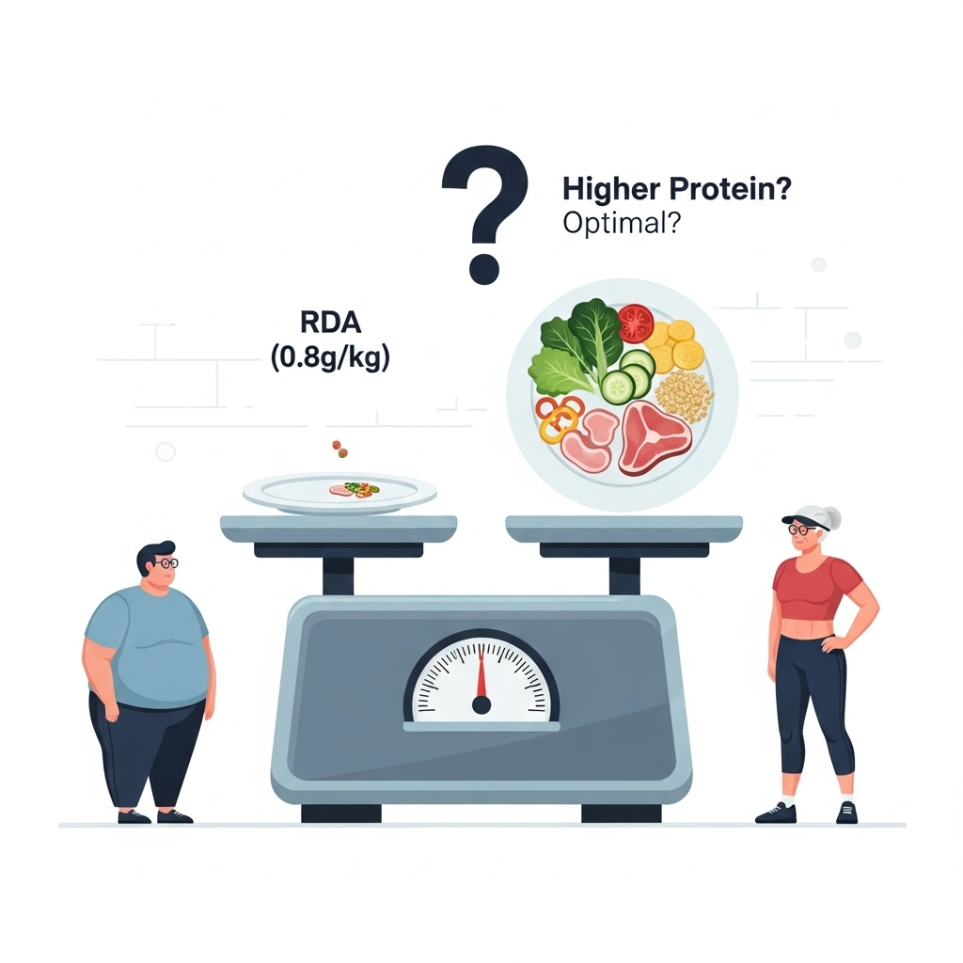
How Much Protein Do You Need? The Debate
Official Recommendation (RDA): 0.8 grams per kilogram of body weight.
  Example: A 150-pound (68 kg) person needs ~54 grams.
  This is considered the minimum to prevent deficiency.
The Higher Protein Argument: Many experts argue the RDA is outdated, especially for active and aging individuals

Slide 18

Why Higher Protein Intake is Recommended
Muscle Preservation: Higher protein, combined with exercise, combats age-related muscle loss (sarcopenia). Prevents weight regain following initial weight loss.
Weight Management: Protein increases satiety, helping you feel fuller and aiding in weight loss by preserving lean muscle.
Metabolic Health: Skeletal muscle is a key metabolic organ, and higher protein intake supports its health and function.
Decreased Mortality: Higher intake of total protein was associated with a lower risk of all cause mortality, and intake of plant protein was associated with a lower risk of all cause and cardiovascular disease mortality.

Slide 19

Pillar 3: Stress Management
The Silent Killer: Taming the Effects of Stress
The Stats: Chronic stress can accelerate the aging process at a cellular level, shortening telomeres and potentially reducing lifespan.
High stress is linked to a higher risk of heart disease, high blood pressure, and impaired immune function.
How it adds years: While a direct "number of years added" is hard to quantify, one study found that high stress levels can accelerate the aging process by 9 to 17 years at a cellular level.
Key takeaway: Practices like mindfulness, meditation, and deep breathing can mitigate the harmful effects of stress on the body.

Slide 20

Pillar 4: Sleep
The Ultimate Reset: The Restorative Power of Sleep
The Stats: Lack of quality sleep can increase the risk of heart disease by 48% and has been linked to a tripling of the risk for type 2 diabetes.
Sleep deprivation can also age your brain by 3-5 years.
How it adds years: According to research, better sleep habits could boost a man's life expectancy by an average of 4.7 years and a woman's by 2.4 years.
Key takeaway: Prioritizing 7-9 hours of quality sleep per night is one of the most powerful things you can do for your health.

Slide 21

Pillar 5: Social Connection
The Community Effect: The Lifesaving Power of Connection
The Stats: Loneliness is linked to an estimated 871,000 deaths annually worldwide. A lack of social connection can be as harmful to your health as smoking 15 cigarettes a day.
Strong social connections can lead to a lower risk of early death and better overall health outcomes.
How it adds years: People with strong social relationships have been found to live an average of 3.7 years longer than those with fewer social ties.
Key takeaway: Nurturing relationships with friends, family, and community members is a powerful investment in your longevity.

Slide 22

Pillar 6: Purpose
The Stats (Purpose): A study found that adults over 50 with the highest sense of purpose were half as likely to have died five years later compared to those with the lowest scores.
How it adds years: While difficult to quantify, research suggests that a strong sense of purpose can add several years to your life by promoting healthier habits and greater resilience.

Slide 23


Slide 24
Pillar 7: Mental Health
The Stats (Mental Health): Serious mental illness can reduce life expectancy by 10 to 20 years. Psychological issues like loneliness and unhappiness may increase a person's biological age more than smoking.
How it adds years: Improving mental well-being and managing conditions like depression and anxiety is crucial for extending both healthspan and lifespan.

Slide 25
Benefits of Hormone Replacement Therapy (HRT):
Females:
Studies have shown that women were less likely to develop Alzheimer’s and bone fractures .and they had a 50% lower risk a dying of a heart attack when they started HRT within 10 years of menopause.
A study has shown that participants who took estrogen alone lowered their risk of breast cancer by 23% and lowered the risk of breast cancer death by 40%
HRT has been shown to reduce the risk of a fracture by 50-60%.
HRT reduces the risk of heart disease by about 50%. One study showed that HRT in women lowered LDL-C, and insulin resistance while HDL-C levels were higher for HT compared to placebo.

Slide 26
Hormonal Balance
Benefits of Hormone Replacement Therapy (HRT):
Females:
Women who take HRT have been shown to have a 25-45% decreased risk of colon cancer, depending on the type and duration of HRT used.
HRT may delay the onset of type 2 diabetes
A study has shown that sever gum disease was 44% lower in women taking HRT

Slide 27
Males:
Improved Sexual Function: Testosterone replacement therapy (TRT) can increase libido, improve erectile function, and enhance overall sexual satisfaction.
Increased Muscle Mass and Strength: Testosterone plays a vital role in muscle development.
Improved Bone Density: Testosterone contributes to bone health. TRT can help increase bone mineral density, reducing the risk of fractures and osteoporosis.
Enhanced Mood and Energy Levels: Some men report improved mood, increased energy levels, and a greater sense of well-being with TRT. However, it's important to note that TRT is not a treatment for depression or other mental health conditions.
Potential Benefits: TRT may also have positive effects on:
    Cognitive function (memory, concentration)
    Red blood cell production
    Body fat distribution
Testosterone's conversion to estrogen is essential for bone and vascular health, preventing excess visceral fat, and promoting insulin sensitivity.

Slide 28
GLP-1 Agonists:
Cardiovascular Benefits: Some studies suggest semaglutide may have protective effects against heart attacks, strokes and sudden death
Neuroprotective Effects: Research is exploring its potential benefits for brain health.
Improved insulin sensitivity and glucose metabolism: This may reduce the risk of metabolic diseases and their associated complication.
Kidney Protection: Research suggests it may have beneficial effects on kidney function, which declines with age.
Reduced liver fat accumulation: This is a key feature of Non-Alcoholic Fatty Liver Disease (NAFLD).

Slide 29


Slide 30
Your gut is a bustling city of microbes! Trillions of microorganisms live
there, profoundly impacting your health.
Probiotics: These are live or dead beneficial microorganisms that can
modulate your gut. Think of them as the "good guys" you introduce.
They're often found in fermented foods like yogurt or in supplements.
Prebiotics: These are non-digestible food components (like fiber and resistant starch)
that act as food for your existing beneficial gut bacteria. They help the "good guys" thrive
and multiply, including common probiotics like Bifidobacteria and Lactobacillus.
THE LIST
Taurine: Recent, compelling research, including human observational
data and animal studies across species (worms, mice, monkeys),
indicates a decline with age and significant benefits for healthspan and
even lifespan from supplementation. Most taurine supplements contain dosages ranging from 500 mg to 2,000 mg (or 0.5 to 2 grams) per day.
Magnesium: Essential for over 300 biochemical reactions, its widespread deficiency is linked to numerous age-related diseases (cardiovascular, metabolic, neurological, bone health), making adequate intake crucial for healthy aging and healthspan. Common dosages typically range from 200 mg to 400 mg per day.

Slide 31
Your gut is a bustling city of microbes! Trillions of microorganisms live
there, profoundly impacting your health.
Probiotics: These are live or dead beneficial microorganisms that can
modulate your gut. Think of them as the "good guys" you introduce.
They're often found in fermented foods like yogurt or in supplements.
Prebiotics: These are non-digestible food components (like fiber and resistant starch)
that act as food for your existing beneficial gut bacteria. They help the "good guys" thrive
and multiply, including common probiotics like Bifidobacteria and Lactobacillus.
Vitamin D: Widespread deficiency significantly impacts bone health, immune function, and risk of various chronic diseases associated with aging, making optimal levels critical for maintaining healthspan.
Daily supplementation often ranges from 1,000 IU to 4,000 IU for most adults.
Creatine: Primarily known for muscle and brain health benefits, maintaining muscle mass and cognitive function are key aspects of healthspan. Its role in cellular energy is fundamental. Recommended dose is 5 g/day
Omega-3 Fatty Acids: Strong evidence supports their cardiovascular benefits, anti-inflammatory effects, and potential to reduce telomere attrition, all of which are fundamental to promoting healthspan and potentially healthy aging
Recommended dosing is 2 g/day
Curcumin: As a potent anti-inflammatory and antioxidant compound, curcumin targets multiple pathways involved in age-related diseases, showing promise for improving healthspan despite challenges with bioavailability

Slide 32
Probiotics and Prebiotics: A healthy gut microbiome is increasingly recognized as a cornerstone of healthy aging, influencing immunity, inflammation, and overall systemic health, thereby contributing to healthspan.
Curcumin: As a potent anti-inflammatory and antioxidant compound, curcumin targets multiple pathways involved in age-related diseases, showing promise for improving healthspan despite challenges with bioavailability. For general health benefits, dosages in studies typically range from 500 mg to 1,500 mg (0.5 to 1.5 grams)/day

Slide 33

Conclusion
Your Longevity Blueprint
Longevity is not a secret; it's a science.
By focusing on the 7 Pillars—Nutrition, Exercise, Stress, Sleep, Social Connection, Purpose, and Mental Health—you can take control of your health.
These pillars are interconnected. Improving one often has a positive ripple effect on the others.

Slide 34


In tests for a hair growth drug
Individual results varied !

Slide 35
