Slide 1

Good Things Come in Small Packages: The Role of Mitochondria in Women’s Health
Risa Schulman, PhD, Tap~Root
December 2, 2025
Notes:
Beyond the production of cellular energy, mitochondria are now known to manage myriad processes critical for cellular homeostasis. Learn how these functions are associated with maintenance of wellness over the course of a woman’s life.

Slide 2
Part One: The Basics

Slide 3
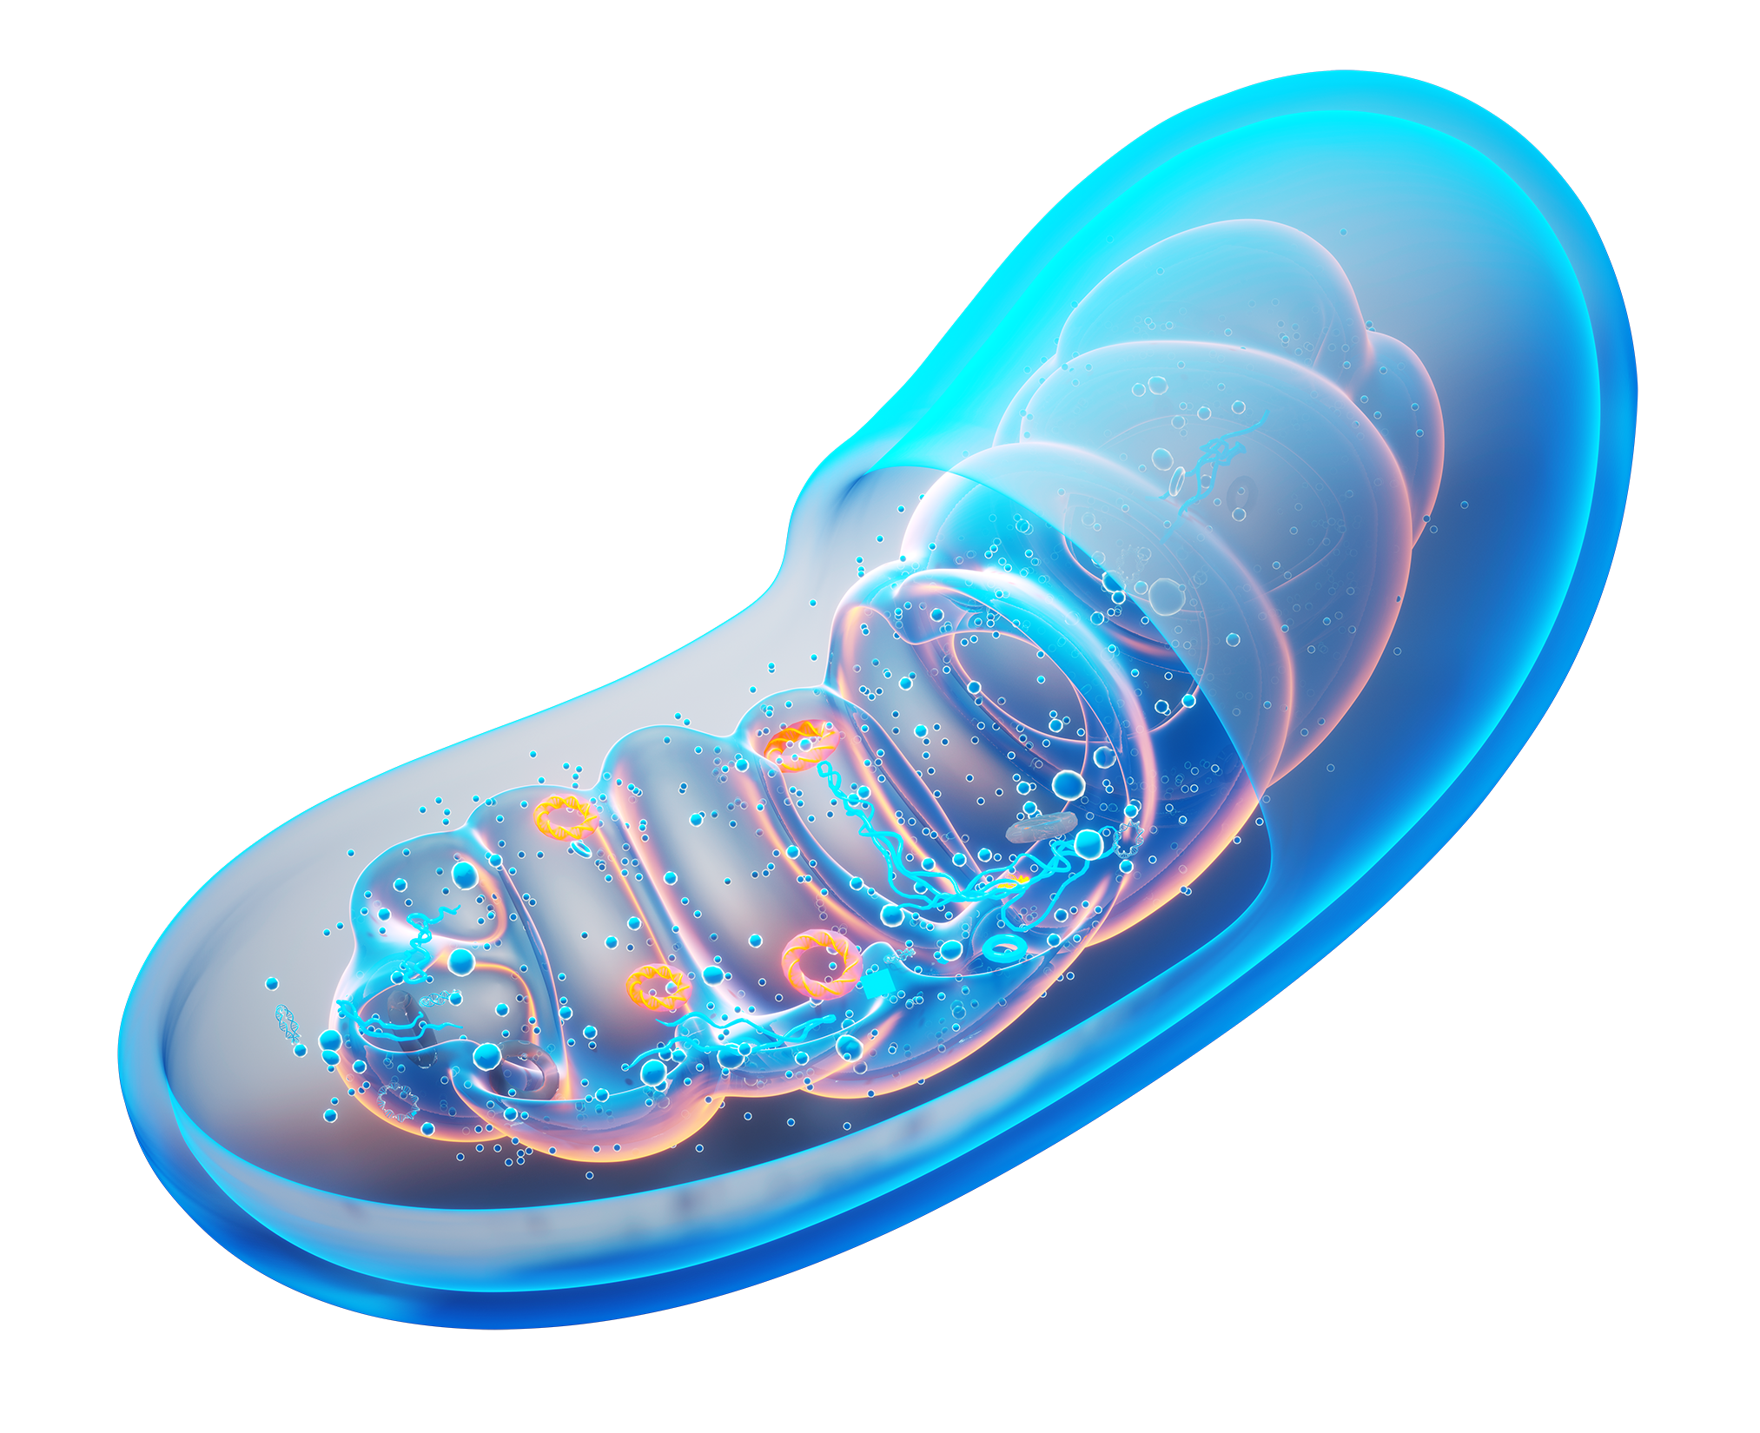
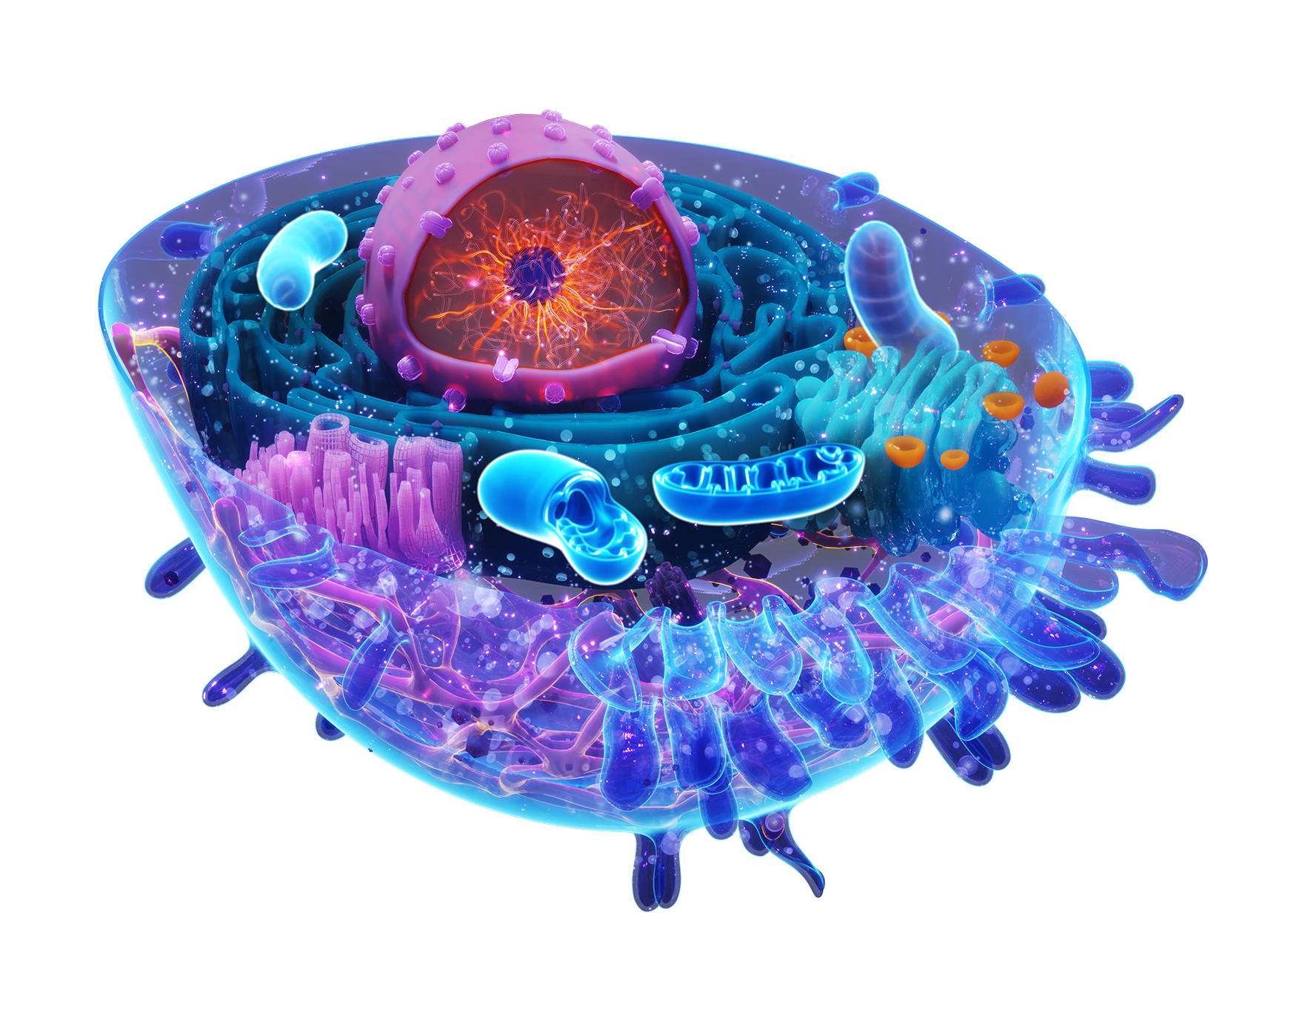


Mitochondria
“Powerhouse of the Cell”
Two membranes
Inner membrane houses the electron transport chain that changes food molecules into usable energy called ATP
Like all engines, there is “exhaust” in the form of free radicals

Slide 4
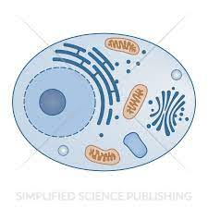
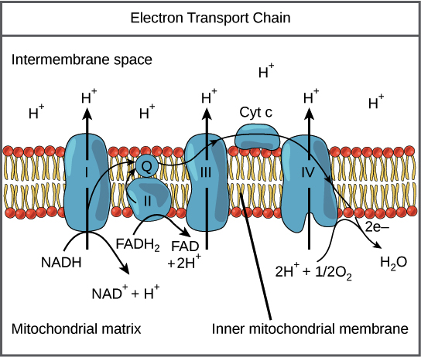
What is Ubiquinol?
Mitochondria
Active, reduced form of CoQ10
Key role in producing cellular energy
Powerful and only lipid soluble antioxidant produced by the body
Source: Wada H. J Am Geriatr Soc. 2007 Jul;55(7):1141-2.
Image modified from "Oxidative phosphorylation: Figure 1", by OpenStax College, Biology (CC BY 3.0).; https://tinyurl.com/yc4nhppa

Slide 5
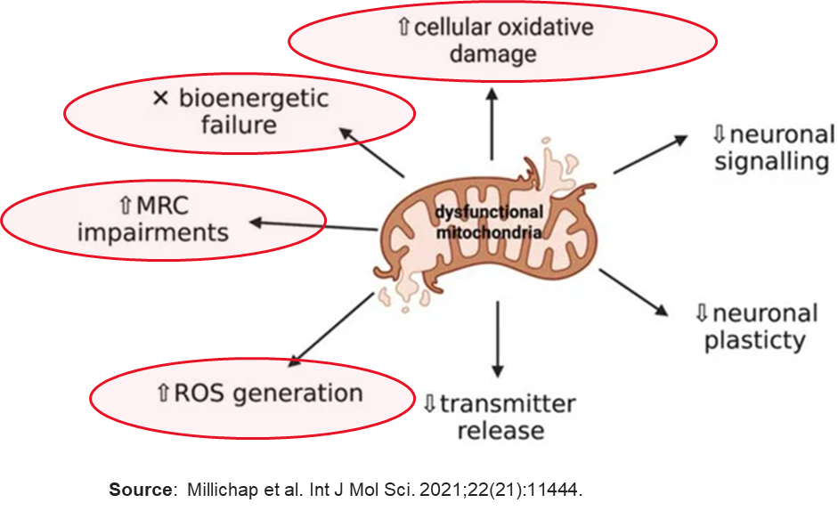

How Oxidative Stress Messes Everything Up
1
Compromises cellular energy production
2
Cell and organelle membrane damage
3
DNA, protein, enzyme damage

Slide 6
Part Two: The Nitty Gritty

Slide 7
Mitochondria Play a Far More Complex Role in Cells Than Formerly Understood
1
Mitochondrial fission and fusion
1
2
Management of programmed cell death (apoptosis) and mitophagy
2
3
3
Triggering of cell senescence
4
4
Regulating expression of certain nuclear genes (-or- Coordinating signaling pathways)
Currently a Hot and Emerging Area of Research
Key for Cell Homeostasis

Slide 8

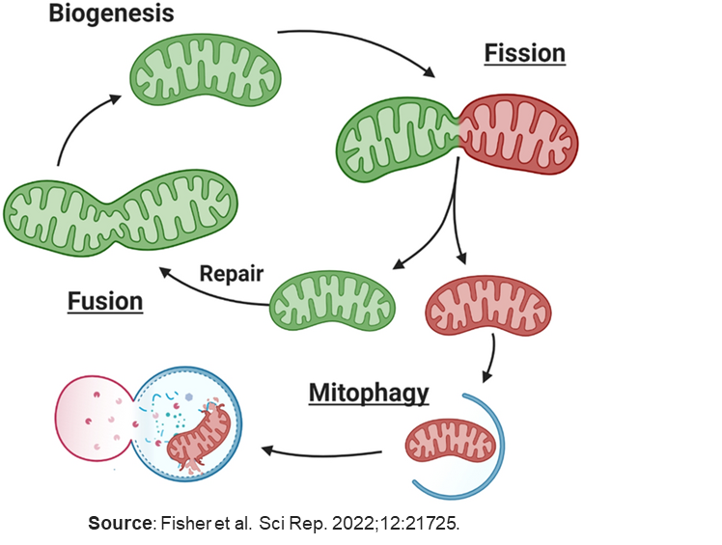

Mitochondrial Fission and Fusion
Ubiquinone has been shown to upregulate Ubiquinol antioxidant activity and positively modulate fission and fusion to promote homeostasis.
1
Fission - intentional breakage of one into two
Used to sequester damaged parts or distribute mitochondria, mtDNA and mitochondrial proteins more equally around cell
Fusion- fusing of two mitochondria into one
Used to consolidate mitochondria, mtDNA and mitochondrial proteins or recycle them from other damaged mitochondria
Thought to increase energy production efficiency
Regulated by circadian rhythms and exercise
Related to starvation/overeating
Reduction or excess is associated with many conditions of aging

Slide 9


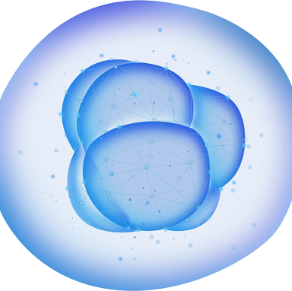

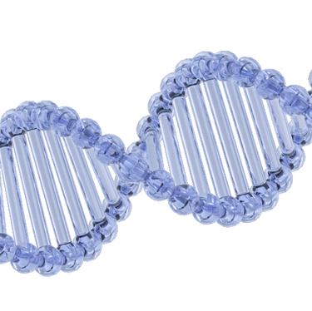


2
Management of Programmed Cell Death
Cells that are beyond repair or have outlived their usefulness must be cleared from the body
Ubiquinol and ubiquinone have been shown to modulate apoptosis to promote homeostasis.
Mitochondria can release a series of molecules that trigger the dismantling of a cell cleanly and efficiently
Apoptotic “flashes” can also be used to “reset” a cell’s metabolism

Slide 10
2
Management of Mitophagy
Damaged mitochondria can release ROS and trigger inflammation and must be cleared from the cell
Ubiquinol and ubiquinone have been shown to positively modulate mitophagy to promote homeostasis.
Mitochondria can release a series of molecules that tag damaged ones for removal; this is called mitophagy
Mitophagy can become defective and overactive

Slide 11

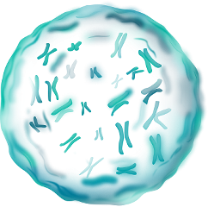

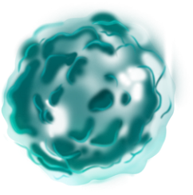

3
Ubiquinol and ubiquinone have been shown to positively modulate cell senescence.
Cell Senescence
For every stressed cell there comes a time...
Senescence is a state of growth arrest that
can be normal but is also triggered by excessive stress and DNA damage
It is meant to protect the cell and is accompanied by changes in secretory activity including increased pro-inflammatory molecules
These molecules can spread to both neighboring and far away cells and change their behavior
Senescence is a hallmark of aging
©Risa Schulman, PhD 2024

Slide 12

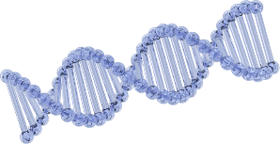
Ubiquinol and ubiquinone have been shown to positively modulate nuclear genes to promote homeostasis.
4
Coordinating Signaling Pathways
-
Mitochondria communicate the cell’s metabolic status via “cross-talk” with the nuclear genes
In particular, mitochondria are the central hub for control of stress and immune pathways, which are triggered by ROS production
This enhances adaptation and integrates appropriate response on a cell, tissue and organ level
Breakdowns in mitochondrial sensing and response coordination are associated with conditions of aging
©Risa Schulman, PhD 2024

Slide 13
Part Three: Wellness Implications

Slide 14


Cardiovascular Health in Women
CVD is #1 cause of death in women!
Typical risk factors pose a greater relative risk for women than men
Risk of CVD increases after menopause because of loss of protective effect of estrogen
Garcia M et al. Cardiovascular Disease in Women: Clinical Perspectives. Circ Res. 2016 Apr 15;118(8):1273-93.

Slide 15
Cardiovascular Health
ROS (in blood and cells)
+
Mitochondrial dysfunction
+
Ubiquinol depletion
1
Oxidative conditions generate oxLDL, which negatively impacts vessel health
Major impact on cardiovascular health
=
2
An imbalance of fission and fusion is thought to correlate with uncontrolled growth of blood vessel (endothelial) cells and accelerate vascular remodeling
3
Depleted Ubiquinol are correlated with decreased vascular function
Chiong M et al. Mitochondrial metabolism and the control of vascular smooth muscle cell proliferation. Front Cell Dev Biol. 2014 Dec 15;2:72.
Zhu T et al. Mitochondrial dynamics in vascular remodeling and target-organ damage. Front Cardiovasc Med. 2023 Feb 13;10:1067732.
Stocker R. Ubiquinol-10 protects human low density lipoprotein more efficiently against lipid peroxidation than does alpha-tocopherol. Proc Natl Acad Sci USA.1991 Mar 1;88(5):1646-50.

Slide 16
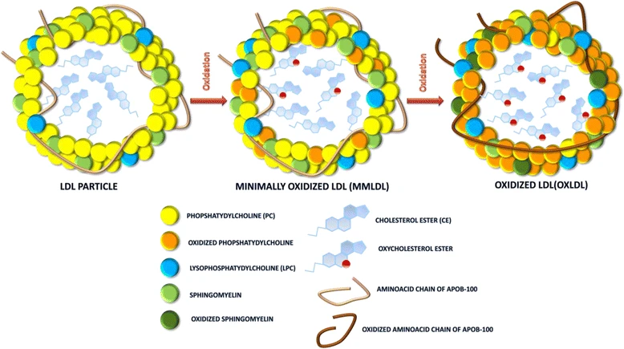
Ubiquinol Lives Right Where it is Needed
Found in the blood attached to LDL cholesterol (gives it a “tow” in the water-soluble blood)
Prevents oxidation of LDL cholesterol
Stocker R Ubiquinol-10 protects human low density lipoprotein more efficiently against lipid peroxidation than does alpha-tocopherol. Proc Natl Acad Sci U S A. 1991 Mar 1;88(5):1646-50.
Source: Zmysłowski A, Szterk A. Lipids Health Dis. 2017 Oct 2;16(1):188.

Slide 17
Ubiquinol Supplementation Improves Vascular Health in Healthy Older Adults
RDBPC, n=48, avg. age 59, healthy subjects (over half women) not taking any Rx, no sign of CVD but with compromised endothelial function
Ubiquinol 100 mg/d or 200 mg/d or placebo for 8 weeks
Primary outcome: effect on flow mediated dilation (measure of endothelial function)
Results
Significant and clinically meaningful* increase in FMD at both doses at 8 weeks (p<0.001)
Dose-dependent increase in NO_{x} (p=0.016)
Decreased LDL oxidation in higher dose (p=0.017)
Marked increase in plasma total CoQ10 and Ubiquinol levels (both p<0.001) to healthy levels by 4 weeks
*FMD increased 1.3% for both doses; Consensus is that each 1% increase in FMD involves a 8%–13% reduction in the risk of cardiovascular events.
Sabbatinelli et al. Ubiquinol ameliorates endothelial dysfunction in subjects with mild-to-moderate dyslipidemia: A randomized clinical trial. Nutrients. 2020 Apr 15;12(4):1098.

Slide 18
Reproductive Health in Women
Unexplained inability to conceive is defined by the World Health Organization (WHO) as:
The failure to initiate a pregnancy after 12 months or more of regular unprotected sexual intercourse when other known causes have been ruled out
Inability to conceive affects 17.5% of couples worldwide (1 out of 6 people); 13% for unexplained reasons
World Health Organization. Infertility prevalence estimates, 1990–2021. Geneva; 2023. License: CC BY-NC-SA 3.0 IGO

Slide 19
Reproductive Health
Chronically elevated ROS and corresponding mitochondrial function have a major impact on reproductive health in women
Effect on Oocyte
Decline in quality and quantity (aneuploidy, autophagy)
Effect on Egg
Faulty ovulation, fertilization, embryo development
Eggs are strong users of cellular energy and so need very large numbers of mitochondria… and produce lots of ROS
Mihalas BP, Redgrove KA, McLaughlin EA, Nixon B. Molecular Mechanisms Responsible for Increased Vulnerability of the Ageing Oocyte to Oxidative Damage. Oxid Med Cell Longev. 2017;2017:4015874.
Peters AE, Mihalas BP, Bromfield EG, Roman SD, Nixon B, Sutherland JM. Autophagy in Female Fertility: A Role in Oxidative Stress and Aging. Antioxid Redox Signal. 2020 Mar 10;32(8):550-568.

Slide 20
Ubiquinol in Women’s Reproductive Health
Ubiquinol’s antioxidant properties have been shown to benefit aged oocyte quality and quantity as well as enhance reproductive function
Most intervention trials have been performed in women undergoing assisted reproductive technology (ART) using CoQ10 as an adjunct
Study currently in process for Ubiquinol
Ben-Meir A et al. Coenzyme Q10 restores oocyte mitochondrial function and fertility during reproductive aging. Aging Cell. 2015 Oct;14(5):887-95.
Bentov Y et al. The use of mitochondrial nutrients to improve the outcome of infertility treatment in older patients. Fertil Steril. 2010 Jan;93(1):272-5.

Slide 21
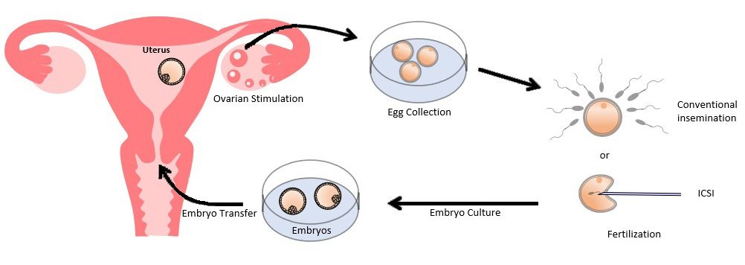
In Vitro Fertilization Process
Source: Hong Kong Assisted Reproduction Centre, https://www.hkarc.com.hk/IVF_en.html

Slide 22
CoQ10 Clinical Study Shows Benefits for Women Undergoing IVF
Prospective, randomized, open-label study, n=186, average age 32, women undergoing in vitro fertilization (IVF)
600 mg/d CoQ10 starting 60 days preceding IVF and through treatment
Results
Higher number retrieved oocytes (median 4 vs 2; p<0.002)
Lower number cancelled cycles due to no retrieved oocytes or no viable embryos (8.33% vs. 22.89%; p=0.04)
Higher fertilization rate (67.49%; p<0.05)
More high-quality day-3 embryos (p=0.03)
Higher frequency of embryos to freeze (18.42% vs. 4.3%, p=0.012)
Higher number frozen embryo transfers (p=0.01)
Trend toward higher rate of pregnancy and live birth rate
Xu Y, Nisenblat V, Lu C, Li R, Qiao J, Zhen X, Wang S. Pretreatment with coenzyme Q10 improves ovarian response and embryo quality in low-prognosis young women with decreased ovarian reserve: a randomized controlled trial. Reprod Biol Endocrinol. 2018 Mar 27;16(1):29.

Slide 23
Menopausal Health
Menopause has been associated with
increased levels of oxidative stress
Menopausal and post-menopausal women had increased isoprostane, MDA and lipoperoxide levels and decreased SOD
compared to pre-menopausal women
Heravi AS et al. Oxidative stress and menopausal status: The Coronary Artery Risk Development in Young Adults Cohort Study. J Women’s Health (Larchmt). 2022 Jul;31(7):1057-1065 .
Sánchez-Rodríguez MA et al.. Menopause as risk factor for oxidative stress. Menopause. 2012 Mar;19(3):361-7.
Vincent J and Inassi J. Comparison of oxidative stress between premenopausal and postmenopausal women. Nat J Physiol Pharm Pharacol. 2020;10(5):359-362..

Slide 24
Clinical Study Shows Ubiquinol Supports Health and Wellbeing for Post-Menopausal Women
Prospective, open label study in healthy, post-menopausal women (n=40; ages 45-65, average 58)
Received 100 mg of Ubiquinol plus vitamin C (12 mg) and vitamin B1 (0.6 mg) daily or no treatment as control for 3 months
Primary outcome: EUROQOL questionnaire, Cervantes Scale, VAS for mood and skin
Results
The EUROQOL survey showed a statistically significant improvement in general health and wellbeing compared to baseline (p<0.001) and trended to significance compared to control (p=0.08).
In the Cervantes scale, significant improvement at the end of treatment (p=0.004 vs baseline and p=0.006 vs control) in a subdomain of menopause and overall health.
Palacios S et al. Estudio clínico para conocer laeficacia de la Coenzima Q-1 O sobre la calidad de vida en mujeres postmenopáusicas. Toko-Gin Pract. 2019.78(1):3-7.

Slide 25
Consumer Study Shows Ubiquinol Supports Health and Wellbeing for Post-Menopausal Women
Consumer use “real life” study by independent research institute Expansion Consulteam
Post-menopausal, healthy French women (n=200; ages 45-55) received 200 mg of Ubiquinol daily for 2 months
Questionnaire at 0, 1, 2 months
Results
81% of the women felt less irritability and fewer mood swings
82% felt less stressed
81% felt less sensitive
Kaneka Internal Report. Real-life UBIQUINOL study on 200 postmenopausal women. Expansion Consulteam. 2024.

Slide 26





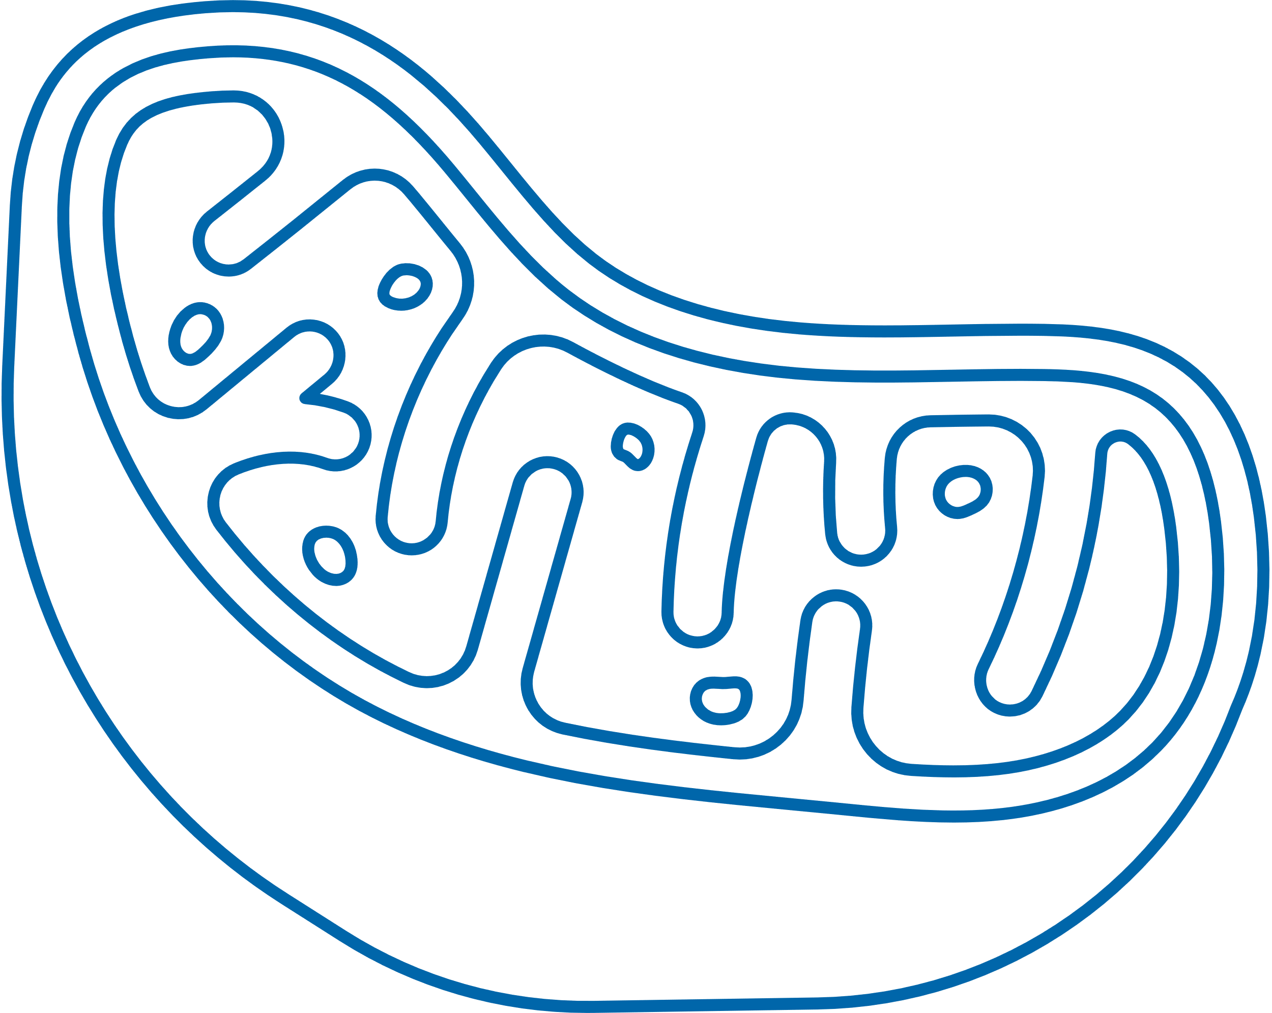


Aging is
Characterized by:
Increased Ubiquinol
is Known to:
Increased oxidative stress
Decrease oxidative stress
Compromised energy production
Improve energy production
Oxidation of cell membranes, DNA, and lipids
Prevent oxidation
Mitochondrial fission and fusion breakdown
Modulate fission and fusion (CoQ10)
More damaged cells needing removal
Trigger apoptosis or other cell death
More senescent cells
Regulate senescence to help clear cells/ prevent premature cell death
Upregulation of genes signal transduction
Modulate gene expression

Slide 27
CoQ10/Ubiquinol Ratio Correlates with Healthy Aging
Increased Ubiquinol correlates with increased muscle strength in middle aged adults
Observational cohort study of 967 subjects, 52 years average age, testing body muscular strength in relation to CoQ10 levels
Measured hand grip as a simple and standard measure of muscle strength; also, lowered hand grip is correlated with all-cause cardiovascular mortality
Results
Weaker hand grip was correlated with increasing %CoQ10 (redox state) and lower %Ubiquinol (p<0.001)
Authors suggest that higher %CoQ10 and lower Ubiquinol content may be associated with increased risk of sarcopenia in older adults
Fischer A, Onur S, Niklowitz P, Menke T, Laudes M, et al. Coenzyme Q10 status as a determinant of muscular strength in two independent cohorts. PLOS ONE. 2016;11(12): e0167124.

Slide 28
Citations/Further reading on mitochondrial function
Adebayo et al. Mitochondrial fusion and fission: The fine-tune balance for cellular homeostasis. FASEB J. 2021; 35:e21620.
Bratic A, Larsson NG. The role of mitochondria in aging. J Clin Invest. 2013 Mar;123(3):951-7.
Beckman KB, Ames BN. The free radical theory of aging matures. Physiol Rev. 1998 Apr;78(2):547-81.
Kumari R, Jat P. Mechanisms of cellular senescence: Cell cycle arrest and senescence associated secretory phenotype. Front Cell Dev Biol. 2021 Mar 29;9:645593.
Lima T, Li TY, Mottis A et al. Pleiotropic effects of mitochondria in aging. Nat Aging 2022;2: 199–213
Liu YJ, McIntyre RL, Janssens GE, Houtkooper RH. Mitochondrial fission and fusion: A dynamic role in aging and potential target for age-related disease. Mech Ageing Dev. 2020 Mar;186:111212.
Marchi S, Guilbaud E, Tait SWG, Yamazaki T, Galluzzi L. Mitochondrial control of inflammation. Nat Rev Immunol. 2023 Mar;23(3):159-173.
Tait SW, Green DR. Mitochondrial regulation of cell death. Cold Spring Harb Perspect Biol. 2013 Sep 1;5(9):a008706.
Schmelzer C, Kitano M, Hosoe K, Döring F. Ubiquinol affects the expression of genes involved in PPARα signalling and lipid metabolism without changes in methylation of CpG promoter islands in the liver of mice. J Clin Biochem Nutr. 2012 Mar;50(2):119-26.

Slide 29
Thank you for your attention! Happy to take your questions!

