Slide 1

Reframing Mobility

Slide 2
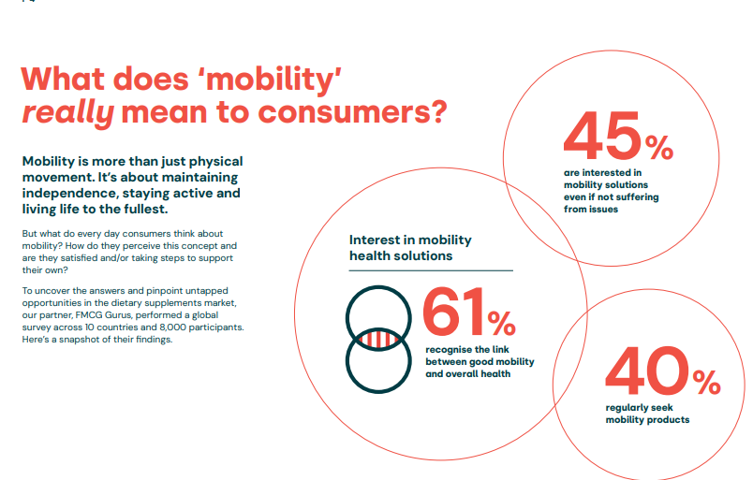

Slide 3
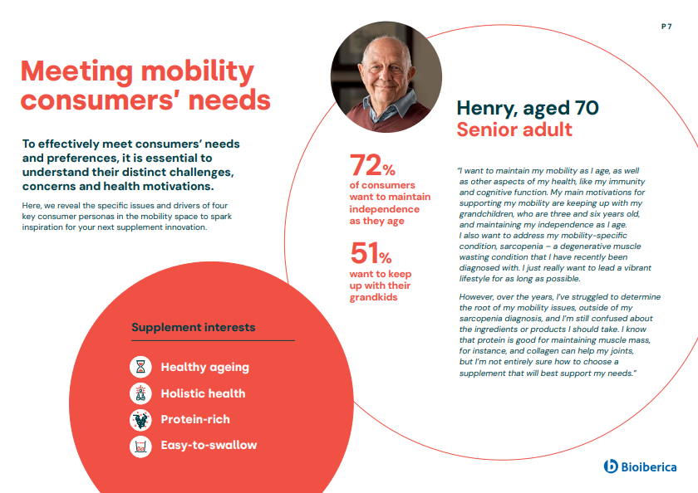

Slide 4
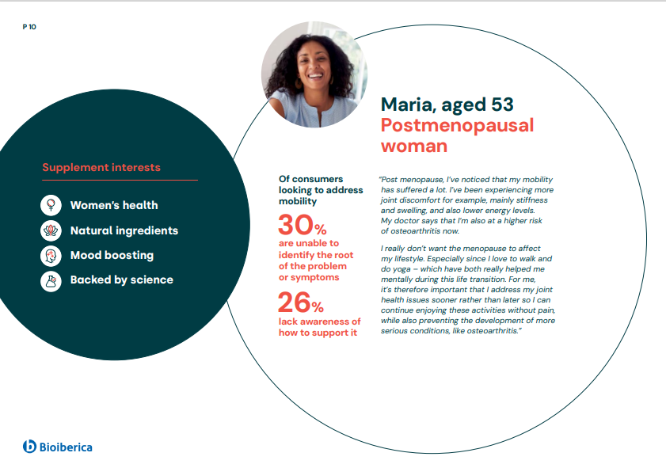




Slide 5
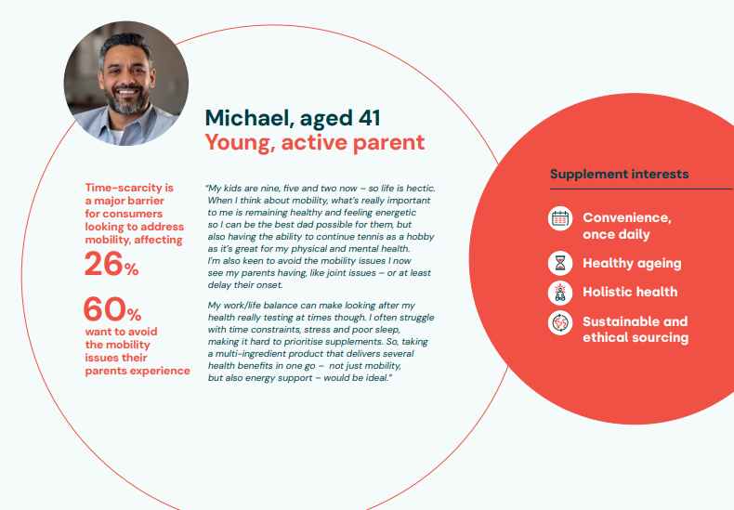

Slide 6
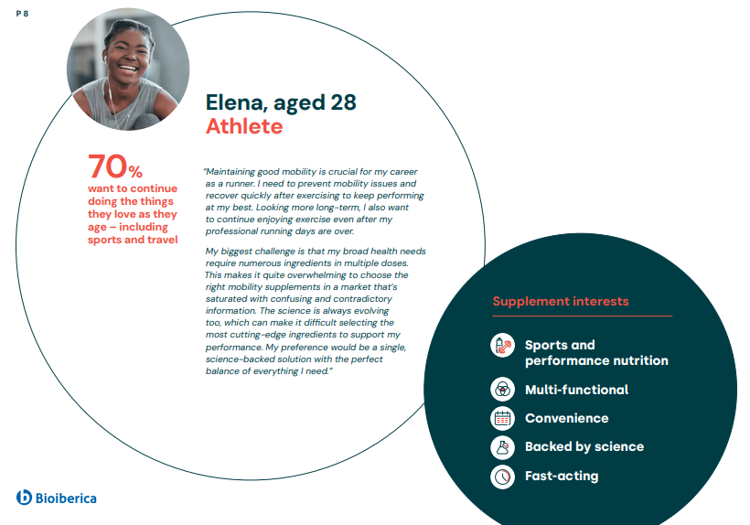

Slide 7
Mobility and Active Ageing
Today’s consumers are looking for holistic solutions that can help them maintain the freedom of movement as they age – supporting both joint AND muscle health

Slide 8

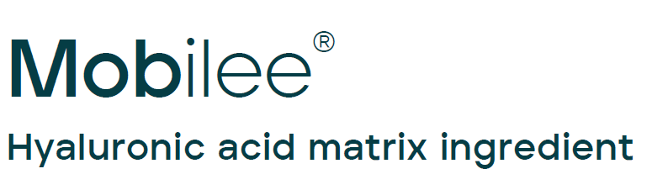
&
Notes:
If you want to go one step further with consumers, you can stay into the future with Bioiberica´s branded ingredients, Collavant & Mobilee

Slide 10
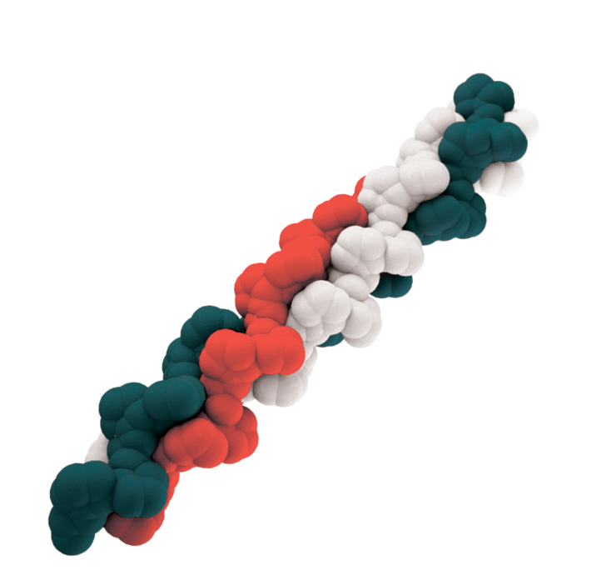
What is Collavant® n2?
Naturally-derived ingredient supplying native (undenatured) type II collagen
Supports joint health at a low dose of 40 mg / day
Immune-mediated mechanism of action
Notes:
· Collavant n2 is a natural ingredient obtained from chicken cartilage that contains native (undenatured) type II collagen.
· It has been demonstrated that oral administration of Collavant n2 at a dose of 40mg/day supports joint health through an immune-mediated mechanism of action.

Slide 11
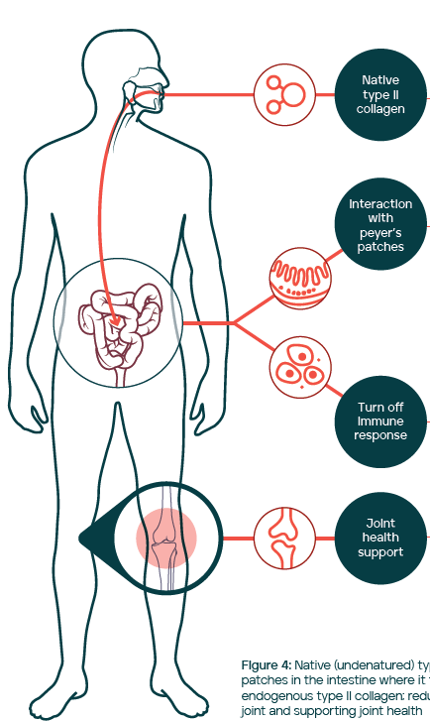
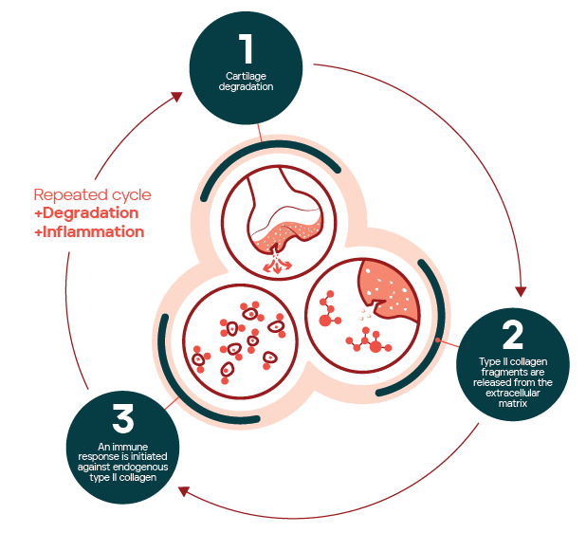
Native type II collagen mechanism of action
Cartilage degradation
& immune response
Notes:
· How it controls inflammatory cytokines and collagen degradation?
Due to trauma, or simply as a consequence of the ageing process, small fragments of type II collagen are released into the synovia. These fragments are recognized as auto-antigens and generate an immune-mediated inflammatory response against articular cartilage. This leads to collagen degradation and the release of more collagen fragments, thus amplifying the cycle of inflammation and degradation.
· One possibility to break this vicious cycle, is through the oral tolerance mechanism. It involves the oral administration of small amounts of native type II collagen to induce tolerance towards endogenous type II collagen and consequently helping to control the immune response against articular cartilage.

Slide 12
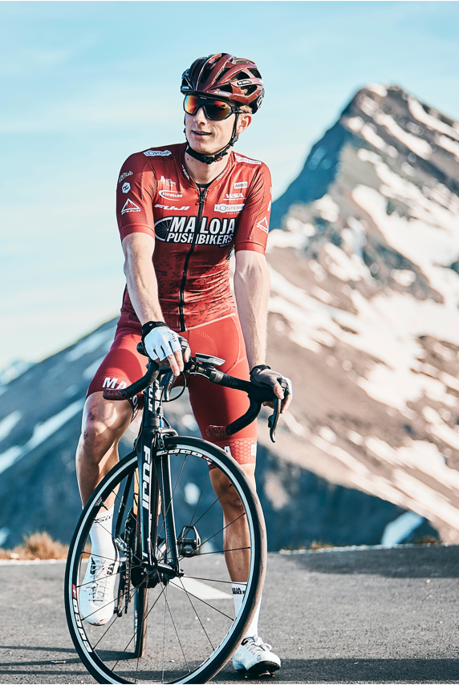
The effect of Collavant n2
Reduces joint discomfort
Supports mobility
Quicker recovery time after exercise
Supports cartilage health
Improves quality of life
[1] Möller et al. Osteoarthritis and Cartilage 2024 2024. 32 (6): P769
[2] Möller et al. Journal of the Academy of Nutrition and Dietetics 125, A73 (2025)
[3] Santana et al. Wien Klin Wochenschr. 2023 135(11-12):291-300
[4] Jain, A et al. Int. Journal of Research in Orthopedics (2021) vol 7 pg. 110-115
[5] Sifre V, et al. Veterinary Surgery, 2020, vol 49, pg. O238–O239
[6] Bakilan et al. Eurasian J Med (2016); 48: 95-101
[7] Mannelli et al. Osteopor. Int. 2015, vol. 26, pg. 184.
[8] Scarpellini, et al. J Orthopaed Traumatol (2008) 9:81–87

Slide 13
ACTIVE: Healthy Subjects Study
Participants: Healthy (discomfort after activity)
Design: Randomized double-blind, placebo-controlled study
Study arms:
  Placebo
  Collavant n2 (40mg/day)
Sample size: n= 74; 35-39/arm
Treatment period: 6 months
Evaluated parameters:
  Pain associated to exercise; time recovery after exercise
  Knee Function (KOOS)
  Collagen degradation biomarker CTX-II
  Safety
Study location: Barcelona
Möller et al. Osteoarthritis and Cartilage 32 (2024) 769
Möller et al. Journal of the Academy of Nutrition and Dietetics 125, A73 (2025)

Slide 14
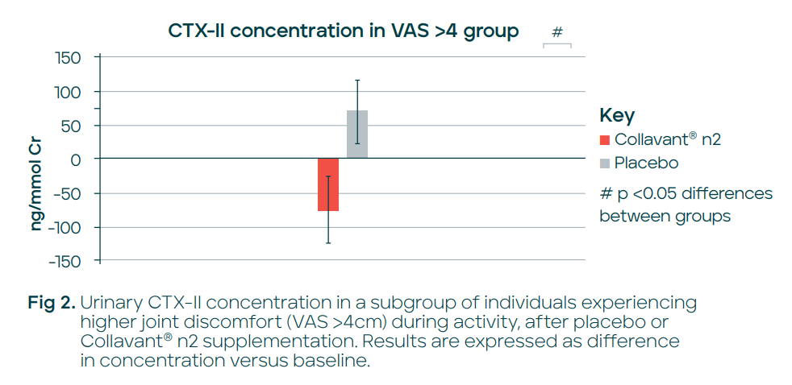
Supports cartilage health
Collavant® n2 at 40 mg/day showed a decrease in CTX-II progression, while levels in the placebo group increased – demonstrating significant between-group differences
CTXII decreased 18.3% in the Collavant® n2 group while increased 20.6% in the PBO group.
+ 20.6 %
-18.3 %
Results are expressed as difference vs baseline
Möller et al. Journal of the Academy of Nutrition and Dietetics 125, A73 (2025)
Results are expressed as difference vs baseline

Slide 15
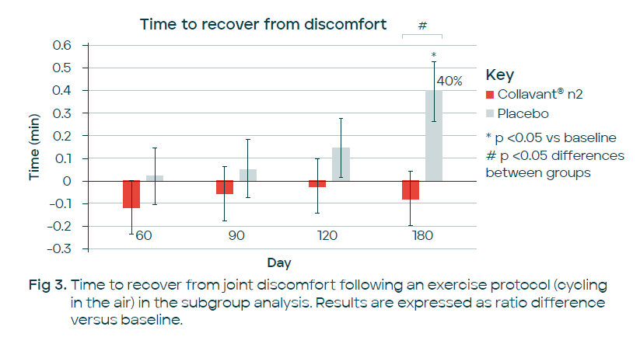
Quicker recovery time
Healthy individuals taking Collavant n2 40 mg / day recovered quicker from joint discomfort after exercise compared to placebo group.
At 180 days, there was a significant
difference in recovery time (40%) between the placebo and Collavant n2 groups.
Möller et al. Osteoarthritis and Cartilage 2024 2024. 32 (6): P769

Slide 16
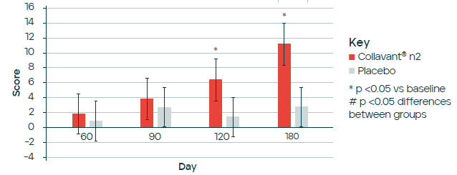
Decreases joint discomfort
KOOS Pain (VAS≤4cm)
#
Healthy individuals with a baseline Visual Analogue Scale (VAS) for knee discomfort of ≤4cm in movement, experienced a significant reduction of joint discomfort compared to placebo, after the supplementation with Collavant n2 at a dose of 40mg/d for 180days.
Fig 1. KOOS Pain in a subgroup of healthy individuals with a baseline VAS score for knee discomfort of ≤4cm in movement. Results are expressed as difference in score versus baseline
Möller et al. Osteoarthritis and Cartilage 2024 2024. 32 (6): P769

Slide 17
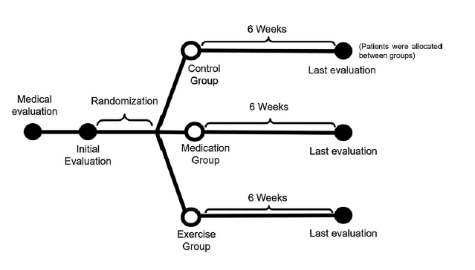
WOMEN ONLY Study
Study design: Blinded randomized controlled clinical trial
Patients: 39 women with knee OA patients
Duration: 6 weeks follow up
Treatment protocol:
  Control group: no intervention
  Medication group: Collavant n2 (40 mg/d)
  Exercise group: rehabilitation protocol
Outcomes:
  WOMAC (pain, stiffness and physical function)
  Angular range of motion (ROM)
  Functionality: 6-minutes walk test (6MWT), Timed Up and Go test (TUG)
Santana et al. Wien Klin Wochenschr. 2023 135(11-12):291-300

Slide 18
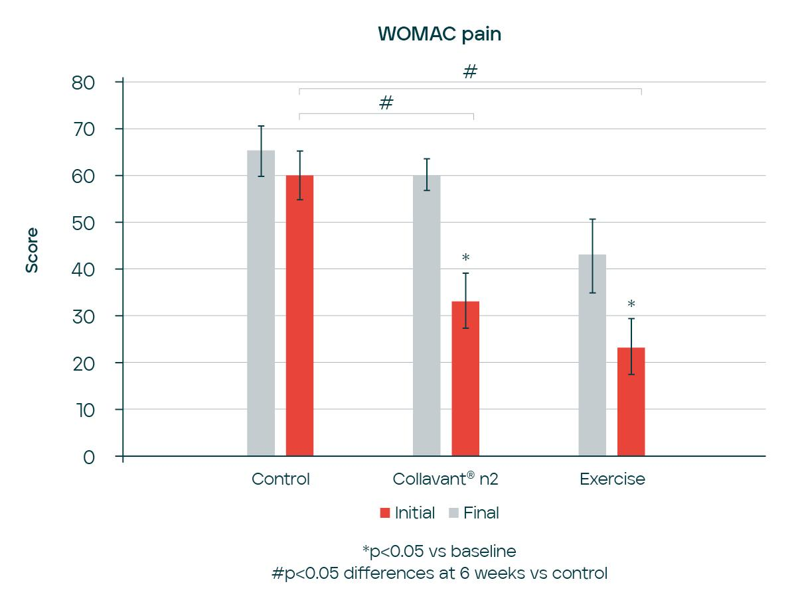
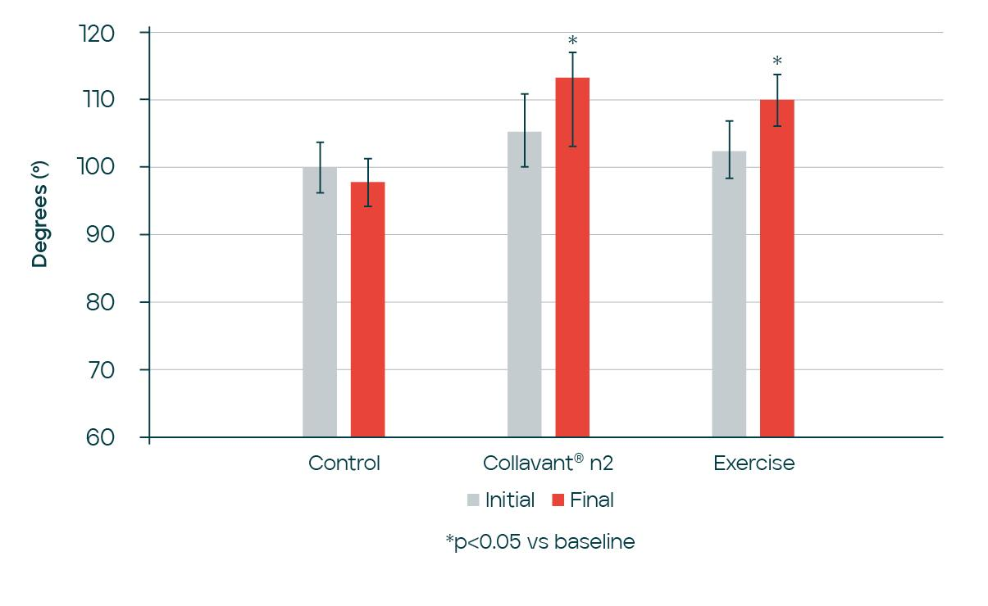
Joint discomfort & mobility
WOMAC pain
Range of Motion
*P<0.05
# P<0.05 differences at 6 weeks vs placebo
Santana et al. Wien Klin Wochenschr. 2023 135(11-12):291-300

Slide 19
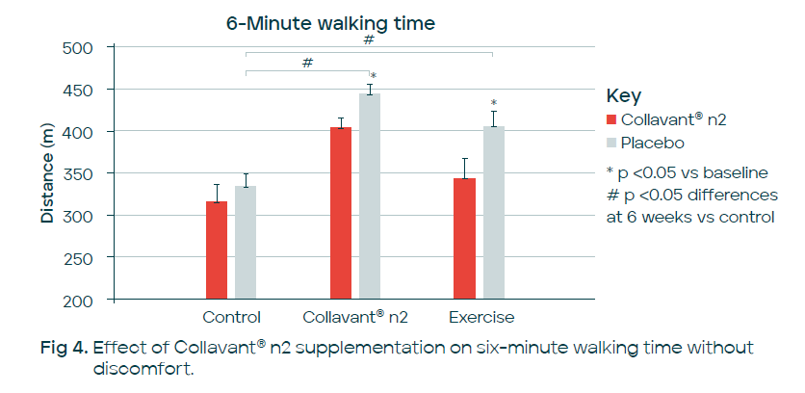
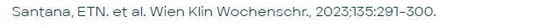
Longer distance walked
In a randomized controlled clinical trial in women with knee osteoarthritis taking Collavant n2 significantly increased distance walked without joint discomfort compared to control group after 6 weeks. The effect was comparable to an exercise intervention
Initial
Final

Slide 20
Collavant n2 – Full list of scientific publications
Preclinical studies
Main finding | Study type | Model | Reference
Cartilage protection | Animal model | Rat with MIA induced OA | Sifre et al 2020¹⁵
Anti-inflammatory effect | Animal model | Rabbit with OA | Mannelli et al 2015¹⁶
Clinical studies
Main finding | Design | Participants | Reference
Mobility improvement and cartilage protection | Randomized double-blind placebo-controlled study | 74 healthy subjects | Möller et al 2024¹⁰ Möller et al 2025¹⁸
Mobility improvement | Randomized controlled study | 39 women with OA | Santana et al 2023¹¹
Improve mobility and reduce pain in combination with Mobilee and Boswellia serrata and curcumin extracts | Retrospective observational study | 100 patients with knee OA | Kamat et al 2023¹²
Improve mobility and reduce pain in combination with Boswellia serrata extract | Observational study | 40 patients with knee OA | Jain et al 2020¹⁷
Mobility improvement and cartilage degradation | Randomized controlled study | 39 subjects with knee OA | Bakilan et al 2016¹³
Cartilage protection | Observational retrospective study | 104 subjects with hand, hip or knee OA | Scarpellini et al 2008¹⁴

Slide 21
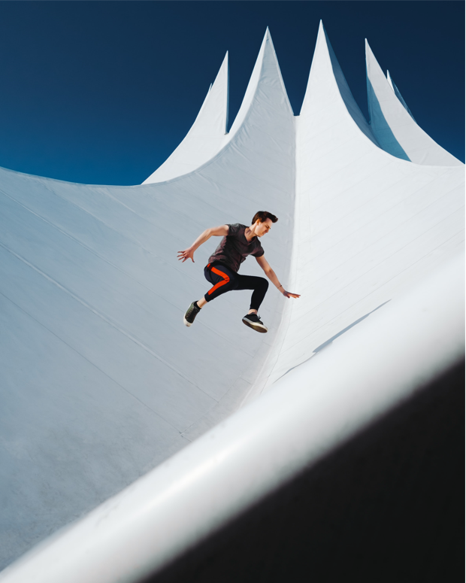
Collavant n2 Benefits
New generation collagen specific for joint health
Low daily dose: only 40 mg /day
Science backed: efficacy demonstrated in 8 scientific studies
Studies in healthy subjects
100 % sourced and manufactured in Europe
GRAS Status, Halal Certified

Slide 22
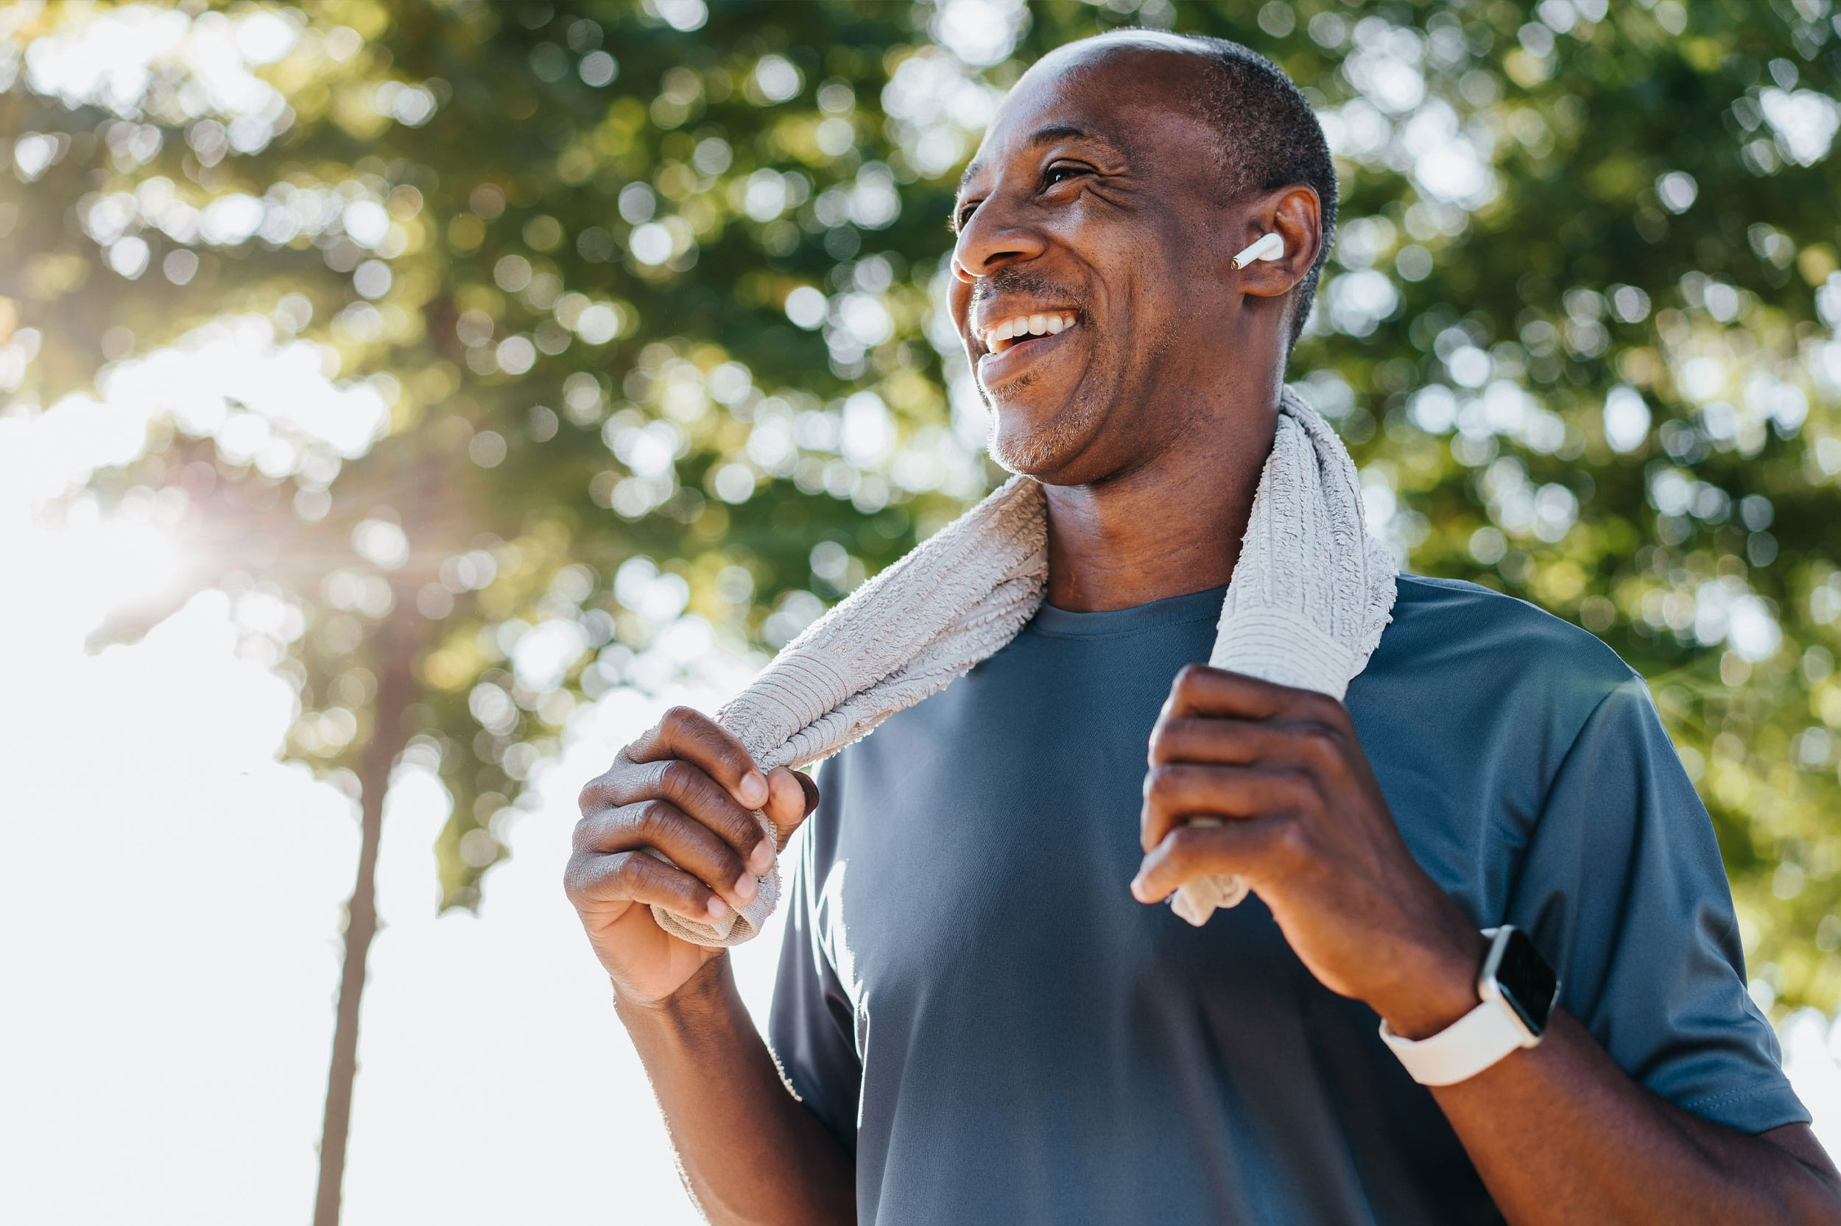
Notes:
· Main effects:
o Increases the endogenous synthesis of hyaluronic acid, thus promoting joint mobility.
o Helps to control inflammatory cytokines.
o Which, consequently, helps to reduces joint discomfort
o And finally, supports muscle function and strength.

Slide 23
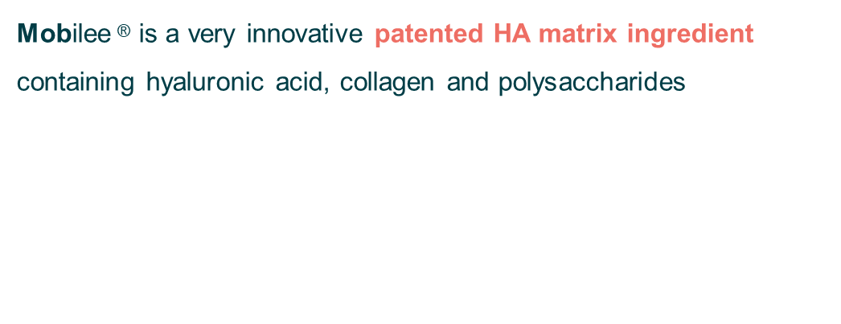
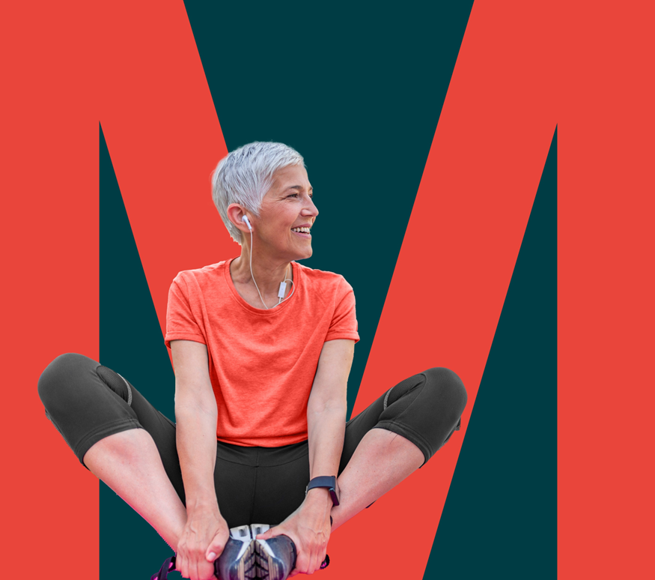
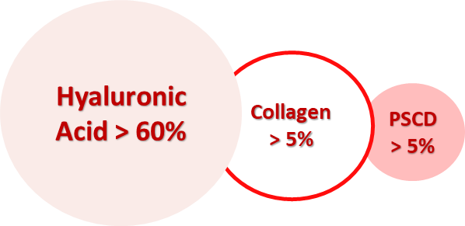

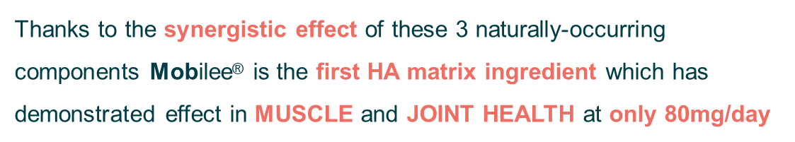
What is Mobilee®?
Notes:
· Main effects:
o Increases the endogenous synthesis of hyaluronic acid, thus promoting joint mobility.
o Helps to control inflammatory cytokines.
o Which, consequently, helps to reduces joint discomfort
o And finally, supports muscle function and strength.

Slide 24

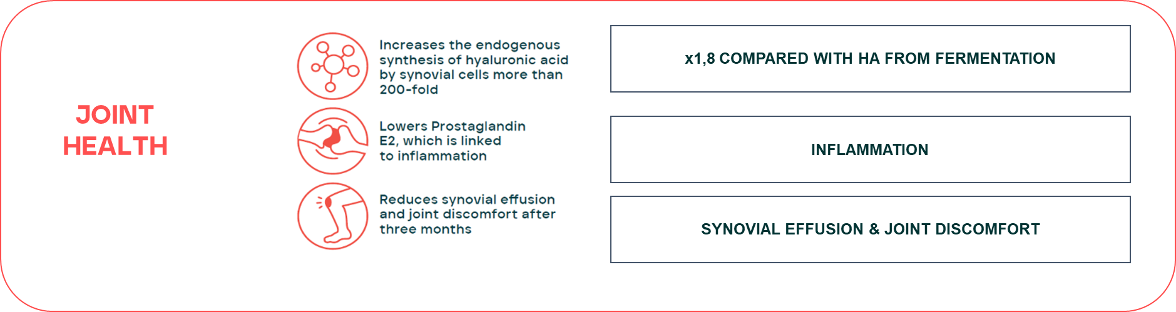
The effects of Mobilee®
Notes:
· Main effects:
o Increases the endogenous synthesis of hyaluronic acid, thus promoting joint mobility.
o Helps to control inflammatory cytokines.
o Which, consequently, helps to reduces joint discomfort
o And finally, supports muscle function and strength.

Slide 25
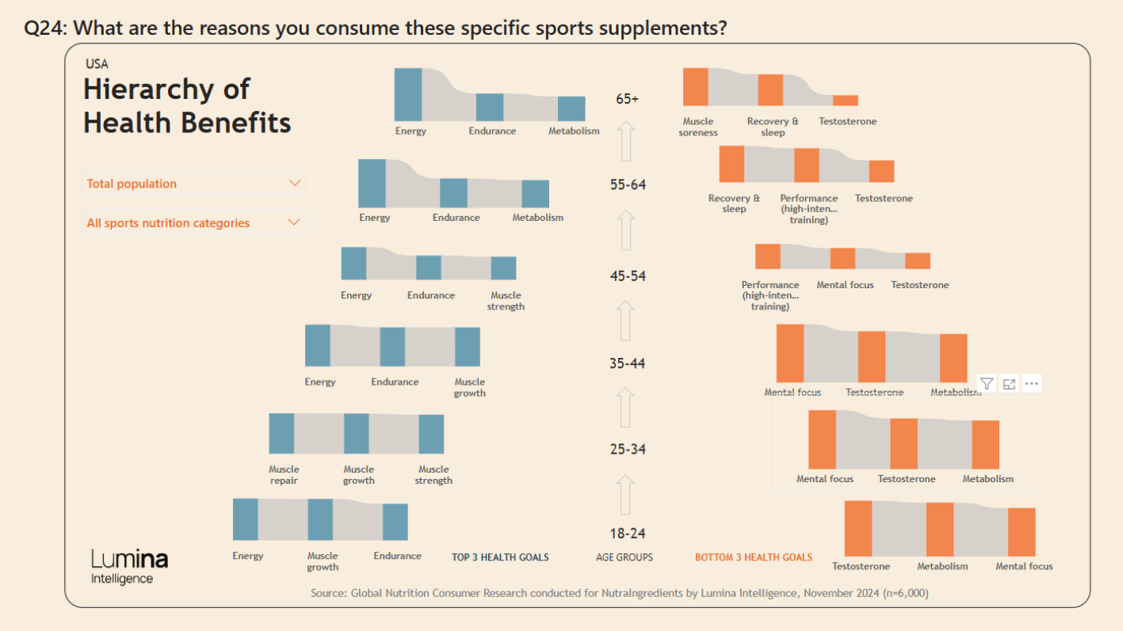
Consumer importance to muscle growth vs strength associated to age
Notes:
· Main effects:
o Increases the endogenous synthesis of hyaluronic acid, thus promoting joint mobility.
o Helps to control inflammatory cytokines.
o Which, consequently, helps to reduces joint discomfort
o And finally, supports muscle function and strength.

Slide 26
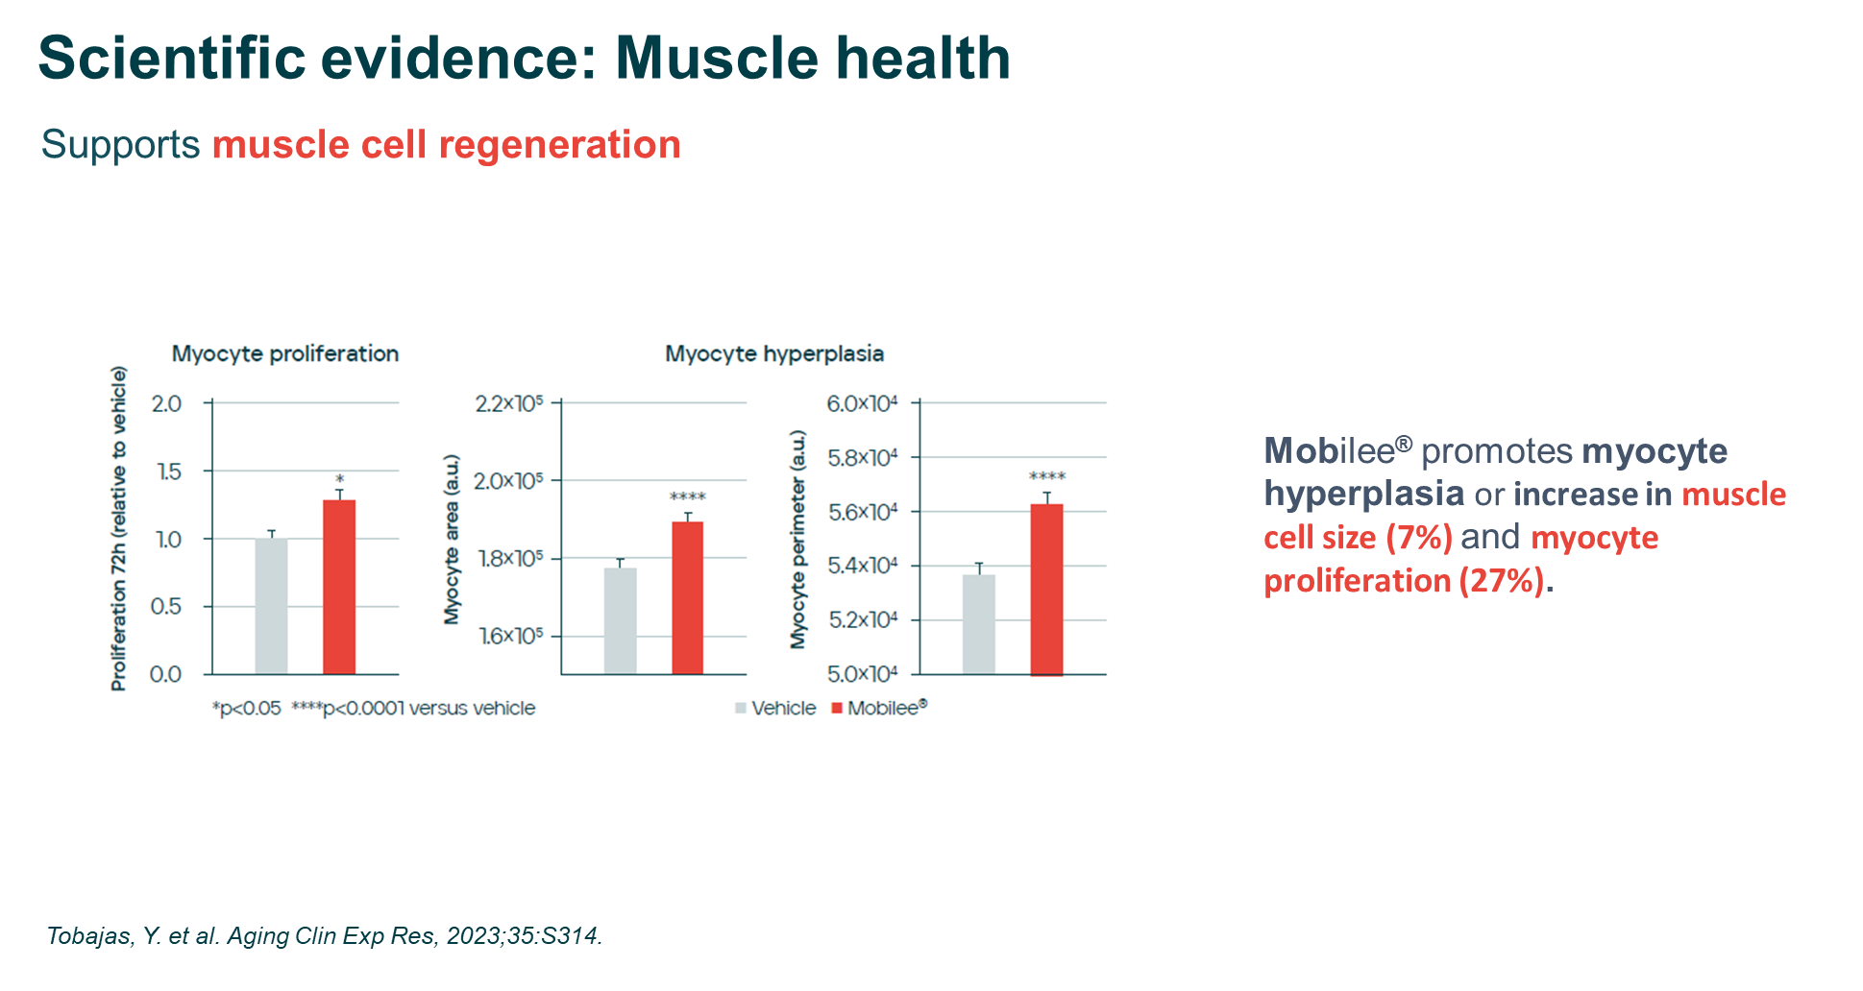
Notes:
· Main effects:
o Increases the endogenous synthesis of hyaluronic acid, thus promoting joint mobility.
o Helps to control inflammatory cytokines.
o Which, consequently, helps to reduces joint discomfort
o And finally, supports muscle function and strength.

Slide 27
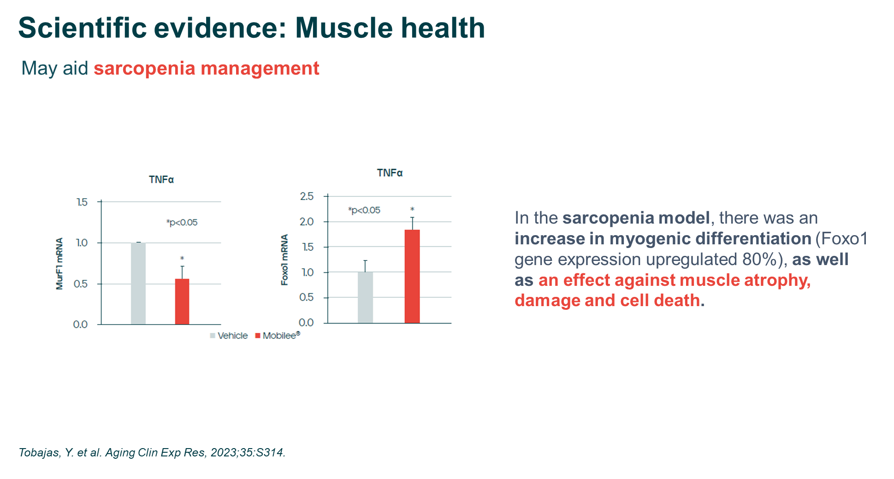
Notes:
· Main effects:
o Increases the endogenous synthesis of hyaluronic acid, thus promoting joint mobility.
o Helps to control inflammatory cytokines.
o Which, consequently, helps to reduces joint discomfort
o And finally, supports muscle function and strength.

Slide 28
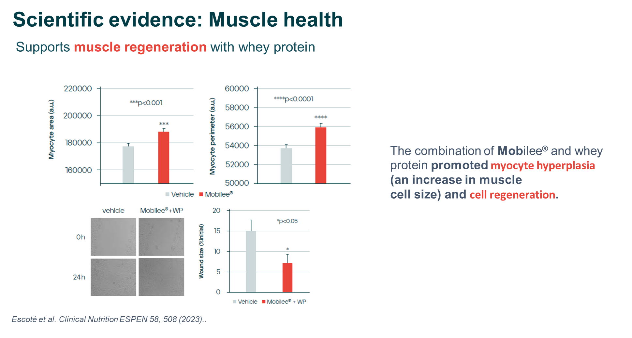
Notes:
· Main effects:
o Increases the endogenous synthesis of hyaluronic acid, thus promoting joint mobility.
o Helps to control inflammatory cytokines.
o Which, consequently, helps to reduces joint discomfort
o And finally, supports muscle function and strength.

Slide 29
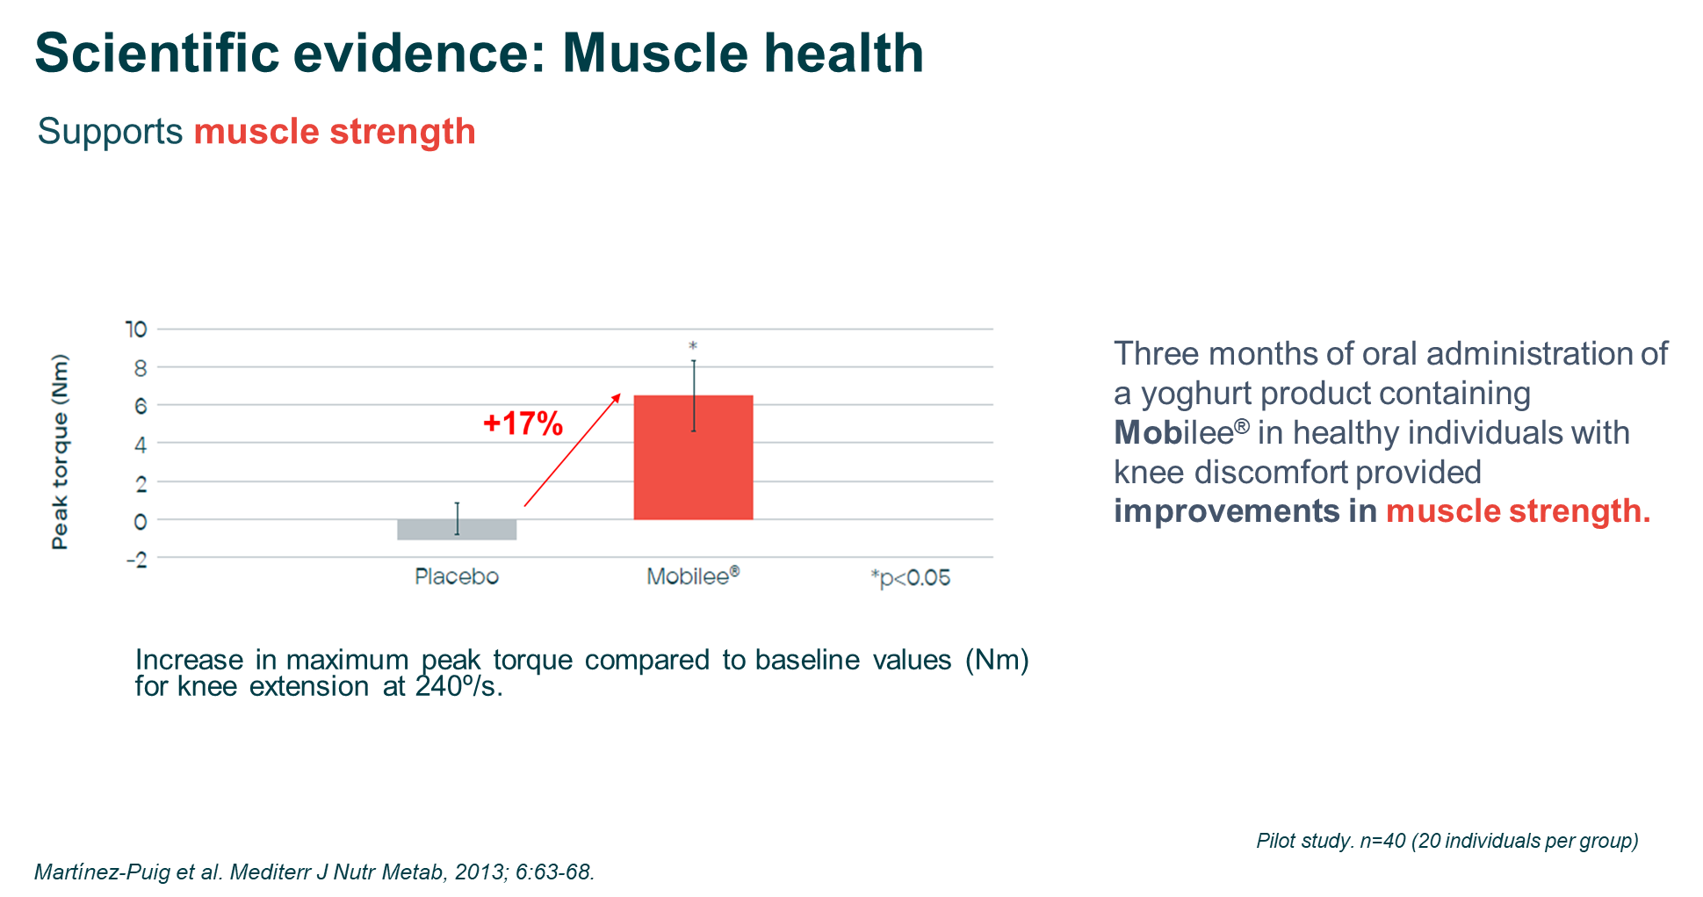
Notes:
· Main effects:
o Increases the endogenous synthesis of hyaluronic acid, thus promoting joint mobility.
o Helps to control inflammatory cytokines.
o Which, consequently, helps to reduces joint discomfort
o And finally, supports muscle function and strength.

Slide 30
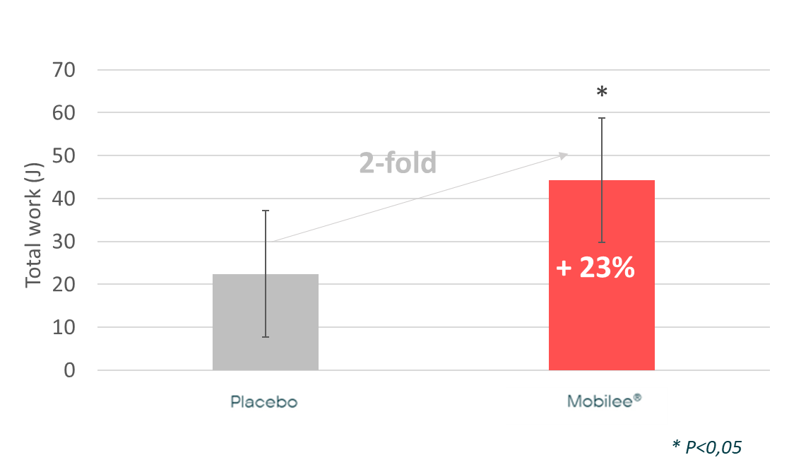
Scientific evidences: Muscle health
Supports muscle strength
Three months of oral administration of a yoghurt product containing Mobilee® in healthy individuals with knee discomfort provided improvements in muscle function.
Increase in total work (J) compared to baseline for knee flexion at 180º/s
Moriña, D. et al. Food Funct 9, 3244-3253 (2018)
Notes:
· In addition, Mobilee has been shown to improve muscle function, measured using isokinetic assessment. This improvement in muscle function has been associated with a direct effect on muscle cells, besides an indirect effect on overall mobility.

Slide 31
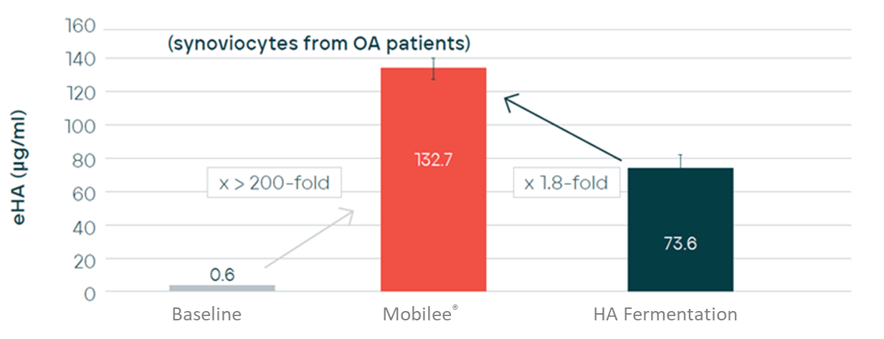
Scientific evidence: Joint health
Increases the endogenous synthesis of hyaluronic acid
Mobilee® increases endogenous HA secretion by more than 200-fold vs baseline and 1,8-fold vs fermentation HA
Effect of Mobilee ® on endogenous synthesis of HA in human osteoarthritic synoviocytes after 24h
Torrent, A. et al. Osteoarthritis and Cartilage, 2009;17:S278-279
Notes:
· It has been demonstrated that Mobilee stimulates the endogenous synthesis of HA by the synoviocytes.
· This stimulation has been shown to be significantly more pronounced when compared to pure HA obtained from fermentation.

Slide 32
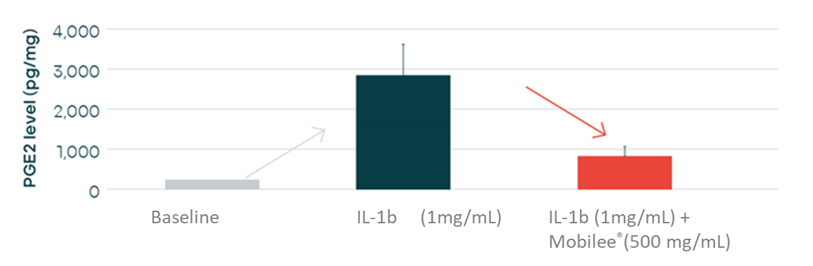
Scientific evidence: Joint health
Lowers Prostaglandin E2, which is linked to inflammation
Mobilee® lowers PGE2 levels, which plays a key role in the inflammatory response.
Effects of Mobilee® on PGE2 levels (pg/ mg of total protein) induced by IL-1ß in human dermal fibroblast cells
Torrent, A. et al. Osteoarthritis and Cartilage, 2010;18:S246-247
Notes:
· Besides this, Mobilee has also demonstrated to interfere with the cascade of inflammatory cytokines, contributing to the support joint function.

Slide 33
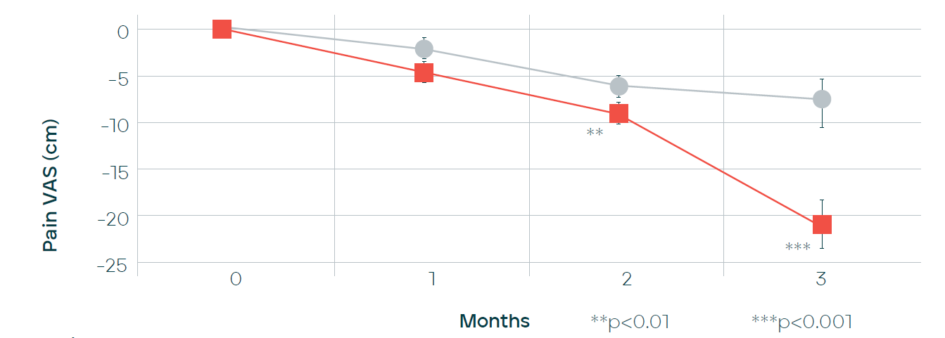

Scientific evidence: Joint health
Reduces joint discomfort
Daily consumption of a yoghurt supplemented with 80mg of Mobilee® significantly reduced pain intensity from the second month of treatment, compared to the placebo group.
Time evolution of the pain reduction (VAS).
Sanchez, J. et al. Ann Nutr Metab, 2013;63:538
Notes:
· As a consequence of the effects described, it has been demonstrated, that oral administration of Mobilee reduces joint discomfort from the second month of treatment.

Slide 34
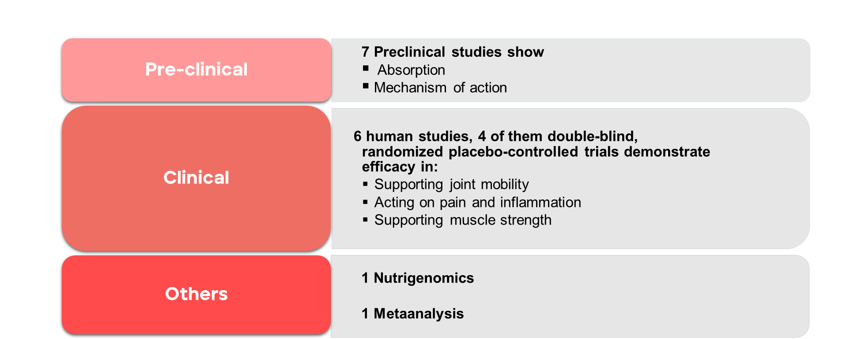
Scientific evidences of Mobilee® - summary
Notes:
· As a consequence of the effects described, it has been demonstrated, that oral administration of Mobilee reduces joint discomfort from the second month of treatment.

Slide 35
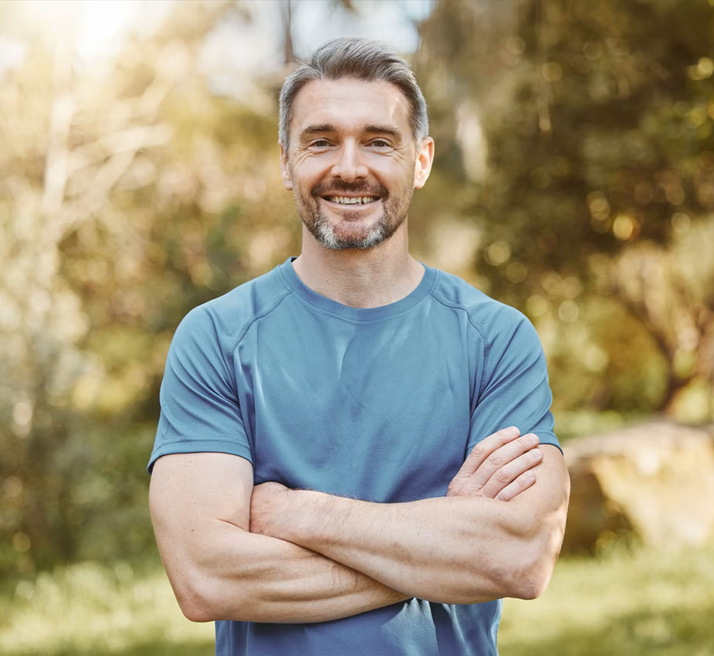
Why Mobilee®?
Patented Hyaluronic Acid matrix ingredient
3 Naturally-occurring components
Synergy effect of its components
For muscle & joint health
Low daily dose: only 80 mg /day
Science backed: efficacy demonstrated in
15 scientific studies
Easy formulation
Notes:
· Main effects:
o Increases the endogenous synthesis of hyaluronic acid, thus promoting joint mobility.
o Helps to control inflammatory cytokines.
o Which, consequently, helps to reduces joint discomfort
o And finally, supports muscle function and strength.

Slide 36
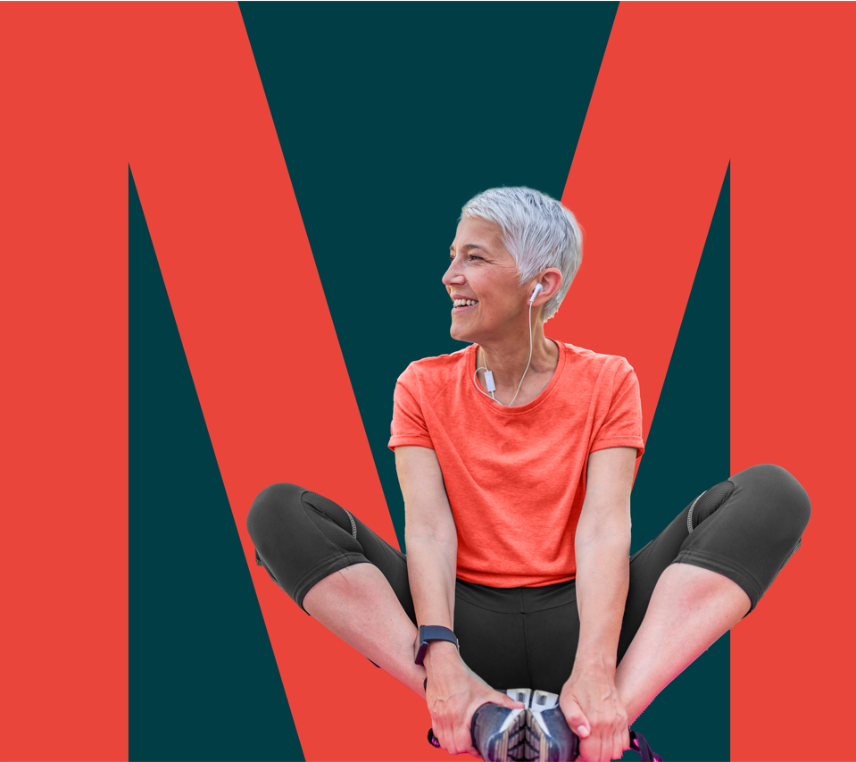
Key takeaways
&
Notes:
Which are the key takeaways of our presentation today?
We have talked about mobility… how it is becoming key among consumers as a driver for overall health,
We have also presented two of our Ingredients for Mobility…
Collavant n2 Native type II Collagen
And Mobilee Hyaluronic Acid Matrix Ingredient

Slide 37
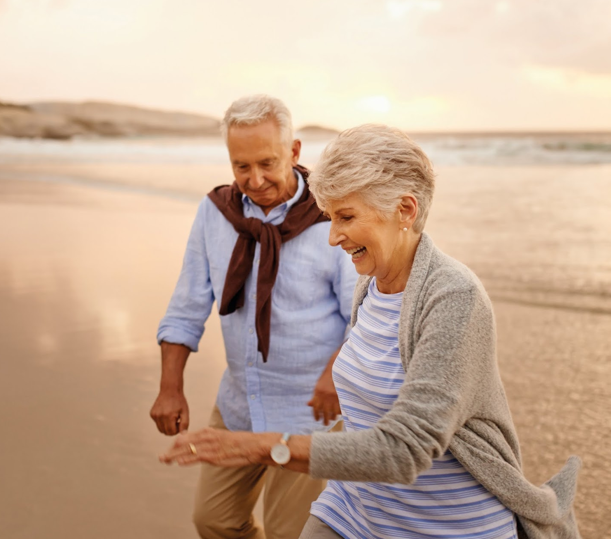
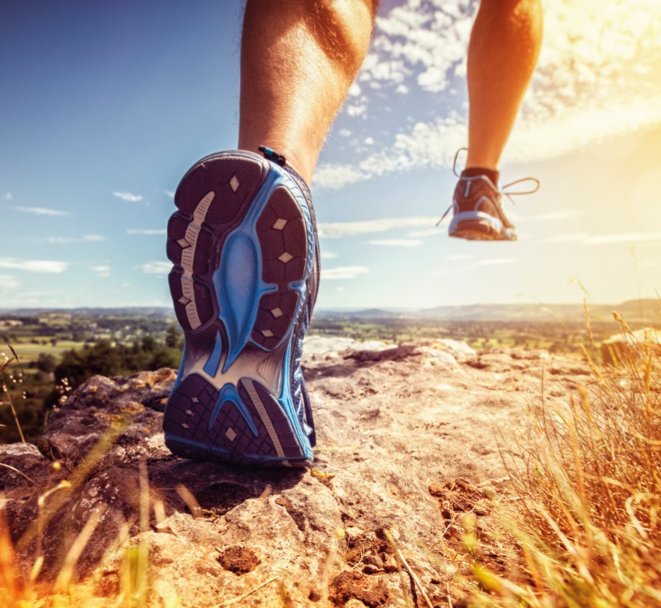


Collavant n2 and Mobilee
Complementary effects for a comprehensive approach to mobility
 | Mobilee | Collavant n2
Ingredient | Hyaluronic Acid Matrix | Native (undenatured) type II collagen
Target Tissues | Synovial fluid Muscle | Cartilage
Mechanism of Action | ↑ Hyaluronic acid synthesis ↓ Inflammatory cytokines ↑ Muscle function | ↓ Immune-mediated collagen destruction ↓ Inflammatory markers
With joint discomfort
Aiming to improve muscle strength
Target Consumers
Seniors + 65
Sporty people
Menopause
Adults (45-65)
Notes:
How are they different?
When to use one or the other in a new product development for Mobility?
Actually, collavant and Mobilee are complementary scientifically backed Ingredients for a comprehensive approach to Mobility.
They are different Ingredients:
Mobilee is a hyaluronic acid matrix and Collavant n2 is a native or undenatured type II Collagen
They target different tissues:
Mobilee acts in the synovial fluid lubricating the joints and in the muscle increasing the strength, while collavant n2 acts in the cartilage slowing down collagen degradation.
They also differ in the mechanism of action.
Mobilee, stimulates the endogenous synthesis of HA, decreases inflammatory cytokines and increases muscle cells proliferation.
While Collavant n2 has an immune mediated mechanism of action, reducing Collagen destruction and inflammatory markers.
So they can be combined in the same product for a comprehensive approach to mobility.
The target consumer can range from:
Seniors + 65, to sporty people, menopause women and Midle Aged Adults with joint discomfort and aiming to improve muscle strength.

Slide 38

CONSUMERS
Are striving to optimise mobility and health at every age
OPPORTUNITY Develop efficacious products that target mobility
Notes:
To sum up…
Consumers of all ages are increasingly looking to improve their mobility as a way to improve they health and wellbeing.
There is an opportunity to develop efficacious products that target mobility worldwide.

Slide 39

Thank You
Daniel Martínez-Puig, PhD
Head of R&D Human & Animal Health
BIOIBERICA, S.A.U.
dmartinez@bioiberica.com
David Foreman, Pharm.D
Pharmacist and Media Natural Health Expert
david@herbalpharmacist.com
DISCLAIMER: These statements have not been evaluated by competent authorities. The products are not intended to diagnose, treat, cure or prevent any disease. This information is only for business-to-business use and not meant to be addressed to final consumers. Therefore, BIOIBERICA assumes no liability for the statements that the producer of the final product may include in its own publicity to consumers.
Notes:
So that’s our presentation for today.
Thank you very much for your attention.
And now we will answer any questions you may have.

