Slide 1

Creatine and Cognition:
Good for the Young and Old?
Douglas Kalman PhD RD
ACTIVE AGING: Mastering the Market
December 3, 2025
https://naturallyinformed.net/2025-active-aging/

Slide 2
Why talk about Creatine and the brain?
Creatine is a naturally occurring molecule in the human body.
It is endogenously produced by the combination of the amino acids methionine, glycine, and arginine.
Creatine is also found in the diet (i.e., red meat, fatty fish).
Vitamin B12 and folate are both catalysts in creatine formation.
Creatine is chiefly found in skeletal muscle (as phosphocreatine-PCR & creatine-Cr).
Creatine is also stored in the body the heart, brain, liver, kidneys, and testes.
Creatine is metabolized by a specific enzyme in the body.
Creatine metabolism in the muscle is via creatine kinase MM
Creatine metabolism in the brain is via creatine kinase BB (known as BB-CK).
This suggests creatine is important for and used in brain energy provision.
Creatine-deficient syndromes that involve brain creatine are characterized by major mental and developmental disorders.
Creatine deficient syndromes may be partially reversed with creatine supplementation.

Slide 3
Creatine 101
Creatine is in the guanidine phosphagen family of compounds.
What other compounds can you name in this family?
Creatine is a nitrogenous amine (naturally occurring non-protein amino acid compound).
Ninety-five percent (95%) of creatine is found in skeletal muscle.
The brain and testes contains ~5% of creatine.
About 2/3rds of intramuscular creatine is Phosphocreatine (PCr).
The other 1/3rd is free creatine
Some individuals experience inborn errors of creatine metabolism that effect ability to maintain normal muscle and brain levels of creatine.
Dietary supplementation of creatine is used as part of life-long treatment.
Vegans, vegetarians have lower Cr stores versus meat eaters.
Vegans have been found to have 90 – 110 mmol/kg Cr vs 120+ for meat eaters.

Slide 4
Totally Creatine
Creatine metabolism in the brain is via creatine kinase BB (known as BB-CK).
In human muscle, total Creatine pool averages 120 mmol/kg (70kg person).
Creatine supplementation can raise this storage to ~170 mmol/kg (70kg person).
One to two percent (1-2%) of intramuscular creatine is degraded into creatinine.
Creatinine is a normal metabolic byproduct excreted in the urine.
This means the body “needs” to replenish 1-3 gm Cr a day.
About half of Cr needs come from diet.

Slide 5
Brain Energy Demands
Cognitive processing (your brain as a computer) may be impacted by creatine metabolism.
Dietary styles impact creatine stores.
Cognitive processing is directly used for tasks such as: ATP synthesis, re-synthesis and for turnover.
Creatine processes are also impacted by sleep deprivation, hypoxia and some neurological conditions.
Creatine is synthesized in neurons (i.e., glial and astrocytes)
Creatine is considered as potentially beneficial for those with a traumatic brain injury (TBI).

Slide 6
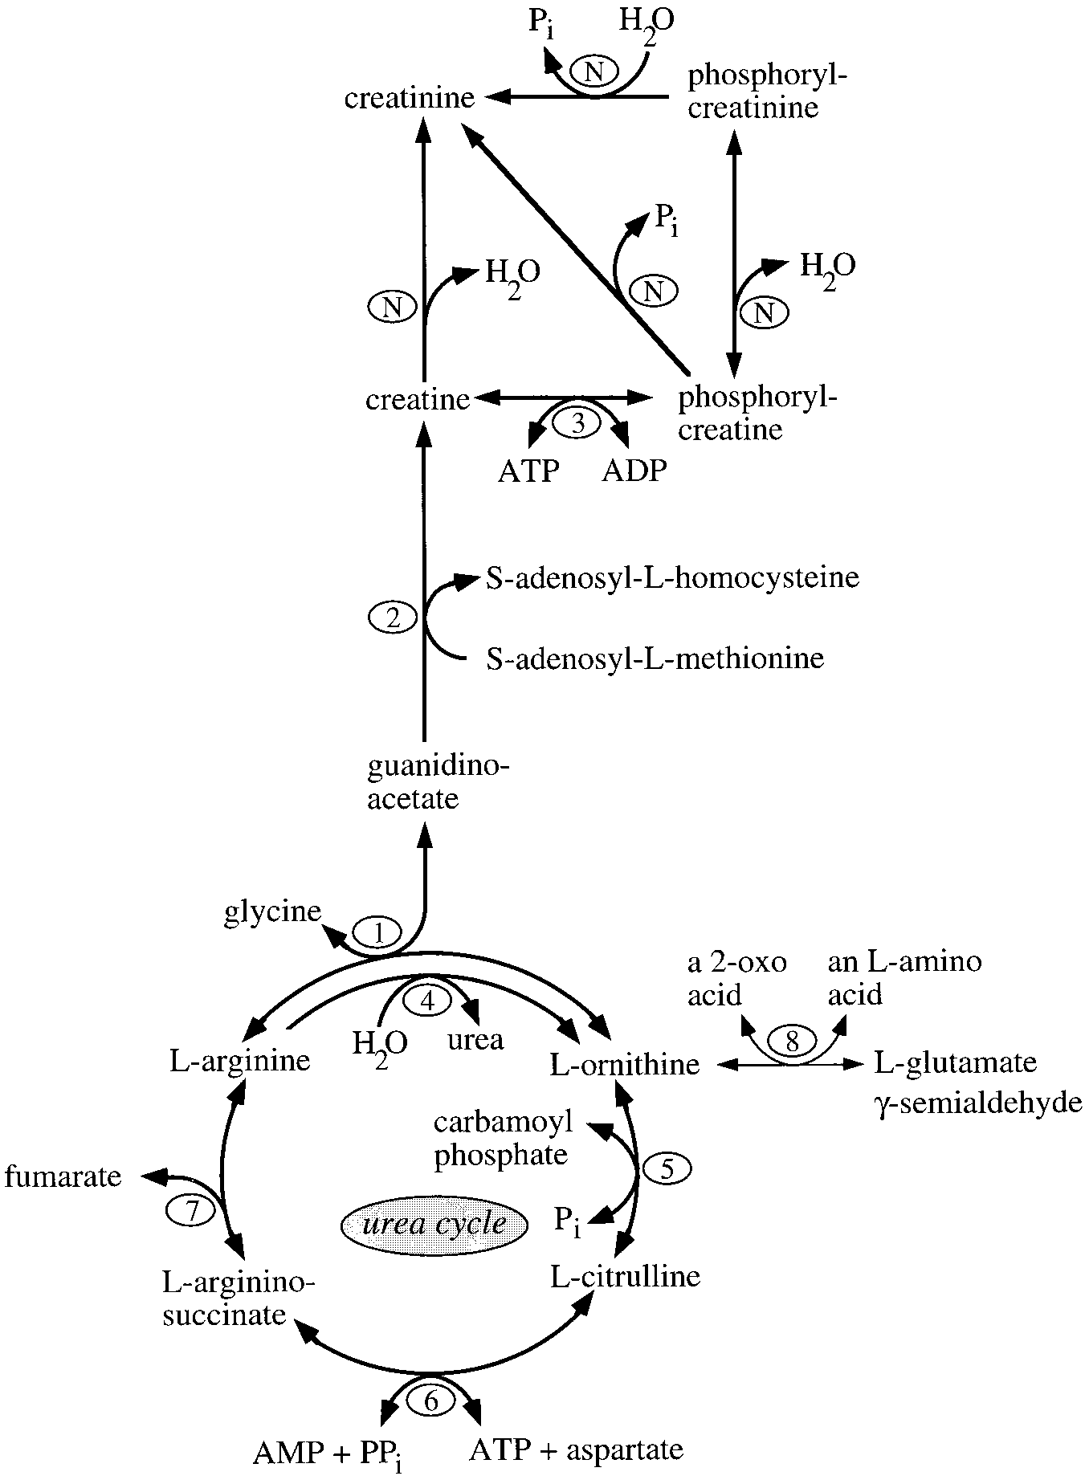
Normal creatine metabolism
Schematic representation of the reactions and enzymes involved in vertebrate creatine and creatinine metabolism. The respective enzymes are denoted by numbers: 1) L-arginine:glycine amidinotransferase (AGAT; EC 2.1.4.1); 2) S-adenosyl-L-methionine:N-guanidinoacetate methyltransferase (GAMT; EC 2.1.1.2); 3) creatine kinase (CK; EC 2.7.3.2); 4) arginase (L-arginine amidinohydro- lase; EC 3.5.3.1); 5) ornithine carbamoyltransferase (EC 2.1.3.3); 6) argininosuccinate synthase (EC 6.3.4.5); 7) argininosuccinate lyase (EC 4.3.2.1); 8) L-ornithine:2-oxo-acid aminotransferase (OAT; EC 2.6.1.13); N) nonenzymatic reaction.

Slide 7
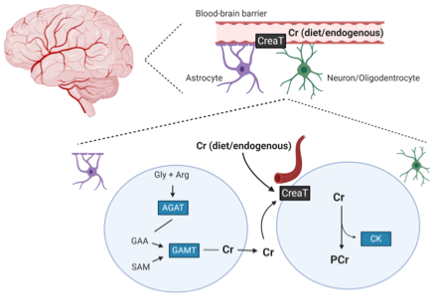
Dietary Creatine Transport - Brain
Dietary creatine is transported through the blood–brain barrier via a creatine transporter.
Astrocytes cells can also endogenously produce creatine, which is taken up by the neurons expressing the creatine transporter.

Slide 8
Creatine – Sleep Deprivation
Rationale: Sleep deprivation has a negative effect on cognitive and psychomotor performance and mood state, partially due to decreases in creatine levels in the brain. Therefore, creatine supplementation should lessen the negative effects of sleep deprivation.
Objectives: The objective of this study was to examine the effect of creatine supplementation and sleep deprivation, with mild exercise, on cognitive and psychomotor performance, mood state, and plasma concentrations of catecholamines and cortisol.
Method: Subjects were divided into a creatine group (n=10) and a placebo group (n=9). They took 5 g of creatine monohydrate or a placebo, dependent on their group, four times a time a day for 7 days, immediately prior to the experiment. The study was double blind. Subjects undertook tests of random movement generation (RMG), verbal and spatial recall, choice reaction time, static balance and mood state pre-test (0 h), after 6, 12 and 24 h of sleep deprivation, with intermittent exercise. They were tested for plasma concentrations of catecholamines and cortisol at 0 and 24 h.
Results: At 24 h, the creatine group demonstrated significantly less change in performance from 0 h (delta) in RMG, choice reaction time, balance and mood state. There were no significant differences between groups in plasma concentrations of catecholamines and cortisol. Norepinephrine and dopamine concentrations were significantly higher at 24 h than 0 h, but cortisol were lower.
Conclusions: Following 24-h sleep deprivation, creatine supplementation had a positive effect on mood state and tasks that place a heavy stress on the prefrontal cortex.
Psychopharmacology (Berl). 2006 Mar;185(1):93-103. doi: 10.1007/s00213-005-0269-z. Epub 2006 Jan 17. PMID: 16416332.

Slide 9
Creatine does not improve cognitive function in young adults with sleep
Abstract
Creatine supplementation has been reported to improve certain aspects of cognitive and psychomotor function in older individuals and in young subjects following 24 and 36 h of sleep deprivation. However, the effects of creatine supplementation on cognitive processing and psychomotor performance in non-sleep deprived young adults have not been assessed with a comprehensive battery of neurocognitive tests. The primary objective of this study was to examine the effects of creatine supplementation on cognitive processing and psychomotor performance in young adults. Twenty-two subjects (21 ± 2 yr) ingested creatine (0.03 g/kg/day) or placebo for 6 weeks in a double-blind placebo-controlled fashion. Subjects completed a battery of neurocognitive tests pre- and post-supplementation, including: simple reaction time (RT), code substitution (CS), code substitution delayed (CSD), logical reasoning symbolic (LRS), mathematical processing (MP), running memory (RM), and Sternberg memory recall (MR). There were no significant effects of group, no significant effects of time, and no significant group by time interactions for RT, CS, CSD, LRS, MP, RM, and MR (all p > 0.05), indicating that there were no differences between creatine and placebo supplemented groups at any time. These results suggest that six weeks of creatine supplementation (0.03/g/kg/day) does not improve cognitive processing in non-sleep deprived young adults. Potentially, creatine supplementation only improves cognitive processing and psychomotor performance in individuals who have impaired cognitive processing abilities.
https://mosaic.messiah.edu/hnes_ed/24/

Slide 10
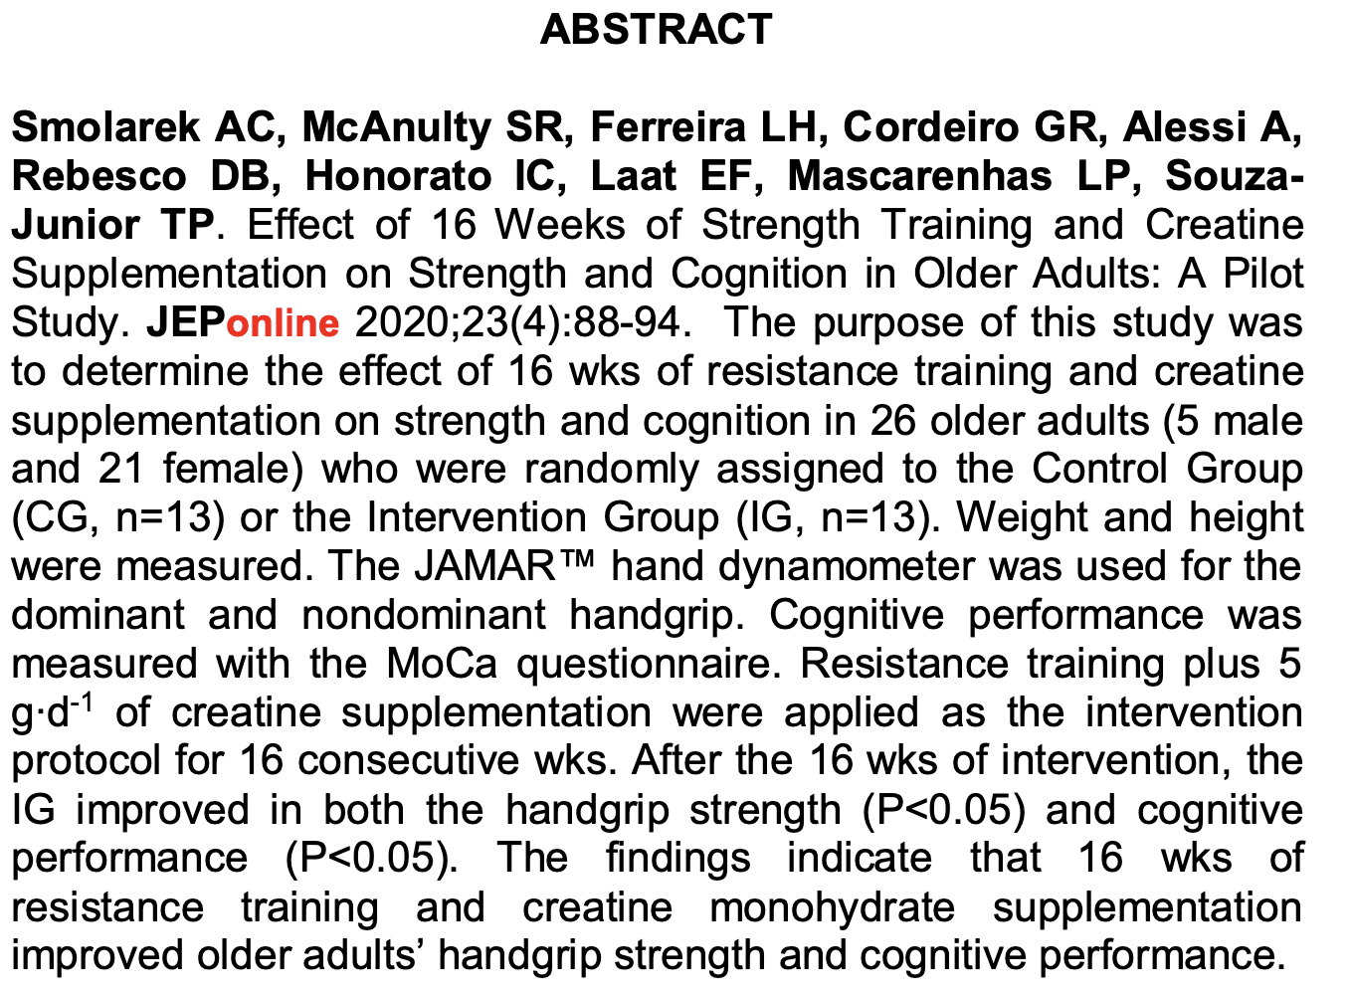
Older Adults – Positive Impact of Creatine
https://www.asep.org/asep/asep/JEPonlineAUGUST2020_Smolarek.pdf

Slide 11
Vegetarians, Vegans & Brain Creatine
Abstract
The present cross-sectional study aimed to examine the influence of diet on brain creatine (Cr) content by comparing vegetarians with omnivores. Brain Cr content in the posterior cingulate cortex was assessed by proton magnetic resonance spectroscopy (1H-MRS). Dietary Cr intake was assessed by 3d food recalls. Vegetarians had lower dietary Cr intake than omnivores (0·03 (SD 0·01) v. 1·34 (SD 0·62)g/d, respectively; P1⁄40·005). However, vegetarians and omnivores had comparable brain total Cr content (5·999 (SD 0·811) v. 5·917 (SD 0·665) IU, respectively; P1⁄40·77). In conclusion, dietary Cr did not influence brain Cr content in healthy individuals, suggesting that in normal conditions brain is dependent on its own Cr synthesis.
British Journal of Nutrition, 111(7), 1272-1274. doi:10.1017/S0007114513003802

Slide 12
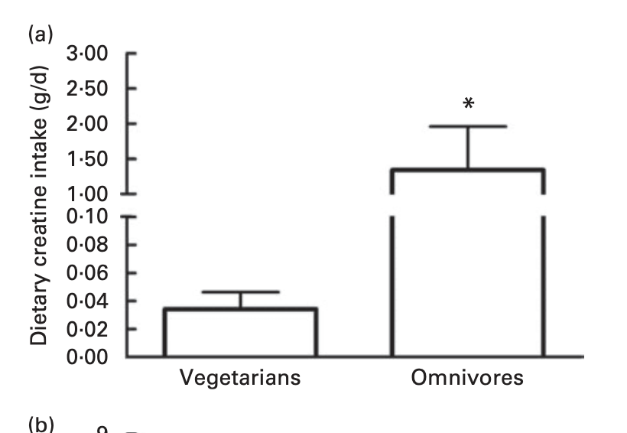
Dietary Creatine Intake Veg vs Non-Veg

Slide 13
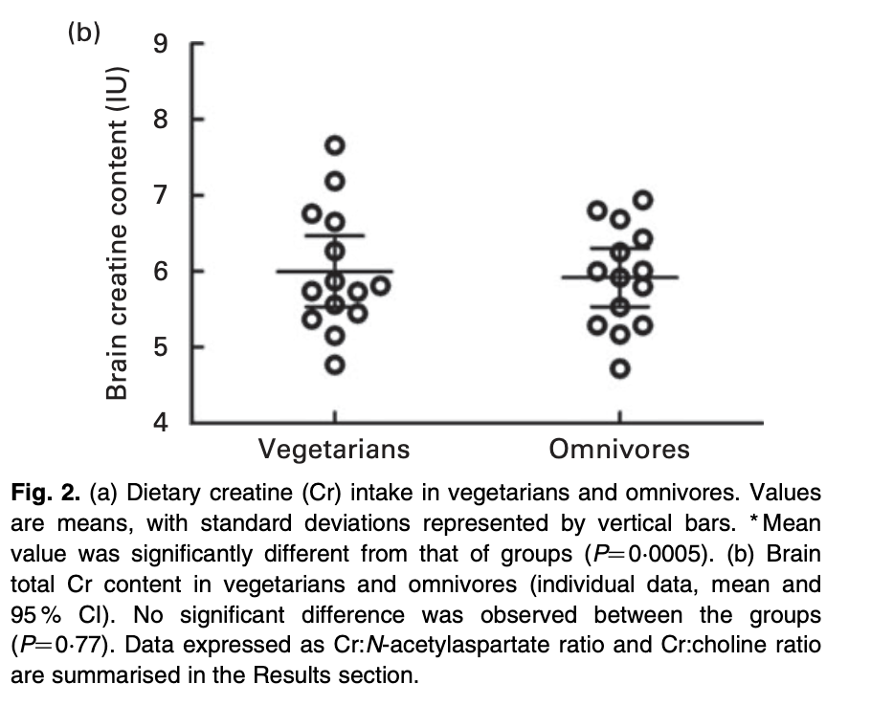
Brain Creatine Levels Veg vs Non-Veg
https://www.cambridge.org/core/journals/british-journal-of-nutrition/article/brain-creatine-depletion-in-vegetarians-a-crosssectional-1hmagnetic-resonance-spectroscopy-1hmrs-study/C01E9E1F222136316801626F6C352B8F

Slide 14
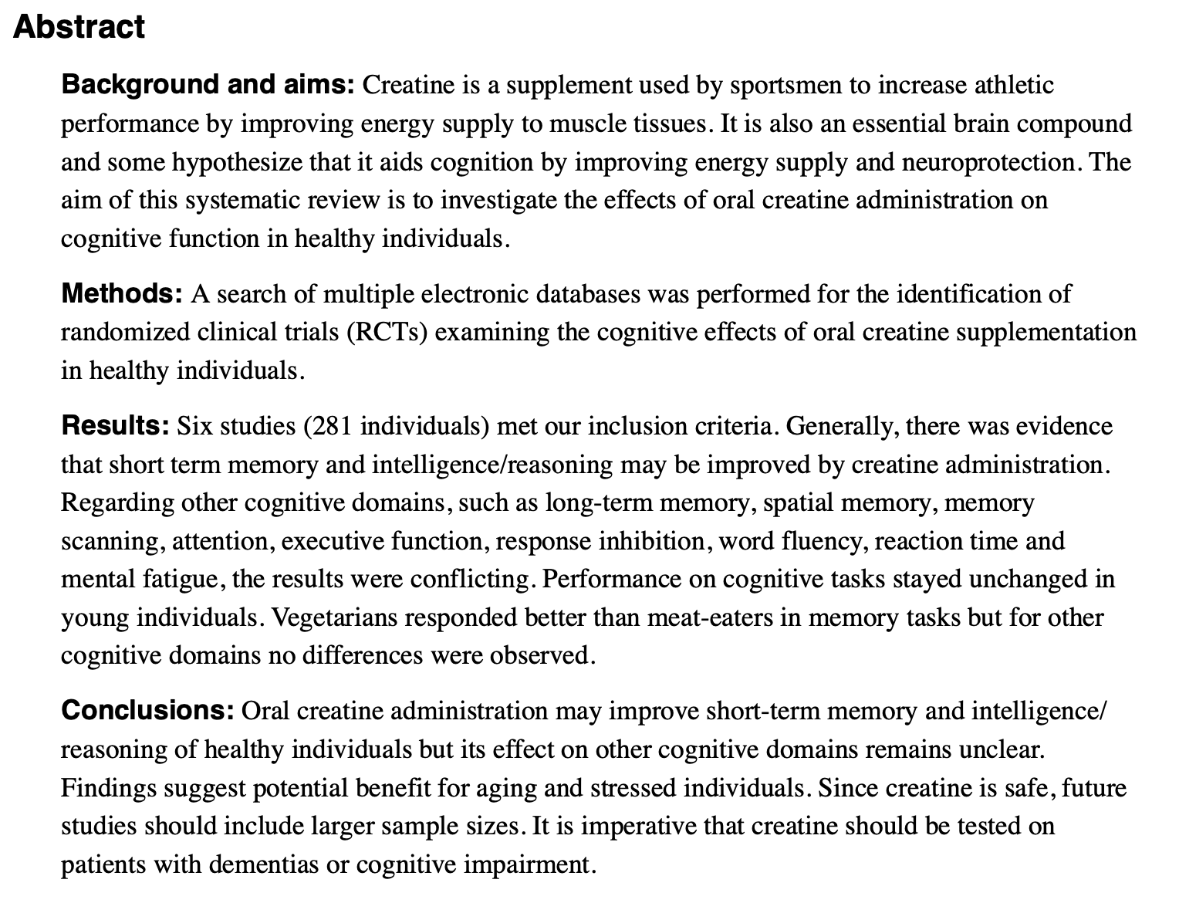
Systematic Review: Creatine & Cognition
https://www.ncbi.nlm.nih.gov/pmc/articles/PMC6093191/pdf/nihms-983799.pdf

Slide 15
Practical Takeaways
Creatine is a nitrogenous amine that plays many roles in the body.
Typically creatine is best known for supporting high-energy output.
Creatine helps with ATP regeneration.
Creatine is intimately involved in brain energetics.
Creatine shows cognitive support and beneficial impacts.
Creatine supplementation during sleep deprivation may be recommended.
Creatine supplementation of vegans/vegetarians may be recommended.
Creatine’s role as a cognitive nutrient is exciting & growing!

Slide 16
To Recap
Current evidence suggests that creatine monohydrate supplementation may confer beneficial effects on cognitive function in adults, particularly in the domains of memory, attention time, and information processing speed.
Creatine exerts a cognitive supportive benefit that is more pronounced when sleep deprived.
Creatine has direct and indirect antioxidant effects.
Creatine has anti-inflammatory impacts
Creatine overall is a great healthy lifecycle nutrient for brain and body health.
https://www.frontiersin.org/journals/nutrition/articles/10.3389/fnut.2024.1424972/full

Slide 17
Thank you
Thank you to all of the attendees!
Thank you to the hosts and sponsors of this Naturally Informed Active Aging Conference.
Thank you to Professor Roger Harris….without Dr Harris and a horse, we may never have been so introduced to creatine!
Science or Regulatory questions?
  Contact us at Substantiation Sciences (www.substantiationsciences.com)
E: dkalman@substantiationsciences.com
https://naturallyinformed.net/2025-active-aging/

