Slide 1
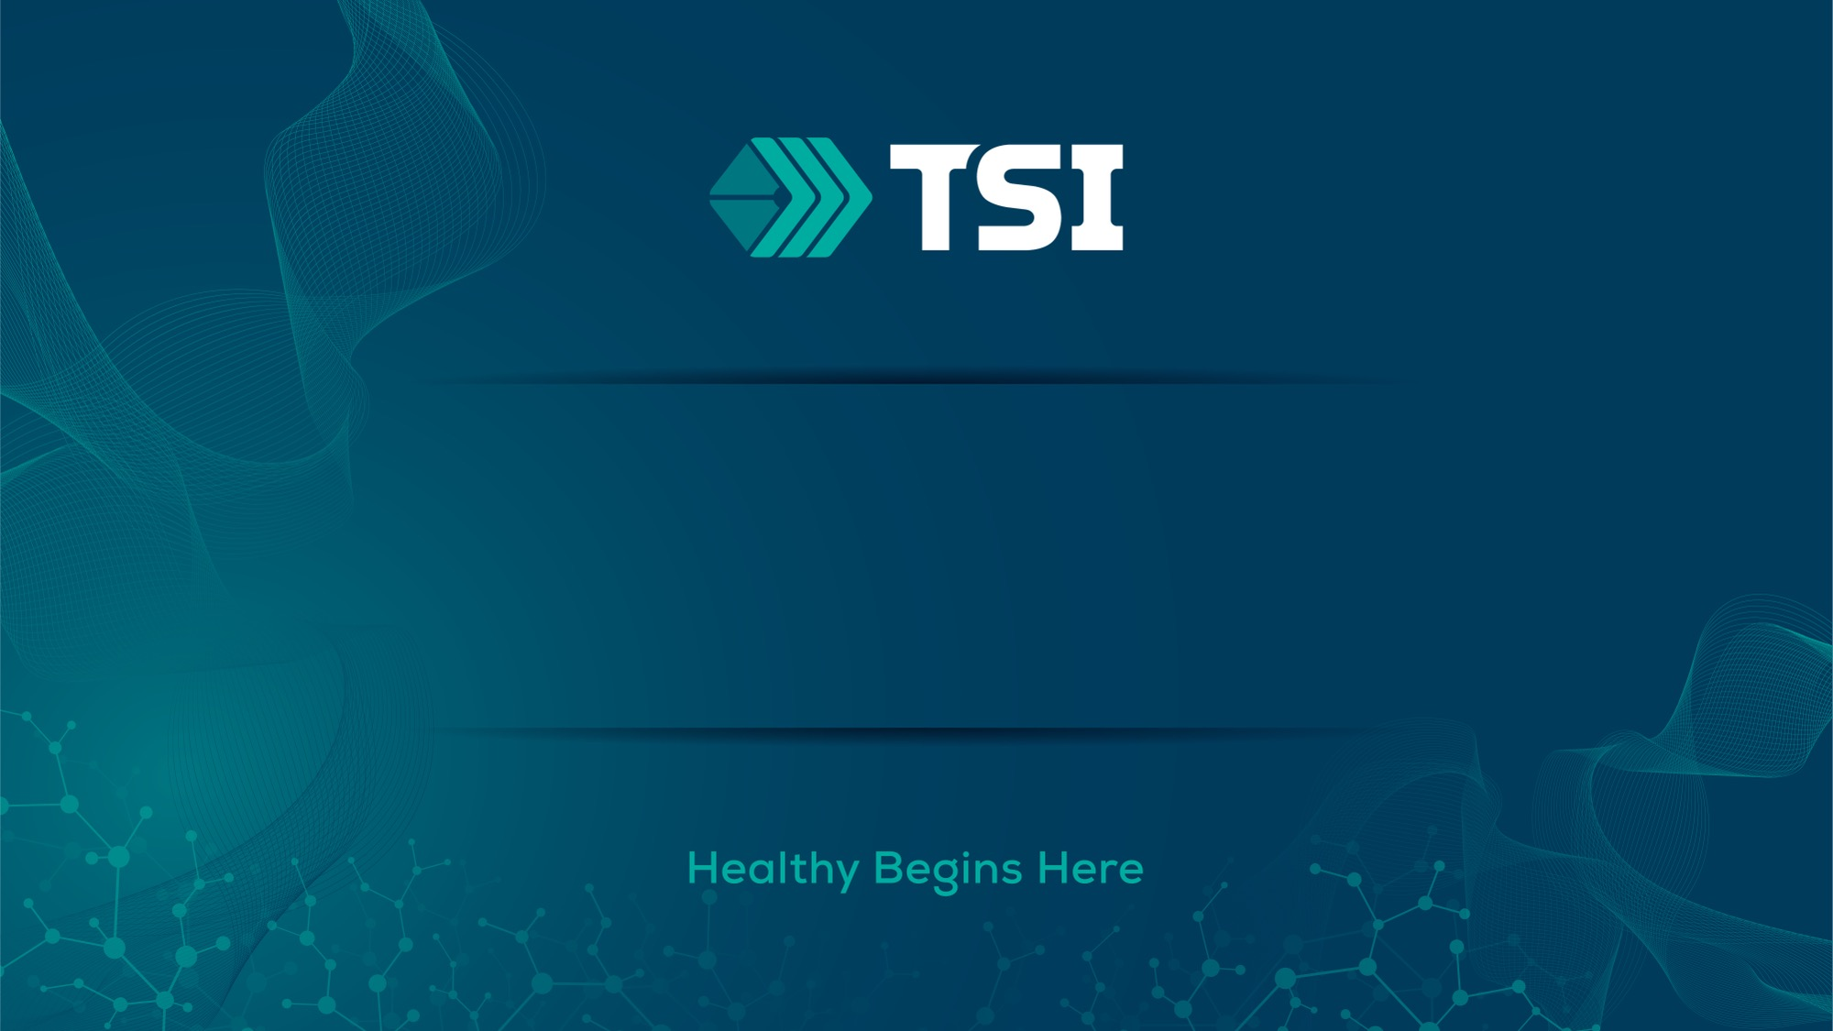
What Worked Then Still Works Now: Proven Strategies for Lifelong Muscle Health
Understanding protein metabolism, muscle health and how HMB, creatine, and vitamin D support muscle preservation across aging
Shawn Baier, MS, MBA
Global Director of Ingredient Science at TSI Group

Slide 2


The reality of Active Aging
Aging population growing rapidly
Muscle is increasingly viewed as a “vital sign” of aging
Muscle health predicts mobility, resilience, independence, and mortality.
Notes:
Silvia - Thought it would be good to mention GLP-1s and what the weight loss drugs have done to muscle health category.

Slide 3
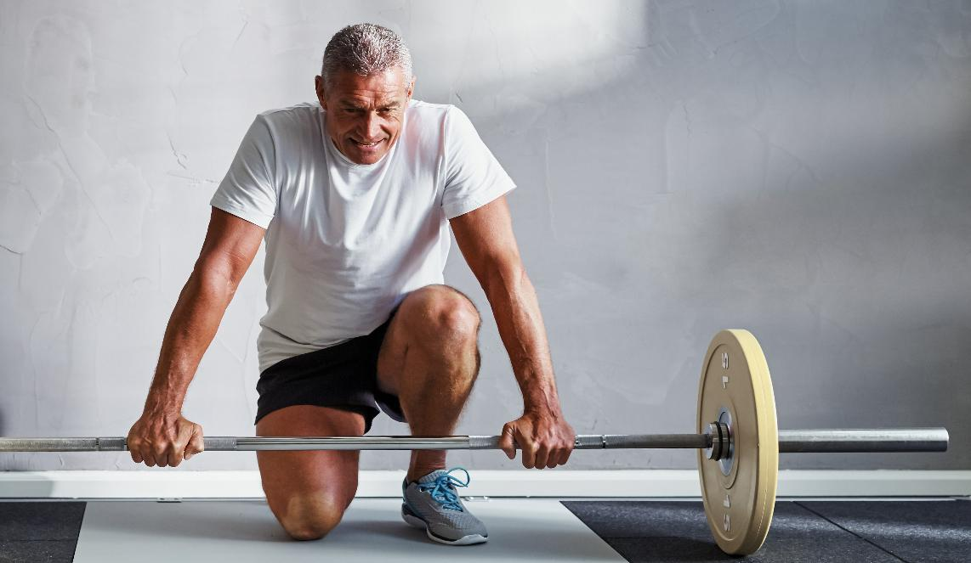


Performance Science → Aging Science
The same pathways that drive performance support healthy aging
Active aging isn’t starting over — it’s continuing what kept you strong.
Mitochondrial efficiency and protein metabolism remain central across decades

Slide 4
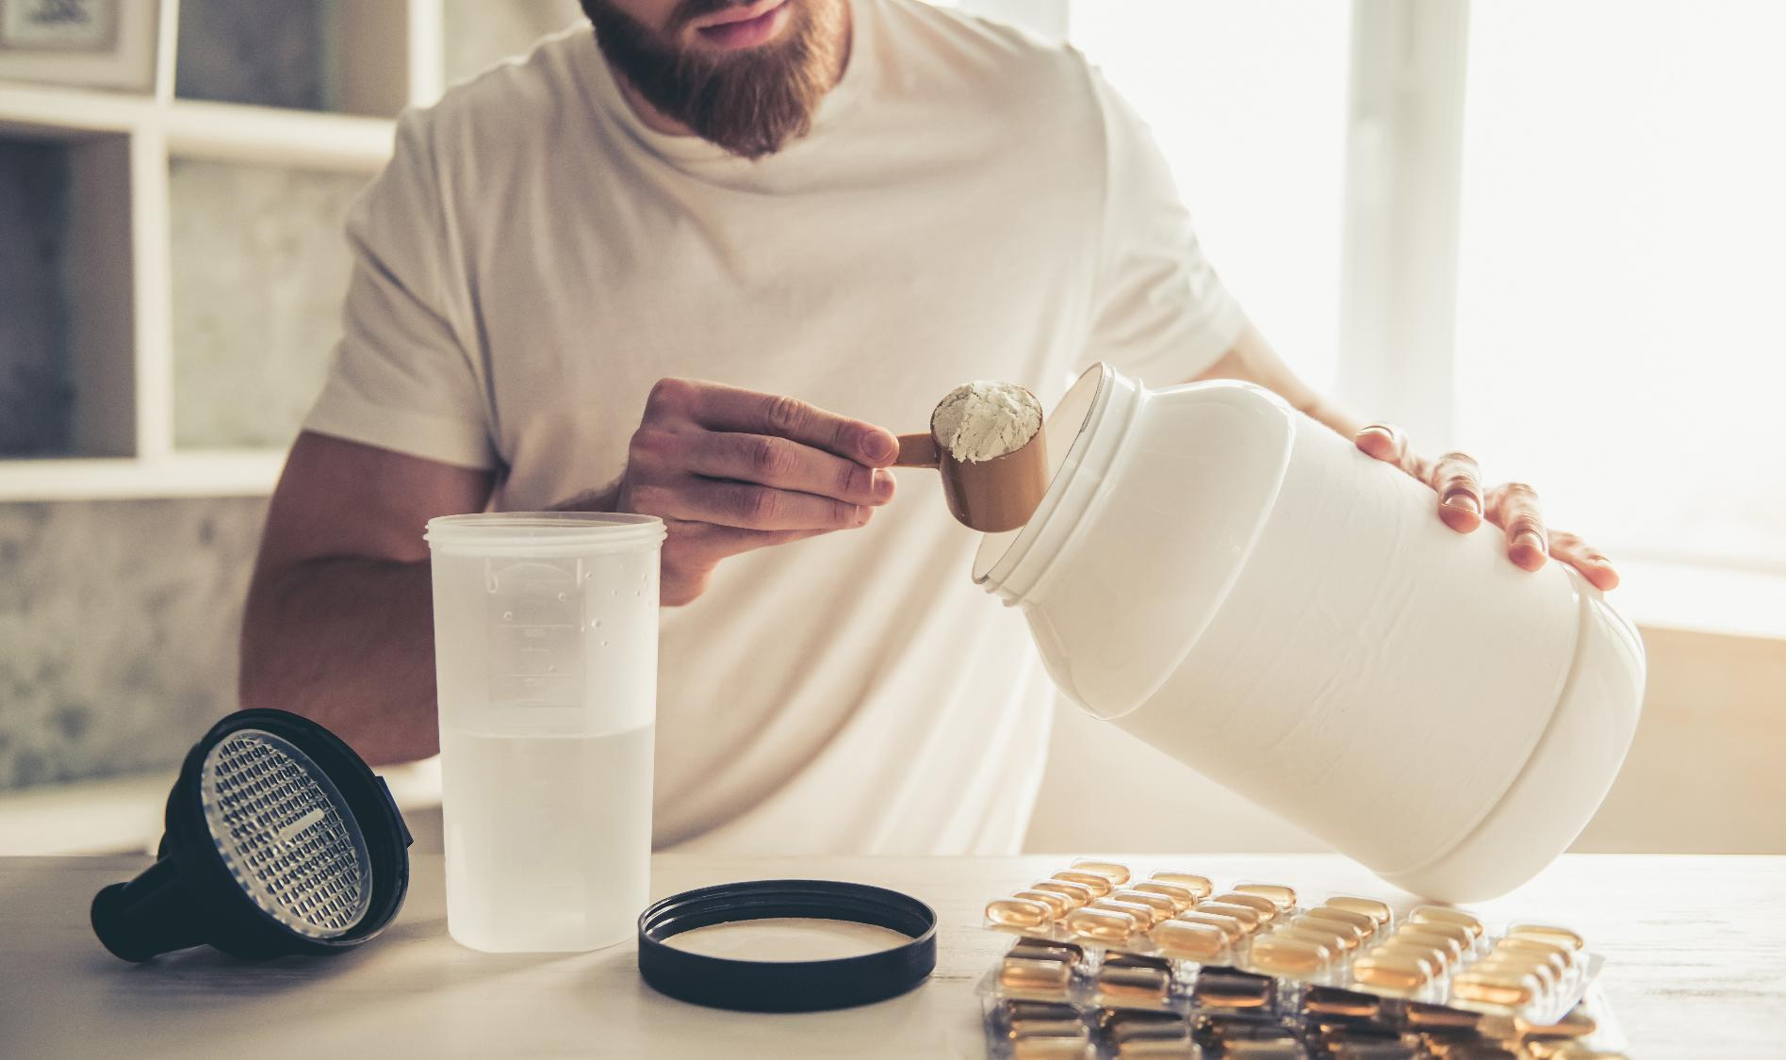
What fueled training in your 20s protects your mobility and strength in your 50s, 60s, and beyond

Slide 5

Why Muscle Declines With Age
Reduced anabolic sensitivity
Increased muscle protein breakdown
Lower muscle protein synthesis
Mitochondrial dysfunction
Greater impact of inactivity
Hormonal and metabolic shifts
Insufficient nutrient intake
Notes:
Reduced anabolic sensitivity Older adults have a weaker response to stimuli that normally activate muscle-building pathways (like mTOR, protein intake, and exercise).
Increased muscle protein breakdown Aging increases catabolic signaling, inflammation, and inactivity-driven muscle loss, shifting protein turnover toward net loss.
Lower muscle protein synthesis The body becomes less efficient at building or repairing muscle tissue, even when adequate nutrition is provided.
Mitochondrial dysfunction Declining ATP production and reduced mitochondrial efficiency impair muscle contraction, recovery, and fatigue resistance.
Greater impact of inactivity Short periods of bed rest, travel, illness, or injury accelerate muscle loss much faster in older adults than in younger adults.
Hormonal and metabolic shifts Changes in anabolic hormones and increased oxidative stress contribute to muscle degradation and slower adaptation.
Insufficient nutrient intake Lower protein intake, insufficient vitamin D, and reduced appetite compound age-related muscle decline.

Slide 6
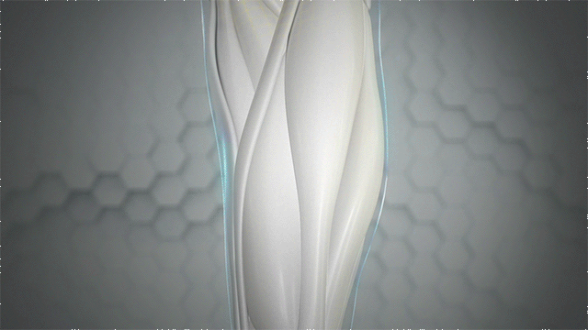





Key Biological Pathways in Muscle Health
mTOR: signals protein synthesis
Protein turnover: balance of building vs breakdown
Mitochondrial Function & Energy Metabolism
Neuromuscular Function
Inflammatory & Oxidative Stress Pathways
Hormonal Pathways
Satellite Cell Function (Muscle Stem Cells)

Slide 7

Why these pathways matter more with Age
Reduced anabolic sensitivity
Older adults have a weaker muscle-building response to protein and exercise.
mTOR activation is less efficient, making muscle maintenance harder.
Greater vulnerability to inactivity
Short periods of reduced activity cause faster muscle loss.
Protein breakdown increases quickly, and recovery is slower.
Longer recovery times
Muscle repair processes slow with age.
Fatigue lasts longer, reducing overall training stimulus.
Higher nutrient needs
Aging muscle requires more targeted nutritional support.
Lower protein intake and vitamin D insufficiency are common, increasing reliance on proven actives like HMB and creatine.

Slide 8


The pathways haven’t changed – but the need to support them increases with age.

Slide 9
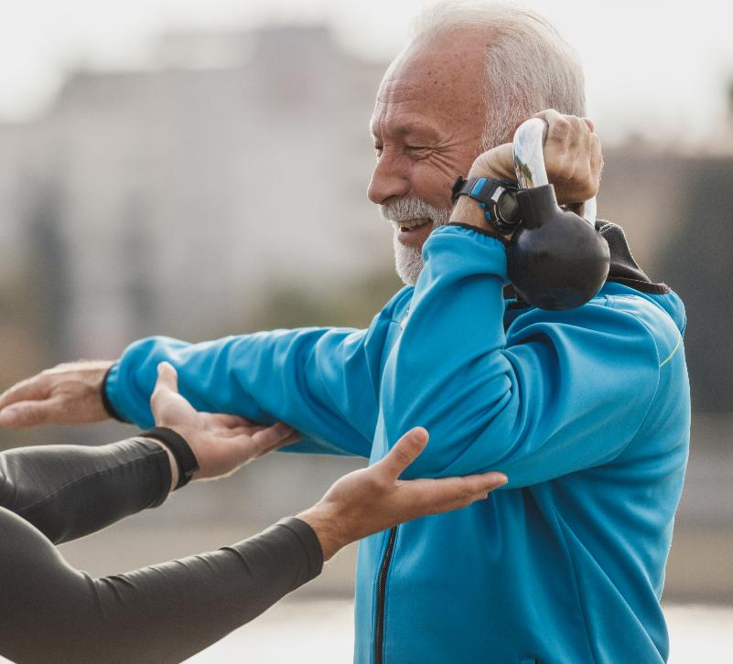
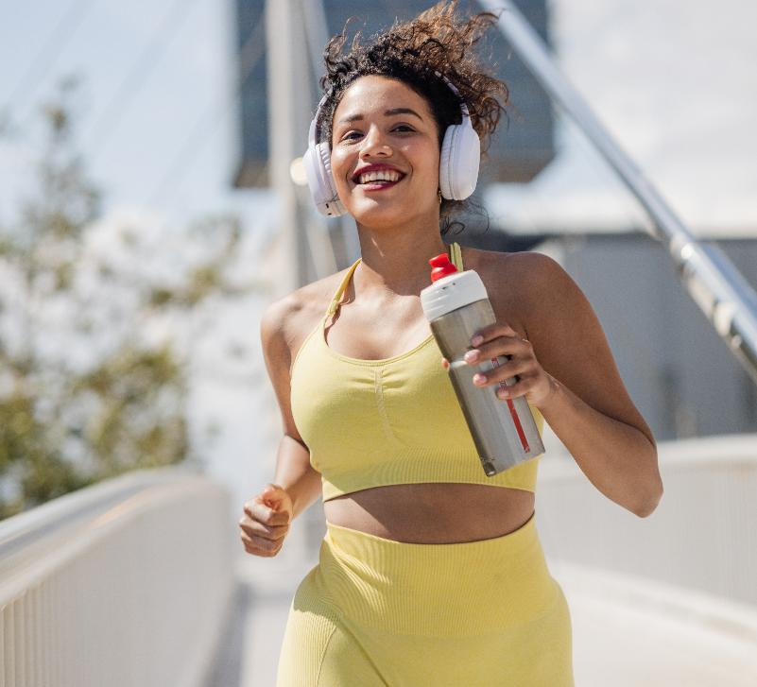

Proven actives for lifelong muscle health
HMB
protein turnover
Creatine
energy metabolism
Vitamin D
cellular function

Slide 10
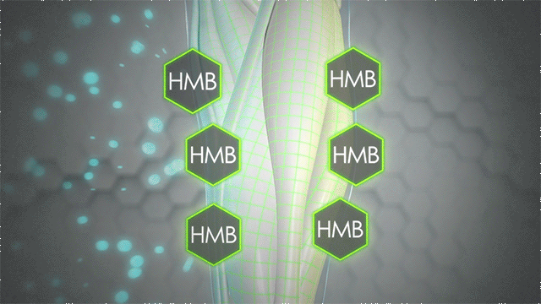
How HMB Works
HMB uniquely both stimulates protein synthesis &
reduces breakdown - dual mechanisms of action
Muscle is a dynamic tissue, continually breaking down and rebuilding itself at a rate of 1-2% per day.
Evidence recommends that 3g of CaHMB or HMB free acid is needed to maximize the anticatabolic benefits.
This requires supplementary HMB consumption as 3g of HMB is the equivalent amount that can be converted from 60g of leucine or 600g of protein.

Slide 11
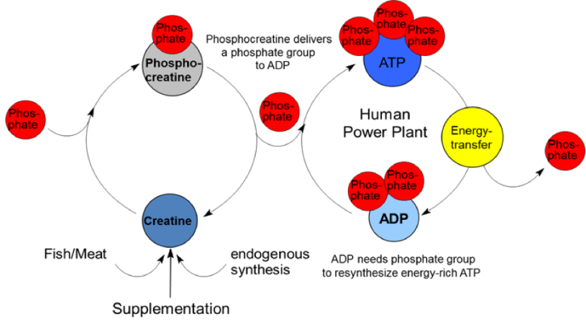
Creatine for Muscle
When you take creatine as a supplement, your muscles store it as phosphocreatine.
During intense activities like lifting weights or sprinting, your muscles need energy. They use a molecule called ATP for this. But ATP runs out quickly. When ATP runs low, phosphocreatine steps in. It gives up a part of itself to regenerate ATP, like a quick energy refill. This rapid ATP replenishment helps you keep going during intense exercise without feeling tired as quickly.
Creatine enhances ATP re-synthesis from ADP

Slide 12

The role of Vitamin D in Muscle Health
Essential for Muscle Function and Strength
Vitamin D is a vital nutrient that plays a key role in muscle function and overall physical performance. It is necessary for both muscle health and strength.
Common Deficiency Impacting Muscle Health
Vitamin D deficiency is common, especially among older adults, leading to muscle weakness and loss of function. Addressing this deficiency is crucial for maintaining muscle health.
Notes:
Vitamin D is well known as a nutrient that supports bone health and strength. We also know it has a host of other benefits, like supporting the immune system, heart and circulation, respiratory system, and brain development. But we’re just recently learning that Vitamin D also plays a vital role in healthy muscle function.
Higher levels of serum vitamin D (at least 32 ng/mL are associated with better muscle function, especially in the elderly (Larson-Meyer, 2010)
Vitamin D status is correlated with muscle strength measures (Hildebrand, 2016)
Many individuals have suboptimal vitamin D levels - including more than half of athletes in one study (Farrokhyar, 2015)
Adequate levels of Vitamin D can support weight loss during a calorie restricted diet (Luisella Vigna et al, 2015)

Slide 13
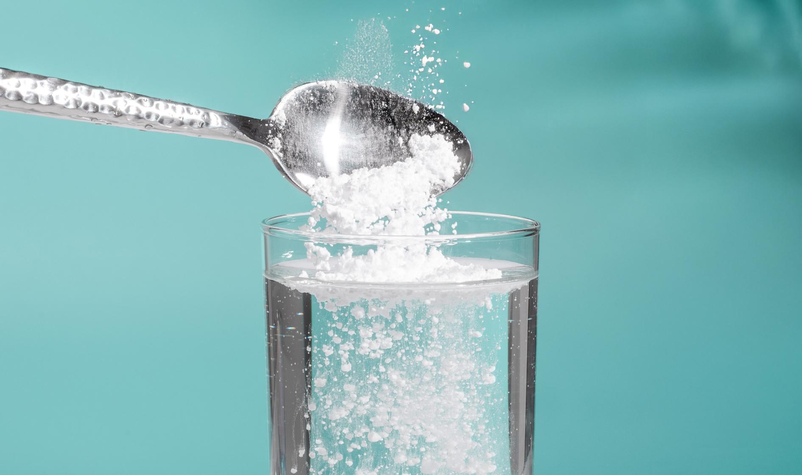
Creatine and HMB A Perfect Match

Slide 14
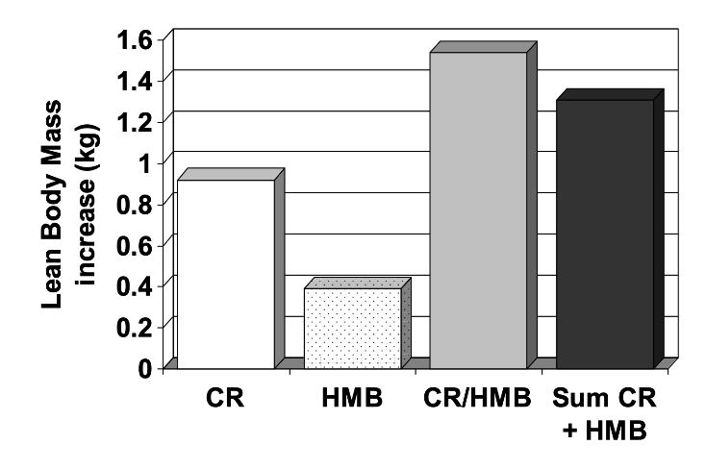
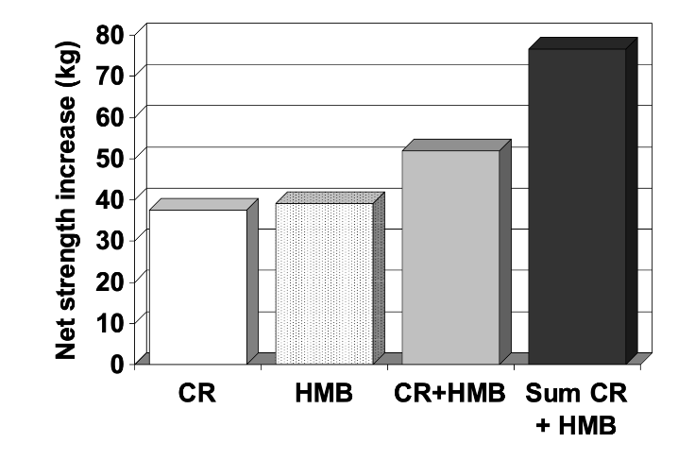
HMB + Creatine in the Sports Nutrition setting
Creatine + HMB > Creatine or HMB alone
40 male subjects; age 19-23 y
Randomized to HMB (3 g/d), creatine, HMB+creatine, or placebo
3 week resistance training
Results
✔️Synergistic effect of HMB and Cr on lean body mass
✔️Both HMB and Cr increased strength gains (additive effect)
Notes:
Jówko, E. et al. Creatine and b-hydroxy-b-methylbutyrate (HMB) additively increase lean body mass and muscle strength during a weight-training program. Nutrition 17, 558-566 (2001).
40 healthy young men were randomized to CaHMB (3 g/d, three equal daily doses), creatine (20 g/d for 7 d, then 10 g/d for 14 d), the combination of HMB + creatine, or a placebo
All subjects underwent 3 weeks of resistance training (whole-body progressive training, 3 days/wk)
Both HMB and Cr improved lean body mass and strength gains
Lean mass gains were synergistic (effect in HMB+Cr than the sum of the effects in HMB and Cr alone)
CR (1.77 kg), HMB (1.24 kg) and CR+HMB (2.39 kg)
Strength gains were additive (though highest in the combined group, lack of synergistic effect suggest partially overlapping benefit or ceiling effect)
CR (57.3 kg), HMB (58.9 kg) and CR+HMB (71.6 kg)
CR and HMB are have unique mechanisms-of-action

Slide 15
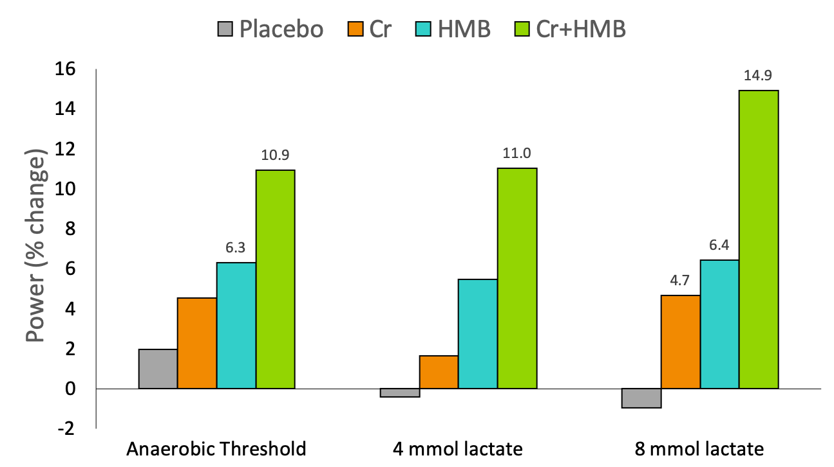
HMB + Creatine in the Sports Nutrition setting
28 elite male rowers (age 30 ± 5 y)
10 week supplementation:
Placebo
Creatine (0.04 g/kg/d)
HMB (3 g/d)
Creatine + HMB
Results:
✔️Significant increase in power generation at anaerobic
threshold in HMB and Cr+HMB
✔️Synergistic improvement in
power generation with Cr+HMB
at 8 mmol lactate
Notes:
(One study, 2 publications)
Fernández-Landa J et al.: Effect of Ten Weeks of Creatine Monohydrate Plus HMB Supplementation on Athletic Performance Tests in Elite Male Endurance Athletes. Nutrients. 2020, 12(1). pii: E193
The purpose of this study was to determine the effect of 10 weeks of creatine monohydrate + HMB supplementation on performance, exercise-induced muscle damage, and anabolic/catabolic hormones.
28 elite male rowers randomized into 4 groups (n=7/group): placebo (P), creatine (0.04g/kg/d), CaHMB (3 g/d), and Cr+CaHMB. Supplements were mixed into a recovery shake (1 g/kg CHO and 0.3 g/kg protein) after training or at bedtime on non-training days.
Measures: anaerobic power (incremental rowing test)
PL group lost muscle mass (1.8%) during the study while no other group did.
Power at anaerobic threshold increased significantly in the HMB and Cr+HMB groups (no significant differences between groups)
Cr, HMB, and Cr+HMB all increased power at 8 mmol lactate -- synergistic improvement observed with Cr+HMB (4.7 + 6.4 = 11.1 … but Cr+HMB = 14.9)
Synergistic benefit of Cr and HMB on anaerobic work performance

Slide 16
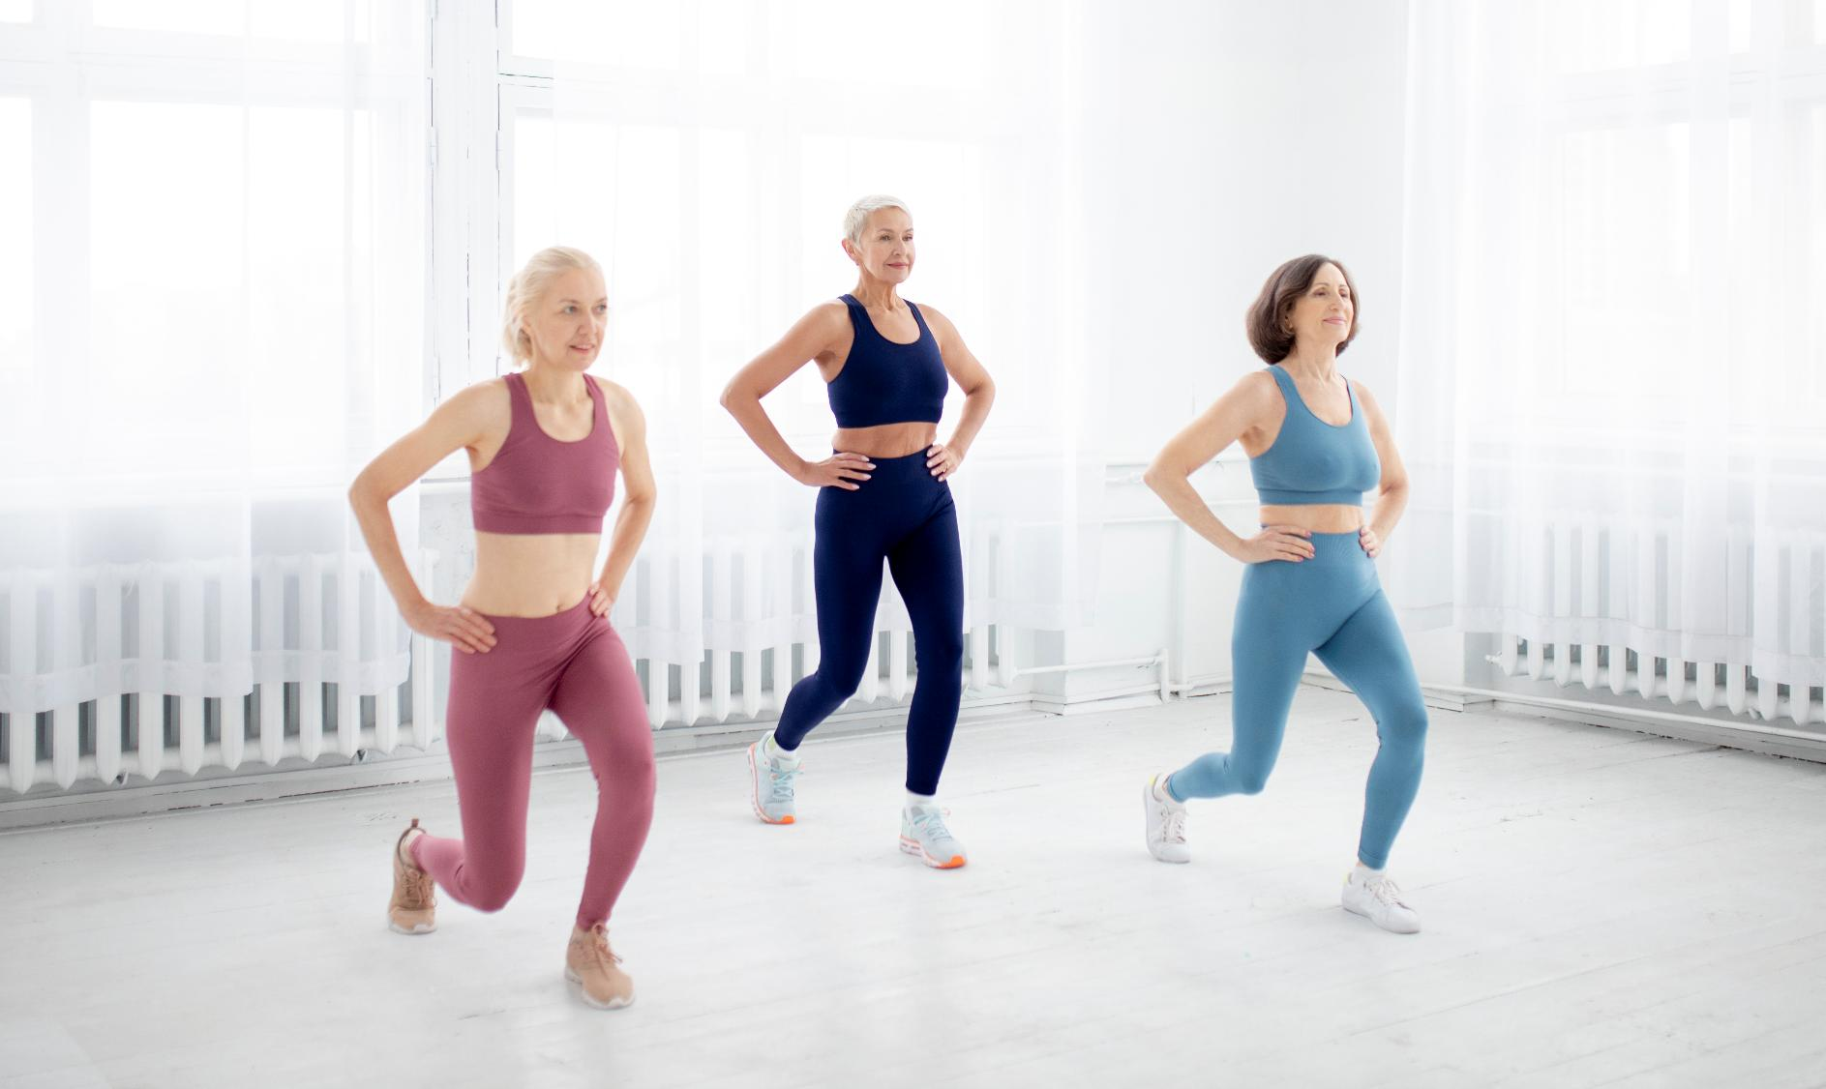
NEW HMB + Creatine Healthy Aging Study
Results:
The creatine + HMB phase produced significant improvements in functional strength, including: • Leg and back strength • Arm flexion strength • Upper-body muscular endurance • Core endurance
Randomized crossover trial in physically active older adults (~62 years)
Participants completed 6 weeks of creatine (3 g/day) + HMB (3 g/day) vs. placebo during a structured training program
Findings suggest creatine + HMB may enhance functional performance and everyday strength in aging adults beyond what training alone provides

Slide 17

HMB and Vitamin D A Synergistic Combination

Slide 18






HMB + Vitamin D Clinical Research Overview
Increased Muscle Strength
Multiple studies show that HMB + Vitamin D significantly improves muscle strength in older adults, even without exercise.
Reduced Muscle Fat (IMAT)
The combination of HMB + Vitamin D reduces intermuscular adipose tissue (IMAT), contributing to healthier, more functional muscles.
Enhanced Recovery
Post-surgery patients experienced faster recovery and increased mobility with HMB + Vitamin D supplementation.
Better Physical Function
HMB + Vitamin D enhances overall physical function, including handgrip strength, mobility, and the ability to perform daily activities.
Improved Lean Muscle Mass
HMB + Vitamin D helps increase lean muscle mass, particularly in sedentary individuals and older adults.
Synergistic Effect with Vitamin D
Vitamin D is necessary to maximize the muscle strength benefits of HMB, with greater improvements seen in individuals with sufficient Vitamin D levels.
Notes:
Explanation of the MOA behind vitamin D for muscle function is needed

Slide 19
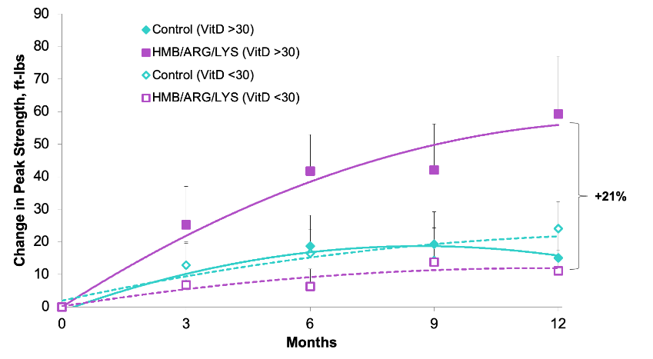
Improves strength gains in older adults with sufficient vitamin D levels
Vitamin D is necessary for strength gains with HMB in older adults
77 men and women ≥ 65y (avg. 77 y)
12-month study - testing at baseline 3, 6, 9, and 12 months
HMB (2-3 g/d) + arginine + lysine or isocaloric placebo
Separated by Vitamin D sufficiency (serum 25(OH)D level ± 30 ng/mL)
Results:
✔️HMB increased fat-free mass in both groups
✔️HMB only increased strength in
participants with adequate
Vitamin D status
Notes:
Fuller et al. Vitamin D Status Affects Strength Gains in Older Adults Supplemented With a Combination of b-Hydroxy-b-Methylbutyrate, Arginine, and Lysine: A Cohort Study. JPEN J Parenter Enteral Nutr 2011 35: 757
Retrospective analysis of Baier et al. study
77 elderly men and women were randomized to a year-long inverention with a nutritional supplement containing CaHMB (2-3 g/d, depending on weight), arginine, and lysine or an isocaloric placebo
Retrospective groups separated by “adequate Vitamin D status” -- sufficiency = serum 25(OH)D level of at least 30 ng/mL)
Strength (knee extension and knee flexion) assessed with BIODEX
Regardless of VitD status, the group receiving the nutritional supplement with HMB gained lean mass, while the group receiving the placebo supplement did not
Only the Vitamin D sufficient group gained strength (21% greater improvement compared to VitD insufficient group)
No effect of Vitamin D status in placebo group -- HMB + VitD = synergistic.

Slide 20
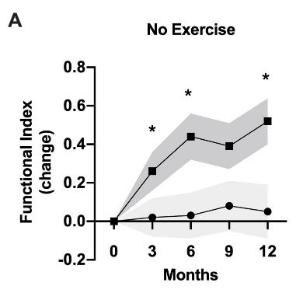
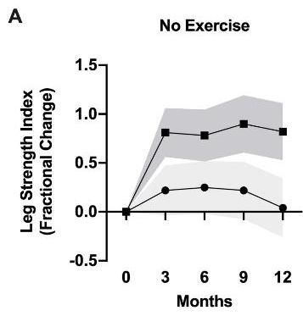

Improves physical function without exercise
HMB+D improves physical function
in non-exercising older adults
117 men and women ≥ 60y (avg. 69 y) with insufficient Vitamin D (15-30 ng/mL 25OHD)
12-month study - testing at baseline
3, 6, 9, and 12 months
HMB (3 g/d) + Vitamin D₃ or placebo ± moderate resistance exercise training
Results:
✔️ HMB+D supplementation increased
25OHD levels into sufficient range
✔️ HMB+D increased functional index and
tended to increase strength in
non-exercisers
Notes:
Journal of Gerontology – Biological Sciences
Functional Index = sum of changes in left and right handgrip, Get Up, and Get Up and Go
In non-exercisers, HMB+D supplementation resulted in a larger increase in functional index at 3 months and even greater benefits at 6 and 12 months
Similar patterns in each component of the functional index (Get Up, Get Up and Go, hand grip strength) (little to no improvement in non-exercising non-supplemented control group, improvement in HMB+D alone group and the exercise groups with or without HMB+D).
The functional index evaluated in the present study incorporates several tests used to evaluate deficits in common daily function. The largest relative improvement was observed for the Get Up test, which evaluates a common critical function (getting up from a chair), and its performance requires muscle strength, power, and balance.
Lower Composite Extremity Strength Index = [(left leg extension peak torque at 60°/sec + 90°/sec + 180°/sec) + (right leg extension peak torque at 60°/sec + 90°/sec + 180°/sec) + (left leg flexion peak torque at 60°/sec + 90°/sec + 180°/sec) + (right leg flexion peak torque at 60°/sec + 90°/sec + 180°/sec)].
HMB+D supplementation tended to improve lower extremity strength index values among non-exercisers at 3 months (p=0.10, d=0.45). This tendency persisted at 9 and 12 months (p=0.10 and 0.07, respectively).
Among non-exercisers, HMB+D supplemented participants maintained a similar improvement to that observed at 3 months (0.82 ± 0.29) throughout the year-long study while control participants remained near baseline values (0.04 ± 0.30, d=0.51)

Slide 21



Improves physical function without exercise
This study provides additional evidence that:
The benefits of HMB are fully realized in Vitamin D sufficiency
HMB can improve muscle health in populations with age-related muscle loss or other conditions where limited physical activity leads to functional decline
HMB+D improved and sustained physical function in healthy, non-exercising older adults.
HMB+D increased ”high activation” emotions (could be interpreted as feeling more energetic).
HMB+D may provide a unique protective effect on muscle strength and physical function in individuals unable or unwilling to exercise.
Individuals who are frail or have age-related muscle loss may experience even greater benefits of HMB+D given their lower baseline functional status.
Notes:
Journal of Gerontology – Biological Sciences
HMB+D supplementation was sufficient to improve physical function in healthy, non-exercising older adults and sustain function over at least 1 year
In addition to physical benefits, HMB+D increased ”high activation” emotions, as described by words such as Active, Aroused, Astonished, Stimulated, Surprised, Intense - which could be interpreted as feeling more energetic. This improvement in physical function likely reflects a greater functional reserve. An increase in functional reserve would lessen the relative effort of daily activities (e.g. climbing stairs, carrying groceries), which could result in feeling more energetic.
Combining HMB+D and moderate resistance training did not provide any further benefit over either exercise or HMB+D alone. Essentially, HMB supplementation and the prescribed exercise program had similar effects on functional improvement, but exercise did not enhance the effect of HMB, nor did HMB supplementation enhance the effects of exercise
Findings underscore the potent effects of supplementation with calcium HMB on improving functionality in non-exercising, healthy older adults with proven Vitamin D sufficiency and demonstrate the effectiveness of HMB independently of other amino acids previously included in older adult studies
These effects are primarily attributed to the benefits of HMB that are fully realized in Vitamin D sufficiency. Vitamin D supplementation alone does not improve muscle strength or power outcomes in older adults.
In summary, this study demonstrated the potential of long-term co-supplementation with calcium HMB and Vitamin D3 to enhance physical functionality in older adults, even in individuals not engaged in an exercise training program. While adequate nutrition and participation in resistance exercise training remain valuable for the maintenance of muscle strength, quality, and function, the combined supplementation with calcium HMB and Vitamin D3 may provide a unique protective effect for the substantial population of older adults who are unable or unwilling to exercise. We hypothesize that the benefits of HMB+D could be even more valuable in individuals with frailty or age-associated muscle loss given their lower baseline functional status and the fact that HMB has been previously shown to have substantial benefits on muscle health in these situations.

Slide 22


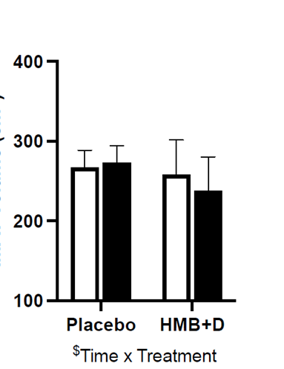
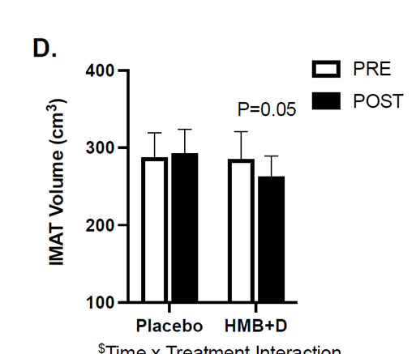
Decreased intermuscular adipose tissue (IMAT) independent of exercise
43 healthy women; age 45-60 y
12 wk study, HMB (3g/d)+ vitamin D3 or placebo
Randomized to HMB (3g/d)+ vitamin D3 or placebo
Randomized to exercise protocol or sedentary behavior
Approximately 10 subjects per group
Results:
✔️ HMB and Vitamin D decreased
IMAT
✔️ HMB and Vitamin D increased
leg muscle mass in sedentary
subjects
Notes:
Konopka, A.R. et al. Small-Scale Randomized Controlled Trial to Explore the Impact of Beta-Hydroxy-Beta-Methylbutyrate Plus Vitamin D3 on Skeletal Muscle Health in Middle Aged Women. Nutrients 14, https://doi.org/10.3390/nu14214674 (2022).
Tested the hypothesis that combining HMB plus Vitamin D3 (HMB + D) supplementation would improve skeletal muscle size, composition, and function in middle-aged women
Randomized to take placebo or HMB + D (3 g Calcium HMB + 2000 IU D per day) during 12 weeks of sedentary behavior (SED) or resistance exercise training (RET)
Results show that the SED placebo group decreased lean arm mass while HMB + D supplementation did not.
HMB + D supplementation may have spared muscle loss specific to the arms during 12-weeks of sedentary behavior
Overall, this study provides initial data to suggest that HMB + D supplementation may be beneficial in middle aged women to maintain or prevent the loss of muscle mass.
HMB + D decreased IMAT independent of exercise status and may prevent the loss or increase muscle size in a small cohort of sedentary middle-aged women.

Slide 23

The best supplements are the ones people take every day.
Consistency matters more than novelty. Enjoyable formats drive long-term use.

Slide 24
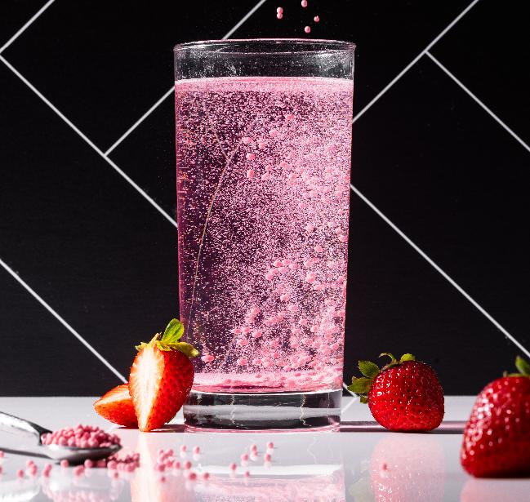
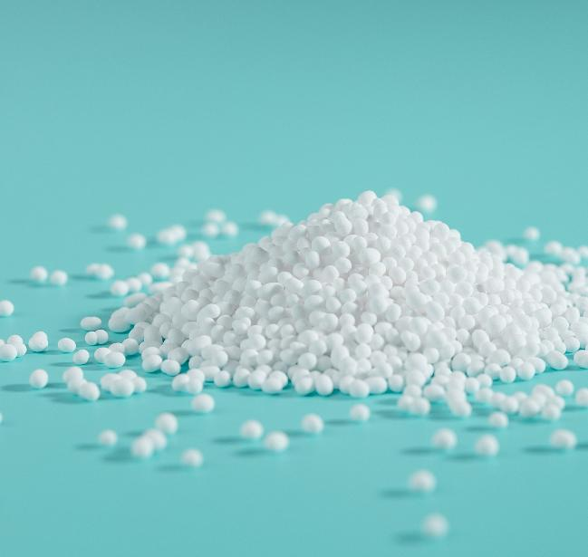
Supplements That Fit Active Aging
What works in Sports Nutrition will not automatically work for Active Aging
Aging adults interact with supplements differently from athletes
Big scoops, gritty textures, and boring tubs don’t translate to this demographic
Compliance drives outcomes
The best ingredients only work when taken consistently
Taste, texture, preparation time, and convenience strongly influence adherence in older adults
Enjoyable formats lead to long-term use — tolerated formats do not
Notes:
The best ingredients and formulations only work when taken consistently

Slide 25
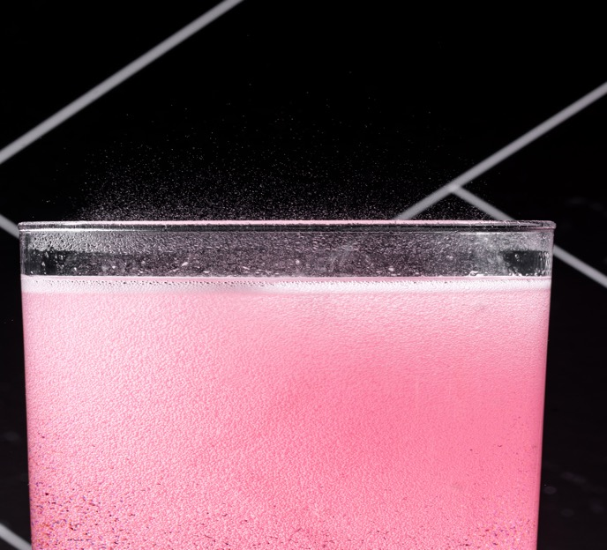
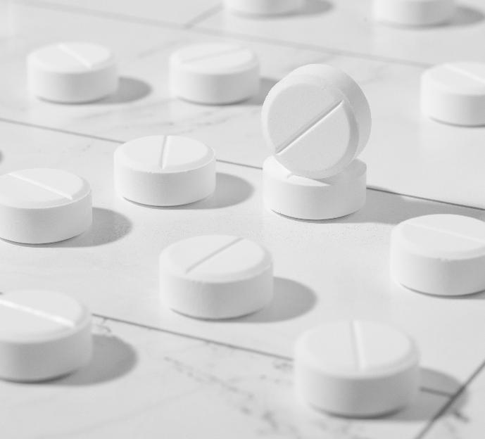
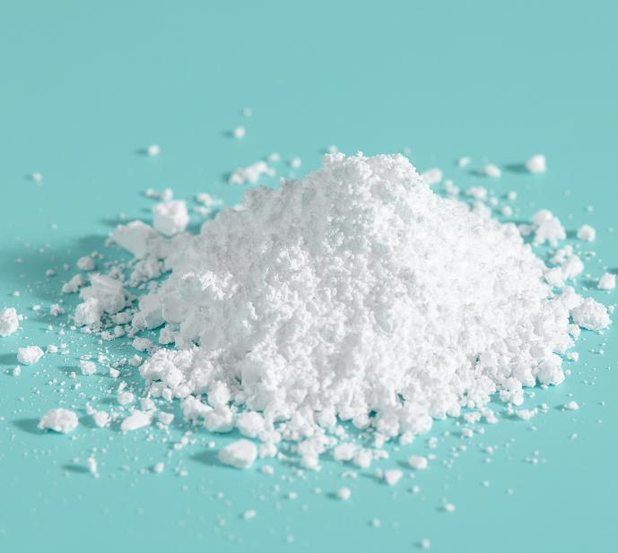
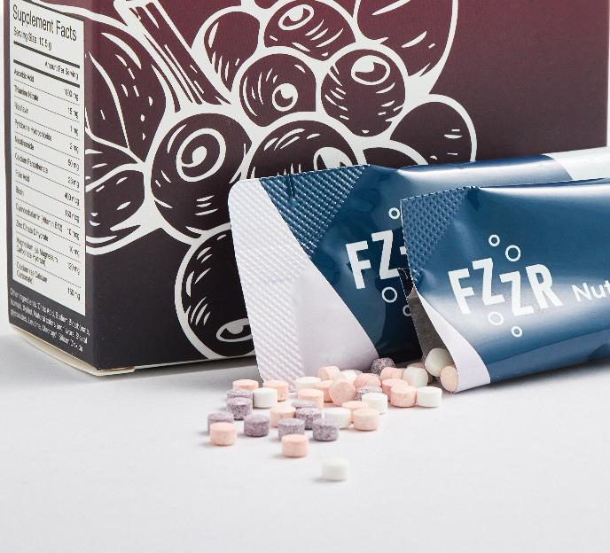
Goal: Create products they love, not ones they tolerate
Effervescents
Pleasant, low-effort,
familiar from
electrolytes/multivitamins
Chewables
Convenient, enjoyable,
quick & portable
Light Powders
Dissolve cleanly &
quickly, no shaker
bottles required
Stick Packs
Multiple actives, intuitive, single-serve

Slide 26










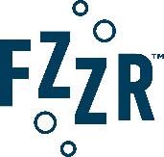

Co-Creating Innovative Active Aging Solutions with Our Brands

Slide 27
THANK YOU! Questions?

