Slide 1
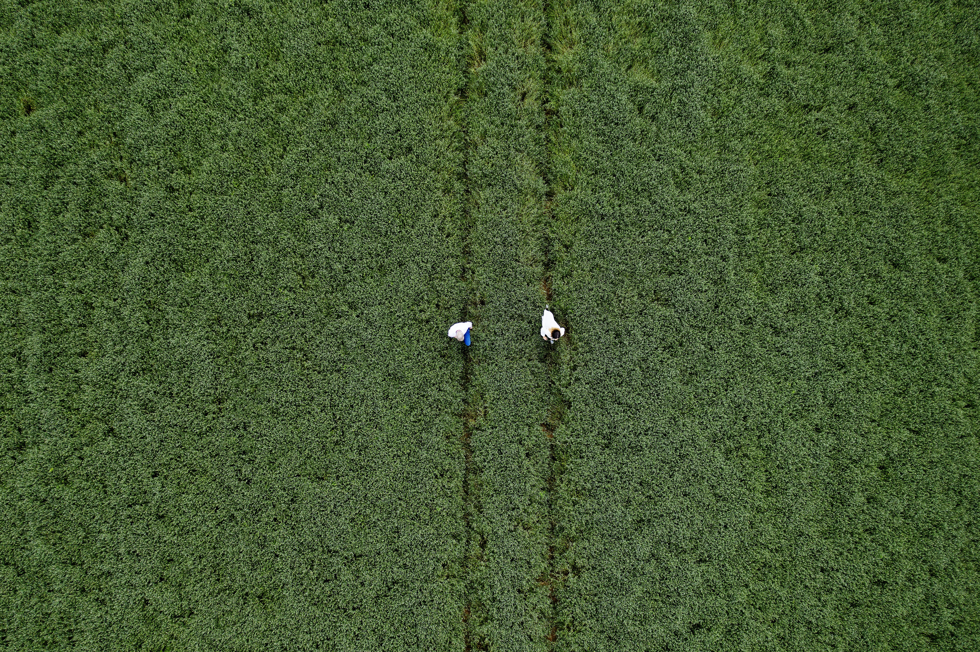
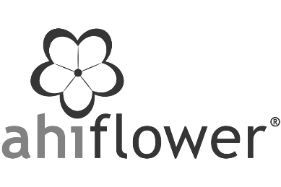

Effective Plant-based Omegas For A Vital Healthspan
Did someone say 'Pro-Aging'?
With Dr. Sue Kleiner,
PhD RD FACN CNS-E FISSN

Slide 2

Culture has shifted
Anti-Aging
Pro-Aging
At the same time, how people take care of their bodies has shifted
Reactive
Throwing in the kitchen sink
Proactive
Foundationally supporting the body’s systems, naturally

Slide 3
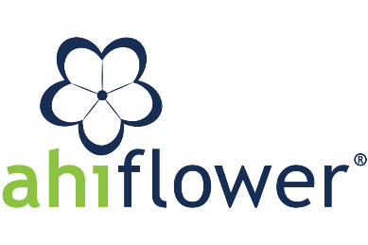
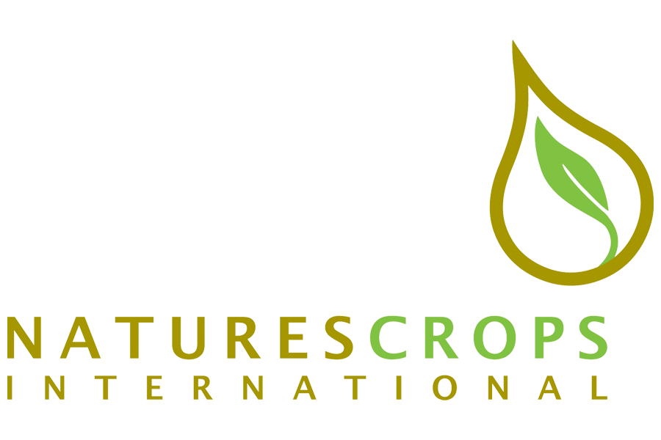
Inflammaging: Opposite of a vital healthspan
Chronic & unchecked inflammation is a root of healthspan-denying diseases:
Obesity & Diabetes
Arthritis
Cancer
Depression/anxiety disorders
Asthma
Coronary diseases
Multiple sclerosis
Alzheimer’s & Parkinson’s
Anti-inflammatory ingredients: What role can plant-based omegas play in assuring a vital and active healthspan?
Pietrobon JA (2020) Front. Immunol v11 doi.org/10.3389/fimmu.2020.579220
Perlmutter D (2015) Brain Maker (Little, Brown & Co), 1st ed. p. 47.

Slide 4
Key omegas come from plants and fish/algae
🌿
🌿
🐟
🌿
ALA (alpha-linolenic acid) | SDA (stearidonic acid) | EPA & DHA (eicosapentaenoic & docosahexaenoic acid) | GLA (gamma-linolenic acid)
The only biologically essential omega-3 Every cell in our bodies requires ALA to function healthfully We must get ALA from our diets → nuts, seeds, leafy greens, etc. | All humans make SDA from ALA as an intermediary step to making EPA and DHA SDA has 8-10x better conversion efficiency to EPA than ALA | Long chain omega-3 fatty acids derived from ALA & SDA Produce anti-inflammatory compounds that reduce chronic inflammation, support heart health, enhance brain, eye, nervous system structure, support mood and well-being | An unusual ANTI-inflammatory omega-6 fatty acid with skin and hormonal balance activity.
🌿= primarily plant-based 🐟 = primarily marine/algal-based

Slide 5
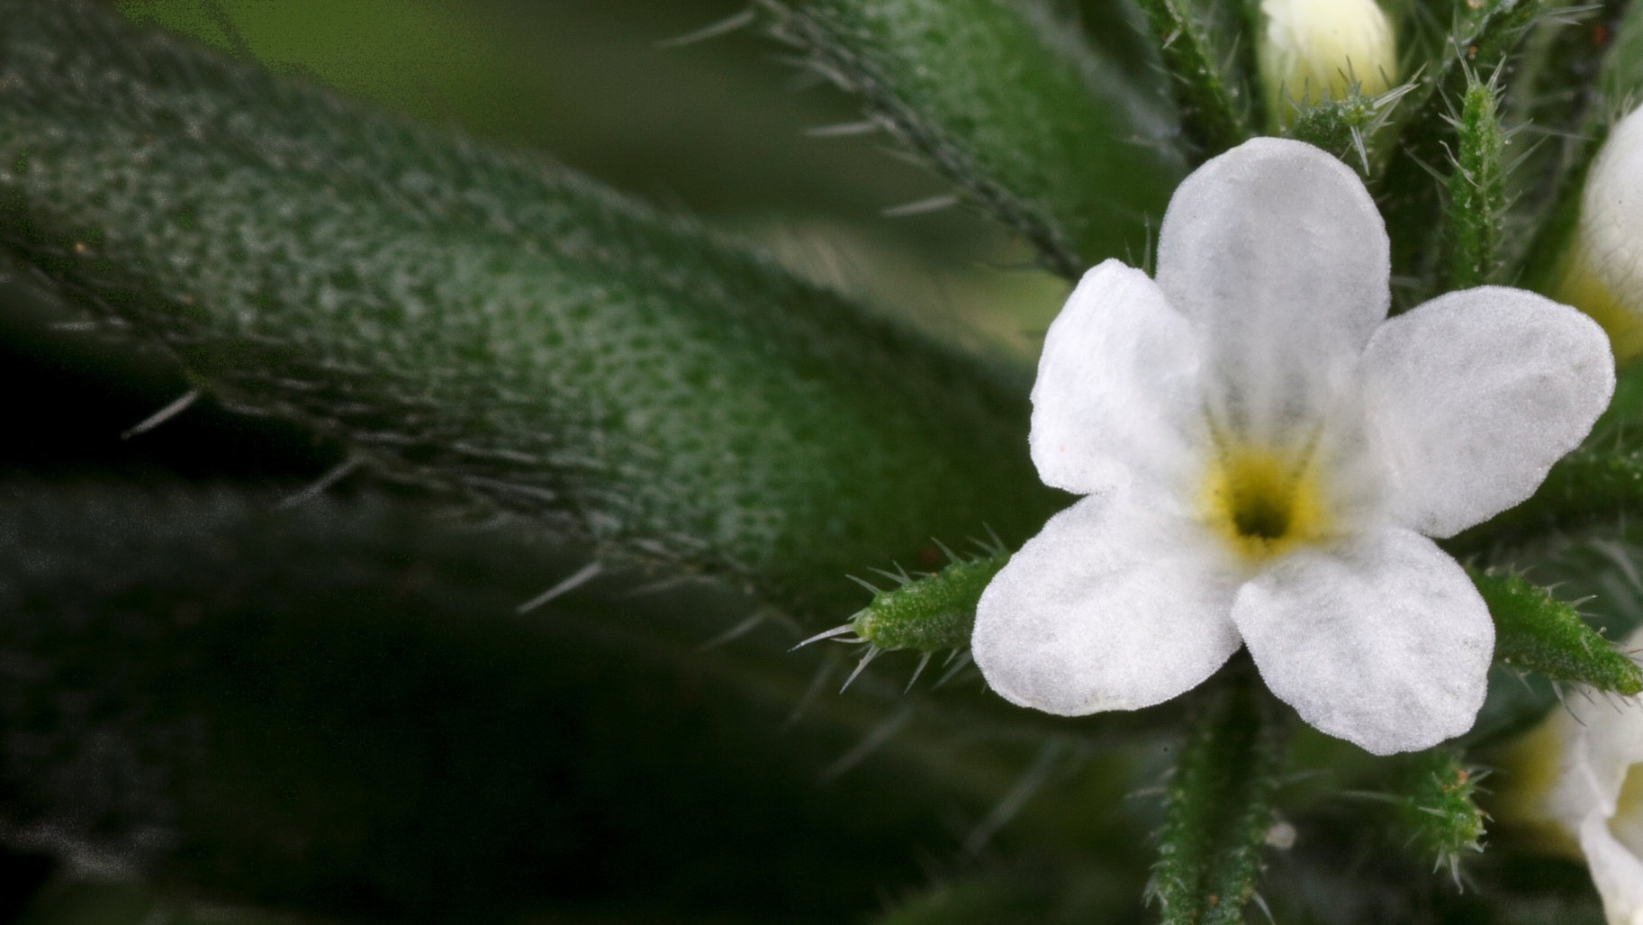
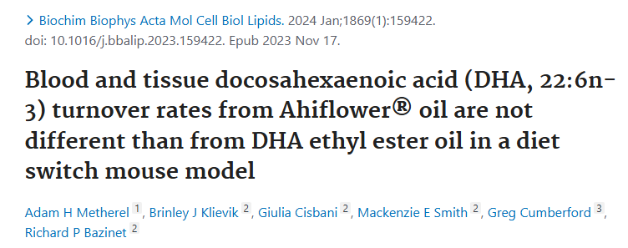
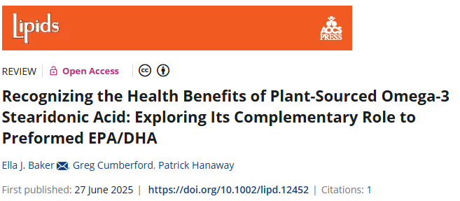

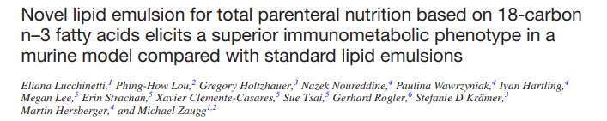
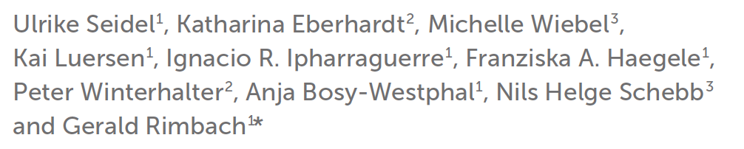





Ahiflower: Nature’s richest source of omega-3, PLUS GLA
Over ten years of research and clinical trials (so far!)…
4
15
Clinical trials:
human
animal
Ahiflower
(Buglossoides arvensis)

Slide 6

Breakthrough science on plant-based omegas has proven old thinking wrong
What we thought
What we have learned
We can’t make enough EPA and DHA in our bodies from ALA to meet the body’s needs to fight inflammaging, so we need to supplement with pre-formed EPA & DHA.
There is a step in-between: when there is enough ALA+SDA available, our bodies make EPA & DHA to meet its needs, comparably to when we supplement with it.
Metherel AH (2024) BBA - Molecular and Cell Biology of Lipids 1869, 159422. DOI: 10.1016/j.bbalip.2023.159422
Metherel et al (2024) J Lipid Res 65(6) 100548. DOI: 10.1016/j.jlr.2024.100548
Rotarescu et al (2024) J Nutr Biochem 131:109689 DOI: 10.1016/j.jnutbio.2024.109689
Seidel et al (2024) Front Nutr 11:1359958. DOI: 10.3389/fnut.2024.1359958

Slide 7

In addition, marine omega-3 sources can’t meet global recommendations sustainably
Sustainability factors of marine derived EPA and DHA have been a catalyst for researchers digging deeper into how plant-based omegas can impact inflammation, metabolic pathways and clinical outcomes.

Slide 8
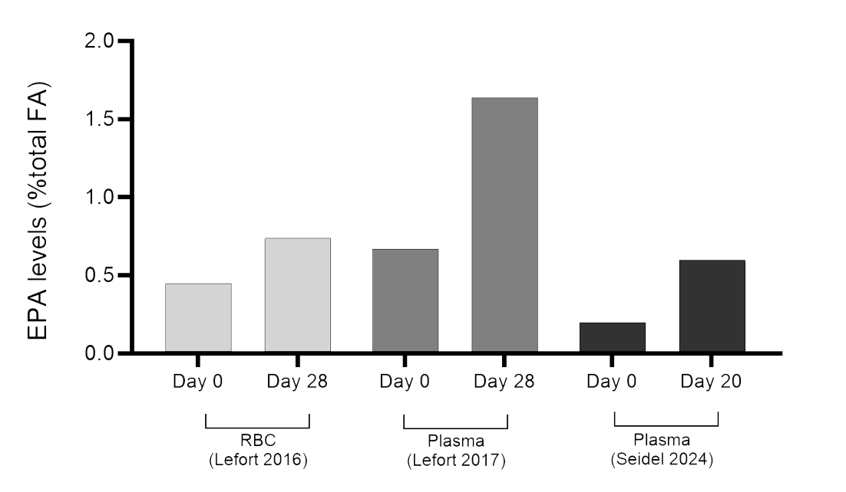
EPA — Long-recognized anti-inflammatory omega-3
Ahiflower consistently and effectively raises EPA in red blood cell and plasma EPA levels in humans
+64% RBC EPA in only 28 days, raising omega-3 index
Tripled plasma EPA levels in 20 days despite high background LA in healthy young males (Seidel 2024).
EPA supports the reduction of androgens by modulating insulin sensitivity and luteinizing hormone (LH) — beneficial for PCOS support (Li 2020 & Raja-Khan 2014)
Li S et al. The effect of marine-based n-3 PUFAs supplementation on metabolic and inflammatory markers in patients with polycystic ovary syndrome: a systematic review and meta-analysis of randomized controlled trials. Nutr Metab Cardiovasc Dis. 2020;30(8):1313-1323
Raja-Khan N et al. Pilot study of dietary omega-3 fatty acid supplementation in overweight and obese women with polycystic ovary syndrome. Reprod Biomed Online. 2014;28(5):684-690.
Lefort (2016) J Nutr Sci 5:e2;1-12
Lefort (2017) Nutrients 9:261; 1-17
Seidel (2024) Front. Nutr. 11:1359958.

Slide 9
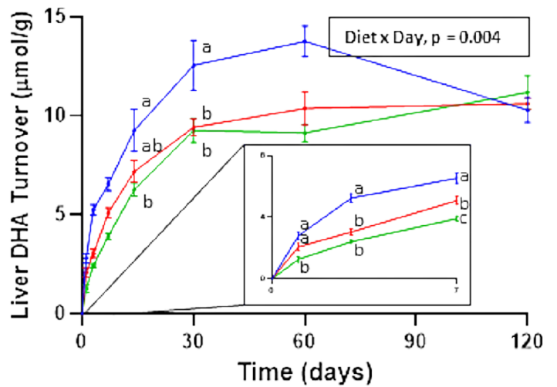
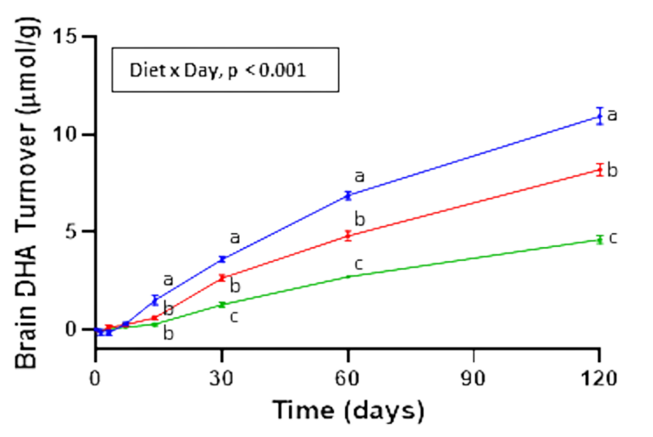
DHA — Ahiflower converts to new DHA in liver and brain comparably to fish-based DHA
Liver (Mice)
Brain (Mice)
DHA turnover in tissues reflects dynamic demand. SDA makes all the difference.
“The distinct Ahiflower n-3 PUFA composition could support tissue DHA needs at a similar rate to dietary DHA, making it a unique plant-based dietary option for maintaining DHA turnover.”
— Adam Metherel, Assistant Professor
Metherel A (2024) BBA – Mol Cell Bio Lipids 1869, 159422. https://doi.org/10.1016/j.bbalip.2023.159422

Slide 10
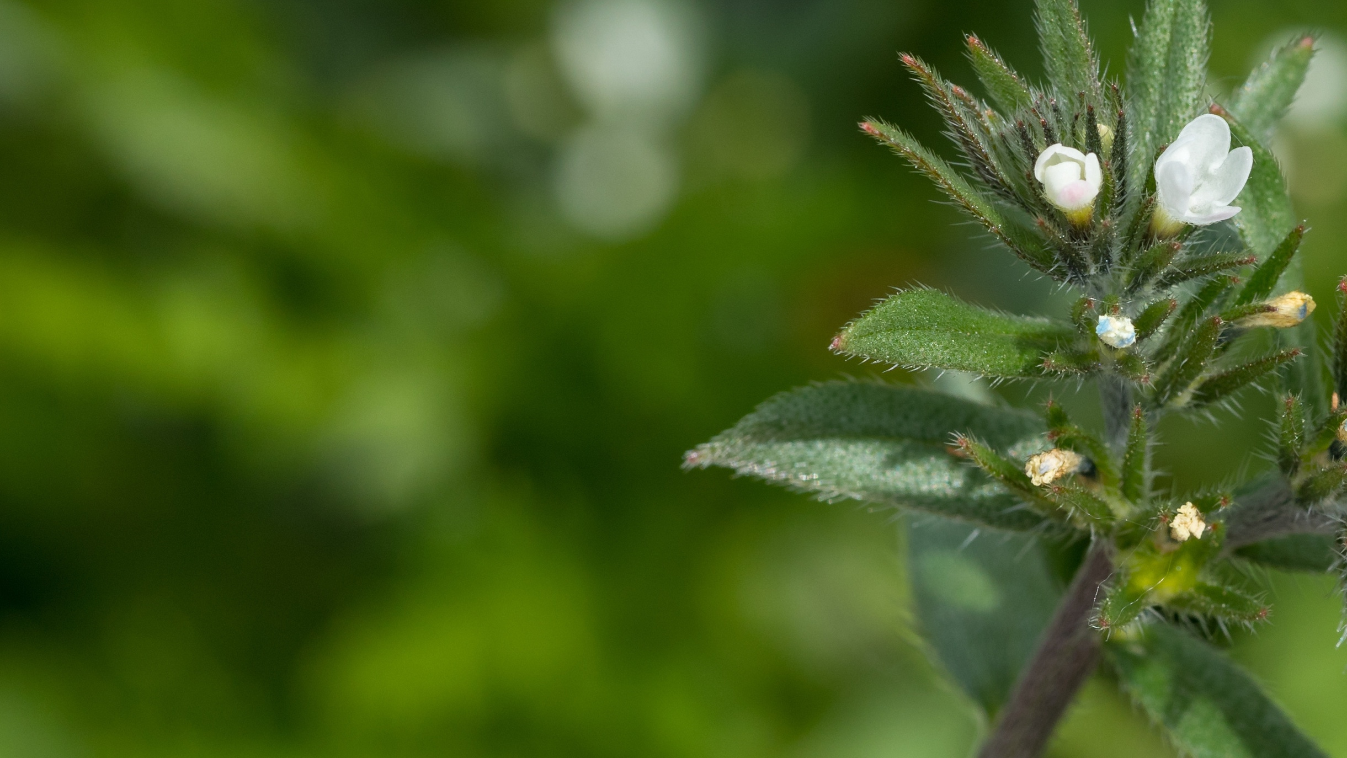
Ahiflower’s unique and balanced fatty acid profile sets it apart among plant-based omega-3 sources.
Let’s dive a little deeper.
What is Ahiflower’s latest evidence — factors to support healthy, active aging?

Slide 11
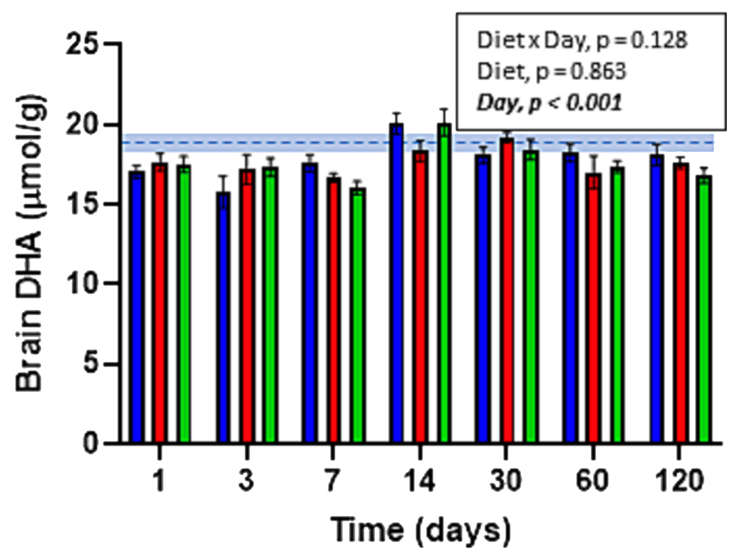
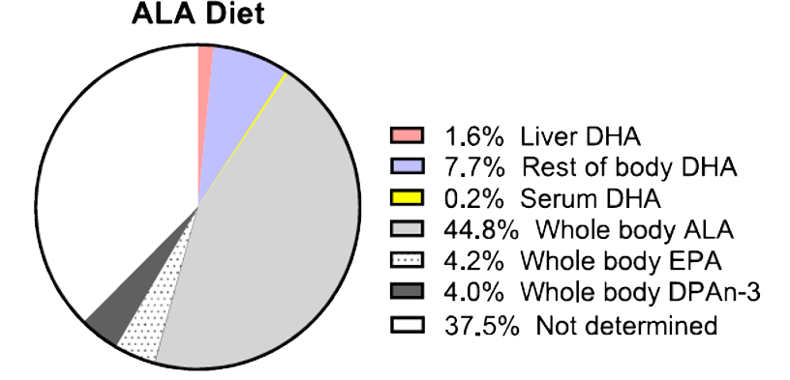
Ahiflower ALA & SDA = Healthy whole body DHA
High ALA and SDA sources maintain brain DHA levels in mice comparably to pure marine DHA at the same levels (isomolar PUFA intakes).
Whole body ALA—>DHA formation is up to 48x higher in mammals than from serum measures.
Only 0.2% in serum but 9.5% across whole body
Shows efficient, self-regulating DHA production, using adipose and liver pools from ALA & SDA to maintain brain and other key tissue DHA levels, not captured by the Omega-3 Index.
Metherel AH (2024) BBA - Molecular and Cell Biology of Lipids 1869, 159422. DOI: 10.1016/j.bbalip.2023.159422
Metherel et al (2024) J Lipid Res 65(6) 100548. DOI: 10.1016/j.jlr.2024.100548
Rotarescu et al (2024) J Nutr Biochem 131:109689 DOI: 10.1016/j.jnutbio.2024.109689

Slide 12
Important clinical implications to the Omega-3 Index
When we do not consume preformed DHA, Omega-3 Index levels may be low.
When the body is using its own pathways from ALA and SDA to EPA and DHA, the relevant measures are in the body tissues and organs instead of the blood, which we now believe is an overflow measure of DHA predominantly—not a meaningful functional measure of EPA and DHA.
This is important because the Omega 3 Index—the medical and industry standard—measures red blood cell values, not key tissues and organs directly.
Reminder: Whole body ALA—>DHA formation is up to 48x higher in mammals than from serum measures.

Slide 13
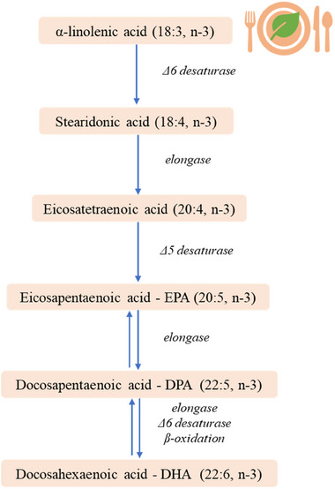

Dietary preformed DHA inhibits or suppresses the body’s natural synthesis of DHA
Dietary preformed DHA inhibits or suppresses the body’s natural synthesis of DHA, effectively shutting down our natural ALA>SDA>EPA>DHA pathway and reducing its natural anti-inflammatory capacity.
Plant-based omega-3 sources avoid this.
Preformed DHA inhibits natural anti-inflammatory signaling pathways
Preformed DHA inhibits EPA to DHA pathway
Image: Bodur M, Yilmaz B, Ağagündüz D, Ozogul Y. Mol Nutr Food Res. 2025 May;69(10):e202400752. doi: 10.1002/mnfr.202400752. Epub 2025 Mar 30. PMID: 40159804; PMCID: PMC12087734.
Metherel et al (2024) J Lipid Res 65(6) 100548. DOI: 10.1016/j.jlr.2024.100548

Slide 14

Why does this matter for Pro-Aging?
Chronic systemic inflammation is at the root of diseases that impair healthspan
How else can plant-based omega sources support Pro-Aging?

Slide 15
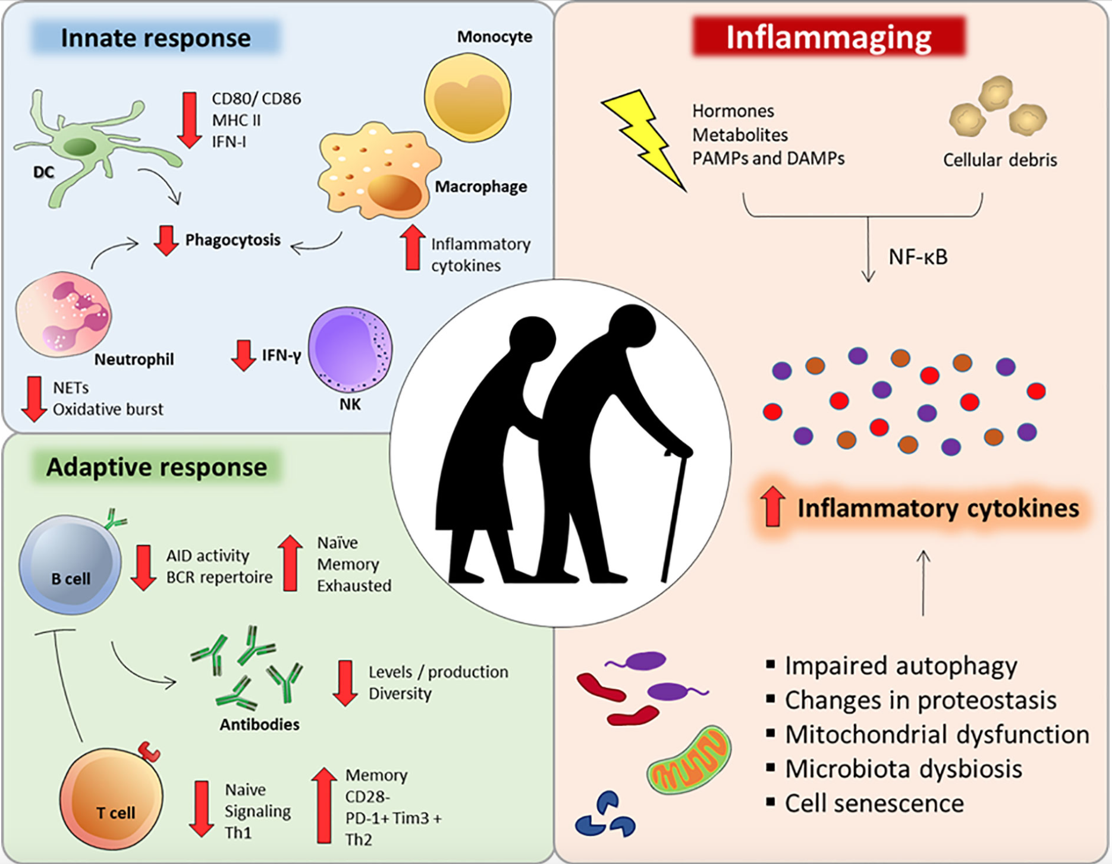
Inflammaging: How do we see it?
Inflammatory markers
Clinical outcomes
Pietrobon JA (2020) Front. Immunol v11 doi.org/10.3389/fimmu.2020.579220Perlmutter D (2015) Brain Maker (Little, Brown & Co), 1st ed. p. 47.3 / 1867%

Slide 16
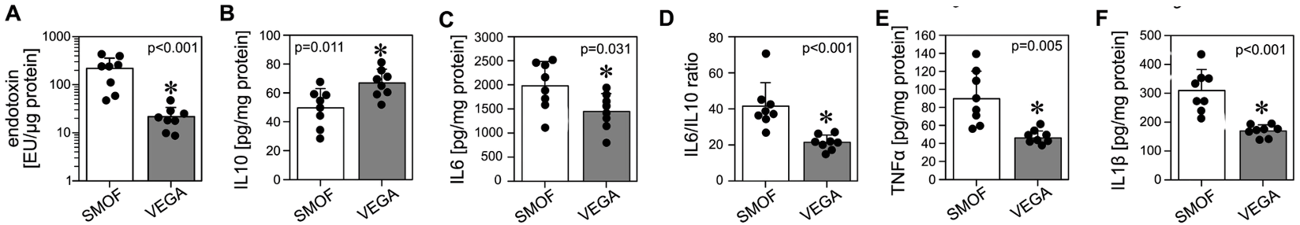
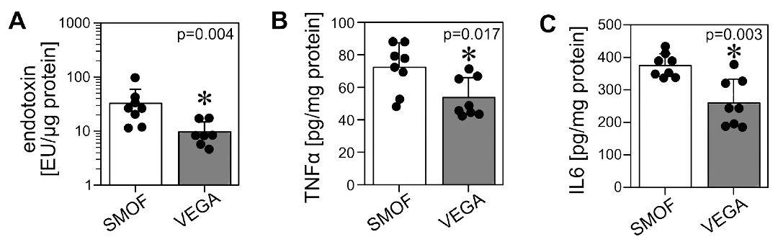
Ahiflower alone improves all inflammatory markers
Parenteral nutrition emulsions: Ahiflower vs fish-based lipid emulsion (SMOF)
Lower endotoxin, IL-6, TNF𝛂, IL-1β, and higher IL-10 in key tissues vs fish/soya. Ahiflower alone improved inflammatory markers.
A-F. Pancreatic protection with significantly lower endotoxin and inflammatory markers.
Ahiflower promotes less pancreatic and brain endotoxemia and a less inflammatory cytokine profile than SMOF.
A-C. Brain protection with significantly lower brain endotoxin and inflammatory markers.
Ahiflower (Vegaven) vs fish based (SMOF) lipid emulsions in neonatal piglets (parenteral nutrition).
Lucchinetti et al (2024) J Nutr doi.org/10.1016/j.tjnut.2024.10.047

Slide 17
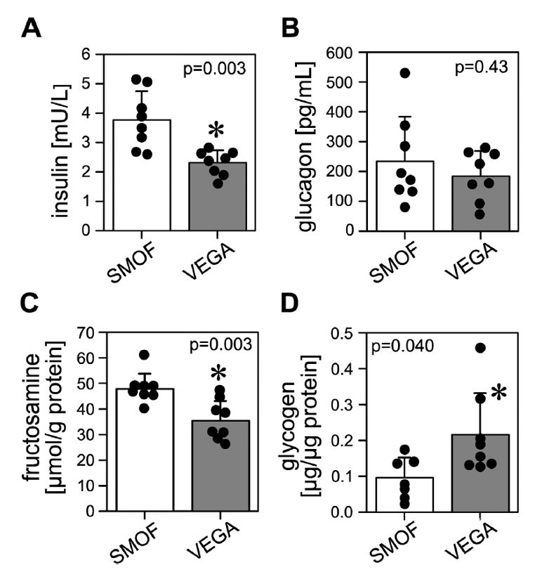
Ahiflower improves clinical outcomes
Parenteral nutrition emulsions: Ahiflower vs fish-based lipid emulsion (SMOF)
Enhanced glucose metabolism (short and long-term)
Glycogen storage
Improved insulin sensitivity
“…the findings suggest anti-inflammatory, immune supporting, insulin sensitizing, and hepato-protective effects of the Ahiflower emulsion relative to the comparator(s). These effects are all clinically relevant.”
— Calder PC 2024 J Nutr doi.org/10.1016/j.tjnut.2024.12.015
Lucchinetti et al (2024) J Nutr doi.org/10.1016/j.tjnut.2024.10.047

Slide 18
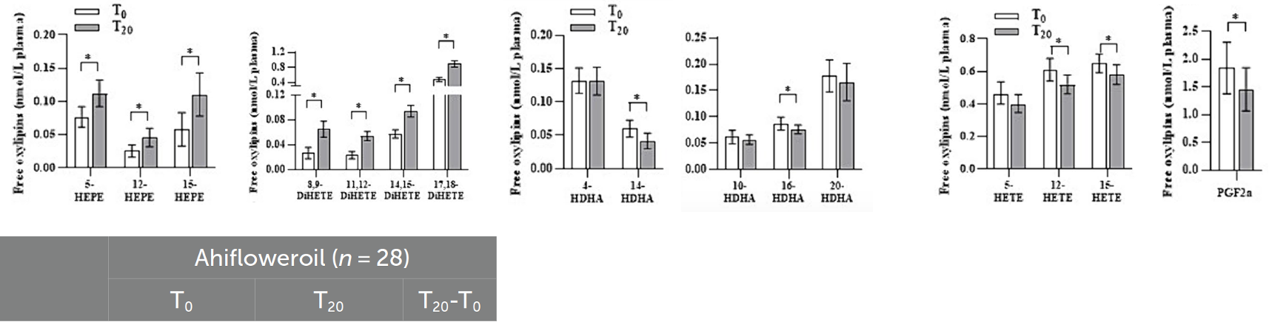
Ahiflower shifted human inflammation status favorably in just 20 days
Ahiflower raised ‘good’ HDL cholesterol and tripled plasma EPA.
“Plant-derived Ahiflower efficiently increases plasma EPA and corresponding eicosanoids and causes a distinct shift in the entire oxylipin pattern.”
—Seidel et al (2024) Front. Nutr. 11:1359958
Omega-3 EPAoxl UP
Omega-3 DHAoxl MAINT
Omega-6 ARAoxl DOWN

Slide 19
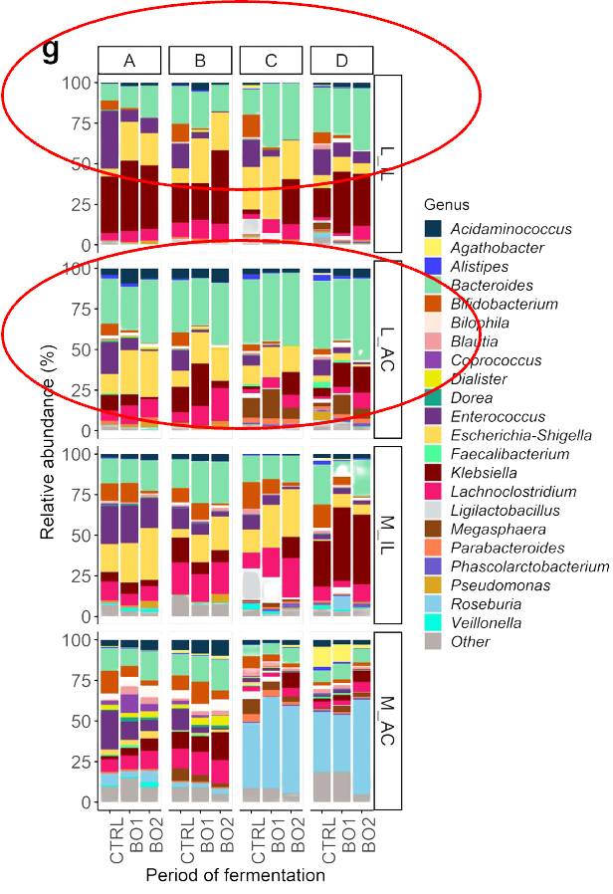
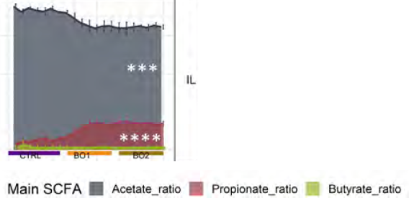
Discovery: SDA-rich Ahiflower is a prebiotic!
Bacteroides up, Clostridia down over time course (M-SHIME)
Ahiflower meets ‘prebiotic’ criteria: feeding healthy gut colonies to calm inflammation. A first for plant-based omega-3 rich dietary oils.
Bacteroides-driven increase in SCFA propionate and maintenance of butyrate.
Key to improving gut barrier integrity.
Roussel et al (2024) Gut Microbes 16:1, 2335879.

Slide 20
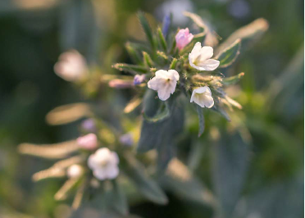


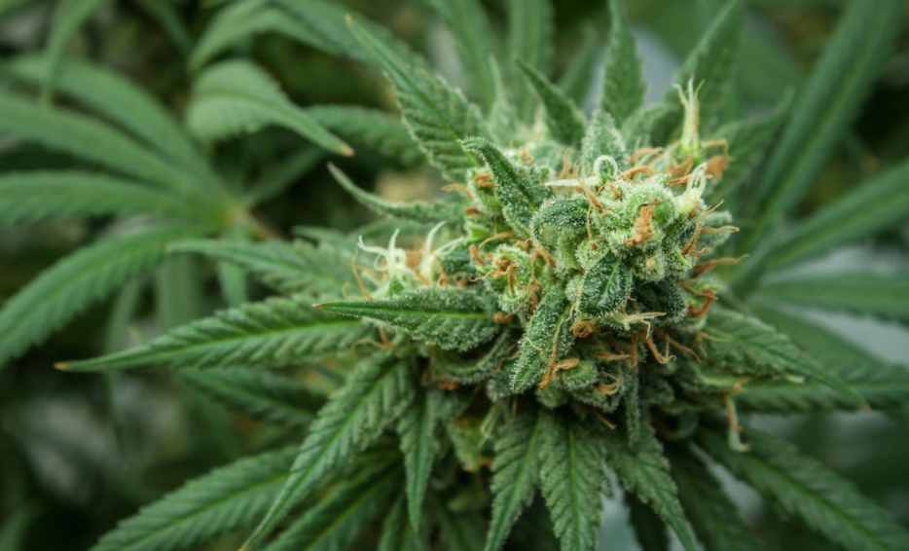
Coming back to GLA…
Ahiflower has uniquely rich ALA + SDA + GLA levels:
Key plant-based ALA/SDA/GLA sources:
 | Omega-3 |  | Omega-6
 | ALA | SDA | GLA | LA
Ahiflower | 45% | 20% | 6% | 12%
Chia Seed | 61% | 0% | 0% | 18%
Flax Seed | 57% | 0% | 0% | 14%
Hemp Seed | 20% | 2% | 3% | 50%
SDA is why Ahiflower raises EPA in humans up to 4x better than flaxseed.
GLA benefits
skin health
cardiovascular support
hormonal balance
nerve health
Ahiflower
Chia
Flax
Hemp

Slide 21

‘Pro-Agers’ get ‘look well, move well, feel well’ benefits with Ahiflower
Ahiflower…
Supports whole-body anti-inflammatory status for
✧ exercise recovery ✧ better mobility ✧ overall wellness
Provides prebiotic gut microbiome balancing and gut barrier protection benefits for
✧ overall gut wellness ✧ digestive comfort
Demonstrate distinct gut-liver-brain axis protection, hormone balancing, and insulin sensitizing effects for
✧ better mood ✧ focus ✧ glucose control
… all from a sustainable, traceable, and clean-tasting plant-based omega source you can trust.

Slide 22



Ahiflower and other plant-based omega sources hold important nutritional keys to healthy, active aging
Did someone say ‘pro-aging’? 😉
Thank you!
Susan M. Kleiner,
PhD RD FACN CNS-E FISSN
High Performance Nutrition® LLC
www.drskleiner.com
For further discussion:
Greg Cumberford
Head of Science & Regulatory at Natures Crops International
gcumberford@naturescrops.com

