Slide 1

for Brain Health and Cognitive Aging
Magtein for Brain Health and Brain Cognitive Longevity
Jennifer Gu, PhD
Senior VP of R&D, Threotech, California, USA

Slide 2
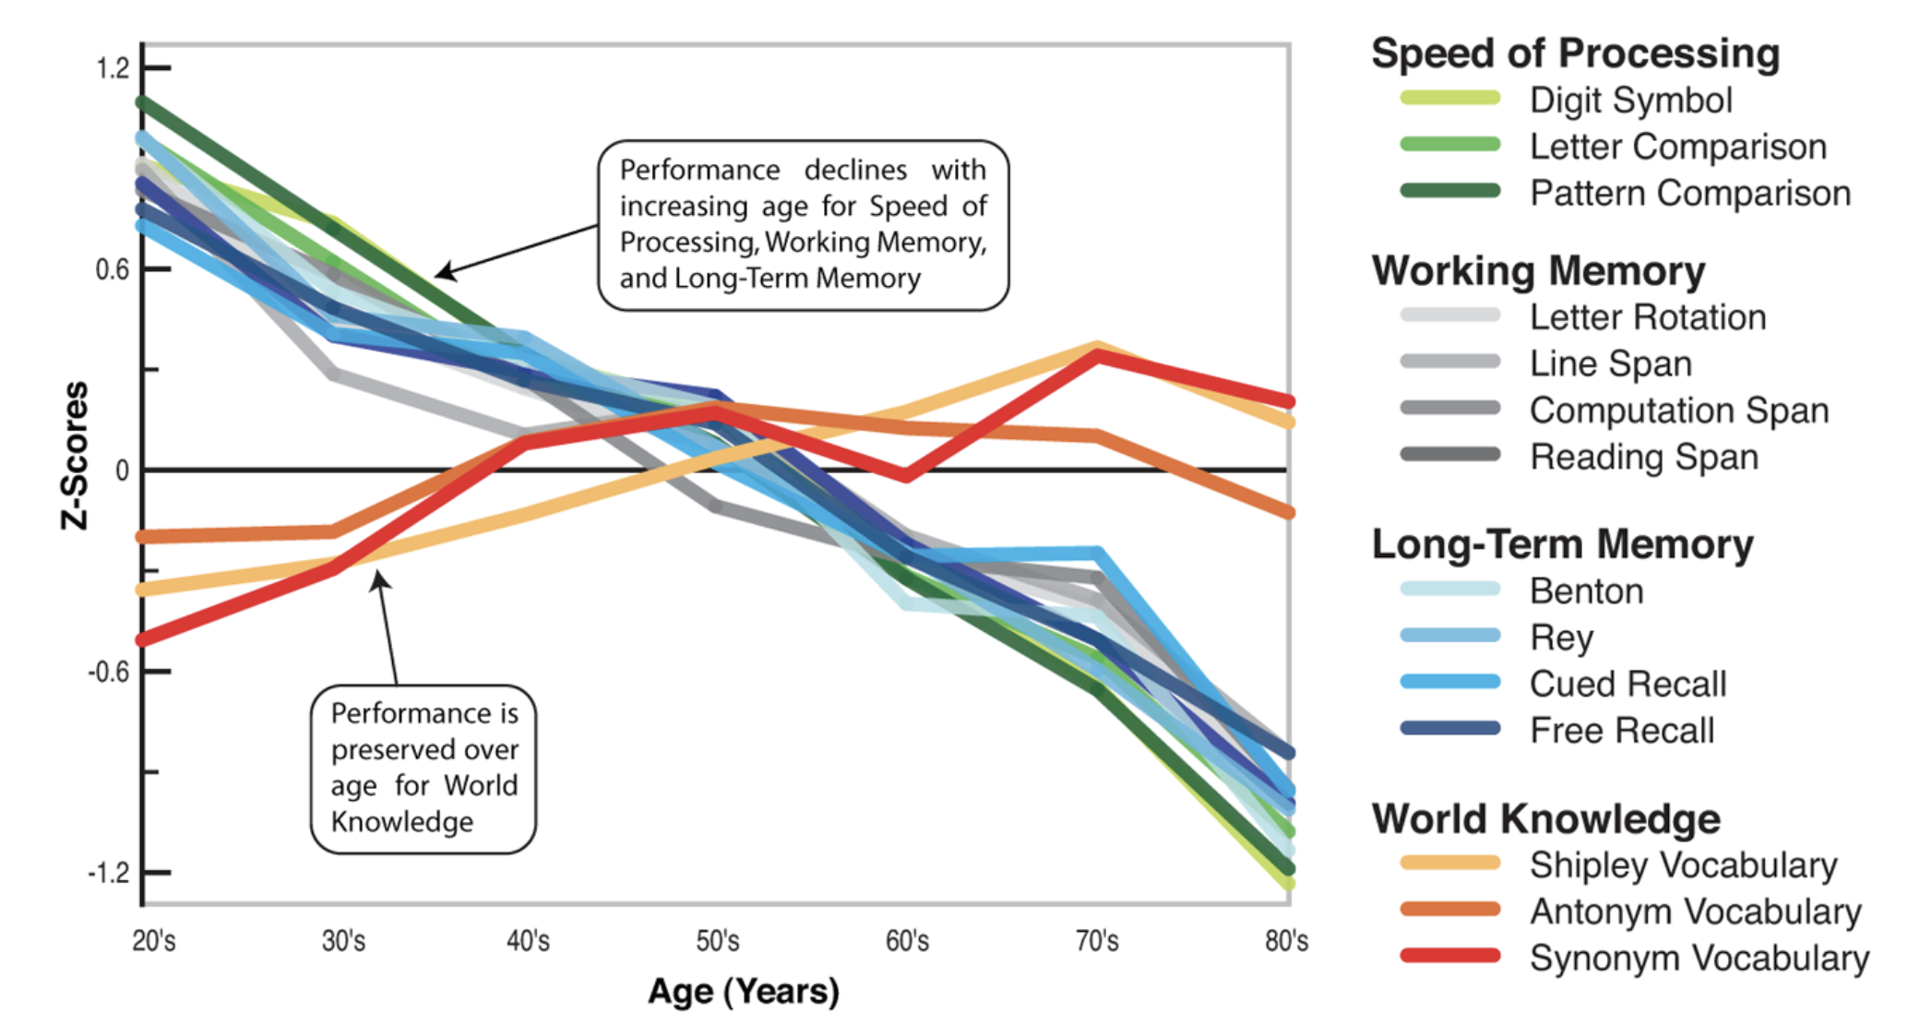
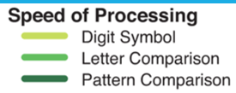
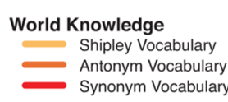
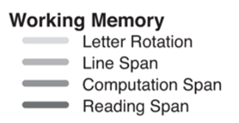
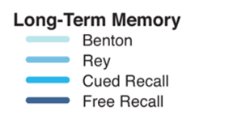
Decline of Cognitive Abilities with Ageing
Global life expectancy at birth increased from 46 years in 1950 to over 70 years in 2023.
By 2050, it is estimated that there will be more than 2.1 billion people aged 60 and over, representing over 21% of the global population.
It has been reported that up to 42% of the population aged over 60 are affected by mild cognitive impairment (MCI) worldwide.
Early interventions can help slow age-related declines.
Park DC, Reuter Lorenz P. 2009

Slide 3
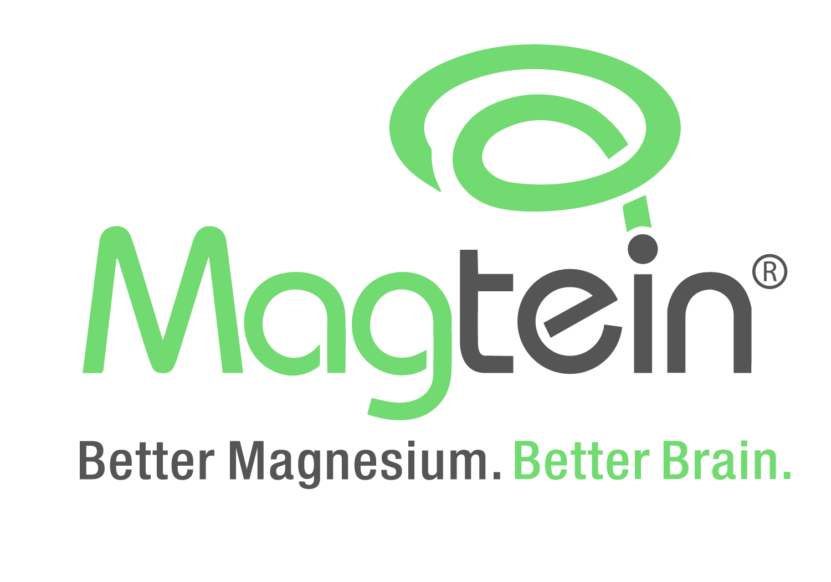
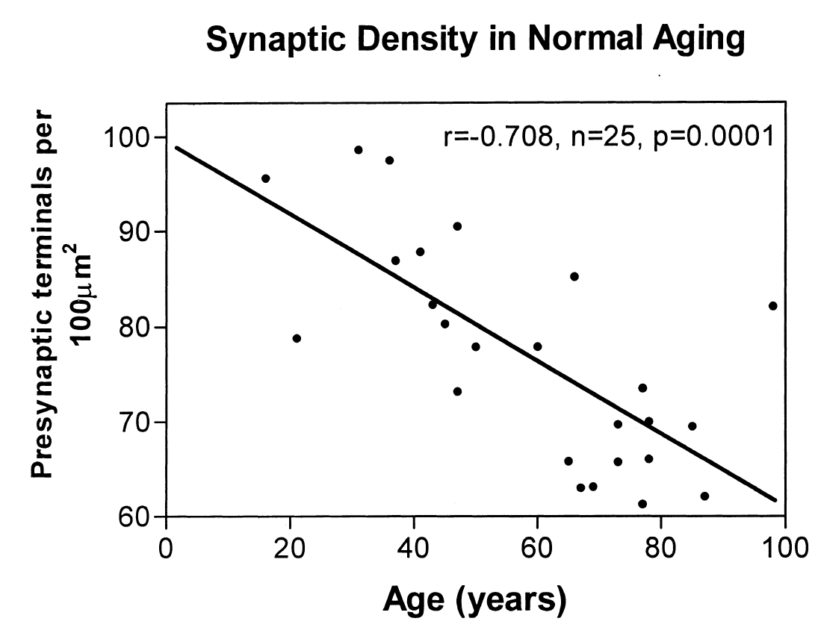
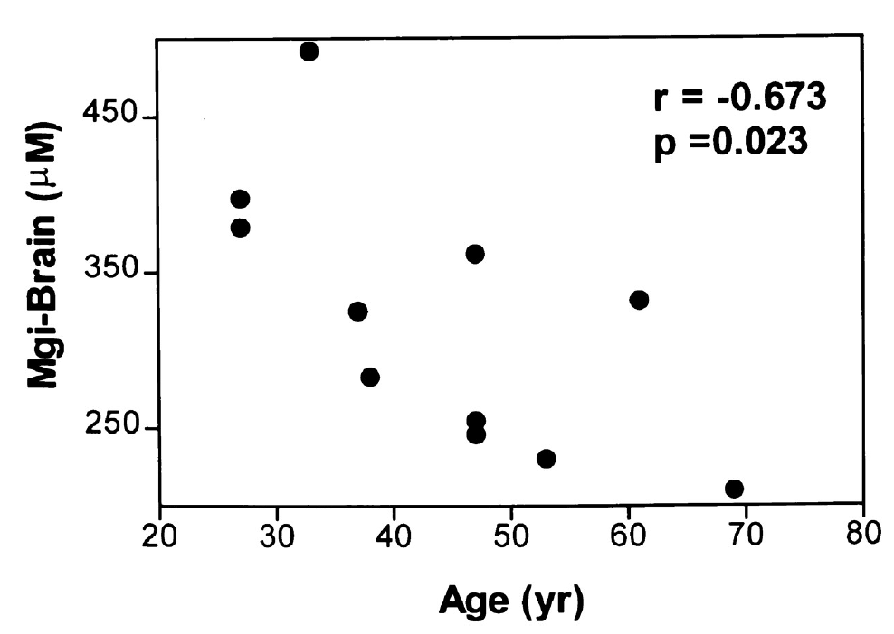
Brain Cognitive Aging & Magnesium
Brain Cognitive Aging:
Cognitive aging is a natural decline in processing speed, memory, and executive function.
Nutritional factors, including magnesium, plays a major role in brain health:
Magnesium: Essential Mineral for nerve transmission, regulate NDMA receptor, support synaptic plasticity, reduce neuroinflammation.
Terry, R. D., & Katzman, R. (2001).
Decline of Brain Magnesium with Ageing
Resnick LM, et al. 1997 Sep;30(3 Pt 2):654-9.
Notes:
Mention brain volume also decrease with age by −0.23%/y.. https://www.sciencedirect.com/science/article/abs/pii/S0720048X11007546
We also found directional evidence of acceleration in atrophy rates with increasing age in all analyses, with the most marked changes occurring after 70 years of age. This increase in rates after 70 years of age was particularly marked in the ventricles (P<.001) and the hippocampi (P = .01). https://jamanetwork.com/journals/jamaneurology/fullarticle/784396

Slide 4
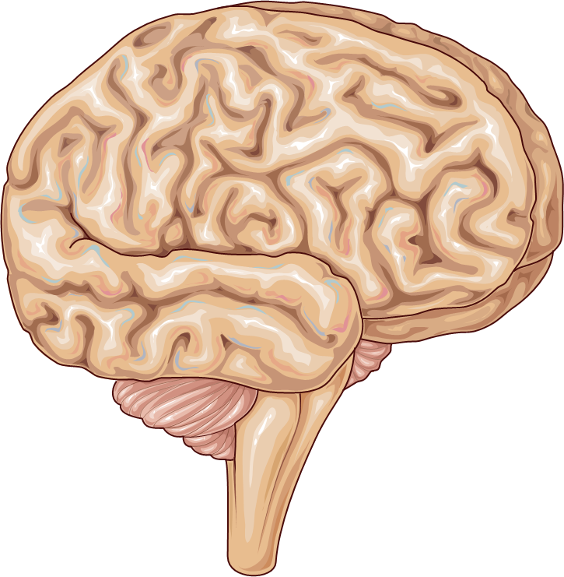
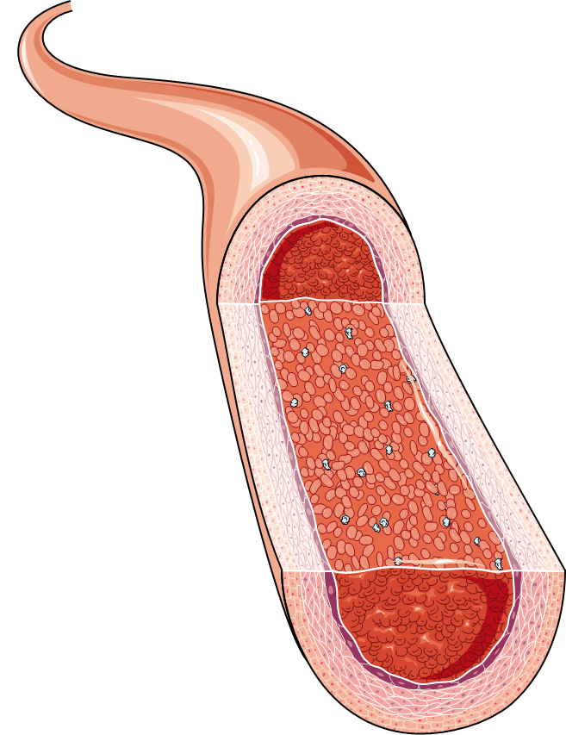
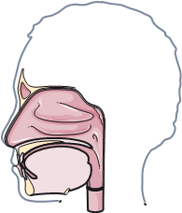
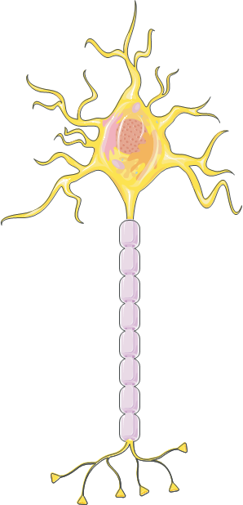

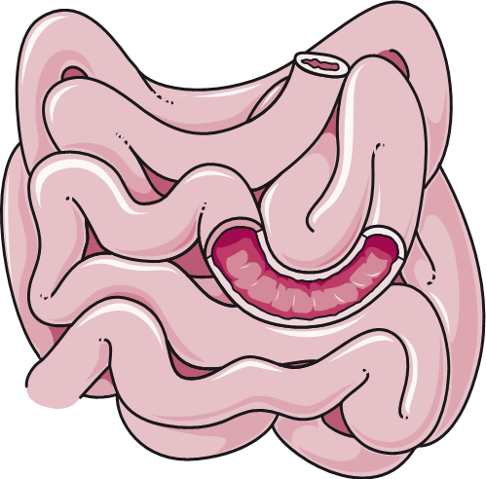
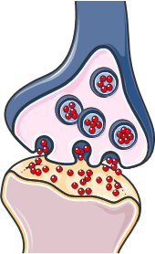

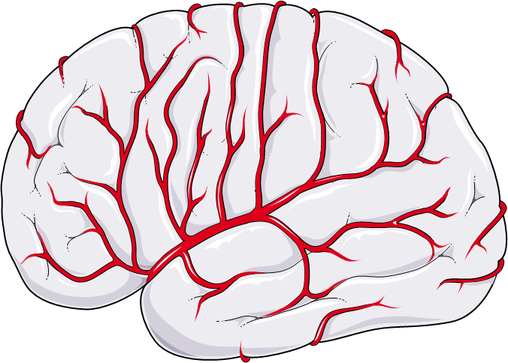
Magnesium: Digestion to Cognition
Passive diffusion and active transport
The blood-brain barrier (BBB)
Blood
Brain
Barrier
Active Transporters
Oral
Ingestion and Digestion
Small Intestine Absorption
Distribution
Free ions
Complexed From
Protein bounds
Neuron
uptake
Structural\Functional Benefits
Competition with other minerals
> 1.0 mM
Synaptic Plasticity
Neuroprotection
Energy Production
Requirements for each Stage
0.75-0.95 mM
Stages of Magnesium Absorption
Notes:
Delivery Forms
& Organoleptic such as
Taste and smell
Solubility & Gastrointestinal discomfort

Slide 5
Absorption of Magnesium Forms
Form
MgO | Medium | Low | Low | Not reported | Not reported (No)
MgSO₄ | High | Medium | Medium | low | Not reported (No)
Mg Citrate | High | Medium | Medium | Low | No
Mg Glycinate | High | High | High | Low | No
 | High | High | High | High* | High*
* Animal models

Slide 6
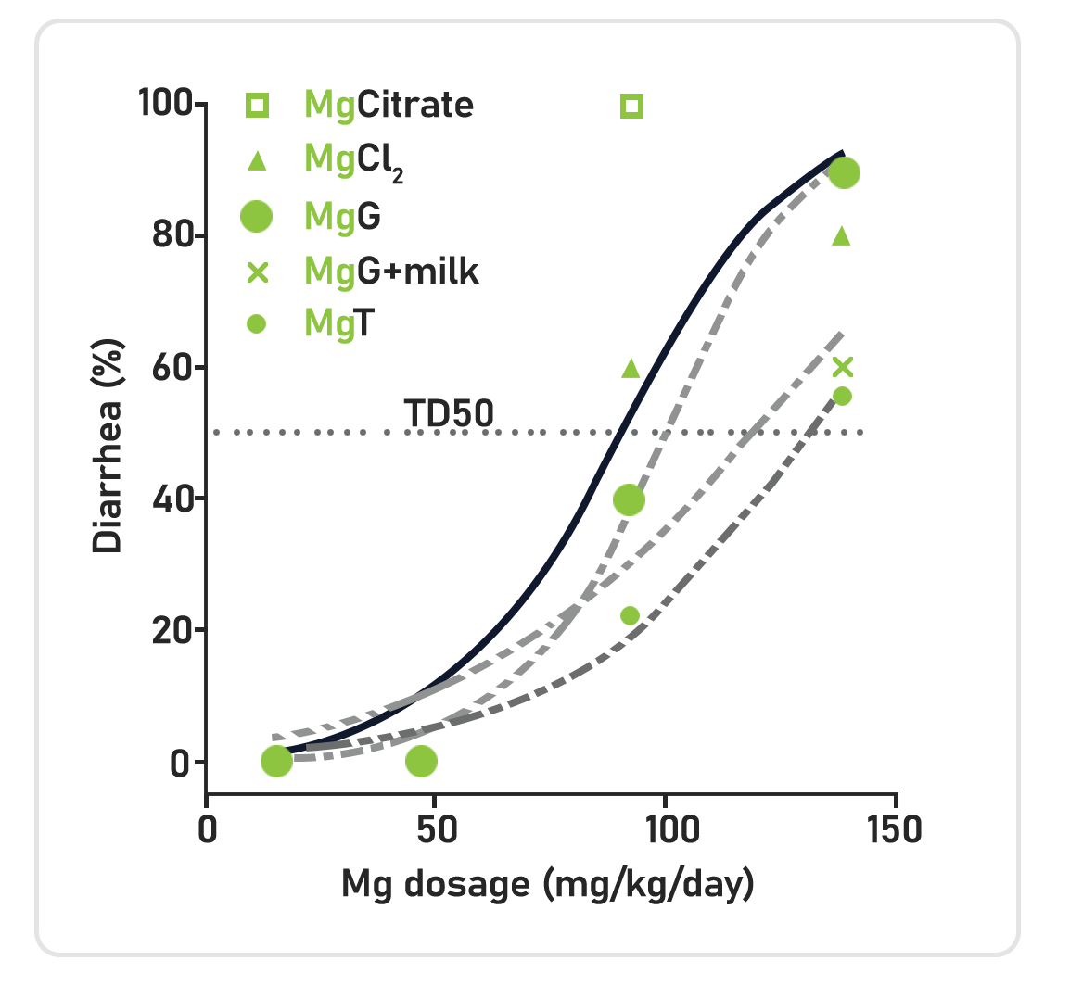
Magtein has the lowest Diarrhea Problem

Slide 7
What is

Slide 8


Magtein® is built on almost two decades of research by inventor Dr. Liu, a former MIT professor includes a portfolio patents, numerous mechanistic studies. It is supported by multiple human clinicals, and a globally recognized safety record.
A patented compound of Magnesium (Magnesium L-Threonate), Magtein® has been shown to effectively cross the blood-brain barrier, increasing brain and neuron magnesium to improve synaptic density and restore brain functions.

Slide 9
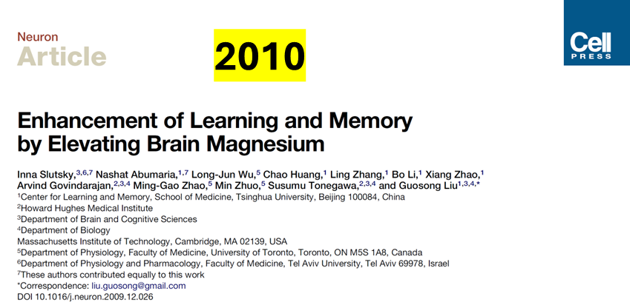
Magtein Discovered in 2010
Magtein developed and tested in 2010 by neuroscience experts including a Nobel Prize winner—reshaping how we think about magnesium and the brain health.

Slide 10
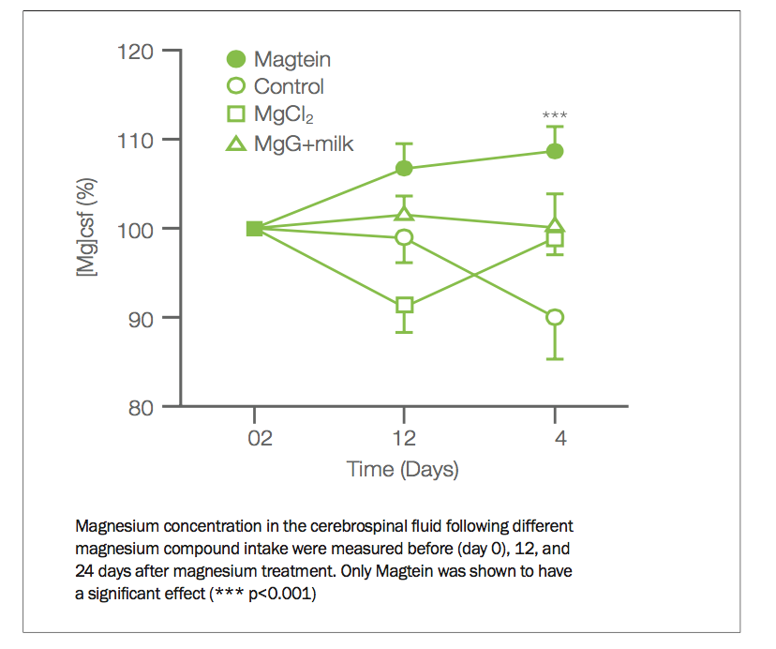
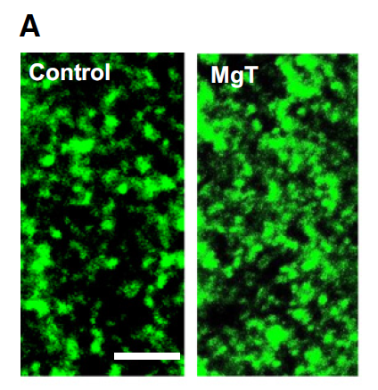
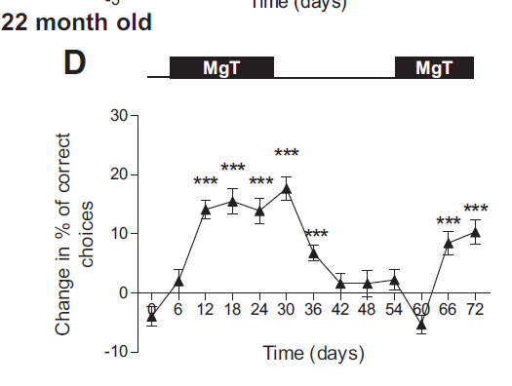
Magtein: A Complete Solution
Bioavailable
Structural
Functional
Magtein increased brain magnesium by 15% in 24 days outperforming other forms of magnesium in CSF delivery when compared to control
Magtein enhanced presynaptic density by 67% in the dentate gyrus and 43% for synaptobrevin strengthening brain connections for cognitive function
Magtein improved spatial memory and learning in both young and aged rats, returned to baseline after stopping highlighting its ongoing use is key
Stopped

Slide 11
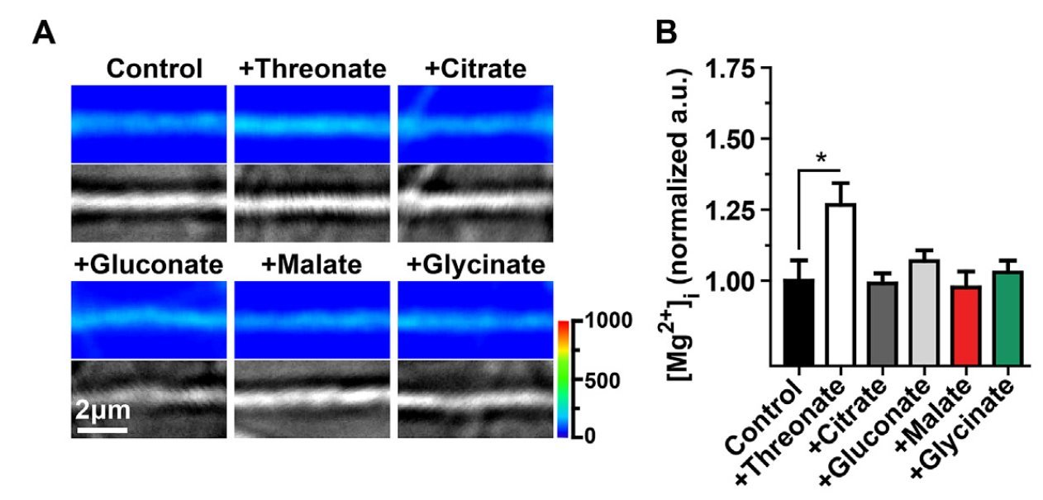
L-Threonate of Magtein regulates the structural and functional synapses Explained [2016]
L-threonate is naturally present in CSF(~100 µM) at higher levels than plasma(~20 µM).​
Enhances intraneuronal Mg²⁺, synapticdensity, plasticity, and mitochondrialfunction in hippocampal neurons.​
Uptake may occur via GLUTs, showingspecificity over other Mg²⁺ carriers.

Slide 12
Magtein
Supports
Brain Cognitive Aging

Slide 13
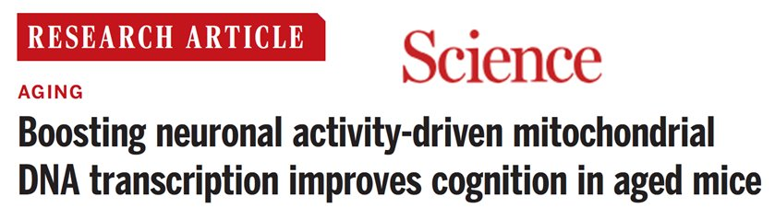
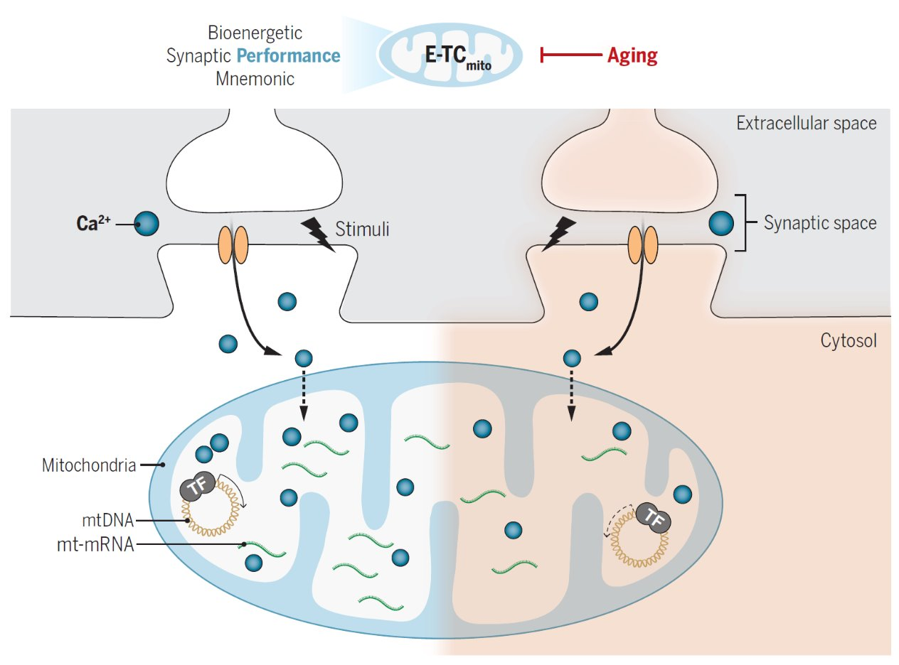
The Science study identified a strong coupling between neuron excitation and mitochondrial transcription
Aging is associated with impairments in mitochondrial functions
Pathway: Synaptic stimulation → Calcium influx → CREB activation → Enhanced mitochondrial DNA transcription.
Boosting mitochondrial activity and ATP production can rejuvenate cognitive performance in aging
Li, Wenwen, et al. "Boosting neuronal activity-driven mitochondrial DNA transcription improves cognition in aged mice." Science 386, no. 6728 (2024): eadp6547.

Slide 14
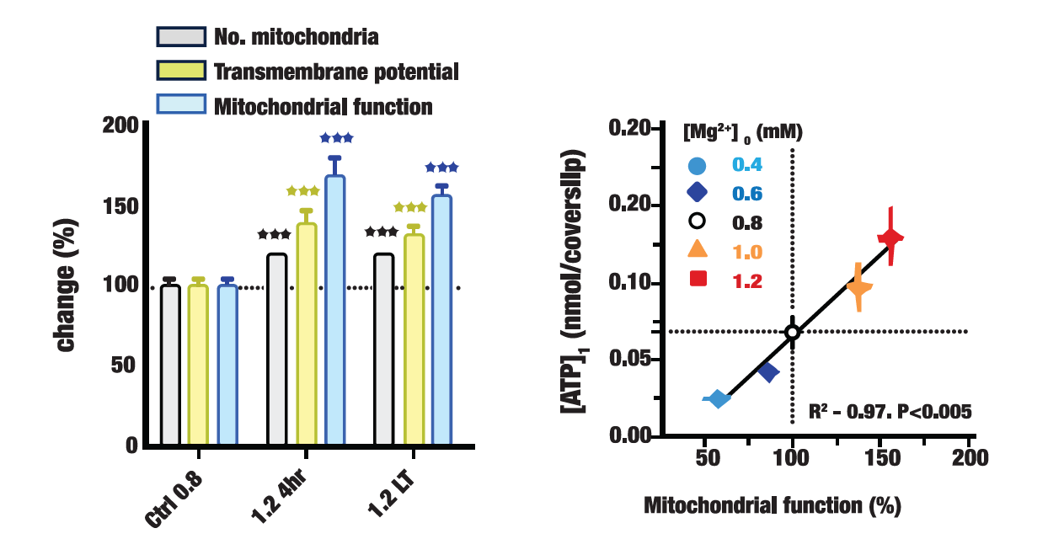
Figure 4. Magtein improves neuron mitochondrial function and energy production.
Left panel: Magnesium increases number of mitochondria (N_{MITO}, black columns), increases mitochondrial transmembrane potential (ΔΨ, yellow columns), and increases overall mitochondrial function expressed as number mitochondria multiplied by mitochondrial transmembrane potential (N_{MITO} x ΔΨ, blue columns). Right panel. Increasing magnesium concentration increases mitochondrial function (N_{MITO} x ΔΨ) and ATP concentration.
Neuropharmacology
Volume 108, September 2016, Pages 426-439

Slide 15
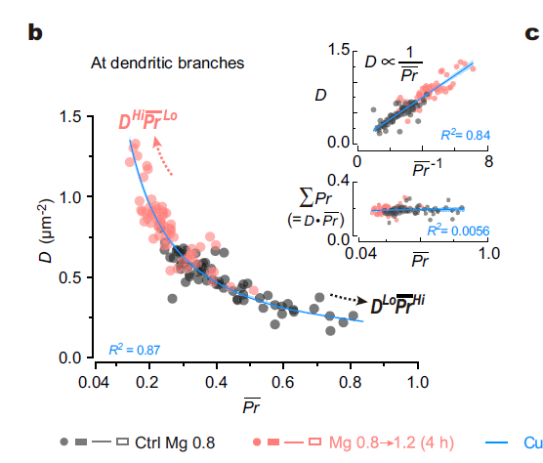
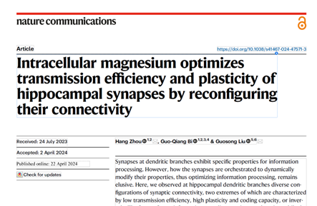
Magtein Converts Old Brain to Young Brain

Slide 16
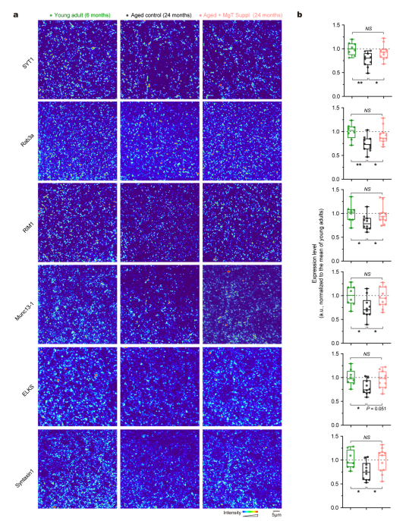
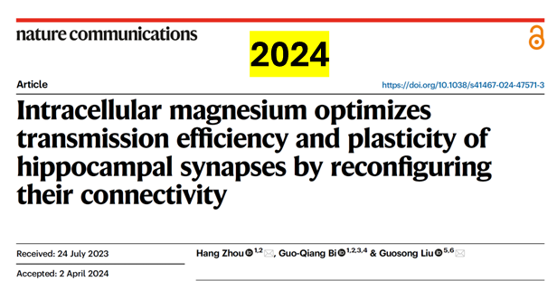
Elevating magnesium levels in the brain with Magtein, older animals were able to rebuild brain connections similar to those of the young, leading to better learning and memory.
Notes:
Magtein Helps the Old Brain Think Young Again
Quantification of the protein levels of individual hippocampus CaSPs

Slide 17
Magtein® - Human Clinical Trials
Study Design | Participants | Intervention | Outcomes
Randomized, double-blind, placebo-controlled, parallel arm study [21]. | 51 healthy participants 50-70 years old. Self-reported complaints of memory problems, anxiety and poor sleep, USA | Magtein® 1.5 – 2 g/day (if >70 kg bodyweight). 12 weeks. | Magtein® significantly raised body magnesium status. Magtein® significantly improved memory and cognition vs placebo. Magtein® reduced brain age by 9 years.
Randomized, double-blind, placebo-controlled, parallel arm study [22]. | 102 healthy participants. 18-65 years old. China. | Magtein® formula: Formula: MgT+PS+C+D (delivered BID). 30 days. | Magtein® significantly improved results over placebo and baseline for the Clinical Memory Test, a standard cognition test that assesses: Memory Associational Learning Figure Recognition Recall Character-Face Association
Randomized, double-blind, placebo-controlled, parallel arm study [23]. | 50 healthy participants 50-70 years old. Self-reported complaints of stress and anxiety. USA. | Magtein® 1.5 – 2 g/day (if >70 kg bodyweight). 12 weeks. | Magtein® significantly reduced Hamilton Anxiety Rating Scale-A (HADS-A) Fear score compared to placebo.
Randomized, double-blind, placebo-controlled, parallel arm study [24]. | 80 healthy participants 35-55 years old. Self-reported complaints of poor sleep and non–clinical anxiety USA. | Magtein® 1 g/day (delivered BID). 3 weeks. | Magtein® significantly improved results over placebo for: Objectively measured (Oura ring): deep sleep score, activity score and activity daily movement score. Leeds Sleep Questionnaire (LSEQ) subcategory behavior following awakening; Restorative Sleep Questionnaire (RSQ) subcategories grouchy, in a good mood, and mental alertness.
Table 1. Magtein human clinical studies in healthy people.

Slide 18
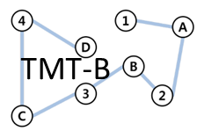

Magtein Supports Brain Cognitive Aging
2016
2022
2025
51 participants
50-70 years
2 g/day
12 weeks
Trail Making Test-B
102 participants
18-65 years
2 g/day
30 days
Clinical Memory Test
100 participants
18-45 years
2 g/day
6 weeks
NIH Cognition Battery

Slide 19
Magtein Healthy Brain Cognitive Aging
2016 Study
Magtein resulted in 10% improvement in a “Trail Making Test-B” a clinical assessment of executive function.
This improvement is equivalent to reverse the trajectory of cognitive aging by an average of 9 years over a 12-week period.
Magtein Supports Healthy Brain Cognitive Aging
Journal of Alzheimer’s Disease 49 (2016) 971–990

Slide 20
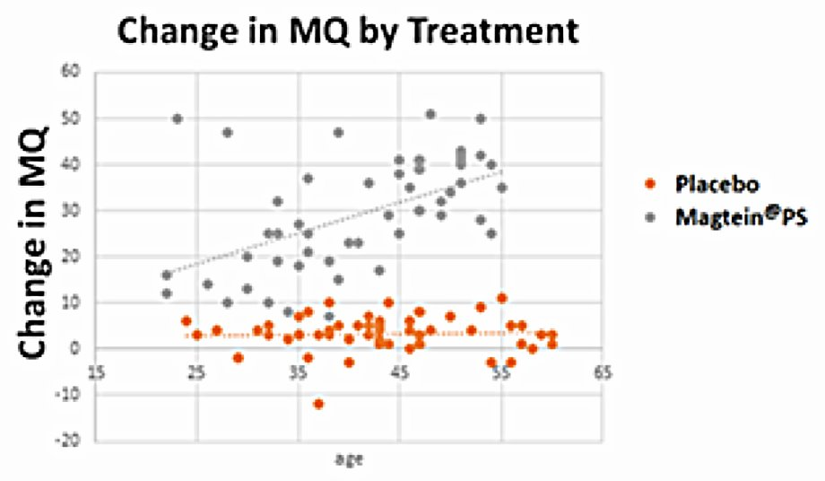
Magtein for Aging Populations
2022 Study
A 2022 Clinical study. 2 g/day Magtein with phosphatidylserine, vitamins C & D for 30 days.
The Clinical Memory Test (CMT) is a standard cognitive assessment widely used in in Chinese Hospitals.
Magtein significantly improved results over placebo for the Clinical Memory Test
Older participants showed greater cognitive improvement.
Old participants scored higher scores
Zhang, Chengxiang, Qi Hu, Shifen Li, Feifei Dai, Wen Qian, Susan Hewlings, Ting Yan, and Yubang Wang. "A Magtein®, magnesium L-Threonate,-based formula improves brain cognitive functions in healthy Chinese adults." Nutrients 14, no. 24 (2022): 5235.

Slide 21
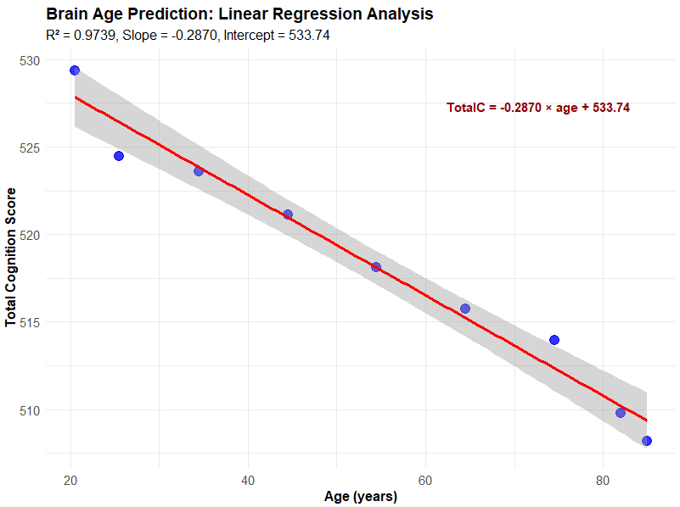
Brain Cognitive\Aging Health 2025 Study
Total Cognition CSS Declines with Age
We calculated the relative change in Cognitive Age
Total cognition composite Change-Sensitive Score
Magtein – placebo = ​2.236, p =0.041
7.5 years of cognitive age benefit vs placebo
This corroborates the Liu 2016 data but now in a younger healthy population
Customers can use the claim: “supports healthy brain cognitive aging”

Slide 22
Magtein Treatment Alters Sleep Architecture:
80 healthy participants
35-55 years old.
1 g/day for 3 weeks.
Increases deep sleep and reduces light sleep

Slide 23
Claims
Magtein supports healthy brain aging
Magtein supports healthy brain cognitive aging

Slide 24
Claims
Magtein increases productivity and focus*
Magtein improves concentration*
Magtein improves mental health*
Magtein improves mental alertness*
Magtein improves daytime functioning and energy*
Magtein promotes feeling refreshed upon awakening*
Magtein supports positive mood*
Magtein improves mood*
Magtein supports quality sleep*
Magtein improves REM sleep*
Magtein improves sleep quality*
Magtein supports overall cognitive ability*
Magtein reduces cognitive fluctuation*
Magtein supports executive function *
Magtein supports memory*†
Magtein supports working memory (short term memory) *
Magtein improves recognition*†
Magtein improves learning*†
Magtein improves recall*†
† in a Magtein formulation with phosphatidylserine,
vitamin C and vitamin D
For Cognition and Memory (2g/day)
For Mood, Sleep and Productivity (1g/day)

Slide 25
Regulatory
ThreoTech is IP owner and exclusive licensor of Magtein
Protected by 10+ strong patents and actively policed
Only sold under TMLA with strict label, logo and formulation requirements
TMLA signed by each brand and their contracted manufacturers
Pre-approval of formulation and logo prior to PO fulfillment
US FDA GRAS approval
EU Novel Food approval
UK FSA assessment complete; awaiting publication
Health Canada granted cognition claim
India FSSAI Ministry of Health approval
Turkish Ministry of Agriculture approval
Thai FDA approval for use in supplements
Japan Food approval (FFC pending submission)

Slide 26
Magtein Commercial Growth

Slide 27









Magtein in the Media
CONFIDENTIAL
Notes:
Additionally, Magnesium and its various health benefits continue to dominate social media feeds Some notable trends we have seen include the “Sleepy Girl Mocktail”, and “what I take” spotlights by longevity expert Peter Attia and neuroscientist Andrew Huberman

Slide 28
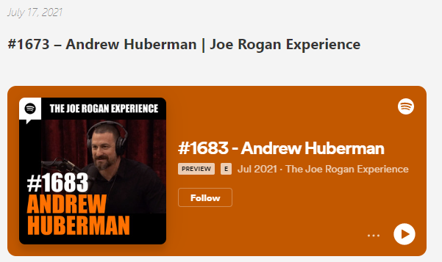
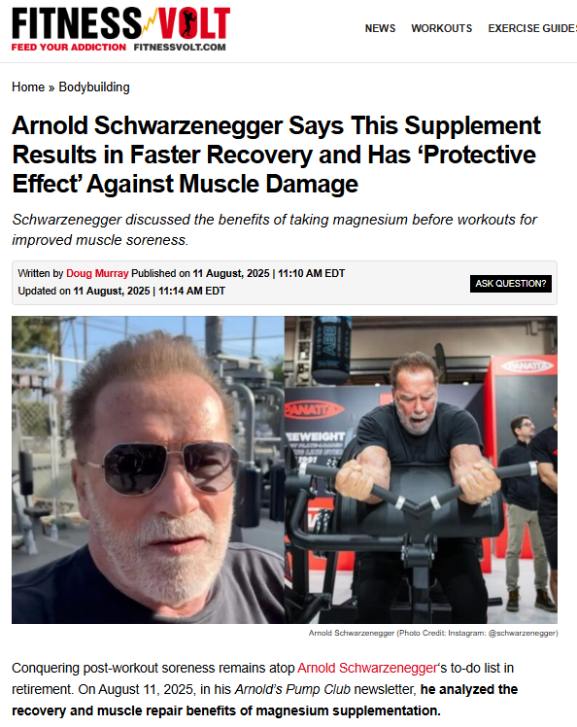
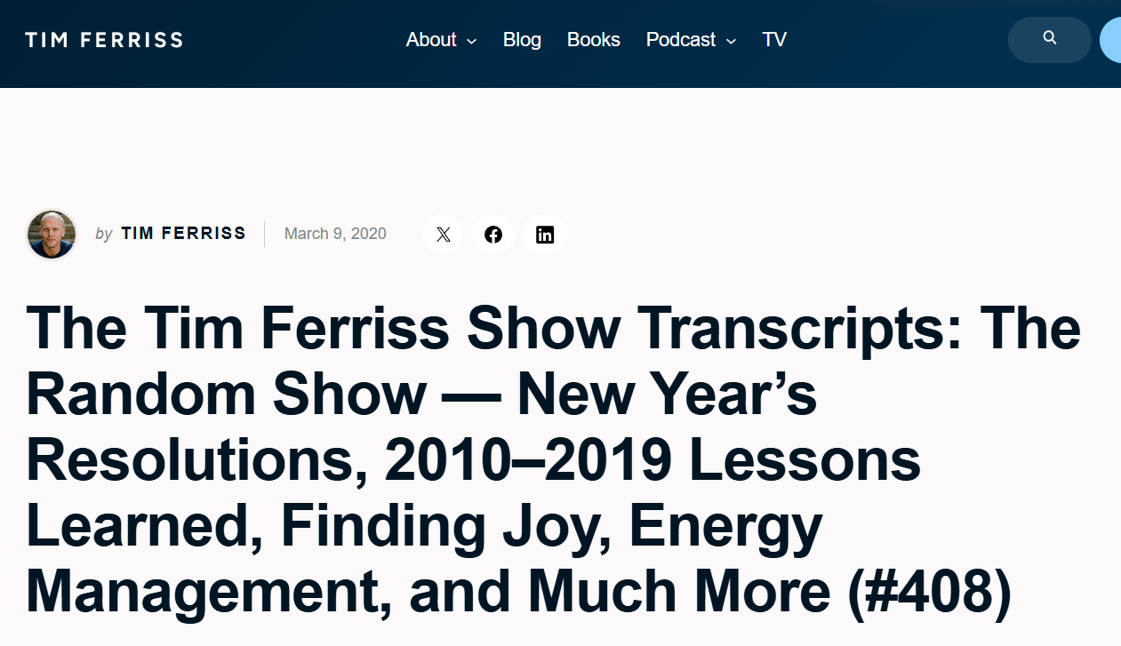
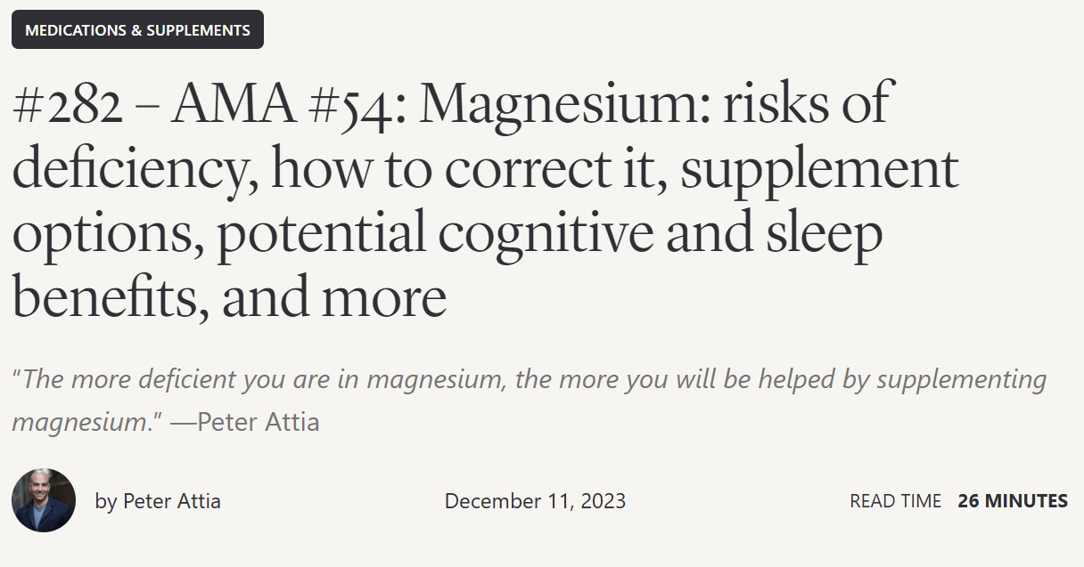
Key Opinion Leaders Organic Mentions
#1 USA Podcast
1 million members
#1 Business Podcast
#17 Health and Fitness Podcast
CONFIDENTIAL
Notes:
Additionally, Magnesium and its various health benefits continue to dominate social media feeds Some notable trends we have seen include the “Sleepy Girl Mocktail”, and “what I take” spotlights by longevity expert Peter Attia and neuroscientist Andrew Huberman

Slide 29

Contact Information
Jennifer Gu, Ph.D.
AIDP, Inc.
jennifer@aidp.com

