Slide 1

Active Aging & Healthspan
December 2, 2025

Slide 2
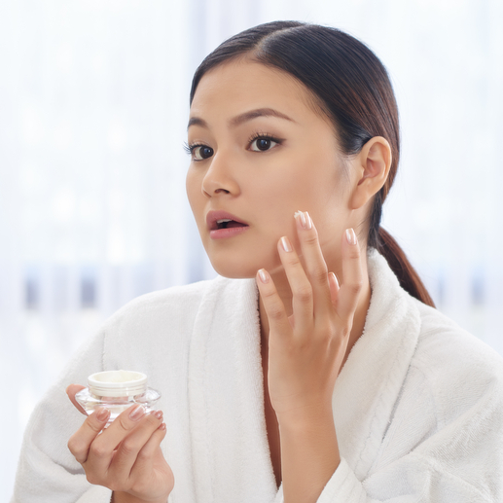
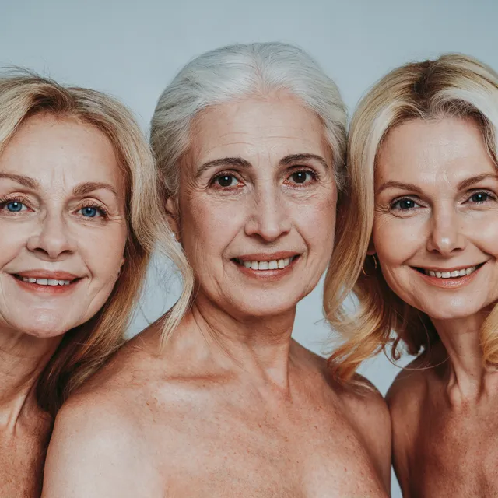

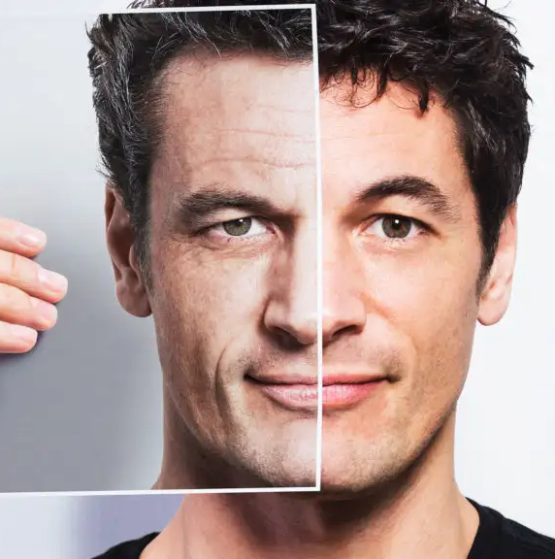

THE HEALTHY/ACTIVE AGING
EVOLUTION:
The natural products industry has undergone a profound transformation in how we approach aging over the past three decades. What began as a battle against time has evolved into a sophisticated, science-driven pursuit of optimal human potential.
This evolution reflects changing consumer preferences and a fundamental shift in our understanding of aging itself, from an inevitable decline to fight against, to a biological process we can influence and optimize.
ANTI-AGING
1990’s – 2000’s
“Fight against aging”
HEALTHY AGING
2000’s – 2010’s
“Age gracefully
and healthily”
ACTIVE AGING
2010’s - 2020’s
“Stay active and
engaged throughout life”
LONGEVITY
2020’s – Present
“Extend lifespan through scientific intervention”
HEALTHSPAN
Present - Future
“Extend years of healthy, functional living”

Slide 3
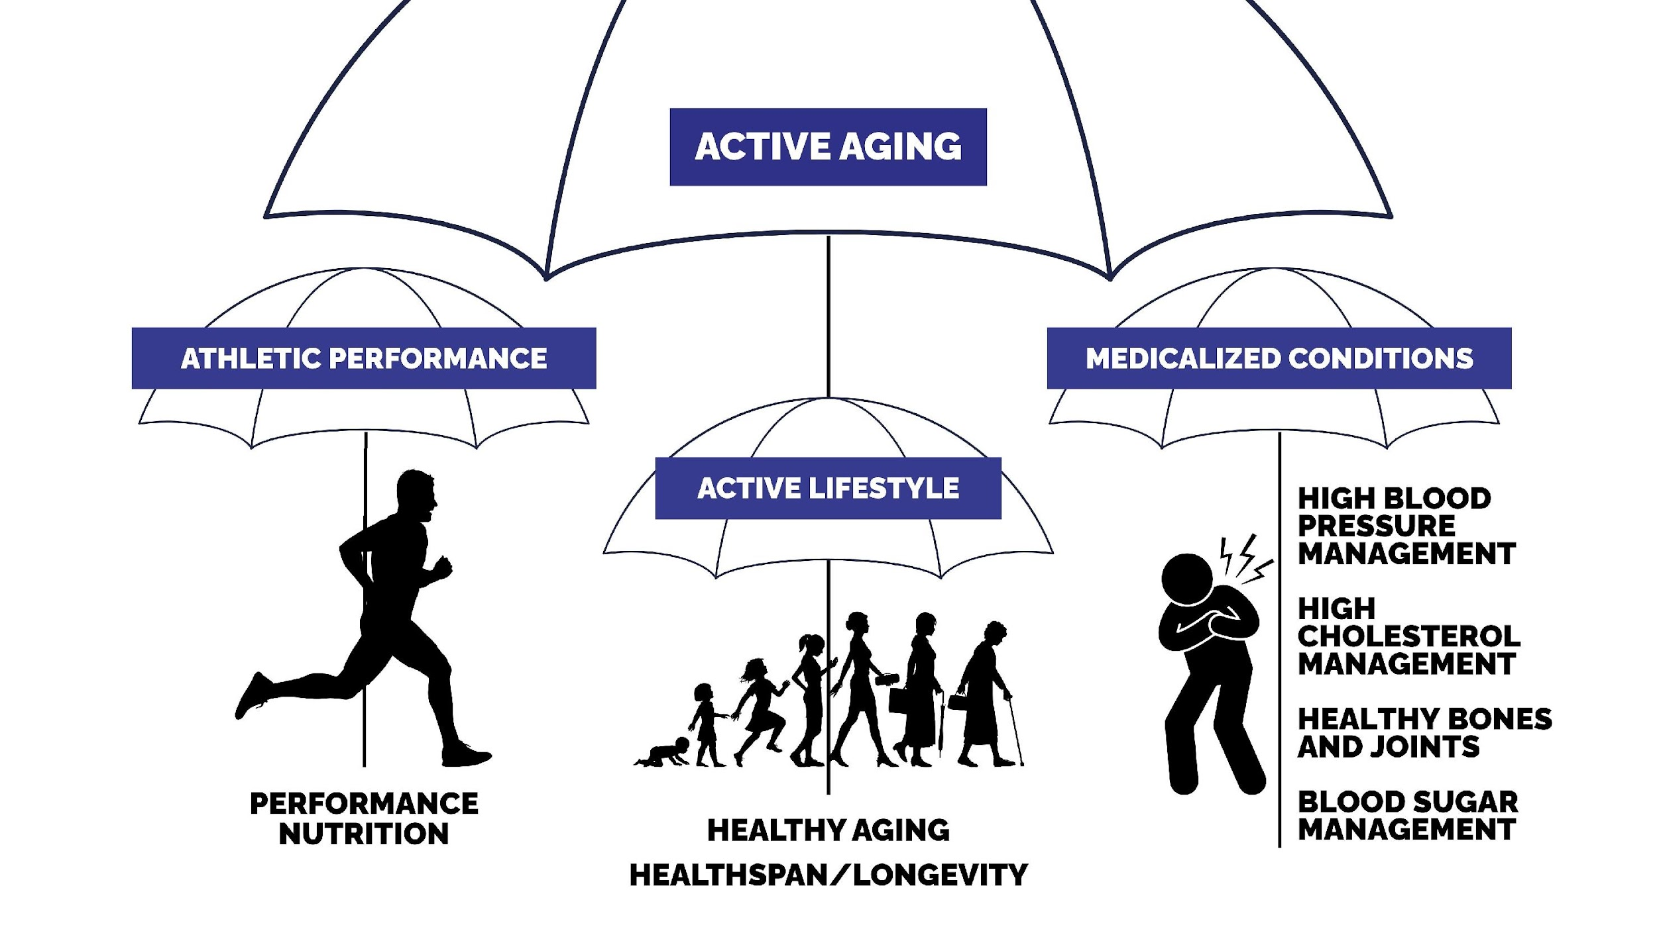

Active Nutrition
Drivers of Chronic Disease
OPTIMAL AGING

Slide 4

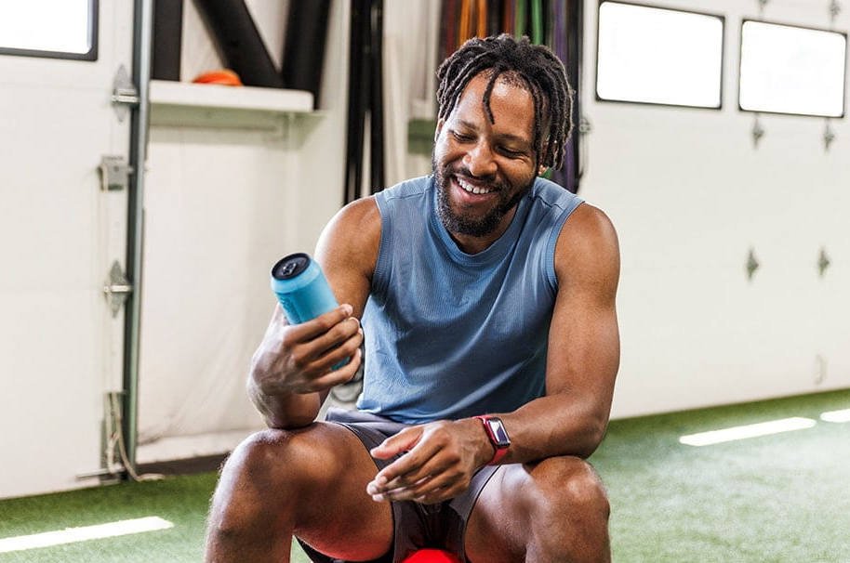

RETHINKING A FEW CONCEPTS:
ENERGY: BRAIN AND BODY
CELLULAR
HEALTH
EXERCISE FOR ALL: MORE THAN JOINTS

Slide 5

ITC INSIGHTS 2025 CONSUMER SUPPLEMENT SURVEY
AGING CONCERNS REPORT

Slide 6

DEMOGRAPHIC OVERVIEW: AGGREGATE CONCERNS
Key Insight:
Respondents were fairly evenly split across genders with users skewing slightly female in Germany and Australia and skewing slightly male in Italy and India.
 | All Respondents |  | US |  | UK |  | DE |  | IT |  | KR |  | AU |  | IN
 | n=4029 |  | n=669 |  | n=333 |  | n=353 |  | n=386 |  | n=412 |  | n=332 |  | n=391
Female | n=1998 | 50% | n=342 | 51% | n=174 | 52% | n=188 | 53% | n=188 | 49% | n=196 | 48% | n=174 | 52% | n=191 | 49%
Male | n=1998 | 50% | n=325 | 49% | n=159 | 48% | n=165 | 47% | n=198 | 51% | n=216 | 52% | n=158 | 48% | n=200 | 51%
Non-binary/prefer to self-describe | n=4 | <1% | n=2 | <1% | n=0 | n/a | n=0 | n/a | n=0 | n/a | n=0 | n/a | n=0 | n/a | n=0 | n/a
18-25 | n=446 | 11% | n=57 | 9% | n=46 | 14% | n=29 | 8% | n=45 | 12% | n=27 | 7% | n=27 | 8% | n=46 | 12%
26-34 | n=872 | 22% | n=145 | 22% | n=72 | 22% | n=72 | 20% | n=80 | 21% | n=91 | 22% | n=73 | 22% | n=81 | 21%
35-44 | n=1100 | 27% | n=172 | 26% | n=81 | 24% | n=98 | 28% | n=91 | 24% | n=108 | 26% | n=86 | 26% | n=147 | 38%
45-54 | n=847 | 21% | n=147 | 22% | n=72 | 22% | n=81 | 23% | n=90 | 23% | n=95 | 23% | n=72 | 22% | n=67 | 17%
55+ | n=764 | 19% | n=148 | 22% | n=62 | 21% | n=73 | 21% | n=80 | 21% | n=91 | 22% | n=74 | 23% | n=50 | 12%

Slide 7
DEMOGRAPHICS: US, AGE & GENDER, AGGREGATE CONCERN
18-25
26-34
35-44
45-54
55+
51%
49%
52%
48%
44%
56%
59%
41%
53%
47%
Note: 18-25 n=57, 26-34 n=145, 35-44 n=172, 45-54 n=147, 55+ n=148.

Slide 8
DEMOGRAPHICS: US, AGE & GENDER, OPTIMAL AGING
18-25
26-34
35-44
45-54
55+
61%
39%
54%
46%
45%
55%
62%
38%
64%
36%
Note: 18-25 n=19, 26-34 n=52, 35-44 n=78, 45-54 n=68, 55+ n=42.

Slide 9
DEMOGRAPHICS: US, AGE & GENDER, DRIVERS OF CHRONIC DISEASE
18-25
26-34
35-44
45-54
55+
49%
51%
51%
49%
42%
58%
60%
40%
52%
48%
Note: 18-25 n=37, 26-34 n=102, 35-44 n=130, 45-54 n=113, 55+ n=132.

Slide 10
DEMOGRAPHICS: US, AGE & GENDER, ACTIVE NUTRITION
18-25
26-34
35-44
45-54
55+
52%
48%
53%
47%
46%
54%
61%
39%
62%
38%
Note: 18-25 n=28, 26-34 n=66, 35-44 n=72, 45-54 n=51, 55+ n=24.

Slide 11

HEALTH CONCERNS
Deep dive into supplement user health concerns and which ones they take supplements for

Slide 12
HEALTH CONCERNS AND WHAT THEY TAKE SUPPLEMENTS FOR (1st 10) AGGREGATE CONCERN
Key Insights:
If we examine the space between the inner (those who have consumed) versus the hatched line (willing to consume) for the top 10 overall concerns, we see huge space for anxiety and stress, joint or other pain, insomnia/sleep problems and mood.
If we examine the space between those willing to consume versus those with a health concern, we have an education conversion opportunity, notably for anxiety or stress, fatigue/tiredness, insomnia/sleep problems, digestive complaints, hair loss, skin health and mood.
Note: n=2876. Results shown top 10 health concerns. Health Concerns Question: “Which of the following health conditions or concerns currently impact or impacted you within the past year?”

Slide 13
HEALTH CONCERNS AND WHAT THEY TAKE SUPPLEMENTS FOR (2nd 10) AGGREGATE CONCERN
Key Insights:
If we examine the space between the inner (those who have consumed) versus the hatched line (willing to consume) for the next 10 overall concerns, we see huge space for overweight/obese, lack of mental energy, oral health, eye fatigue and healthy aging.
If we examine the space between those willing to consume versus those with a health concern, we have an education conversion opportunity, notably for overweight/obese, lack of mental energy, depression, high cholesterol, eye fatigue, oral health and poor/declining vision.
Note: n=2876. Results shown next 10 health concerns. Health Concerns Question: “Which of the following health conditions or concerns currently impact or impacted you within the past year?”

Slide 14
HEALTH CONCERNS AND WHAT THEY TAKE SUPPLEMENTS FOR (3rd 10) AGGREGATE CONCERN
Key Insights:
If we examine the space between the inner (those who have consumed) versus the hatched line (willing to consume) for the third set of 10 overall concerns, we see huge space for memory issues, lack of mental acuity, cognition, focus and sexual health.
If we examine the space between those willing to consume versus those with a health concern, we have an education conversion opportunity, notably for memory issues, diabetes/blood sugar management, athletic performance, lack of mental acuity, cognition, focus, poor hydration, inflammation and sexual health.
Note: n=2876. Results shown next 10 health concerns. Health Concerns Question: “Which of the following health conditions or concerns currently impact or impacted you within the past year?”

Slide 15

FAMILIARITY & REASONS THEY BUY

Slide 16
FAMILIARITY: US, AGGREGATE CONCERN
Key Insight:
For this user group, multis and vitamin C are over 80% top-2, probiotics is solidly in the top-5 at 33% extremely familiar and take/recommend, omega-3s sit 7th in take or recommend as well as top-2, magnesium tops the top 10in both as well.
Note: US n=669. Question: “How familiar would you consider yourself regarding the use of these supplements?”

Slide 17
PERCEIVED EFFECTIVENESS: US, AGGREGATE CONCERN
Key Insights:
US respondents have many supplements over 70% top-2, including antioxidants, magnesium and even melatonin.
Note: n varies. Question: “What is your opinion of the effectiveness/benefit of each of these supplements?”

Slide 18
ATTRIBUTES INFLUENCING PURCHASE: US, AGE & GENDER, AGGREGATE CONCERN
Key Insight:
For the aggregate concern, we see ‘addresses my specific health concern’ as a strong response, especially for those older and females under 44. the health care professional recommendation response is high also for those older and those 26-34.
Note natural source, clinical research on the ingredient for males 18-25 and clinical research on the ingredient for females 18-25.
Note: US Female 18-25 n=28, US Male 18-25 n=28, US Female 26-34 n=75, US Male 26-34 n=70, US Female 35-44 n=75, US Male 35-44 n=96, US Female 45-54 n=86, US Male 45-54 n=61, US Female 55+ n=78, US Male 55+ n=70 . Question: “What are the most important attributes you look for when purchasing supplements?”

Slide 19
ATTRIBUTES INFLUENCING PURCHASE: US, AGE & GENDER, OPTIMAL AGING
Key Insight:
For the optimal aging group, responses are quite muted, but we do see the addresses my specific health concerns still strong for females and then males 55+. The health care professional response is much lower. Clinical research on the brand is sharper.
Note: US Female 18-25 n=11, US Male 18-25 n=7, US Female 26-34 n=28, US Male 26-34 n=52, US Female 35-44 n=35, US Male 35-44 n=42, US Female 45-54 n=42, US Male 45-54 n=26, US Female 55+ n=27, US Male 55+ n=15. Question: “What are the most important attributes you look for when purchasing supplements?”

Slide 20
ATTRIBUTES INFLUENCING PURCHASE: US, AGE & GENDER, DRIVERS OF CHRONIC DISEASE
Key Insight:
In this group, we also see a high response for addresses my specific concerns and the health care professional response.
Online ratings/reviews are higher, as is detailed ingredient information. So too is clinical research on the ingredient.
Note: US Female 18-25 n=18, US Male 18-25 n=19, US Female 26-34 n=52, US Male 26-34 n=50, US Female 35-44 n=55, US Male 35-44 n=74, US Female 45-54 n=68, US Male 45-54 n=45, US Female 55+ n=69, US Male 55+ n=63 . Question: “What are the most important attributes you look for when purchasing supplements?”

Slide 21
ATTRIBUTES INFLUENCING PURCHASE: US, AGE & GENDER, ACTIVE NUTRITION
Key Insight:
For active nutrition, addresses my specific concerns is again high, higher than the health care professional response, and the clinical research on the ingredient response clearly skews older and male.
Note: US Female 18-25 n=14, US Male 18-25 n=13, US Female 26-34 n=35, US Male 26-34 n=31, US Female 35-44 n=33, US Male 35-44 n=38, US Female 45-54 n=31, US Male 45-54 n=20, US Female 55+ n=15, US Male 55+ n=9. Question: “What are the most important attributes you look for when purchasing supplements?”

Slide 22
PRIORITIZING SPENDING CUTS: US, AGGREGATE CONCERN
Key Insights:
Core vitamins and minerals have the largest essential response, as well as by far the lowest response for non-essential.
Specialty supplements rank third for essential and second least for non-essential.
Note: US n=669. Question: “If you had to cut household spending, how would you prioritize your cuts?”

Slide 23

BRANDED INGREDIENTS

Slide 24
BRANDED INGREDIENTS: COUNTRY, AGGREGATE CONCERN
Key Insights:
Indian respondents over-index for always looking for branded ingredients, their 60% for that response is 30% higher than the next group (US and UK at 30%).
As in last year's survey, respondents, in order to access this section, had to go through a screening in which they were asked to note the label or site that did not contain a branded ingredient. The number of survey respondents that “passed” this screening is located in the footer, typically sitting at between 60% and 75% of users.
Note: US n=454, UK n=260, DE n=241, IT n=282, KR n=291, AU n=274, IN n=324, All Respondents n=2953. Question: “When deciding which supplements to purchase, how important is the inclusion of branded or proprietary ingredients?”

Slide 25
BRANDED INGREDIENTS: US, AGE & GENDER, AGGREGATE CONCERN
Key Insight:
For the aggregate concern, we see a sharp male skew getting older until 35-44.
The ‘appreciate’ response skews females younger and male older.
As in last year's survey, respondents, in order to access this section, had to go through a screening in which they were asked to note the label or site that did not contain a branded ingredient. The number of survey respondents that “passed” this screening is located in the footer, typically sitting at between 60% and 75% of users.
Note: US Female 18-25 n=18, US Male 18-25 n=18, US Female 26-34 n=52, US Male 26-34 n=45, US Female 35-44 n=53, US Male 35-44 n=66, US Female 45-54 n=59, US Male 45-54 n=43, US Female 55+ n=53, US Male 55+ n=45. Question: “When deciding which supplements to purchase, how important is the inclusion of branded or proprietary ingredients?”

Slide 26
BRANDED INGREDIENT VALUE PROPOSITION: US, AGE & GENDER, AGGREGATE CONCERN
Key Insights:
Quality is clearly the most important value for most groups, especially those over 35.
US respondents are putting more weight toward established safety, which now emerges, along with trust as the second highest value for most demographic groups.
Clinical research resonates for most groups, especially those 35-44 and 45-54.
Note: US Female 18-25 n=18, US Male 18-25 n=18, US Female 26-34 n=52, US Male 26-34 n=45, US Female 35-44 n=53, US Male 35-44 n=66, US Female 45-54 n=59, US Male 45-54 n=43, US Female 55+ n=53, US Male 55+ n=45. Question: “When deciding which supplements to purchase, how important are the following qualities/values related to any branded ingredient?” Percentage of responses marked “Extremely Important”

Slide 27
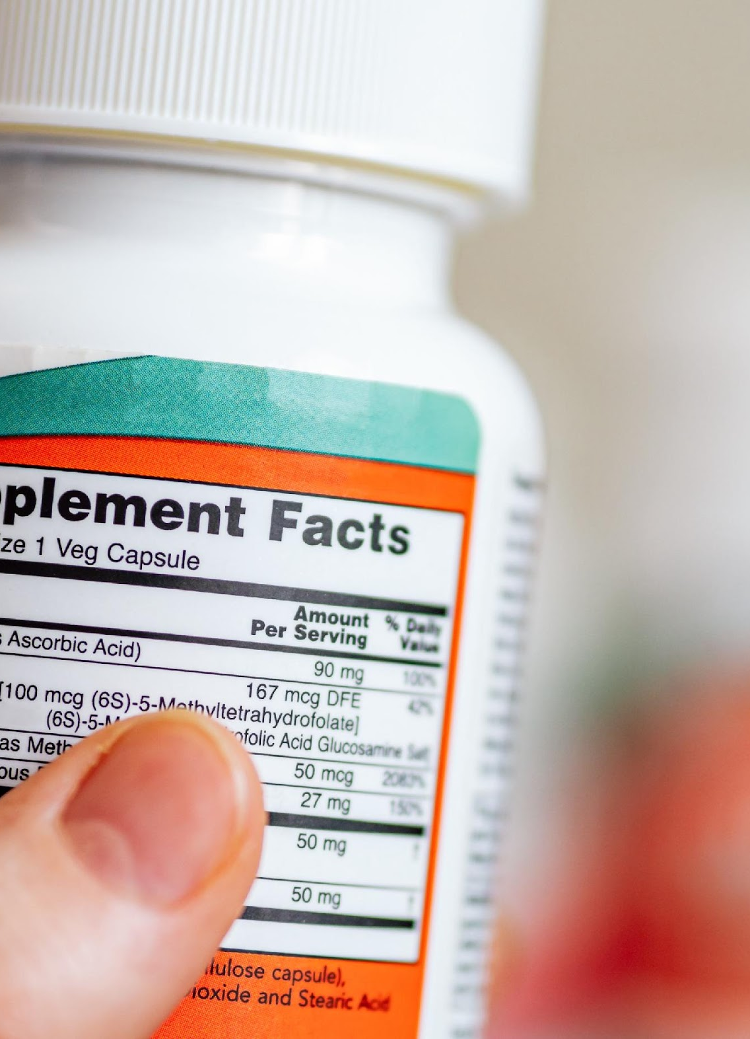
VALUES
Trust, Transparency & Sustainability

Slide 28
TRUST: US, AGE & GENDER, AGGREGATE CONCERN
Key Insight:
The health care professional recommendation is the top response for most groups, especially those 55+, while we see clinical research on the ingredient as a strong response for young females and then males 55+, and clinical research on the brand as the second highest response for most groups – in m any cases approximately equal to consistent product quality.
Note: US Female 18-25 n=28, US Male 18-25 n=28, US Female 26-34 n=75, US Male 26-34 n=70, US Female 35-44 n=75, US Male 35-44 n=96, US Female 45-54 n=86, US Male 45-54 n=61, US Female 55+ n=78, US Male 55+ n=70 . Question: “What characteristics most encourage you to trust a supplement brand?”

Slide 29
TRANSPARENCY PURCHASE INFLUENCE: US, AGE & GENDER, AGGREGATE CONCERN
Key Insights:
Males 35-44 are by far the strongest responders to transparency, sitting at 68%. Males 26-34 and females 35-44 are next at 57%.
Note: US Female 18-25 n=28, US Male 18-25 n=28, US Female 26-34 n=75, US Male 26-34 n=70, US Female 35-44 n=75, US Male 35-44 n=96, US Female 45-54 n=86, US Male 45-54 n=61, US Female 55+ n=78, US Male 55+ n=70. Question: “How likely are you to purchase supplements from a manufacturer that provides transparency information on its label or website?”

Slide 30
SUSTAINABILITY: US, AGE & GENDER, AGGREGATE CONCERN
Key Insights:
Sustainability is important to this user group, especially males 35-44 and then 18-25. We don’t see the heavily male skew we see with all users.
Note: US Female 18-25 n=28, US Male 18-25 n=28, US Female 26-34 n=75, US Male 26-34 n=70, US Female 35-44 n=75, US Male 35-44 n=96, US Female 45-54 n=86, US Male 45-54 n=61, US Female 55+ n=78, US Male 55+ n=70. Question: “When deciding which supplements to purchase, to what degree does the sustainability/environmental impact of a supplement ingredient influence your purchasing decision?”

Slide 31

QUESTIONS?
+1 (303) 746-9555
len@itcstrategy.com
itcstrategy.com
#itcinsights
#itcinsights

