Slide 1





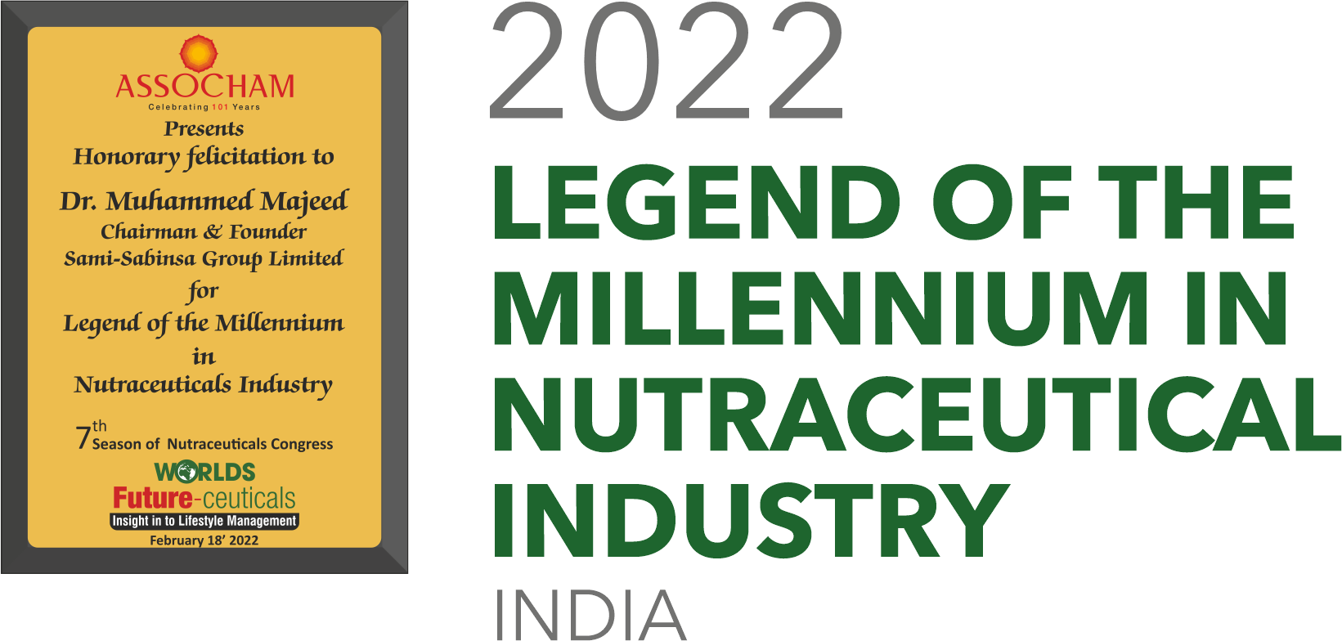
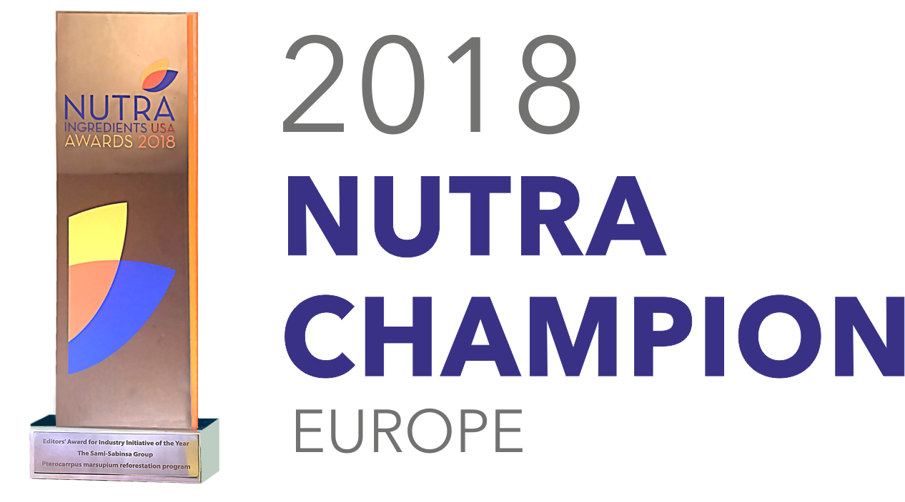

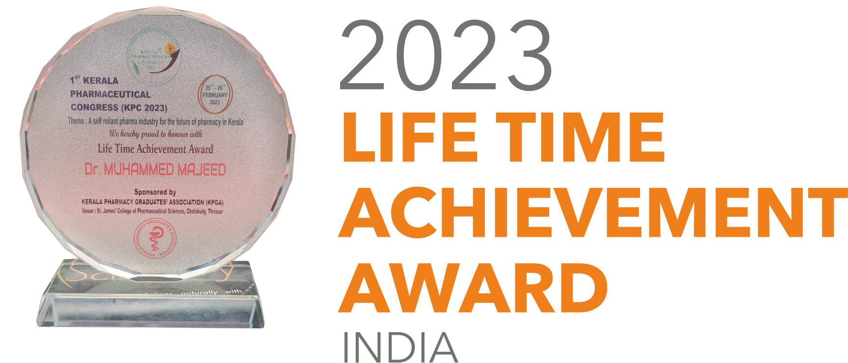

LIVER HEALTH & HEALTHY AGING
The Science Behind Supporting the Body's Most Resilient Organ
Mo Hussain, VP Strategic Affairs

Slide 2

Agenda
Act 1: The Aging Liver
What makes it remarkable
What threatens it with age
Why it matters for active aging
Act 2: The Crisis
Risk factors
MASLD/MASH progression
The detox dilemma
Act 3: Evidence-based approach
LivLonga formulation
Clinical proof
Safety
Q&A

Slide 3
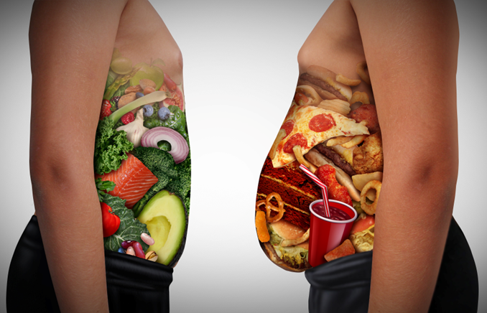
The Aging Liver: Increased Vulnerability
Liver health is compromised by
Natural age-related changes:
Decreased regenerative capacity
Reduced blood flow
Increased oxidative stress
Impaired detoxification
Modern lifestyle factors compound aging effects:
Sedentary lifestyle & obesity
Poor diet & excess sugar
Medication burden
Environmental toxins
Excess alcohol
Viral infection

Slide 4
Active aging isn't just about avoiding disease—it's about maintaining the metabolic resilience that keeps you energetic, clear-minded, and physically capable. Your liver is the metabolic command center that makes this possible.

Slide 5
Liver: The Largest Internal Organ
Largest organ performing more than 500 functions
Situated at the right side of the abdominal cavity beneath the diaphragm
The only organ that can completely regenerate
Considered a part of the digestive tract as it produces bile to support emulsification of fatty foods
Completely resilient, yet vulnerable
While your liver can regenerate from 75% damage, aging reduces this capacity by 30-40% after age 50—making prevention critical for maintaining vitality

Slide 6
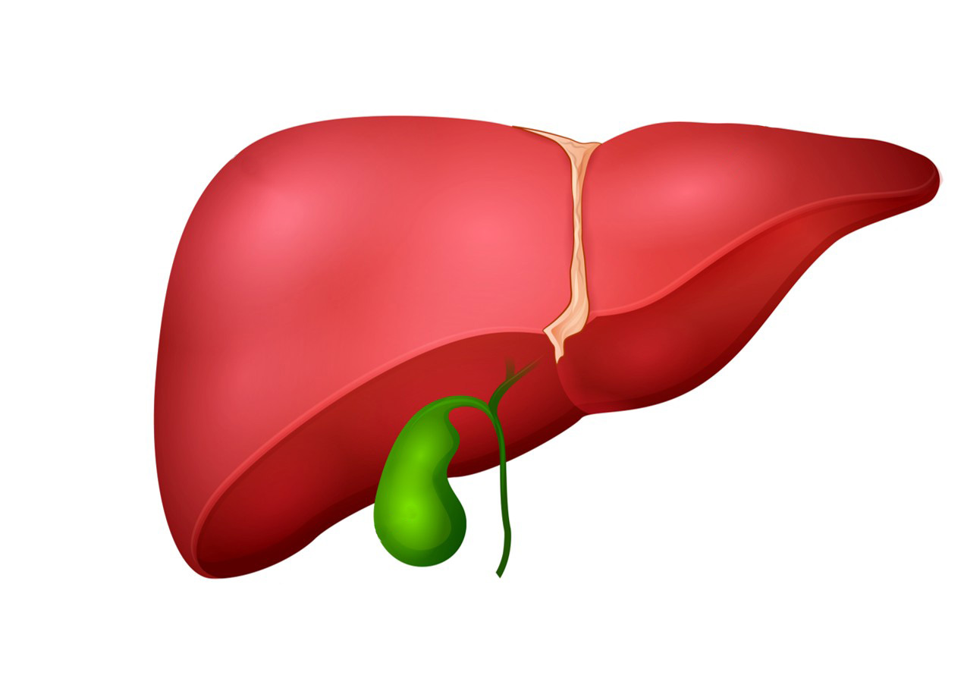
Functions of the Liver
Production of
Bile
Production of
Cholesterol (precursor for hormone vitamin D biosynthesis)
Micronutrient storage
Copper, Zinc, Magnesium, Iron
Vitamin A, D, E, K, B12
Metabolism
Fat breakdown
Conversion of T4 to T3
Important Protein synthesis
Blood clotting factors, Prothrombin, Fibrinogen
Lipoproteins (cholesterol transport)
Globulins (Immune function)
Albumins (Carrier protein)
Immune regulation
Production of
Acute phase proteins
Complement components
Cytokines and chemokines
Clears viruses and pathogens
Detoxification
Drugs
Alcohol
Steroids
Toxins/Allergens
Ammonia (to urea)
Blood sugar regulation
Conversion of glucose to glycogen

Slide 7

Liver and Active Aging
Each function impacts your capacity for active living:
Energy production → Sustained physical activity
Detoxification → Mental clarity and focus
Protein synthesis → Muscle maintenance and recovery
Blood sugar regulation → Stable energy throughout the day
Bile production → Lipid metabolism and nutrient absorption for metabolic health

Slide 8
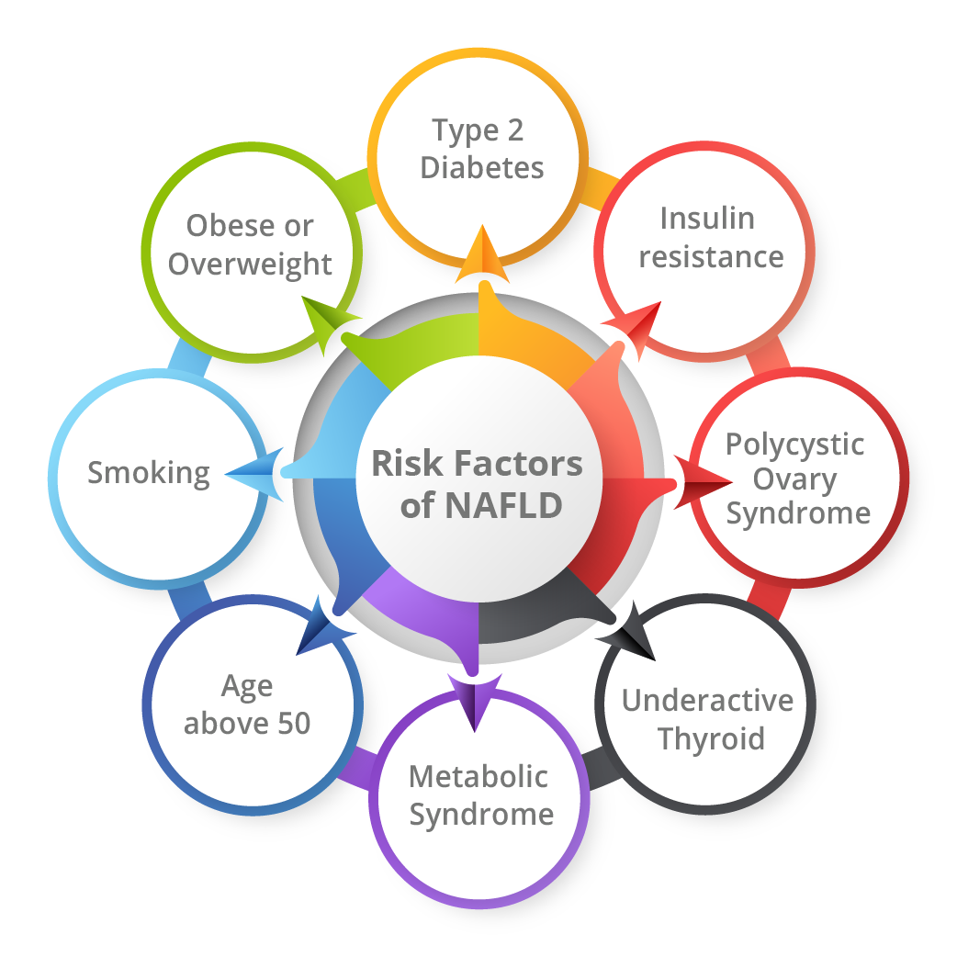
Risk Factors for Liver Dysfunction
Obese or Overweight
Type 2 Diabetes
Insulin Resistance
Polycystic Ovary Syndrome
Underactive Thyroid
High Blood Pressure
High Cholesterol
Metabolic Syndrome
Age Above 50
Smoking
Risk factors rarely act alone—they cluster and compound, creating a powerful, multiplicative impact.

Slide 9
These risk factors don't just threaten liver health—they rob you of energy, mental clarity, and physical stamina. The path from healthy liver to metabolic dysfunction is also the path from active to sedentary aging.

Slide 10
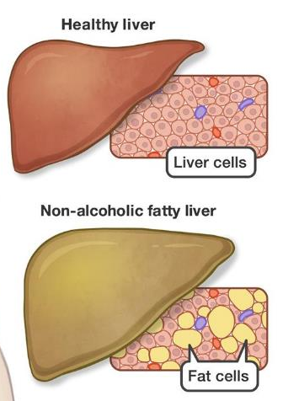
Non-alcoholic Fatty Liver Disease (NAFLD)
A condition in which fat builds up in the liver
Characterized by liver damage, similar to that caused by alcohol abuse
Nonalcoholic fatty liver (NAFL) and nonalcoholic steatohepatitis (NASH) are types of NAFLD
A chronic condition which may progress to fatal liver cancer
Weight loss and diet changes are generally recommended

Slide 11
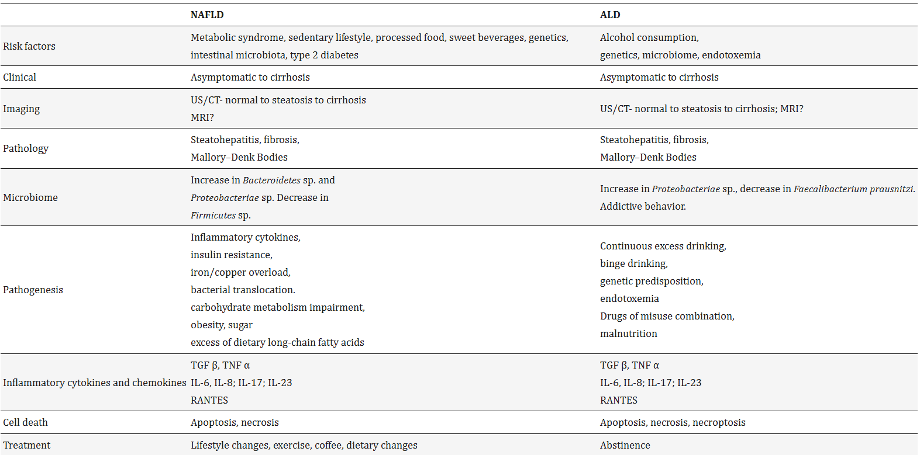
NAFLD
ALD
Int J Mol Sci. 2022 Dec 19;23(24):16226. doi: 10.3390/ijms232416226

Slide 12
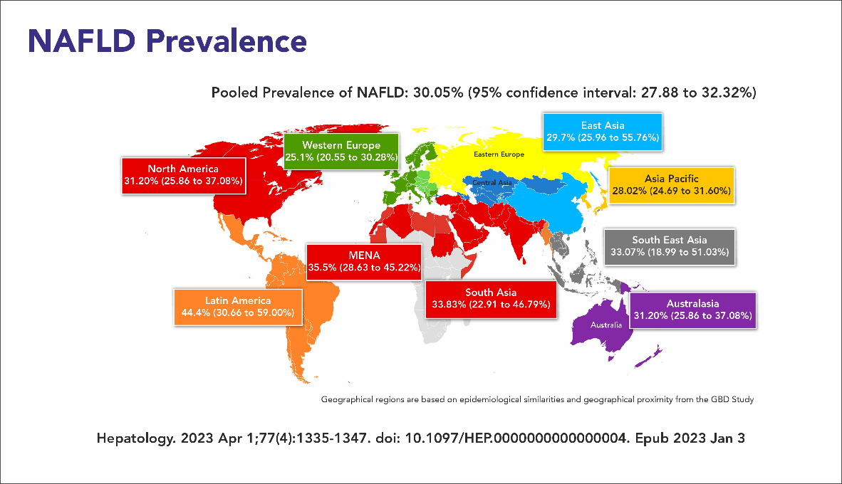
MASLD: A Growing Global Health Crisis
Metabolic Dysfunction-Associated Steatotic Liver Disease (MASLD)
Formerly known as NAFLD
General term for all conditions of fatty liver not caused by excess alcohol, viral hepatitis, or HIV
Affects 30% of adults globally
50% of individuals with Type 2 diabetes
90% of morbidly obese individuals
Silent disease with minimal early symptoms
Leading indication for liver transplantation in the U.S.
Hepatology. 2023 Apr 1;77(4):1335-1347. doi: 10.1097/HEP.0000000000000004. Epub 2023 Jan 3

Slide 13





The Active Aging Connection
MASLD isn't just a liver disease—it's a whole-body metabolic failure that accelerates aging:
40% increased risk of cardiovascular disease
2x risk of Type 2 diabetes progression
Decreased energy and exercise tolerance
Increased frailty and reduced independence
Cognitive decline and brain fog

Slide 14
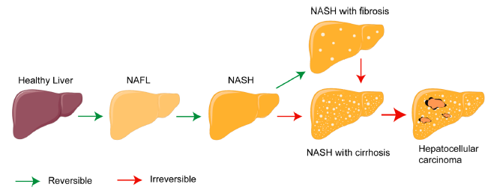
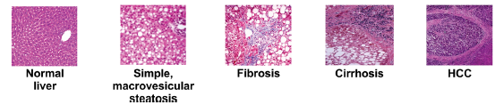
NAFLD (MASLD)-PROGRESSION
TANG ET AL. ACS Nano 2021; 15(11): 17016–17046; BESONE ET AL. Cell. Mol. Life Sci. 2019; 76: 99–128

Slide 15
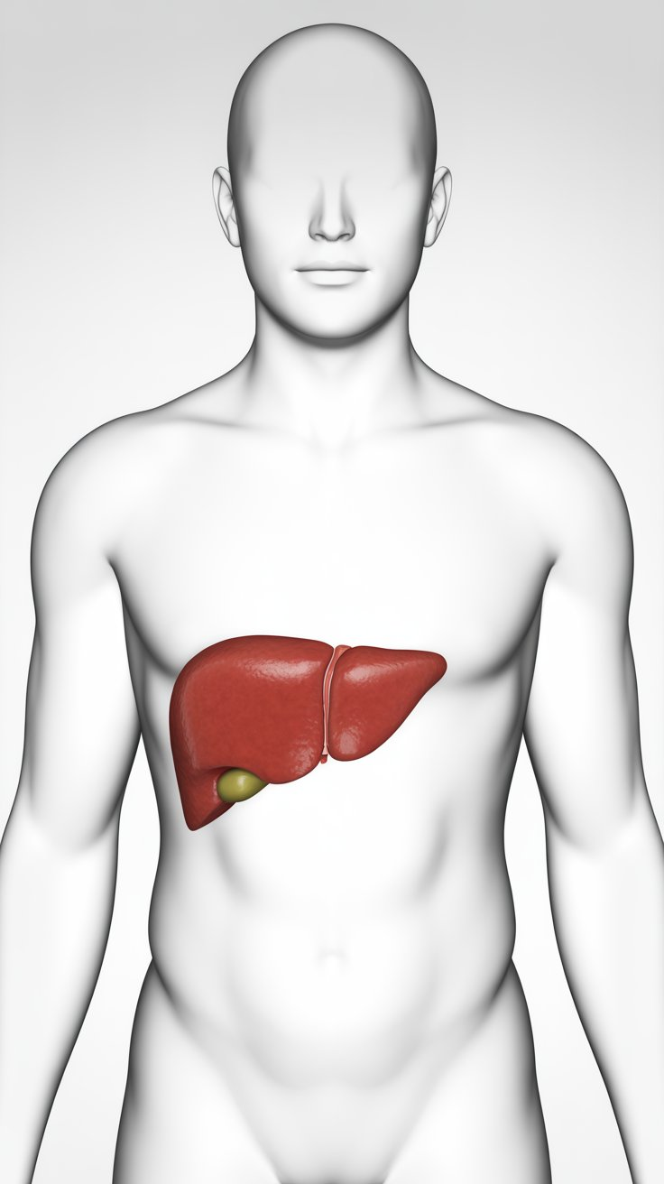
Metabolic dysfunction-associated steatohepatitis (MASH) is a dangerously progressive form of fatty liver in which patients have inflammation of the liver and liver damage, attributed to excess fat (steatosis)
MASH
MASLD has the potential to progress to the more serious MASH
MASH — the updated term for NASH (non-alcoholic steatohepatitis)
About 1.5% to 6.5% of U.S. adults have MASH. One estimate is that nine to 15 million adults have MASH. MASH prevalence is projected to increase by 63% by 2030.
Source: American Liver Foundation

Slide 16
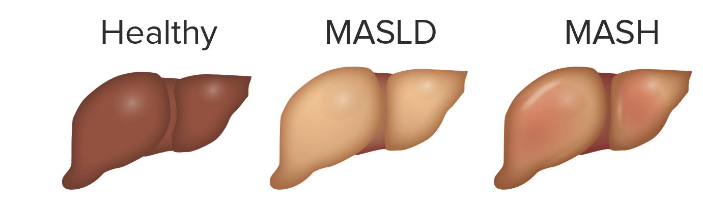
Managing MASLD
Lifestyle changes like exercise, caloric restriction
Nutrition Vitamin E, pioglitazone
Diabetic medications are used to treat NASH and its progressive conditions
Drugs
Targeting lipid metabolism pathways,
Nuclear receptor agonists (Obetocholic acid, GFT505, elafibranor),
Insulin sensitizers (pioglitazone), and
Glucagon-like peptide-1 receptor agonists are in the pipeline
Natural products: Need for evidence-based natural interventions with clinical validation

Slide 17

The Detox Dilemma
Overwhelmed liver tries to tuck away incompletely metabolized compounds into fatty storage like one of us might shove our messes into an extra closet
Occasional detox can’t “clear the closet”
Many “detox” products ask for 7-14 days of dietary changes and can cause unpleasant effects
Maintenance of our liver health is a daily priority as it in turn maintains the health of all our tissues

Slide 18
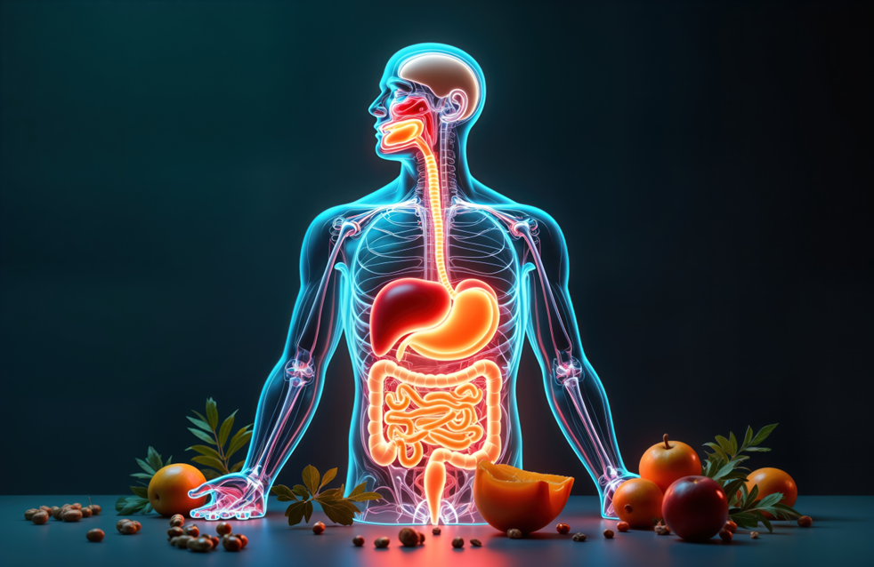
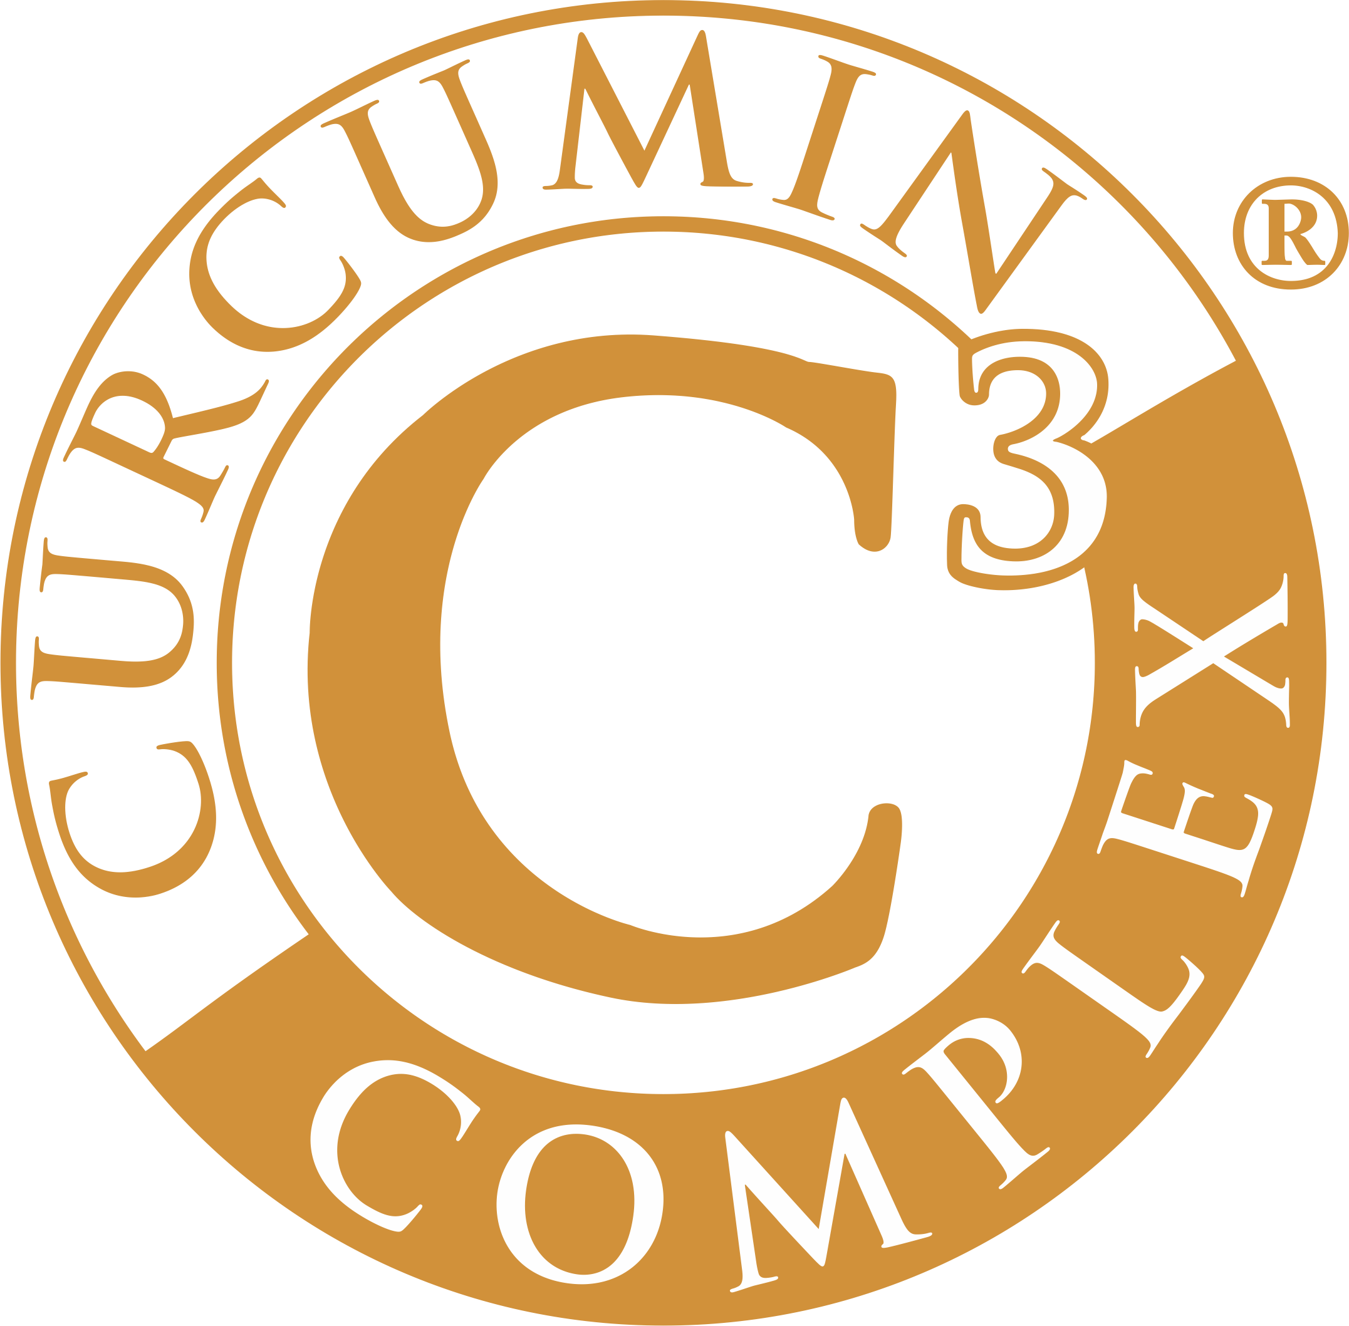

The Liver “detox” market is Liver Support
Standardized herbals can bring the missing therapeutic tastes to receptors all over the body, but first to the digestive tract, even in pill form
Daily Detoxification Support is the new focus for long term liver health—start early
Must include herbals that “clean out the closets” as well as those that provide future protection and encourage better overall digestion of the foods we put in our mouths

Slide 19
Active aging requires daily metabolic support, not periodic cleanses. Think of LivLonga as maintenance for your body's metabolic engine—keeping it running efficiently so you can stay active, focused, and independent.

Slide 20

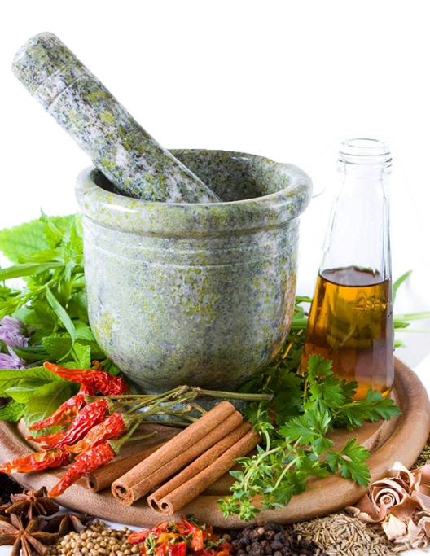
The Power of Synergy
Herbs are traditionally used in Compounds or Formulas
Primary herb plus Synergists and/or Balancers, also Stimulants or Energizers like black pepper
Preparation carries actives to deeper tissues: decoctions, ghee, milk, cooking, etc. which very few do today
Importance of STANDARDIZING: Herbal active compounds are intensified, synergy between actives is more powerful without the consumer needing to use carriers, Whole is greater than the Sum of the parts
It also allows us to perform Gold Standard Human Clinical RCTs because actives and potencies are consistent

Slide 21

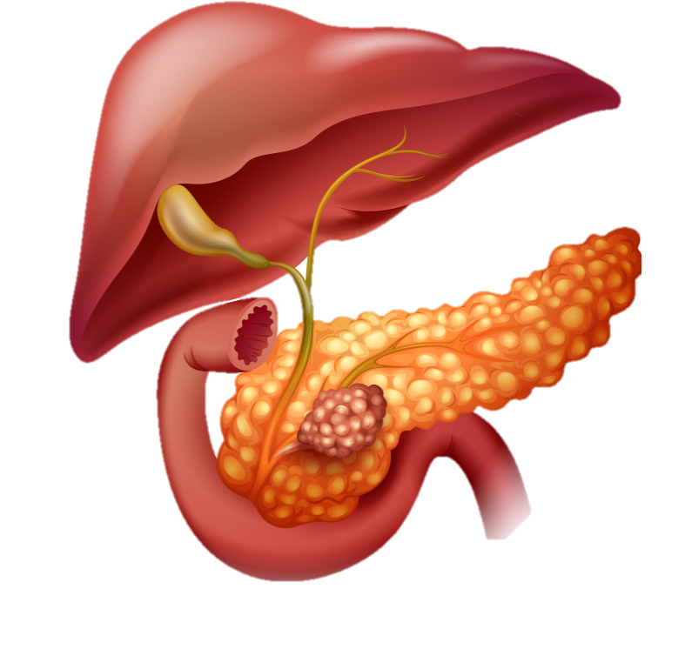


Sabinsa's Approach to Liver Health
Founded on Dr. Muhammed Majeed's principle:
Standardized natural actives + ideal dosage + healthy lifestyle = healthy lifespan
Clinical validation is essential
Liver health as a priority research area for 37 years
Evidence-based botanical solutions backed by:
Preclinical studies
Clinical trials
International patents

Slide 22
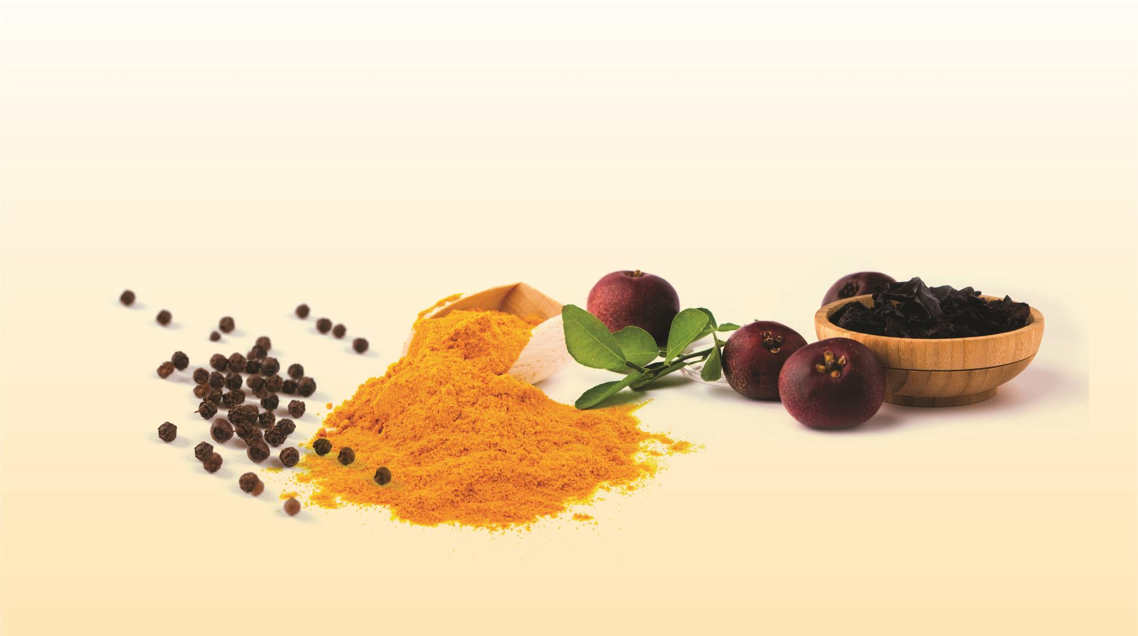

Patents: KR10-2498126, AU2019240210, ZA2020/06540, JP7411564,
EA045555, US10653643, CA3094625, EP3768237, HK40045252
22
22
© 2025 Sabinsa | sabinsa.com

Slide 23

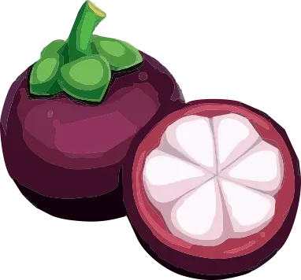
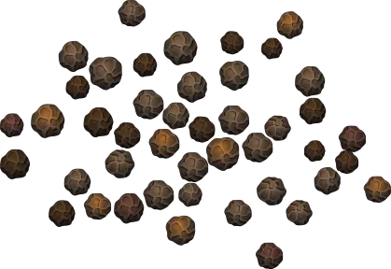
LivLonga®
LivLonga® is a synergistic, tri-ingredient formulation:
Curcumin C³ Complex® (250 mg)
95% curcuminoids (Curcuma longa extract)
Antioxidant and anti-inflammatory support
GRAS status
Livinol® (50 mg)
20% garcinol from Garcinia indica (kokum)
Hepatoprotective properties
Multiple international patents
BioPerine® (5 mg)
95% piperine (Piper nigrum extract)
Bioavailability enhancer
Each ingredient in the blend has unique pharmacological properties and many preclinical and clinical studies have been carried out to show their impact on liver health

Slide 24

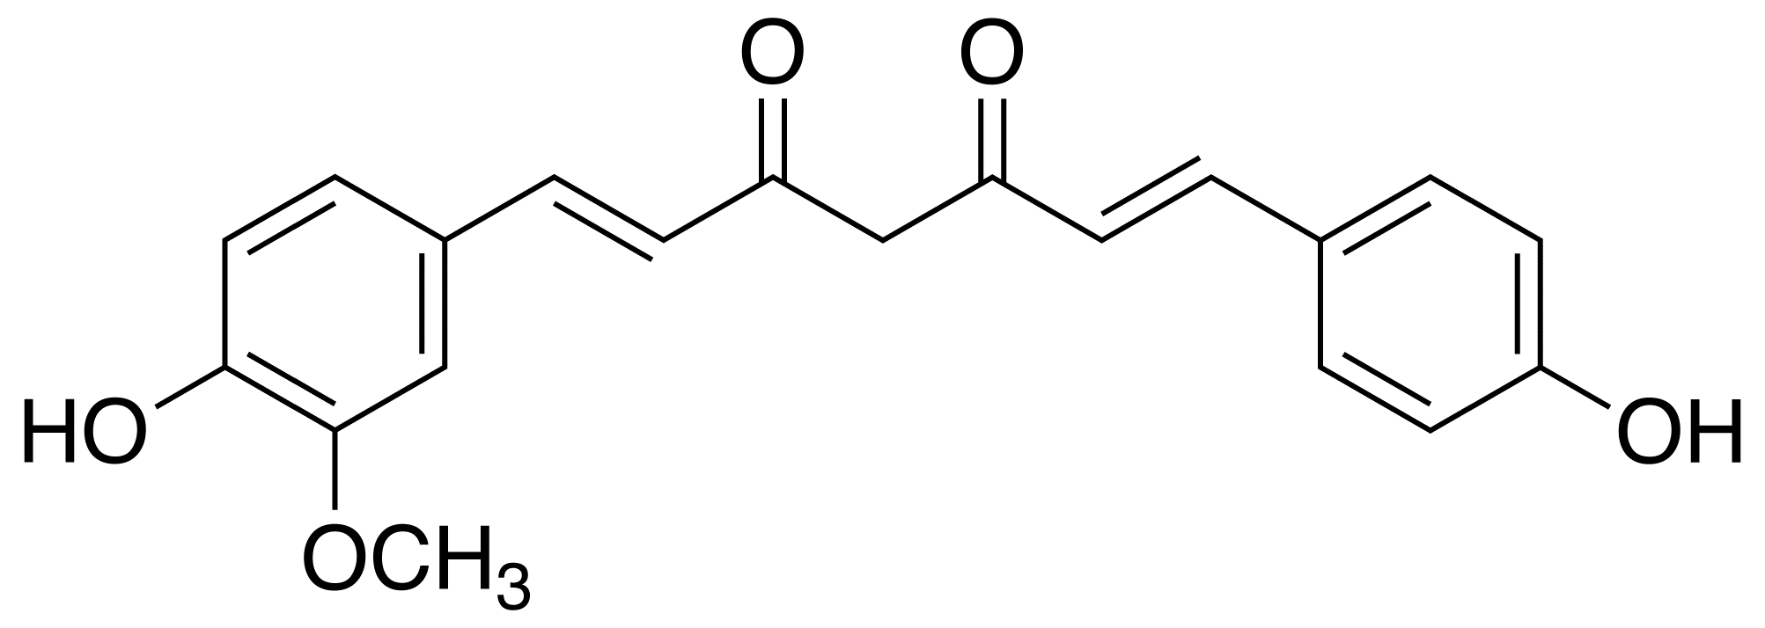
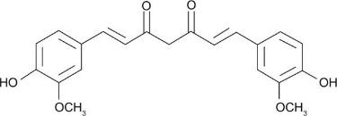
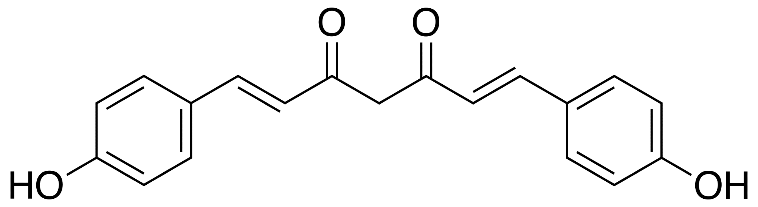
Curcumin C3 Complex®
Commercial extract from the rhizomes of Curcuma longa
Clinically proven health benefits
Contents
Health benefits
95% Curcuminoids
Curcumin (75-81%)
Demethoxycurcumin (15-19%)
Bisdemethoxycurcumin (2.2-6.5%)
Antioxidant
Anti-inflammatory
Lipid regulatory activities
Hepatoprotective activity
Curcumin
Demethoxycurcumin
Bisdemethoxycurcumin

Slide 25
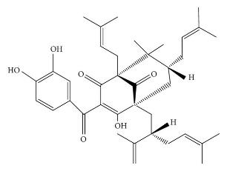
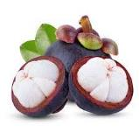
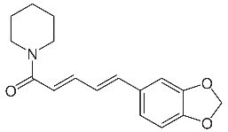
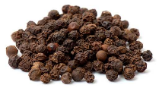
Livinol®
Commercial extract of Garcinia indica
Clinically proven health benefits
Health benefits
Contents
Antioxidant
Antiglycation
Immune Health
Liver protection
20% Garcinol (w/w))
BioPerine®
Obtained from the dried fruits of black pepper (Piper nigrum)
Contents
Health benefits
95% piperine
Bioavailability enhancer

Slide 26
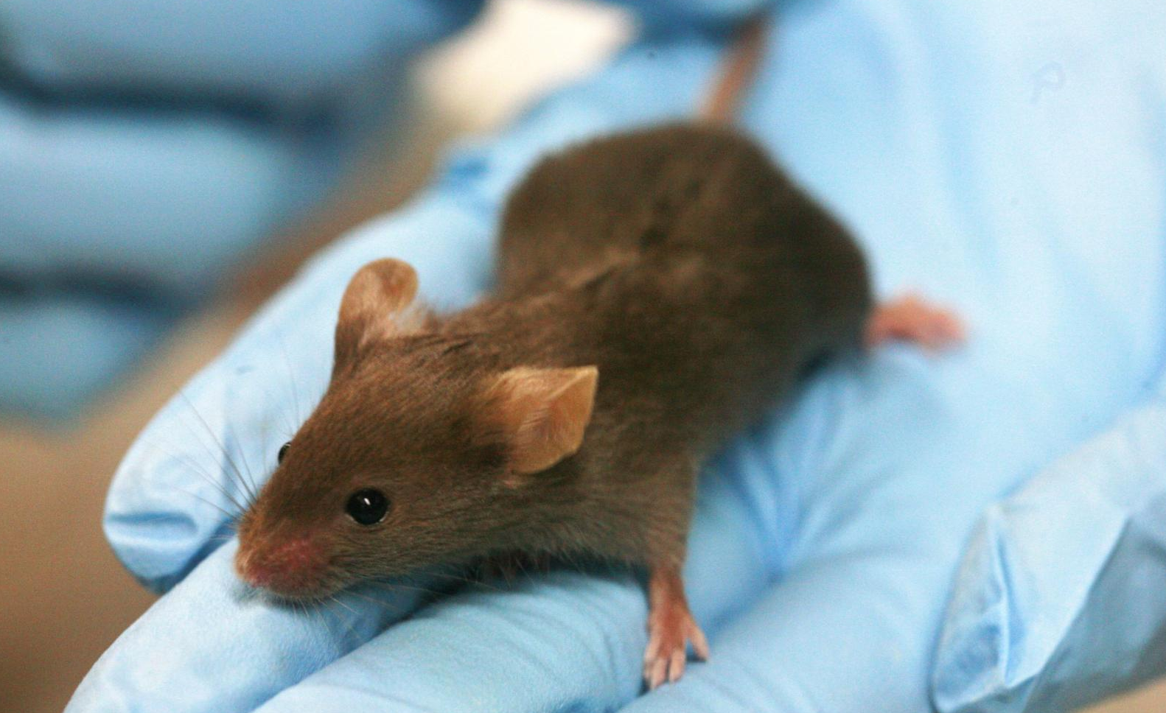
LivLonga® Preclinical Evidence – STAM™ Model
LivLonga® Results:
37.5% reduction in NAFLD Activity Score
75% inhibition of hepatocyte ballooning
Significantly reduced liver fibrosis
Decreased inflammatory markers (TNF-α, NF-κB, MCP-1, CRP)
Increased antioxidant activity (GSH, GPx, SOD)
Superior results vs. individual ingredients
STAM™ Mouse Model (Gold Standard for NASH Research):
Mimics human disease progression

Slide 27
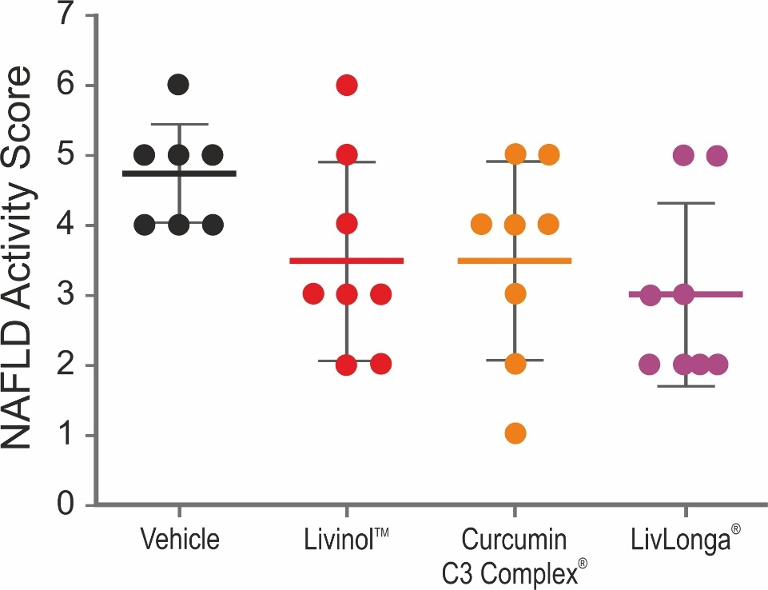
NAFLD Activity Score
Non Alcoholic fatty liver disease (NAFLD) Score is calculated based on the histological sections stained with hematoxylin and eosin
LivLonga® showed significant decrease in fatty liver
Livinol™ and Curcumin C3 Complex® individual treatment showed lower score compared to untreated control

Slide 28
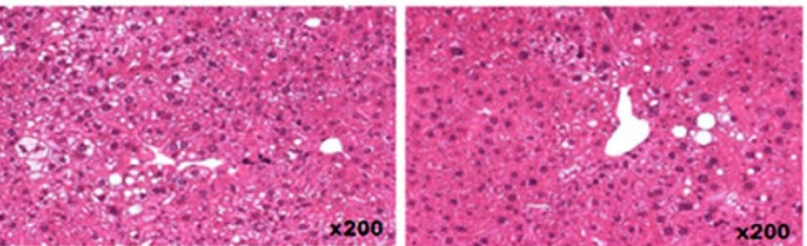
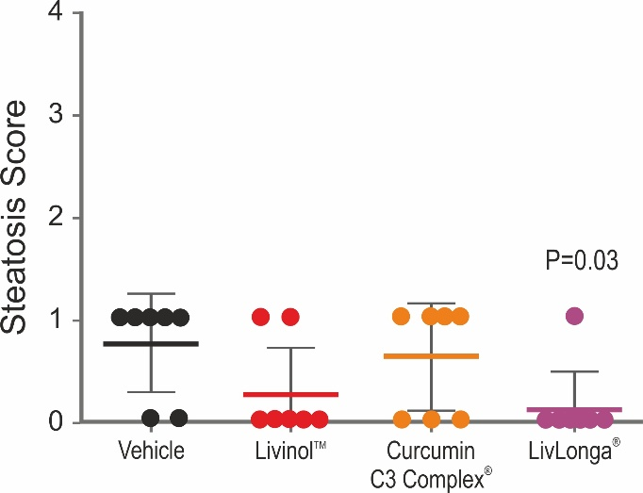
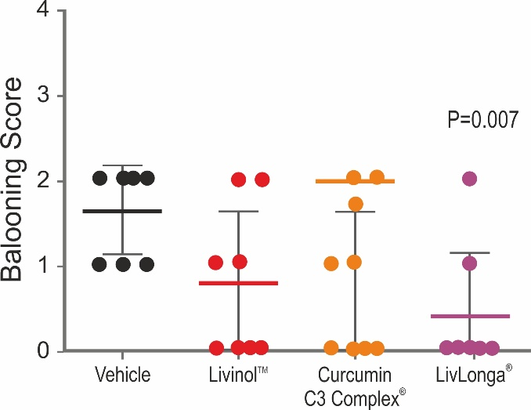
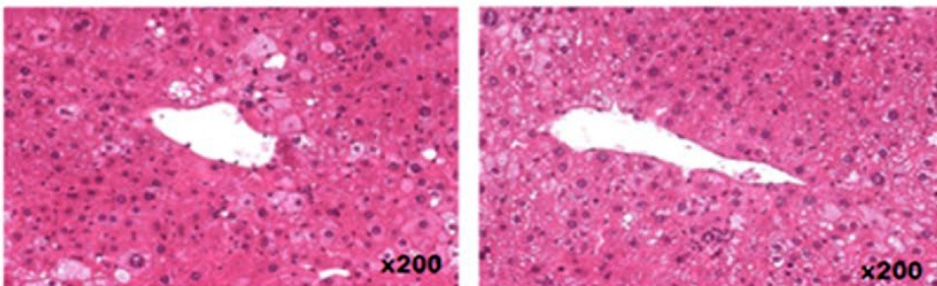
Fatty Liver
Vehicle
LivLonga® showed significant decrease in Steatosis and Hepatocyte ballooning
Livinol™
Vehicle
Curcumin C3 Complex®
LivLonga®

Slide 29
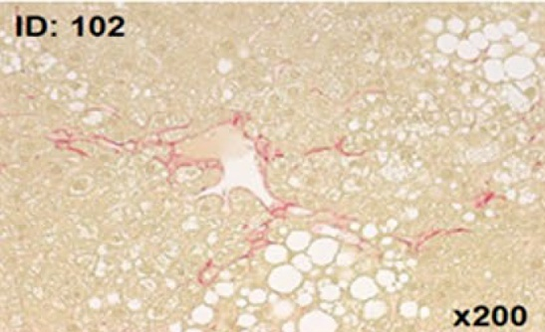
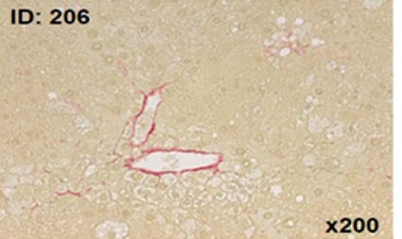
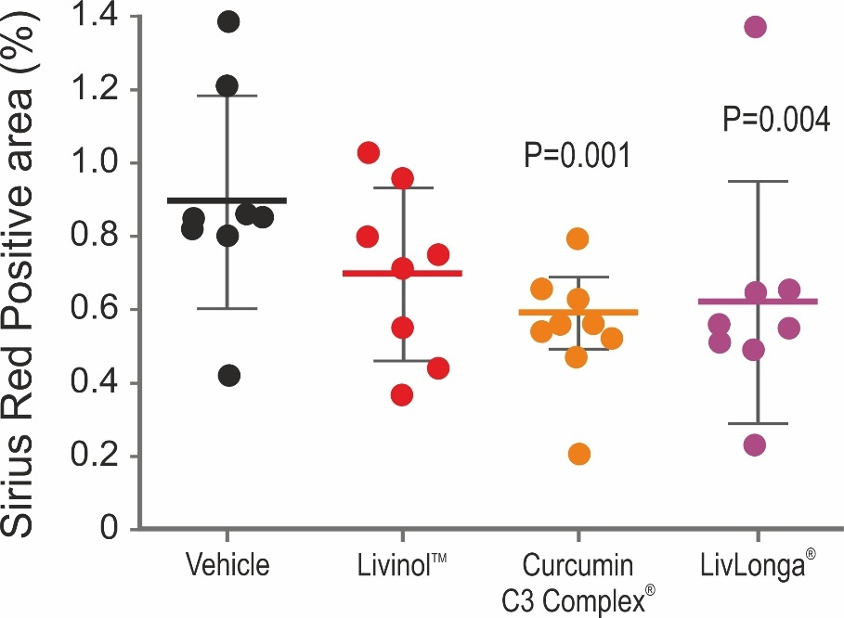
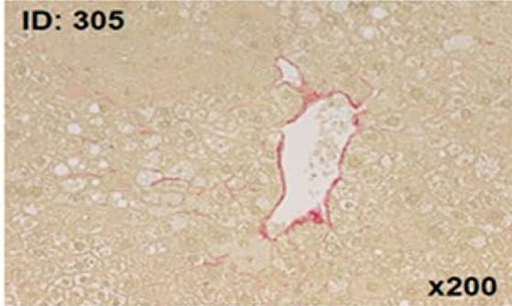
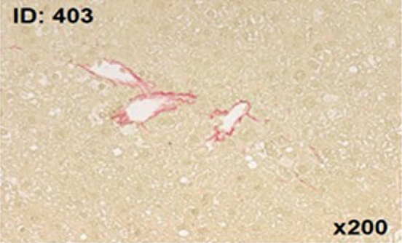
Liver Fibrosis
Vehicle
Reduced Collagen deposition as seen by Picrosirius red
Reduction in Area of Fibrosis
Livinol™
Curcumin C3 Complex®
LivLonga®

Slide 30







LivLonga® Clinical Trial Design
Study Type: Randomized, double-blind, placebo-controlled
Population: 72 patients with mild-to-moderate NASH
Age: 30-65 years
BMI: 25-35 kg/m²
Dosage: 2 tablets daily (450 mg each)
Duration: 90 days
Publication: Frontiers in Nutrition, 2023

Slide 31
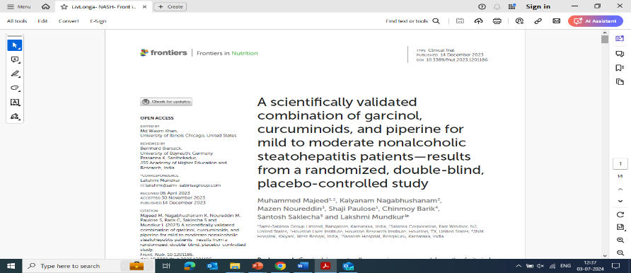

LivLonga® Effective in NASH Patients
Design & Subjects: Randomized, double-blind, placebo-controlled study in 72 mild-moderate NASH patients
Treatment: One tablet of LivLonga® (450 mg) or placebo twice daily for 90 days
Results: LivLonga® supplementation is safe and effective in
Improving liver enzymes, liver steatosis and fibrosis, inflammation, and lipid markers
Acts as an adjunct supplement in the management of NAFLD progressing to NASH
Clinical Study
Majeed et al., 2023. Front Nutr. 10: 1201186. doi: 10.3389/fnut.2023.1201186

Slide 32
Results
LivLonga® was effective in improving liver enzymes, and reduction in liver fat and liver stiffness.
Parameter | Group | Day 0 | Day 90 | Mean change D90- D0 | P1
AST (IU/L) | Placebo | 60.74 ± 14.7 | 57.58 ± 19.2 | −3.16 (−6.78, 0.47) | <0.001
 | GCP | 63.09 ± 16.9 | 53.56 ± 17.3* | −9.53 (−12.79, −6.27)
ALT (IU/L) | Placebo | 69.16 ± 14.9 | 61.73 ± 22.8* | −7.43 (−13.12, −1.75) | 0.002
 | GCP | 70.69 ± 14.3 | 57.22 ± 18.9* | −13.47 (−18.43, −8.51)
LSM (kPa) | Placebo | 9.80 ± 3.00 | 9.86 ± 2.56* | 0.064 (−0.89, 1.03) | 0.001
 | GCP | 10.23 ± 3.38 | 9.60 ± 2.87** | −0.56 (−1.4, 0.26)
CAP (db/m) | Placebo | 270.5 ± 22.36 | 260.1 ± 30.75 | −10.42 (−21.59, 0.75) | 0.03
 | GCP | 269.6 ± 22.17 | 257.2 ± 21.42* | −12.38 (−17.37, −7.38)
FAST Score | Placebo | 0.54 ± 0.12 | 0.49 ± 0.17 | −0.04 (−0.088, 0.008) | 0.001
 | GCP | 0.55 ± 0.17 | 0.46 ± 0.17** | −0.08 (−0.12, −0.04)
ALT: Alanine Aminotransferase; AST: Aspartate Aminotransferase; CAP: Controlled attenuation parameter (fat attenuation by Fibroscan);
LSM: Liver stiffness measurement by Fibroscan; FAST: Fibroscan AST Score.
GCP means LivLonga®
Majeed et al., 2023. Front Nutr. 10: 1201186. doi: 10.3389/fnut.2023.1201186

Slide 33

LivLonga® Clinical Results - Liver Health
Significant Improvements vs. Placebo:
Liver Enzymes:
AST: -9.53 U/L (p<0.001)
ALT: -13.47 U/L (p=0.002)
Liver Stiffness (LSM): -0.56 kPa (p=0.001)
Liver Fat (CAP): -12.38 db/m (p=0.03)
FAST Score: -0.08 (p=0.001)
Non-invasive marker for NASH with fibrosis

Slide 34
Lipid Levels
Parameter | Group | Day 0 | Day 90 | % change | #P value
Total Cholesterol | Placebo | 258.19±37.45 | 256.23±44.37 | 0.76% | <0.001
 | LivLonga® | 261.21±33.98 | 247.38±27.32** | 5.29%
Triglycerides | Placebo | 192.68±42.07 | 184.09±56.20 | 4.45% | <0.001
 | LivLonga® | 191.13±40.72 | 167.38±25.17 | 12.43%
Low -density lipoprotein-cholesterol | Placebo | 142.26±26.95 | 138.6±27.33 | 2.57% | 0.002
 | LivLonga® | 143.21±19.97 | 136.66±13.13 | 4.57%
Very low -density lipoprotein-cholesterol | Placebo | 43.26±8.85 | 41.55±12.76 | 3.95% | 0.005
 | LivLonga® | 43.75±8.6 | 38.69±6.20** | 11.56%

Slide 35
LivLonga® Clinical Results – Metabolic Benefits
Comprehensive Metabolic Support:
Lipid Profile:
Total cholesterol: -12.44 mg/dL
LDL-C: -11.05 mg/dL
VLDL-C: -5.06 mg/dL
Triglycerides: -23.75 mg/dL
Body Composition:
Weight loss: -2.72 kg
BMI reduction: -1.18 kg/m²
Waist circumference: -1.45 cm
The mean change in body weight (2.8%) and waist circumference (1.5%) from baseline to end of study was significant ( P<0.001) in LivLonga compared to placebo

Slide 36
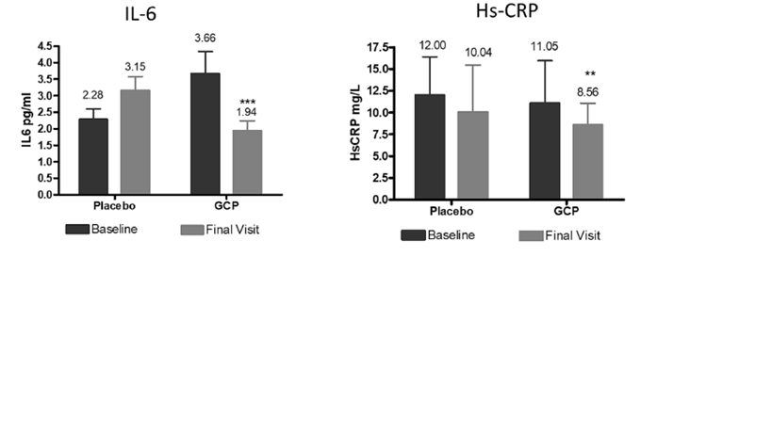
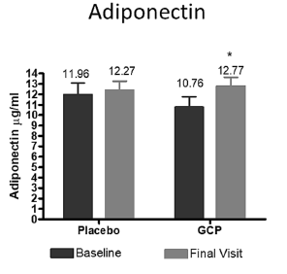
Results
LivLonga® was effective on inflammatory markers. It showed:
Significant decrease in interleukin-6 and C Reactive Protein (hs-CRP)
Significant increase in adiponectin (a hormone that prevents lipid storage and protects the liver from inflammation and fibrosis)
Improvement in body weight and serum lipid levels
Majeed et al., 2023. Front Nutr. 10: 1201186. doi: 10.3389/fnut.2023.1201186
GCP means LivLonga®

Slide 37

Safety
LivLonga® was found to be safe in the clinical study with no changes in the vital parameters, hematological and biochemical parameters like:
Hematology
Serum electrolysis
Urine analysis
Thyroid function test
Renal function test (serum creatine, uric acid)
Safety profile of LivLonga®, was comparable to placebo without any adverse events
Preclinical 90 day repeated dose safety studies - No observed toxicity at 600mg/kg (5g/day human dose)
LivLonga® is a safe liver nutrient for human consumption

Slide 38
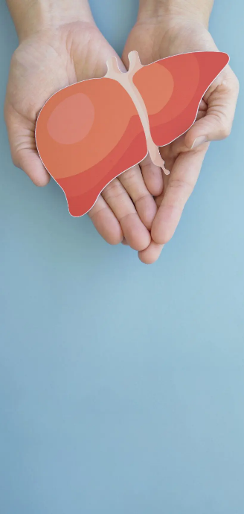
LivLonga® Mechanisms of Action Summary
Multi-Pathway Approach:
Reduces hepatocyte ballooning
Reduces pathological collagen deposition
Lowers inflammation (TNF-α, IL-6, NF-κB)
Decreases oxidative stress
Supports healthy lipid metabolism
Reduces liver steatosis and fibrosis
Improves overall liver function

Slide 39






LivLonga® Supports Active Aging
Multi-Pathway Approach
Metabolic resilience - sustained energy for daily activities
Anti-inflammatory action - reduced systemic inflammation that accelerates aging
Healthy body composition - supports weight management and muscle maintenance
Cardiovascular support - improved lipid profile for heart health
Glucose regulation - stable blood sugar for consistent energy
Detoxification capacity - mental clarity and reduced toxic burden

Slide 40
Active Aging Starts with Liver Health
Your liver determines your metabolic age—not your chronological age
MASLD affects 30% of adults, silently stealing metabolic vitality
Early intervention reverses dysfunction and restores resilience
Prevention today = vitality tomorrow
LivLonga® provides comprehensive, clinically-proven support for:
Maintaining metabolic efficiency
Supporting healthy inflammation response
Preserving detoxification capacity
Enabling the active, independent life you want to live

Slide 41















A Pioneer in Botanical Innovations Established standards for Curcumin and other popular botanicals!
Sabinsa Snapshot
35+ Years of Botanical Expertise
130+
Products
503+
Patents
350+
Scientific Studies
8+
Manufacturing Sites
19
Countries
120+
Scientists
700+
Publications

Slide 42



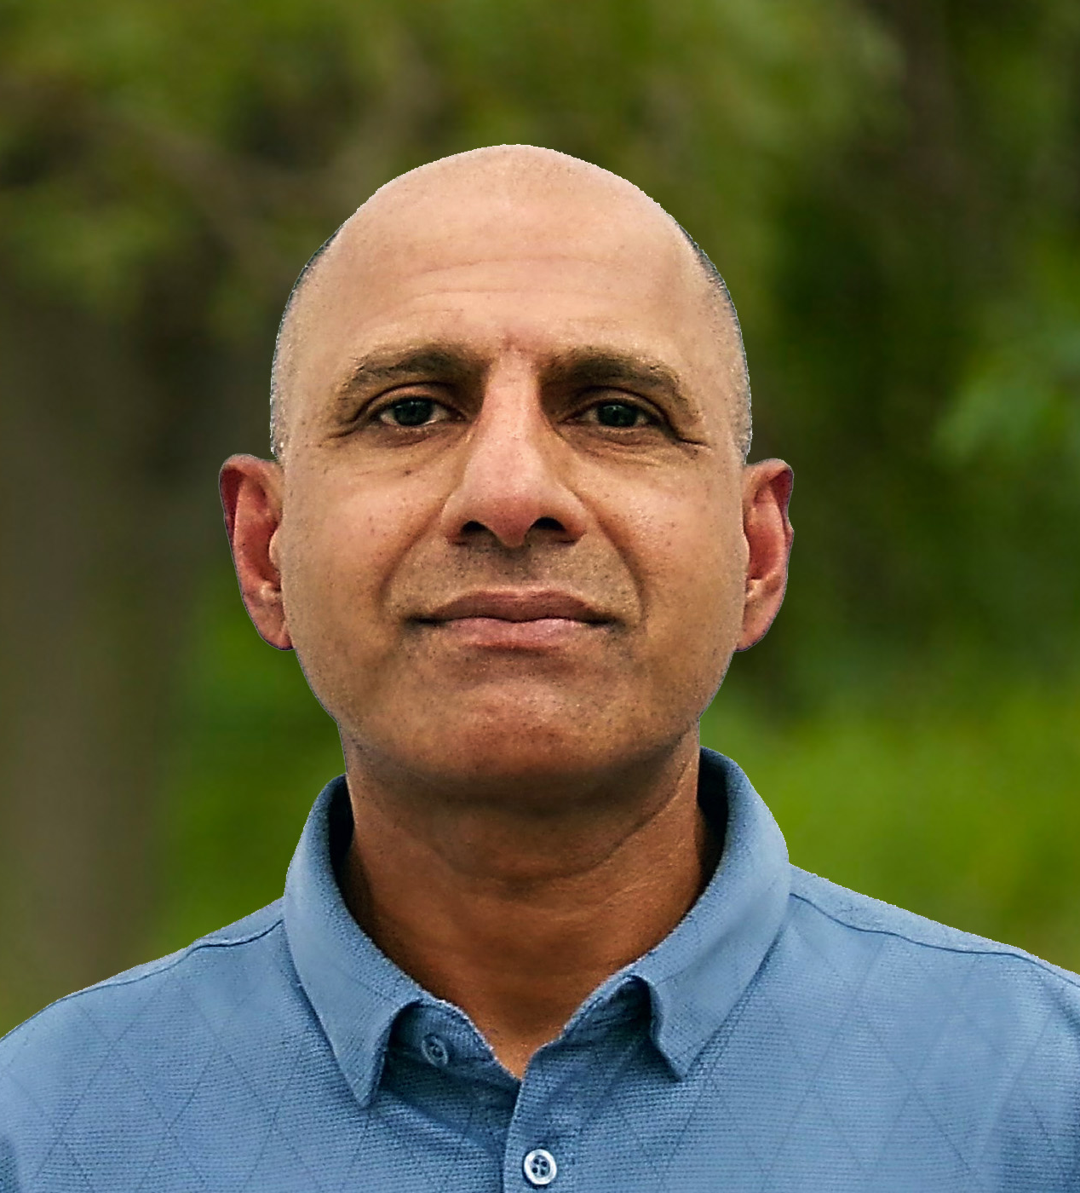

Questions & Answers
Contact Information:
Website: www.sabinsa.com | www.livlonga.com
Email: info@sabinsa.com
Phone: +1 (732) 777-1111
Speakers:
Mo Hussain
VP Strategic Affairs
Dr. Sreeram Krishnan
Global Sr. Manager, IP & Scientific Strategy and Compliance

Slide 43
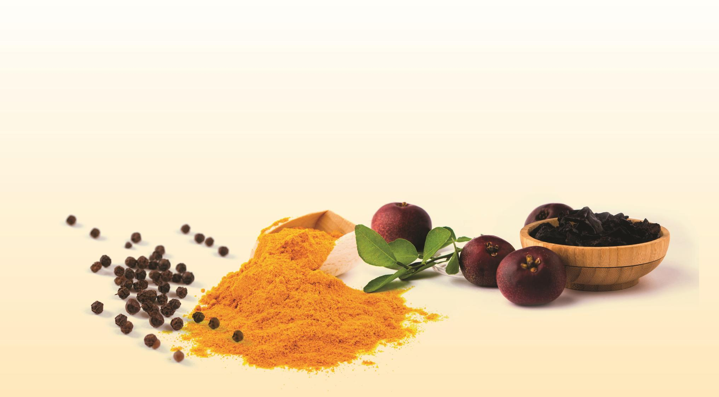

Thank You!

Slide 44


























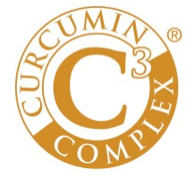





















sabinsa.com
participating members of:

