Slide 1

BioCell Collagen®
The Quintessential Lifetime
Wellness Ingredient

Slide 2


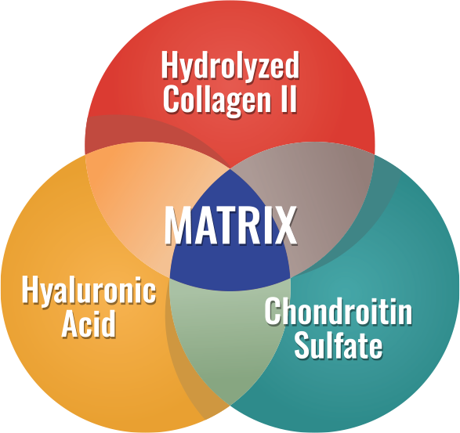

Not All Collagens are Alike!TM
CLINICALLY PROVEN DIETARY SUPPLEMENT INGREDIENT
UNIQUE SYNERGISTIC INGREDIENT

Slide 3
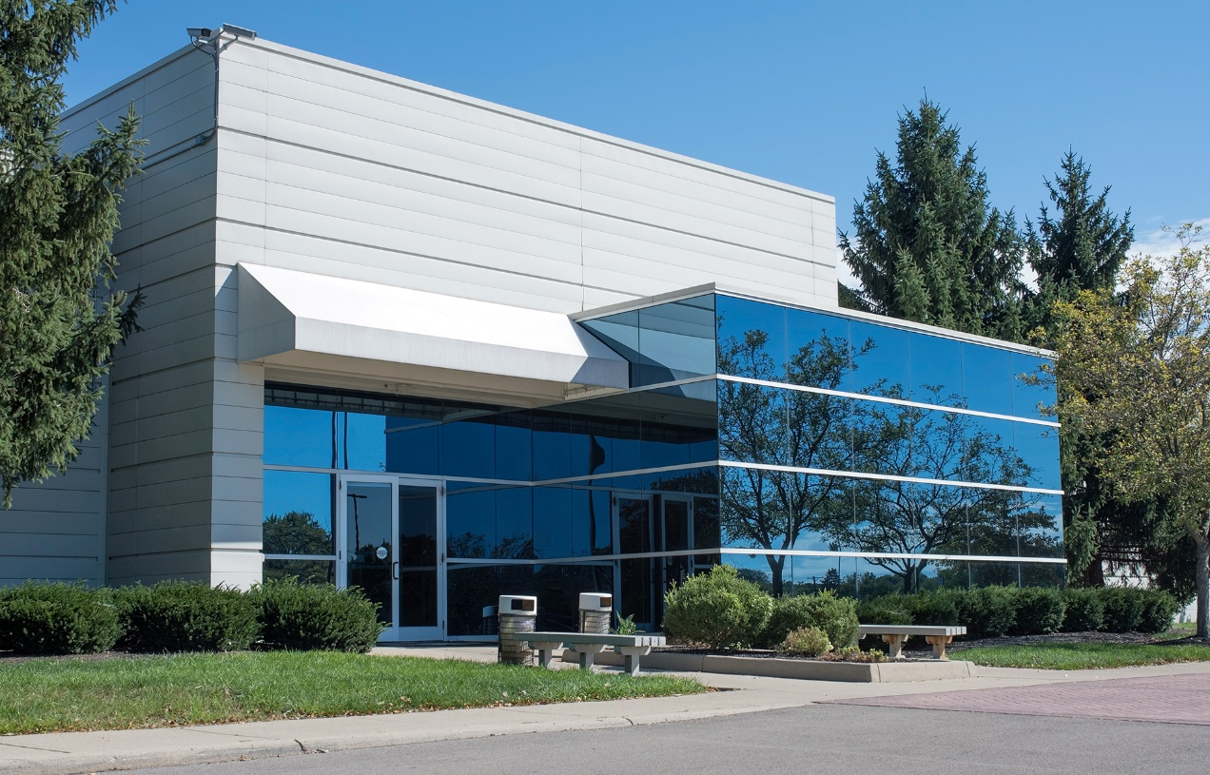

About BioCell Technology, LLC
Science in Every Cell, Beauty in Every You…
Born in 1997 – Revolution in Beauty begins with BioCell Collagen®, redefining the future of health and wellness
Innovation Without Borders – Global Trademarked — from Irvine, USA → Appen, Germany → 25+ Countries
Science-Backed Formula – Collagen II + Chondroitin Sulphate + Hyaluronic Acid where innovation meets protection
Where Science Meets Scale – B2B Licensing & Distribution
From Lab to Label – Ready innovation for marketers and manufacturers through trusted licensing partnerships.

Slide 4
BioCell Collagen®
Not All Collagens are Alike!
BioCell Collagen® — A patented matrix of hydrolyzed collagen II, chondroitin sulfate, and hyaluronic acid
Backed by 7 landmark clinical trials, BioCell Collagen® — proves its safety, efficacy, and bioavailability worldwide
UNIQUE SYNERGISTIC INGREDIENT

Slide 5
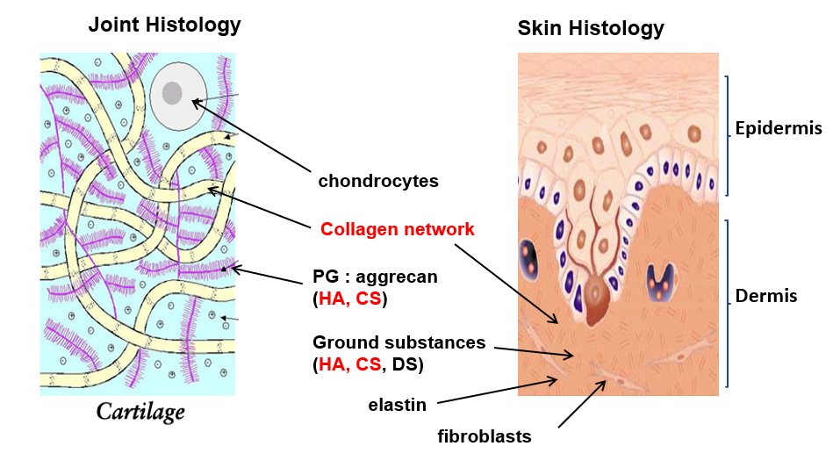
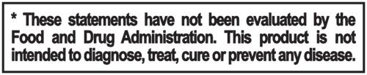
Extracellular Matrix (ECM)
Components of Connective Tissue
PG – Proteoglycan, HA - Hyaluronic Acid, CS - Chondroitin Sulphate, DS – Dermis and Subcutaneous Fatty Tissues

Slide 6
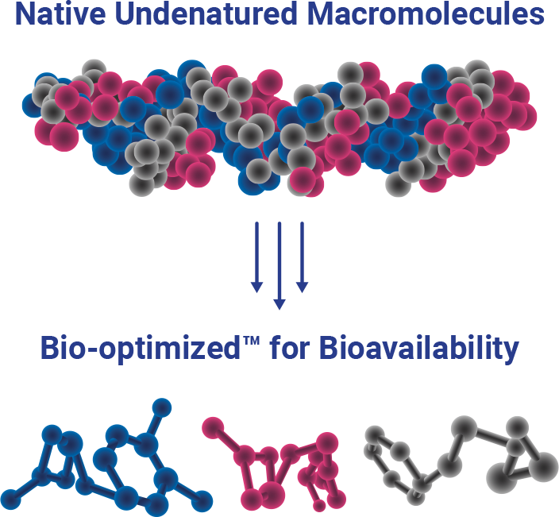
Innovation
Proprietary Technology
BioCell Collagen®
Dietary Ingredient
Better absorption
Novel biological properties

Slide 7


BioCell Collagen®
Nutricosmetic Human Studies
BEAUTY FROM
WITHIN

Slide 8
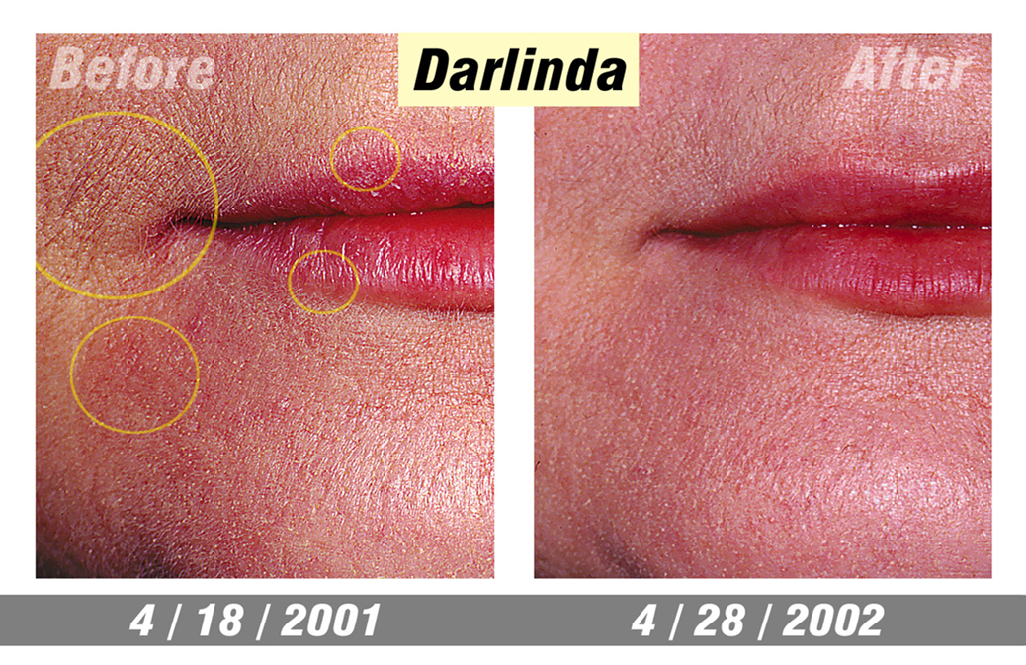
BioCell Collagen®
Human Case Study
*BioCell Collagen® supplementation in conjunction with facial exercises. Results not typical, individual results may vary.
Source: Sardi, B. (2002). How to Live 100 Years Without Growing Old. San Dimas: Here and Now Books

Slide 9
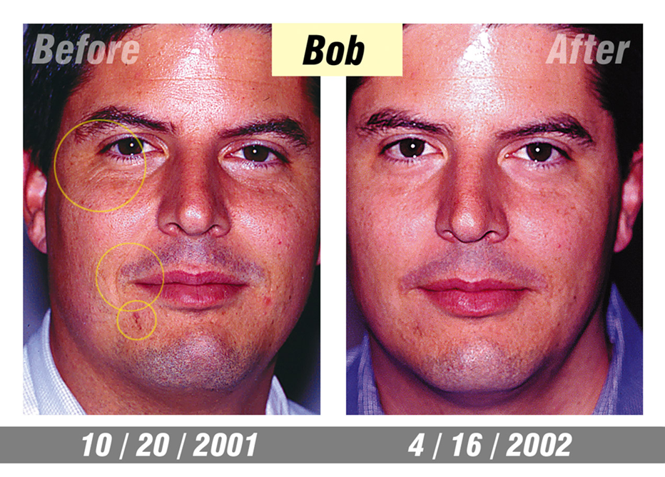
BioCell Collagen®
Human Case Study
*BioCell Collagen® supplementation in conjunction with facial exercises. Results not typical, individual results may vary.
Source: Sardi, B. (2002). How to Live 100 Years Without Growing Old. San Dimas: Here and Now Books

Slide 10

BioCell Collagen®
Clinical Study (2012)
Open-Label Study on Facial Aging Signs study design
Participants: 26 women (ages 35–59)
Intervention: 1 g BioCell Collagen® daily, 12 weeks
Efficacy endpoints
Category | Measures
Visible Skin Changes | Skin dryness/scaling Wrinkles & fine lines Skin tone
Skin Health & Function | Hydration Collagen levels Blood microcirculation
Source: (Schwartz and Park et al., 2012; Schwartz et al., 2019)

Slide 11
Hydration and Wrinkle Reduction*

Slide 12
Facial Collagen & Microcirculation Boost*
P=0.018
P=0.002

Slide 13
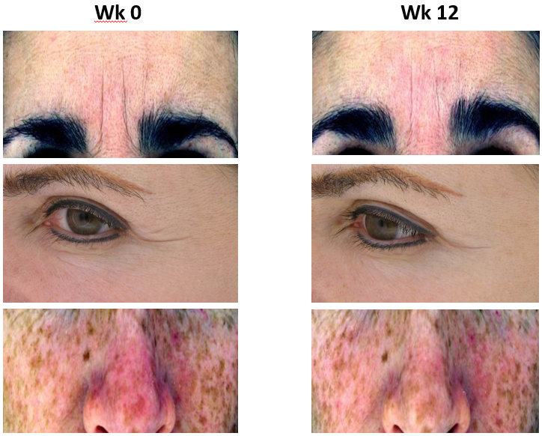
Conclusions
BioCell Collagen® Demonstrated:
Reduction in Facial Aging Signs
Significant reduction of facial lines & wrinkles*
Improved Skin Hydration
Significant reduction of facial skin dryness & scaling*
Boosted Skin Structure
Significant increase in dermal collagen content & microcirculation*
Source: (Schwartz and Park et al., 2012; Schwartz et al., 2019)

Slide 14

BioCell Collagen® RCT Clinical Study (2019)
Clinical Trial Overview
Design: Randomized, Double-Blind, Placebo-Controlled
Participants: 113 women (ages 39–59)
Intervention: 1g BioCell Collagen® daily for 12 weeks
Efficacy Endpoints
Category | Measures
Skin Hydration & Barrier Function | Transepidermal water loss Hydration levels
Skin Structure & Elasticity | Viscoelasticity Collagen content (indirect)
Skin Tone & Appearance | Melanin & hemoglobin levels Photographic analysis
Visible Signs of Aging | Facial lines & wrinkles Crow’s feet wrinkles Skin texture & smoothness Skin tone, erythema, dryness
The study findings are published in the journal of Alternative Therapies in Health and Medicine (2019). (https://www.ncbi.nlm.nih.gov/pubmed/31221944)

Slide 15
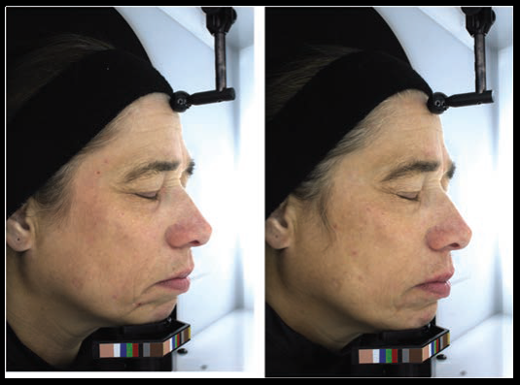
Conclusions
BioCell Collagen® Clinical Results (vs. Placebo)
Wrinkle Reduction
↓ Facial lines & wrinkles (P = .019)
↓ Crow’s feet wrinkles (P = .05)
Skin Strength & Elasticity
↑ Skin elasticity (P = .008)
↑ Collagen content by 12% (P < .001)
Youthful Skin Appearance
Improved visual grading & wrinkle width (P = .046)
Hydration & Comfort
↓ Skin dryness & erythema
Safe & Well Tolerated
No adverse events reported
Baseline 12 weeks
The study findings are published in the journal of Alternative Therapies in Health and Medicine (2019). (https://www.ncbi.nlm.nih.gov/pubmed/31221944)

Slide 16
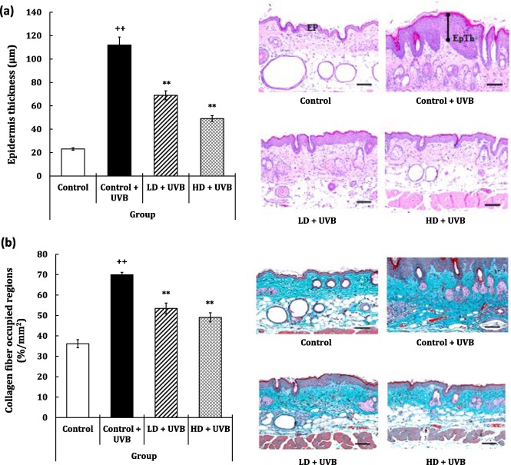
BioCell Collagen® Photoaging Lab Study (2020)
Study Design (40 Subjects, Divided Equally)
No UVB + No Supplement
UVB Exposure + No Supplement
UVB Exposure + BioCell Collagen® (1 g & 3 g daily)
Results:
Reduced photoaging
Fewer Wrinkles – Visible reduction in fine lines
Better Hydration – Lower transepidermal water loss (TEWL)
Stronger Skin – Improved elasticity and resilience
Boosted Hyaluronic Acid – More supple, plump skin
The study findings are published in the Journal of Functional Foods (2020). (https://www.sciencedirect.com/science/article/pii/S1756464620300943)
**BioCell Collagen® cannot replace sunscreen

Slide 17
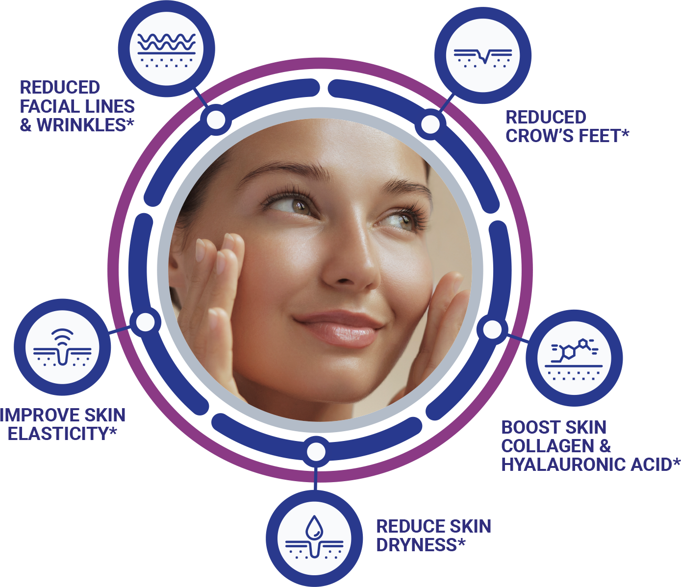
Skin Health Structure Function Claims & Clinical Dosage
Meets Gold Standard of Two Human Clinical Studies
Dietary supplements that contain a daily dosage of 1 gram of BioCell Collagen® can substantiate:

Slide 18

BioCell Collagen® Joint Health Human Studies
Not All Collagens Are AlikeTM
Promotes Joint comfort and mobility*
Boosts collagen type II & hyaluronic acid*

Slide 19
BioCell Collagen®
Joint Health Human Clinical Trial (2004)
Trial Design | Randomized, Double-Blind, Placebo-Controlled Pilot Trial
Population | 16 adults, evenly split into 2 groups
Intervention | 1000 mg BioCell Collagen® twice daily (2 g total) for 8 weeks
Comparison | Placebo
Results | BioCell group showed 40% improvement in joint comfort
Safety | No adverse events reported
40%
Average
Improvement
The study details were presented at the international conference of Experimental Biology, 2004, Washington, DC.

Slide 20
BioCell Collagen®
Joint Health Human Clinical Trial (2012)
Effect of BioCell Collagen®, on Improving Joint Comfort:
A Randomized, Double-Blind, Placebo-Controlled Trial
Study Parameter | Details
Sample Size | 80 subjects divided into two groups
Dosage | 2 g BioCell Collagen® or placebo daily for 10 weeks
Joint Comfort | Significant improvement at day 35 (p=0.017) and day 70 (p<0.001)
Physical Activity | Improved compared to placebo at day 35 (p=0.007) and day 70 (p<0.001)
Tolerance & Safety | Well tolerated and effective; improved mobility & quality of life
The peer-reviewed study was published in the Journal of Agriculture and Food Chemistry. (https://pubs.acs.org/doi/10.1021/jf205295u)
(Schauss et al., 2012).

Slide 21
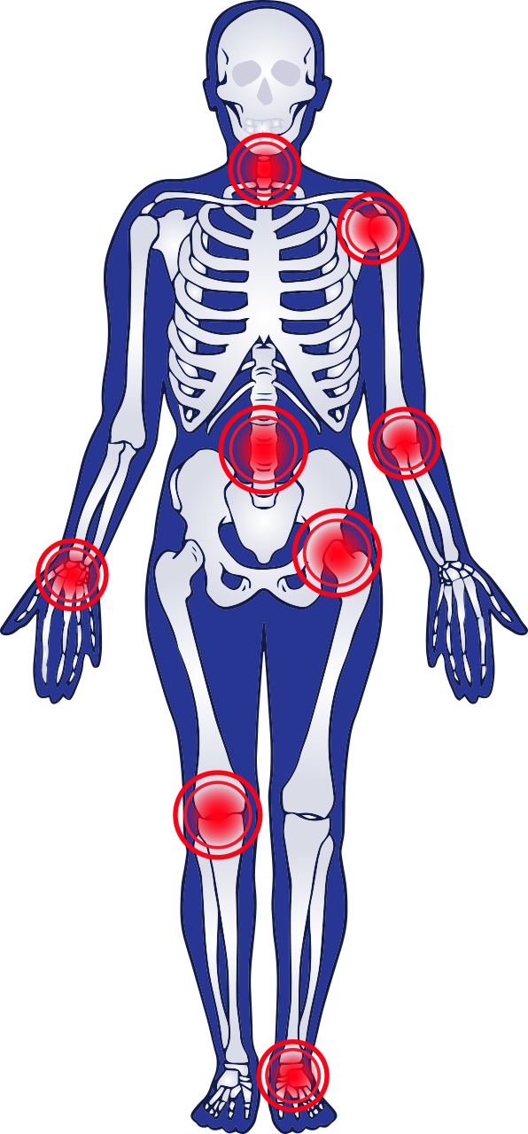
Joint Health Structure Function Claims & Clinical Dosage
Meets Gold Standard of Two Human Clinical Studies
Dietary supplements that contain a daily dosage of 2 grams of BioCell Collagen® can substantiate:
Promotes Joint comfort and mobility*
Boosts collagen type II & hyaluronic acid*
http://www.ncbi.nlm.nih.gov/pubmed/22486722

Slide 22
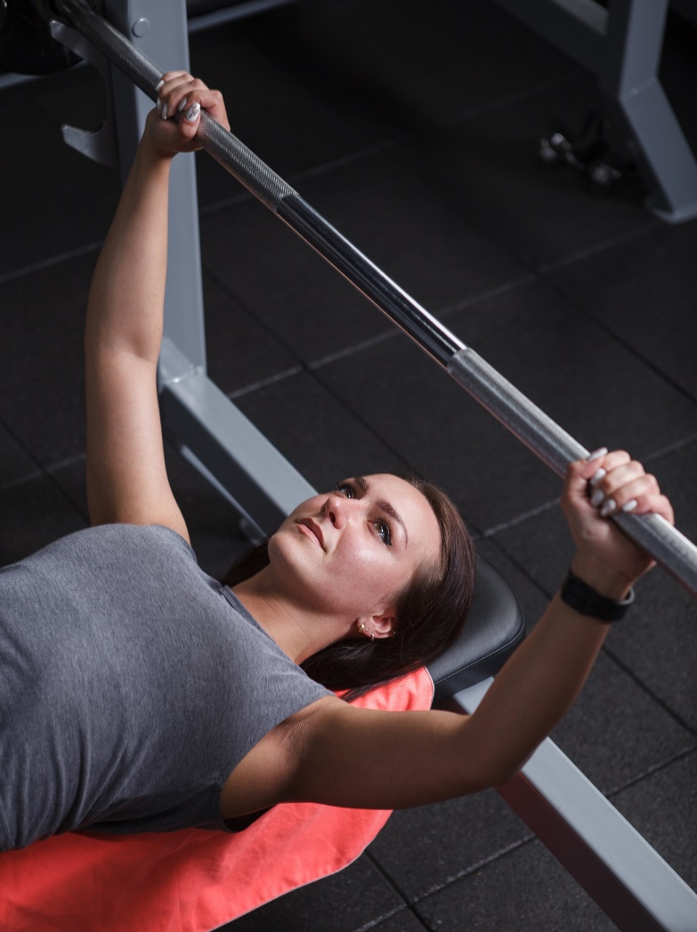
RCT on Sports Nutrition (2014)
Study Design: Randomized, double-blind, placebo-controlled trial, Total participants: N = 8, BioCell Collagen (BCC): 4 subjects, Placebo: 4 subjects
Participant Profile & Intervention: Healthy, recreationally active adults, Age range: 18–55 years, Daily Dose: 3 g BioCell Collagen or placebo, Duration: 6 weeks
Exercise Stress Challenge Protocol: Post-Supplementation Exercise Assessment - Conducted 6 weeks after daily supplementation
Day 43: Bench Press Protocol:
8 sets at 80% of body weight
Complete maximum repetitions per set
Objective: Assess muscle strength-endurance response to stress
Day 46: Repeat the same bench-press challenge
Objective: Evaluate muscle strength-endurance recovery and return of functional performance
http://www.ncbi.nlm.nih.gov/pubmed/22486722

Slide 23
Reduced Decrement in Repetition Performance*
-Evidence of “RBE” in both groups
-Less performance decrement and amplified RBE in BioCell group
BCC may enhance “stress resilience” to high intensity resistance exercise, as the decrement in bench press repetitions to failure was only 43-49%, vs. 55-60% in the placebo group.*

Slide 24
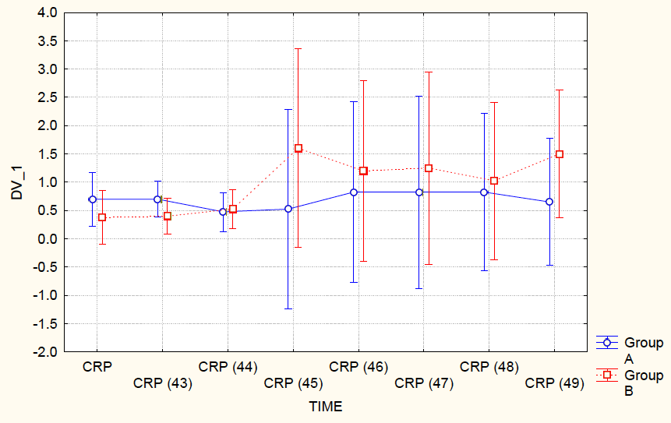
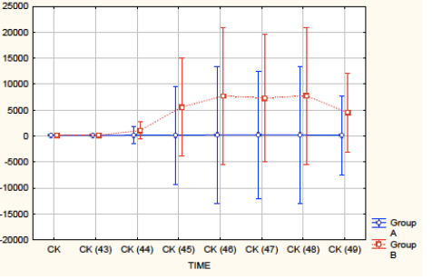
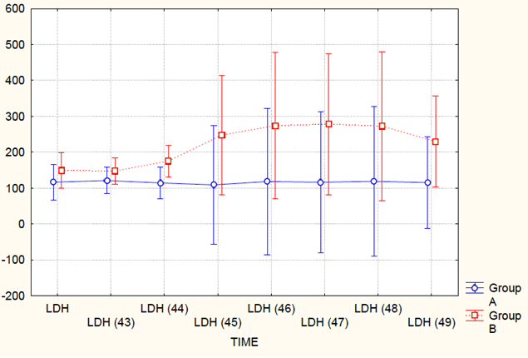
Mitigation of the Effect of Exercise-
Induced Muscle Damage*
CRP: C-Reactive Protein
CK: Creatine Kinase
LDH: Lactate Dehydrogenase
Group A - BioCell Collagen
Group B - Placebo
http://www.ncbi.nlm.nih.gov/pubmed/22486722

Slide 25
SPORTS
NUTRITION

Slide 26
BioCell Collagen®
^{Branded Ingredient}
Offers 5 Strong Value Propositions
to CPG Brands

Slide 27

Why Choose Us?
Unshakable Consumer Confidence
Clinically Backed Brilliance
Gold-Standard Quality & Compliance
Transparent & Trusted Supply Chain
Education + Marketing Powerhouse

Slide 28

Proud makers of BioCell Collagen® ERP
(Extra Refined Palatable)
Specially formulated for sensory delivery formats such as gummies, soft chews, lozenges, and lollipops
ERP stands for “Extra Refined Palatable” — designed for consumers who prefer the convenience and ease of taking supplements in a non-pill format

Slide 29


NOT ALL COLLAGENS ARE ALIKE!TM
EVEN FEWER ARE HALAL CERTIFIED!
BIOCELL COLLAGEN HAS A VERSION THAT IS HALAL CERTIFED BY THE ISLAMIC INFORMATION DOCUMENTATION AND CERTIFICATATION GmbH

Slide 30
THANK YOU!
info@biocelltechnology.com
www.biocelltechnology.com
BIOCELL TECHNOLOGY, LLC 20 TRUMAN STREET,
SUITE 105 IRVINE, CA 92620 USA
PHONE: 714-632-1231
BIOCELL TECHNOLOGY INTERNATIONAL GMBH GROTHWISCH 6 B 25482 APPEN GERMANY
PH+49 (0) 4101 58 777 22
DISCLAIMER: BioCell Technology, LLC (“BioCell”) makes no representations or warranties, express or implied, of the accuracy, reliability, or completeness of the information concerning this product or brochure, or its use or fitness for any purpose. BioCell does not assume liability, whether direct or indirect, for any use of the information presented in this brochure for any reason by any person or entity. Use of this information shall be at your discretion and risk. Nothing herein relieves you from consulting with an attorney or regulatory consultant or carrying out suitability determinations and tests and from your obligation to comply with all applicable laws and regulations and to observe all third-party rights. Nothing in this presentation constitutes a license (explicit or implicit) of any of BioCell’s intellectual property rights. The statements about this product have not been evaluated by the United States Food and Drug Administration (FDA). This product is not intended to diagnose, treat, cure, or prevent any disease. The uses and claims for BioCell’s products recommended in the brochure should be adapted to the local regulations in connection with the manufacturing, marketing, sale and use of BioCell products.

