Slide 1
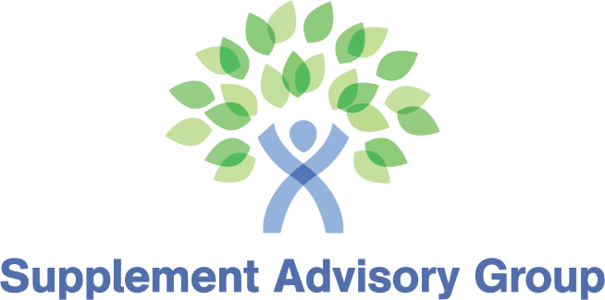
Regulatory Reality Check:
What Supplement Brands Need to Know About the Healthspan Category
Asa Waldstein
Principal, Supplement Advisory Group

Slide 2

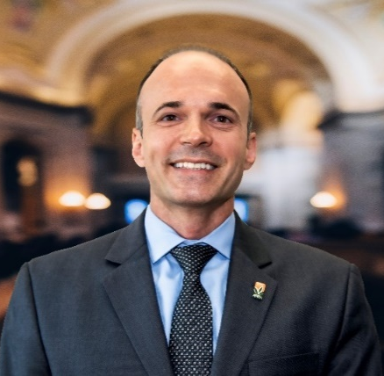

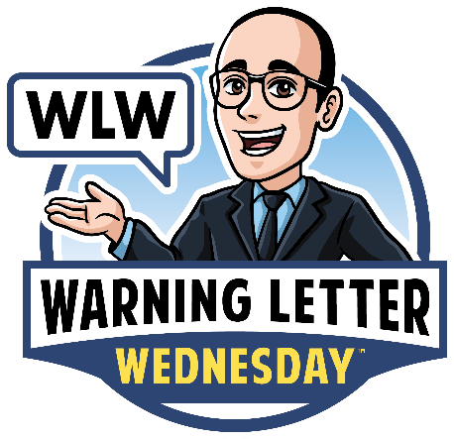
Asa Waldstein
Principal: Supplement Advisory Group
Founder: Asa’s Regulatory Education Series
American Herbal Products Association (AHPA)
  Technology & AI Innovation Committee Chair
20+ Years Manufacturing/Marketing Supplements
Warning Letter Wednesday:
  Weekly regulatory post
AsaWaldstein.com

Slide 3

This presentation consists of general information. It is intended for general education only.
Due to the importance of individual facts of every situation, the generalization in this presentation may not necessarily be applicable to all situations. Changes in the law could make parts of this presentation obsolete in the future.
This information is provided with the understanding that if specific advice is required, the services of a competent attorney should be sought.
Legal
Disclaimer
AsaWaldstein.com

Slide 4



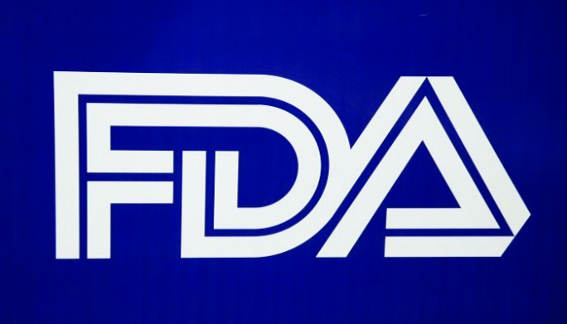
Substantiation is Important
FDA
FTC: Truth in advertising
NAD
  Challenges
  Monitoring case
Plaintiff’s Bar
Retailers/Advertisers: Amazon, Whole Foods

Slide 5

What Is Substantiation
Having sufficient evidence to support the truthfulness and non-misleading nature of statements.
Human data versus animal studies
RCT trials on ingredients versus product studies
Observational versus experimental studies

Slide 6
Competent & Reliable
Scientific Evidence (CARSE)
“tests, analyses, research, studies, or other evidence based on the expertise of professionals in the relevant area, that has been conducted and evaluated in an objective manner by persons qualified to do so, using procedures generally accepted in the profession to yield accurate and reliable results

Slide 7
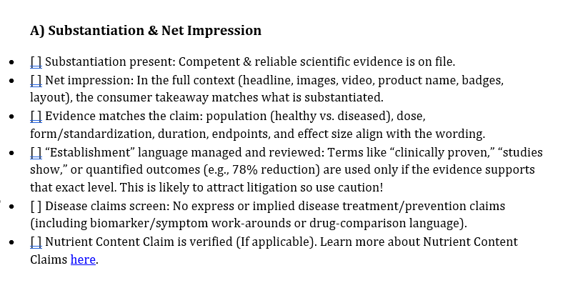

Your Compliance Checklist
Scan for download

Slide 8
Structure/Function Claims
Established by DSHEA
Labeling or material that describes
Effect on a structure or function of the human body
Characterization of how the nutrient affects the body
General well-being claims
Nutrient deficiency claims are allowed (Vitamin C and Scurvy, for example) but only if the disease prevalence in US is disclosed
Notes:
Let’s start off by talking about Structure/Function clams which are a type of claim established by FDA, and I have a few guiding principes of what this means here on the slide, >>> but essentially these are claims the structure or function of the body but do not have an impact on disease.

Slide 9

Structure/Function Claims
Examples:
“Calcium Helps Support Strong Bones*”
“Vitamin D Helps Support Positive Mood*”
“Magnesium Helps Support Digestive Regularity*”
Contrasted with non-compliant examples:
“Calcium Prevents Osteoporosis”
“Vitamin D Cures Depression”
“Magnesium helps treat chronic IBD-related constipation”

Slide 10



Lifespan: Targeted Claims Areas
Heart Disease
Mind & Memory
Joint Health (Implied Arthritis)
AsaWaldstein.com

Slide 11
Biomarker Claims Enforcement
  BergaMet North America LLC, FDA Warning Letter
“BergaMet Cholesterol Command is clinically proven to improve cholesterol levels. It reduces LDL”
AsaWaldstein.com
Notes:
.

Slide 12
Discussing Ingredient Benefits
Are Marketing Claims
  Essential Nutrients, FDA Warning Letter
  "Vitamin B3, red yeast rice, and pine bark extract [ingredients in CholestAid] supply a natural way to help your body lower bad cholesterol levels"
AsaWaldstein.com

Slide 13

Menopause Related Claims
Attribute statements to menopause
Night sweats = crossing the compliance line
Menopause-related night sweats = more compliant
AsaWaldstein.com

Slide 14
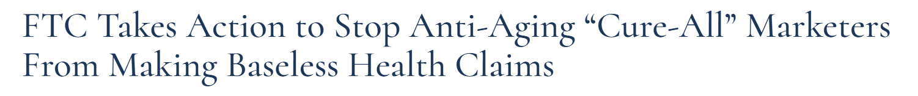
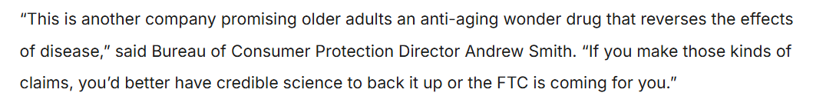
Longevity Products = Risky Category
Older adults = vulnerable population
AsaWaldstein.com

Slide 15
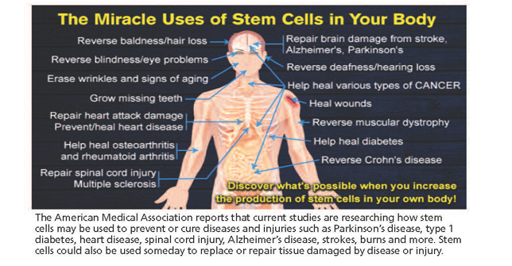
Vulnerable Populations + “Proven” Claims + Disease Prevention = FTC Action
AsaWaldstein.com

Slide 16
“Inflammaging” Claims
“Supports a healthy inflammaging response”
versus
“Reduces inflammaging, an indication of chronic disease”
AsaWaldstein.com

Slide 17
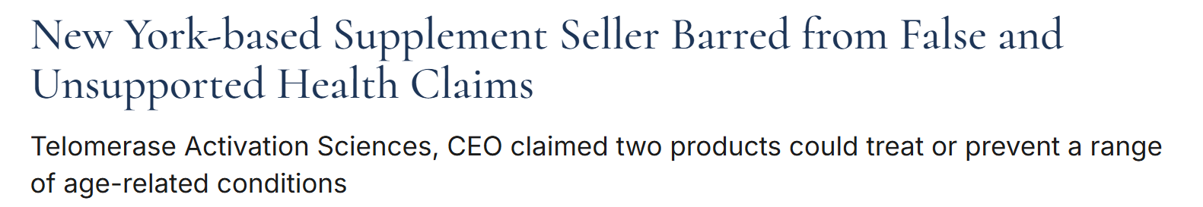
Telomere Claims
AsaWaldstein.com

Slide 18

“Better Than Drugs” Statements = Risky
FDA Warning Letter: JLM Nutritionals, Inc. dba JLM Nutrition—Super Naturals Health
On your blog "Natural IBS Treatment Versus Prescription Treatment For IBS Symptoms"
page:
• "On 04/25/16, Jordyn in Los Angeles wrote: . . . I have been suffering for about a year now with IBS-D. . . . I was then diagnosed with IBS-D. I had no idea that IBS could be so debilitating. . .Luckily I found IBS Formula! I have been off my medications and on this formula for a month. An entire month of no issues, no stomach pains, no missed days of work."
AsaWaldstein.com

Slide 19


Testimonials & Product
Reviews Can Be Claims
BergaMet North America LLC LLC, FDA Warning Letter
On your testimonial page
“Love Cholesterol Command! My ldl is down 28 points, my doctor was extremely surprised because I am allergic to statins so working on my cholesterol levels has been difficult until I found out about BergaMet ... haven’t seen my cholesterol this low in 15 years”
AsaWaldstein.com

Slide 20
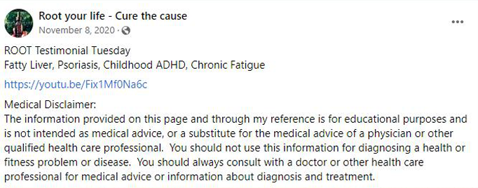
NAD Enforcement: Anti Aging Company
NAD Case: Root Wellness LLC, a/k/a Root Brands
AsaWaldstein.com

Slide 21
Product Names Are
Marketing Claims
  iwi FDA Warning Letter
  “The product’s name (iwi Cholesterol) is an implied claim that it reduces cholesterol.”
AsaWaldstein.com

Slide 22


Cognitive Function
FDA Claims Enforcement
  “Improved cognitive function” + “Parkinson’s = warning letter
AsaWaldstein.com

Slide 23

Risks Making “Libido” Claims
  Amazon will require increased testing
  Invites increased regulatory scrutiny
  Test product to ensure no adulteration
AsaWaldstein.com

Slide 24
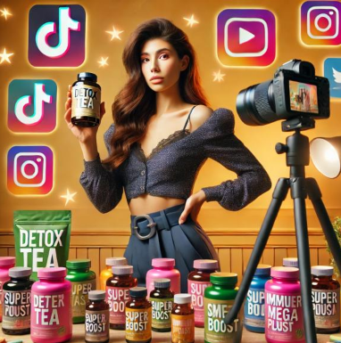
Social Media & Influencer Responsibility
Material Connection Is Required
Disclose connection in same manner as
endorsement. Example: verbal endorsement
requires verbal disclosure
Disclose free products
Use Platform Disclosures
Not sufficient for FTC disclosure
AsaWaldstein.com

Slide 25

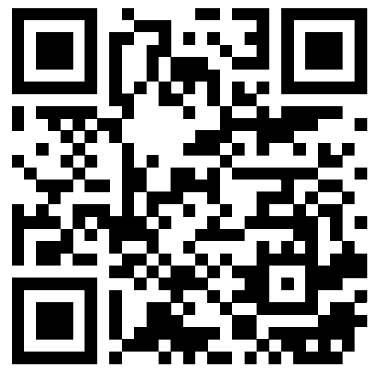
Thank You
    AsaWaldstein.com
    Supplement Advisory Group
AsaWaldstein.com

