Slide 1
A Longevity Lens on
Cardiometabolic Health

Slide 2
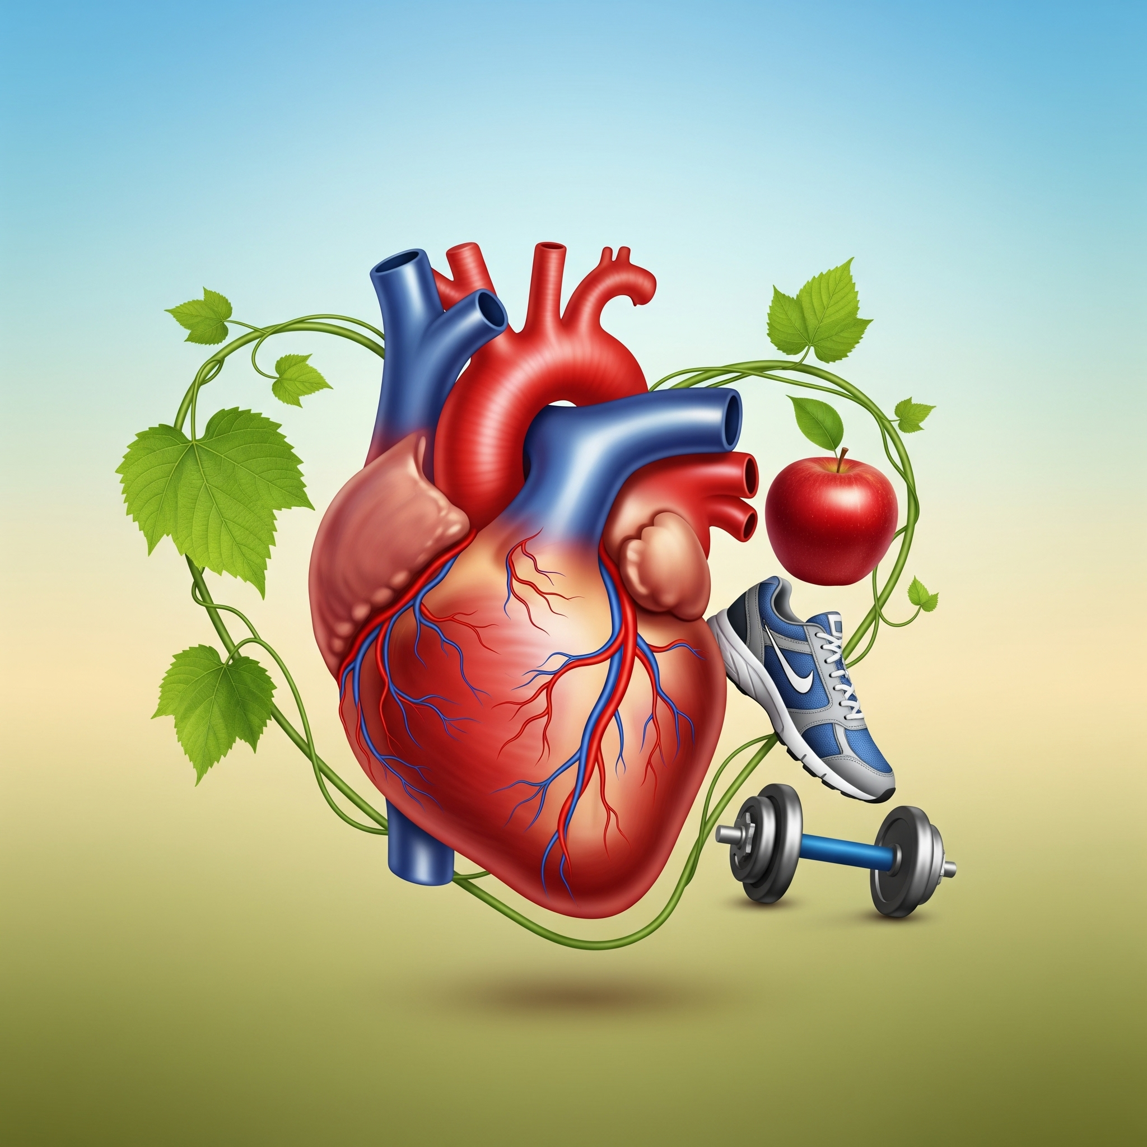
What is Cardiometabolic Health?
Cardiometabolic health is the combined well-being of your cardiovascular system (heart and blood vessels) and metabolic system (how your body processes energy).
It is a key indicator of overall health and a crucial factor in preventing common conditions of aging.

Slide 3
Indicators of Good Cardiometabolic Health
Normal blood pressure
Normal blood sugar levels
Healthy range cholesterol & triglyceride levels
Healthy waist circumference
Healthy body mass index (BMI)
No evidence of existing cardiovascular disease like a prior heart attack or stroke

Slide 4
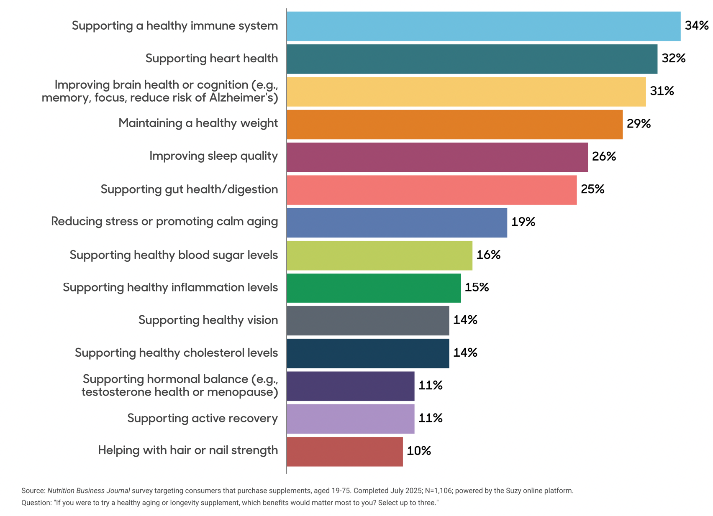
Healthy Aging Categories Consumers are Seeking
Cardiovascular Health is #2
Healthy weight is #4
But also high on the list are:
  Blood Sugar
  Inflammation
  Cholesterol
It is clear that health-minded consumers are already associating healthspan with cardiovascular and metabolic health

Slide 5
Key Focus Areas for
Natural Product

Slide 6
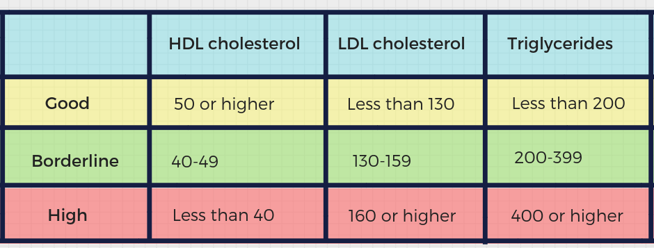
Healthy Blood Fats
The major blood fats are cholesterol (HDL, LDL, VLDL) and triglyceride
Healthy blood fats influence heart health, metabolic health, and inflammation.
Keeping them in range supports circulation, energy metabolism, and reduced long-term risk of conditions like heart attack and stroke

Slide 7
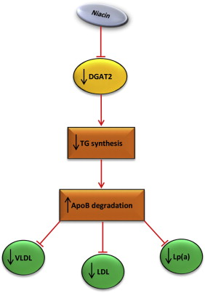
Niacin
Used both as a supplement and a drug
Only the crystalline form has CV benefits
Lowers LDL-C and triglycerides, raises HDL-C
Highly effective and well studied…BUT
Flushing, itching, tingling
Risk of liver tox with high or sustained-release forms.
Can worsen insulin resistance or raise fasting glucose
  Downregulates an enzyme that is important for insulin signaling

Slide 8
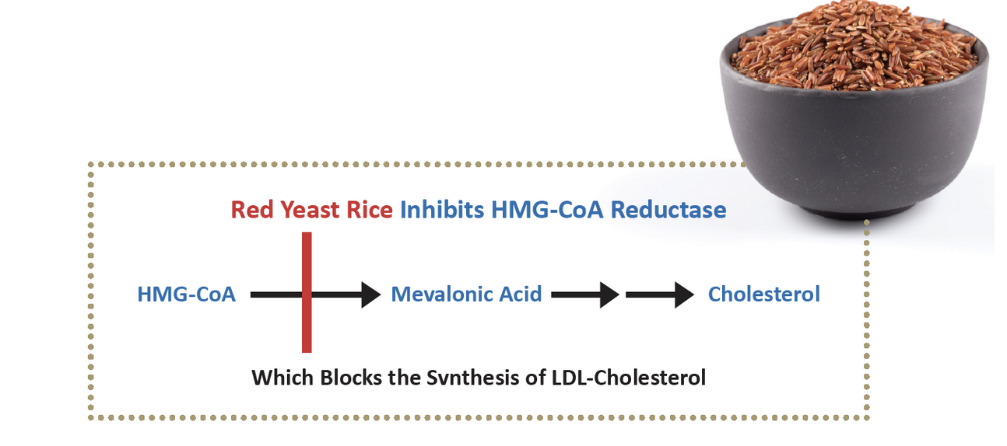
Red Yeast Rice (RYR)
Lowers LDL-C, total cholesterol, and ApoB.
Clinically comparable to low-dose statin therapy (monacolin K = lovastatin)
Also has anti-inflammatory vascular effects such as reduction of hsCRP
Should be used with CoQ10
Challenging regulatory history - mostly recently nearly banned in EU

Slide 9
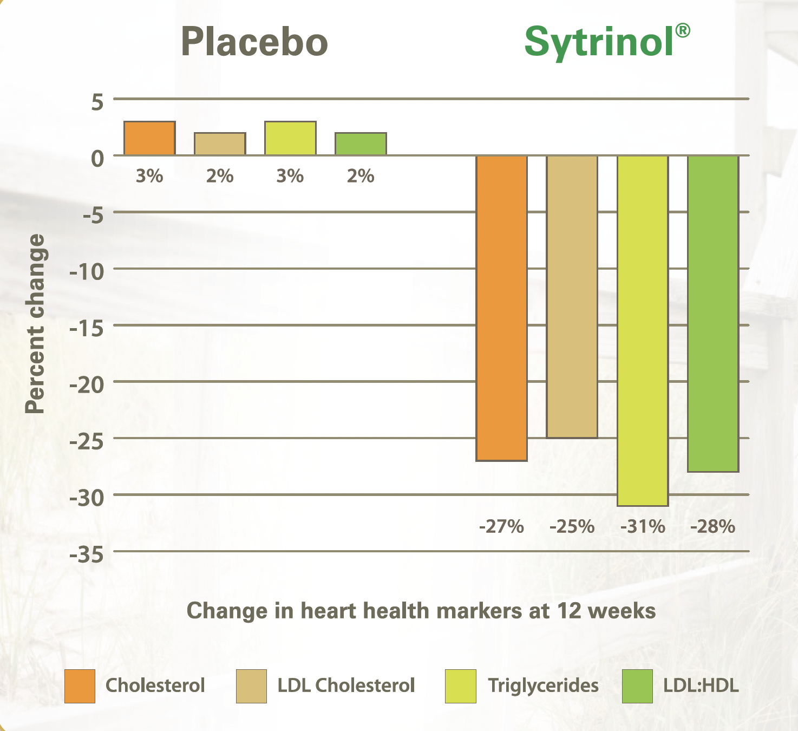
Polymethoxylated Flavones (PMFs)
PMFs do it all…
Class of flavonoid-related compounds compounds primarily found in the peels of citrus fruits
Dose of 150mg BID shows significant benefit at 4 weeks and even more at 12 weeks
Multiple clinical trials that repeat these results

Slide 10
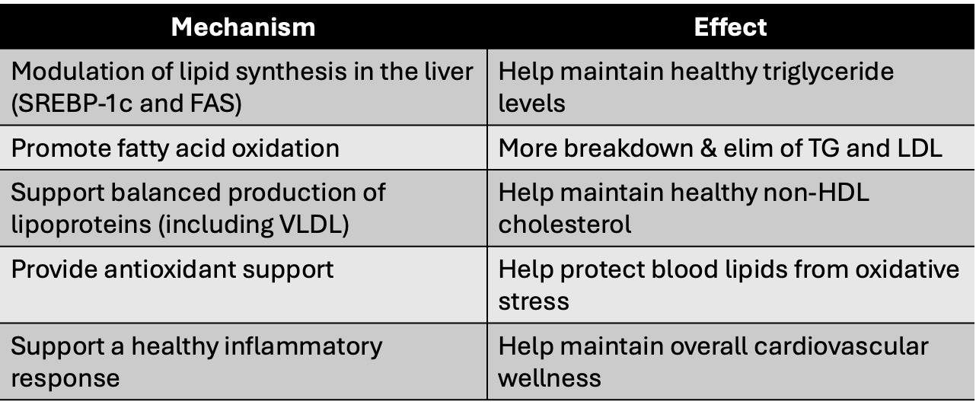
PMFs: Multi-mechanistic powerhouses

Slide 11
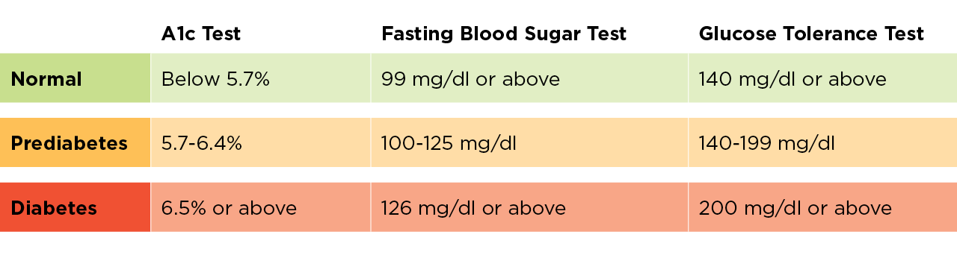
Blood Glucose Regulation
Keeping blood glucose and HbA1c in a healthy range is essential as high or fluctuating levels accelerate the processes that drive aging
Elevated glucose increases inflammation, oxidative stress, and glycation (the chemical reactions that damage proteins, blood vessels, and organs) over time.

Slide 12
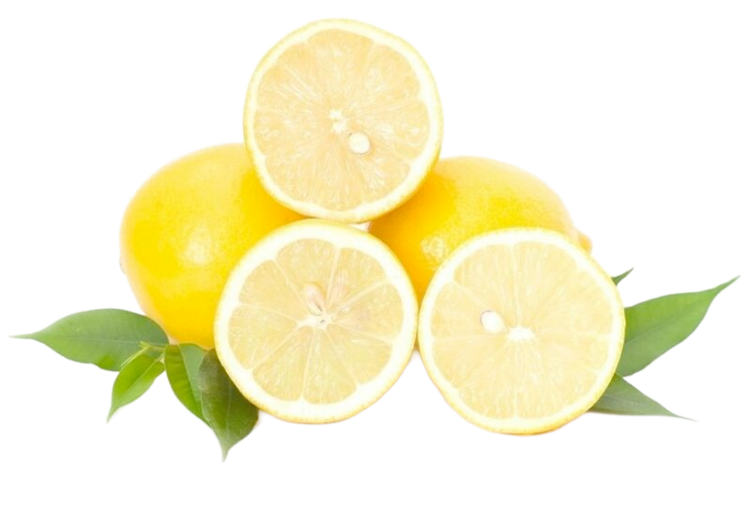
Lemon Flavonoids
Supports healthy blood glucose levels
Promotes increased insulin production
Boosts GLP-1 levels naturally
Maintains healthy inflammation response
Low dose: 200mg for a standardized blend of eriocitrin, hesperidin, naringin, and didymin (EriominⓇ)

Slide 13
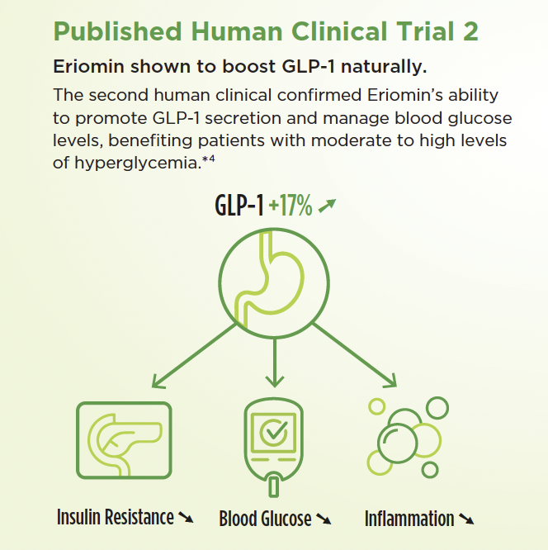
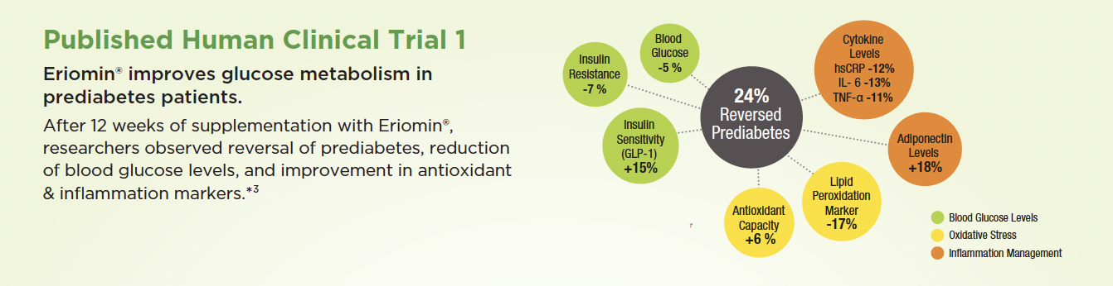
Lemon Flavonoids
The mechanisms proposed to explain the hypoglycemic properties of Eriomin-like compounds include:
Inhibition of the DPP-4 enzyme thereby boosting GLP-1 levels
Improving insulin secretion and glucose uptake
Parmar et al., 2012
Phytotherapy Research.2019;33:1921-1933.
Journal of medicinal food vol. 25,11 (2022): 1050-1058.

Slide 14
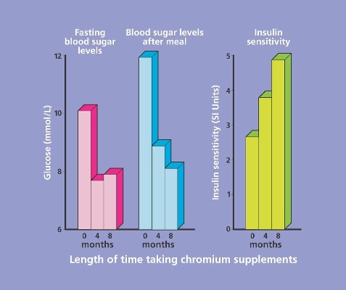
Chromium
Supports insulin sensitivity
Facilitates glucose transport into cells
Aids glucose tolerance and carbohydrate metabolism
May help modestly lower fasting blood glucose & post prandial
Int J Vitam Nutr Res 2004, Vol 74: pp. 178–182

Slide 15
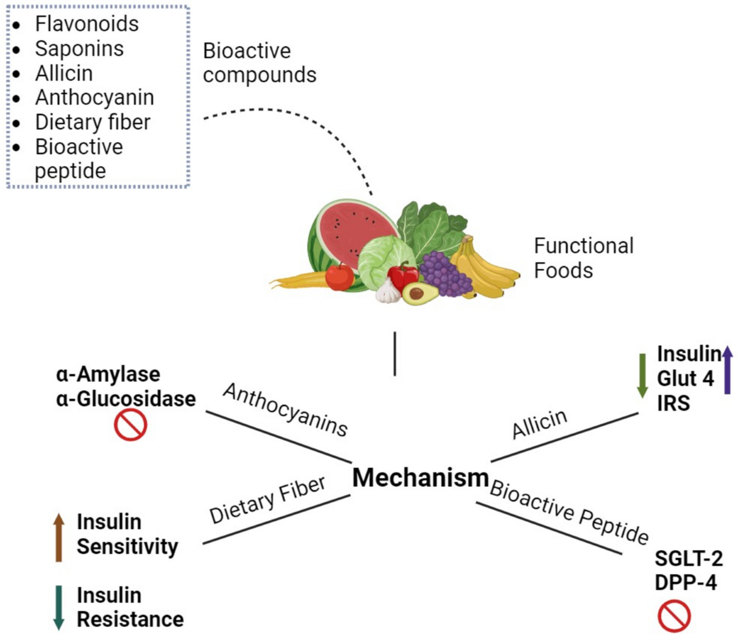
Other Notable Ingredients
Chromium
Bergamot
Garlic
Resistant Starch
Mulberry Extract
Artichoke Extract
Cocoa Flavonols
Chlorogenic Acid

Slide 16
Why this matters more than ever
More people than ever are focused on metabolic health and are motivated to make change
The more we can support them with effective tools the more impactful the changes will be

Slide 17
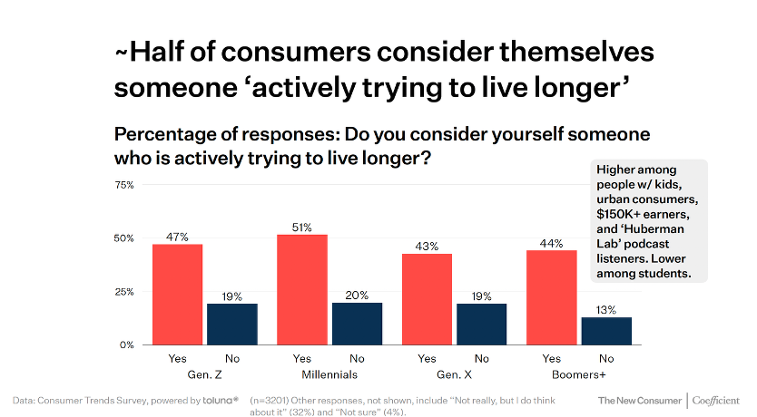
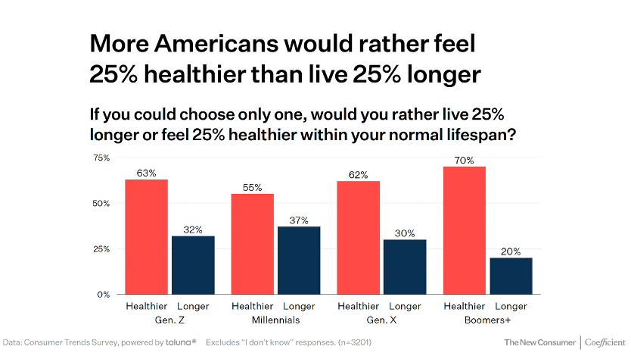
People want to live longer…but they want those years to be healthier
Addressing cardiometabolic health is probably one of the most powerful places to intervene with natural, preventive tools.

Slide 18
Thank you!

