Slide 1
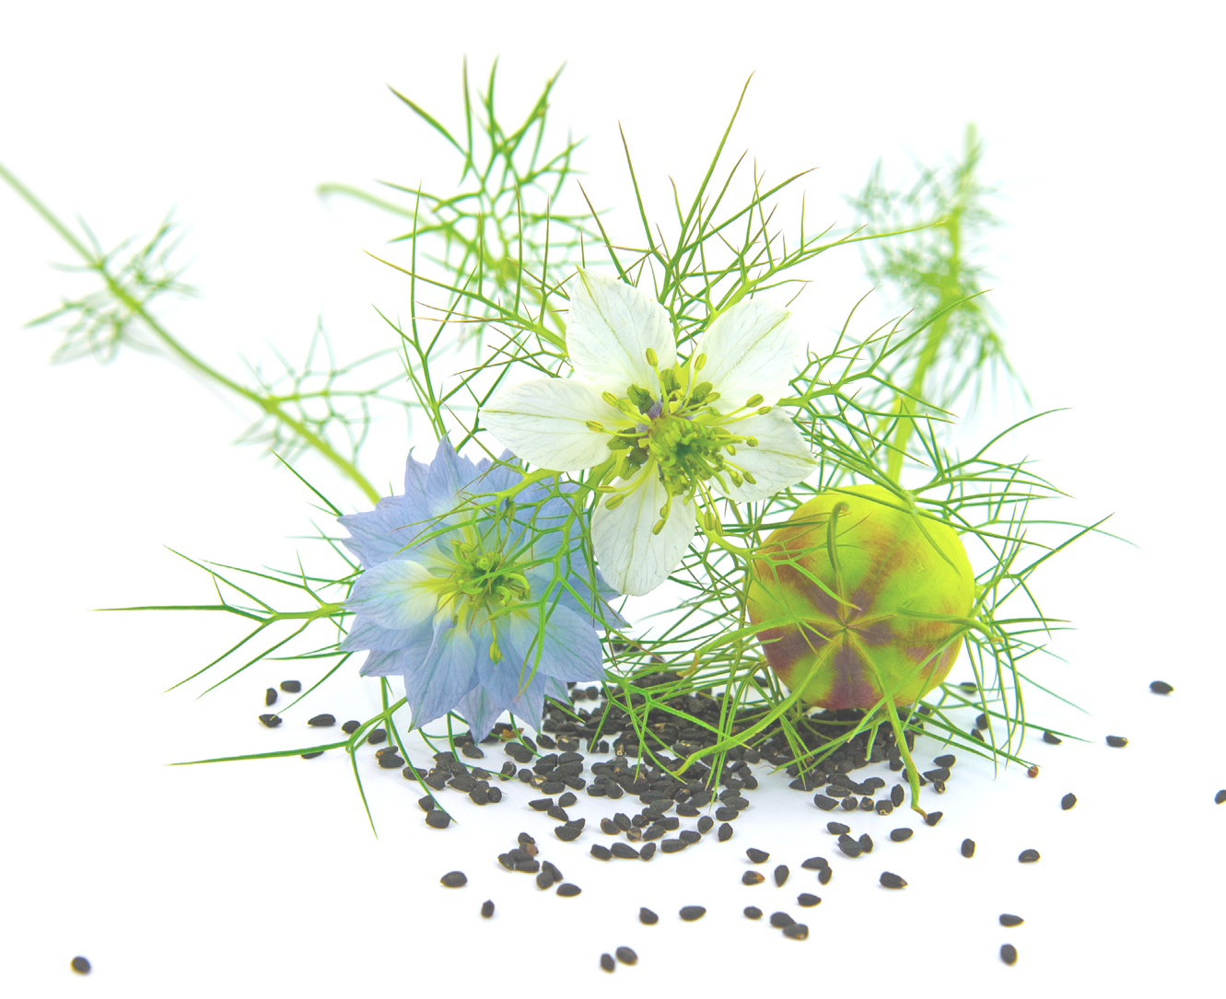

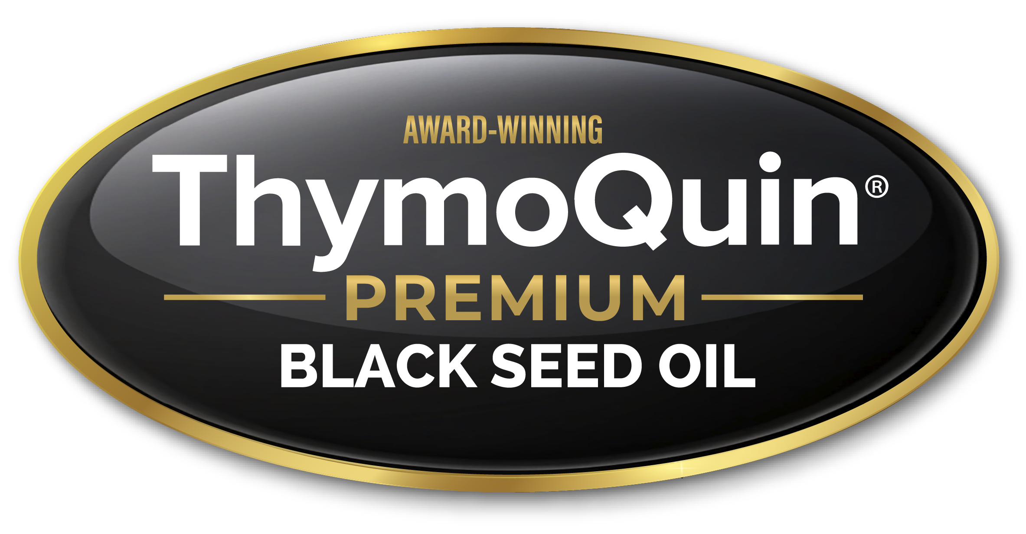
Gut Microbiome Diversity and Healthy Aging
The Role of Cortisol & Microbiome Harmony with ThymoQuin®
Michael T. Murray, N.D.

Slide 2
What is Cortisol?
Cortisol is a “stress hormone” that when chronically elevated produces significant detrimental effects including:
  Depression, anxiety, and insomnia.
  Reduced insulin sensitivity, obesity, and accumulation of visceral fat.
  Breakdown of collagen, muscle, and bone.
  High blood pressure and heart disease.
  Hormonal imbalances.
  Poor immune function and frequent infections.
  Accelerated aging and reduced longevity.
Many of the effects are mediated through impact on GI microbiome

Slide 3
The Key Gut Microbiome Feature Associated With Longevity……
Microbiome diversity
The variety and relative abundance of different microorganisms—bacteria, archaea, fungi, and viruses—living within a microbial community (such as the human gut).
Longevity is associated with a broad range of species that provides “functional redundancy,” making the gut ecosystem more resilient.
High diversity correlates with lower systemic inflammation, better metabolic health, and healthier aging.

Slide 4
Why Microbiome Diversity is the Key
A more diverse gut microbiome:
  Produces more SCFAs (butyrate, acetate, propionate)
  Supports a stronger gut barrier
  Regulates the immune system
  Protects against pathogens
  Enhances metabolic flexibility
  Maintains neuroendocrine balance and positive mood states
  Increases resilience to stress, illness, antibiotics, and aging

Slide 5
The Dangers of Low Microbiome Diversity
Low diversity is associated with:
  Poor metabolic health
  Obesity
  Type 2 diabetes
  Cardiovascular disease
  IBD
  Autoimmune disease
  Depression/anxiety
  Frailty and accelerated biological aging

Slide 6
All the Keys to a “Longevity” Microbiome
High diversity
Strong SCFA production particularly butyrate
Enriched level of beneficial organisms (Akkermansia, Anaerobutyricum, Christensenella, Bifidobacterium, etc.)
Reduced pathogens and less “friendly” species (pathobionts)
Enhanced metabolic output of key longevity-promoting compounds
Reduced production of inflammatory compounds and gut-derived toxins

Slide 7
Negative Effects of Elevated Cortisol on the Gut Microbiome
↓ Microbial diversity & richness → loss of resilience
  ↓ SCFA producers: Faecalibacterium, Roseburia, Eubacterium
  ↓ Butyrate, acetate, propionate → impaired epithelial repair
  ↓ Akkermansia & Bifidobacterium → weaker gut barrier
  ↑ Pathobionts (Enterobacteriaceae, Klebsiella, Desulfovibrio)
  ↑ Intestinal permeability & mucus thinning
  ↓ Polyphenol conversion → ↓ Urolithin A, equol, indoles
  Altered bile acid metabolism → ↓ beneficial secondary bile acids
  ↓ sIgA & mucosal immune tolerance
  Disrupted motility & circadian rhythmicity → unstable ecosystem

Slide 8
Consequences of Cortisol Disruption of Gut Microbiome on Longevity
Chronic inflammation (“inflammaging”) → ↑ IL-6, TNF-α, CRP
Metabolic dysfunction: insulin resistance, visceral fat
Mitochondrial dysfunction & impaired mitophagy
↑ Oxidative stress → DNA damage & faster epigenetic aging
↑ Endotoxemia (LPS leakage) → cardiovascular & neurodegenerative risk
Loss of muscle mass (sarcopenia) → frailty
Gut–brain axis disruption → anxiety, depression, cognitive decline
Immunosenescence → weakened defense, ↑ autoimmunity
Microbiome shifts resemble an “older” biological age
Overall ↓ healthspan and lifespan

Slide 9


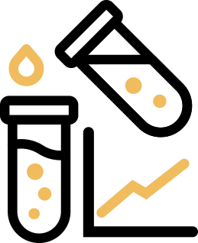

Healthy Microbiome Diversity and Systemic Resilience
Maintaining high microbiome diversity and resilience is a critical focus for preventative and therapeutic strategies in modern healthcare.
ThymoQuin® – Premium Black Seed Oil
Human Clinical Research
Demonstrates positive impact on:
Lowers cortisol up to 44%
Healthy gut microbiome
Stress resilience
Gut-brain-immune triangle support
Immune function
In vitro studies
Demonstrated:
Dose-dependent effects on microbial balance including pathogenic and probiotic gut bacteria.

Slide 10

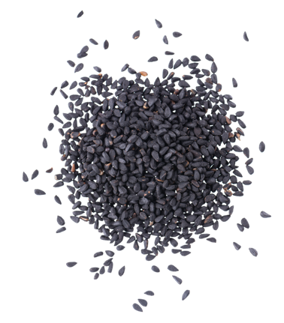
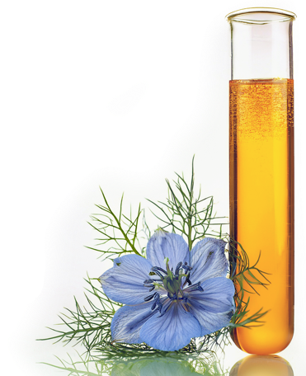
Defined Quality
A patented award-winning, premium BSO.
The only BSO that meets the USP monograph quality standards.
  Cold-pressed from non-GMO Nigella sativa (black cumin seed)
  variety naturally bred for a higher thymoquinone content
  Sustainable and quality control in place from seed-to-shelf
  Standardized to min 3% thymoquinone (TQ) + min 1% p-cymene + low free fatty acids (FFA <1.25%)
  Significant scientific portfolio
Next-generation adaptogen, multiple mechanisms of actions.
Promotes healthy microbiome diversity and eubiosis.
CLINICALLY
PROVEN TO:
  Lower cortisol levels greater than other adaptogens
  Balance microbial diversity
  Support general health, mood,
  and wellbeing
  Reduce feelings of stress
  Support gut-brain-immune axis

Slide 11
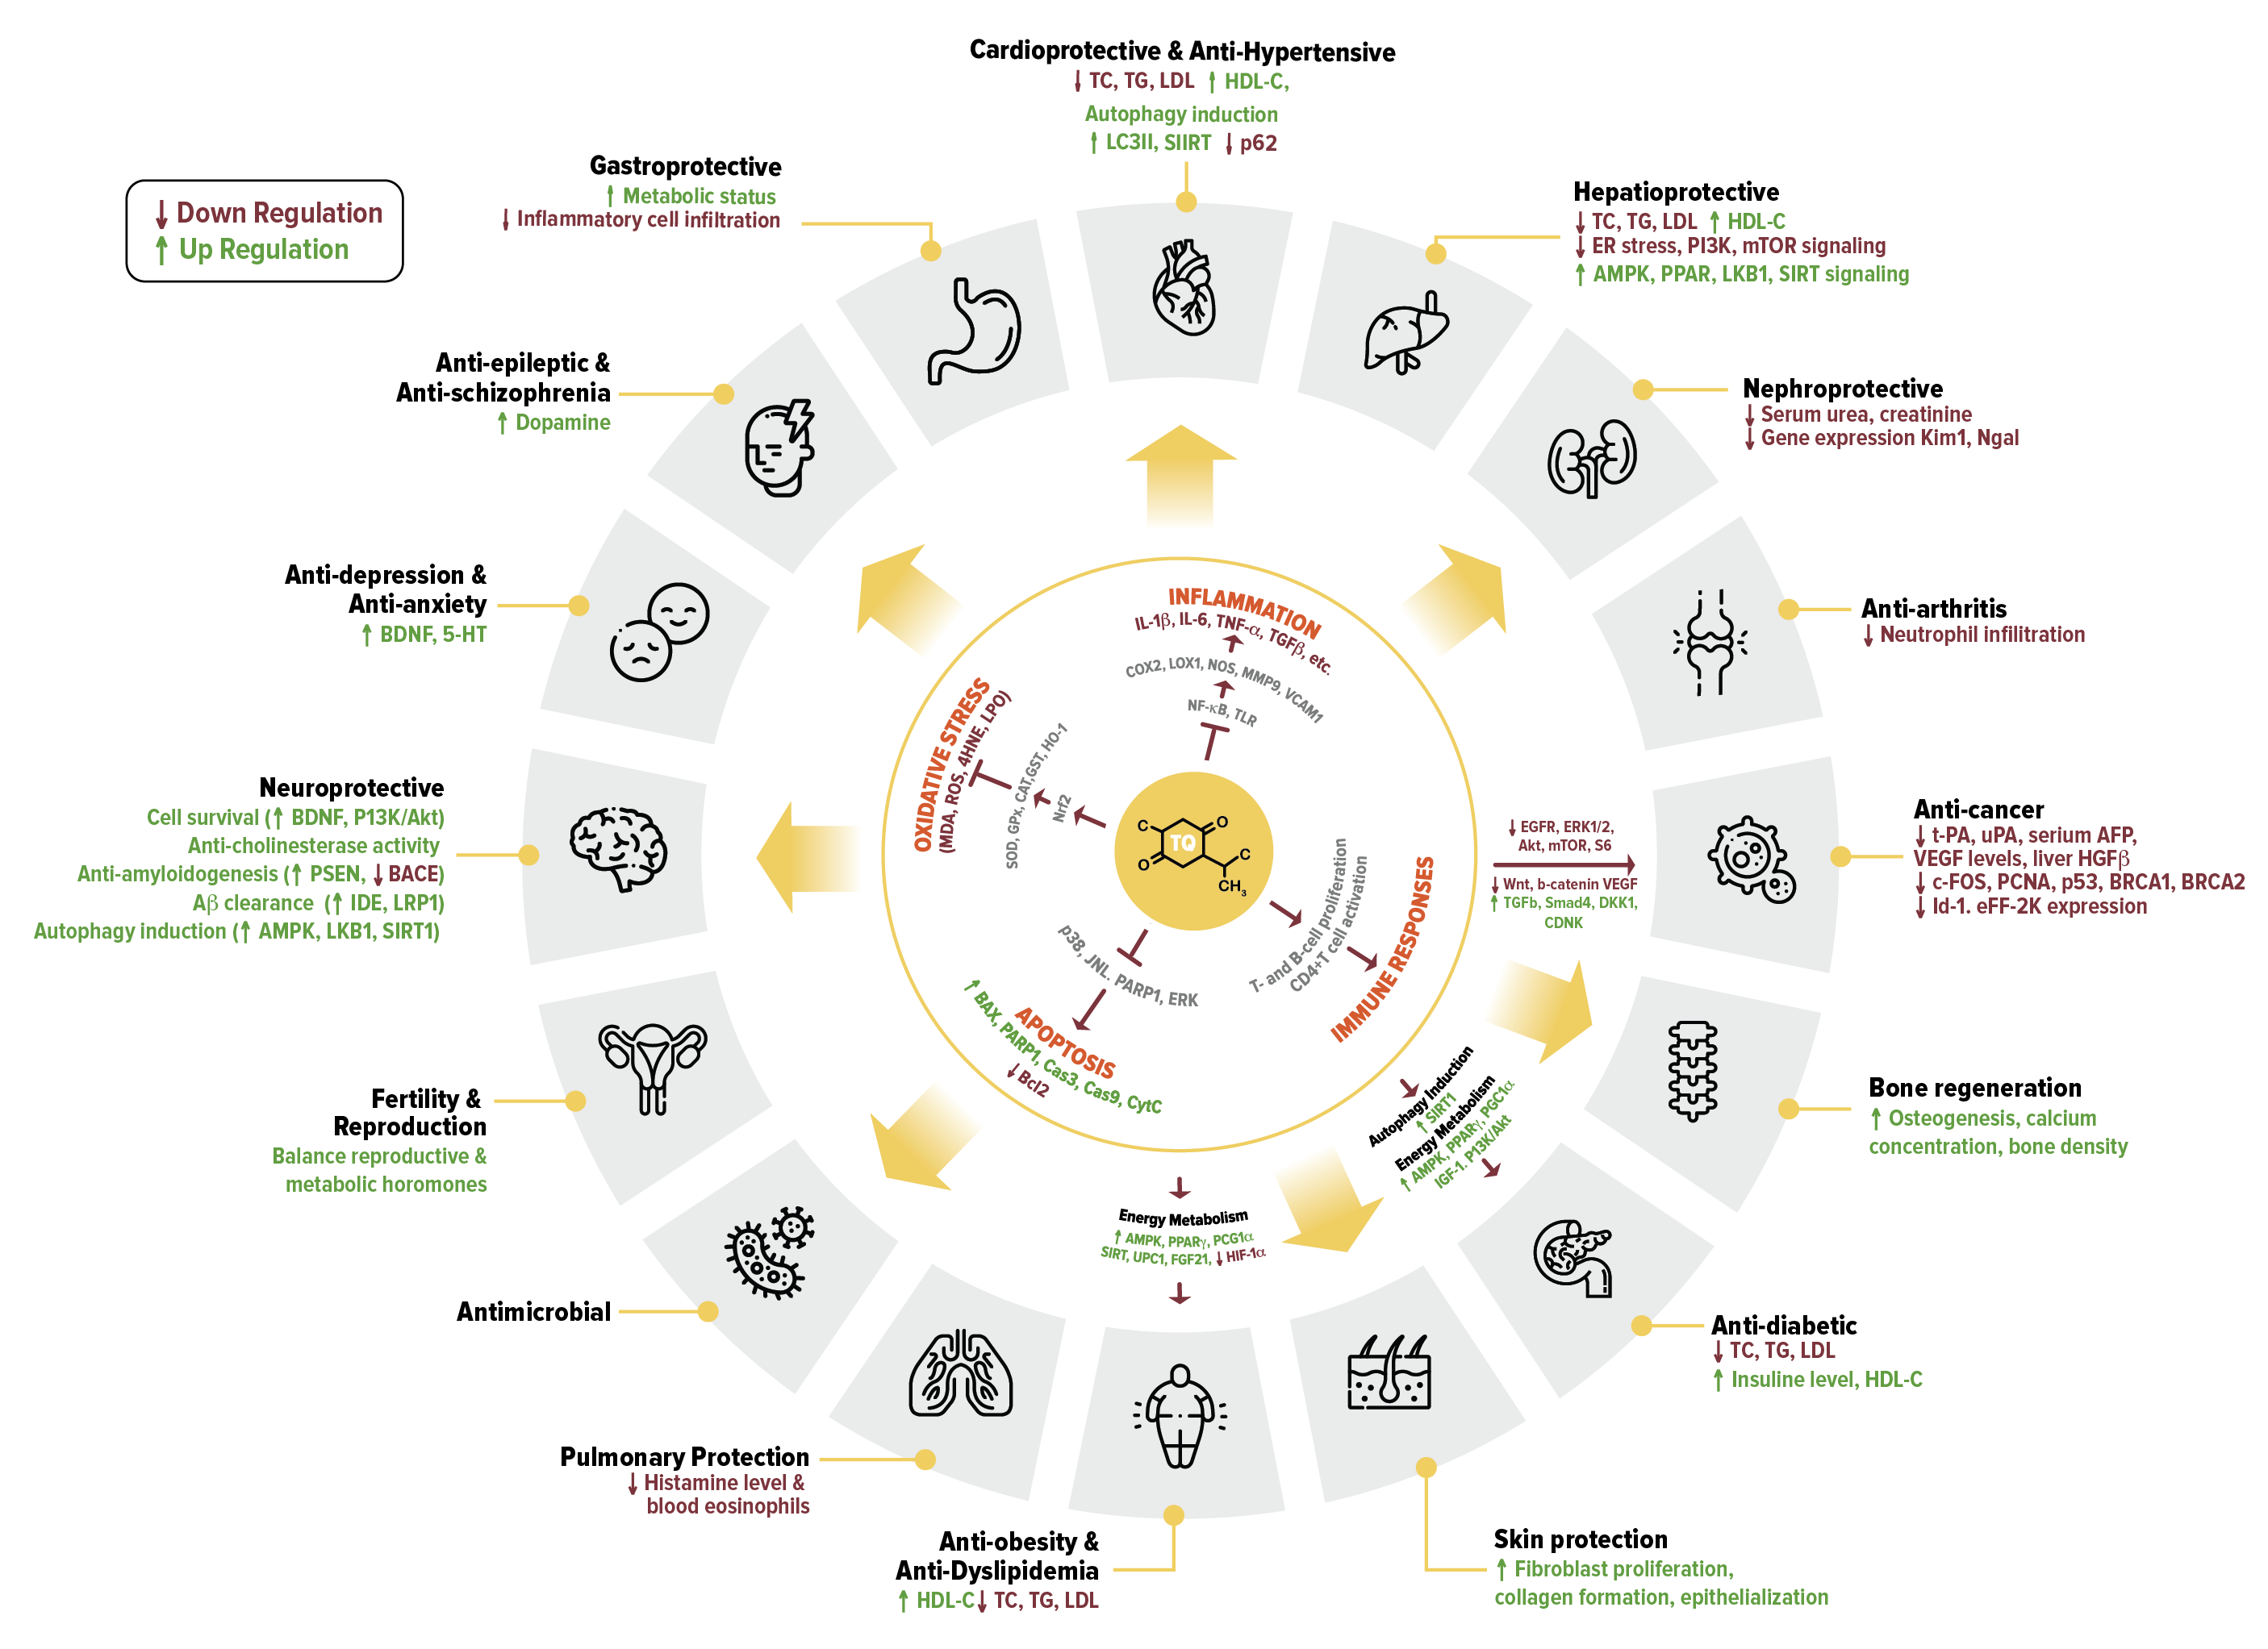
Biological
Actions of
Black Seed Oil
Brain
Cardiovascular System
Digestive System
Endocrine System
Immune System
Muscular System
Nervous System
Renal system
Reproductive System
Respiratory System
Skeletal System

Slide 12
ThymoQuin® vs. Ashwagandha
Mechanisms of action:
  ThymoQuin® - modulates the gut-immune axis and improves microbiome health.*
  Ashwagandha – modulates the hypothalamic-pituitary-adrenal axis.
 | Dosage (per day) | Study Period | Cortisol Decrease
Ashwagandha extract (5% withanolides) | 600 mg | 60 days | 33%
ThymoQuin® | 500 mg | 28 days | 44%

Slide 13
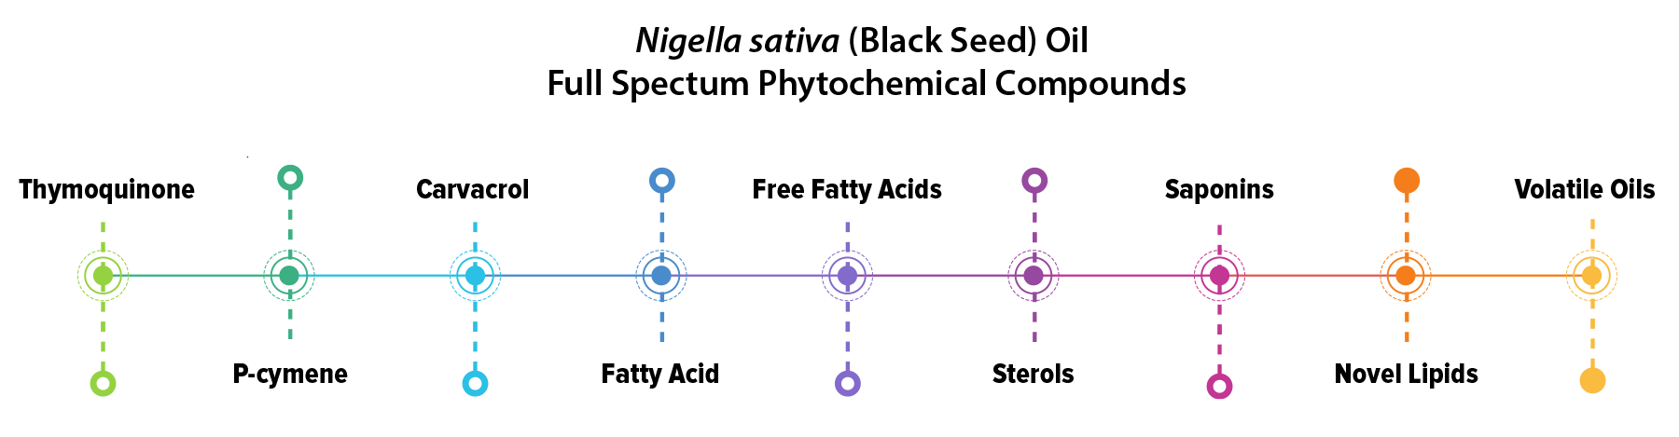
ThymoQuin® is Full Spectrum
Essential phytochemicals include thymoquinone, p-cymens, phytosterols and many other BSO actives that have medicinal benefits.
Selective extraction alters the ratio of actives and can have significant influence on BSO efficacy.

Slide 14

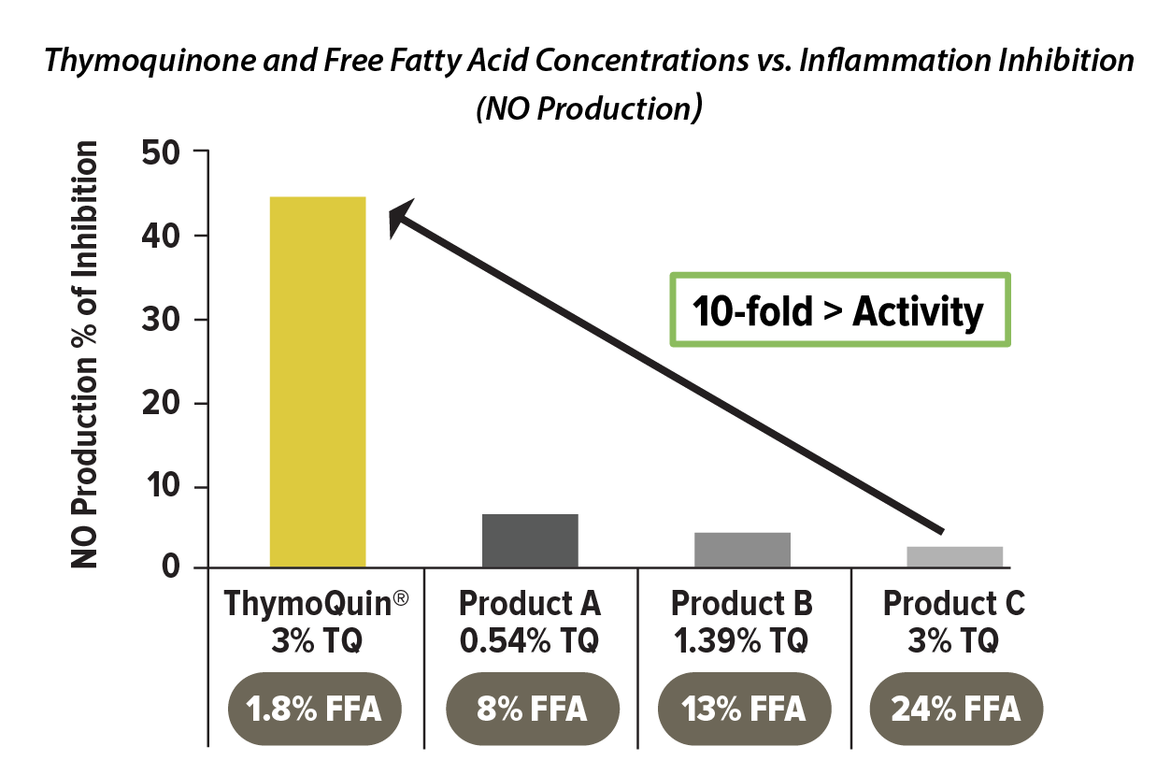
The ThymoQuin® Advantage
3% Thymoquinone
Low Free Fatty Acids
TriNutra® began a Nigella sativa breeding program in 2015 to yield high concentration, non-GMO thymoquinone varietals that yield 3-4 times the thymoquinone content than other varieties.
Studies show that this percentage, combined with low FFA
(less than 2%), (and other important bioactive at optimal levels) provides superior inflammatory-fighting potential compared to other BSO compositions.
ThymoQuin® is the only BSO that meets the USP monograph standards for strength, purity, and quality.
  Thymoquinone minimum of 3%
  P-cymene minimum of 1%
  Carvacrol no more than 0.1%,
  FFA value no more than 1.25%

Slide 15
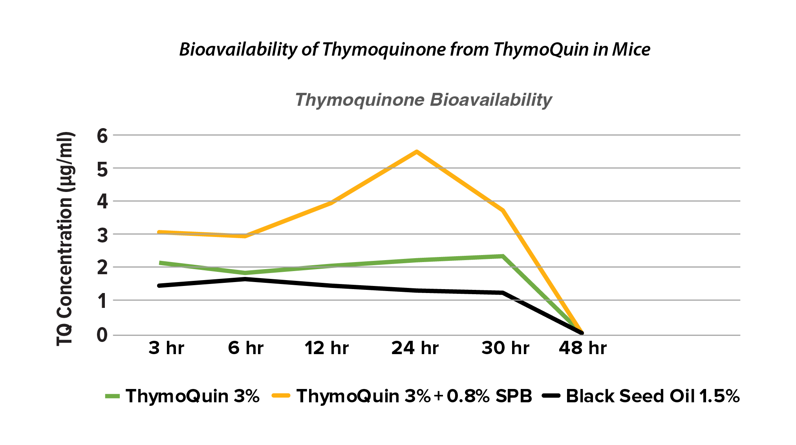
Bioavailability Matters
Bioavailability is critical to achieving therapeutic benefits of TQ to get it into the bloodstream
ThymoQuin® contains a sunflower proprietary blend that provide compounds that produce a considerable increase in bioavailability

Slide 16
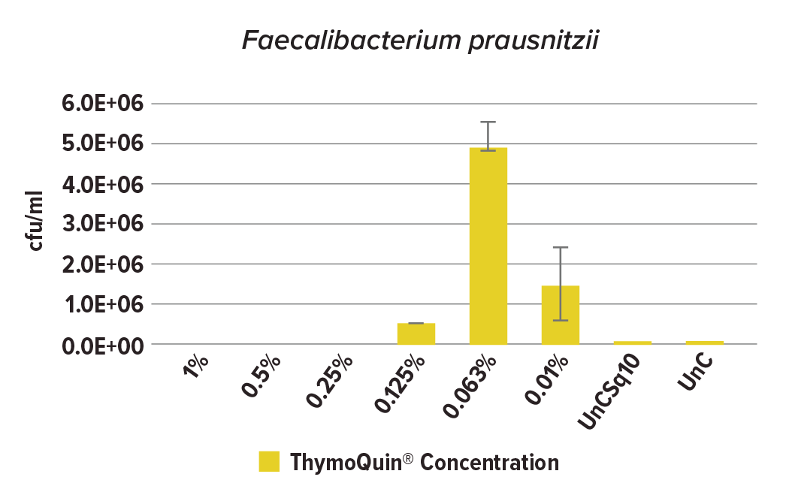
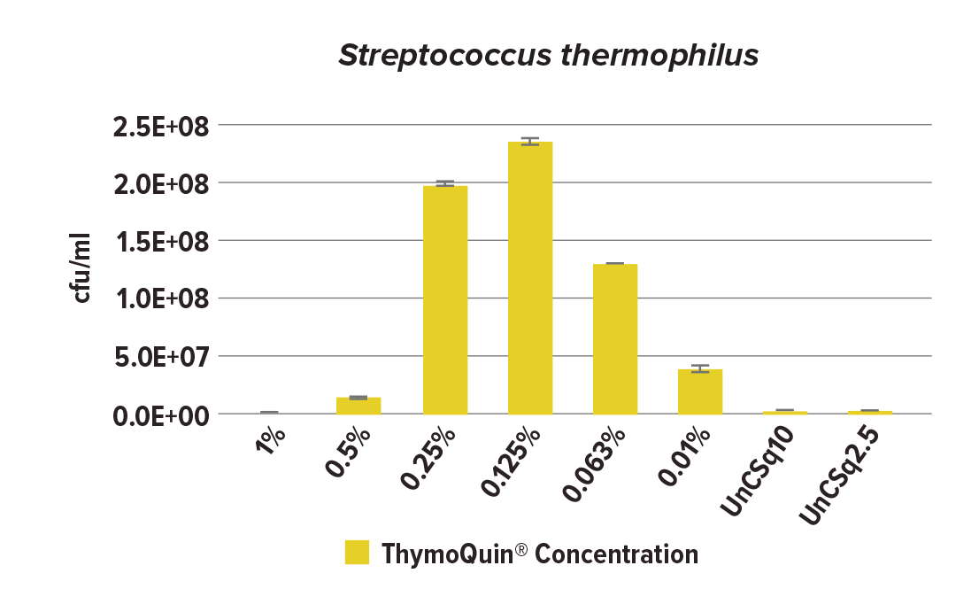
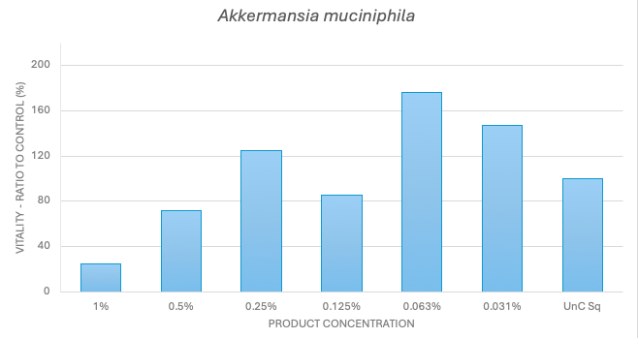
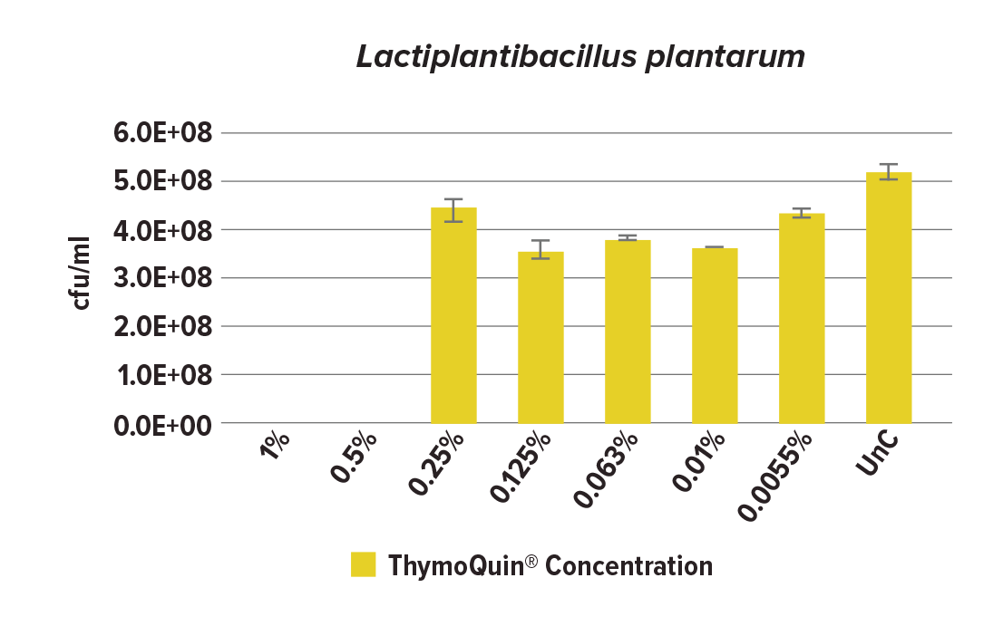
ThymoQuin® Supports Healthy Microbiome Diversity
ThymoQuin® promotes eubiosis by selectively targeting the following microbial populations:
Klebsiella pneumoniae (pathogen)
Lactobacillus plantarum
Streptococcus thermophilus
Faecalibacterium prausnitzii

Slide 17



Connecting In Vitro to Human Outcomes
Superior Microbiome Diversity
Streptococcus thermophilus values were 66% higher in the ThymoQuin® group and overall microbiome composite score was 8% higher, indicating improved microbiome diversity.
Stress Resilience
44% reduction in cortisol levels, indicating improved adaptation to psychological and
physical stress.
Gut-Brain Axis Support
  Preliminary findings suggest enhancements in mood and cognition, potentially linked to microbial shifts

Slide 18


Clinical Efficacy in High Stress
STUDY DETAILS:
Design: Double-blind, placebo-controlled, randomized (DBPCr)
N: 37 Healthy runners training for marathon/half-marathon (36+6 yrs; 17♀/20♂)
Dose: 500 mg, ThymoQuin® once daily
Duration: 4 wks (3 wks < marathon/half-marathon + 1 wk after)
REFERENCE: Talbott SM, Talbott JA. Effect of ThymoQuin® black cumin seed oil as a natural immune modulator of upper-respiratory tract complaints and psychological mood state. Food Sci Nutr Res, 2022;5:1-6.

Slide 19
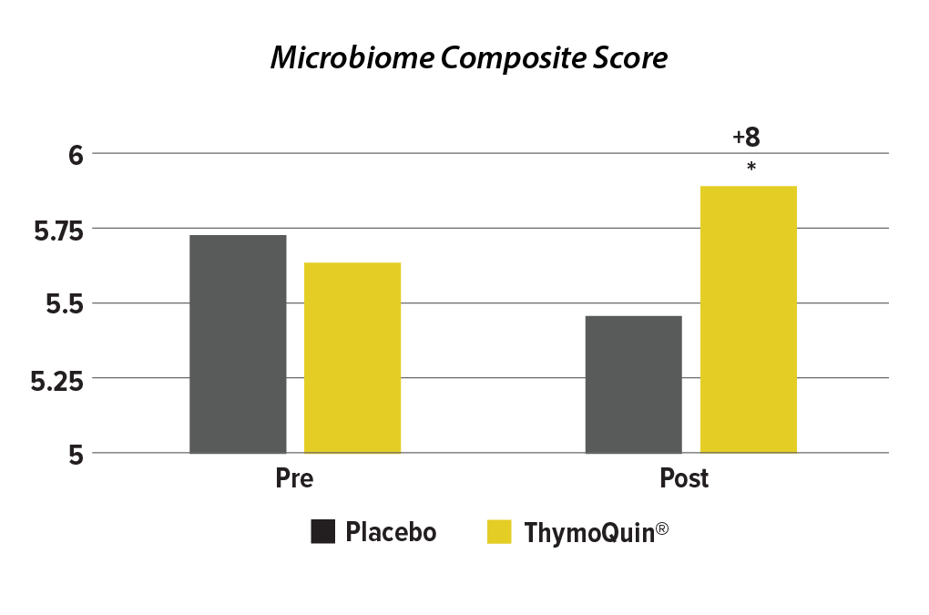
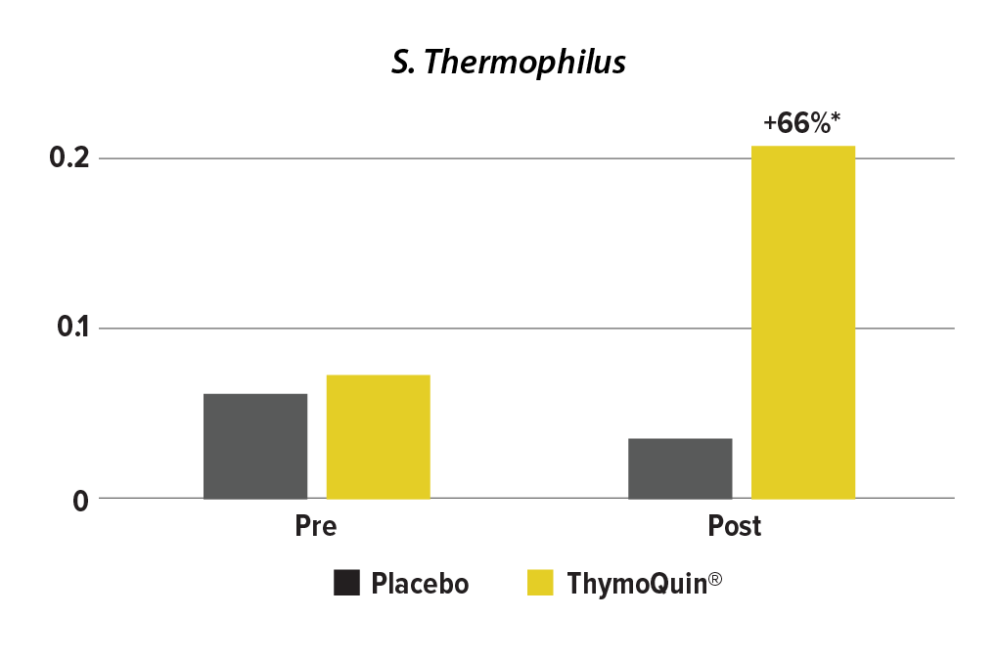
Clinical Efficacy in High Stress
Study Results:

Slide 20
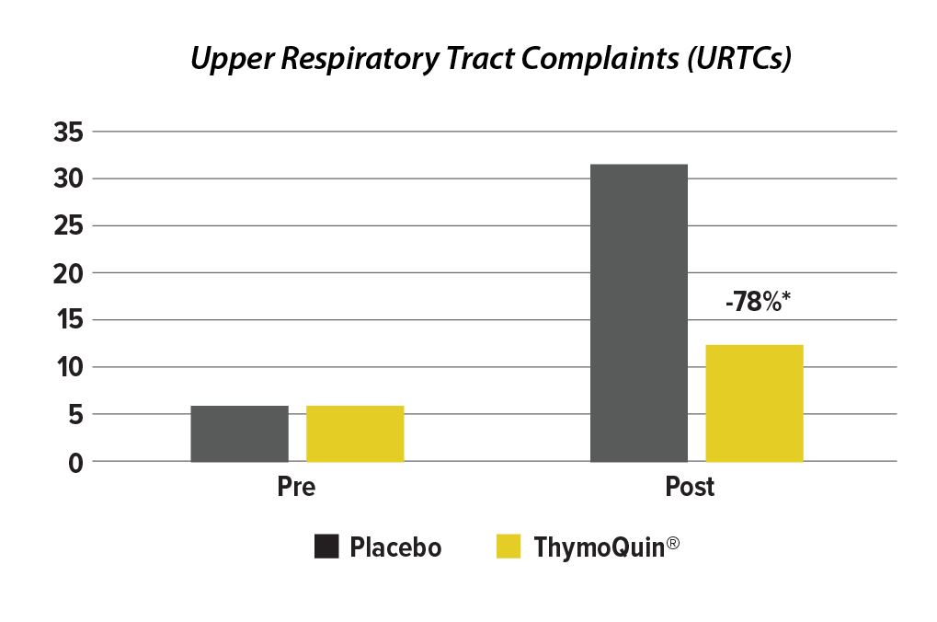
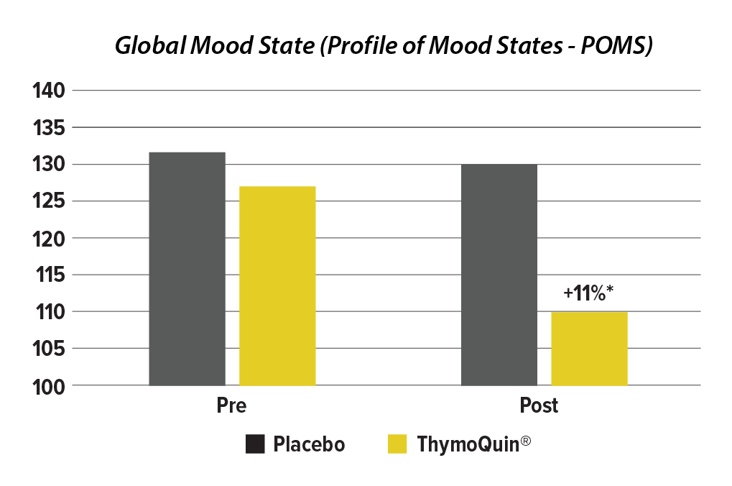
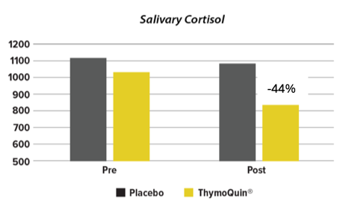
Clinical Efficacy in High Stress
Study Results:

Slide 21
ThymoQuin® - Summary of Health Benefits
A true adaptogen
  Enhances mitochondrial functions and upregulates mitochondrial biogenesis
  Promotes a healthy and balanced microbiome diversity via multiple mechanisms
  Increases ATP production leads to improved cellular metabolism and function
  Supports optimal metabolic health – promotes healthy liver function, blood pressure, insulin response, and blood glucose levels
  Promotes systemic resilience
  Potentiates other actives including omega-3 fatty acids, proanthocyanidins, vitamin D3, astaxanthin, lycopene, lutein and curcumin
  Reduces salivary cortisol by 44% within 3 weeks

Slide 22
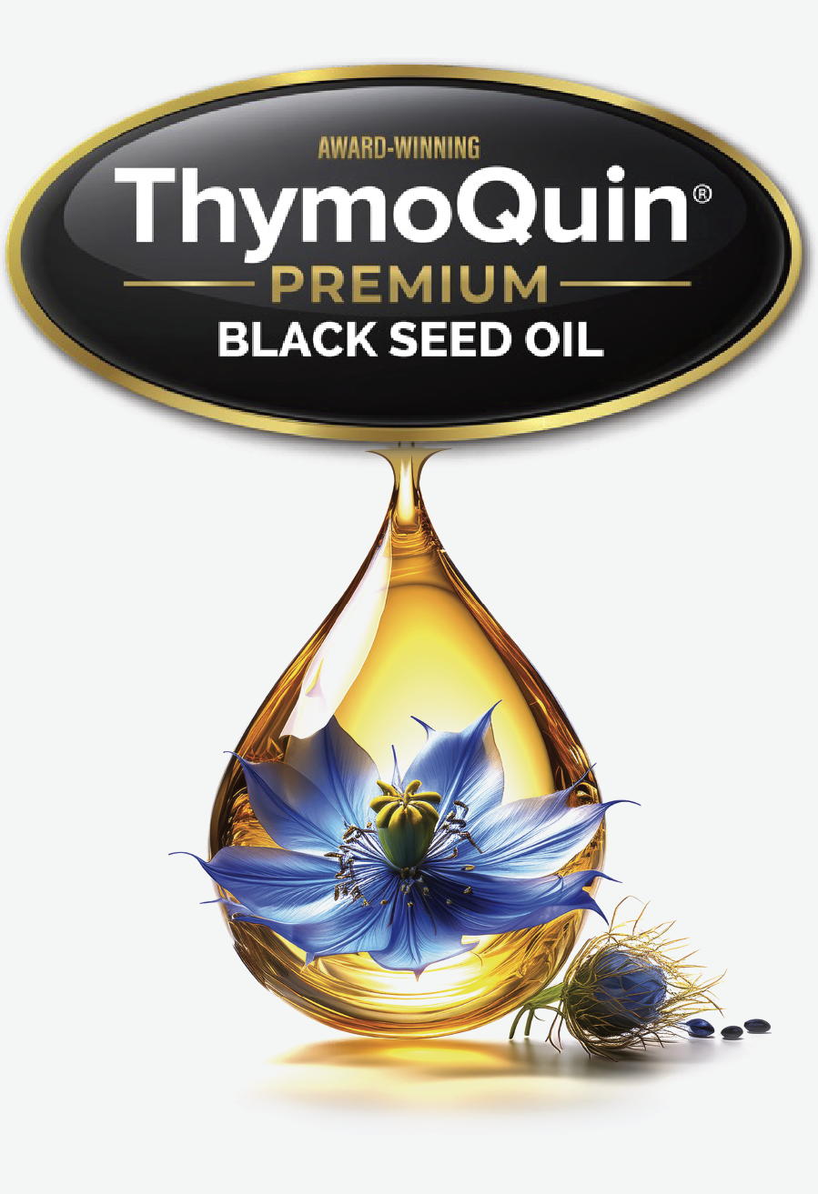
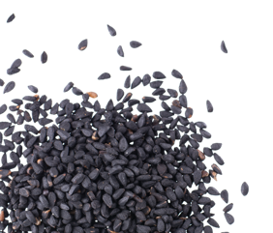
Thank You!
Scan to learn more or connect with us.
  VISIT US
  EMAIL US
  trinutra.com/thymoquin
  thymoquin.com
  service@trinutra.com

